Slide 1
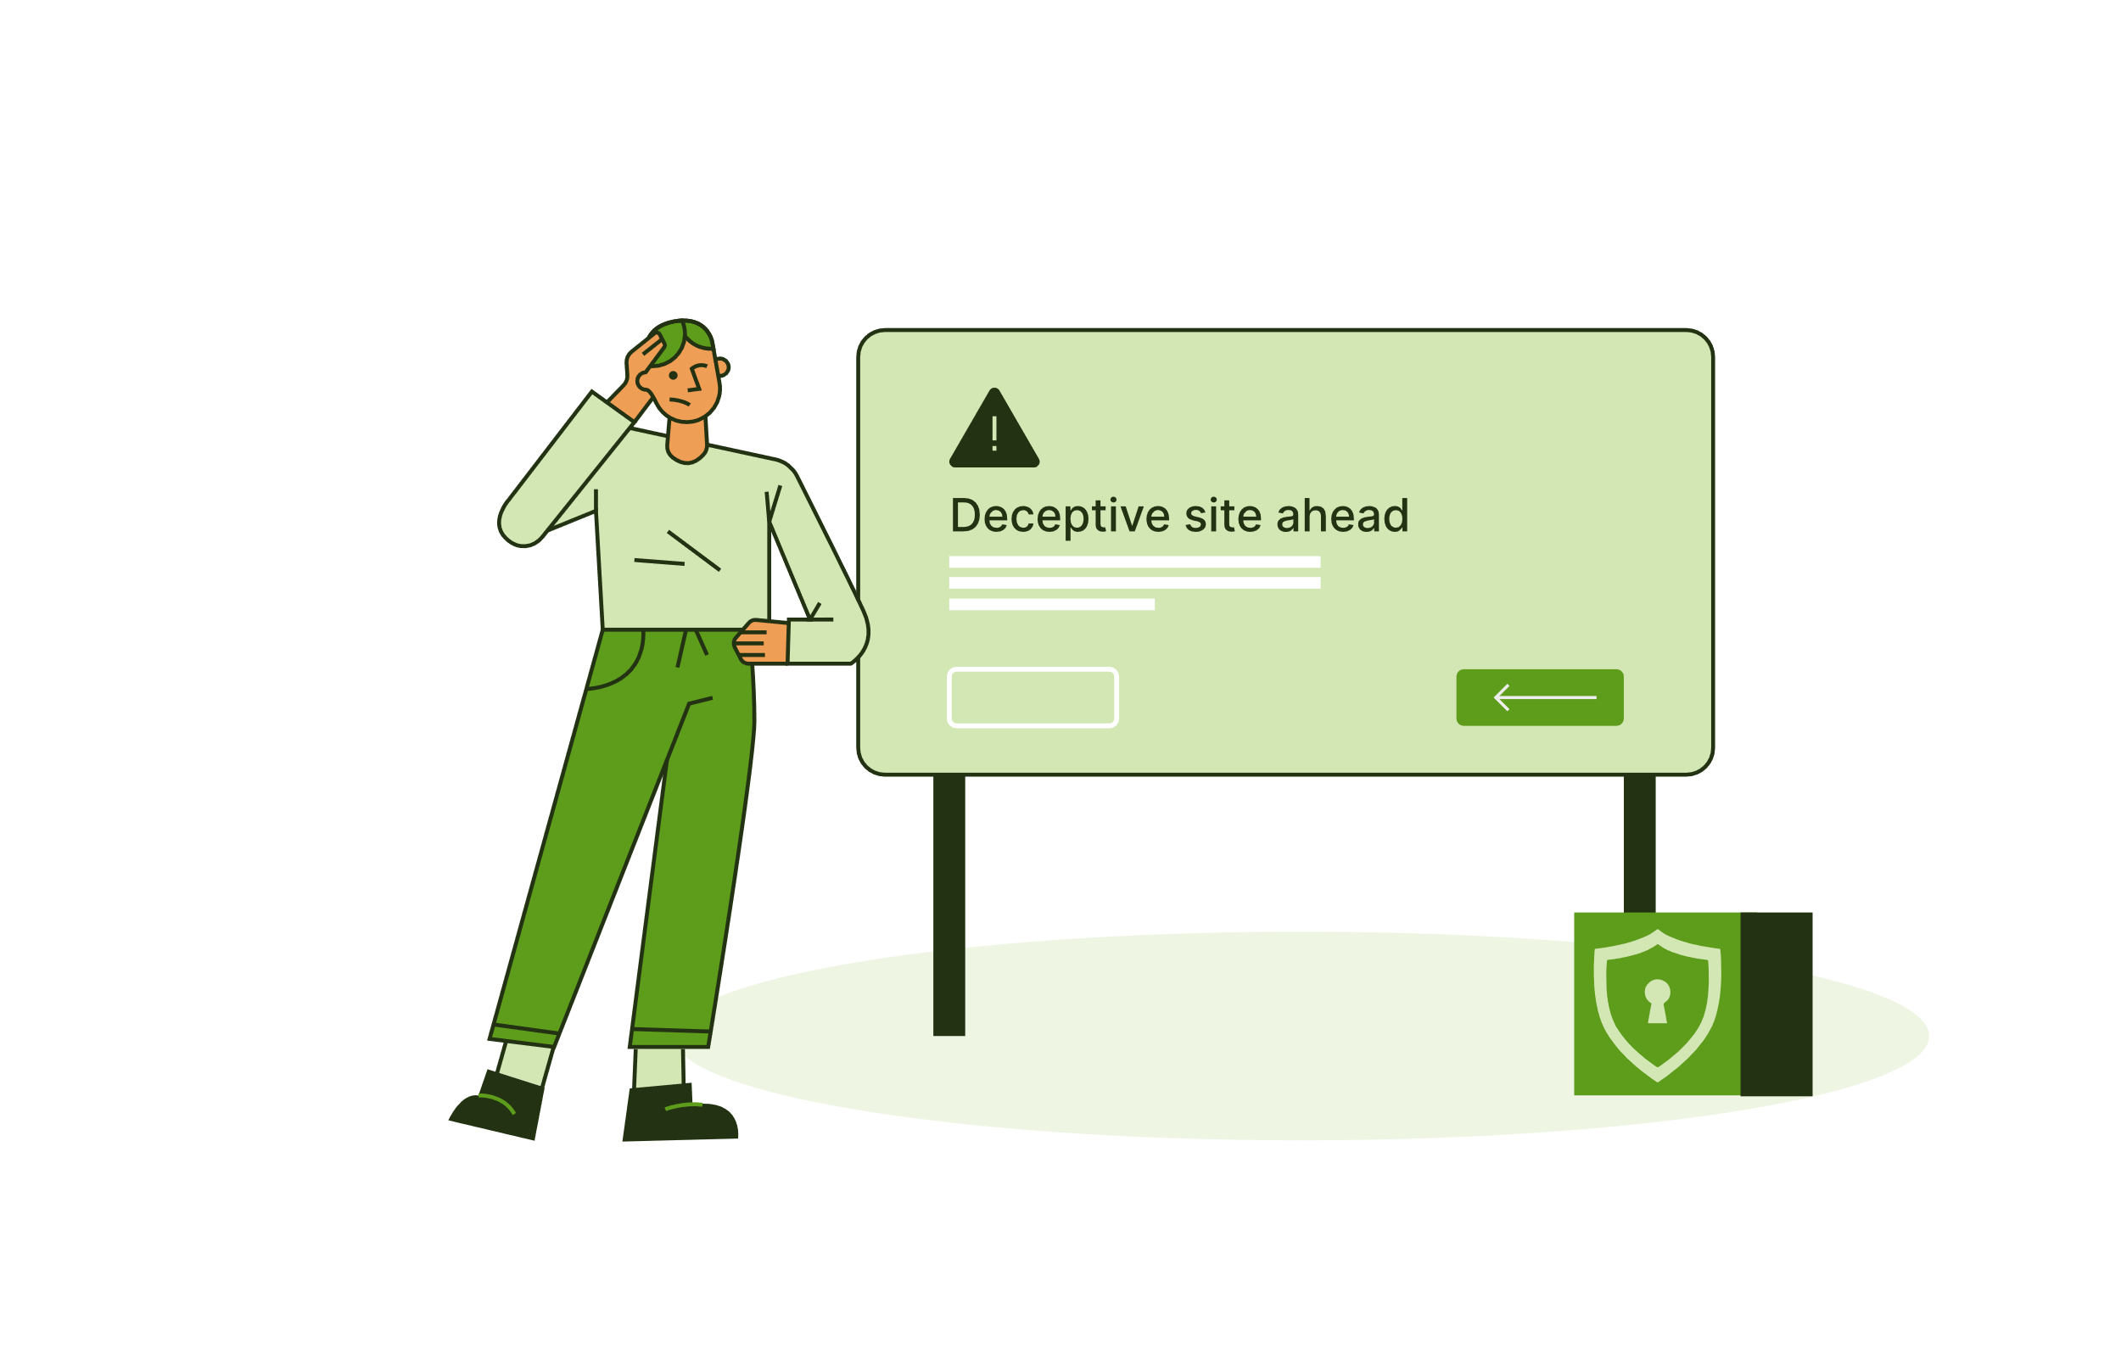
Phishing Awareness Training
Presented by: Anushka Gautam
CodeAlpha – Cyber Security Internship
July 20, 2025

Slide 2
What is Phishing?
Phishing is a deceptive cyber attack designed to trick individuals into revealing sensitive information, such as passwords, credit card numbers, or login credentials. Attackers often disguise their attempts as legitimate communications from trusted sources.
Deceptive Tactics
Information Targeted
Common Example
Often disguised as a legitimate email or message.
Aims to steal passwords, credit card numbers, or login credentials.
An email pretending to be your bank requesting immediate action.

Slide 3
Understanding Phishing Variants
Phishing isn't just about emails. Attackers use various methods:
1
2
3
Email Phishing
Smishing
Vishing
Fraudulent emails designed to look like they're from legitimate sources, tricking recipients into revealing data or clicking malicious links.
Phishing attempts conducted via SMS (text messages), often containing malicious links or requests for personal information.
Voice phishing where attackers impersonate officials or trusted entities over phone calls to extract sensitive data.
4
5
Spear Phishing
Fake Websites
Highly targeted attacks aimed at specific individuals or organizations, often using personalized information to increase credibility.
Deceptive websites that mimic legitimate ones to steal login credentials or financial information entered by unsuspecting users.

Slide 4
Spotting the Red Flags
Learning to recognize phishing attempts is your first line of defense. Pay close attention to these common indicators:
Spelling or grammar mistakes: Legitimate organizations rarely have errors.
Generic greetings: Instead of your name, they might say "Dear Customer."
Suspicious links or attachments: Hover over links to see the real URL; avoid opening unexpected attachments.
Sender address looks fake or off: Slight misspellings or unusual domains (e.g., "support@yourbankk.com" instead of "support@yourbank.com").
Urgent or threatening tone: Phrases like "Verify your account now!" or threats of account closure are common tactics.
Requests for personal information: No legitimate entity will ask for your password or full credit card number via email.

Slide 5
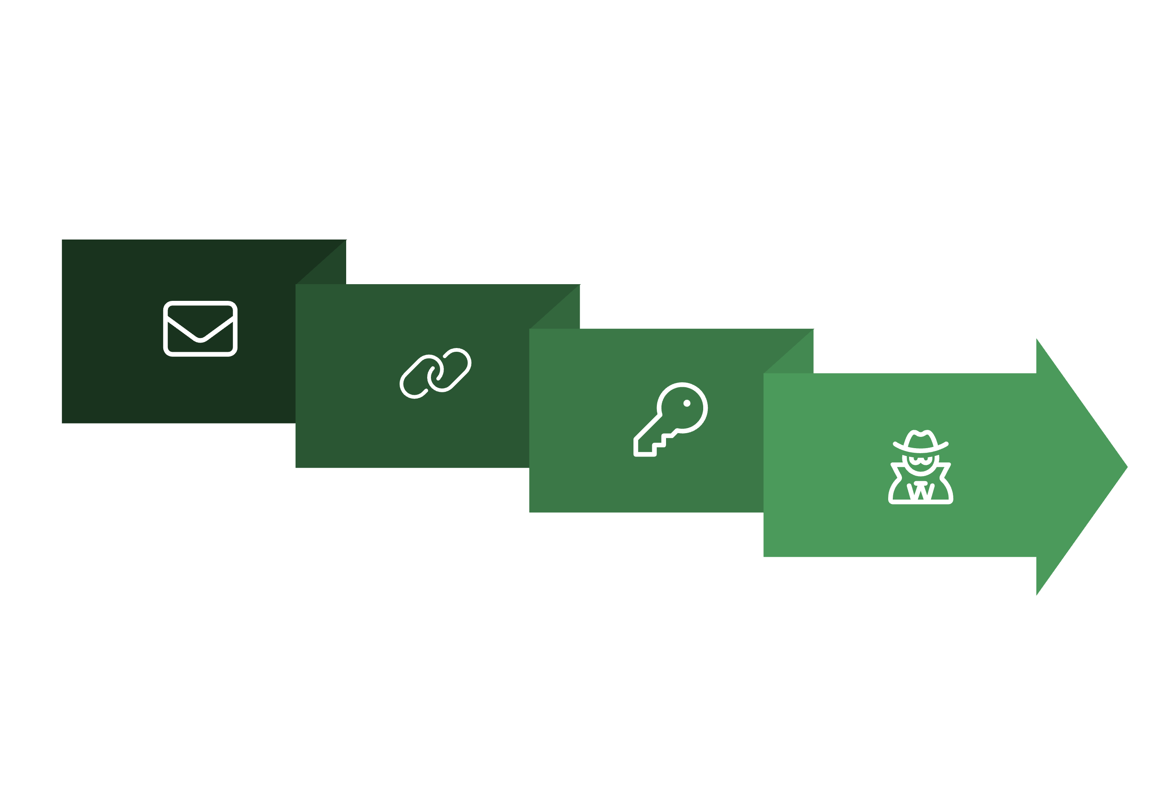




A Real-Life Phishing Scenario
Imagine you receive an email that looks exactly like it's from your bank.
Deceptive Link
Credentials Stolen
Fake Email
Password Entered
This type of scam has successfully stolen millions globally, highlighting the importance of vigilance. Always double-check URLs and verify requests through official channels.

Slide 6
Best Practices for Cybersecurity
Protecting yourself from phishing requires a combination of awareness and proactive measures. Incorporate these habits into your digital routine:
Never Click Unknown Links or Attachments
Always Verify Sender Identity
Use Strong Passwords and 2FA
Even if an email seems legitimate, if it's unexpected or suspicious, avoid clicking any embedded links or opening attachments.
If in doubt, contact the organization directly using a known official phone number or website, not details provided in the suspicious message.
Combine complex passwords with Two-Factor Authentication (2FA) for an extra layer of security on all your accounts.
Keep Antivirus and Software Updated
Report Suspicious Messages Immediately
Regularly update your operating system, browser, and antivirus software to protect against the latest threats and vulnerabilities.
Report any potential phishing attempts to your IT department or email provider to help protect others and prevent future attacks.

Slide 7
Quick Quiz: Test Your Phishing Knowledge
Let's see how well you've absorbed the information. Choose the best answer for each question:
1. What is phishing?
2. You receive an email saying "Click to win ₹10,000!" What do you do?
A scam to steal your info
A fishing competition
Click it immediately
A social media game
Ignore and report it
Forward it to friends
Answer: A. A scam to steal your info.
Answer: B. Ignore and report it.

Slide 8
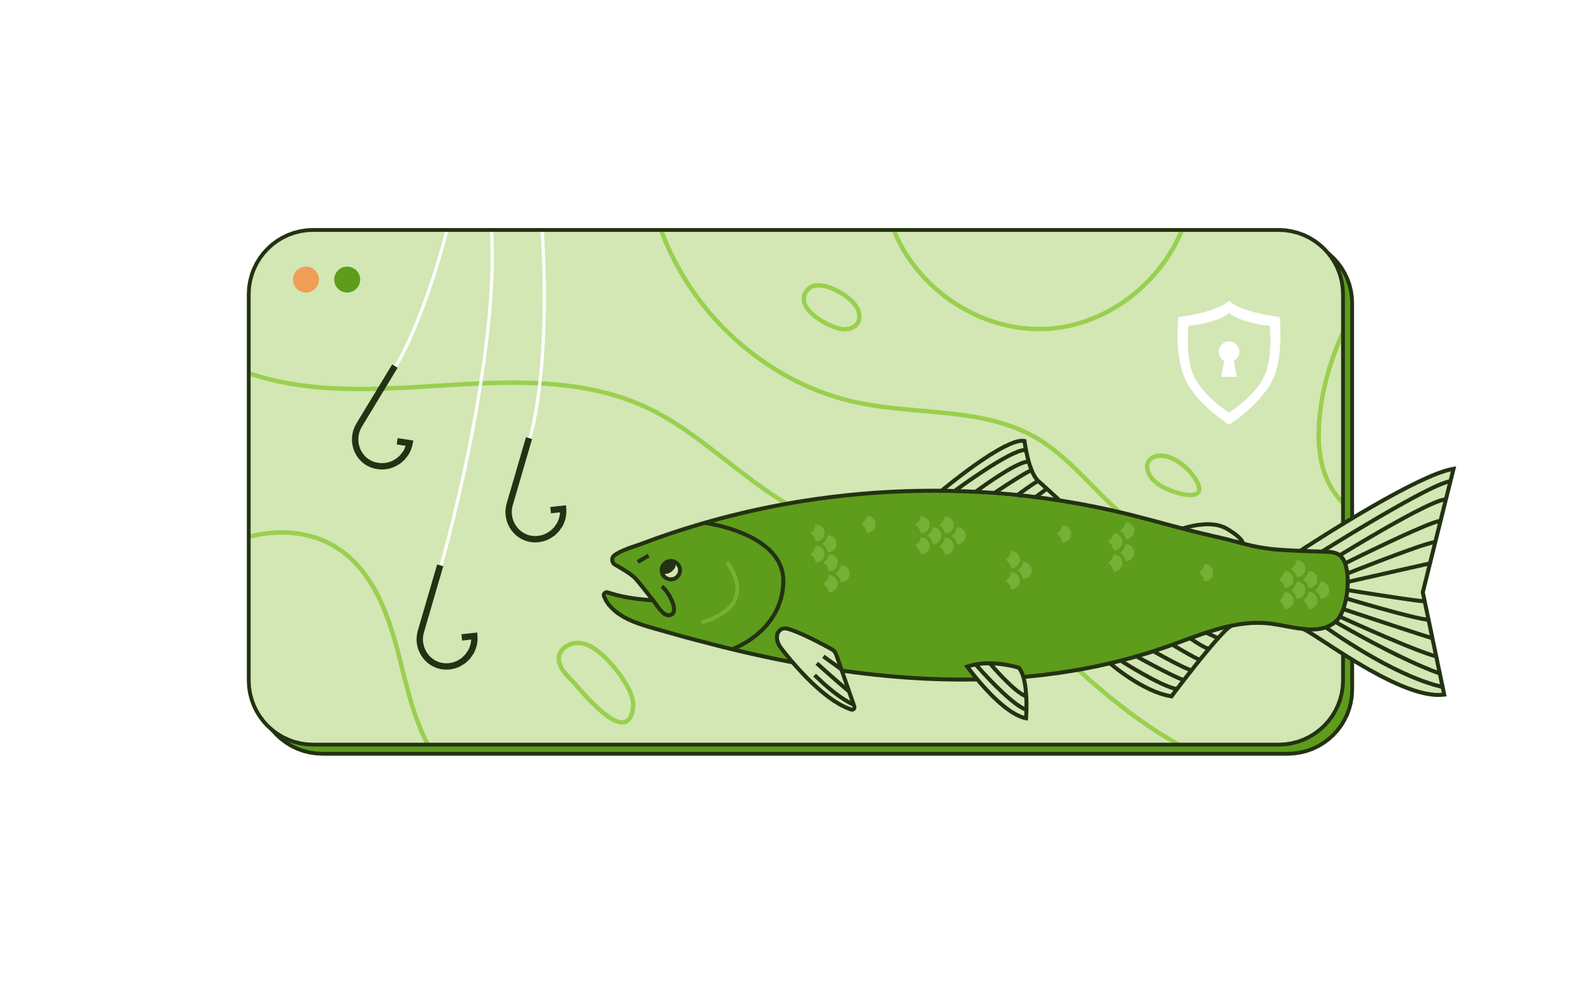
Thank You!
Anushka Gautam
CodeAlpha – Cyber Security Internship
github.com/anushkagautam31
Stay safe. Stay smart. Don't take the bait.

