Slide 1
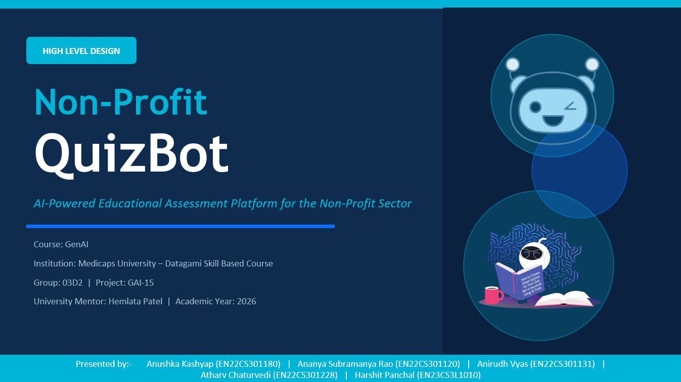
QuizBot
High Level Design
AI-Powered Educational Assessment Platform for the Non-Profit Sector
GenAI Course | Medicaps University – Datagami | Academic Year 2026
Group 03D2 | Project GAI-15
Anushka Kashyap (EN22CS301180) | Ananya Subramanya Rao (EN22CS301120) | Anirudh Vyas (EN22CS301131) | Atharv Chaturvedi (EN22CS301228) | Harshit Panchal (EN23CS3L1010)

Slide 2
Table of Contents
01
Introduction & Problem Statement
06
API Catalogue
02
System Overview
07
Data Design & Models
03
System Architecture & Process Flow
08
Interfaces
04
Information Flow & DFDs
09
State & Session Management
05
Components Design
10
Non-Functional Requirements
QuizBot HLD | Group 03D2 | GAI-15 | GenAI Course | Datagami Skill Based Course | Medicaps University

Slide 3
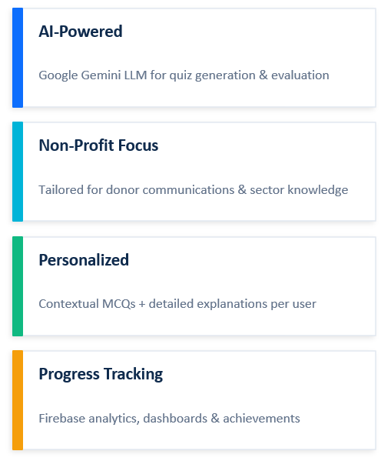
Introduction
The Challenge
Non-profit professionals need continuous learning on best practices
Traditional learning lacks personalization and immediate feedback
Gap between donor communications and structured learning experiences
The Solution: QuizBot
QuizBot is an AI-powered web application for the non-profit sector. It transforms real-world donor emails into intelligent, AI-powered assessments — testing comprehension, reinforcing learning, and tracking progress over time.
QuizBot HLD | Group 03D2 | GAI-15 | GenAI Course | Datagami Skill Based Course | Medicaps University

Slide 4
Problem Statement & Project Objectives
Develop an interactive AI-driven educational bot for the Non-Profit domain that engages users in targeted assessments based on donor emails, evaluates their responses using an LLM, and provides deep contextual explanations — creating a personalized learning loop.
Key Objectives
Accept donor email content and auto-generate contextual MCQ-based quizzes
Track user quiz history, scores, and learning progress via Firebase Realtime Database
Use Google Gemini LLM to generate questions, evaluate answers, and give personalized feedback
Display analytics dashboards showing performance trends, accuracy rates, and achievements
Store donor email embeddings in ChromaDB/FAISS for semantic search and retrieval
Implement secure user authentication via Firebase Authentication
QuizBot HLD | Group 03D2 | GAI-15 | GenAI Course | Datagami Skill Based Course | Medicaps University

Slide 5
System Overview
QuizBot is a full-stack, AI-powered web application for non-profit sector education. It allows users to paste donor emails and the system automatically generates contextual MCQs using a Large Language Model i.e. Google Gemini API, and evaluates responses, provide detailed AI-generated explanations and tracks user learning over time.
🧠 AI Quiz Generation
🔍 Vector Semantic Search
✅ Smart Evaluation
Google Gemini API processes donor emails and generates 3–10 contextual MCQs
ChromaDB stores email embeddings using Sentence Transformers for similarity matching
LLM evaluates each answer and generates personalized explanations
🔐 User Authentication
📊 Progress Tracking
📈 Analytics Dashboard
Firebase Authentication handles secure email/password login and registration
Firebase Realtime Database stores quiz history, scores, and analytics
Users see performance trends, accuracy rates, and achievements
QuizBot HLD | Group 03D2 | GAI-15 | GenAI Course | Datagami Skill Based Course | Medicaps University

Slide 6
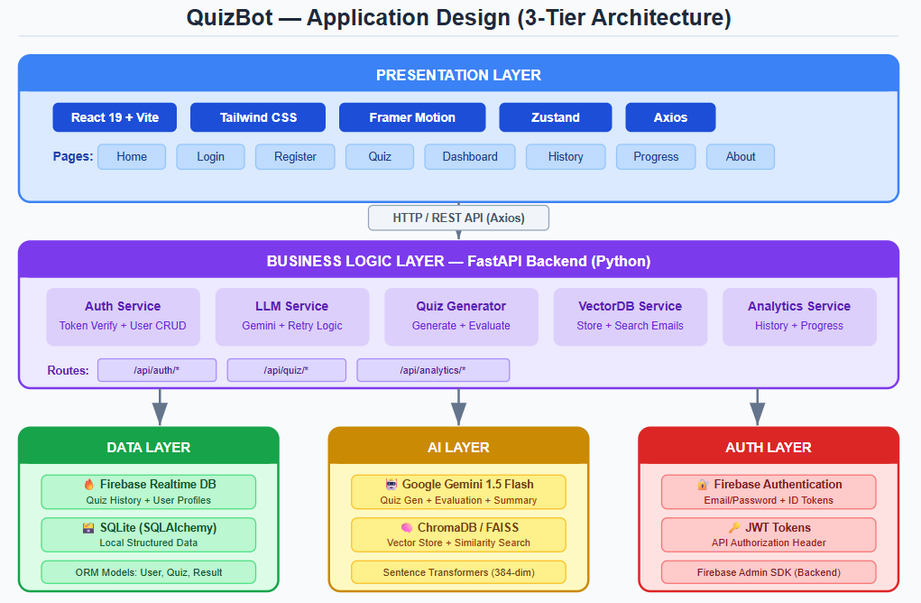
System Architecture – 3-Tier Client-Server
QuizBot follows a 3-Tier Client-Server Architecture with clear separation between Presentation, Business Logic, and Data layers.
Presentation Layer
Business Logic Layer
Data Layer
React 19 + Vite SPA
FastAPI Backend (Python)
Multi-Database Strategy
▸ EmailInput Component
▸ Auth Service
▸ Firebase Realtime Database
▸ QuizInterface + QuestionCard
▸ Quiz Generation Service
▸ ChromaDB (Vector Store)
▸ Dashboard + Analytics
▸ LLM Evaluation Service
▸ SQLite (Local Structured)
▸ Framer Motion Animations
▸ Vector DB Service
▸ Firebase Auth
▸ Zustand State Management
▸ Analytics Service
▸ Google Gemini AI API
QuizBot HLD | Group 03D2 | GAI-15 | GenAI Course | Datagami Skill Based Course | Medicaps University

Slide 7
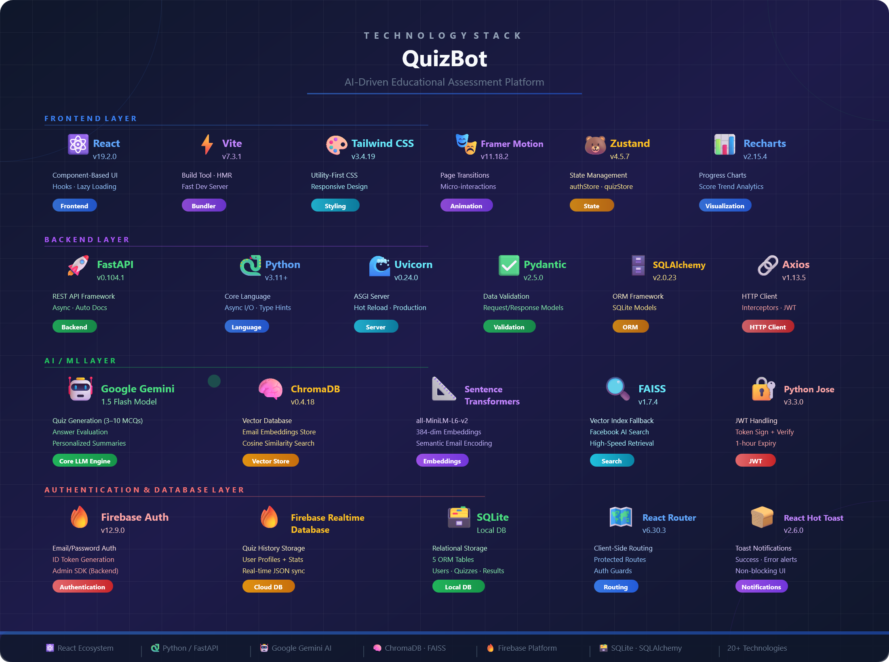

Slide 8
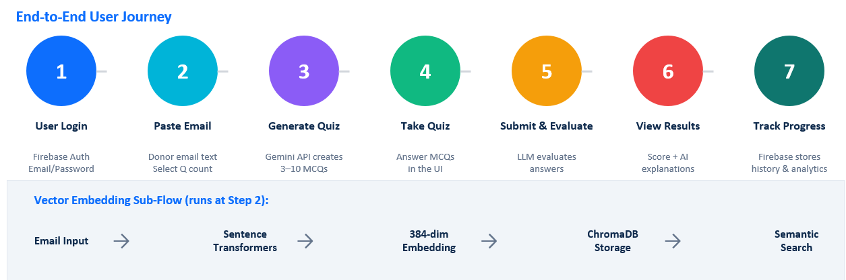
Process Flow
QuizBot HLD | Group 03D2 | GAI-15 | GenAI Course | Datagami Skill Based Course | Medicaps University

Slide 9
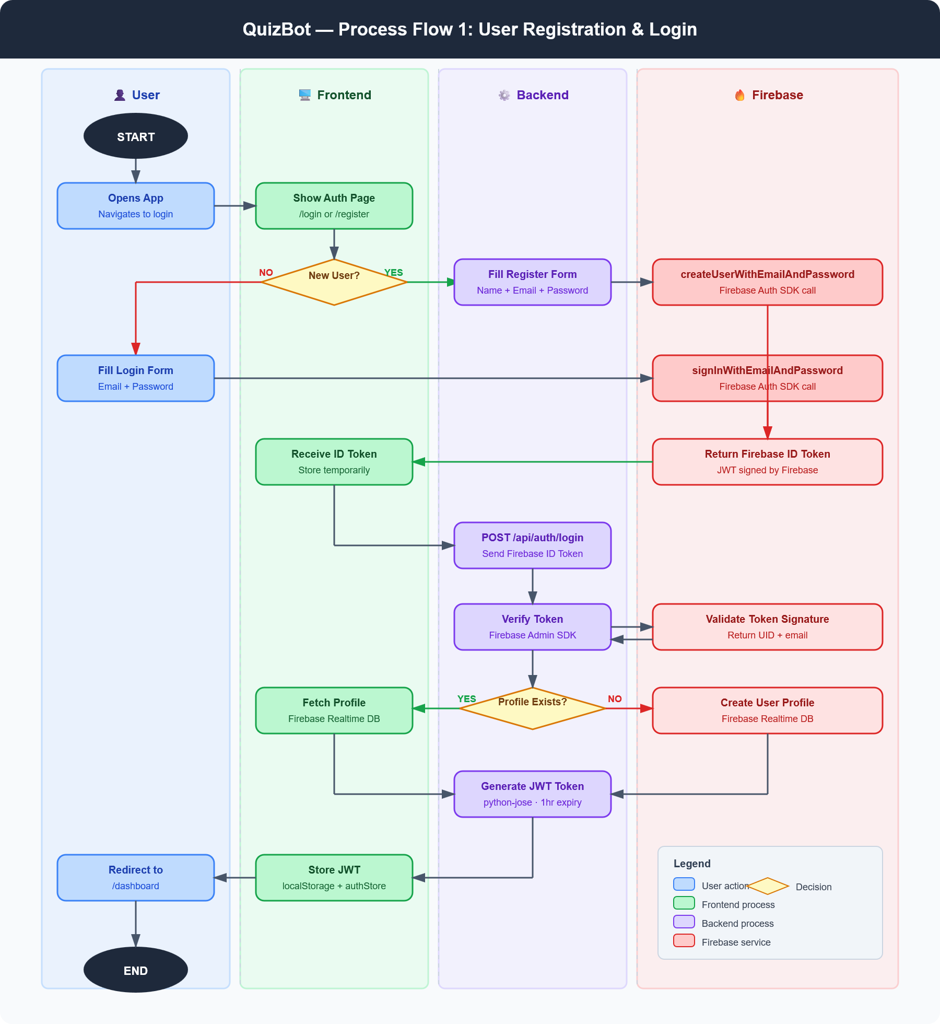
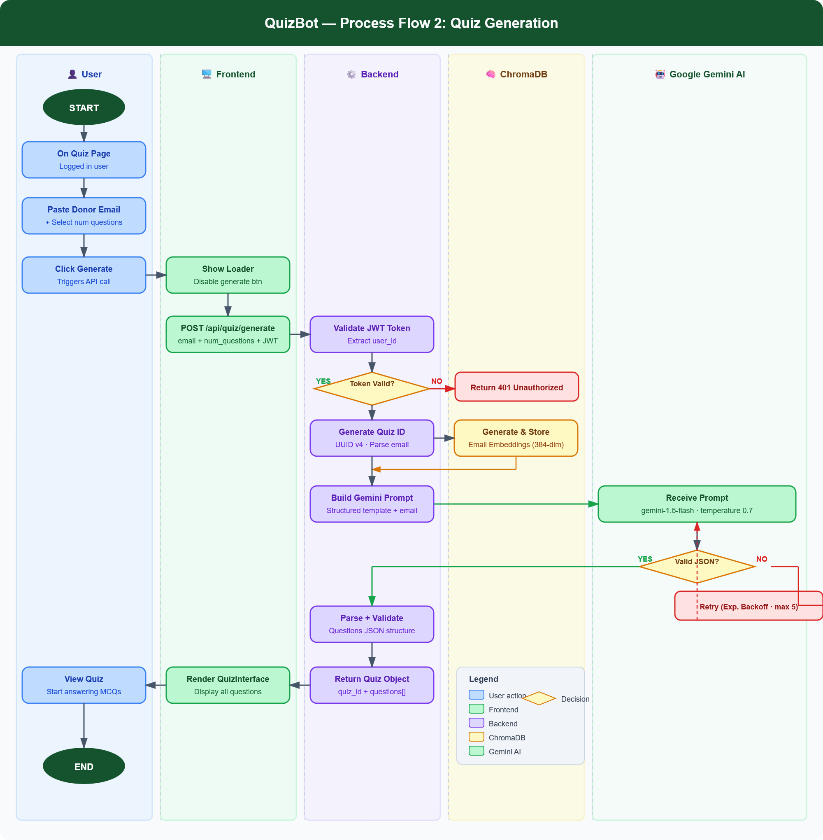
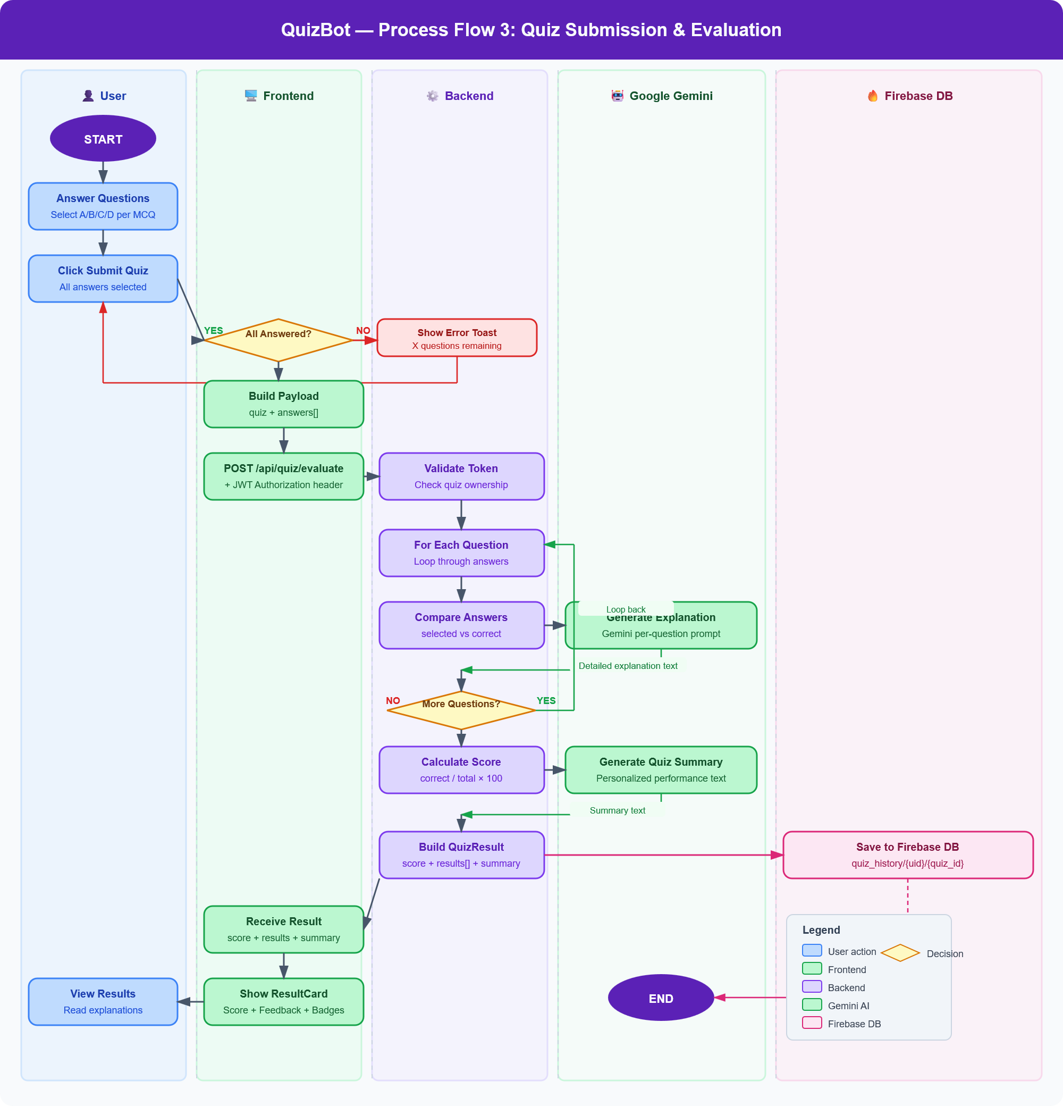
Process Flow
Step-by-step user journey: from pasting a donor email to receiving quiz results and progress analytics.
QuizBot HLD | Group 03D2 | GAI-15 | GenAI Course | Datagami Skill Based Course | Medicaps University

Slide 10
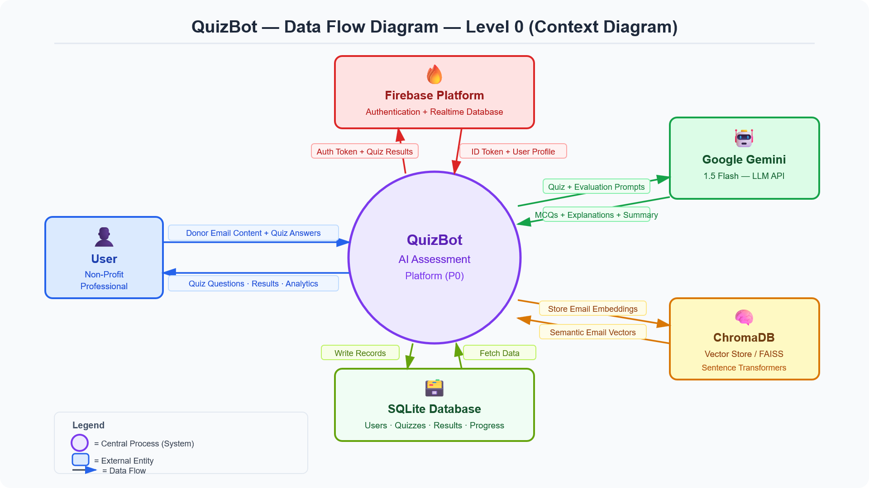
Information Flow – Data Flow Diagram – Level 0
Full-stack architecture showing component interactions, data flow, and service integrations.
QuizBot HLD | Group 03D2 | GAI-15 | GenAI Course | Datagami Skill Based Course | Medicaps University

Slide 11
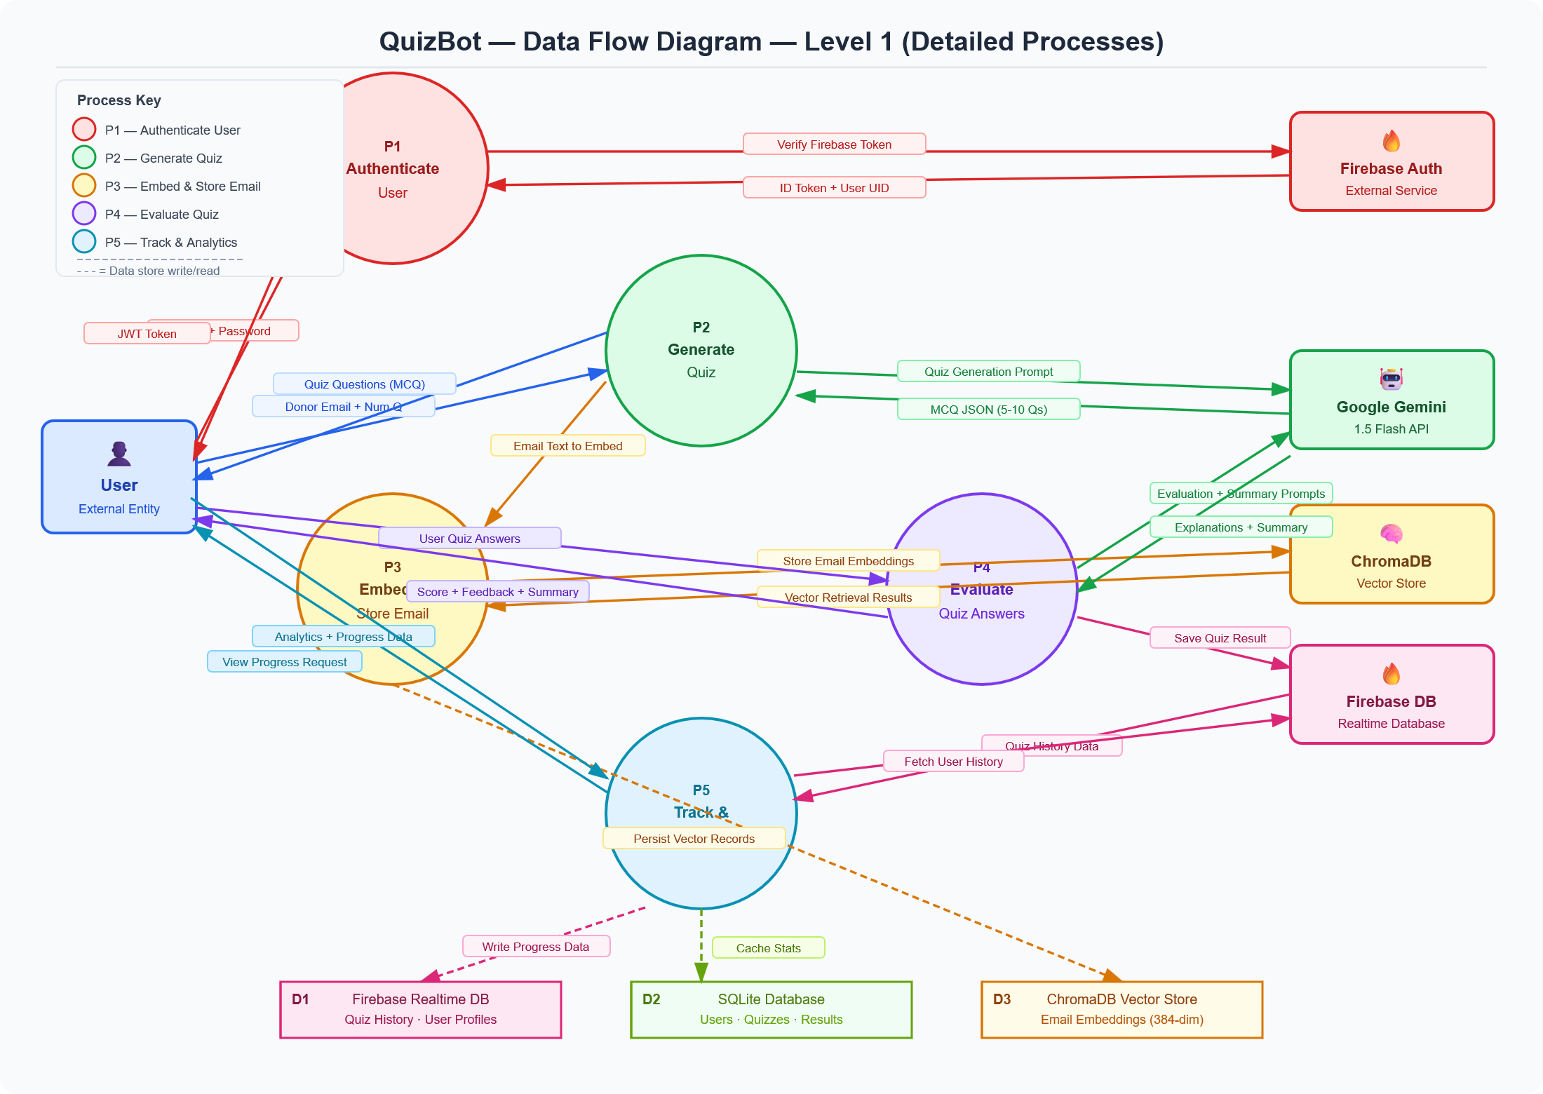
Information Flow – Data Flow Diagram – Level 1
High-level context diagram showing external entities and their data flows with the QuizBot system.
QuizBot HLD | Group 03D2 | GAI-15 | GenAI Course | Datagami Skill Based Course | Medicaps University

Slide 12
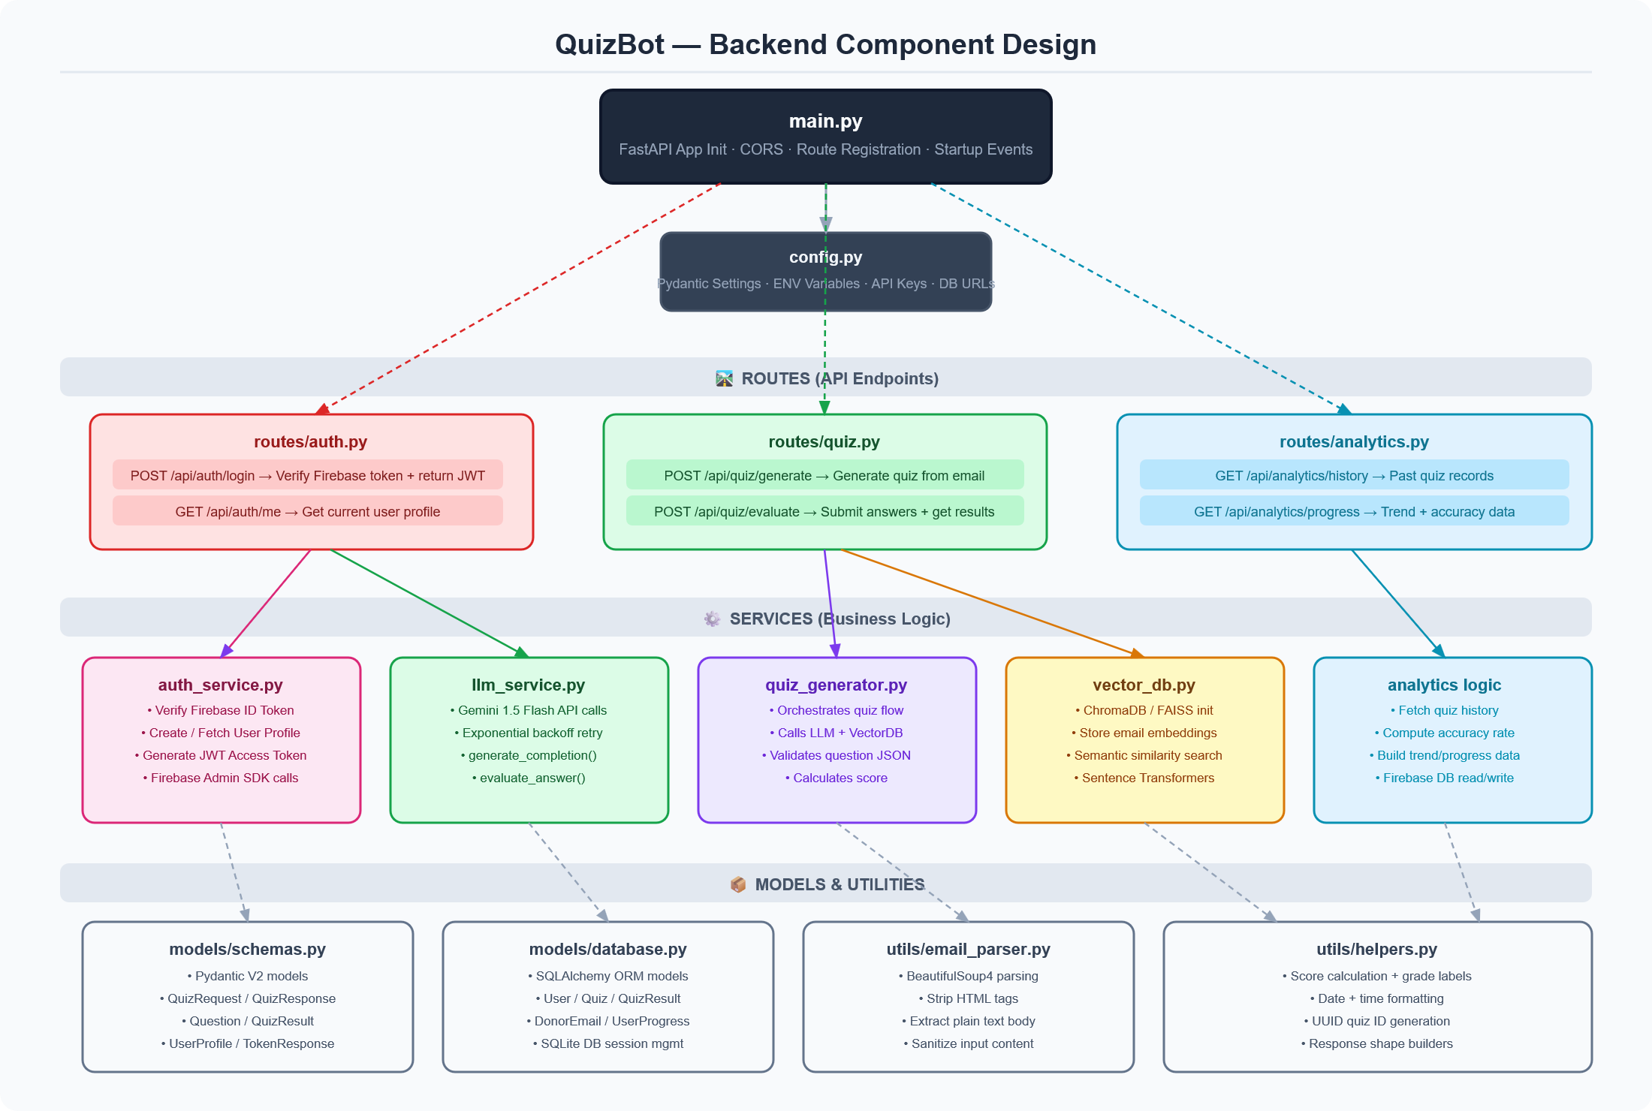
Components Design – Backend Components Design
QuizBot HLD | Group 03D2 | GAI-15 | GenAI Course | Datagami Skill Based Course | Medicaps University

Slide 13
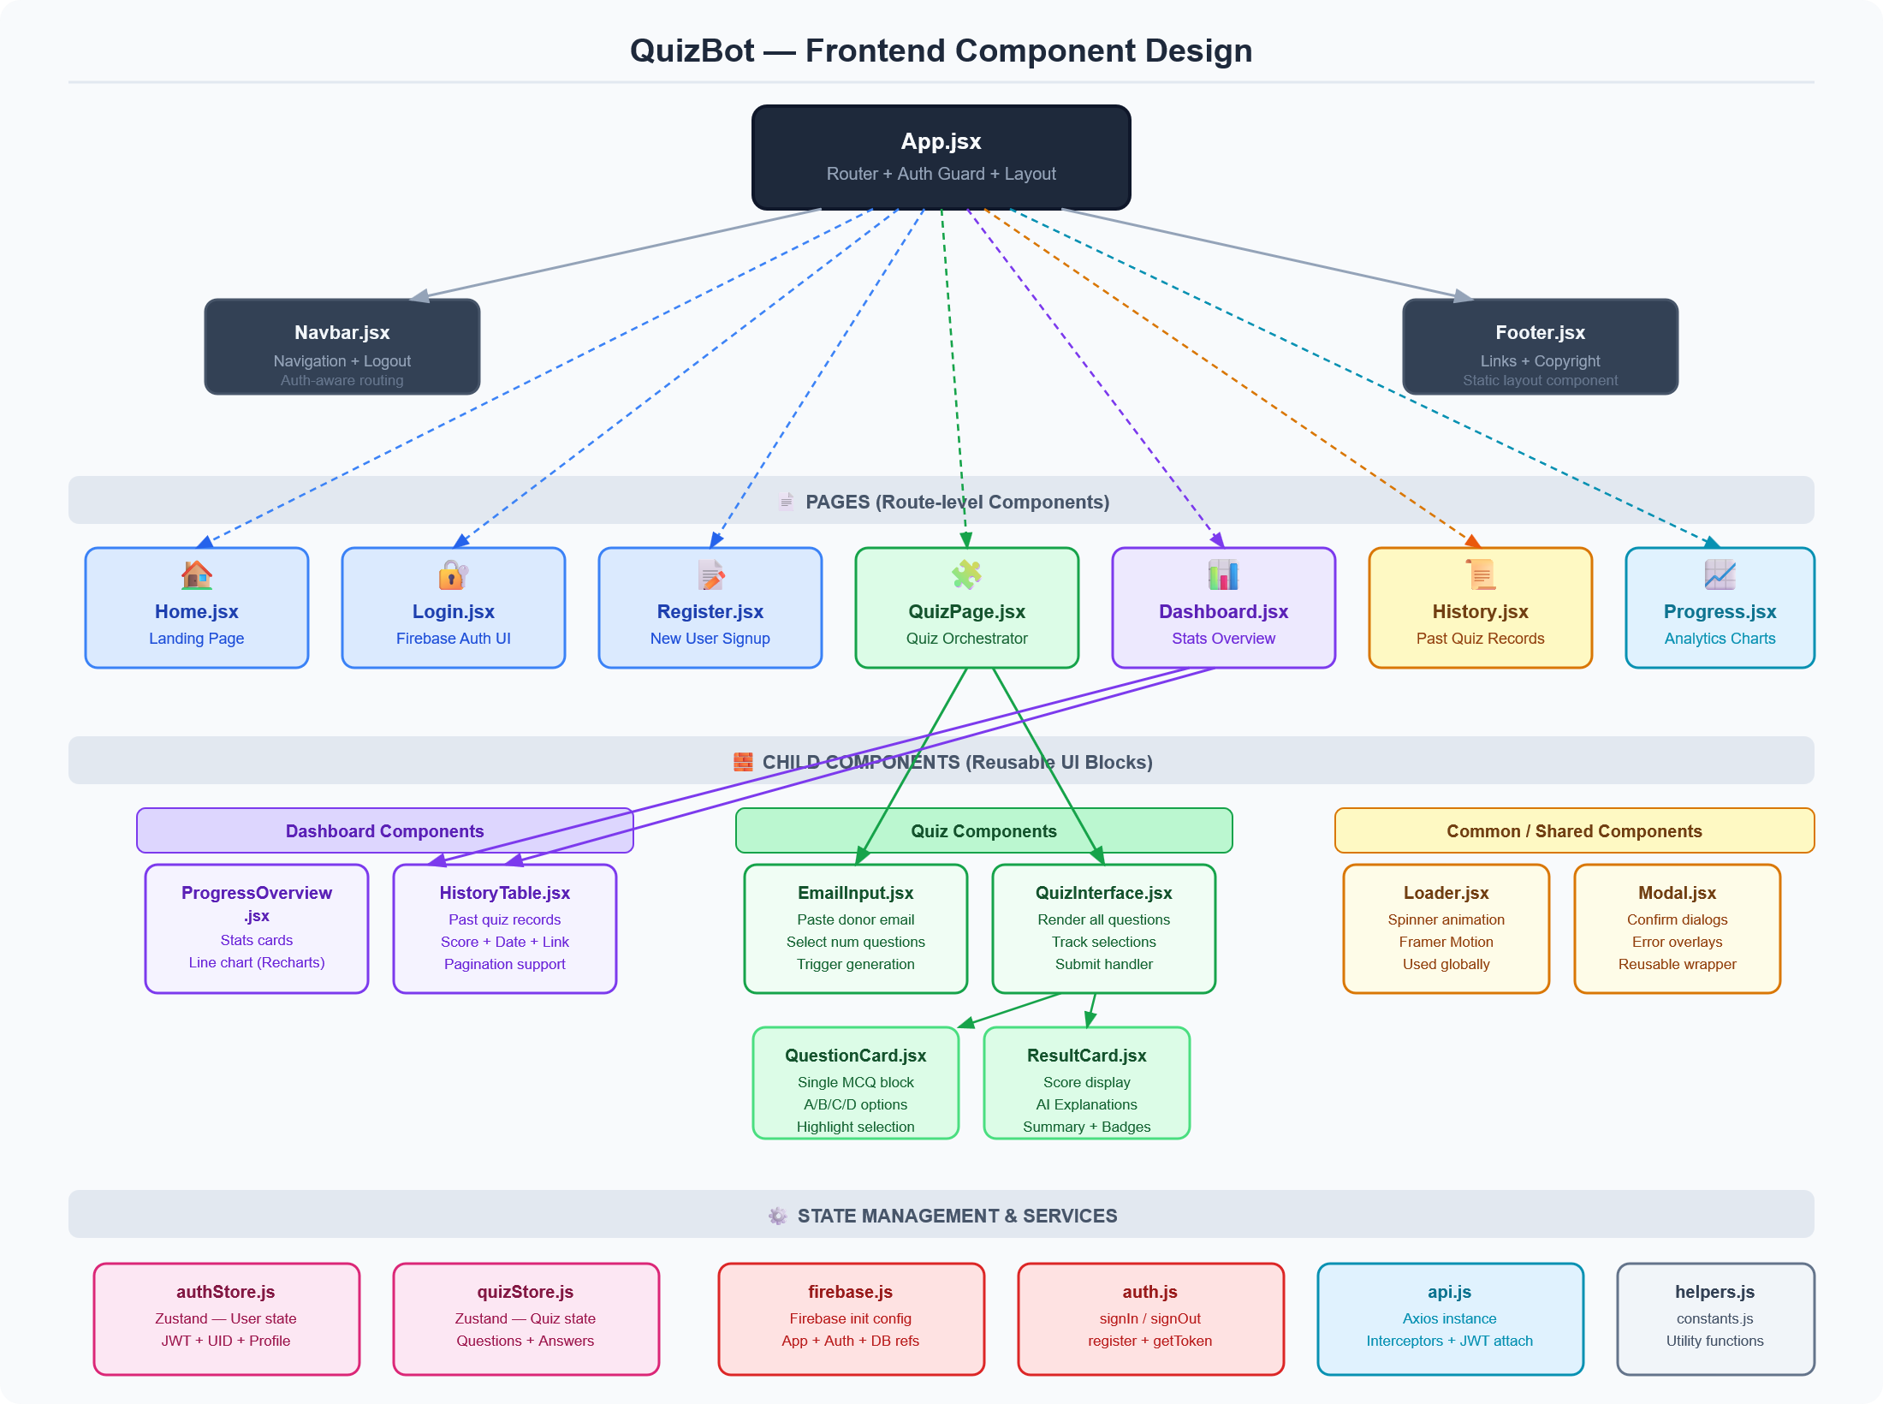
Components Design – Frontend Components Design
QuizBot HLD | Group 03D2 | GAI-15 | GenAI Course | Datagami Skill Based Course | Medicaps University

Slide 14
Information Flow Summary
Data Source | Destination | Format | When
Donor Email Text | Backend → ChromaDB + Gemini | Plain Text | Quiz Generation
Email Embeddings | Sentence Transformers → ChromaDB | 384-dim Vector | Quiz Generation
Quiz Questions | Google Gemini → Frontend | JSON Array | After Generation
User Answers | Frontend → Backend | JSON Array | Quiz Submission
Answer Explanations | Google Gemini → Frontend | Plain Text | After Submission
Quiz Results | Backend → Firebase Realtime DB | JSON Object | After Evaluation
Auth Token | Firebase Auth → Frontend/Backend | JWT String | Login/Register
Progress Analytics | Firebase → Backend → Frontend | JSON Object | Progress Page
QuizBot HLD | Group 03D2 | GAI-15 | GenAI Course | Datagami Skill Based Course | Medicaps University

Slide 15
API Catalogue
Base URL: http://localhost:8000
Authentication APIs (/api/auth)
POST
/api/auth/login
Verify Firebase token, return JWT + user profile
Auth: No
GET
/api/auth/me
Get current authenticated user profile
Auth: Yes
Quiz APIs (/api/quiz)
POST
/api/quiz/generate
Generate quiz from donor email content
Auth: Yes
POST
/api/quiz/evaluate
Submit answers and get evaluated results
Auth: Yes
Analytics APIs (/api/analytics)
GET
/api/analytics/history
Get all past quiz records for user
Auth: Yes
GET
/api/analytics/progress
Get progress analytics and trend data
Auth: Yes
GET
/api/analytics/stats
Get combined user stats + analytics
Auth: Yes
QuizBot HLD | Group 03D2 | GAI-15 | GenAI Course | Datagami Skill Based Course | Medicaps University

Slide 16
Data Design – Multi-Database Strategy
QuizBot uses three databases, each chosen for specific strengths:
Firebase Realtime DB
Cloud
SQLite
Local
ChromaDB
Vector
Cloud-synced hierarchical JSON storage.
Stores users/ and quiz_history/ root nodes.
Real-time sync, server-side access via Admin SDK.
Local structured relational storage.
SQLAlchemy ORM for data access.
Local file-based — no external exposure.
Vector store for semantic embeddings.
Stores 384-dim Sentence Transformer vectors.
Enables semantic similarity search on emails.
QuizBot HLD | Group 03D2 | GAI-15 | GenAI Course | Datagami Skill Based Course | Medicaps University

Slide 17
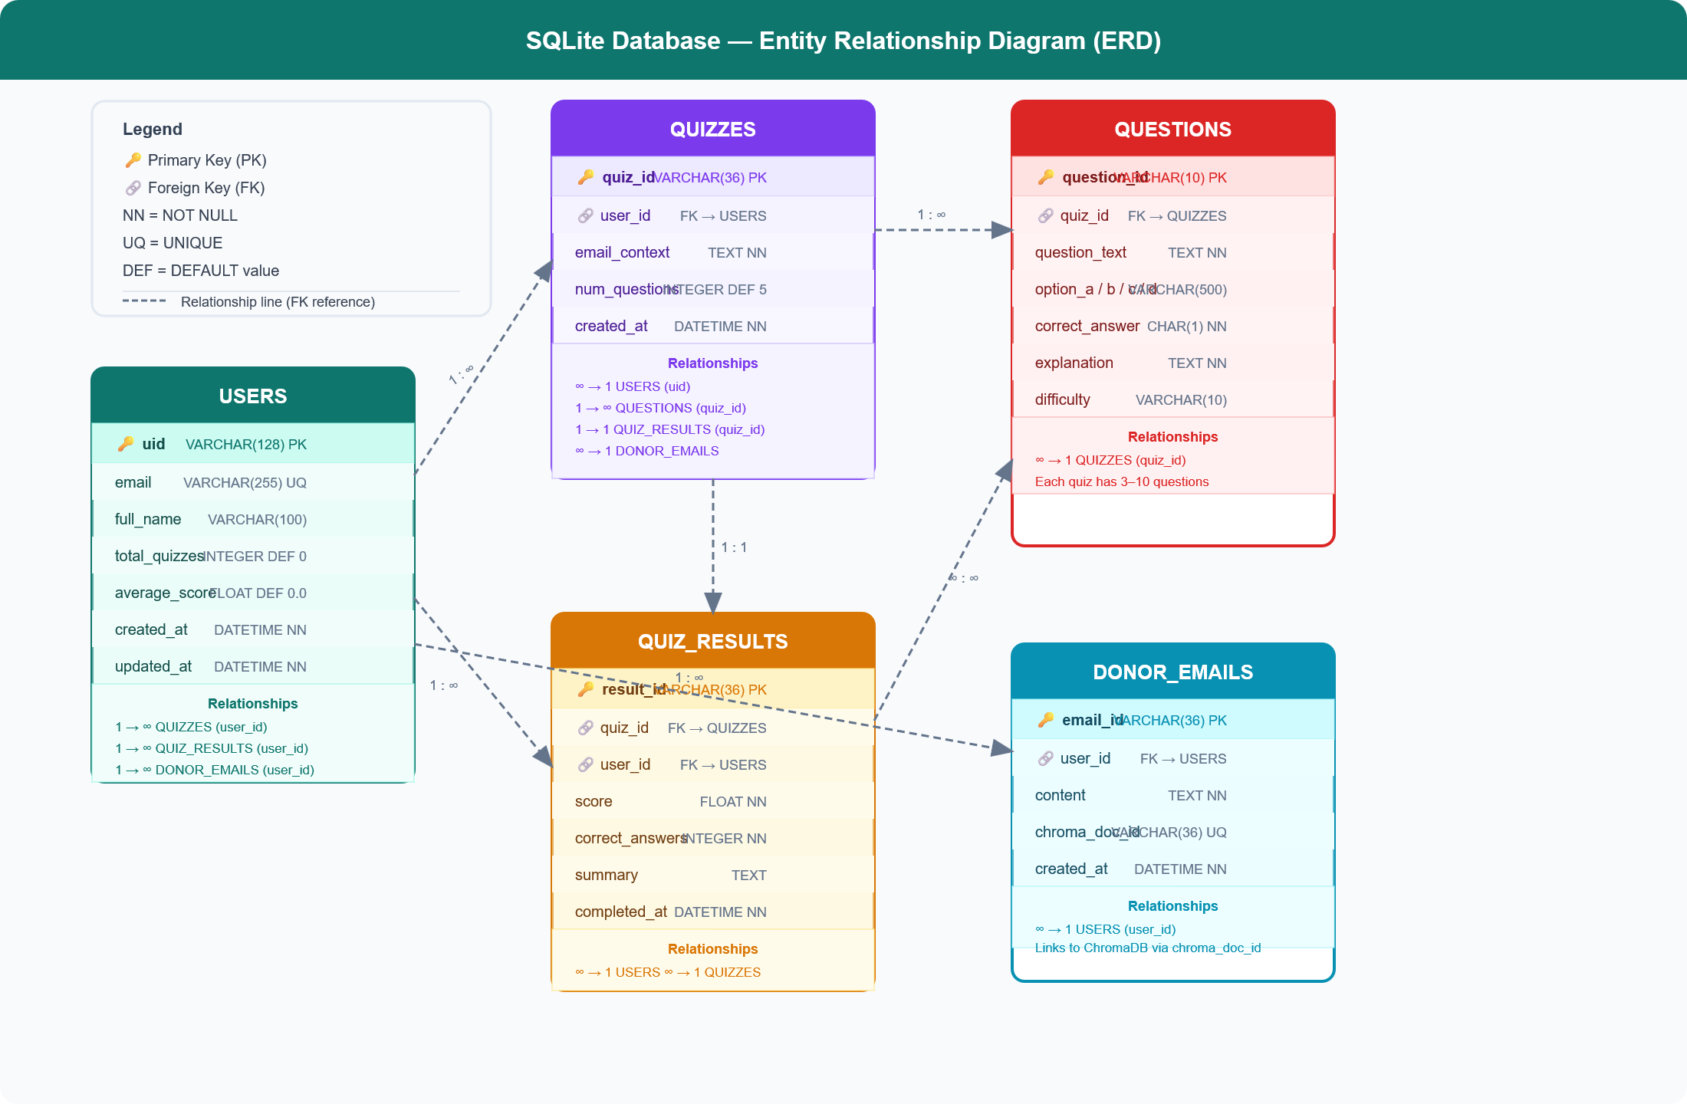
Data Design – Entity Relationship Diagram
FastAPI services organized into Auth, Quiz Generation, LLM Evaluation, Vector DB, and Analytics layers.
QuizBot HLD | Group 03D2 | GAI-15 | GenAI Course | Datagami Skill Based Course | Medicaps University

Slide 18
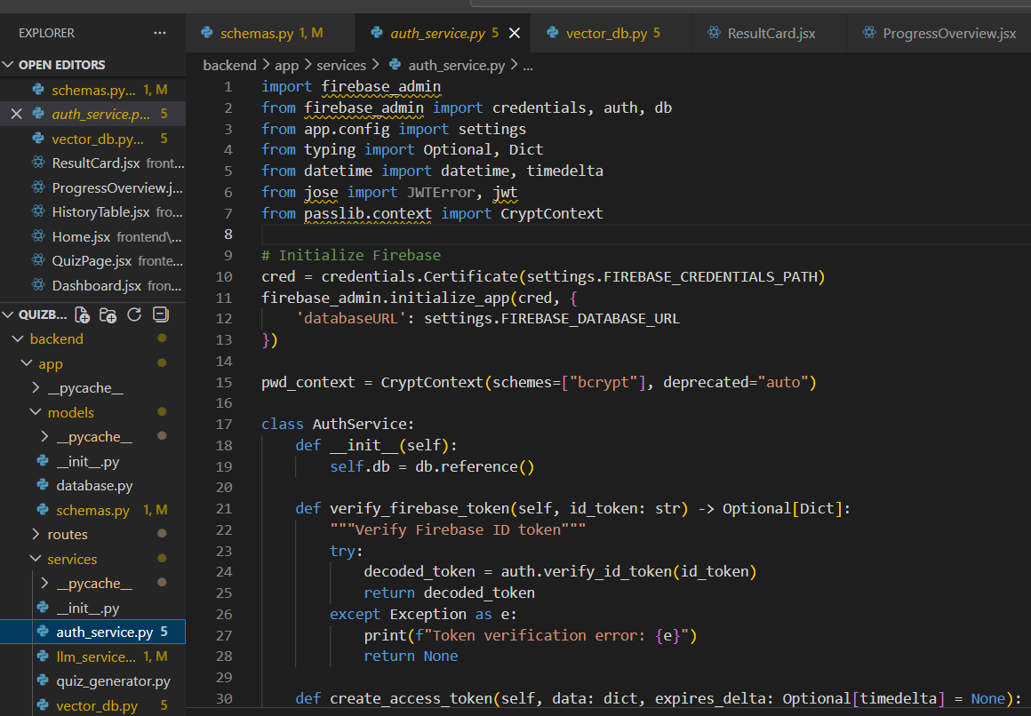
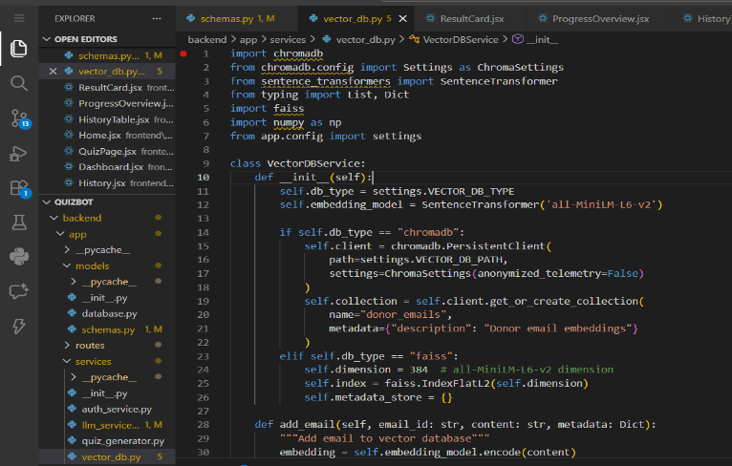
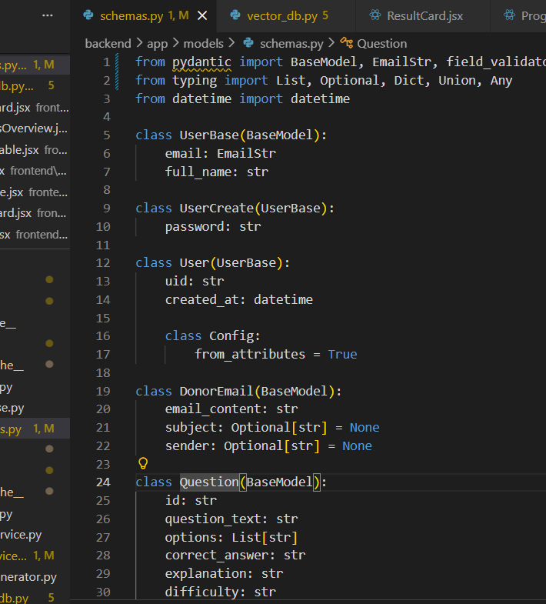
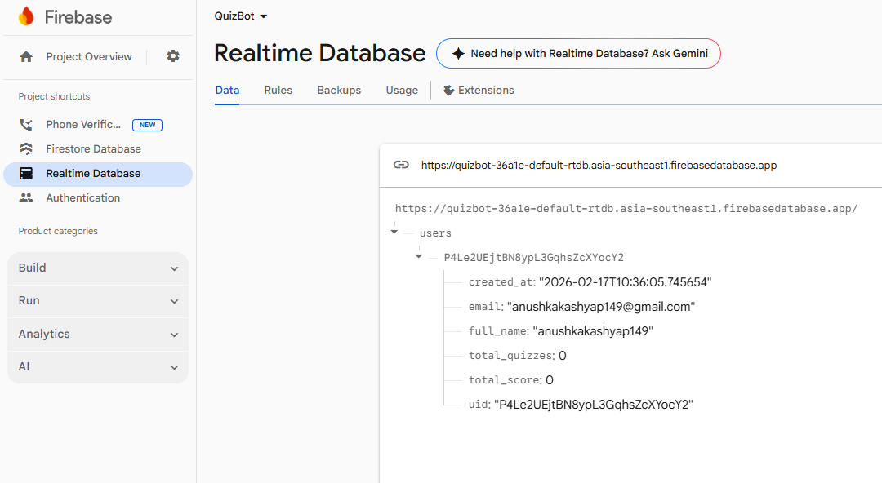
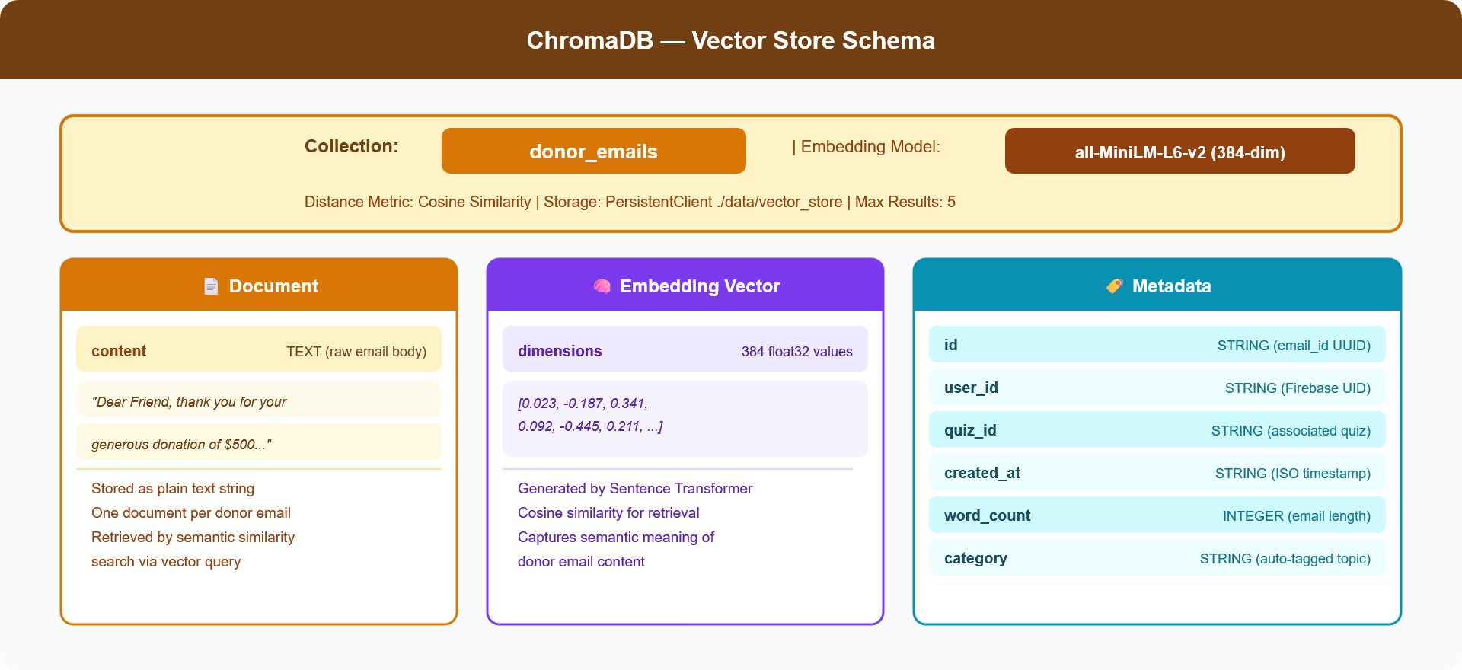
Data Design – Firebase Realtime Databse Schema and ChromaDB Vector Store Schema
QuizBot HLD | Group 03D2 | GAI-15 | GenAI Course | Datagami Skill Based Course | Medicaps University

Slide 19
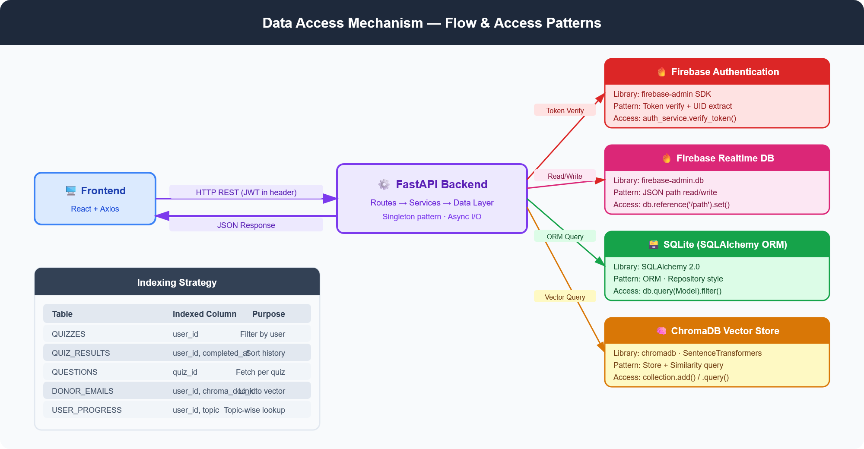
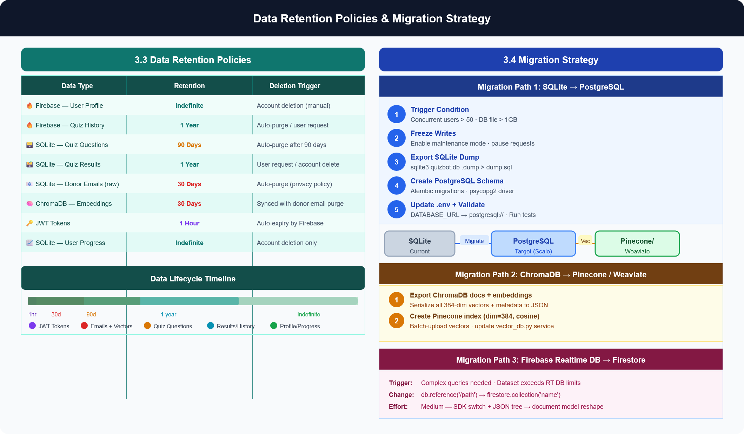
Data Design
QuizBot HLD | Group 03D2 | GAI-15 | GenAI Course | Datagami Skill Based Course | Medicaps University

Slide 20
Interfaces - User Interfaces (UI)
React 19 + Vite Single Page Application with Framer Motion animations. All interfaces are responsive and transition-animated.
/home
Home Page
Public
Landing page, product overview, CTA
/login
Login
Public
Firebase email/password login
/register
Register
Public
New user account creation
/quiz
Quiz Page
Protected
Email input + quiz generation + quiz taking
/dashboard
Dashboard
Protected
Stats overview + recent quizzes
/history
History
Protected
All past quiz records paginated
/progress
Progress
Protected
Analytics charts + achievement badges
QuizBot HLD | Group 03D2 | GAI-15 | GenAI Course | Datagami Skill Based Course | Medicaps University

Slide 21
Interfaces - External Service Interfaces
Service | Interface Type | Protocol | Auth Method
Google Gemini AI | REST API | HTTPS | API Key in header
Firebase Authentication | SDK + REST | HTTPS | Service Account JSON
Firebase Realtime DB | SDK | HTTPS/WSS | Service Account JSON
ChromaDB | Python Client | In-process | None (local)
SQLite | SQLAlchemy ORM | File I/O | None (local file)
QuizBot HLD | Group 03D2 | GAI-15 | GenAI Course | Datagami Skill Based Course | Medicaps University

Slide 22
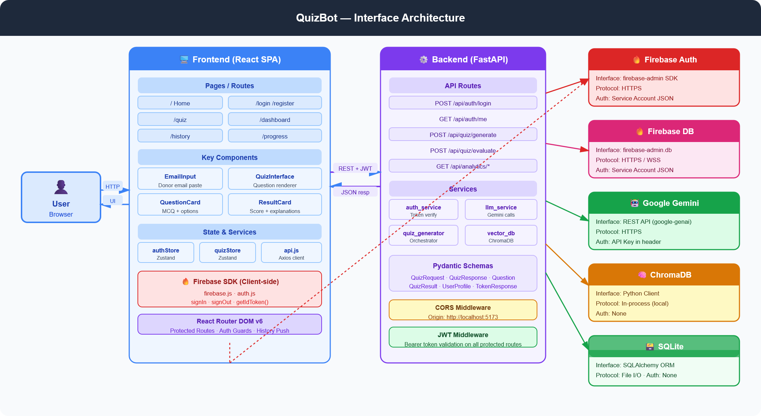
Interfaces Flow diagram
QuizBot HLD | Group 03D2 | GAI-15 | GenAI Course | Datagami Skill Based Course | Medicaps University

Slide 23
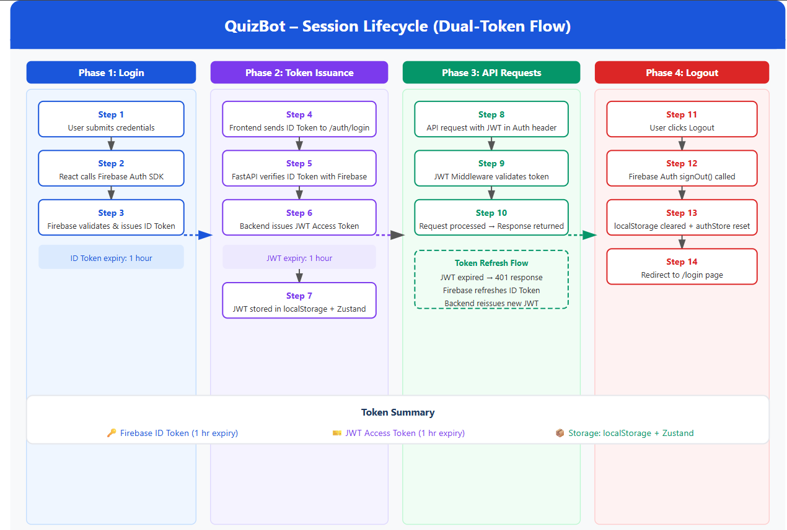
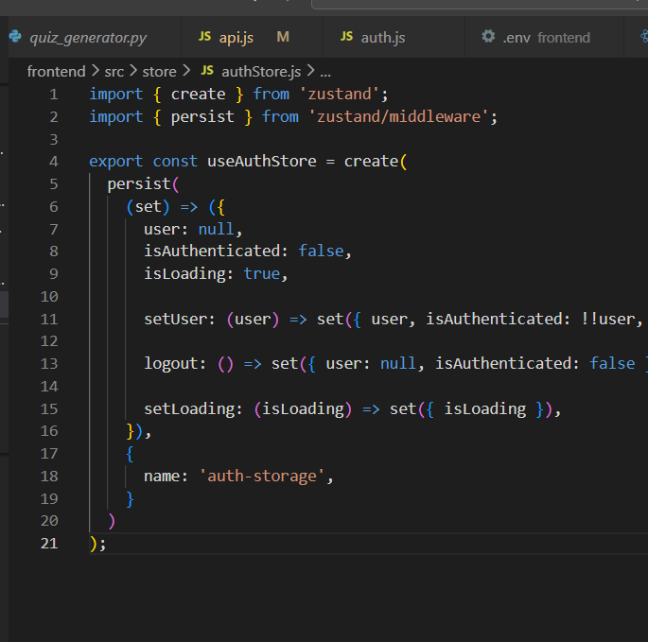
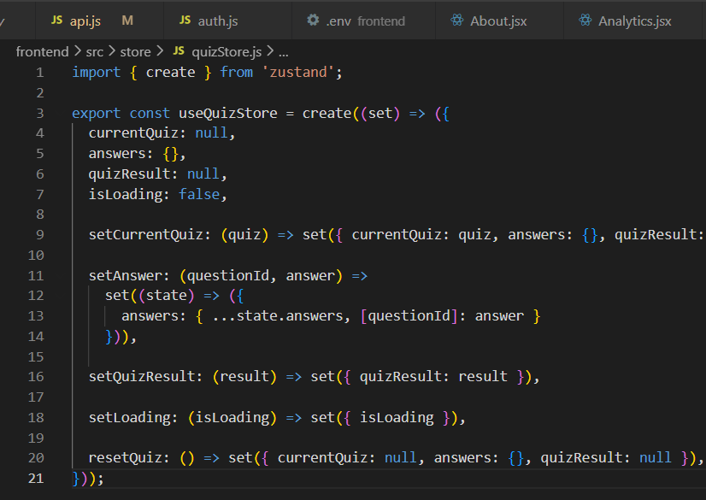
State & Session Management
Zustand Global State (Frontend)
Dual-Token Session Model
Firebase ID Token for authentication
Backend JWT for API authorization
JWT expires after 1 hour (matches Firebase ID token)
Tokens stored in localStorage only (no CSRF risk)
Backend verifies every request — stateless
Axios interceptor attaches valid token automatically
Token refresh failure → silent logout + redirect to /login
authStore.js
• user, token, isAuthenticated, isLoading
• Actions: setUser, setToken, logout, checkAuth
• JWT persisted in localStorage
quizStore.js
• currentQuiz, selectedAnswers, quizResult
• isGenerating, isSubmitting flags
• Actions: setQuiz, setAnswer, setResult, resetQuiz
QuizBot HLD | Group 03D2 | GAI-15 | GenAI Course | Datagami Skill Based Course | Medicaps University

Slide 24
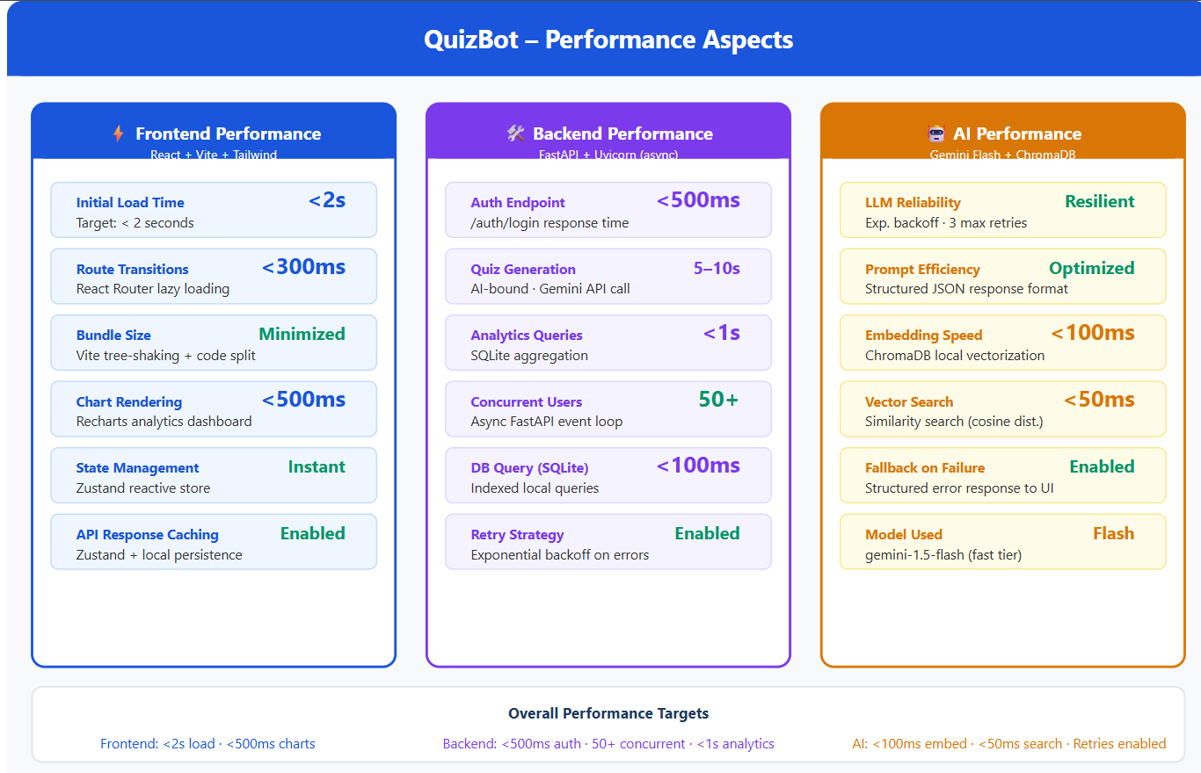
Non-Functional Requirements - Security Aspects
Authentication Security
API & Data Security
Firebase Authentication
email + password
Implemented
CORS policy
allows only localhost:5173
✅ Implemented
JWT via python-jose
1hr expiry
Implemented
Protected routes
JWT middleware on all private endpoints
✅ Implemented
Input validation
Pydantic V2 schema validation
✅ Implemented
Firebase Admin SDK
server-side token validation
Implemented
Rate limiting
Not yet implemented
🔜 Planned
Frontend auto-refresh
getIdToken(true)
Implemented
HTTPS enforcement
Required in production
🔜 Production
Password hashing
bcrypt via Firebase Auth
Implemented
Email content privacy
Donor emails purged after 30 days
✅ Policy Set
QuizBot HLD | Group 03D2 | GAI-15 | GenAI Course | Datagami Skill Based Course | Medicaps University

Slide 25
Thank You
QuizBot – High Level Design
Key Highlights:
AI-powered quiz generation from donor emails • Vector semantic search via ChromaDB • Dual-token session security • Real-time progress analytics • 3-Tier scalable architecture
Group 03D2 | GAI-15 | Medicaps University | Academic Year 2026

