Slide 1
QUIZBOT
AI-Powered Educational Assessment Platform
Low Level Design Document

Slide 2
PROJECT OVERVIEW
🎯 OBJECTIVE
  Transform donor emails into intelligent, AI-driven quizzes for non-profit sector education
📊 PROJECT TYPE
  Full-Stack Web Application with AI Integration
🎓 DOMAIN
  Educational Technology (EdTech) for Non-Profit Sector
✨ KEY FEATURES
  • AI-powered quiz generation (Google Gemini)
  • Real-time assessment and evaluation
  • Comprehensive learning analytics
  • Progress tracking and insights
  • Firebase authentication
  • Vector-based content similarity search

Slide 3
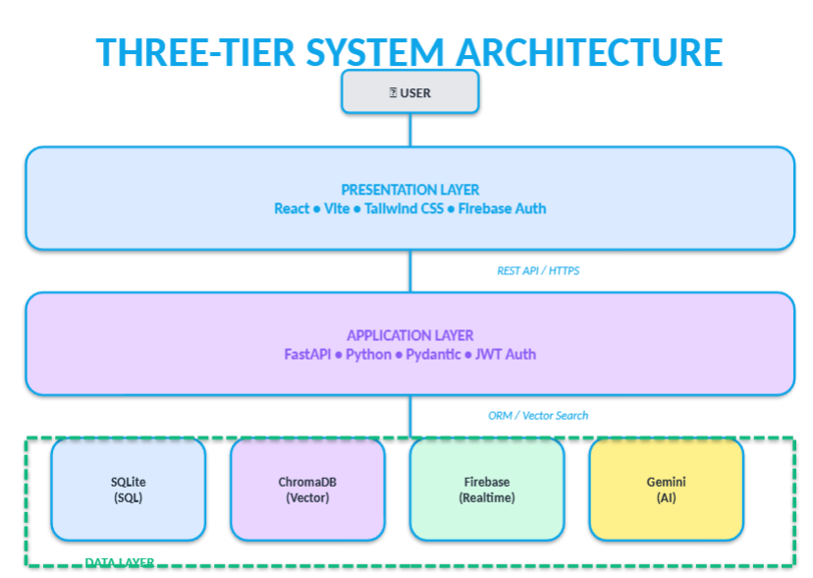
THREE-TIER ARCHITECTURE

Slide 4
TECHNOLOGY STACK
FRONTEND TECHNOLOGIES
Framework: React 19.2.0
Build Tool: Vite 7.3.1
Styling: Tailwind CSS 3.4.19
State Mgmt: Zustand 4.5.7
Animations: Framer Motion 11.18.2
Routing: React Router 6.30.3
HTTP Client: Axios 1.13.5
Charts: Recharts 2.15.4
Auth: Firebase 12.9.0
BACKEND TECHNOLOGIES
Language: Python 3.9+
Framework: FastAPI 0.104.1
Server: Uvicorn 0.24.0
ORM: SQLAlchemy 2.0.23
AI/ML: Google Gemini AI 0.3.2
Vector DB: ChromaDB 0.4.18
Embeddings: Sentence Trans. 2.2.2
Auth: Firebase Admin 6.3.0
Validation: Pydantic 2.5.0

Slide 5
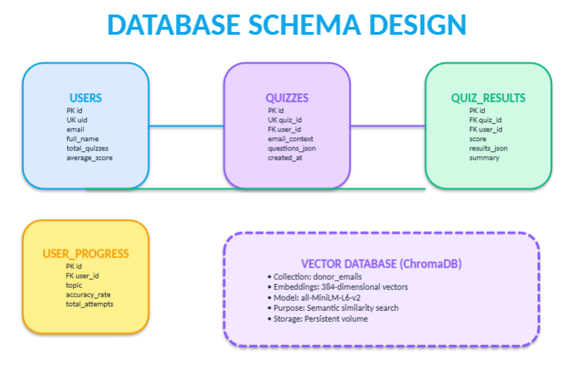
DATABASE SCHEMA DESIGN
USERS
  PK id
  UK uid
  email
  full_name
  total_quizzes
  average_score
QUIZZES
  PK id
  UK quiz_id
  FK user_id
  email_context
  questions_json
  created_at
QUIZ_RESULTS
  PK id
  FK quiz_id
  FK user_id
  score
  results_json
  summary
USER_PROGRESS
  PK id
  FK user_id
  topic
  accuracy_rate
  total_attempts
VECTOR DATABASE (ChromaDB)
  • Collection: donor_emails
  • Embeddings: 384-dim vectors
  • Model: all-MiniLM-L6-v2
  • Purpose: Semantic search

Slide 6
REST API ENDPOINTS
AUTHENTICATION
  POST /api/auth/register → Register new user
  POST /api/auth/login → Login with Firebase token
  GET /api/auth/me → Get current user profile
QUIZ MANAGEMENT
  POST /api/quiz/generate → Generate quiz from email
  POST /api/quiz/evaluate → Submit and evaluate quiz
ANALYTICS
  GET /api/analytics/history → Get quiz history
  GET /api/analytics/progress → Get progress metrics
  GET /api/analytics/stats → Get comprehensive stats

Slide 7
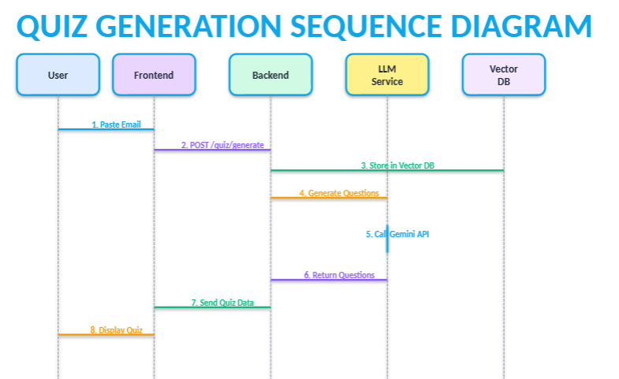
QUIZ GENERATION SEQUENCE
1. User Input
  User pastes donor email content into form
2. Frontend Request
  POST /api/quiz/generate with email content
3. Email Storage
  Backend stores email in Vector DB (ChromaDB)
4. AI Processing
  LLMService calls Google Gemini Pro API
5. Question Generation
  AI generates 3-10 contextual MCQ questions
6. Database Save
  Quiz saved to SQLite database
7. Response
  Frontend receives quiz data with questions
8. Display
  User sees quiz interface with all questions
⏱️ Total Time: 3-5 seconds

Slide 8
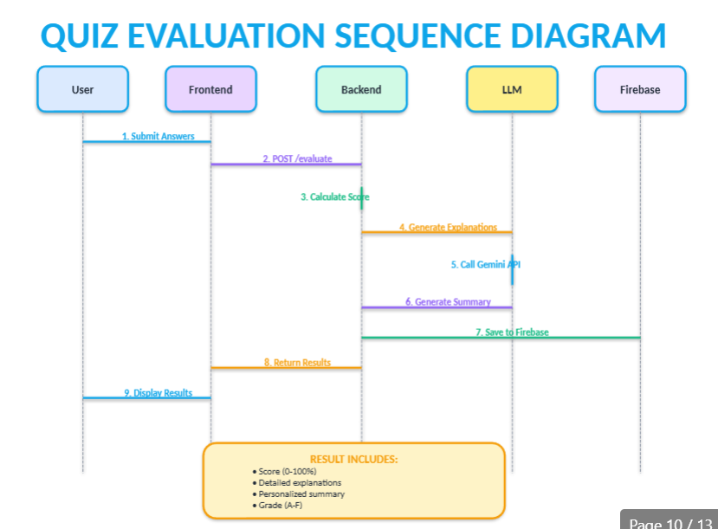

Slide 9
IMPLEMENTED KEY FEATURES
✅ AI-Powered Quiz Generation
  • Input: Donor email (any length)
  • Processing: Google Gemini Pro
  • Output: 3-10 contextual MCQs
  • Time: ~3-5 seconds per quiz
✅ Intelligent Evaluation
  • Automatic scoring (0-100%)
  • Detailed explanations
  • Personalized summary
  • Performance grades (A-F)
✅ Analytics Dashboard
  • Total quizzes & average score
  • Performance trend charts
  • Accuracy rate tracking
  • Historical visualization
✅ Authentication & Security
  • Firebase Authentication
  • JWT token-based API
  • Protected routes
  • Secure session management

Slide 10
PROJECT COMPLETION STATUS
Backend Development
95%
Frontend Development
90%
Integration & Testing
70%
Deployment & Documentation
50%
OVERALL PROJECT COMPLETION: 85%
Key Achievements:
  ✅ Full-stack application operational
  ✅ AI integration successful (Gemini Pro)
  ✅ User authentication implemented
  ✅ All core features working

Slide 11
THANK YOU!
Questions & Discussion
QuizBot - AI-Powered Learning Platform

