Slide 1
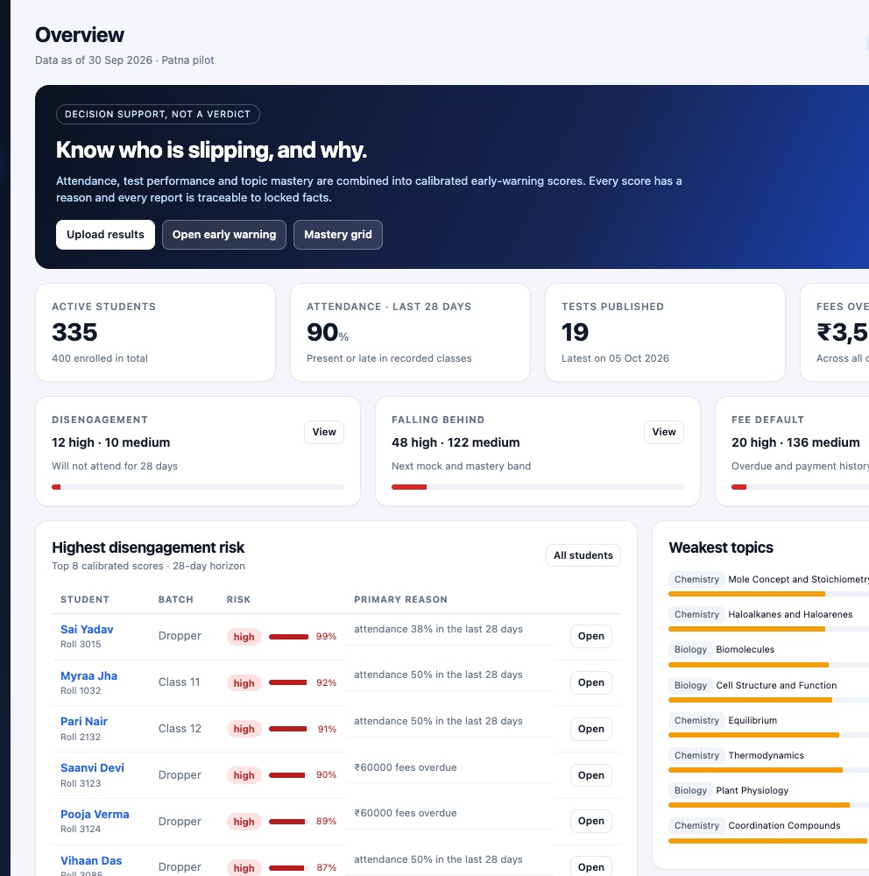
CASE B · THE DATA MOAT
Know who is slipping — before they leave.
A privacy-first analytics layer for Tier-2 NEET/JEE coaching institutes.
3 institutes
1,000 students
181k responses
Synthetic pilot · working prototype · not a concept deck
Nextute × Finance Club IIT Patna · 2026

Slide 2
THE PROBLEM
The data exists. The action arrives late.
01
02
03
Signals are trapped
Teachers see a score
Parents see a rank
Attendance registers, OMR sheets, fee ledgers and WhatsApp groups do not talk to each other.
An average mark hides the topic gap. By the time it is obvious, the student has stopped attending.
Generic updates create anxiety, not trust. Institutes have no time to personalise 400 reports.
ILLUSTRATIVE, NOT A CLAIM
A 400-student institute with ₹60k annual fees and 15% attrition has ₹36L of fee revenue at risk — before replacement cost.
Institute Intelligence · Case B · The Data Moat · 2026
02
Notes:
Open with the owner's reality: the signals are already in the institute, but they are fragmented. The ₹36L number is an explicit illustrative calculation, not a market claim. The point is that retention is a revenue problem, not just an academic one.

Slide 3
WHY NOW
A trust window is opening.
DPDP Rules 2025
WhatsApp first
Consent, retention and breach discipline are now board-level. Institutes need a vendor that can show its controls.
Parents already live on WhatsApp. A report that arrives there beats a portal nobody opens.
Consolidation
No data team
Owners are professionalising. They want retention and fee visibility, not another LMS.
A 400-student institute cannot hire a data scientist. A ₹35/student layer is affordable.
Institute Intelligence · Case B · The Data Moat · 2026
03
Notes:
The timing is regulatory and behavioural: DPDP raises the bar for anyone touching student data, while WhatsApp makes parent communication cheap. The wedge is the data the institute already exports.

Slide 4
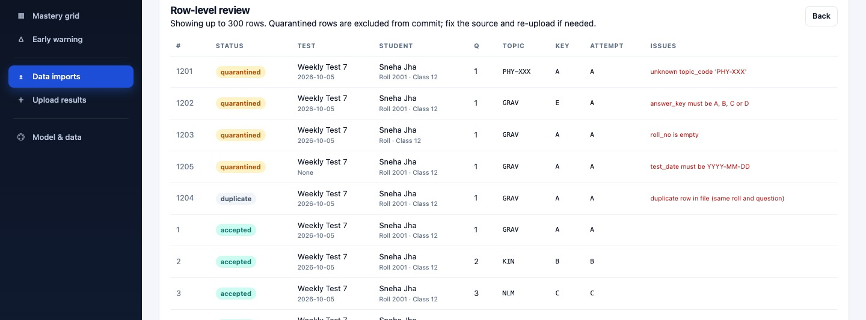
THE PRODUCT
From CSV to a conversation in minutes.
1
2
3
4
Import
Measure
Prioritise
Communicate
CSV or Forms export. Validate, quarantine, commit. Every row auditable.
Rasch ability and topic mastery with recency and shrinkage.
Three risk targets, each with reasons — not a black box.
Intervention, study plan, EN/HI report, consented parent link.
DEMO FILE
1,205 rows
1,200 accepted · 4 quarantined · 1 duplicate
Quarantined rows are shown first. Commit is a separate, explicit step.
Institute Intelligence · Case B · The Data Moat · 2026
04
Notes:
This is the core loop. The import screen is deliberately boring: row-level quarantine, a separate commit, and a job you can audit. The demo file exercises all four failure classes.

Slide 5
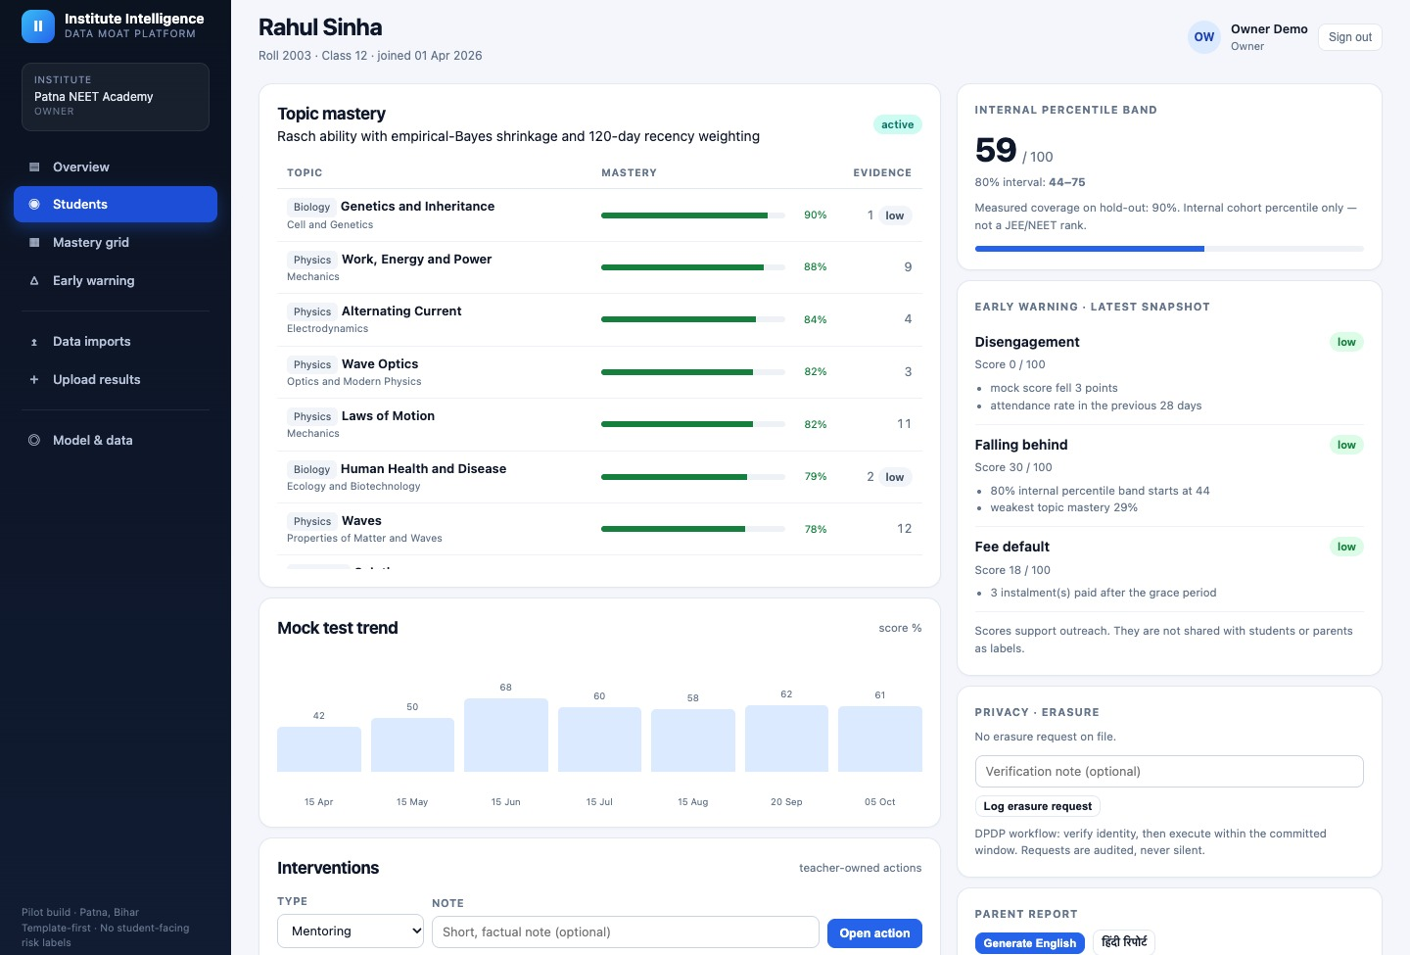
TEACHER VIEW
One student. The next best action.
WHAT THE TEACHER SEES
• Topic mastery with low-evidence labels — no false certainty.
• Internal percentile band with an 80% interval, not a rank.
• Risk reasons in plain language: attendance, trend, mastery.
• Retrieval-grounded study plan for the three weakest topics.
• Interventions are teacher-owned and audited.
• Fee data is redacted for teachers by role.
Institute Intelligence · Case B · The Data Moat · 2026
05
Notes:
Walk the audience through one student. The important design choice is that the teacher sees reasons and evidence, not a naked probability. Low-evidence topics are marked so a single question does not look like a verdict.

Slide 6
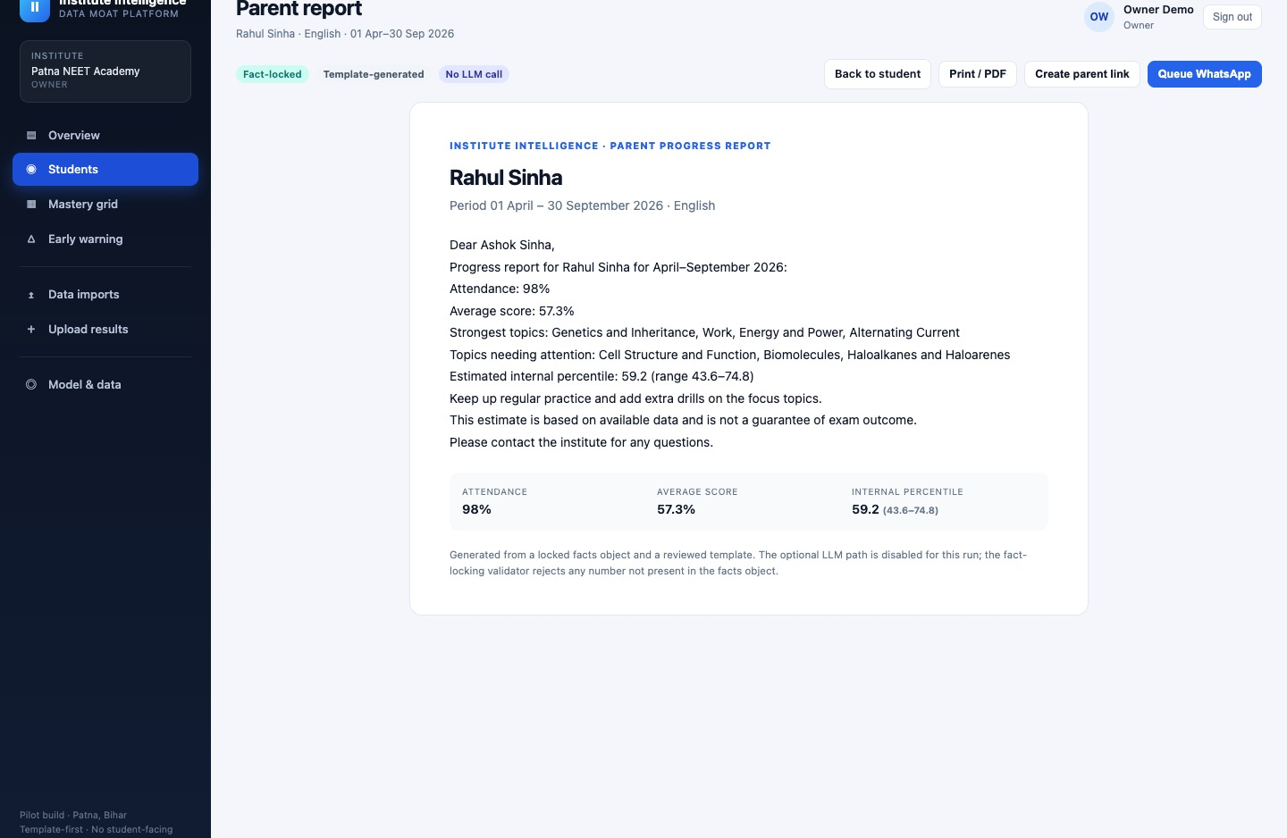
PARENT VIEW
A report a parent can trust.
GUARDRAILS
• Numbers come from one locked facts object.
• English and Hindi templates; no invented advice.
• No risk label. No fee data. No exam-rank claim.
• Consent is checked before the link is created.
• 90-day bearer link, hashed at rest.
The LLM path is off by default.
Institute Intelligence · Case B · The Data Moat · 2026
06
Notes:
The parent report is the trust surface. The design is deliberately conservative: a locked facts object, a reviewed template, and a validator that rejects numbers not in the facts. Parent links are consent-gated and expiring.

Slide 7
AI / ML
Boring ML where it matters.
Rasch / 1PL
Disengagement
P = logistic(θ − b). Shrinkage κ=8, 120-day half-life, 10 common anchors.
Logistic + Platt. Attendance trend, recency, score delta, mastery, fee signal.
Mastery, not a percentage rank.
AUC 0.92–0.99 on synthetic hold-out.
Rules where data is thin
LLM guardrails
Falling behind and fee default are transparent rule_v1 scores.
Template-first. Fact validator. LLM off by default. RAG-lite study plans.
No fake precision.
No student data sent out.
Institute Intelligence · Case B · The Data Moat · 2026
07
Notes:
We are deliberately not claiming a deep-learning breakthrough. Rasch is the right measurement model for small tests; the risk model is calibrated and explainable; the rules are labelled as rules. The LLM is optional, and the retrieval plan uses a curated library.

Slide 8
ARCHITECTURE & PRIVACY
Tenant-safe by construction.
Browser
FastAPI
Postgres 16
owner · teacher · admin · parent
→
auth · imports · analytics · reports
→
RLS · PII side table · audit
TENANT RLS
MINIMISE
Forced row-level security; no tenant context returns zero rows.
Names and phones in a separate PII table; phone values HMACed.
CONSENT
REDACT
Report, parent link and WhatsApp require parent_communication consent.
Teachers never see fee amounts; parents never see risk or fees.
AUDIT
Import, report, link, intervention and erasure events are logged.
Institute Intelligence · Case B · The Data Moat · 2026
08
Notes:
Privacy is not a slide bolted on at the end; it is in the transaction boundary. RLS is forced, PII is separated, consent is checked in the route, and role redaction is tested. The parent is never shown a risk label.

Slide 9
VALIDATION
Validated end to end — with honest limits.
RESPONSES
TESTS
DASHBOARD P95
ANALYTICS REBUILD
181,201
6 / 6
257 ms
7.7 s
3 institutes · 1,000 students
pytest suite
100 requests · 10 workers
181k responses · 3 institutes
Disengagement AUC
0.922 – 0.992
synthetic hold-out
WHAT THIS DOES NOT PROVE
80% band coverage
74.3% – 90.0%
nominal 80%
The data is synthetic and the withdrawal signal is designed. AUC 1.0 is not a real-world claim. The next test is temporal, on consented data, with a pre-registered success bar.
Percentile MAE
8.1 – 8.5 marks
hold-out
Import
1,200 / 1,205
4 quarantined · 1 duplicate
Also validated: tenant isolation, consent gate, teacher fee redaction, parent no-risk view, WhatsApp entry, erasure request.
Institute Intelligence · Case B · The Data Moat · 2026
09
Notes:
Lead with the working system, then defuse the obvious objection: the metrics are synthetic. The correct next step is a time-based pilot, not a claim that the model already predicts real dropout.

Slide 10
MARKET
A focused wedge, not a horizontal LMS.
TAM
~1,20,000 coaching institutes in India (assumption)
SAM
~12,000 NEET/JEE institutes in Tier-2/3 with 150+ students
SOM
320 institutes by Year 3 = 2.7% of SAM
STARTER
150-student floor
10 billed months
GROWTH
Benchmarks, multi-branch
reports, priority support
₹35
₹55
/ student / month
/ student / month
Institute Intelligence · Case B · The Data Moat · 2026
10
Notes:
The market sizing is explicitly top-down and assumption-led. The credible number is SAM, not TAM. We only need 320 institutes for ₹2.5Cr revenue; that is a focused sales problem, not a category-creation problem.

Slide 11
BUSINESS MODEL
Unit economics that can fund the pilot.
GROWTH ACV
CONTRIBUTION
CAC
PAYBACK / LTV:CAC
₹1.93L
65%
₹38k
3.6 mo · 4.8x
350 students · ₹55
₹1.26L per institute
founder-led sales
30-month conservative life
3-YEAR PLAN
• 40 institutes / 9,500 students by Year 1.
• 140 institutes / 34,300 students by Year 2.
• 320 institutes / 80,800 students by Year 3.
• Break-even ~110 institutes at Year-1 cost base.
₹1.0Cr ask covers peak burn with buffer.
Institute Intelligence · Case B · The Data Moat · 2026
11
Notes:
The unit economics are deliberately conservative: 65% contribution, 30-month life, 4.8x LTV/CAC. The plan reaches operational break-even around 110 institutes at the Year-1 cost base; the raise covers the peak cumulative burn of about ₹95L plus buffer.

Slide 12
GO TO MARKET
Own Patna, then the Hindi-belt Tier-2.
NOW
0–6 MONTHS
6–18 MONTHS
10 design partners
40 paying institutes
110+ institutes
Patna. Historical CSV, 8-week pilot. Weekly teacher review. Success bar: 70% of flags actionable.
Patna + Gaya + Muzaffarpur. Owner referrals, local associations, WhatsApp groups.
UP, Jharkhand, West Bengal Tier-2. Distributor partnerships. Hindi-first onboarding.
SALES MOTION
Land with a free historical-data pilot → show 3 parent reports in week 1 → convert to annual pre-paid. Sales cycle target: 4–6 weeks.
Institute Intelligence · Case B · The Data Moat · 2026
12
Notes:
The GTM is local and referral-led. The free historical-data pilot is the wedge because it proves value before asking for a full migration. The buyer is the owner, not the teacher.

Slide 13
MOAT
Why this compounds.
01
Workflow, not dashboard
Attendance, tests, fees and parent communication in one loop.
WHAT WE ARE / ARE NOT
We are
02
Local trust
The retention and parent-trust layer on top of the institute's existing tests.
Patna-first, Hindi-first, owner-led onboarding.
We are not
03
Switching cost
An LMS, a content marketplace, a rank predictor, or a student-facing chatbot. Those are integrations or later products.
Historical mastery, model versions and intervention history live here.
04
Consented network
Aggregate benchmarks only with explicit consent.
Institute Intelligence · Case B · The Data Moat · 2026
13
Notes:
The moat is not the model. It is the workflow and the trust built by being local, bilingual and consent-first. Every intervention and report makes the switching cost higher.

Slide 14
THE ASK
₹1.0 crore to prove the loop.
18 months. 10 design partners. 110+ institutes. One proof that retention improves.
MILESTONES
Product & engineering
35%
• 10 paid pilots
• 110 break-even institutes
• 25,000 students
• 2 states
• Audited DPDP controls
Pilots & onboarding
20%
Sales & channel
20%
Content & compliance
15%
Working capital
10%
Start with 10 institutes. Prove retention. Then own the Tier-2 data layer.
Institute Intelligence · Case B · The Data Moat · 2026
14
Notes:
Close with the narrow ask and the proof point. We are not asking to build a category; we are asking to fund a controlled pilot and a repeatable local sales motion. The milestone is retention improvement, not a model demo.

