Slide 1
Yes Bank
Stock Price Prediction
Prepared by: Anushka Reddy Paturi

Slide 2
Problem Statement
• Predict the Closing Stock Price of Yes Bank using historical stock data. • Understand market behaviour through EDA. • Compare multiple regression models and identify the best performer.

Slide 3
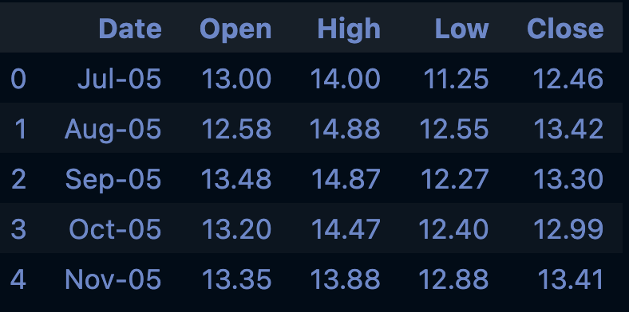
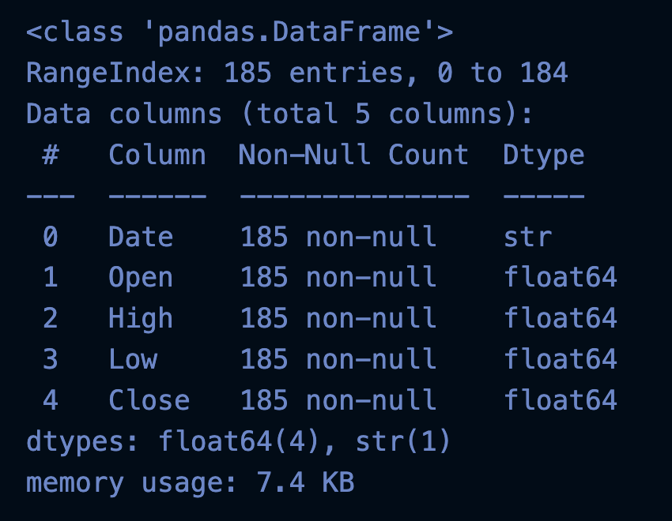
Dataset Overview
Dataset Features: • Date • Open • High • Low • Close (Target) Preprocessing: • Converted Date to datetime • Extracted Year & Month • Checked missing values & duplicates

Slide 4
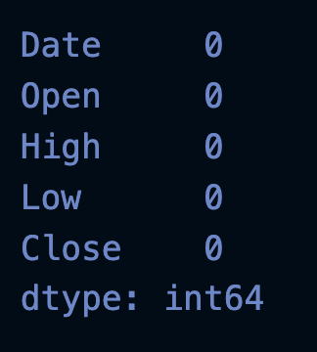
Data Cleaning
✓ No significant missing values ✓ Duplicate records checked and removed if present ✓ Corrected data types ✓ Dataset prepared for analysis

Slide 5
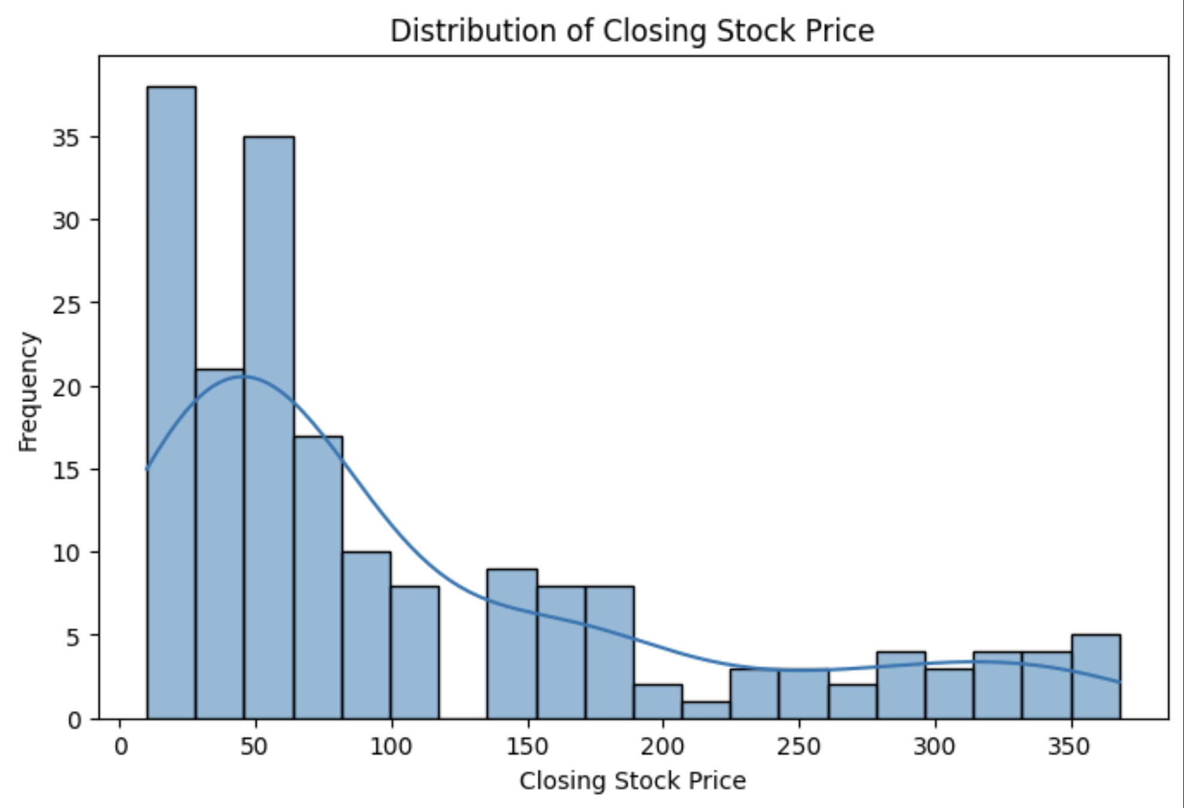
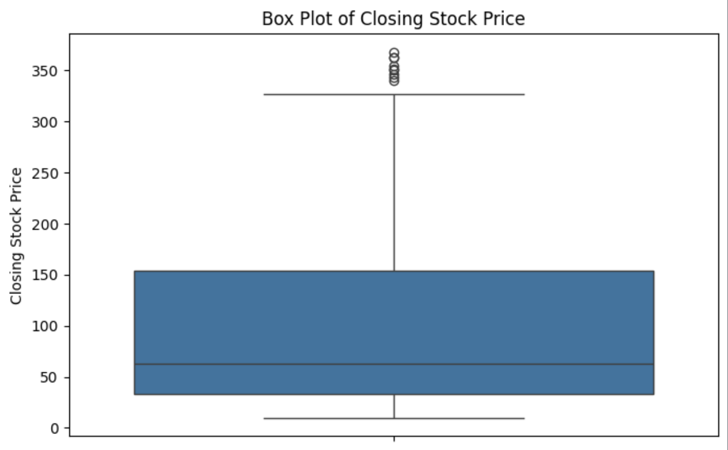
EDA & Business Insights
• Stock prices moved together with strong positive correlation. • Most prices were concentrated in lower ranges. • Significant price decline observed after 2018. • Outliers reflected actual market events.

Slide 6
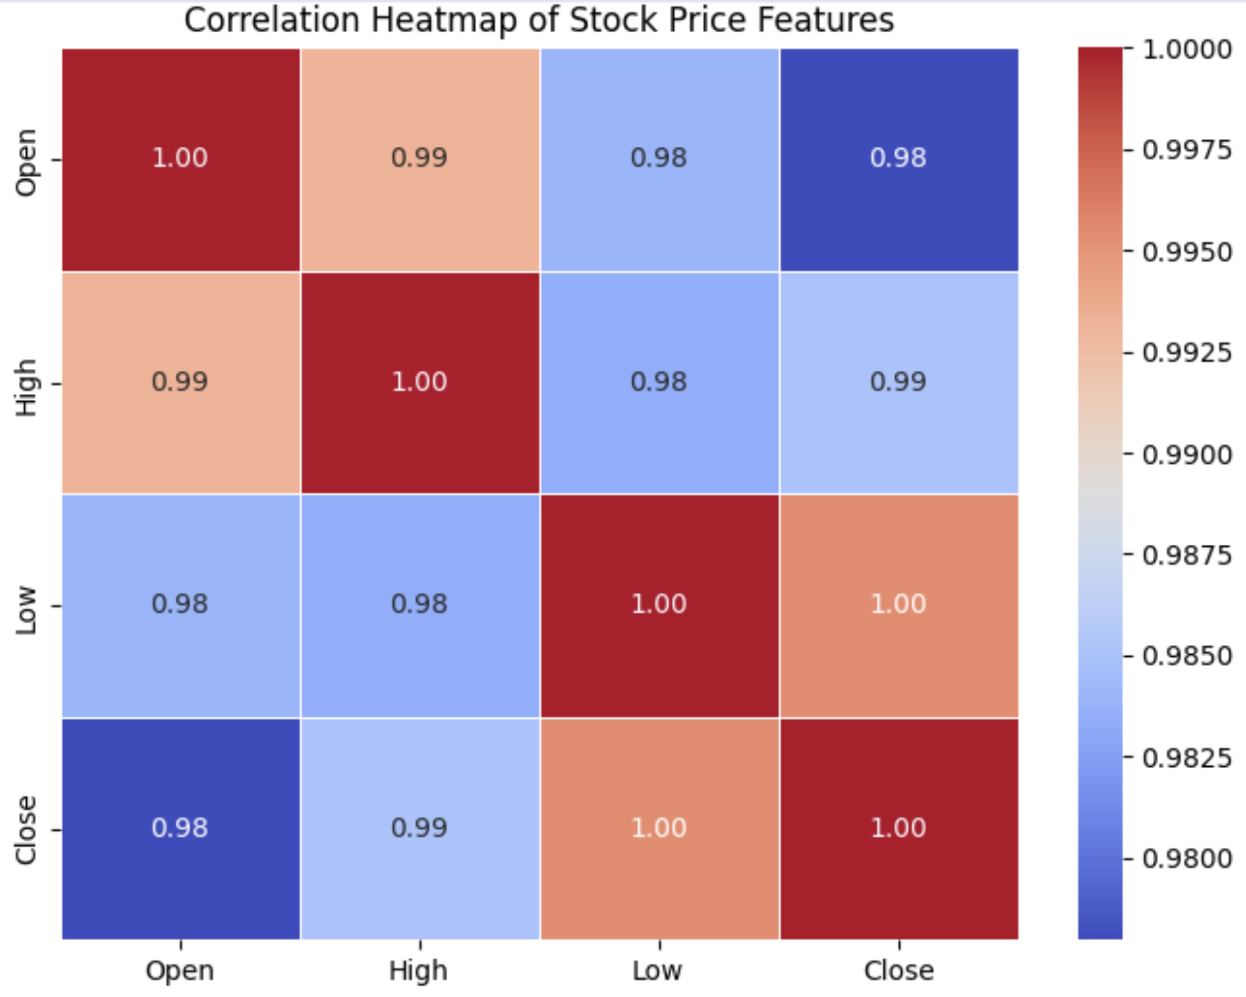
Correlation Analysis
Heatmap observations: • Open ↔ Close : Very Strong • High ↔ Close : Very Strong • Low ↔ Close : Very Strong These variables were selected as important predictors.

Slide 7
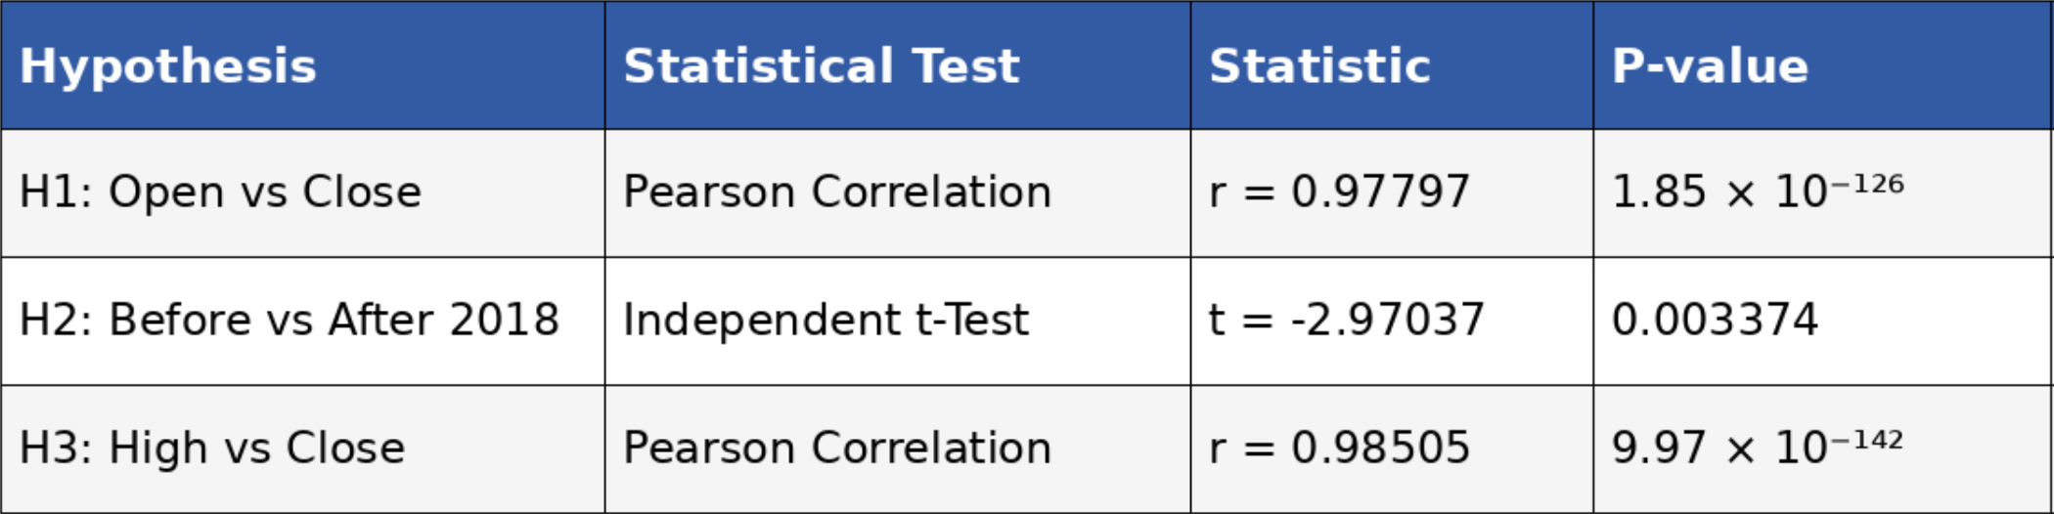
Hypothesis Testing
Hypothesis 1: Open vs Close → Pearson Correlation Hypothesis 2: Before 2018 vs After 2018 → Independent t-test Hypothesis 3: High vs Close → Pearson Correlation All tests produced p-values < 0.05.

Slide 8
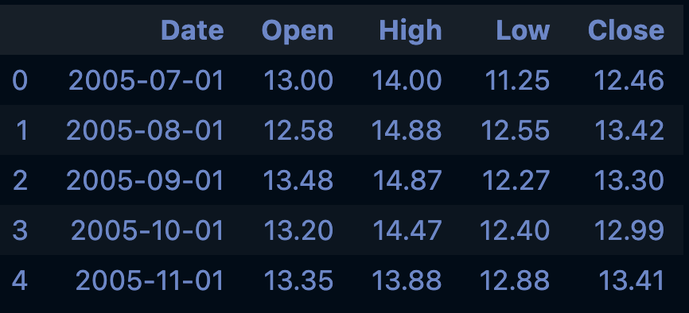
Feature Engineering
• Created Year and Month features. • Selected numerical predictors. • Train-Test Split: 80% / 20%.

Slide 9
Models Implemented
1. Linear Regression 2. Decision Tree Regressor 3. Random Forest Regressor Hyperparameter tuning performed using GridSearchCV.

Slide 10
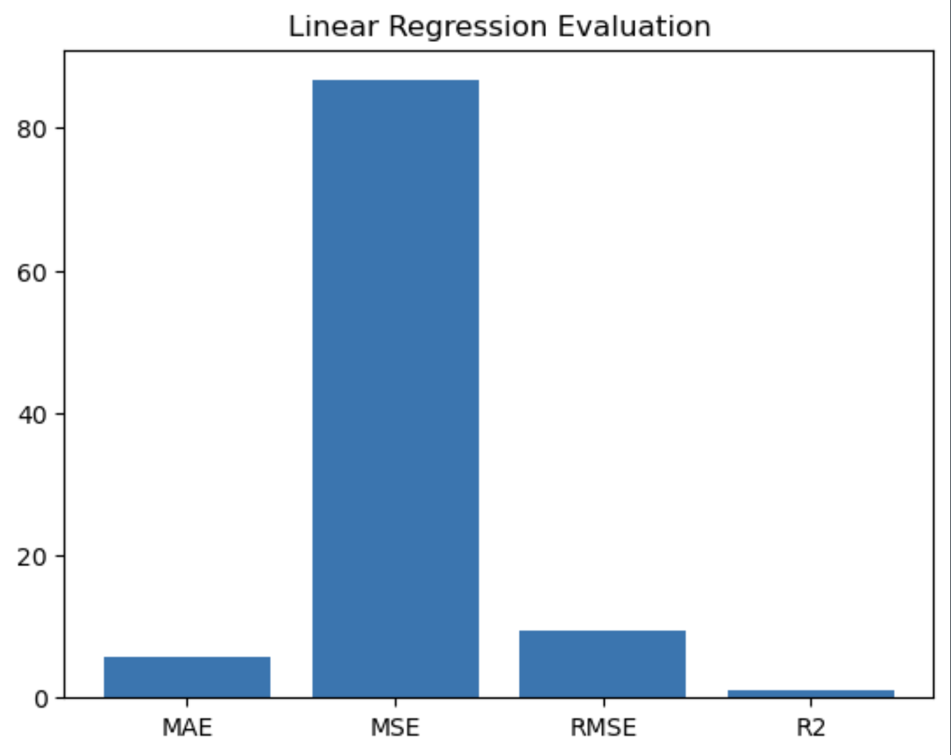
Model Evaluation
Evaluation Metrics: • MAE • MSE • RMSE • R² Score
Linear Regression was selected as the final model because it achieved the lowest prediction error and the highest R² score among all the models.

Slide 11
Business Impact
• Supports investment decision-making. • Helps estimate future closing prices. • Can assist analysts in understanding market behaviour. • Demonstrates practical application of ML in finance.

Slide 12
Conclusion & Future Work
Conclusion: Linear Regression provided the best overall prediction performance by achieving the lowest prediction error and the highest R² score among the implemented models. Therefore, it was selected as the final model for stock price prediction. Future Work: • Use live stock market data • Add technical indicators • Deploy as a web application

