Slide 1
CIFAR-10 Image Classification using Deep Learning
Dataset: CIFAR-10 (60,000 images / 10 classes)

Slide 2
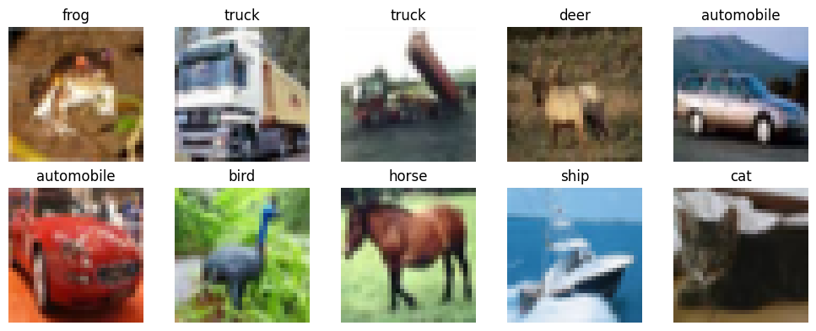
Objective & Dataset
Goal: Train and evaluate multiple deep learning models for CIFAR-10 image recognition
10 object classes (airplane, auto, bird, etc.)
32×32 RGB images
Challenges: low resolution, visual similarity (e.g., cat vs dog)

Slide 3
Model Architectures
We tested three deep learning models:
Baseline CNN (simple conv + pooling)
Improved CNN (BatchNorm + Dropout + Augmentation)
MobileNetV2 Transfer Learning (Best performance)

Slide 4
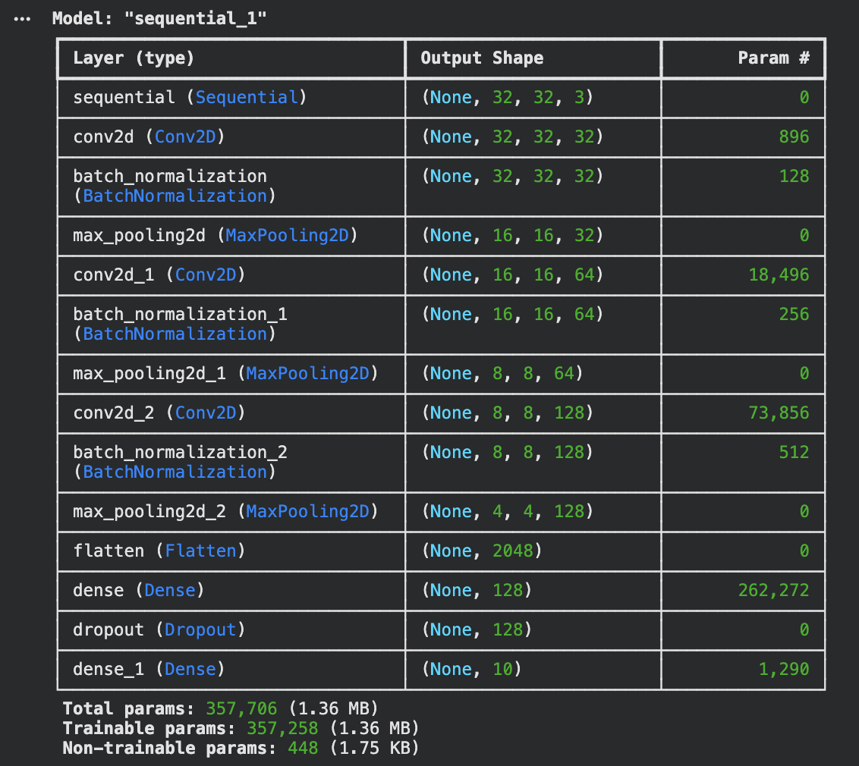
Model Design Improvements
Highlight your contribution:
Data Augmentation (horizontal flip + rotation)
More filters: 32 → 64 → 128
Batch Normalization for stable training
Dropout (0.5) to reduce overfitting

Slide 5
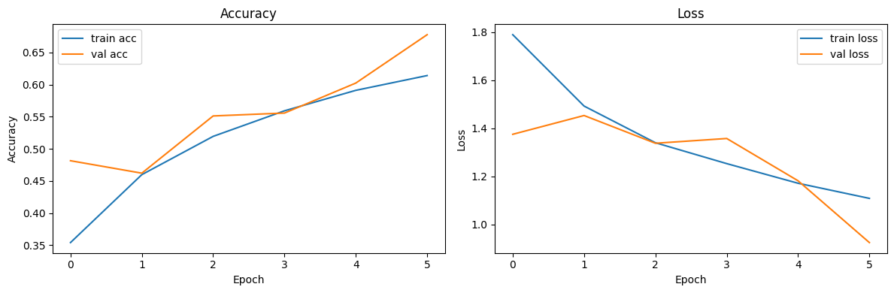
Accuracy & Loss Curves
Training and validation accuracy increased across epochs
Validation accuracy is close to training → reduced overfitting
Loss steadily decreases → model is learning effectively

Slide 6
Results Comparison Table
Model | Test Accuracy | Notes
Baseline CNN | ≈ 0.60 | Underfits due to limited depth
Improved CNN (Adam) | ≈ 0.66 | Better generalization
Improved CNN (SGD) | ≈ 0.63 | Slower convergence
MobileNetV2 Transfer Learning | ≈ 0.76 | Best overall due to pretrained features

Slide 7
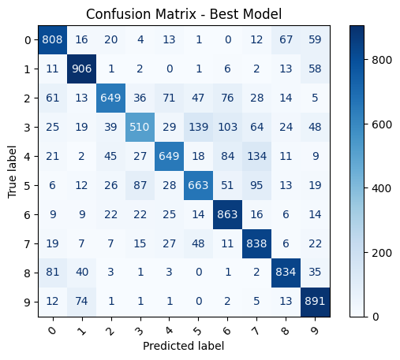
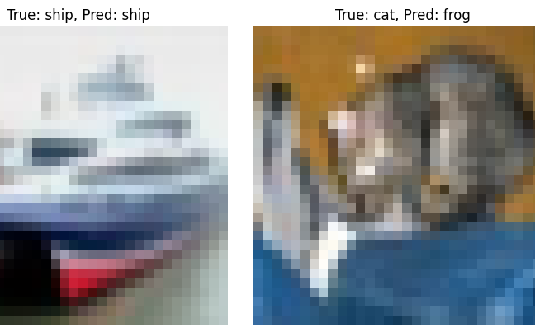
Confusion Matrix & Predictions
Best model: MobileNetV2 (~76% test accuracy)
Performs well on clear classes (ship, airplane, truck)
Most confusion: cat ↔ dog, truck ↔ automobile
Low resolution (32×32) makes fine details difficult to classify

Slide 8
Key Takeaways
• Deeper CNN models learn better features than a basic CNN
• MobileNetV2 transfer learning gave the highest accuracy (~76%)
• Adam optimizer converged faster and performed better than SGD
• Data augmentation reduced overfitting and improved validation accuracy
• Misclassifications mostly occurred in visually similar classes (e.g., cat vs dog)

Slide 9
Limitations &
Future Work
Limitations:
• Limited compute in Colab → fewer training epochs
• MobileNetV2 base layers frozen → not fully optimized for CIFAR-10
• Fixed learning rates (no scheduling)
• Only one dataset tested (no cross-dataset generalization)
Future Work:
• Fine-tune deeper MobileNetV2 layers for higher accuracy
• Add stronger augmentation (cutout, mixup)
• Use learning-rate scheduling + early stopping
• Test on CIFAR-100 or TinyImageNet for more challenging tasks

