Slide 1
IBM University Engagement Project Submission
“Exploring the Power of Agentic AI with IBM Granite and LangFlow”

Slide 2

Project Tile – [AI-powered Travel Agent system ]
Domain of Project – [Travel/Tourism]
Student Name | Recent Passport Photo | Email ID | Mobile number [WhatsApp]
Kodakandla Anushka reddy |  | anushkareddykodakandla@gmail.com | 8333052057

Slide 3
Problem Statement -
Problem Statement : Travel Agent
The Challenge
Travel planning today is fragmented, time-consuming, and inefficient. Users need to search across multiple platforms to gather information about destinations, hotels, food options, transportation, and budgets. This leads to information overload and inconsistent travel decisions.
The Objective
The main objective of this project is to develop an AI-powered Travel Agent system that simplifies and automates the travel planning process using intelligent, structured recommendations.
The system aims to:
• Provide personalized travel itineraries based on destination, budget, duration, and user interests
• Generate structured day-wise travel plans for better trip organization
• Suggest relevant tourist attractions, food options, and accommodations
• Optimize travel plans based on budget constraints and user preferences
• Simulate an Agentic AI workflow using multiple specialized agents
• Deliver a unified and user-friendly travel planning experience
• Improve decision-making through structured, data-driven recommendations

Slide 4
Technology Used
The project is implemented using a simulated Agentic AI architecture inspired by IBM technologies.
LangFlow (Architecture Inspiration – Not directly implemented)
IBM watsonx.ai (Conceptual Reference)
IBM Granite Models (Conceptual Reference)
Python Flask (Implementation Layer)
Local Dataset (RAG Simulation)

Slide 5
Proposed Solution -
Proposed Solution: AI-Powered Travel Agent
The proposed solution is an AI-powered Travel Planning System designed to simplify and automate the travel planning process by generating personalized, structured, and efficient travel itineraries. The system is developed using a simulated Agentic AI architecture inspired by IBM watsonx.ai, LangFlow, and Granite model concepts.
The system is built to overcome the limitations of traditional travel planning methods by providing a single unified platform where users can generate complete travel plans based on their preferences such as destination, budget, duration, and interests.
The core idea is based on a multi-agent system design, where the overall task of travel planning is divided into smaller intelligent components. Each component acts like an independent agent and performs a specific function such as itinerary creation, place recommendation, food suggestions, hotel selection, and budget optimization. These agents work together to produce a final structured travel plan.
A simulated Retrieval-Augmented Generation (RAG) approach is used by integrating a local dataset containing travel-related information such as tourist attractions, food options, and accommodation details. This helps in generating more accurate and consistent recommendations.
The final system output includes a complete day-wise itinerary, destination insights, food and hotel suggestions, and budget-based recommendations, all presented through a user-friendly Flask-based web application interface.
Overall, the system demonstrates how Agentic AI principles can be applied in a simplified and practical manner to build an intelligent travel assistant that improves planning efficiency and user experience.

Slide 6
Langflow component Used -
1. Chat Input Component
Used to capture user inputs such as destination, budget, number of days, and travel interests. This acts as the entry point of the system.
2. AI Agent / Processing Node
Simulates the Agent Controller logic, which processes user input and distributes tasks to different travel agents such as itinerary, food, hotel, and budget agents.
3. Travel Intelligence Agents
Represents multiple functional agents:
Travel Planning Agent
Place Recommendation Agent
Food Recommendation Agent
4. Knowledge / Data Component (RAG Simulation)
Simulates a Retrieval-Augmented Generation (RAG) system using a local dataset containing travel information like destinations, food, and hotels.
5. Output Component
Displays the final structured travel itinerary and recommendations in a user-friendly format using a Flask web interface.

Slide 7
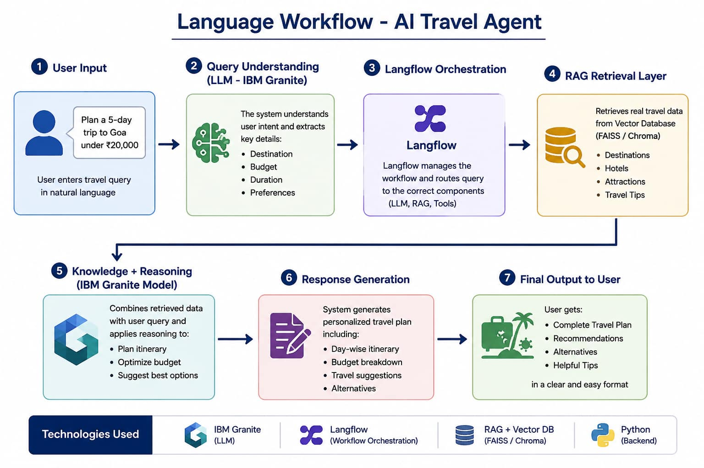
Langflow workflow -

Slide 8
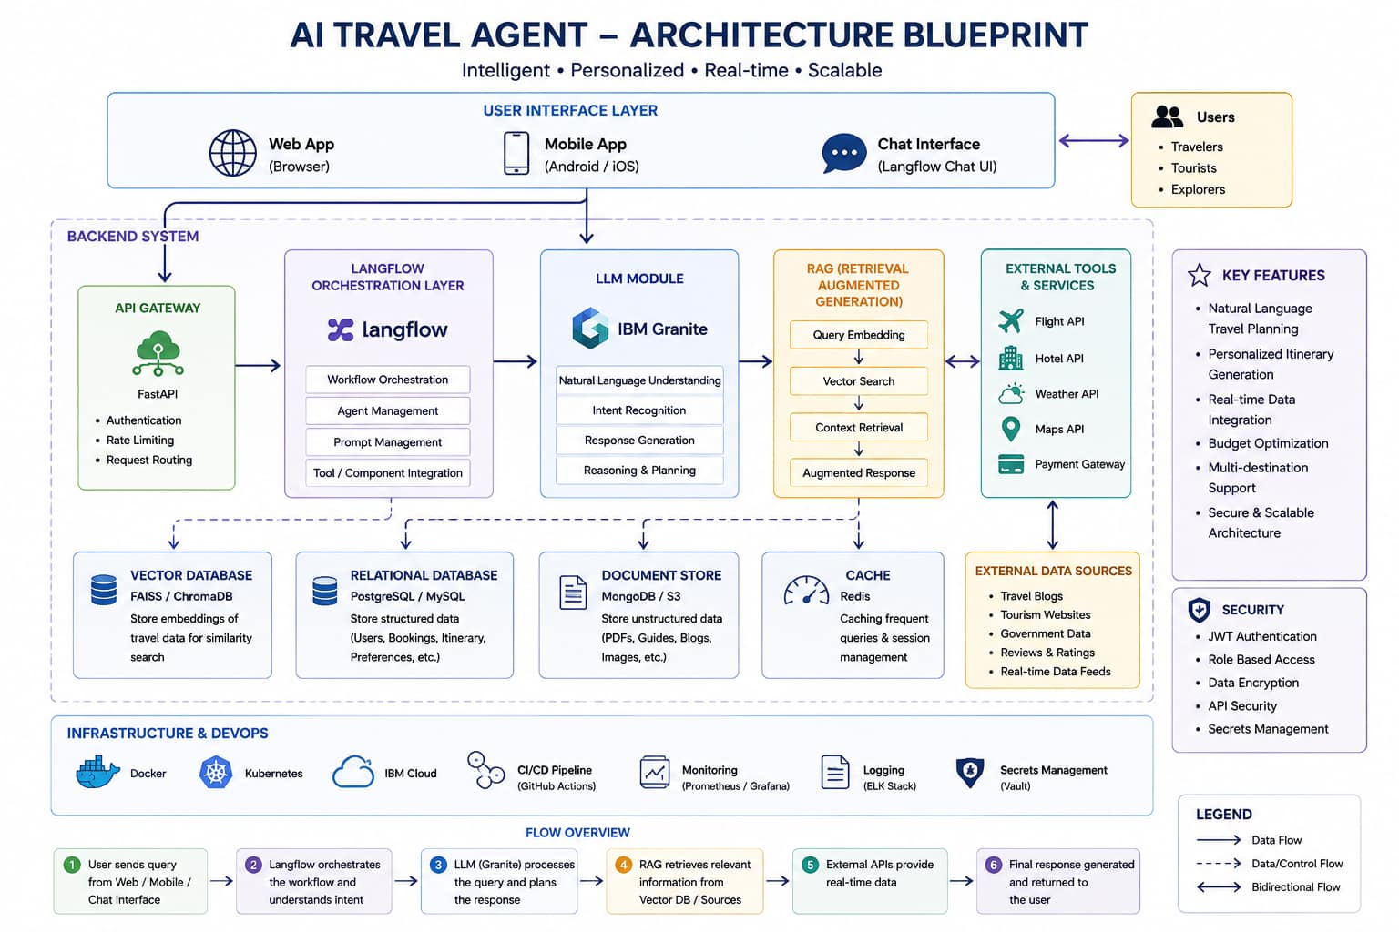
Architecture blueprint

Slide 9

Role of Agentic AI in the solution
Agentic AI plays a crucial role in the proposed Travel Agent system by enabling it to function as a coordinated, intelligent, and goal-driven system rather than a simple chatbot. It breaks the complex task of travel planning into multiple specialized agents such as the Travel Planning Agent, Place Recommendation Agent, Food Recommendation Agent, Hotel Recommendation Agent, and Budget Optimization Agent. Each agent is responsible for handling a specific sub-task and works collaboratively to generate a unified and structured travel plan. Agentic AI also enables task decomposition, context-aware processing, and modular decision-making, allowing the system to understand user inputs like budget, destination, duration, and interests to provide personalized recommendations. Although implemented in a simulated form, it mimics intelligent behavior by filtering options, optimizing plans, and generating a coherent output. Overall, Agentic AI enhances the system by making it more organized, adaptive, and user-centric, improving the quality and relevance of travel recommendations.

Slide 10
Technology Used
Langflow Platform – For designing and orchestrating multi-agent travel workflows visually, including itinerary planning, hotel recommendations, budget analysis, and travel assistance.
IBM Granite Model (e.g., IBM Granite) – For natural language understanding, travel planning, destination recommendations, reasoning, and personalized trip suggestions.
IBM Cloud – Provides the infrastructure to build, deploy, and scale the Travel Agent efficiently. It offers a secure, reliable, and scalable environment for hosting AI services and travel applications.
RAG (Retrieval-Augmented Generation) – Retrieves real-time travel information such as destinations, attractions, visa requirements, weather conditions, and transportation details before generating responses, making recommendations more accurate and trustworthy.
IBM Watsonx.ai – For model deployment, prompt engineering, embeddings, AI governance, and monitoring of the Travel Agent system.
Vector Database (FAISS/Chroma) – Stores and retrieves travel-related knowledge, including destination guides, hotel information, transportation options, and tourist attractions to support RAG-based recommendations.
Travel APIs (Optional) – Integrates flight, hotel, weather, and map services to provide real-time travel information, bookings, and route planning.

Slide 11
Novelty and Uniqueness
The proposed AI-Powered Travel Agent stands out due to its simulated Agentic AI architecture, which transforms traditional travel planning into an intelligent and structured decision-making system. Unlike conventional travel websites that provide static suggestions, this system uses a multi-agent approach where different components independently handle tasks such as itinerary generation, place recommendation, food suggestions, hotel selection, and budget optimization.
A key novelty of the system is the task decomposition strategy, where complex travel planning is broken into smaller intelligent sub-tasks, improving organization and efficiency. The system also incorporates a simulated Retrieval-Augmented Generation (RAG) mechanism using a local dataset, ensuring structured and consistent travel information without relying on external APIs.
Another unique aspect is the personalization capability, where travel plans are generated based on user-specific inputs such as budget, interests, destination, and duration. This allows the system to produce highly relevant and user-centric travel recommendations.
Additionally, the system demonstrates a lightweight and scalable web-based implementation using Flask, making it easy to deploy and understand while still reflecting advanced AI concepts.
Overall, the project is unique because it combines Agentic AI principles, modular design, and personalized recommendation logic into a single unified travel planning system.

Slide 12
Git Hub Link
https://github.com/anushkareddykodakandla-004/ai-travel-agent.git
·
·
·

Slide 13
Future Scope
1. Integration with Google Maps API for route planning
2. Real-time hotel and flight booking APIs
3. Voice-based AI travel assistant
4. Mobile application development
5. Real LLM integration using IBM watsonx.ai or OpenAI
·
·
·

Slide 14


