Slide 1
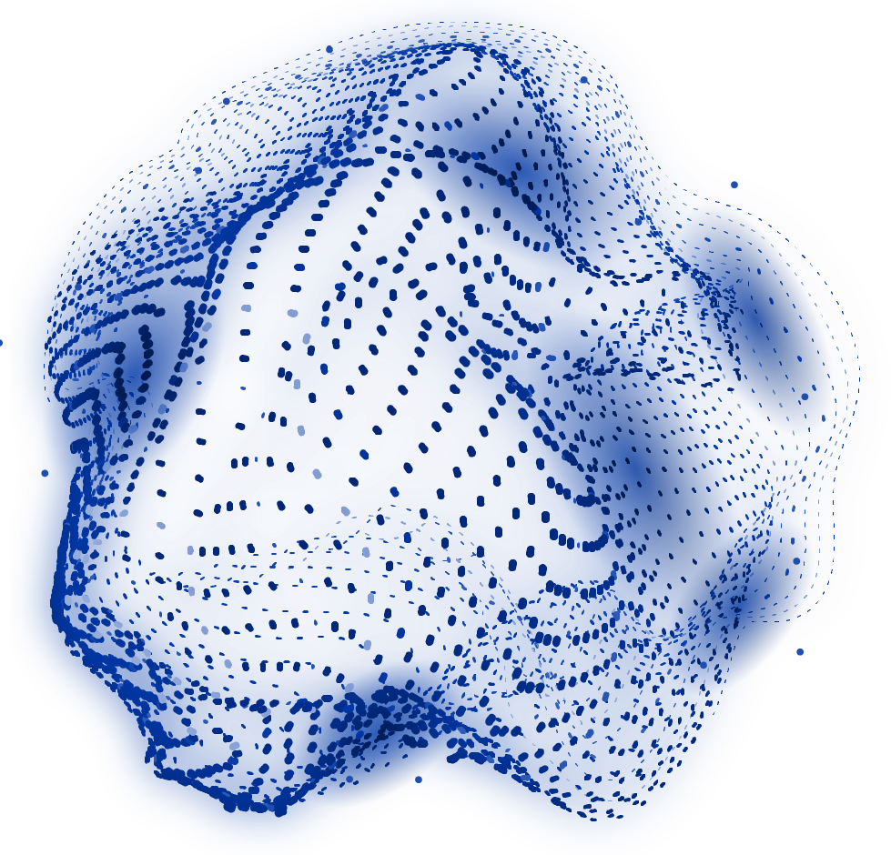
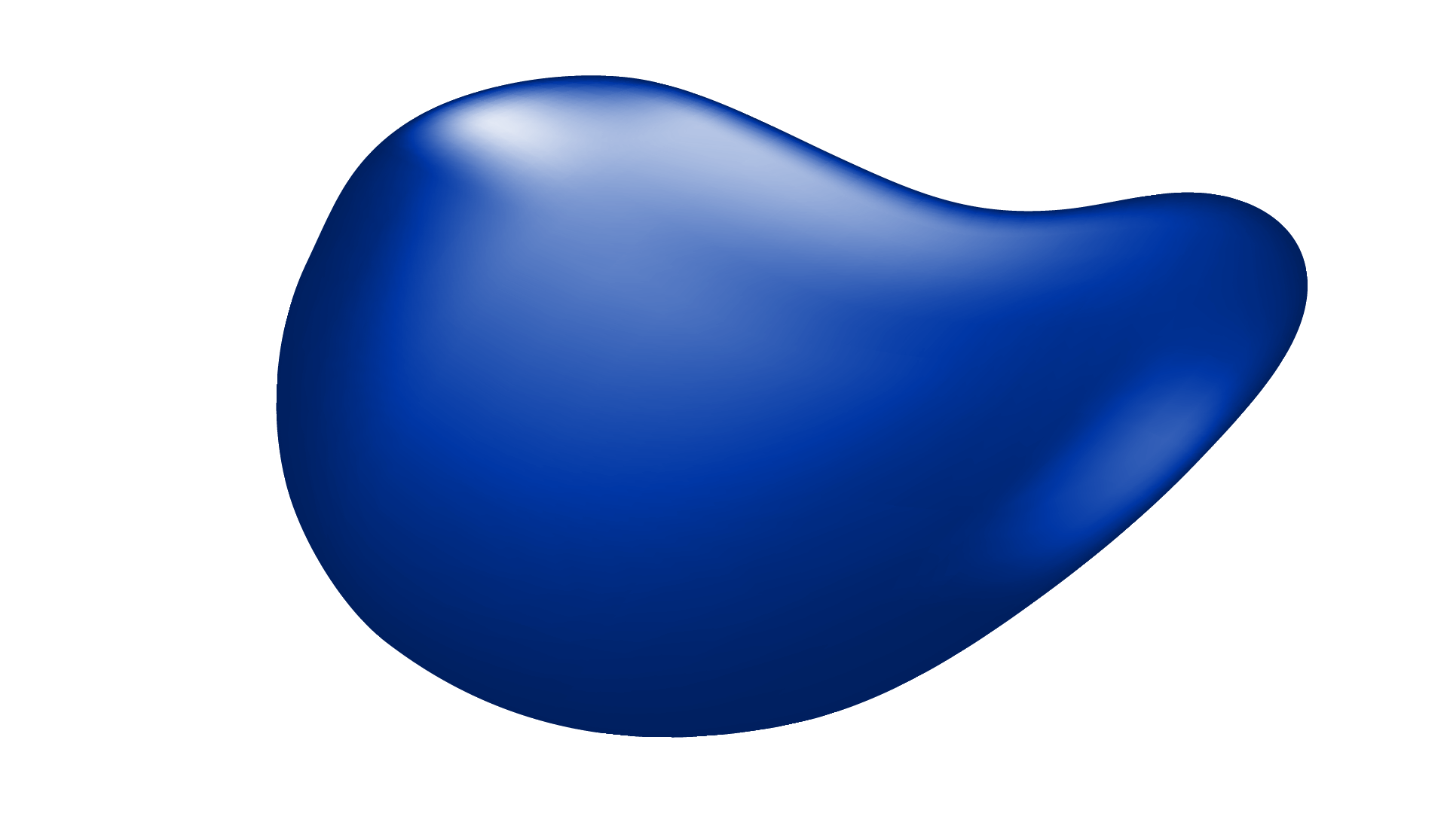

ARTIFICIAL INTELLIGENCE (AI)
Streamlining Information Retrieval with LLMs
Advaith Sujith - 7837524
Asraa Shaikh - 7859557
Anushka Roy - 7753226
Rhythm Shahi - 7877304

Slide 2
TABLE OF CONTENTS
01
02
03
04
05
06
07
BRIEF OVERVIEW
PROBLEM STATEMENT
TECHNICAL REQUIREMENTS
OUR ARCHITECTURE
IMPLEMENTATION
CHALLENGES & LIMITATIONS
CONCLUSION

Slide 3
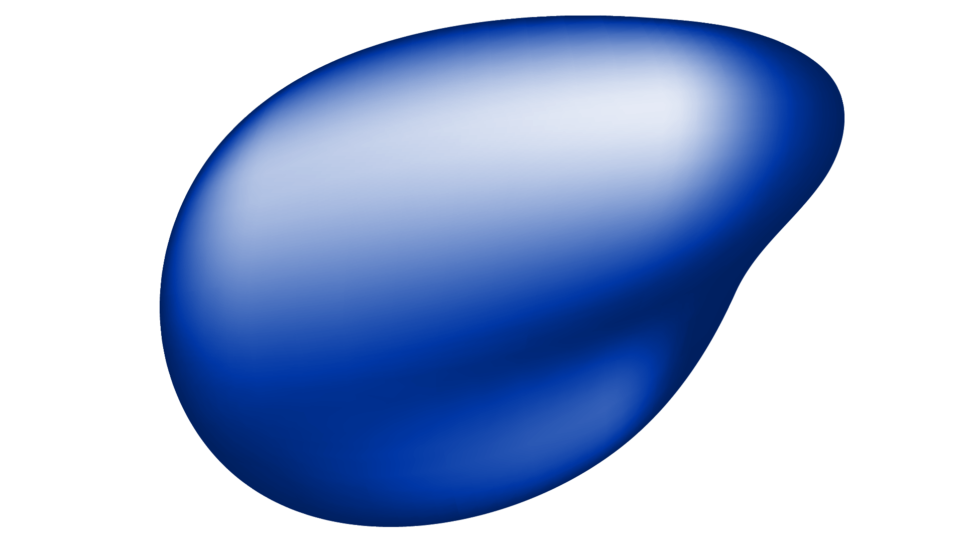
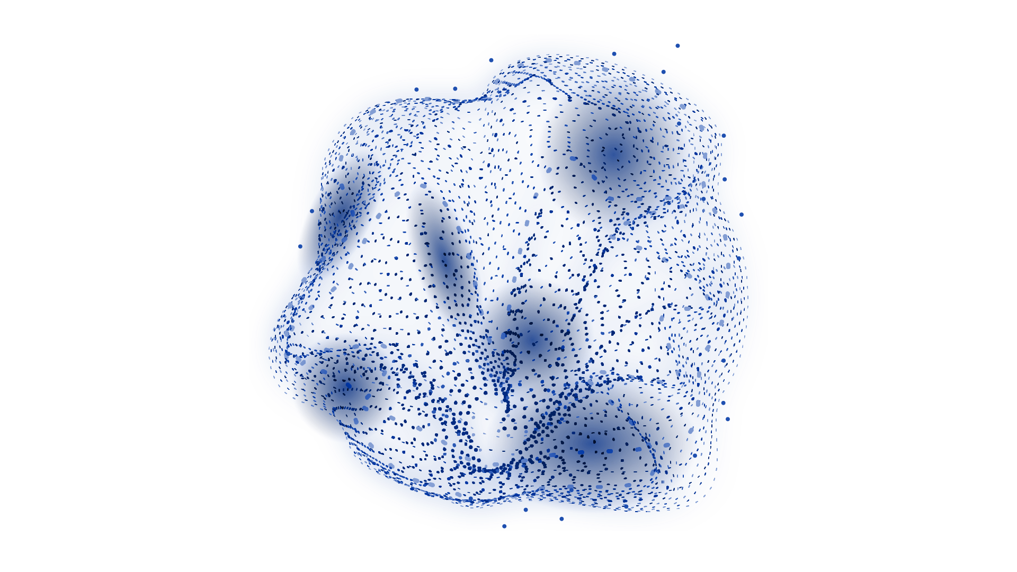
01
BRIEF OVERVIEW

Slide 4
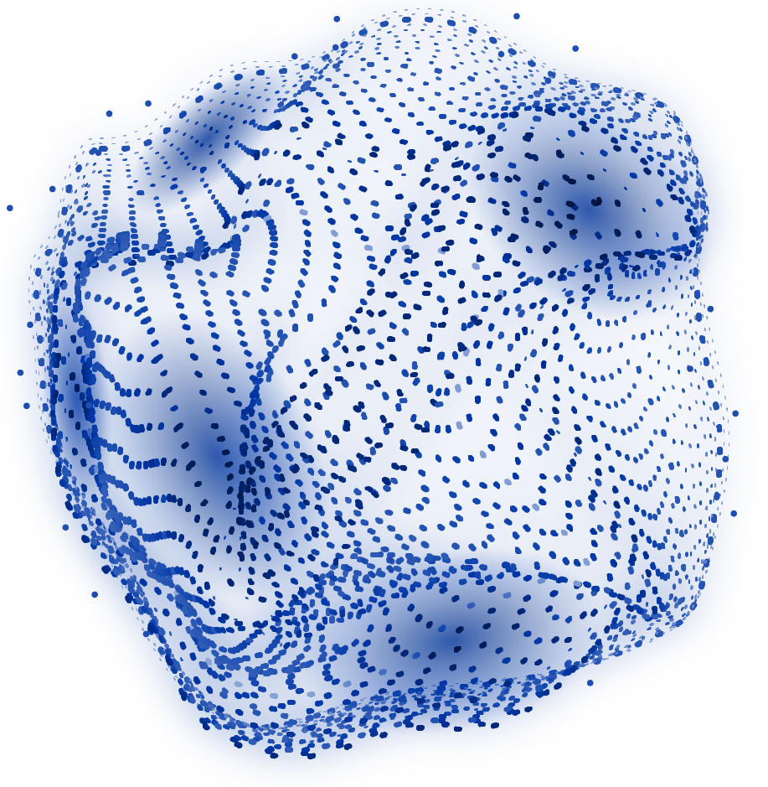
BRIEF OVERVIEW
Addresses a widespread challenge.
Offers swift and precise extraction.
Simplifies information retrieval.
Enhances usefulness with automatic Q/A.

Slide 5
02
PROBLEM
STATEMENT

Slide 6
PROBLEM STATEMENT
The Challenge of Extracting Information

Slide 7
PROBLEM STATEMENT
LARGE SIZE
of the PDFs
COMPLEXITY
of the PDFs
REDUNDANCY
of the PDFs
VARIABILITY
of the PDFs

Slide 8
03
TECHNICAL REQUIREMENTS

Slide 9
TECHNICAL REQUIREMENTS
PROGRAMMING LANGUAGES
LIBRARIES
Python, HTML, JavaScript
Torch, Google Cloud, pymupdf, fitz, gc, re, transformers, pprint
HARDWARE
TOOLS
T4 GPU, 15GB RAM, 12.7GB System RAM
Ngrok, DeepSeek R1

Slide 10
04
OUR ARCHITECTURE

Slide 11
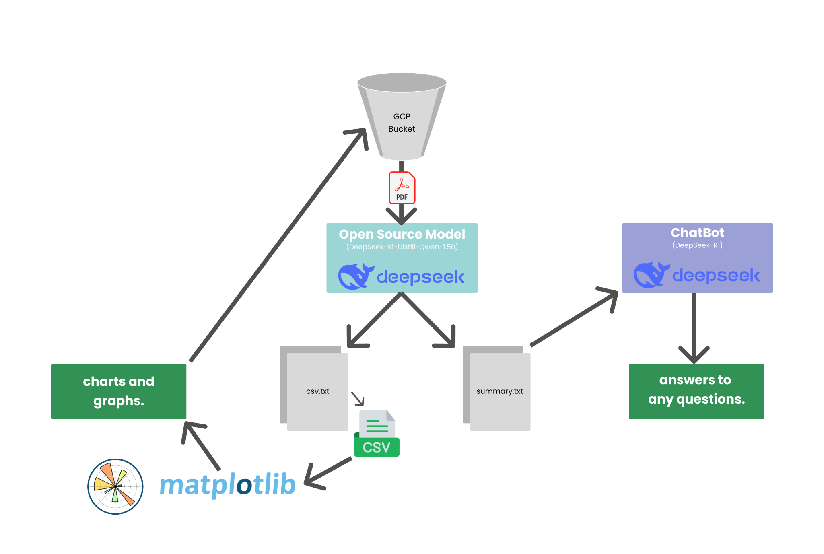
OUR ARCHITECTURE

Slide 12
05
IMPLEMENTATION

Slide 13
Our Code & UI

Slide 14
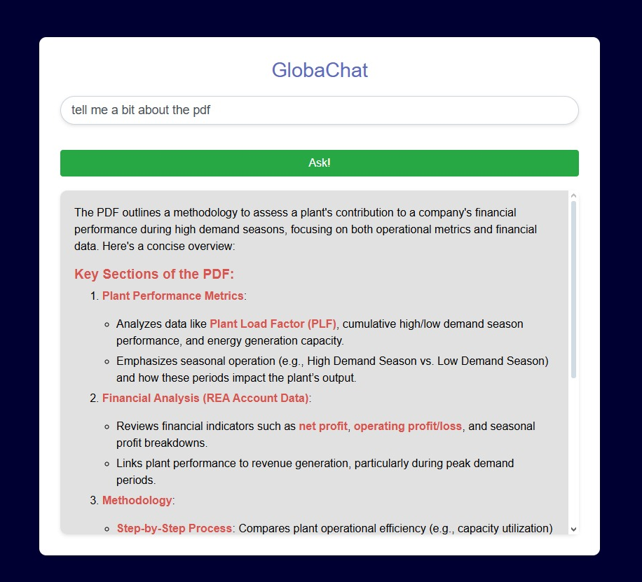

Slide 15
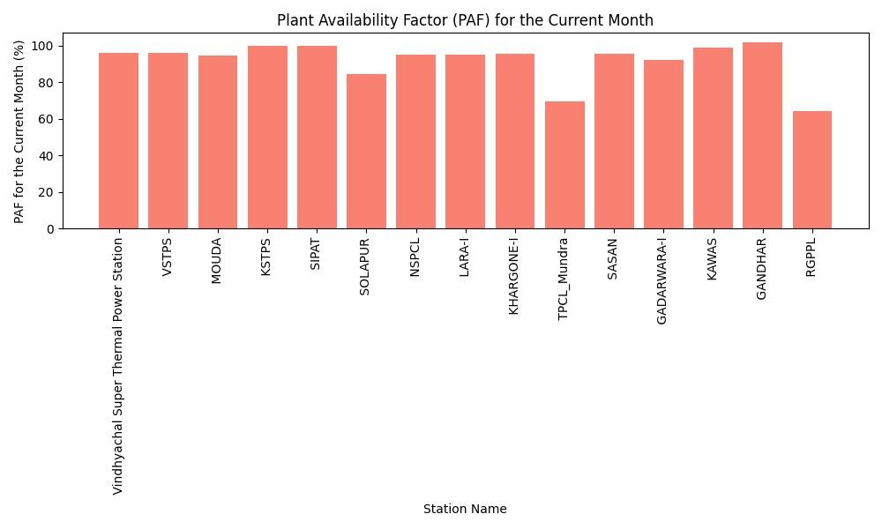

Slide 16
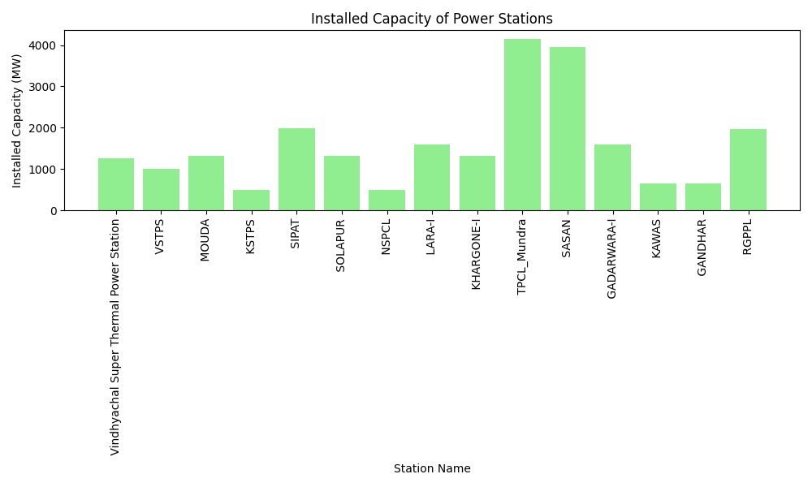

Slide 17
06
CHALLENGES
& LIMITATIONS

Slide 18
CHALLENGES
Lack of sufficient GPU and RAM
PDF quality and consistency

Slide 19
LIMITATIONS
PDF File Size Constraint
Large PDF files may exceed the memory limits of the Google Colab GPU.
Users may need to split large documents into smaller sections for processing.
Extended Processing Time
Computational constraints limit the complexity of the AI model.
Longer and more complex documents may take more time to analyze and summarize.
Character Limit in Chatbot
The chatbot can only process a limited number of characters at a time.
Users may need to truncate or split long inputs for better results.

Slide 20
CONCLUSION

Slide 21
THANKS!
Any Questions?

