Slide 1

Inventory & Sales
Analytics Dashboard
End-to-End Data Analytics Project
Tools Used:
SQL
Excel
Power BI
Anushka Saarsar
24\04\2026

Slide 2




Project Overview
About the Project
Business Importance
This end-to-end analytics project transforms raw grocery inventory and sales data into actionable business intelligence using SQL, Excel, and Power BI.
Revenue Optimization
Identify high-value products and improve pricing strategy
Risk Reduction
What It Analyzes
Prevent stockouts and reduce overstock carrying costs
Inventory levels & stock health
Supplier Intelligence
Evaluate and optimize supplier relationships
Sales trends & revenue performance
Data-Driven Decisions
Supplier efficiency & dependencies
Replace guesswork with real-time KPI monitoring

Slide 3

Problem Statement & Objectives
⚠ Challenges
🎯 Objectives
1
Overstock & Stockouts
1
Identify Top & Bottom Products
Inventory imbalance leading to capital waste or lost sales
Rank products by revenue and sales volume
2
Lack of Product Visibility
2
Analyze Inventory Efficiency
No clear view of top/bottom performing SKUs
Classify stock as low, healthy, overstock, or dead
3
Supplier Inefficiencies
3
Evaluate Supplier Performance
Over-reliance on few suppliers with no performance tracking
Measure supplier revenue share and reliability

Slide 4




Dataset Overview
Dataset: Grocery Inventory & Sales
Key Fields
Product
Category
Stock Quantity
Sales Volume
Unit Price
Supplier
Data Cleaning:
Removed duplicates and null values · Standardized field formats · Validated stock quantities and prices · Ensured referential integrity across tables

Slide 5

Data Modeling & Preparation
01
02
03
Revenue Calculation
Stock Status Classification
DAX Measures (Power BI)
Computed Total Revenue for each product using:
Revenue = Sales Volume × Unit Price
Enables comparison across all products and categories.
Categorized inventory into four states based on thresholds:
Low Stock · Healthy Stock · Overstock · Dead Stock
Allows quick risk identification in dashboards.
Used DAX formulas to create calculated KPIs such as Total Revenue, Stock Health %, Supplier Share %, and dynamic filters for interactive drill-downs.

Slide 6
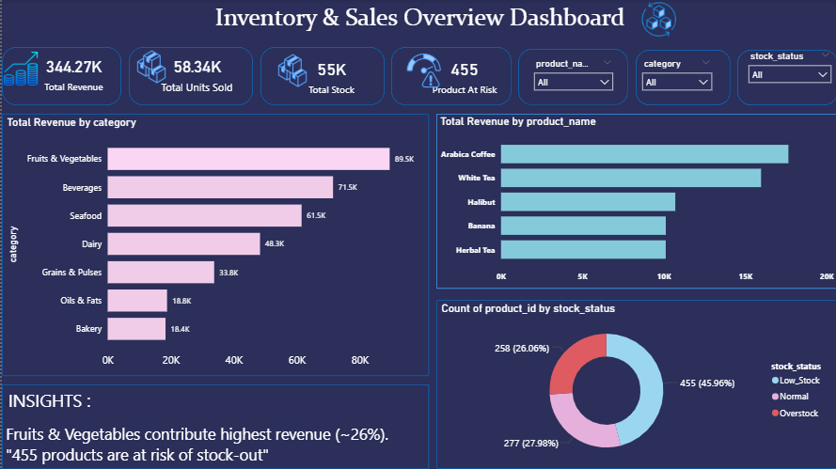
Dashboard 1 — Executive Overview
📊 Insert Executive Overview Dashboard Screenshot Here
Executive KPI Snapshot:
Real time visibility into revenue, sales trends, and inventory risks.
Category Performance Analysis:
Identifies top and underperforming categories for better decision making.

Slide 7
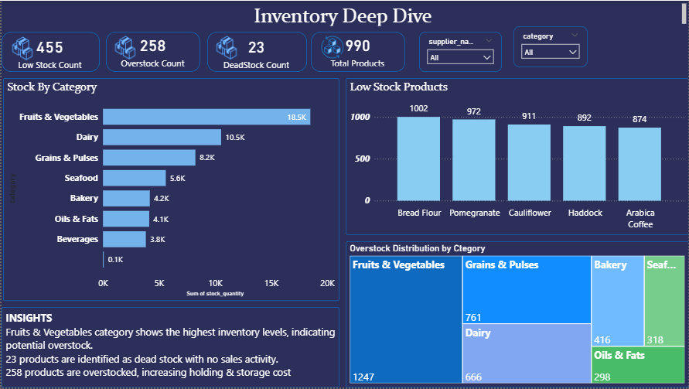
Dashboard 2 — Inventory Deep Dive
📦 Insert Inventory Dashboard Screenshot Here
Inventory Risk Analysis:
Identifies low stock, overstock, and dead stock to improve efficiency and reduce costs.
Stock Health Monitoring:
Enables proactive decisions through clear stock classification and risk visibility.

Slide 8
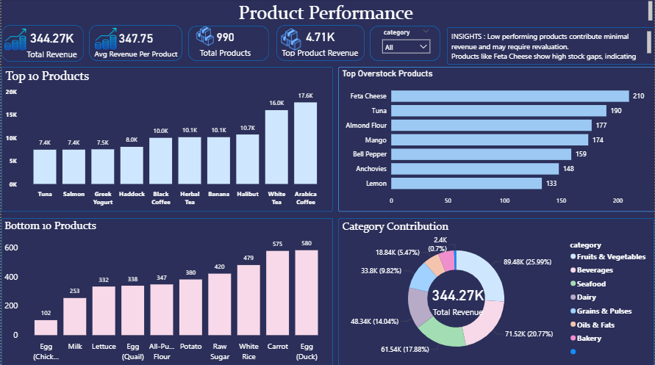
Dashboard 3 — Product Performance
🏆 Insert Product Performance Dashboard Screenshot Here
Product Portfolio Optimization :
Evaluates high and low performing products to drive better assortment and revenue growth.
Demand Vs Supply Gap Analysis :
Uncovers mismatches between sales performance and inventory levels for smarter stock planning.

Slide 9
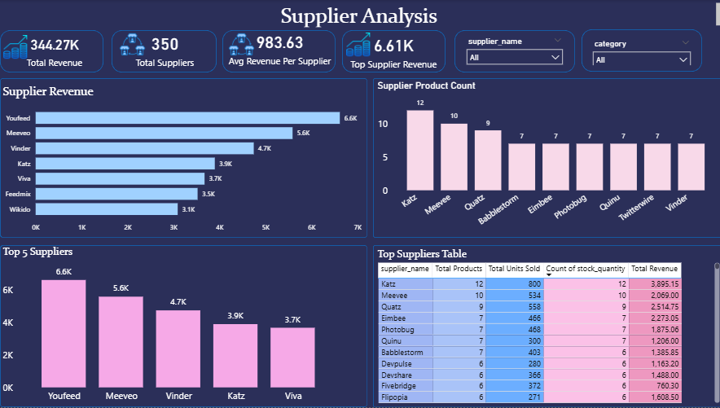
Dashboard 4 — Supplier Analysis
🚚 Insert Supplier Dashboard Screenshot Here
Supplier Contribution & Revenue Impact :
Highlights key Suppliers contributing to revenue and supports strategic sourcing decisions,
Supplier Risk & Dependency Analysis :
Detects over reliance on specific suppliers to mitigate supply chain risks.

Slide 10
Key Insights, Recommendations & Conclusion
KEY INSIGHTS
RECOMMENDATIONS
CONCLUSION
Fruits & Vegetables contribute highest revenue share
Improve inventory planning with data-driven reorder points
Data-driven decision-making transforms business outcomes by replacing guesswork with actionable intelligence.
This dashboard suite empowers stakeholders to:
· Monitor inventory health in real time
· Identify and act on revenue opportunities
· Optimize supplier partnerships
· Reduce waste and operational risk
High number of low-stock products indicates supply risk
Reduce overstock and dead stock to free capital
Overstock and dead stock identified across multiple categories
Focus marketing on high-performing product categories
Few suppliers dominate overall revenue — high dependency risk
Diversify supplier base to reduce dependency risk
Inventory & Sales Analytics Dashboard | End-to-End Data Analytics Project

