Slide 1
INTERNSHIP PRESENTATION
Introduction to Cyber Security
Presented by: ANUSHKA SRIVASTAVA
B.Tech CSE | Batch 2026–27
Course Completion: November 23, 2025

Slide 2
1. Internship Overview
• Internship/course: Introduction to Cyber Security
• Issuing organization: Infosys
• Learning platform branding: Infosys Springboard
• Focus: foundational cybersecurity awareness and safe digital practices
• Completion date recorded on the certificate: November 23, 2025
Introduction to Cyber Security | Anushka Srivastava | 2

Slide 3
2. Introduction
• Cybersecurity is essential for protecting digital systems, networks, applications, and information.
• The internship focused on understanding basic cybersecurity concepts and security risks.
• The learning activity encouraged responsible digital behaviour and safer use of technology.
• The acquired foundation can support further study in cybersecurity, networking, and secure software development.
Introduction to Cyber Security | Anushka Srivastava | 3

Slide 4
3. Problem Statement & Objectives
• Problem: Increasing dependence on digital services creates greater exposure to cyber risks.
• Need: Students require structured foundational knowledge of threats and protective practices.
• Objective: Understand cybersecurity and information security fundamentals.
• Objective: Recognize common security risks and learn basic preventive practices.
• Objective: Build security-aware and responsible digital habits.
Introduction to Cyber Security | Anushka Srivastava | 4

Slide 5
4. Scope of the Internship
• Foundational cybersecurity awareness
• Recognition of cyber threats and security risks
• Basic security principles and protective practices
• Safe use of computers, networks, accounts, and online resources
• Relevance of cybersecurity to Computer Science and Engineering
• The report does not claim a production cybersecurity implementation or penetration-testing project.
Introduction to Cyber Security | Anushka Srivastava | 5

Slide 6
5. Technologies, Tools & Methodology
Tools / Environment
Methodology
• Digital learning platform
• Computer / Internet environment
• Online course resources
• QR-based certificate verification
• Course orientation
• Concept learning
• Threat awareness
• Security practices
• Application and reflection
• Course completion
Introduction to Cyber Security | Anushka Srivastava | 6

Slide 7
6. Conceptual System Architecture
Digital Learning
Platform
Learner
Cybersecurity
Content
Security Awareness
Figure: Conceptual flow of the cybersecurity learning activity
Introduction to Cyber Security | Anushka Srivastava | 7

Slide 8
7. Expected Outcomes
• Improved awareness of cybersecurity risks.
• Better understanding of basic security practices.
• Ability to recognize common digital security risks.
• Greater appreciation of security in software and computing systems.
• A stronger foundation for future learning in cybersecurity and information security.
Introduction to Cyber Security | Anushka Srivastava | 8

Slide 9
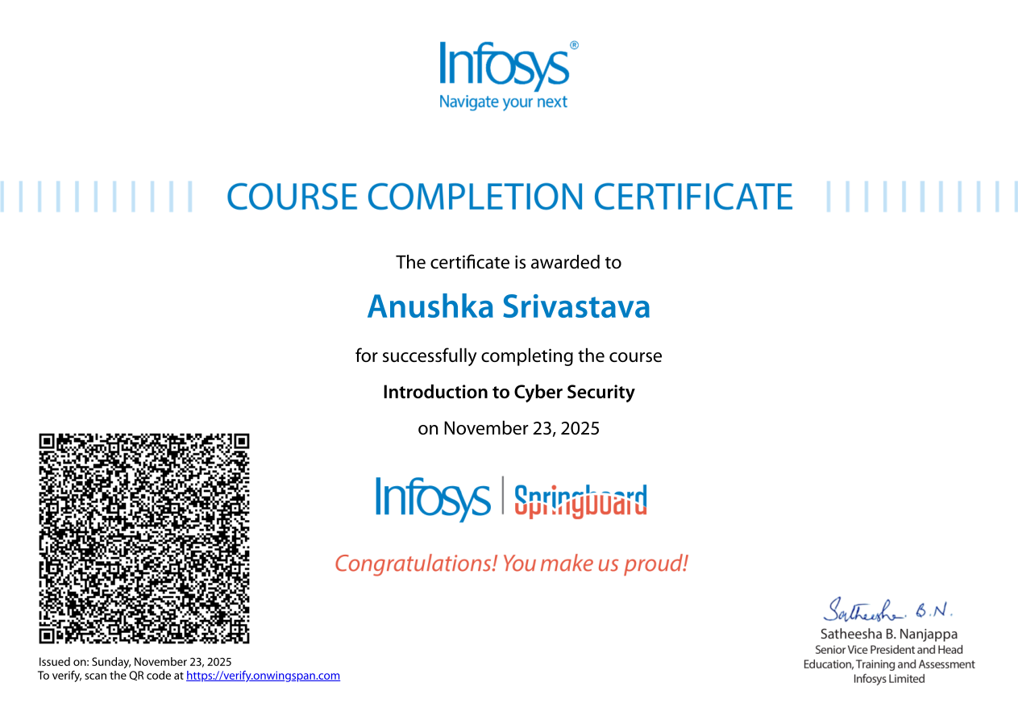
8. Certificate of Completion
Infosys – Introduction to Cyber Security | Completed: November 23, 2025
Introduction to Cyber Security | Anushka Srivastava | 9

Slide 10
9. Conclusion
• The internship provided a structured introduction to cybersecurity concepts.
• It strengthened awareness of cyber risks and the importance of information protection.
• The learning experience supports safer digital practices and future technical studies.
• The completion certificate serves as documentary proof of successful course completion.
Introduction to Cyber Security | Anushka Srivastava | 10

Slide 11
THANK YOU
Questions & Discussion

