Slide 1
AI-Powered Customer Support Automation using Classification Models and Generative AI
Presented By: Anushka T
AIML(Weekday Batch)

Slide 2
Introduction
Customer support systems receive thousands of tickets every day.
Manual ticket categorization is time-consuming and prone to errors.
Incorrect routing delays issue resolution and reduces customer satisfaction.
Artificial Intelligence and Natural Language Processing can automate ticket classification and response generation.

Slide 3
Problem Statement
Existing System
Proposed System
Manual ticket sorting.
Delayed responses.
Increased operational cost.
Misclassification of tickets.
Automatically classify customer tickets.
Route tickets to the correct department.
Generate automatic acknowledgment responses using Generative AI.

Slide 4
Objectives
1
2
3
Automate customer ticket classification.
Compare multiple machine learning models.
Generate professional responses using Gemini API.
4
5
Reduce manual effort and response time.
Develop an interactive Streamlit application.

Slide 5
Dataset Description
Dataset
Features
Source: Hugging Face – Tobi-Bueck/customer-support-tickets
Feature
Description
body
Customer ticket text
queue
Department label (Target)
subject
Ticket subject
priority
Priority level
tags
Additional information

Slide 6
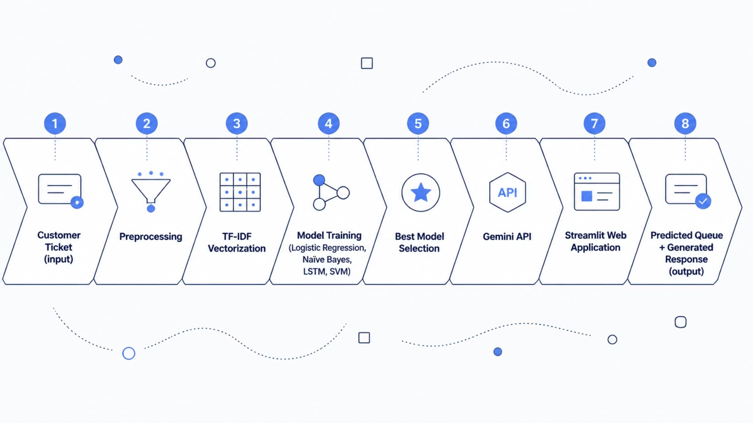
System Architecture

Slide 7
Methodology
01
02
Dataset Preparation
Text Preprocessing
Lowercasing
Special Character Removal
Stopword Removal
Tokenization
03
04
Feature Extraction
Model Training
TF-IDF Vectorization
05
06
Evaluation
Deployment

Slide 8
Technologies Used
Technology
Purpose
Python
Programming
Pandas
Data Processing
NLTK
Text Preprocessing
Scikit-Learn
Machine Learning
TensorFlow/Keras
LSTM Model
Gemini API
Response Generation
Streamlit
Web Application

Slide 9
Models Implemented
Logistic Regression
Naïve Bayes
Baseline classification model.
Probabilistic text classification model.
LSTM
Improved SVM
Deep learning sequence classification model.
Best-performing model for text classification.

Slide 10
Model Performance Comparison
Model
Accuracy (%)
Logistic Regression
48.74
Naïve Bayes
40.74
LSTM
37.39
Improved SVM
61.18

Slide 11
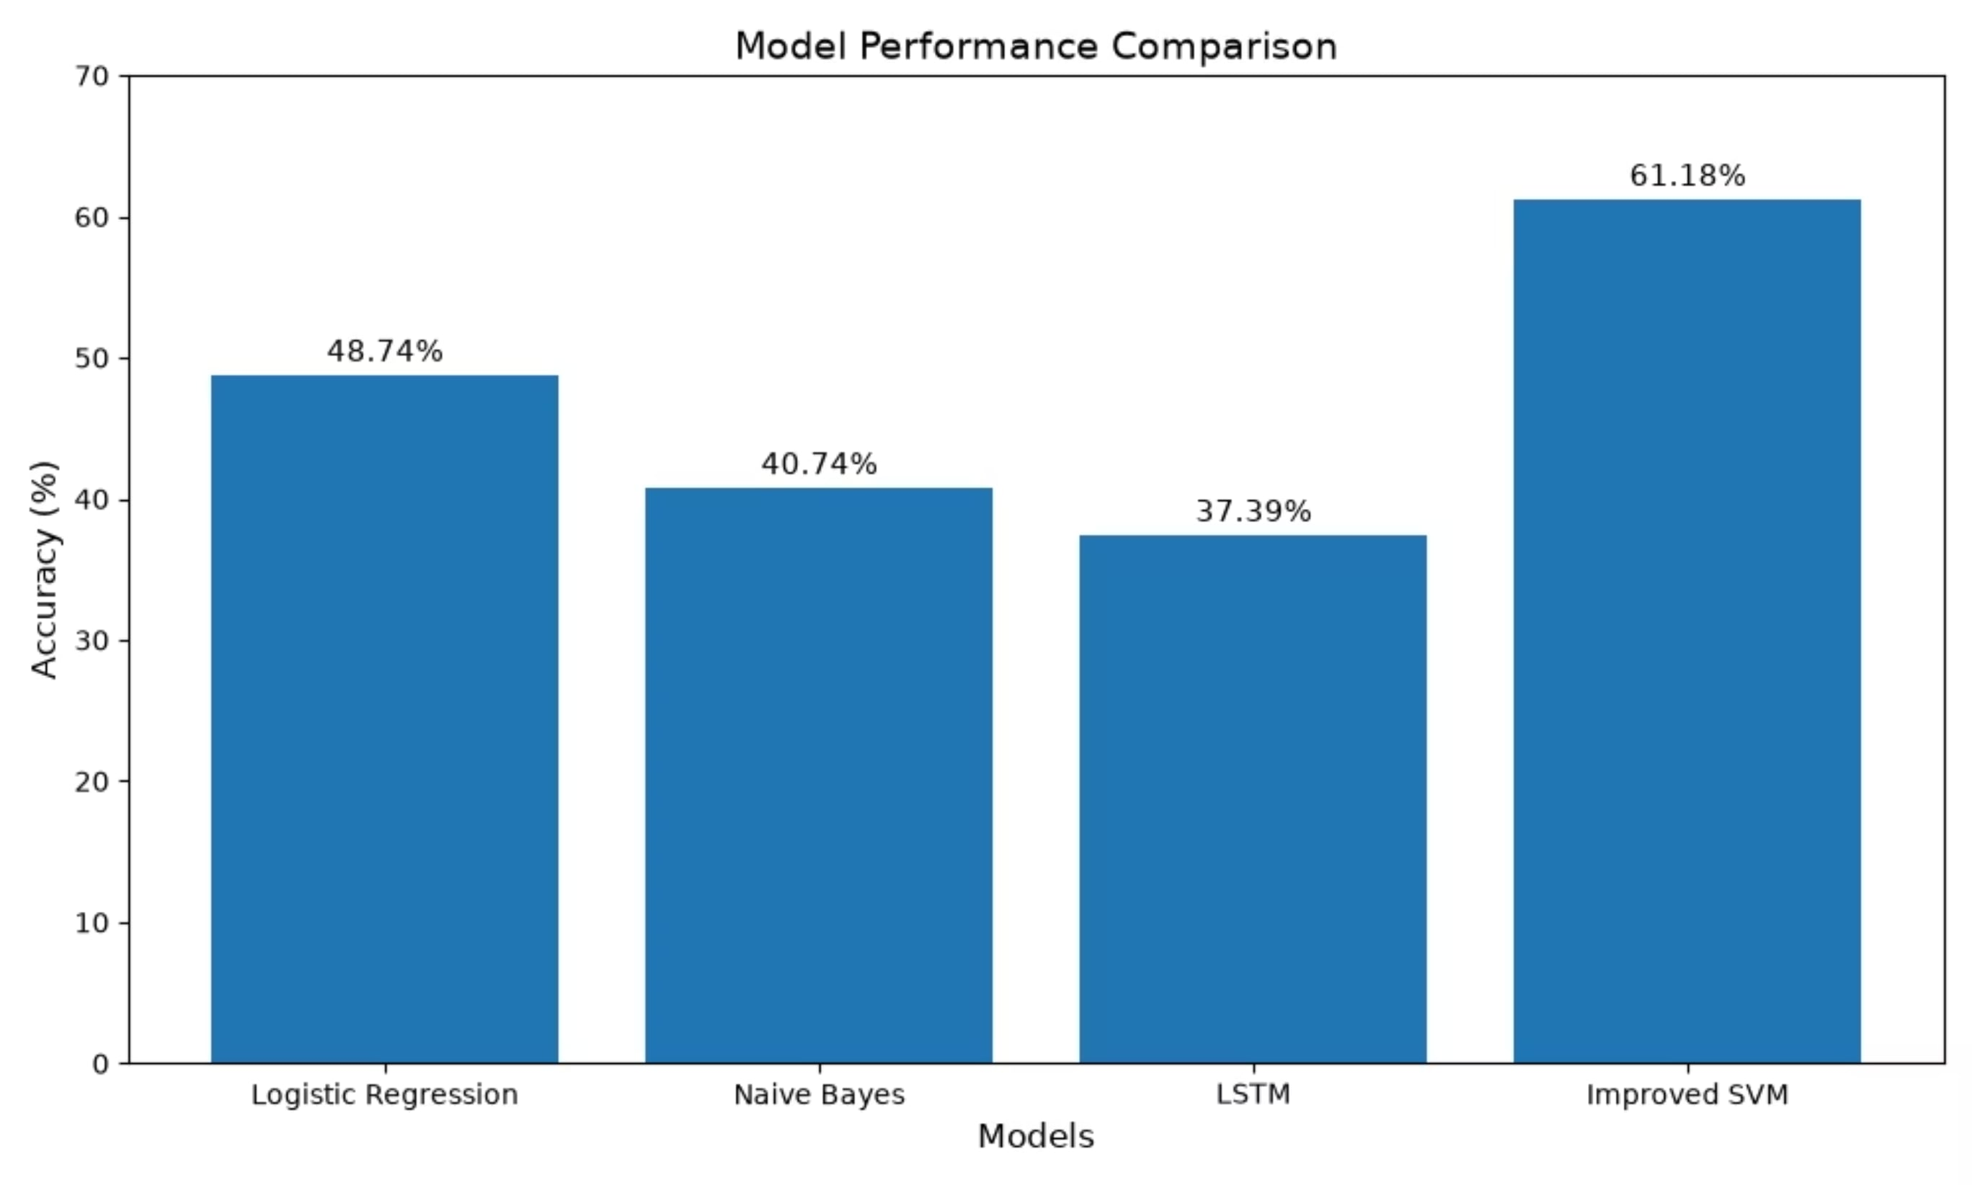

Slide 12
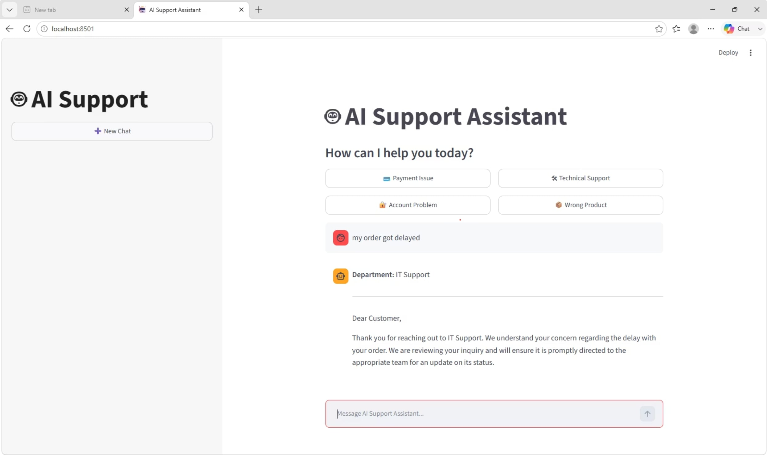
Streamlit Application

Slide 13
Conclusion
Successfully developed an AI-powered customer support automation system.
Compared multiple machine learning models.
Improved SVM achieved the highest accuracy of 61.18%.
Integrated Gemini API to generate professional responses.
Deployed the solution using Streamlit.

