Slide 1
01
PROBLEM UNDERSTANDING AND OBJECTIVE
Clinical Document Intelligence Hub · 2-day prototype
Clinical and administrative staff read the same documents twice.
Intake forms, discharge summaries, lab reports and physician notes arrive as text, PDF, scans and faxes. Someone reads each one for the same handful of facts, then re-keys them elsewhere. Slow, inconsistent between readers, and the errors it produces are silent.
The hard part is not reading the document. It is whether a clinician can check what was read — quickly, per field, without re-reading the chart.
OBJECTIVE
Ingest one unstructured clinical document and return a decision-ready patient summary card:
— structured fields, each with a confidence and its source quote
— a risk flag a clinician can defend
— concrete recommended next steps
THREE CONSTRAINTS THAT SHAPED EVERY DECISION
Absent data must stay absent
Silent imputation is the failure mode that actually hurts someone. Missing fields become the literal string “not documented”; if three or more NEWS2 parameters are missing the band is INDETERMINATE, not a score built on partial vitals.
The risk score must not be generated
A prose rationale from a model cannot be tested, audited, or held still while a prompt is edited. NEWS2 is ordinary Python, covered by 18 tests.
Every value must be traceable
Each field carries a verbatim source quote, expandable in the UI. Verifying a dose should take a click, not a re-read.
Synthetic data only — no real PHI. Decision support, not a medical device.

Slide 2
02
SOLUTION ARCHITECTURE AND DESIGN FLOW
One model call, one schema, one deterministic scorer
INPUT
Text · PDF Image · Scan
single document
INGEST
bytes + MIME type
src/ingest.py no OCR stage
EXTRACT
Gemini 3.6 Flash
one call schema-enforced
VALIDATE
ClinicalExtraction
Pydantic typed or rejected
the typed record forks
DETERMINISTIC src/triage.py · src/compare.py
NEWS2 risk score — plain Python
RCP scoring from the extracted vitals; every point attributable to a reading. A second document for the same patient is diffed by the same scorers, so “improved” always means fewer NEWS2 points. 46 tests. The model never sees this step.
GENERATIVE summary · reasoning · next steps
Narrative, grounded in quotes
Prose a clinician reads in under 20 seconds, plus recommended actions ordered most urgent first and an explicit list of what is missing from the document.
The model extracts; Python decides. The risk band cannot drift when a prompt is edited, a clinician can be shown which reading contributed which point, and the whole scoring layer is testable without an API key.
Streamlit renders the summary card, extracted-detail tables, NEWS2 breakdown, source text and a JSON export.

Slide 3
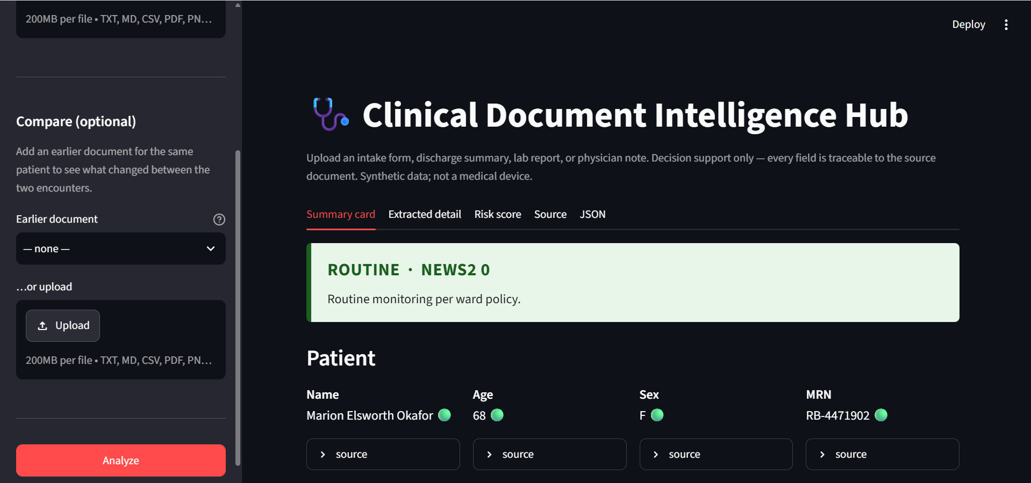
03
IMPLEMENTATION HIGHLIGHTS
The card a reviewer sees, and the call that produces it
ONE CALL — THE API ENFORCES THE SCHEMA
interaction = client.interactions.create(
model=model,
system_instruction=SYSTEM_PROMPT,
input=_input_blocks(document),
response_format={
"type": "text",
"mime_type": "application/json",
"schema": response_schema(),
},
store=False, # nothing retained
)
Risk band, then the fields it rests on. Each value carries a confidence marker and an expandable source holding the verbatim quote it came from.
No JSON parsing, no repair loop, no prose-to-struct step that can drift. response_schema() inlines the $defs/$ref Gemini does not document.
MEASURED ON THE SIX BUNDLED SAMPLES
95
source quotes audited against their documents
0
containing content absent from the source
59
tests — scoring, diffing and failure handling
~29 s
per document, end to end
$0.00
free tier — reproducible by anyone
Model: gemini-3.6-flash · extract.py is the only module aware of the provider.

Slide 4
04
CHALLENGES AND LEARNINGS
The confidence score was decoration — measuring it is what proved that
The prototype reported high confidence on almost every field. That looks like success until you ask whether the signal moves. So I rendered the same ED triage note at three degradation levels and compared confidence against ground truth.
BEFORE confidence is flat while accuracy collapses
AFTER the signal tracks legibility
Degradation | Vitals right | Confidence
As shipped | 6 / 6 | 21 high, 1 med
Degraded | 5 / 6 | 23 high, 0 med
Severe | 3 / 6 | 20 high, 0 med
Degradation | Vitals right | Confidence
As shipped | 6 / 6 | 8 high, 16 med
Degraded | 4 / 6 | 6 high, 18 med
Severe | 1 / 6 | 0 high, 17 med
At severe degradation the model read temperature as 37.9 °C instead of 38.9, and heart rate as 118 instead of 124 — and labelled both high confidence.
The fix was conceptual, not mechanical: confidence had been written as a statement of belief. It is now a statement about the source — any digit that could be a different digit under this much blur is medium, however sure the model feels. Clean digital text is unaffected: 105 high / 0 medium.
ALSO LEARNED
The cheap model was a trap
flash-lite: 4x faster, same NEWS2, but it fabricated 3 of 65 source quotes — one carried the reference range from the row above. Rejected.
A green tick is a claim
Uniform high confidence tells a clinician there is nothing to check. That is worse than showing no confidence at all.
One document cannot check itself
Diffing two encounters exposed a triage bug that had survived 18 tests and five samples: “nil allergies, confirmed” was being flagged as a missing allergy history.
Degradation levels generated reproducibly (fixed seed) by scripts/make_scanned_sample.py. · The after-fix ladder reproduced exactly (8 → 6 → 0 high) on a second independent run.

Slide 5
05
DEMO SUMMARY AND NEXT STEPS
Six synthetic documents, two modalities, one paired encounter
END-TO-END RESULTS AGAINST THE LIVE API
Document | Input | Classified as | NEWS2 | Risk
ED triage note — suspected urosepsis | text | triage_note | 17 | HIGH
same note, printed → photocopied → faxed | image | triage_note | 17 | HIGH
Discharge summary — resolved sepsis | text | discharge_summary | 0 | ROUTINE
New-patient intake form — headaches | text | intake_form | 0 | ROUTINE
same patient, 7 days later — discharge | text | discharge_summary | 0 | ROUTINE
Lab report — potassium 6.8, no vitals recorded | text | lab_report | — | INDETERMINATE
A degraded fax produced the identical decision — NEWS2 17, HIGH, all 7 parameters, all 7 labs, the same 5 flags. No OCR stage.
Load the same patient's discharge summary and the app diffs the encounters: NEWS2 17 → 0, HIGH → ROUTINE, lactate critical → normal, five flags resolved.
GIVEN MORE TIME
TO TAKE THIS BEYOND A PROTOTYPE
— Close the audit trail. One run produced a vitals quote that skipped a line while reading as continuous. Mark elisions; give each vital its own quote.
— Widen the comparison. It diffs two documents; a real record is a timeline. Identity matching also needs more than MRN-then-surname.
— Pin the non-determinism. Values are stable across runs; formatting is not (BD vs twice daily). Normalise in the schema.
— Gate on patient category. NEWS2 is validated for acutely ill adults — not paediatric or obstetric patients, and the tool does not detect those cases.
— Human-in-the-loop by default. Reviewed-and-accepted should be a recorded state with reviewer and timestamp, not an assumption.
— Structured interoperability. Emit FHIR resources rather than bespoke JSON, so output can re-enter the record it came from.
Repository github.com/anushkavb4/clinical-document-intelligence-hub README.md — setup and worked example · FINDINGS.md — measured findings · Synthetic data only.

