Slide 1


Efficient Cryptanalysis Techniques for
Privacy-Preserving Record Linkage
Anushka Vidanage¹
Supervisory panel: Peter Christen¹ (panel-chair), Thilina Ranbaduge¹ (co-supervisor), and Rainer Schnell² (co-supervisor)
¹ School of Computing
College of Engineering and Computer Science
The Australian National University
Canberra, Australia
² Methodology Research Group
University Duisburg-Essen
Duisburg, Germany
Contact: anushka.vidanage@anu.edu.au
Code: https://dmm.anu.edu.au/pprlattack

Slide 2

Outline
Introduction
Record Linkage (RL)
Privacy-Preserving Record Linkage (PPRL)
Motivation of Our Research
Objectives and Contributions
Conceptual Analysis of PPRL
A Taxonomy of Privacy Attacks on PPRL
A Vulnerability Framework for PPRL
Novel Privacy Attacks on PPRL
Frequency based Attack on Multiple Dynamic Match-key Encoding
Pattern-mining based Attack on Bloom Filter Encoding
Graph Matching based Attack on Multiple PPRL Encoding Techniques
Conclusions and Future Work

Slide 3
Outline
Introduction
Record Linkage (RL)
Privacy-Preserving Record Linkage (PPRL)
Motivation of Our Research
Objectives and Contributions
Conceptual Analysis of PPRL
A Taxonomy of Privacy Attacks on PPRL
A Vulnerability Framework for PPRL
Novel Privacy Attacks on PPRL
Frequency based Attack on Multiple Dynamic Match-key Encoding
Pattern-mining based Attack on Bloom Filter Encoding
Graph Matching based Attack on Multiple PPRL Encoding Techniques
Conclusions and Future Work

Slide 4


Record Linkage (RL)
Record linkage is the process of identifying and linking records that belong to the same real-world entity either within the same data source or across different data sources
Match
D
D
A
B
Challenges
Because of the lack of unique entity identifiers, linking of records is often based on personal identifying information such as names, addresses, and dates of birth (also called quasi-identifiers (QIDs))
When databases are linked across organisations, it is crucial to ensure privacy and confidentiality

Slide 5
Privacy-Preserving Record Linkage (PPRL)
PPRL aims to link records that correspond to the same entities across databases while protecting the privacy and confidentiality of these entities
Why PPRL?
Challenges
The demand for PPRL is increasing because:
Privacy and confidentiality laws and regulations are in place, such as EU GDPR¹ and AU Privacy Act²
Can improve data quality
Can allow sophisticated data analytics
Allow for approximate linking of values
Trade-off between scalability, linkage quality, and privacy
Have techniques that are not vulnerable to different privacy attacks (frequency, dictionary, cryptanalysis, etc.)
https://gdpr-info.eu/
https://www.oaic.gov.au/privacy/the-privacy-act/

Slide 6
PPRL Techniques and Privacy Attacks
In the past two decades various privacy techniques have been proposed for PPRL
Perturbation based techniques
Secure multi-party computation (SMC) based techniques
Perturbation based techniques such as Bloom filter (BF) encoding ^{(Schnell et al. 2009)} have become popular because they allow accurate approximate linkage of records while being efficient
However, BF encoding was shown to be susceptible to privacy attacks
Different attack methods have been proposed for BF encoding over the years

Slide 7
Motivation of Our Research
Challenges
Limitations of existing attacks
Categorising existing privacy attacks on PPRL techniques based on the characteristics of these attacks
Quantifying the vulnerabilities of both plaintext and encoded values in a sensitive database
Exploring and exploiting new vulnerabilities in PPRL techniques
Require knowledge of specific parameters used in the PPRL encoding process
Only applicable on a single encoding technique, or only on limited sets of parameter values
Have significant memory and run-time requirements

Slide 8
Aims and Contributions
Aims: Explore the means of quantifying the vulnerabilities that exists in PPRL encoding techniques, and investigate novel attack methods for PPRL techniques with the purpose of identifying the limitations of these techniques
Contributions
A taxonomy of existing attack methods on PPRL techniques
A vulnerability assessment framework for PPRL
Three novel attack methods on different PPRL techniques
A frequency based privacy attack on multiple dynamic match-key encoding
A pattern-mining based cryptanalysis attack on BF encoding
A graph matching based privacy attack on multiple encoding techniques

Slide 9
Outline
Introduction
Record Linkage (RL)
Privacy-Preserving Record Linkage (PPRL)
Motivation of Our Research
Objectives and Contributions
Conceptual Analysis of PPRL
A Taxonomy of Privacy Attacks on PPRL
A Vulnerability Framework for PPRL
Novel Privacy Attacks on PPRL
Frequency based Attack on Multiple Dynamic Match-key Encoding
Pattern-mining based Attack on Bloom Filter Encoding
Graph Matching based Attack on Multiple PPRL Encoding Techniques
Conclusions and Future Work

Slide 10

Overview of an Attack on PPRL
Database owners
Linkage unit
s
e
E
Encoded values E
D
D
Random / non-random sampling
Sensitive plaintext database
encoding()
Encoded database
linkage()
p
Encoding parameters
L
Linkage results L
G
Global population
Has limited access to
D
p
Attribute reidentification
r
D
Random / non-random sampling
Plaintext database
Identity reidentification
Reidentified database
Has access to
Adversary
attack()

Slide 11
A Taxonomy of Attacks on PPRL
Taxonomy of Attacks on PPRL
Adversarial Aspects
Technical Aspects
Practical Aspects
Adversary Type
Attack Type
Assessing the Success
Encoding Parameters
Attack Scope
Assessing the Scalability
Availability of Data
Exploited Vulnerability
Implementation
Non-technical Issues
Complexity
Evaluated Data

Slide 12
Outline
Introduction
Record Linkage (RL)
Privacy-Preserving Record Linkage (PPRL)
Motivation of Our Research
Objectives and Contributions
Conceptual Analysis of PPRL
A Taxonomy of Privacy Attacks on PPRL
A Vulnerability Framework for PPRL
Novel Privacy Attacks on PPRL
Frequency based Attack on Multiple Dynamic Match-key Encoding
Pattern-mining based Attack on Bloom Filter Encoding
Graph Matching based Attack on Multiple PPRL Encoding Techniques
Conclusions and Future Work

Slide 13
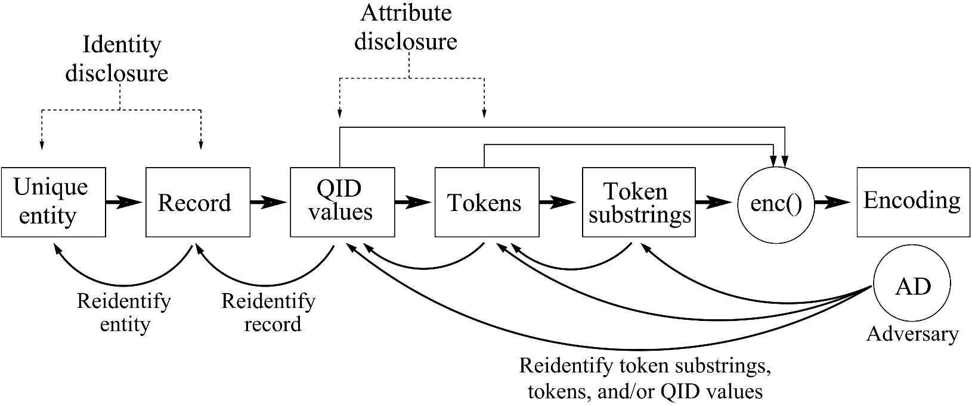
A Vulnerability Assessment Framework for PPRL
 | First name | Last name | Street address | City
Record | Jean Pierre | Miller | 42 Miller Street | Chapel Hill
QID values (Q) | Jean Pierre, Miller, 42 Miller Street, Chapel Hill
Tokens (T) | Jean, Pierre, Miller, 42, Street, Chapel, Hill
Token substrings (S) | an, ap, ch, ea, ee, el, er, et, ha, hi, ie, il, je, le, ll, mi, pe, pi, re, rr, st, tr, 42
Encoded value (BF) | 0 1 1 0 0 1 0 1 1 1 0 1 0 1 0 1 0 1 0 0 0 1 1 1 0 1 1 1 0 1 0 0 1 1 1 0 1 1 0 1
An adversary usually aims to reverse-engineer the encoding process to reidentify encoded values
Hence, either token substrings, tokens, or QID values should be vulnerable

Slide 14
Vulnerability of a Single Value
Three types of vulnerabilities of a single value can be exploited by an attack
Frequency vulnerability
Length vulnerability
Last name | Frequency
Smith | 800
Johnson | 400
David | 395
Vidanage | 2
Last name | Length
Wolfeschlegelsteinhausenbergerdorff¹ | 35
Kellermann | 10
Williams | 8
Li | 2
Similarity neighbourhood vulnerability
v₁
v₆
0.71
0.9
v₃
0.91
v₇
0.95
0.81
v₂
0.56
v₅
0.64
https://en.wikipedia.org/wiki/Hubert_Blaine_Wolfeschlegelsteinhausenbergerdorff_Sr.
0.82
Notes:
Frequency vulnerability - The frequency of a value is distinguishable from the frequencies of all other values in a database
Length vulnerability - The length of a value is distinguishable from the lengths of all other values in a database
Similarity neighbourhood vulnerability - The similarity neighbourhood of a value is distinguishable from the similarity neighbourhoods of all other values in a database

Slide 15
Vulnerability of a Pair of Values
Two types of vulnerabilities of a value pair can be exploited by an attack on PPRL
Co-occurrence vulnerability
Similarity vulnerability
Value/ Value pair | Frequency
Johnson | 400
David | 395
David, Johnson | 150
Peter, Miller | 90
Value pair | Edit distance similarity
Miller, Mills | 0.67
Smith, Smyth | 0.8
Johnson, John | 0.57
Peter, Pete | 0.8
Notes:
Co-occurrence vulnerability - The co-occurrence frequency of a pair of values is distinguishable from the co-occurrence frequencies of all other pair of values in a database
Similarity vulnerability - The similarity between a pair of values is distinguishable from the similarities between all other pairs of values in a database

Slide 16


Vulnerability Analysis (2)
Analysis of PPRL encoding techniques
Vulnerability | Plaintext |  |  | Encoding
Vulnerability | QID | Token | Substring | SLK¹ | BF² | TMH³ | MDM⁴ | 2SH⁵
Frequency
Length
Co-occurrence
Similarity
Similarity neighbourhood
Exploited vulnerability
Potential vulnerability
Statistical linkage key - Karmel 2005
Bloom filter encoding - Schnell et al. 2009
Tabulation min-hash encoding - Smith 2017
Multiple dynamic match-key encoding - Randall et al. 2019
Two-step hash encoding - Ranbaduge et al. 2020

Slide 17
Outline
Introduction
Record Linkage (RL)
Privacy-Preserving Record Linkage (PPRL)
Motivation of Our Research
Objectives and Contributions
Conceptual Analysis of PPRL
A Taxonomy of Privacy Attacks on PPRL
A Vulnerability Framework for PPRL
Novel Privacy Attacks on PPRL
Frequency based Attack on Multiple Dynamic Match-key Encoding
Pattern-mining based Attack on Bloom Filter Encoding
Graph Matching based Attack on Multiple PPRL Encoding Techniques
Conclusions and Future Work

Slide 18
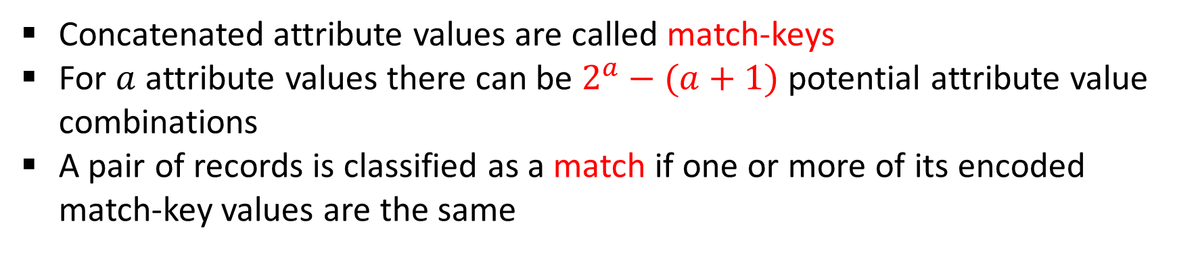
Multiple Dynamic Match-key (MDM) Encoding
Randall et al. (2019)
Record ID | First Name (F) | Last Name (L) | Gender (G) | Birth Year (B)
r₁ | John | Smith | M | 1985
r₂ | Peter | Miller |  | 1990
D
p
Plain-text database
Record ID | HMAC (F + L + G) | HMAC (F + L + B) | HMAC (L + G + B)
r₁ | HMAC(JohnSmithM) | HMAC(JohnSmith1985) | HMAC(SmithM1985)
r₂ |  | HMAC(PeterMiller1990)
e
MDM encoded database
D
Concatenated attribute values are called match-keys
For $a$ attribute values there can be $2^{a}−(a+1)$potential attribute value combinations
A pair of records is classified as a match if one or more of its encoded match-key values are the same

Slide 19
Frequency based Privacy Attack
Our proposed attack exploits the frequencies between encoded match-keys and plaintext match-keys
The attack calculates the correlations between the frequency distributions in order to align encoded match-keys with plaintext match-keys
We assume that the adversary has access to a MDM encoded database and a plaintext database
The attack consists of four steps:
Calculating the frequency distributions
Correlation analysis of frequency distributions
Filtering candidate plaintext match-keys
Reidentifying encoded match-keys and encoded plaintext values

Slide 20
Step 1 – Calculating the Frequency Distributions
Encoded match-keys | Match-keys in plaintext database D^{p} using attributes F, L, and B
HMAC (F + B) | F + L | F + B | L + B | F + L + B
heYcgrjawf3AVtt | JohnSmith | John1987 | Smith1987 | JohnSmith1987
heYcgrjawf3AVtt | JohnSmith | John1987 | Smith1987 | JohnSmith1987
heYcgrjawf3AVtt | JohnBrown | John1987 | Brown1987 | JohnBrown1987
JbsJvZQ7lucFDcE | PeterBrown | Peter1964 | Brown1964 | PeterBrown1964
JbsJvZQ7lucFDcE | PeterMiller | Peter1964 | Miller1964 | PeterMiller1964
…. | … | …. | …. | ….
5qIiMWET4suKARu | DavidMiller | David1990 | Miller1990 | DavidMiller1990
Calculate frequency distribution of each encoded match-key
Get all possible plaintext match-keys and calculate their frequency distributions

Slide 21
Step 2 – Correlation Analysis
Plaintext match-key | Statistical test correlation values when compared with encoded match-key HMAC (F + B)
 | Mean | Skewness | …. | EMD | KS Test | Entropy
F + L | 0.865 | 0.795 | …. | 0.647 | 0.912 | 0.456
F + B | 0.965 | 0.912 | …. | 0.895 | 0.997 | 0.932
L + B | 0.569 | 0.412 | …. | 0.621 | 0.792 | 0.628
F + L + B | 0.658 | 0.354 | …. | 0.415 | 0.647 | 0.587
A correlation matrix is built for each encoded match-key frequency distribution comparing that with plaintext match-key distributions
We use following tests
Earth mover’s distance (EMD)
Kolmogorov-Smirnov (KS) test
Pearson’s correlation coefficient
Spearman’s rank correlation
Entropy
Mean
Standard deviation
Variation
Skewness

Slide 22
Step 3 – Filtering Candidate Plaintext Match-keys
Plaintext match-key | Statistical test correlation values when compared with encoded match-key HMAC (F + B)
 | Mean | Skewness | …. | EMD | KS Test | Entropy
F + L | 0.865 | 0.795 | …. | 0.747 | 0.912 | 0.456
F + B | 0.965 | 0.912 | …. | 0.895 | 0.997 | 0.932
L + B | 0.569 | 0.412 | …. | 0.721 | 0.792 | 0.628
F + L + B | 0.658 | 0.354 | …. | 0.415 | 0.647 | 0.787
For each correlation test (eg: mean, EMD, entropy, etc.):
Sort correlation values descending order
Calculate correlation value difference (d) between next two plaintext match-keys
If d ≤ θ
No
Stop the selection of plaintext match-keys
Yes
Select the corresponding plaintext match-key pair

Slide 23
Step 4 – Reidentifying Encoded Match-keys
Plaintext match-key | Statistical test correlation values when compared with encoded match-key HMAC (F + B) |  |  |  |  |  | Average correlation | Rank
 | Mean | Skewness | …. | EMD | KS Test | Entropy
F + L | 0.865 | 0.795 | …. | 0.747 | 0.912 | 0.456 | 0.830 | 2
F + B | 0.965 | 0.912 | …. | 0.895 | 0.997 | 0.932 | 0.940 | 1
L + B | 0.569 | 0.412 | …. | 0.721 | 0.792 | 0.628 | 0.678 | 3
F + L + B | 0.658 | 0.354 | …. | 0.415 | 0.647 | 0.687 | 0.664 | 4
Rank plaintext match-keys in each correlation matrix based on the average of filtered correlation values
Highest ranked plaintext match-keys are likely to be more similar to each of the encoded match-key

Slide 24
Step 4 – Reidentifying Encoded Plaintext Values
Finally, we use frequency alignment to align hash values in an encoded match-key with plaintext values in a plaintext match-key
Encoded match-key HMAC (F + B) |  | Highest ranked plaintext match-key (F + B)
Encoded value | Frequency | Plaintext value | Frequency
heYcgrjawf3AVtt | 100 | John1987 | 100
JbsJvZQ7lucFDcE | 80 | Peter1964 | 78
NDZ5v3pzT7tvlko | 20 | David1990 | 21
1XW13iYzExn4KGZ | 20 | Nicole1987 | 20
5qIiMWET4suKARu | 10 | Brian1967 | 10
b97VABaDFZSg9OM | 10 | Ashley1975 | 9

Slide 25
Experimental Evaluation
Databases
Evaluation criteria
North Carolina voter registration (NCVR)
5 dataset pairs with temporal differences (6 million to 8 million records)
First name, Middle name, Last name, Birth year, Street address, Zipcode
Michigan voter registration (MVR)
3 dataset pairs with temporal differences (6 million to 7 million records)
First name, Middle name, Last name, Birth year, Street address, Zipcode
Accuracy of identified plaintext match-keys for each encoded match-key
Precision/Recall results for reidentified plaintext QID values in encoded match-keys

Slide 26
Match-key and Plaintext Reidentification Accuracy
Reidentification accuracy results for the NCVR and MVR databases
r = rank value
Database | Time interval between encoded and plaintext datasets | Precision / Recall
NCVR | 2 months | 96.33 / 95.97
 | 8 months | 80.13 / 81.23
 | 1 year | 66.03 /66.43
 | 2 years | 55.8 / 52.5
 | 8 years | 26.0 / 25.03
MVR | 8 months | 36.46 / 31.8
 | 2 years | 37.23 / 38.83
 | 8 years | 29.2 / 30.63

Slide 27
Outline
Introduction
Record Linkage (RL)
Privacy-Preserving Record Linkage (PPRL)
Motivation of Our Research
Objectives and Contributions
Conceptual Analysis of PPRL
A Taxonomy of Privacy Attacks on PPRL
A Vulnerability Framework for PPRL
Novel Privacy Attacks on PPRL
Frequency based Attack on Multiple Dynamic Match-key Encoding
Pattern-mining based Attack on Bloom Filter Encoding
Graph Matching based Attack on Multiple PPRL Encoding Techniques
Conclusions and Future Work

Slide 28
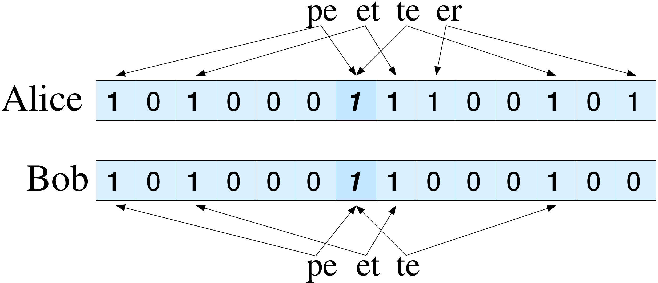
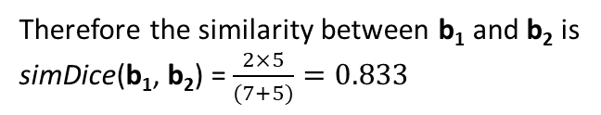
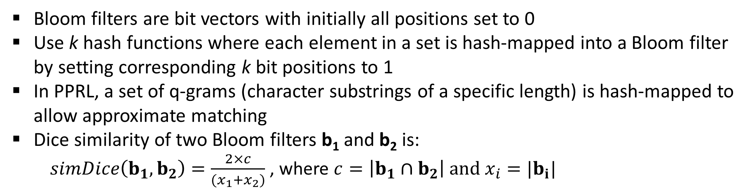
Bloom Filter (BF) Encoding
Schnell et al. (2009)
peter
Number of 1 bits
x₁ = 7
x₂ = 5
Number of common 1 bits
c = 5
b₁
b₂
Therefore the similarity between b₁ and b₂ is
simDice(b₁, b₂) = $\frac{2×5}{(7+5)}=0.833$
pete
k=2
Bloom filters are bit vectors with initially all positions set to 0
Use k hash functions where each element in a set is hash-mapped into a Bloom filter by setting corresponding k bit positions to 1
In PPRL, a set of q-grams (character substrings of a specific length) is hash-mapped to allow approximate matching
Dice similarity of two Bloom filters b₁ and b₂ is:
$simDice\left(b_{1}, b_{2}\right)=\frac{2×c}{(x_{1}+x_{2})}$ , where $c=\left|b_{1}∩b_{2}\right| and x_{i}=|b_{i}|$

Slide 29
Pattern-mining based Privacy Attack
Our proposed cryptanalysis attack exploits the bit pattern frequencies between bit positions in BFs rather than frequencies between BFs
The attack is independent of the hash encoding function and its parameters used
We assume that the adversary has access to a BF encoded database and a plain-text database and can guess the encoded attribute combination
The attack consists of four steps:
Identify frequent bit positions and align them with frequent q-grams using a pattern-mining algorithm (eg: Apriori, FP-max)
Language model based q-gram set expansion
Partitioning based q-gram set expansion
Reidentify plain-text values using identified q-grams for each BF

Slide 30
Step 1 – Identifying Frequent Bit Positions
e
D
BF encoded database
b₁
1
0 | 0 | 0 | 0 | 1 | 0 | 0 | 0 | 0 | 0 | 0 | 0 | 1 | 1 | 0 | 1 | 0 | 0 | 0 | 0
0 | 0 | 1 | 0 | 0 | 0 | 0 | 1 | 0 | 0 | 1 | 0 | 0 | 1 | 0 | 0 | 0 | 0 | 0 | 0
1 | 0 | 0 | 0 | 1 | 0 | 1 | 0 | 0 | 1 | 0 | 0 | 1 | 0 | 0 | 0 | 1 | 0 | 0 | 1
0 | 0 | 0 | 0 | 1 | 1 | 0 | 0 | 0 | 0 | 0 | 1 | 1 | 0 | 0 | 1 | 0 | 0 | 1 | 0
1 | 1 | 0 | 1 | 0 | 0 | 0 | 0 | 0 | 1 | 0 | 0 | 0 | 0 | 0 | 0 | 0 | 1 | 0 | 0
1
matt
b₂
manny
max
b₃
1
1
1
1
joan
b₄
1
1
jim
b₅
1
1
D
p
Plain-text database
p₁
p₅
p₁₀
p₁₃
Q-gram counts:
Based on co-occurring bit patterns in positions, we find that:
p₅ and p₁₃ must encode ‘ma’
p₁ and p₁₀ must encode ‘an’
Q-gram | Count
ma | 3
an | 2
at, tt, nn, ax, ny, oa, jo, ji, im | 1
For BFs with 0 in positions p₅, p₁₃, p₁ and p₁₀ we assume these BFs cannot encode either ‘ma’ or ‘an’

Slide 31
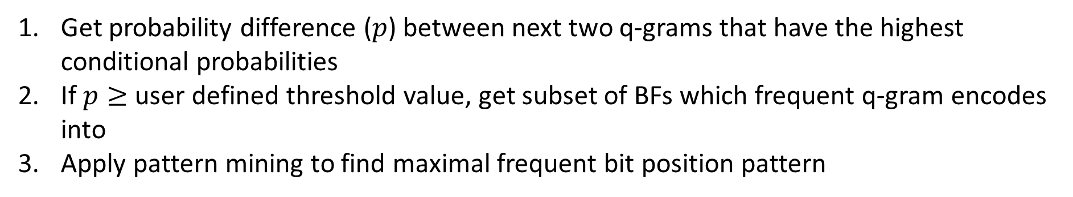
Step 2 – Language Model based Q-gram Expansion
Q-gram counts
ny
nn
ny
150
180
150
ma: 350 an: 250
ax: 200 nn: 180
ny: 150 jo, oa: 70
nn
max: 200
manny: 150
john: 70
ann: 30
150
0.72
0.429
0.60
0.429
ma
an
0.28
jo
F = [ma, an]
350
250
70
ax
0.571
D
p
200
0.28
oa
Plain-text database
70
Get probability difference ($p$) between next two q-grams that have the highest conditional probabilities
If $p≥$ user defined threshold value, get subset of BFs which frequent q-gram encodes into
Apply pattern mining to find maximal frequent bit position pattern
F - The list of frequent q-grams identified in the first step
Notes:
Reduce the size of graph text

Slide 32
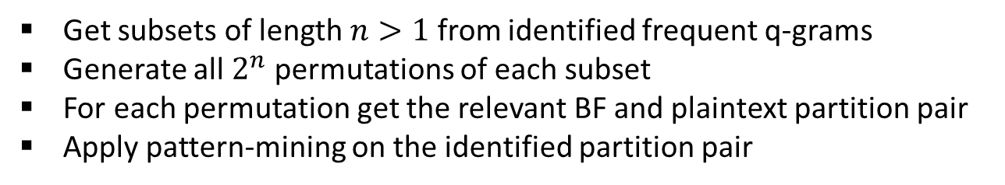
Step 3 – Partitioning based Q-gram Expansion
e
D
BF encoded database
b₁
0 | 0 | 1 | 0 | 1 | 0 | 0 | 0 | 0 | 0 | 0 | 0 | 1 | 1 | 0 | 1 | 0 | 0 | 1 | 0
0 | 1 | 1 | 0 | 1 | 1 | 0 | 1 | 0 | 0 | 1 | 0 | 1 | 1 | 0 | 0 | 0 | 1 | 0 | 1
1 | 0 | 0 | 0 | 1 | 0 | 1 | 0 | 0 | 1 | 0 | 0 | 1 | 0 | 0 | 0 | 1 | 0 | 0 | 1
1 | 0 | 0 | 0 | 1 | 1 | 1 | 0 | 0 | 1 | 0 | 1 | 1 | 0 | 0 | 1 | 1 | 1 | 1 | 0
1 | 1 | 0 | 1 | 0 | 0 | 0 | 0 | 0 | 1 | 0 | 0 | 0 | 0 | 1 | 0 | 0 | 1 | 0 | 0
matt
b₂
manny
F = [ma, an]
mannix
b₃
1
1
1
1
1
1
joan
b₄
1
1
1
1
1
1
mathew
p
b₅
D
Plain-text database
p₁
p₅
p₇
p₁₀
p₁₃
p₁₇
Frequent q-gram pairs
Get subsets of length $n>1$ from identified frequent q-grams
Generate all $2^{n}$ permutations of each subset
For each permutation get the relevant BF and plaintext partition pair
Apply pattern-mining on the identified partition pair
Q-gram perm. | BFs
ma, an | 2 (b₃, b₄)
ma, an | 2 (b₁, b₂)
ma, an | 1 (b₅)
ma, an | 0
From (ma, an) permutation we can identify that
p₇ and p₁₇ must encode ‘nn’

Slide 33
Step 4 – Plaintext Reidentification
e
D
BF encoded database
Plain-text database
b₁
0 | 0 | 0 | 0 | 1 | 0 | 0 | 0 | 0 | 0 | 0 | 0 | 1 | 1 | 0 | 1 | 0 | 0 | 0 | 0
0 | 0 | 1 | 0 | 0 | 0 | 0 | 1 | 0 | 0 | 1 | 0 | 0 | 1 | 0 | 0 | 0 | 0 | 0 | 0
1 | 0 | 0 | 0 | 1 | 0 | 1 | 0 | 0 | 1 | 0 | 0 | 1 | 0 | 0 | 0 | 1 | 0 | 0 | 1
matt
manny
p
b₂
max
D
joan
b₃
jim
p₁
p₁₀
p₁₃
p₅
p₅ and p₁₃ must encode ‘ma’
p₁ and p₁₀ must encode ‘an’
Based on possible and not possible q-gram sets for each BF, we can determine,
b₁ should encode either matt or max
b₂ should encode jim
b₃ should encode manny
b₁ => q⁺ = {ma}, q⁻ = {an}
b₂ => q⁺ = { }, q⁻ = {ma, an}
b₃ => q⁺ = {ma, an}, q⁻ = { }
q⁺ = Set of possible q-grams that can be encoded in a BF
q⁻ = Set of not possible q-grams that can be encoded in a BF

Slide 34
Experimental Evaluation
Databases
Evaluation criteria
North Carolina voter registration (NCVR)
Four snapshots of dataset pairs (three with 500,000 and one with 220,000 records) (sampled)
First name, Last name, Street address, City
Michigan voter registration (MVR)
One snapshot of dataset pair (with 220,000 records) (sampled)
First name, Last name, Street address, City
Quality of identified bit positions of frequent and non-frequent q-grams in each step
Number of exact, partial and wrong reidentifications
Number of 1-to-1 and 1-to-many reidentifications

Slide 35
Q-gram Reidentification Accuracy
Accuracy of identified bit positions for the NCVR datasets
First name, Last name
First name, Last name, Street, City
Pattern-mining
Language model
Partitioning
k = 10 k = 15 k = 20
k = 10 k = 15 k = 20
k = 10 k = 15 k = 20
k = 10 k = 15 k = 20

Slide 36
Plaintext Reidentification Accuracy
Accuracy of reidentified plaintext QID values
 |  | Christen et al. 2017 1-to-1 / 1-to-m | Christen et al. 2018a 1-to-1 / 1-to-m | Christen et al. 2018b (previous version) 1-to-1 / 1-to-m | Our new method 1-to-1 / 1-to-m
First name | Exact | 4 / 8 | 1,345 / 22,640 | 1,084 / 9,406 | 12,931 / 28,608
 | Partial | 0 / 0 | 0 / 0 | 5 / 12 | 2 / 7
 | Wrong | 3 | 3,325 / 8,635 | 697 / 2,193 | 4,283 / 6,647
First name, Last name | Exact | 2 / 3 | 0 / 138 | 2,010 / 5,368 | 14,829 / 15,373
 | Partial | 0 / 0 | 0 / 0 | 577 / 2,424 | 1,924 / 5,252
 | Wrong | 10 | 10 / 226 | 823 / 1,831 | 2,348 / 4,107
First name, Last name, Street, City | Exact | 0 / 0 | 0 / 0 | 75 / 147 | 8,152 / 2,618
 | Partial | 0 / 0 | 0 / 0 | 8,837 / 24,911 | 8,896 / 17,613
 | Wrong | 0 | 0 / 0 | 2,976 / 3,112 | 3,729 / 2,765

Slide 37
Outline
Introduction
Record Linkage (RL)
Privacy-Preserving Record Linkage (PPRL)
Motivation of Our Research
Objectives and Contributions
Conceptual Analysis of PPRL
A Taxonomy of Privacy Attacks on PPRL
A Vulnerability Framework for PPRL
Novel Privacy Attacks on PPRL
Frequency based Attack on Multiple Dynamic Match-key Encoding
Pattern-mining based Attack on Bloom Filter Encoding
Graph Matching based Attack on Multiple PPRL Encoding Techniques
Conclusions and Future Work

Slide 38
Graph Matching based Privacy Attack
Our proposed graph attack can be applied on any PPRL technique that calculates approximate similarities between encoded records
It exploits the calculated similarities between encoded records using a graph based matching approach to reidentify encoded values
We assume that the adversary has access to an encoded database and a plaintext database, and can guess the encoded attribute combination
Our attack consists of three main steps
Similarity graph generation
Node feature generation
Node matching and plaintext reidentification

Slide 39
Step 1 – Generating Similarity Graphs
v₁
v₆
Two similarity graphs G_{P} and G_{E} are generated using corresponding pair-wise similarities between plaintext values and encodings, respectively
We use a similarity threshold s to limit the number of edges in the graphs
0.95
0.82
D
p
0.64
v₇
0.56
v₃
v₂
0.81
Plaintext database
0.9
0.71
0.91
v₅
G
P
v₄
u₃
u₂
0.96
0.7
0.85
0.79
e
0.6
u₄
D
0.63
u₇
u₅
0.92
0.9
0.81
Encoded database
u₆
0.75
G
u₁
E

Slide 40
Step 2 – Node Feature Generation
u₃
u₂
G
E
0.96
0.7
0.85
For each node in both graphs we calculate a set of (normalised) features, including:
Node frequency
Node length
Degree of the node
Minimum, maximum, average, standard deviation of edge similarities
Egonet degree
Egonet density
Centrality features
Degree distributions of one-hop and two-hop neighbours
0.79
0.6
u₄
0.63
u₇
0.9
0.81
u₅
0.92
u₆
0.75
u₁
f₁
f₂
f₃
f₄
…
f_{m}
u₁
0.84 | 0.75 | 0.42 | 0.21 | …. | 0.65
0.96 | 0.65 | 0.36 | 0.94 | …. | 0.46
…. | …. | …. | …. | …. | ….
0.77 | 0.54 | 0.17 | 0.36 | …. | 0.73
u₂
…
u₇
Encoded feature matrix
F
E

Slide 41
Step 3 – Node Matching /Plaintext Reidentification
Nodes in both graphs are matched based on their feature vectors
We use three bi-partite graph matching methods for one-to-one node matching
f₁
f₂
f₃
…
f_{m}
v₁
0.95 | 0.69 | 0.32 | …. | 0.50
0.85 | 0.71 | 0.39 | …. | 0.68
…. | …. | …. | …. | ….
0.70 | 0.49 | 0.25 | …. | 0.83
v₁
0.51
0.9
u₁
v₁
u₁
v₂
0.95
F
v₂
u₂
v₂
u₂
P
…
0.91
0.91
v₇
v₃
0.95
u₃
v₃
u₃
f₁
f₂
f₃
…
f_{m}
0.84
0.84
u₁
v₄
u₄
v₄
u₄
0.84 | 0.75 | 0.42 | …. | 0.65
0.96 | 0.65 | 0.36 | …. | 0.46
…. | …. | …. | …. | ….
0.77 | 0.54 | 0.17 | …. | 0.73
0.64
F
u₂
0.56
E
…
…
…
…
…
0.81
0.61
v₇
u₇
v₇
u₇
u₇
0.61

Slide 42
Experimental Evaluation
Databases
Evaluation criteria
Titanic passenger database
1,317 records (encoded and plaintext)
First name and Last name
European census (EURO) database (synthetic)
25,343 records (encoded and plaintext)
First name, Last name, Street address
North Carolina voter registration database
One dataset pair each with 100,000 records (sampled)
First name, Last name, Street address
Three PPRL encoding techniques
Bloom filter (BF) encoding
Tabulation min-hash (TMH) encoding
Two-step hash (2SH) encoding
Accuracy percentage of the top one-to-one t plaintext reidentifications, where:
t = [10, 100, 500, 1000]
Usability of three bi-partite matching approaches based on matching accuracy

Slide 43
Plaintext Reidentification Accuracy
Accuracy results for the Titanic and EURO databases with different attribute combinations
TITANIC
EURO
First name
First name and Last name
BF TMH 2SH
BF TMH 2SH
First name and Last name
First name, Last name, Street
BF TMH 2SH
BF TMH 2SH

Slide 44
Percentages of Total Reidentifications
Total plaintext reidentification percentages for the Europe census database when using three different bi-partite graph matching techniques
Attribute Combination | Encoding Technique | Bi-partite Graph Matching Method
 |  | SHM | SMM | MWM
First name, Last name | BF | 32.0 | 34.0 | 32.4
 | TMH | 41.4 | 47.8 | 36.7
 | 2SH | 43.4 | 49.7 | 40.6
First name, Last name, Street address | BF | 57.0 | 62.5 | 60.1
 | TMH | 24.0 | 31.7 | 17.1
 | 2SH | 16.1 | 22.0 | 11.6
SHM = Symmetric highest match (Edge with highest weight)
SMM = Stable marriage match (Gale-Shapley algorithm)
MWM = Maximum weight match (Hungarian algorithm)

Slide 45
Outline
Introduction
Record Linkage (RL)
Privacy-Preserving Record Linkage (PPRL)
Motivation of Our Research
Objectives and Contributions
Conceptual Analysis of PPRL
A Taxonomy of Privacy Attacks on PPRL
A Vulnerability Framework for PPRL
Novel Privacy Attacks on PPRL
Frequency based Attack on Multiple Dynamic Match-key Encoding
Pattern-mining based Attack on Bloom Filter Encoding
Graph Matching based Attack on Multiple PPRL Encoding Techniques
Conclusions and Future Work

Slide 46
Conclusions and Future Work
Summary of our contributions:
A taxonomy of privacy attacks on PPRL which can be used to characterise and compare existing privacy attacks under twelve dimensions
A vulnerability framework for PPRL for assessing the vulnerabilities associated with both plaintext and encoded databases
A frequency based privacy attack on multiple dynamic match-key encoding for PPRL
A pattern-mining based cryptanalysis on Bloom filter encoding for PPRL
A graph matching based cryptanalysis that is independent of the PPRL encoding method used
Future research directions:
Explore how our attacks works with privacy improvements such as BF hardening techniques
Development of more efficient secure multi-party computation (SMC) based PPRL techniques
Explore potential attack methods for numerical and other encoding techniques for PPRL

Slide 47
List of Publications
Major:
Anushka Vidanage, Thilina Ranbaduge, Peter Christen, Rainer Schnell. 2020. “A Taxonomy of Attacks on Privacy-Preserving Record Linkage”. (Under review).
Anushka Vidanage, Thilina Ranbaduge, Peter Christen, Rainer Schnell. 2020. “A Graph Matching Attack on Privacy-Preserving Record Linkage”. In ACM International Conference on Information and Knowledge Management (CIKM), Ireland (online), 1485–1494.
Anushka Vidanage, Thilina Ranbaduge, Peter Christen, Sean Randall. 2020. “A Privacy Attack on Multiple Dynamic Match-key based Privacy-Preserving Record Linkage”. In International Journal of Population Data Science (IJPDS), 5 (1).
Anushka Vidanage, Thilina Ranbaduge, Peter Christen, Rainer Schnell. 2019. "Efficient Pattern Mining Based Cryptanalysis for Privacy-Preserving Record Linkage". In IEEE International Conference on Data Engineering (ICDE), Macau, 1698-1701.
Peter Christen, Anushka Vidanage, Thilina Ranbaduge, Rainer Schnell. 2018. “Pattern mining based cryptanalysis of Bloom filters for privacy-preserving record linkage”. In Pacific-Asia Conference on Knowledge Discovery and Data Mining (PAKDD), Melbourne, 530-542.
Minor:
Peter Christen, Thilina Ranbaduge, Rainer Schnell, Anushka Vidanage and Christian Borgs (co-authored book chapter). 2020. “Bloom Filter based Encoding Methods”. In Linking Sensitive Data - Methods and Techniques for Practical Privacy-Preserving Information Sharing, Springer, ch. 8, 193-219.
Peter Christen, Thilina Ranbaduge, Rainer Schnell, Anushka Vidanage and Sirintra Vaiwsri (co-authored book chapter). 2020. “Attacking and Hardening Bloom Filter Encoding”. In Linking Sensitive Data - Methods and Techniques for Practical Privacy-Preserving Information Sharing, Springer, ch. 9, 221-251.
Peter Christen, Thilina Ranbaduge, and Rainer Schnell, Anushka Vidanage and Sirintra Vaiwsri (co-authored book chapter). 2020. “Empirical Evaluation”. In Linking Sensitive Data - Methods and Techniques for Practical Privacy-Preserving Information Sharing, Springer, ch. 12, 323-344.
Thilina Ranbaduge, Anushka Vidanage, Sirintra Vaiwsri, Rainer Schnell, Peter Christen. 2018. “Evaluating hardening techniques against cryptanalysis attacks on Bloom filter encodings for record linkage”. In International Journal of Population Data Science (IJPDS), 3 (4).

Slide 48
Any Questions?
Efficient Cryptanalysis Techniques for
Privacy-Preserving Record Linkage
Anushka Vidanage¹
Supervisory panel: Peter Christen¹ (panel-chair), Thilina Ranbaduge¹ (co-supervisor), and Rainer Schnell² (co-supervisor)
Contact: anushka.vidanage@anu.edu.au
Code: https://dmm.anu.edu.au/pprlattack

