Slide 1
SalesSense
Scalable Sales Prediction & Analytics System
Built with Apache Spark, Spark MLlib & Streamlit
College Mini Project

Slide 2
Problem Statement
Retail businesses generate large volumes of transactional sales data, but manually analyzing it to understand trends and forecast future sales is slow and error-prone.
9,994
SalesSense builds a scalable system that processes historical sales data with Apache Spark, engineers features, trains a Spark MLlib Linear Regression model to predict sales, evaluates it with standard regression metrics, and presents everything through an interactive dashboard.
real sales transactions
4 years
of order history (2014-2017)
21 columns
across product, customer & order data
SalesSense | 2

Slide 3
Motivation
Scale matters
Single-machine tools (pandas, spreadsheets) struggle as sales datasets grow; Spark is the industry standard for distributed data processing.
Industry relevance
Building an ML pipeline directly on Spark's DataFrame + MLlib APIs mirrors real production data-engineering workflows.
Beyond the notebook
A polished, working web application demonstrates a deployable system, not just an isolated analysis script.
SalesSense | 3

Slide 4
Objectives
01
02
Inspect a real dataset & report actual quality metrics
Clean & preprocess data using PySpark's DataFrame API
03
04
Engineer features without target leakage
Build a Spark ML Pipeline: Indexer → Encoder → Assembler → Scaler → Regressor
05
06
Train & evaluate with RMSE / MAE / R² on real held-out data
Deliver an interactive Streamlit + Plotly GUI
SalesSense | 4

Slide 5
Dataset: Sample Superstore
Source: Kaggle (vivek468/superstore-dataset-final) — inspected, not assumed
Rows
9,994
Columns (raw)
21
Missing values
0
Duplicate rows
0
Date range
2014 – 2017
Categories
3 (Office Supplies, Furniture, Technology)
Sub-categories
17
Regions
4
Target variable: Sales (₹0.44 – ₹22,638). Profit excluded from features — it is derived from Sales (corr. 0.48) and would leak the target.
SalesSense | 5

Slide 6
Proposed System
1
2
3
Data & ML Layer
→
Persistence Layer
→
Application Layer
Apache Spark cleans data, engineers features, trains & evaluates a Linear Regression model via Spark MLlib.
The fitted Spark ML Pipeline (all stages) is saved to disk as a single reloadable artifact.
Streamlit loads the saved model and exposes dashboard, prediction, and analytics pages.
SalesSense | 6

Slide 7
System Architecture
Raw CSV
→
Spark: Clean
→
Feature
Engineering
→
Spark ML
Pipeline
→
Linear
Regression
→
Saved
Model
→
Streamlit
App
Every arrow above is real Spark computation — loading, cleaning, feature transforms, training and inference all run through Spark's DataFrame & MLlib APIs.
SalesSense | 7

Slide 8
Methodology
1
Ingest CSV into a Spark DataFrame with schema inference
2
Clean: handle nulls, duplicates, type casts, date parsing
3
Engineer features: Order_Month, Order_DayOfWeek
4
Split 80% train / 20% test (seed = 42)
5
Fit the full Pipeline on the training set only (no leakage)
6
Evaluate on the held-out test set with RMSE / MAE / R²
7
Persist the fitted PipelineModel for reuse at inference time
SalesSense | 8

Slide 9
Spark + MLlib Implementation
5× StringIndexer
→
5× OneHotEncoder
→
VectorAssembler
→
StandardScaler
→
LinearRegression
Why Spark?
Feature Vector
local[*] uses every CPU core on this machine — the exact same code would run unchanged on a multi-node cluster by only changing the master URL. Spark performs the CSV load, cleaning, feature transforms, aggregations, training AND inference — not just a token import.
35 dimensions
4 numeric (Quantity, Discount, Order_Month, Order_DayOfWeek) + 5 one-hot encoded categoricals (Category, Sub_Category, Segment, Region, Ship_Mode)
SalesSense | 9

Slide 10
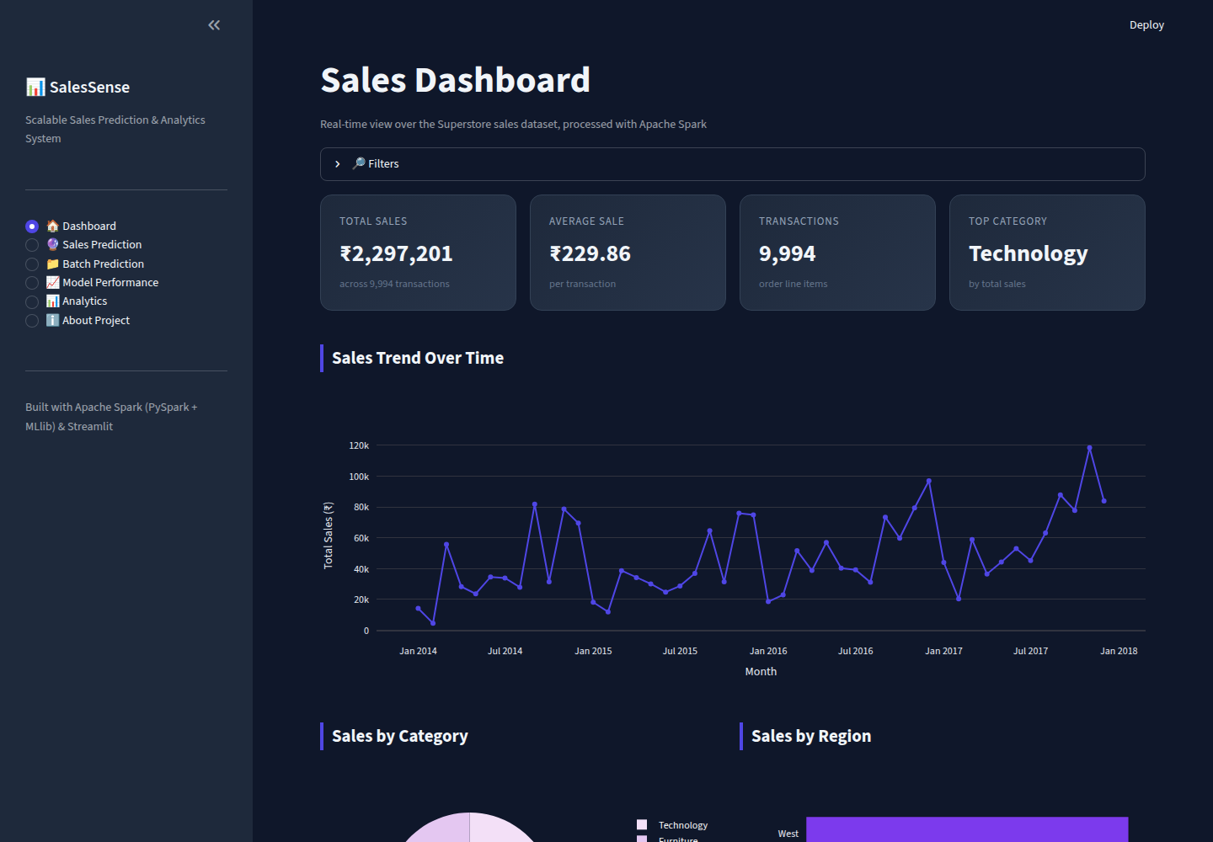
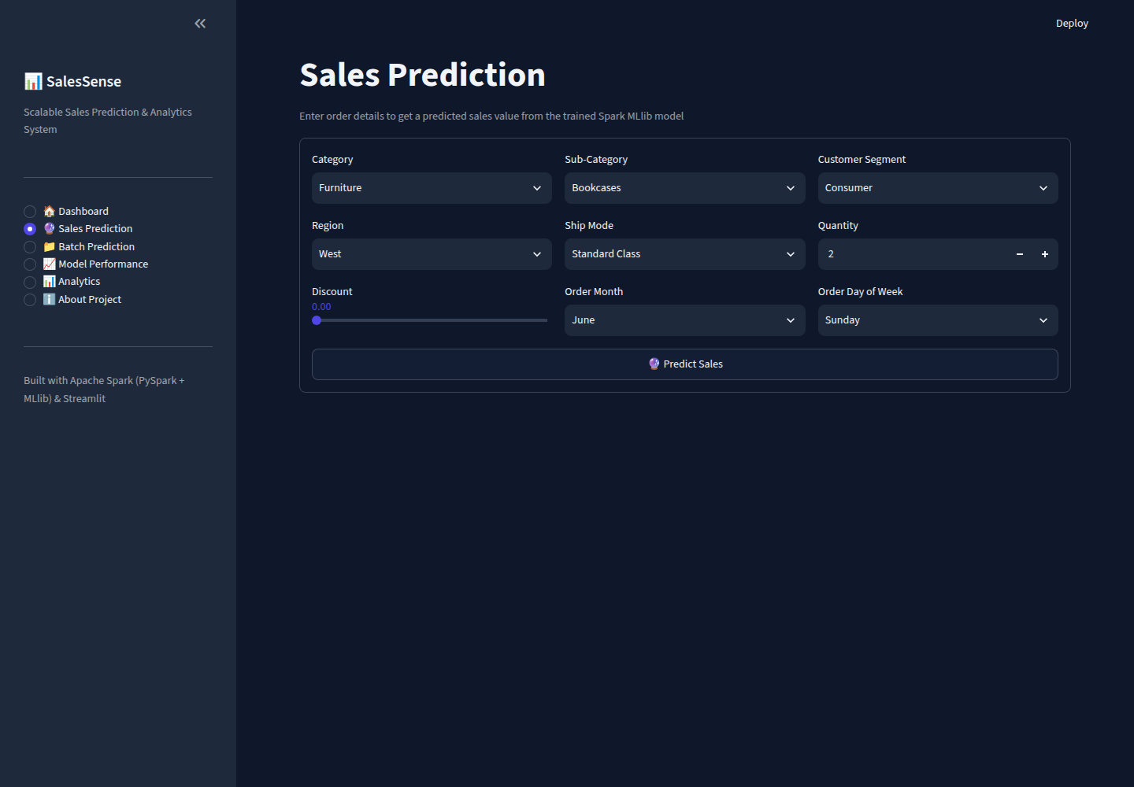
The Application
Six pages: Dashboard · Prediction · Batch Prediction · Model Performance · Analytics · About
Dashboard — live KPIs & trends
Sales Prediction — single-record form
SalesSense | 10

Slide 11
Results & Evaluation
Real metrics from an actual training run — 8,042 train / 1,952 test rows, seed = 42
536.33
227.99
0.292
RMSE
MAE
R²
Test performance (RMSE 536.33, R² 0.292) is close to — and slightly better than — training performance (RMSE 540.82, R² 0.238), showing the model is NOT overfitting. Its modest R² reflects the purely linear model applied to a heavily right-skewed Sales target (₹0.44 – ₹22,638), not a data or pipeline flaw.
Training completed in 7.11 seconds on local[*] Spark · Model verified: single & batch prediction tested with real inputs
SalesSense | 11

Slide 12
Conclusion & Future Scope
Conclusion
Future Scope
SalesSense delivers a complete, working pipeline — Spark-based cleaning, feature engineering, MLlib training/evaluation, and a polished Streamlit GUI — with every stage actually executed and verified, not assumed.
• Tree-based Spark MLlib models (Random Forest, GBT)
• Hyperparameter tuning via CrossValidator
• Log-transform the skewed Sales target
• Deploy on a real multi-node Spark cluster
Thank You
SalesSense | 12

