Slide 1

Lead Time Algorithm
Anush Kundu

Slide 2
Lead Time Dates
Demand Date (Need Date / Requirement Date): When the customer or consuming process needs the material available. This is the anchor everything else is calculated from.
Due Date: When the order must be complete or received to meet the demand. In MRP it is often the demand date minus safety lead time (a buffer).
Dock Date: When the goods arrive at your receiving dock. This is the date the supplier or upstream plant needs to deliver to.
Stock Date: When the material is received, inspected, put away, and available for use. Dock date plus dock-to-stock time.
Ship Date: When the supplier or origin plant actually ships. Dock date minus transit time.
Build Date (Production/Completion Date): When production finishes and goods are ready to ship.
Start Date (Release Date / Order Start): When the work order or purchase order must be released or begin, so that it completes on time. Due date minus the lead time.

Slide 3
Lead Time Elements
Pre-ship time: The time the supplier needs to get your order ready before it leaves their warehouse. They receive the PO, find or make the goods, pack them, and do the paperwork. Example: you place the order on Nov 12, and the box is ready to leave on Nov 17. Pre-ship is 5 days.
Transit time: The time the goods spend traveling, from the supplier’s door to yours, whether by truck, ship, or plane (including customs if it crosses a border). Example: the truck takes 10 days.
Dock-to-stock time: The time between the truck arriving at your gate and the goods being ready to sell or use. Staff have to unload, count, check for damage, and put the items on shelves. Example: the truck arrives, and it takes 1 day before the phones can be sold.
Safety lead time: A cushion of extra time you add on purpose. You plan for the goods to arrive earlier than you need them, so a late truck or a slow supplier doesn’t cause a problem. Example: you need the phones on Nov 30, but you plan to have them by Nov 28. The 2 days in between are your safety lead time.
Fixed lead time: The part of the wait that is the same whether you order 1 unit or 1,000. It covers things like machine setup, approvals, waiting in the queue, and transit. Example: a factory always needs 2 days to set up the machine, however many brackets you order.
Variable lead time: The part of the wait that grows with the quantity. More units means more production time. Example: the factory makes 100 brackets per day, so an order of 500 takes 5 days and an order of 100 takes 1 day.
Lead time adjust (offset): A manual correction to the normal lead time when you know conditions are different from usual. It can be an increase or a decrease. Example: the normal transit time is 10 days, but during the festival season trucks are slower, so you add 2 days.

Slide 4
Example: Diwali Stock of Smartphones
A Nagpur electronics retailer needs phones on shelves by Nov 30 for the festival sale. Supplier is in Delhi.
Nov 12
Nov 16
Nov 17
Nov 27
Nov 28
Nov 30
Start Date
Build Date
Ship Date
Dock Date
Due / Stock Date
Demand Date
Build time
4 days
Pack & ship prep
1 day
Transit
10 days
Dock-to-stock
1 day
Safety lead time
2 days
Total lead time = 4 + 1 + 10 + 1 + 2 = 18 days.

Slide 5
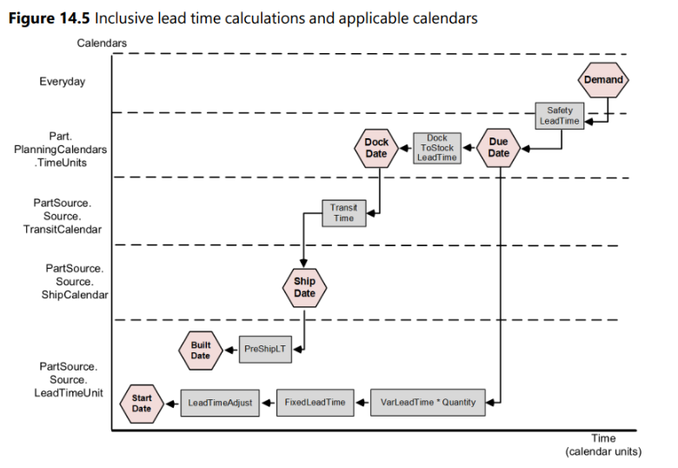
Inclusive Lead Time:

Slide 6
Effective Lead Time Calculation:
Transit Rule: Inclusive
How lead time works for supply chain for Inclusive Lead Time:
Type: Make/Buy
Demand Date: 10/16/2026 (10 Qtd)
Safety Time: 1
Due Date: 10/15/2026
Dock To Stock: 1
Dock Date: 10/15/2026
Transit Time: 1
Ship Date: 10/15/2026
Pre-Ship Time: 1
Build Date: 10/15/2026
Fixed Time: 1
Variable Time: 0.2*10 = 2
Lead Time Adjust: 1
Start Date: 10/11/2026
Lead Time Elements | Make | Buy | Transfer
Safety Lead Time | 1 | 1 | 1
Dock To Stock Time | 0 | 0 | 1
Transit Time | 0 | 0 | 1
Pre-Ship Lead Time | 0 | 0 | 1
Fixed Lead Time | 1 | 1 | 0
Lead Time Adjust | 1 | 1 | 0
Variable Lead Time | 1 | 1 | 0
Effective Lead Time | 4 | 4 | 4

Slide 7
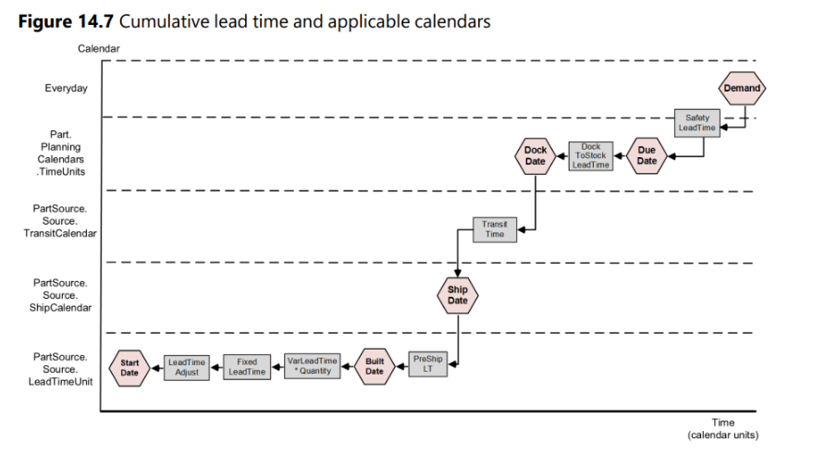
Cumulative lead time:

Slide 8
Effective Lead Time Calculation:
Transit Rule: Cumulative
How lead time works for supply chain for Cumulative Lead Time:
Type: Make/Buy
Demand Date: 10/16/2026 (10 Qtd)
Safety Time: 1
Due Date: 10/15/2026
Dock To Stock: 1
Dock Date: 10/14/2026
Transit Time: 1
Ship Date: 10/13/2026
Pre-Ship Time: 1
Build Date: 10/12/2026
Fixed Time: 1
Variable Time: 0.2*10 = 2
Lead Time Adjust: 1
Start Date: 10/08/2026
Lead Time Elements | Make | Buy | Transfer
Safety Lead Time | 1 | 1 | 1
Dock To Stock Time | 1 | 1 | 1
Transit Time | 1 | 1 | 1
Pre-Ship Lead Time | 1 | 1 | 1
Fixed Lead Time | 1 | 1 | 0
Lead Time Adjust | 1 | 1 | 0
Variable Lead Time | 1 | 1 | 0
Effective Lead Time | 7 | 7 | 4

Slide 9
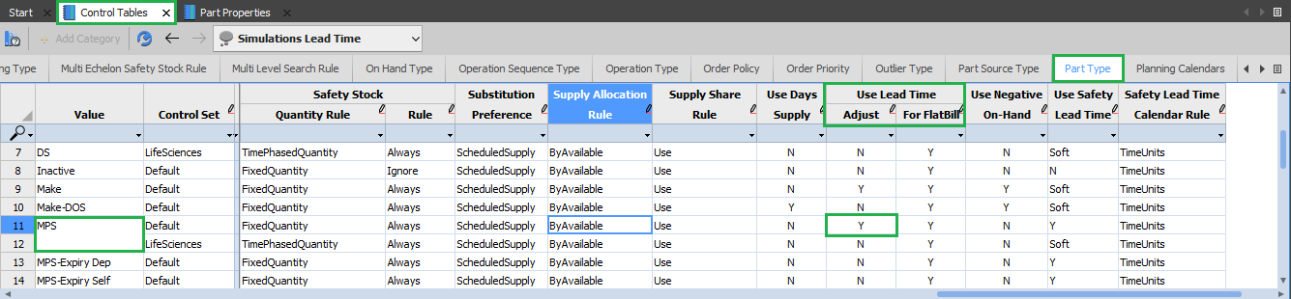
Lead Time Adjust:
Lead Time Adjust rule can be set from Control Table Workbook, Part Type Worksheet, and Use Lead Time Adjust Column.
Lead Time Adjust can be set as Y/N.
At Part Level we change for MPS/MRP values.

Slide 10
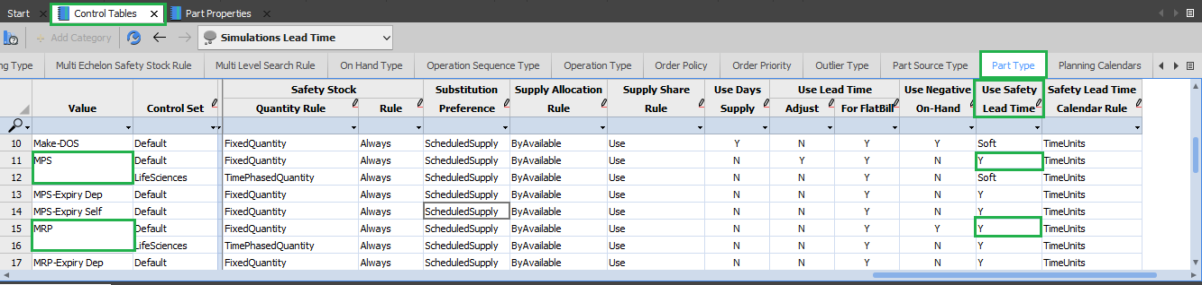
Safety Lead Time:
Safety Lead Time rule can be set from Control Table Workbook, Part Type Worksheet, and Use Safety Lead Time Column.
Safety Lead Time can be set as:
                Y
                N
                Soft
At Part Level we change for MPS/MRP values.

Slide 11
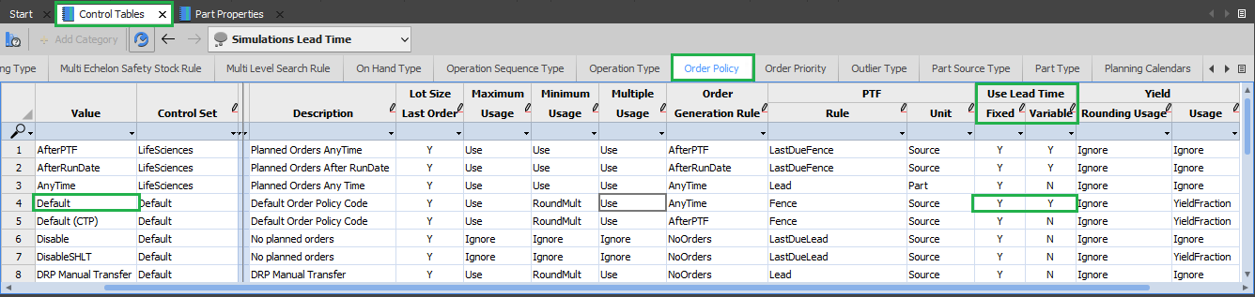
Lead Time (Fixed/Variable):
Lead Time rule can be set from Control Table Workbook, Order Policy Worksheet, and Use Lead Time Column.
Fixed and Variable rule can be set as:
                Y
                N
                Change the lead time values for Default type.

Slide 12
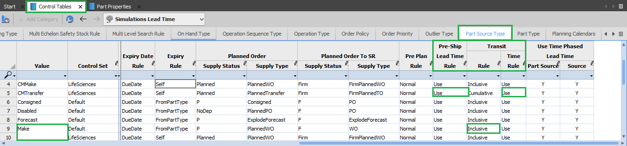
Transit and Pre-Ship:
Transit rule and Pre-Ship Lead Time rule can be set from Control Table Workbook, Part Source Type Worksheet, and Use Transit and Pre-Ship Lead Time Column.
Transit rule can be set as
Inclusive
Cumulative
Transit Time rule and Pre-Ship Time rule can be set as
    Use
    Ignore.
At Part Source Level we change for Make/Buy/Transfer values.

Slide 13
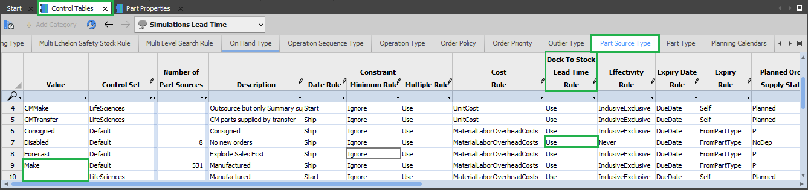
Dock To Stock:
Dock To Stock Lead Time rule can be set from Control Table Workbook, Part Source Type Worksheet, and Use Dock To Stock Lead Time Column.
Dock To Stock Lead Time rule can be set as
    Use
    Ignore.
At Part Source Level we change for Make/Buy/Transfer values.

Slide 14
Inclusive
Make

Slide 15
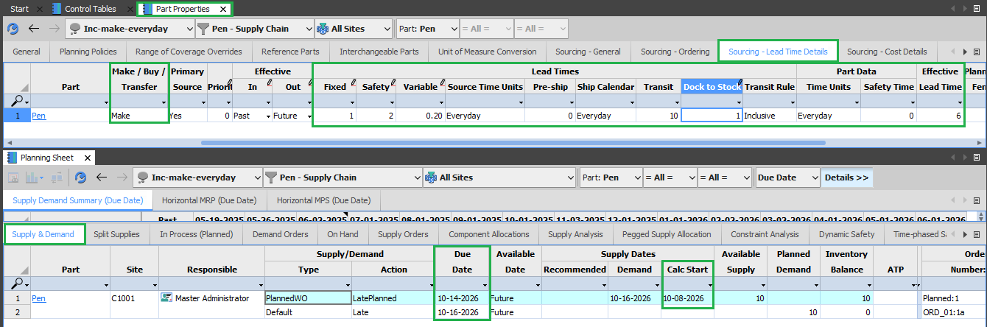
Simulation 1:
Transit Rule: Inclusive
Type: Make
Calendar: Everyday
Site: C1001
Demand Date | Due Date | Dock Date | Ship Date | Build Date | Start Date
Safety time (2) | Dock To Stock (1) | Transit Time (10) | Pre-Ship Time (0) | Fixed Time (1)
 |  |  |  | Lead Time Adjust (3)
 |  |  |  | Var*Qtd (0.2*10)
10/16/2026 | 10/14/2026 | 10/14/2026 | 10/14/2026 | 10/14/2026 | 10/08/2026

Slide 16
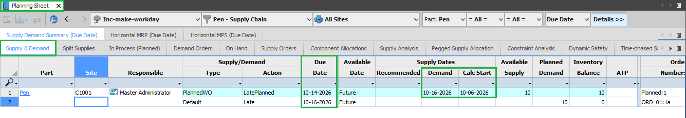
Simulation 2:
Transit Rule: Inclusive
Type: Make
Calendar: Workday
Site: C1001
Demand Date | Due Date | Dock Date | Ship Date | Build Date | Start Date
Safety time (2) | Dock To Stock (1) | Transit Time (10) | Pre-Ship Time (0) | Fixed Time (1)
 |  |  |  | Lead Time Adjust (3)
 |  |  |  | Var*Qtd (0.2*10)
10/16/2026 | 10/14/2026 | 10/14/2026 | 10/14/2026 | 10/14/2026 | 10/06/2026

Slide 17
Inclusive
Transfer

Slide 18
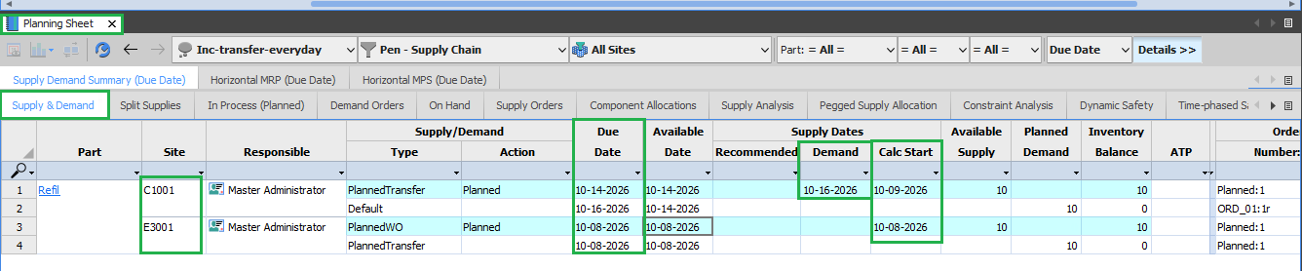
Simulation 3:
Transit Rule: Inclusive
Type: Transfer
Calendar: Everyday
Site: C1001
Demand Date | Due Date | Dock Date | Ship Date | Build Date | Start Date
Safety time (2) | Dock To Stock (1) | Transit Time (3) | Pre-Ship Time (2) | Fixed Time (1)
 |  |  |  | Lead Time Adjust (2)
 |  |  |  | Var*Qtd (0.2*10)
10/16/2026 | 10/14/2026 | 10/14/2026 | 10/14/2026 | 10/14/2026 | 10/09/2026

Slide 19
Simulation 3:
Transit Rule: Inclusive
Type: Transfer
Calendar: Everyday
Site: E3001
Demand Date | Due Date | Dock Date | Ship Date | Build Date | Start Date
Safety time (2) | Dock To Stock (1) | Transit Time (3) | Pre-Ship Time (2) | Fixed Time (1)
 |  |  |  | Lead Time Adjust (2)
 |  |  |  | Var*Qtd (0.2*10)
10/16/2026 | 10/14/2026 | 10/13/2026 | 10/10/2026 | 10/08/2026 | 10/08/2026

Slide 20
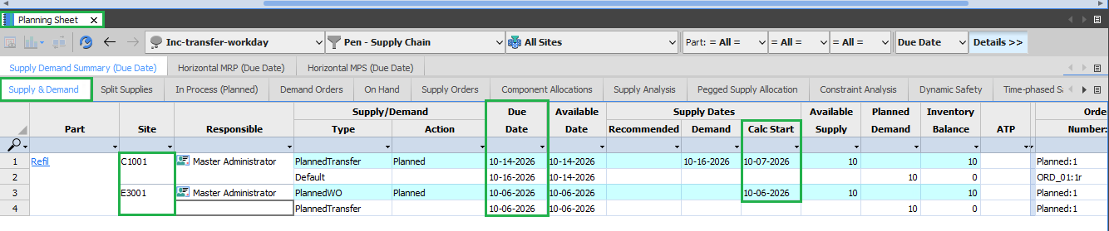
Simulation 4:
Transit Rule: Inclusive
Type: Transfer
Calendar: Workday
Site: C1001
Demand Date | Due Date | Dock Date | Ship Date | Build Date | Start Date
Safety time (2) | Dock To Stock (1) | Transit Time (3) | Pre-Ship Time (2) | Fixed Time (1)
 |  |  |  | Lead Time Adjust (2)
 |  |  |  | Var*Qtd (0.2*10)
10/16/2026 | 10/14/2026 | 10/14/2026 | 10/14/2026 | 10/07/2026 | 10/07/2026

Slide 21
Simulation 4:
Transit Rule: Inclusive
Type: Transfer
Calendar: Workday
Site: E3001
Demand Date | Due Date | Dock Date | Ship Date | Build Date | Start Date
Safety time (2) | Dock To Stock (1) | Transit Time (3) | Pre-Ship Time (2) | Fixed Time (1)
 |  |  |  | Lead Time Adjust (2)
 |  |  |  | Var*Qtd (0.2*10)
10/16/2026 | 10/14/2026 | 10/13/2026 | 10/08/2026 | 10/06/2026 | 10/06/2026

Slide 22
Cumulative
Make

Slide 23
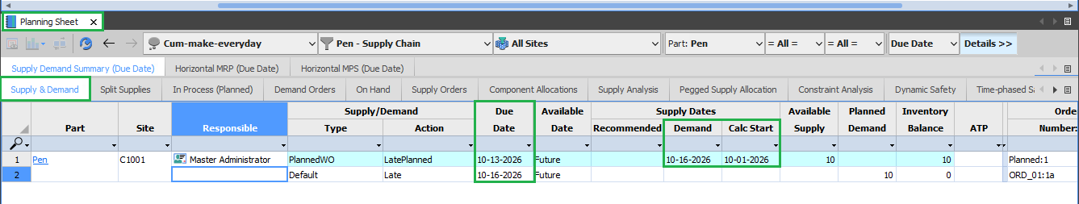
Simulation 5:
Transit Rule: Cumulative
Type: Make
Calendar: Everyday
Site: C1001
Demand Date | Due Date | Dock Date | Ship Date | Build Date | Start Date
Safety time (3) (Y) | Dock To Stock (2) (Y) | Transit Time (3) (Y) | Pre-Ship Time (1) (Y) | Fixed Time (2) (Y)
 |  |  |  | Lead Time Adjust (2) (Y)
 |  |  |  | Var*Qtd (0.2*10) (Y)
10/16/2026 | 10/13/2026 | 10/11/2026 | 10/08/2026 | 10/07/2026 | 10/01/2026

Slide 24
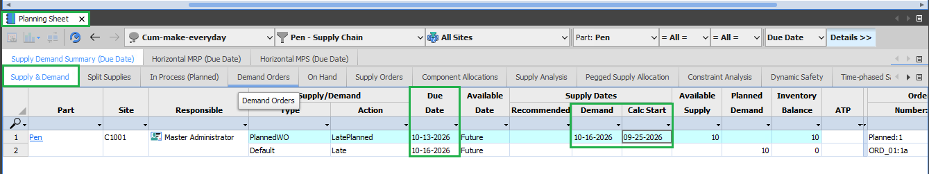
Simulation 6:
Transit Rule: Cumulative
Type: Make
Calendar: Workday
Site: C1001
Demand Date | Due Date | Dock Date | Ship Date | Build Date | Start Date
Safety time (3) (Y) | Dock To Stock (2) (Y) | Transit Time (3) (Y) | Pre-Ship Time (1) (Y) | Fixed Time (2) (Y)
 |  |  |  | Lead Time Adjust (2) (Y)
 |  |  |  | Var*Qtd (0.2*10) (Y)
10/16/2026 | 10/13/2026 | 10/09/2026 | 10/06/2026 | 10/05/2026 | 09/25/2026

Slide 25
Cumulative
Transfer

Slide 26
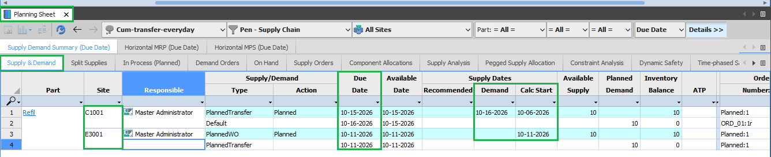
Simulation 7:
Transit Rule: Cumulative
Type: Transfer
Calendar: Everyday
Site: C1001
Demand Date | Due Date | Dock Date | Ship Date | Build Date | Start Date
Safety time (1) | Dock To Stock (1) | Transit Time (2) | Pre-Ship Time (1) | Fixed Time (1)
 |  |  |  | Lead Time Adjust (2)
 |  |  |  | Var*Qtd (0.2*10)
10/16/2026 | 10/15/2026 | 10/14/2026 | 10/12/2026 | 10/11/2026 | 10/06/2026

Slide 27
Simulation 7:
Transit Rule: Cumulative
Type: Transfer
Calendar: Everyday
Site: E3001
Demand Date | Due Date | Dock Date | Ship Date | Build Date | Start Date
Safety time (1) | Dock To Stock (1) | Transit Time (2) | Pre-Ship Time (1) | Fixed Time (1)
 |  |  |  | Lead Time Adjust (2)
 |  |  |  | Var*Qtd (0.2*10)
10/16/2026 | 10/15/2026 | 10/14/2026 | 10/12/2026 | 10/11/2026 | 10/11/2026

Slide 28
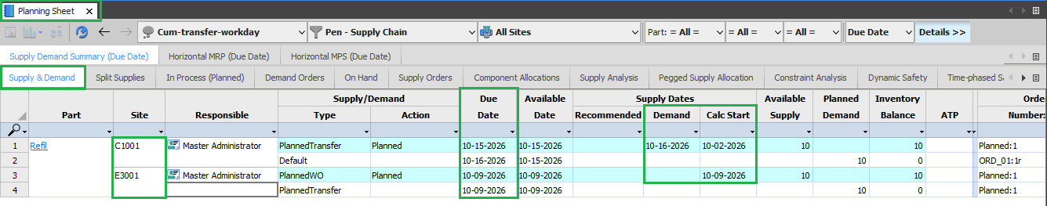
Simulation 8:
Transit Rule: Cumulative
Type: Transfer
Calendar: Workday
Site: C1001
Demand Date | Due Date | Dock Date | Ship Date | Build Date | Start Date
Safety time (1) | Dock To Stock (1) | Transit Time (2) | Pre-Ship Time (1) | Fixed Time (1)
 |  |  |  | Lead Time Adjust (2)
 |  |  |  | Var*Qtd (0.2*10)
10/16/2026 | 10/15/2026 | 10/14/2026 | 10/12/2026 | 10/11/2026 | 10/02/2026

Slide 29
Simulation 8:
Transit Rule: Cumulative
Type: Transfer
Calendar: Workday
Site: E3001
Demand Date | Due Date | Dock Date | Ship Date | Build Date | Start Date
Safety time (1) | Dock To Stock (1) | Transit Time (2) | Pre-Ship Time (1) | Fixed Time (1)
 |  |  |  | Lead Time Adjust (2)
 |  |  |  | Var*Qtd (0.2*10)
10/16/2026 | 10/15/2026 | 10/14/2026 | 10/12/2026 | 10/09/2026 | 10/09/2026

Slide 30
Time – Phased Lead Time
Lead time that changes with the calendar, instead of one fixed number all year.
What it is
Lead time values can change over time. You set them for specific date ranges, and they override the standard (default) value.
Where it is stored
Date-range records in the TimePhasedPartSourceLeadTime and TimePhasedSourceLeadTime tables. The defaults live in PartSource / Source.
EffectiveInDate
The start date of a time-phased lead time record. It stays valid until the next EffectiveInDate.
ParameterDate
Found on PlannedOrder and ScheduledReceipt. It usually equals the order's due date.
How it works
Compare ParameterDate with EffectiveInDate. The closest EffectiveInDate on or before ParameterDate applies.
Real-life example
A courier normally delivers in 10 days. In festival season (Oct 15 to Nov 15) trucks are slower, so it takes 14 days. Planning with one fixed number would make festival orders late.

Slide 31
How the Lookup Works:
Default transit lead time in PartSource = 8 days
Time-phased records
Which lead time applies?
Effective In Date | Transit Time
Oct 15 | 14 days
Nov 16 | 10 days
Dec 1 | -1 (negative)
Order due date | Record used | Result
Nov 5 | Oct 15 | 14 days
Nov 20 | Nov 16 | 10 days
Dec 5 | Dec 1 is -1, so previous (Nov 16) | 10 days
Oct 1 | None on or before, so default | 8 days
Negative value rule
A negative value means: use the previous (next earliest) record.
No earlier record?
Then the default value from the PartSource or Source table is used.

Slide 32
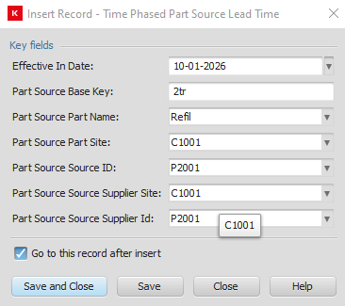
Time-Phased Lead Time: Cumulative Transit Rule (Type: Transfer)
Scenario
Destination site: C1001
Source site: E3001, where the part is made and supplied from
Transit rule: Cumulative
Type: Transfer
Setup steps
Create the TimePhasedPartSourceLeadTime and TimePhasedSourceLeadTime worksheet.
Insert a record for both the supplier site and the destination site.
Fill in these fields on each record for TimePhasedPartSourceLeadTime :
  Part basekey (the one used when creating the supply chain)
  Part Name
  SourceID
  Supplier Site
  Supplier ID
Add the lead time values to each record.
Use the records in the simulation.
Which lead times the simulation uses
Destination site C1001
All of its lead time values are considered during the simulation.
Based on them, the simulation gives us the start date.
Source site E3001
From C1001, only these values are considered: Safety, DTS (dock-to-stock), Transit and Pre-Ship.
Any lead times defined for E3001 itself are also considered.

Slide 33
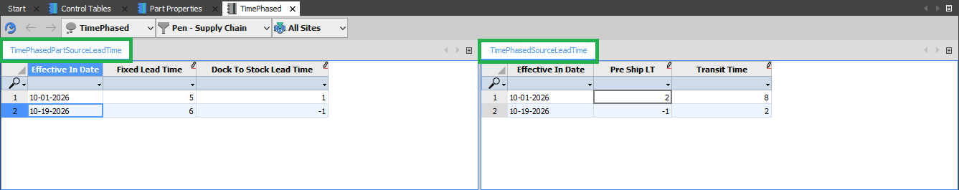
Time Phased Simulation 1:
Transit Rule = Inclusive
Demand Quantity = 10.
Part Source Type = Make
Original/ Destination Site = C1001
Demand Date | Due Date | Dock Date | Ship Date | Build Date | Start Date
Safety (1) | Dock To Stock (2) | Transit (2) | Pre-Ship (1) | Fixed (2), Var (2), LTA (2)
09/25/2026 | 09/24/2026 | 09/24/2026 | 09/24/2026 | 09/24/2026 | 09/18/2026
10/15/2026 | 10/14/2026 | 10/14/2026 | 10/14/2026 | 10/14/2026 LTA(1) | 10/05/2026
10/20/2026 | 10/19/2026 | 10/19/2026 | 10/19/2026 | 10/19/2026 LTA(1) | 10/09/2026

Slide 34
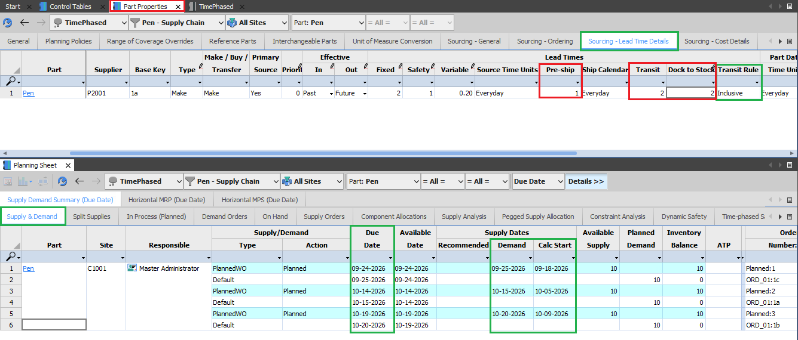

Slide 35
Time Phased Simulation 2:
Transit Rule = Cumulative
Demand Quantity = 10.
Part Source Type = Make
Original/ Destination Site = C1001
Demand Date | Due Date | Dock Date | Ship Date | Build Date | Start Date
Safety (1) | DTS (2) | Transit (2) | Pre-Ship (1) | Fixed (2), Var (2), LTA (2)
09/25/2026 | 09/24/2026 | 09/22/2026 | 09/20/2026 | 09/19/2026 | 09/13/2026
10/01/2026 | 09/30/2026 | 09/28/2026 | 09/26/2026 | 09/25/2026 | 09/19/2026
10/15/2026 | 10/14/2026 | 10/13/2026 | 10/05/2026 | 10/03/2026 | 09/24/2026
10/20/2026 | 10/19/2026 | 10/18/2026 | 10/16/2026 | 10/14/2026 | 10/04/2026

Slide 36
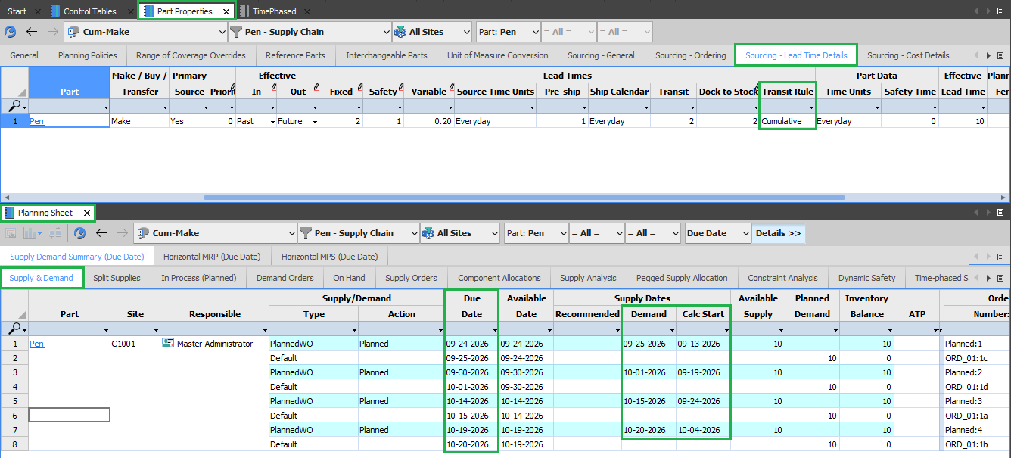

Slide 37
Time Phased Simulation 3:
Transit Rule = Cumulative
Demand Quantity = 10.
Part Source Type = Transfer
Original/ Destination Site = C1001
Supplier Site: E3001
All the values highlighted in red color are not considered/ used during calculations.
Dates | Elements | Values (C1001) | C1001 | Values (C1001 + E3001) | E3001
Demand Date |  |  | 10/15/2026 |  | 10/15/2026
Due Date | Safety | 1 | 10/14/2026 | 1 + 0 | 10/14/2026
Dock Date | Dock To Stock | 2 | 10/12/2026 | 2 + 1 | 10/11/2026
Ship Date | Transit Time | 2 | 10/10/2026 | 2 + 2 | 10/07/2026
Build Date | Pre-Ship | 1 | 10/09/2026 | 1 + 1 | 10/05/2026
 | LTA | 2 |  | 2 + 1
 | Fixed | 2 |  | 2 + 1
Start Date | Var*Qtd | 0.2*10 = 2 | 10/03/2026 | 2 + 0 | 10/03/2026

Slide 38
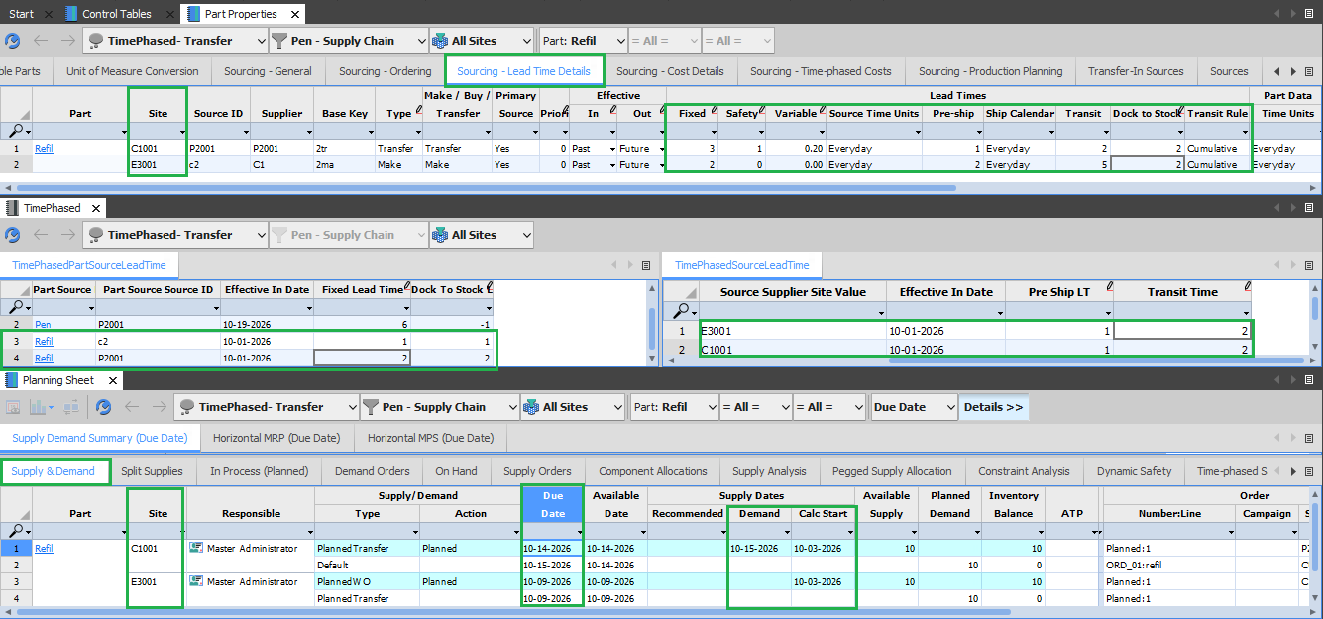

Slide 39
Time Phased Simulation 4:
Transit Rule = Inclusive
Demand Quantity = 10.
Part Source Type = Transfer
Original/ Destination Site = C1001
Supplier Site: E3001
All the values highlighted in red color are not considered/ used during calculations.
Dates | Elements | Values (C1001) | C1001 | Values (C1001 + E3001) | E3001
Demand Date |  |  | 10/15/2026 |  | 10/15/2026
Due Date | Safety | 1 | 10/14/2026 | 1 + 0 | 10/14/2026
Dock Date | Dock To Stock | 2 | 10/14/2026 | 2 + 1 | 10/12/2026
Ship Date | Transit Time | 2 | 10/14/2026 | 2 + 2 | 10/10/2026
Build Date | Pre-Ship | 1 | 10/04/2026 | 1 + 1 | 10/09/2026
 | LTA | 2 |  | 2 + 1
 | Fixed | 2 |  | 2 + 1
Start Date | Var*Qtd | 0.2*10 = 2 | 10/08/2026 | 2 + 0 | 10/07/2026

Slide 40
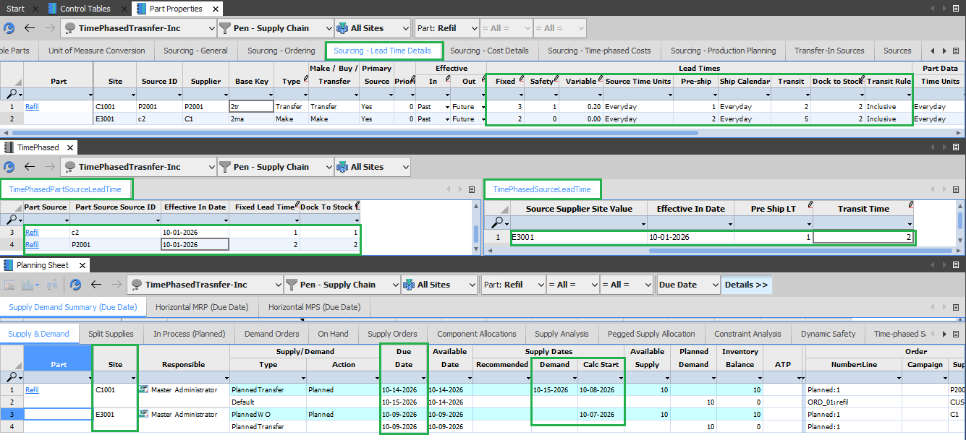

Slide 41
Lead Time Rounding:
When a lead time value contains a fractional portion, the effective number of intervals to use in
lead time calculations is determined by rounding as follows:
If the fractional portion is less than .001, the fractional portion is ignored.
Otherwise, if the fractional portion is greater than .001, round up to the next integer.
Assuming an order for 2001 units, the number of days lead time required to build the order is calculated as:
(FixedLeadTime + (quantity * VarLeadTime))
(10 + (2001 * .0005))
(10 + 1.0005)
11.0005 which by rule is rounded down to 11.

Slide 42
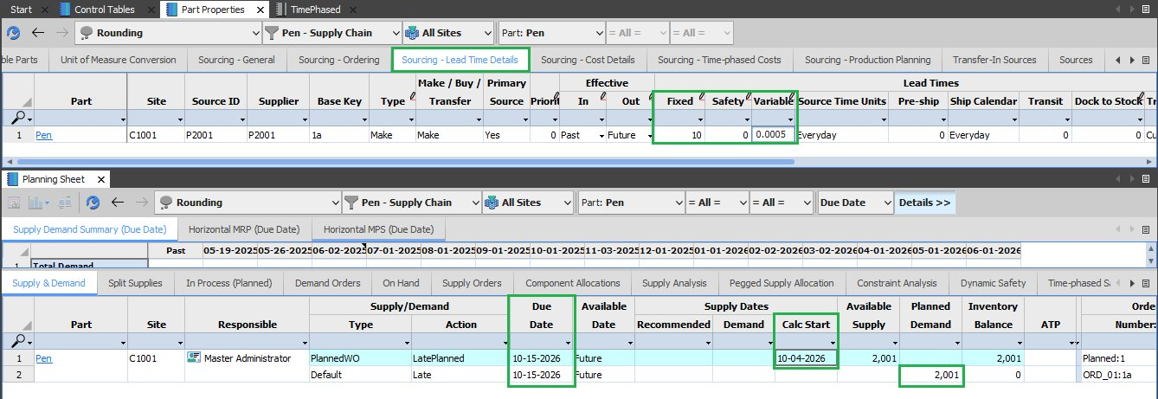

Slide 43
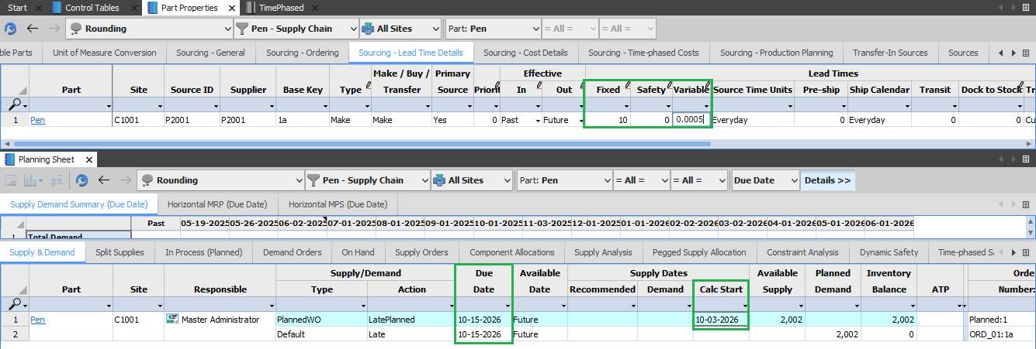
(FixedLeadTime + (quantity * VarLeadTime)) ​
(10 + (2002 * .0005)) ​
(10 + 1.001) ​
11.001 which by rule is rounded down to 12.​

Slide 44
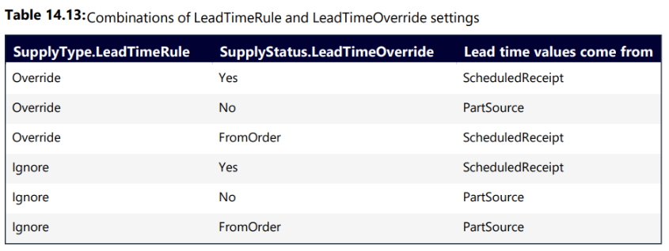
Lead time overrides from scheduled receipts
If necessary, various values stored on the Source and PartSource table used in lead time calculations can be overridden with values stored on a ScheduledReceipt record.

Slide 45
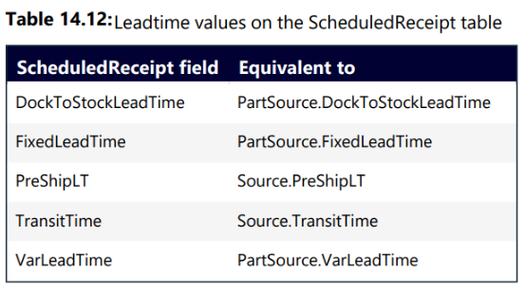
Lead time overrides from scheduled receipts
To use Scheduled Receipt Fields, create a copy of planning sheet and in the private workbook, inside the Supply Order worksheet.
Add additional columns from the table 14.12. Inside a private scenario we can add values to the Scheduled Receipt Fields and see how calculations works.

Slide 46
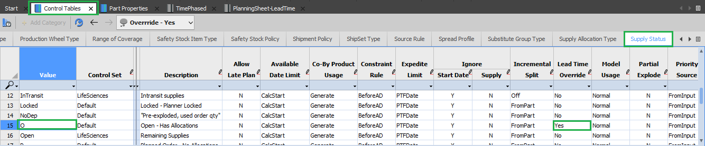
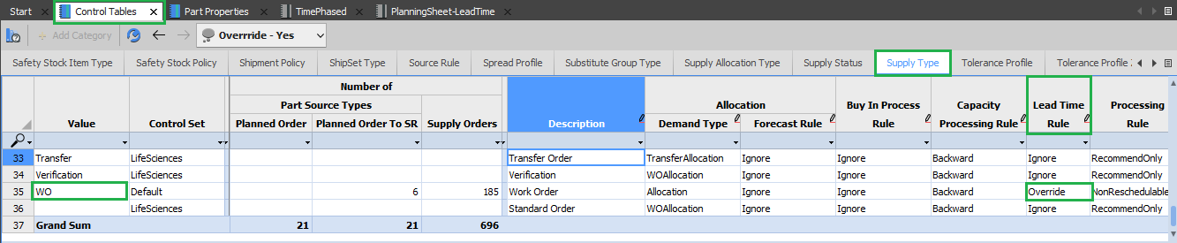
SupplyStatus.LeadTimeOverride
SupplyType.LeadTimeRule

Slide 47
Lead Time Override Simulation 1:
SupplyType.LeadTimeRule = Override/Ignore
SupplyStatus.LeadTimeOverride = Yes
Transit Rule = Cumulative
Scheduled Receipt for Qtd (2).
Lead Time Value come from Scheduled Receipt Table. All the Lead time elements are involved in Calculations.
Demand Date | Due Date | Dock Date | Ship Date | Build Date | Start Date
Safety Time (1) | Dock To Stock (2) | Transit Time (3) | Pre-Ship Time (1) | Lead Time Adjust (1)
 |  |  |  | Fixed (2)
 |  |  |  | Variable (1*2)
 | 10/13/2026 | 10/11/2026 | 10/08/11 | 10/07/2026 | 10/02/2026

Slide 48
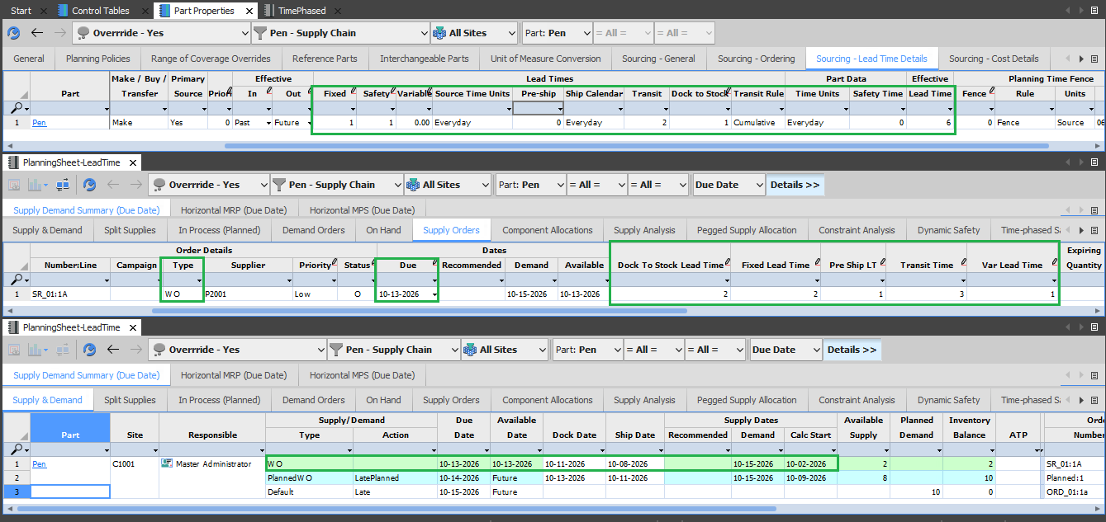

Slide 49
Lead Time Override Simulation 2:
SupplyType.LeadTimeRule = Ignore
SupplyStatus.LeadTimeOverride = FromOrder
Transit Rule = Cumulative
Scheduled Receipt for Qtd (2).
Lead Time Value come from Part Source Table. All the Lead time elements are involved in Calculations.
Demand Date | Due Date | Dock Date | Ship Date | Build Date | Start Date
Safety Time (1) | Dock To Stock (1) | Transit Time (2) | Pre-Ship Time (0) | Lead Time Adjust (1)
 |  |  |  | Fixed (1)
 |  |  |  | Variable (0*2)
 | 10/13/2026 | 10/12/2026 | 10/10/2026 | 10/10/2026 | 10/08/2026

Slide 50
Lead Time Override Simulation 3:
SupplyType.LeadTimeRule = Override
SupplyStatus.LeadTimeOverride = FromOrder
Transit Rule = Cumulative
Scheduled Receipt for Qtd (2).
Lead Time Value come from Scheduled Receipt Table. All the Lead time elements are involved in Calculations.
Demand Date | Due Date | Dock Date | Ship Date | Build Date | Start Date
Safety Time (1) | Dock To Stock (2) | Transit Time (3) | Pre-Ship Time (1) | Lead Time Adjust (1)
 |  |  |  | Fixed (2)
 |  |  |  | Variable (1*2)
 | 10/13/2026 | 10/11/2026 | 10/08/11 | 10/07/2026 | 10/02/2026

Slide 51
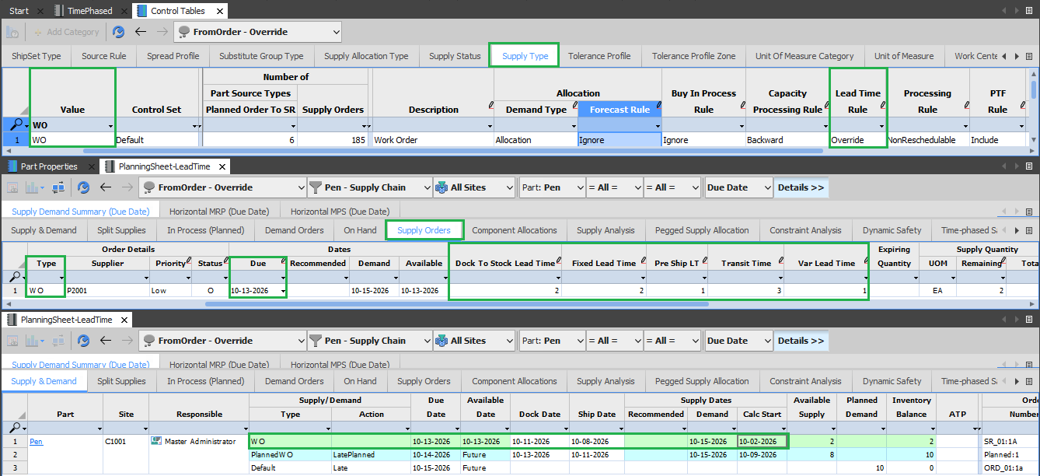

Slide 52
Lead Time Override Simulation 4:
SupplyType.LeadTimeRule = Override
SupplyStatus.LeadTimeOverride = FromOrder
Transit Rule = Inclusive
Scheduled Receipt for Qtd (2).
Lead Time Value come from Scheduled Receipt Table, without considering lead time elements DTS, Transit and Pre-Ship Time into calculations.
Demand Date | Due Date | Dock Date | Ship Date | Build Date | Start Date
Safety Time (1) | Dock To Stock (2) | Transit Time (3) | Pre-Ship Time (1) | Lead Time Adjust (1)
 |  |  |  | Fixed (2)
 |  |  |  | Variable (1*2)
 | 10/13/2026 | 10/13/2026 | 10/13/11 | 10/13/2026 | 10/08/2026

Slide 53
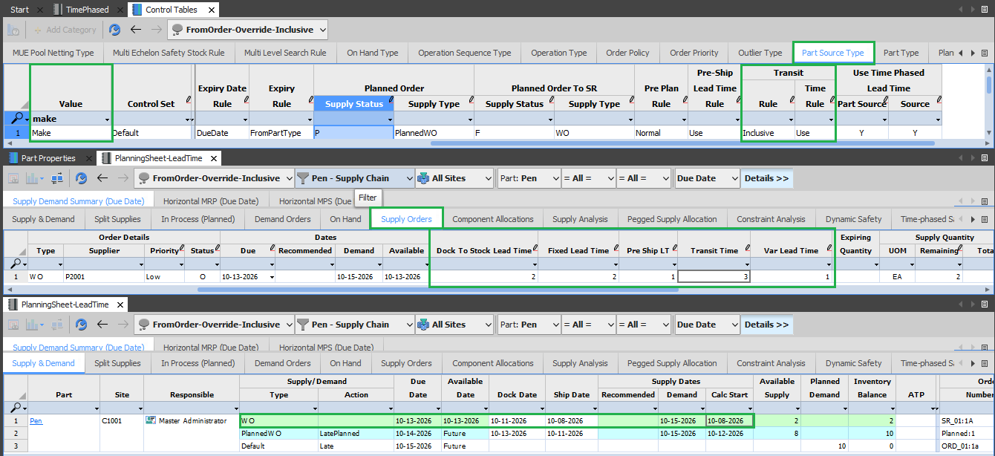

Slide 54
Lead Time Override Simulation 5:
SupplyType.LeadTimeRule = Ignore
SupplyStatus.LeadTimeOverride = FromOrder
Transit Rule = Inclusive
Scheduled Receipt for Qtd (2).
Lead Time Value come from Part Source Table, without considering lead time elements DTS, Transit and Pre-Ship Time into calculations.
Demand Date | Due Date | Dock Date | Ship Date | Build Date | Start Date
Safety Time (1) | Dock To Stock (1) | Transit Time (2) | Pre-Ship Time (0) | Lead Time Adjust (1)
 |  |  |  | Fixed (1)
 |  |  |  | Variable (0*2)
 | 10/13/2026 | 10/13/2026 | 10/13/2026 | 10/13/2026 | 10/11/2026

Slide 55
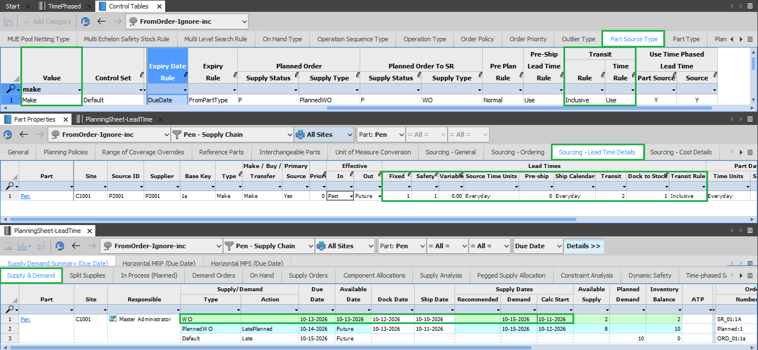

Slide 56
Lead Time Override Simulation 6:
SupplyType.LeadTimeRule = Override/Ignore
SupplyStatus.LeadTimeOverride = Yes
Transit Rule = Inclusive
Scheduled Receipt for Qtd (2).
Lead Time Value come from Scheduled Receipt Table, without considering lead time elements DTS, Transit and Pre-Ship Time into calculations.
Demand Date | Due Date | Dock Date | Ship Date | Build Date | Start Date
Safety Time (1) | Dock To Stock (2) | Transit Time (3) | Pre-Ship Time (1) | Lead Time Adjust (1)
 |  |  |  | Fixed (2)
 |  |  |  | Variable (1*2)
 | 10/13/2026 | 10/13/2026 | 10/13/11 | 10/13/2026 | 10/08/2026

Slide 57
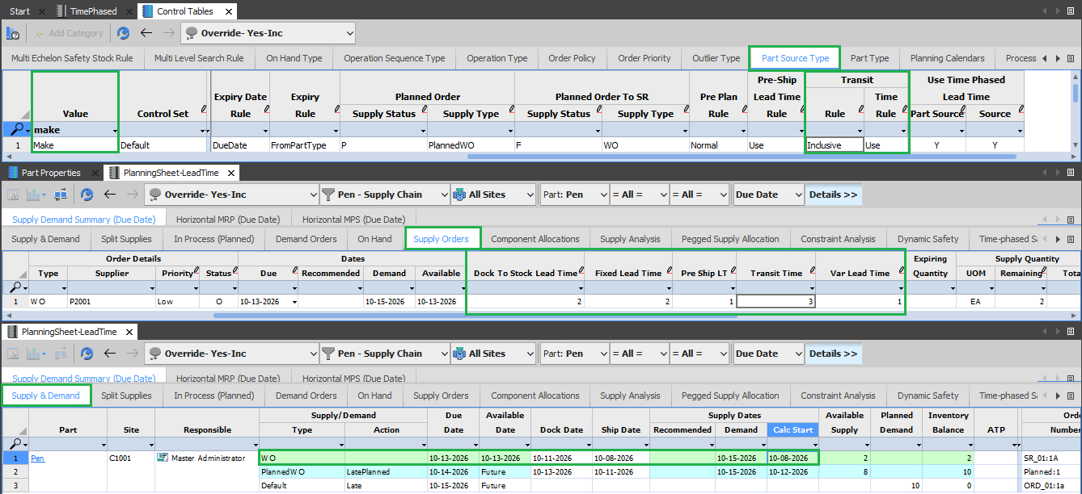

Slide 58
Lead Time Override Simulation 7:
SupplyType.LeadTimeRule = Ignore/Override
SupplyStatus.LeadTimeOverride = No
Transit Rule = Cumulative
Scheduled Receipt for Qtd (2).
Lead Time Value come from Part Source Table. All the Lead time elements are involved in Calculations.
Demand Date | Due Date | Dock Date | Ship Date | Build Date | Start Date
Safety Time (1) | Dock To Stock (1) | Transit Time (2) | Pre-Ship Time (0) | Lead Time Adjust (1)
 |  |  |  | Fixed (1)
 |  |  |  | Variable (0*2)
 | 10/13/2026 | 10/12/2026 | 10/10/2026 | 10/10/2026 | 10/08/2026

Slide 59
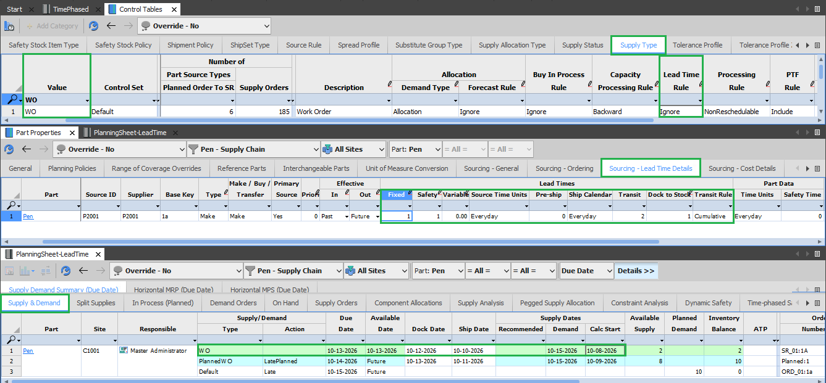

Slide 60
Lead Time Override Simulation 8:
SupplyType.LeadTimeRule = Ignore/Override
SupplyStatus.LeadTimeOverride = No
Transit Rule = Inclusive
Scheduled Receipt for Qtd (2).
Lead Time Value come from Part Source Table, without considering lead time elements DTS, Transit and Pre-Ship Time into calculations.
Demand Date | Due Date | Dock Date | Ship Date | Build Date | Start Date
Safety Time (1) | Dock To Stock (1) | Transit Time (2) | Pre-Ship Time (0) | Lead Time Adjust (1)
 |  |  |  | Fixed (1)
 |  |  |  | Variable (0*2)
 | 10/13/2026 | 10/13/2026 | 10/13/2026 | 10/13/2026 | 10/11/2026

Slide 61
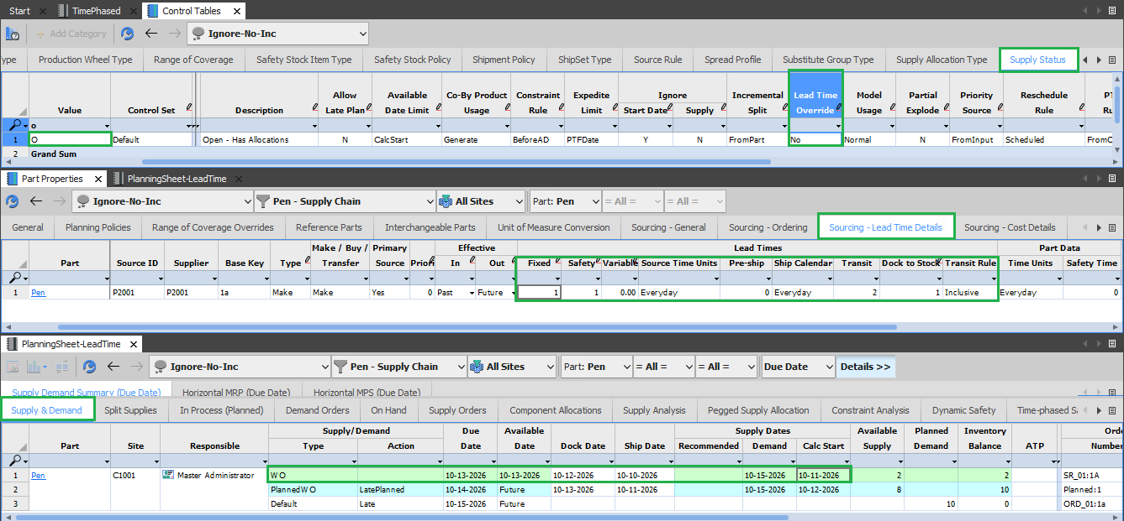

Slide 62
Thank You

