Slide 1
Mortality and Fertility in Orange County, CA
Anushna Prakash

Slide 2
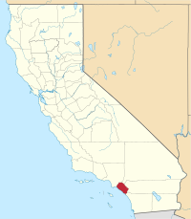
Background & Motivation
Orange County, California
Population of almost 3.2M
Sixth most-populous county in the US
Home to Anaheim, Santa Ana, and Irvine
How did COVID-19 affect mortality?
Did overall non-COVID-related deaths increase or decrease during the pandemic?
Did overall number of accident-related deaths increase or decrease during the pandemic?
Did overall suicides increase or decrease during the pandemic?
How did COVID-19 affect fertility?
Did the number of births increase or decrease during the pandemic?

Slide 3
Data
Johns Hopkins COVID-19 deaths
Daily COVID-19 deaths by county
Mortality
California Health & Human Services Data
Monthly deaths by county and cause, from 1960-2021
Includes causes such as: Overall, accidents, suicide, assault, and several disease-related categories (Alzheimer’s, diabetes, heart disease, pneumonia & influenza)
Includes figures based on demographics (gender, race, age, etc.), which was not used due to granularity of COVID-19 data.
Fertility
California Health & Human Services Data
Monthly deaths by county and cause, from 1960-2021
Includes figures based on demographics (race, age, etc.) and location (hospital, free-standing clinic, home, etc.) which was not used.

Slide 4
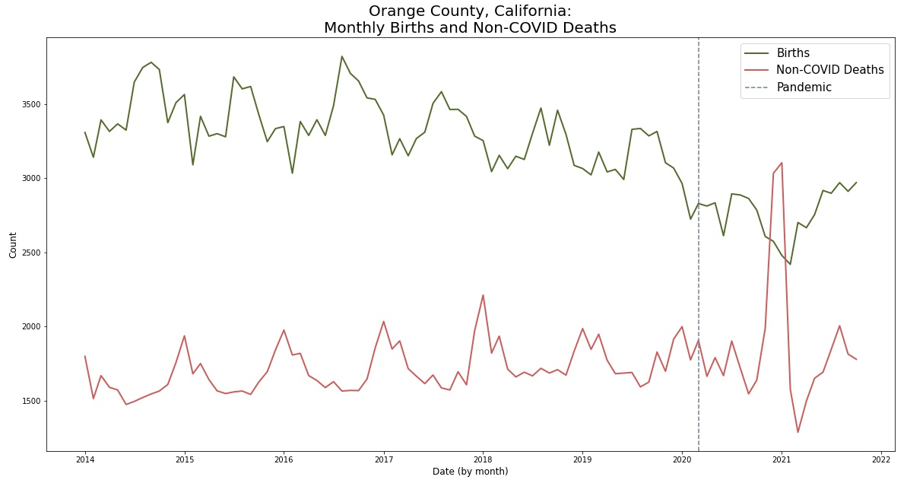
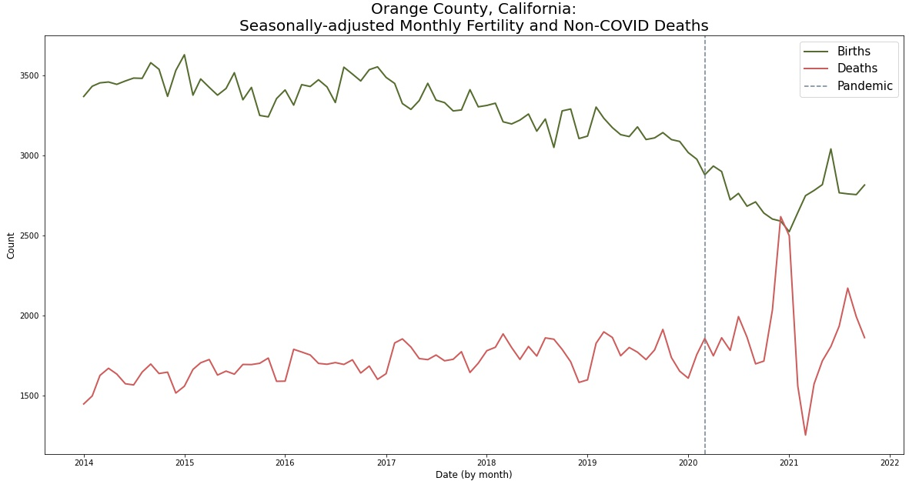
Data Preparation: Seasonal adjustment
Top graph is raw births and non-COVID deaths.
Births tend to be highest in late summer/early autumn
Deaths tend to be highest in the winter months January and December
Bottom graph is seasonally-adjusted births and non-COVID deaths.
Births do seem to be trending lower pre-pandemic, and are noticeably lower during.
Deaths do not have a noticeable trend, but do become much more volatile.
*Data is from Jan 2014 – October 2021.

Slide 5
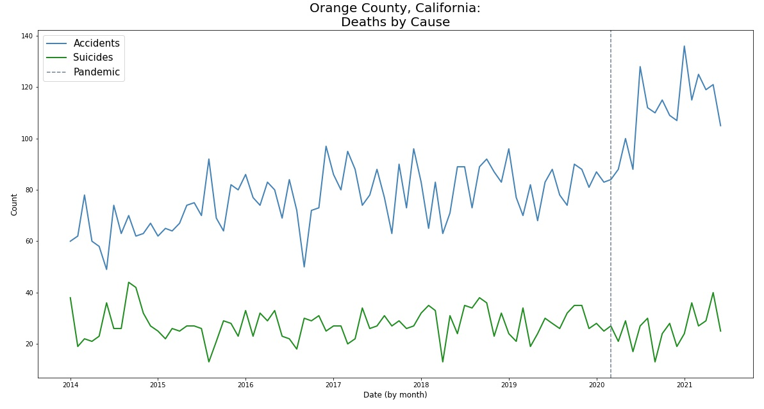
Mortality: Accidents & Suicide Trend
Accidents and suicides did not have a seasonal component.
There does seem to be an increase in the number of accidents after the pandemic.
There does not seem to be a change in the number of suicides after the pandemic.

