Slide 1
Mortality and Fertility in Orange County, CA
Anushna Prakash

Slide 2
Questions
How did COVID-19 affect mortality?
Overall deaths?
Accident-related deaths?
Suicide-related deaths?
How did COVID-19 affect fertility?

Slide 3

Motivation
Lockdowns, lifestyle changes reduced the need and ability to be in potentially dangerous situations.
What happened to the total non-COVID-related deaths?
Did the pandemic help?
What about the mental health crisis?

Slide 4

Motivation (cont.)
People may have changed their family planning strategies, perhaps due to lack of confidence in the future, or perhaps greater work flexibility sped up plans.

Slide 5
Data
Johns Hopkins COVID-19 deaths
Daily COVID-19 deaths by county
Mortality
California Health & Human Services Data
Monthly deaths by county and cause, from 1960-2021
Includes causes such as: Overall, accidents, suicide, assault, and several disease-related categories (Alzheimer’s, diabetes, heart disease, pneumonia & influenza)
Fertility
California Health & Human Services Data
Monthly births by county, from 1960-2021

Slide 6
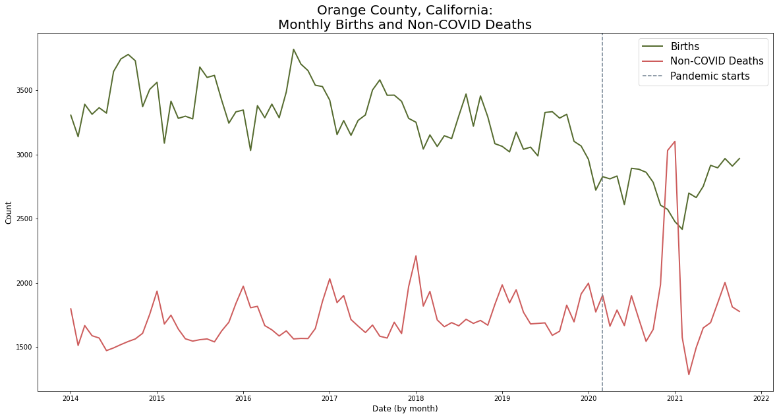

Slide 7
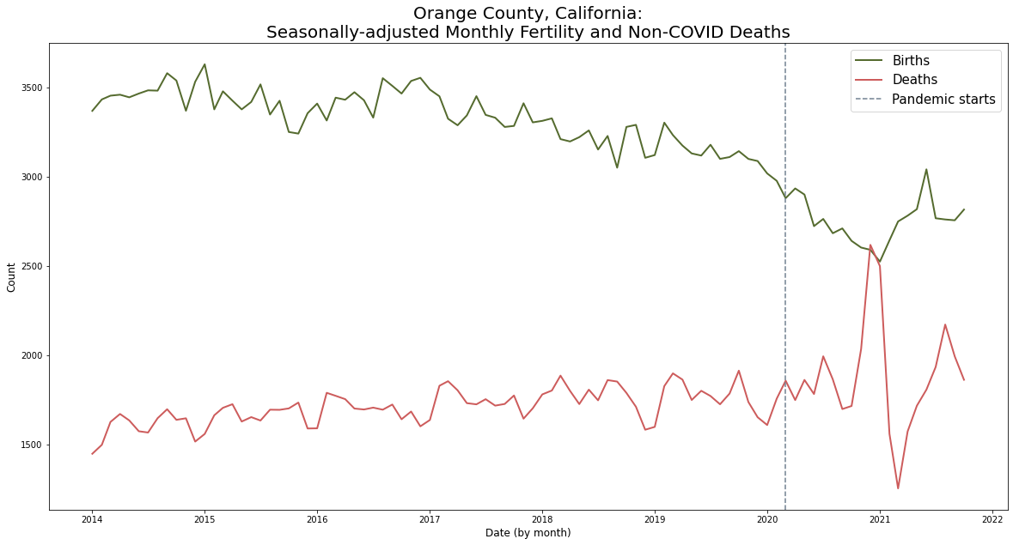

Slide 8
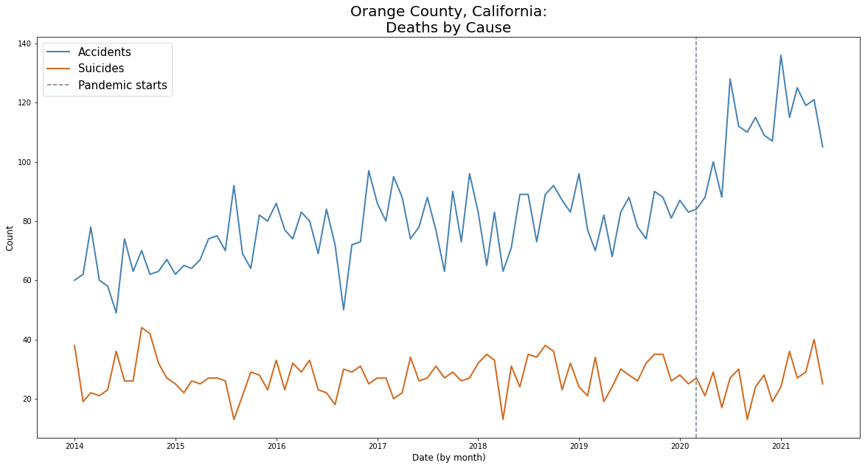

Slide 9
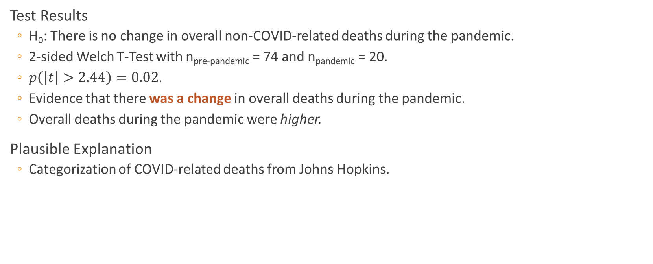
Result 1: Overall Deaths Increased
Test Results
H₀: There is no change in overall non-COVID-related deaths during the pandemic.
2-sided Welch T-Test with n_{pre-pandemic} = 74 and n_{pandemic} = 20.
$p\left(\left|t\right|>2.44\right)=0.02$.
Evidence that there was a change in overall deaths during the pandemic.
Overall deaths during the pandemic were higher.
Plausible Explanation
Categorization of COVID-related deaths from Johns Hopkins.

Slide 10
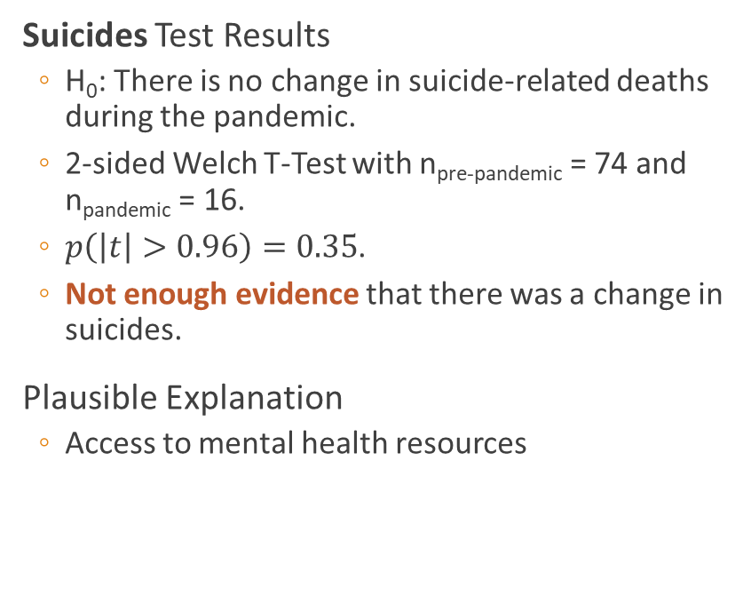
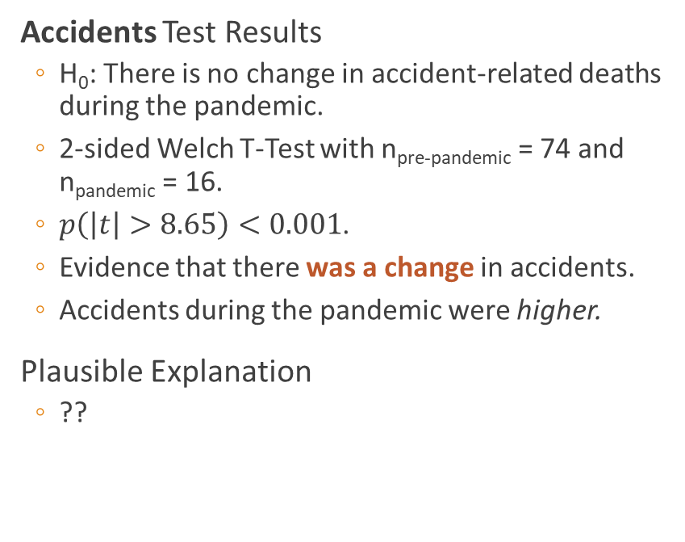
Results 2 & 3: Overall Accidents Increased And Suicides Did Not Change
Accidents Test Results
H₀: There is no change in accident-related deaths during the pandemic.
2-sided Welch T-Test with n_{pre-pandemic} = 74 and n_{pandemic} = 16.
$p\left(\left|t\right|>8.65\right)<0.001$.
Evidence that there was a change in accidents.
Accidents during the pandemic were higher.
Plausible Explanation
??
Suicides Test Results
H₀: There is no change in suicide-related deaths during the pandemic.
2-sided Welch T-Test with n_{pre-pandemic} = 74 and n_{pandemic} = 16.
$p\left(\left|t\right|>0.96\right)=0.35$.
Not enough evidence that there was a change in suicides.
Plausible Explanation
Access to mental health resources

Slide 11
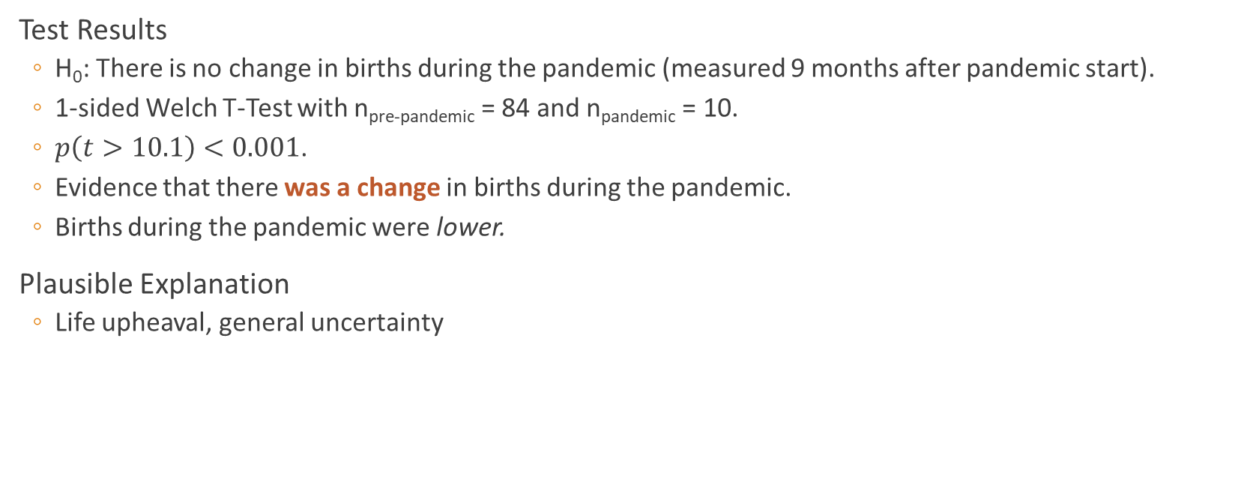
Result 4: Overall Births Decreased
Test Results
H₀: There is no change in births during the pandemic (measured 9 months after pandemic start).
1-sided Welch T-Test with n_{pre-pandemic} = 84 and n_{pandemic} = 10.
$p\left(t>10.1\right)<0.001$.
Evidence that there was a change in births during the pandemic.
Births during the pandemic were lower.
Plausible Explanation
Life upheaval, general uncertainty

Slide 12
Conclusion
Health was affected in many ways
Behaviors may be changing – why are accidents up?
Mental health crisis is real. Comparison of Orange County to other counties where suicides were up may provide insights.
Data consistency & documentation.
Matching granularity.
Drawing conclusions from developing situations.

