Slide 1
PARALLEL & GPU COMPUTING • LAB EVALUATION
Parallel Sum &
Average of Dataset
using OpenMP
CPU parallelism • Shared-memory threads • Performance benchmarking
A practical comparison of sequential and parallel sum/average calculations across dataset sizes and thread counts.
Anupriya Savant
01FE24BCI046
Anushree Angadi
01FE24BCI050
Sahana Awaradi
01FE24BCI030
Pavitra Jalibenchi
01FE24BCI049
01

Slide 2
CHECKPOINT 1
Problem Definition, Algorithm & Parallel Design
From a simple O(N) loop to shared-memory parallel sum and average.
01 • PROBLEM & SEQUENTIAL ALGORITHM
02 • PARALLEL DESIGN
Compute the sum and average of a generated dataset D = [1, 2, …, N].
Each array element contributes independently to the total sum.
#pragma omp parallel for reduction(+:par_sum)
data[i] = i + 1 for i = 0 … N−1
sum = 0
for i = 0 … N−1:
sum = sum + data[i]
average = sum / N
OpenMP distributes loop iterations; reduction combines partial sums safely.
Dataset
›
Threads
›
Reduction
›
Average
1 … N
partial sums
combine
sum / N
SUM
AVERAGE
Threads write to private reduction accumulators; OpenMP combines them at the end.
N(N + 1) / 2
(N + 1) / 2
The same input and formula are used for sequential and parallel runs.
Complexity: O(N) time • O(N) storage
KEY IDEA • Independent iterations → parallelizable work
KLE TECHNOLOGICAL UNIVERSITY • COMPUTER SCIENCE (AI)
OPENMP • SUM / AVERAGE
02

Slide 3
CHECKPOINT 2
Parallel Implementation & Environment
The calculation stays the same; OpenMP controls how the loop is executed.
CORE IMPLEMENTATION
BUILD & RUN
Sequential baseline
Compile
long long seq_sum = 0;
for (long long i = 0; i < N; i++)
seq_sum += data[i];
gcc -O2 -fopenmp sum_average.c -o sum_average
Run
OpenMP parallel sum
./sum_average
long long par_sum = 0;
omp_set_num_threads(threads);
#pragma omp parallel for reduction(+:par_sum)
for (long long i = 0; i < N; i++)
par_sum += data[i];
double average = (double)par_sum / N;
TEST ENVIRONMENT
Ubuntu running under VMware
GCC compiler with OpenMP enabled by -fopenmp
Python 3 + Matplotlib for plotting the recorded results
Reduction safely combines thread-local partial sums.
Dataset sizes: 100K • 1M • 10M
KLE TECHNOLOGICAL UNIVERSITY • COMPUTER SCIENCE (AI)
OPENMP • SUM / AVERAGE
03

Slide 4
CHECKPOINT 3
04 / 08
Experimental Setup & Results
3 dataset sizes × 6 thread counts, plus one sequential baseline per dataset.
DATASET SIZES
THREAD COUNTS
CORRECTNESS CHECK
100,000 • 1,000,000 • 10,000,000
1 • 2 • 4 • 8 • 16 • 32
Sum and average matched expected values
Execution time (seconds): sequential baseline vs. OpenMP thread count
Dataset
T seq
1 thread
2 threads
4 threads
8 threads
16 threads
32 threads
100K
0.000086
0.000095
0.000470
0.002205
0.001852
0.000628
0.002468
1M
0.001584
0.001218
0.002829
0.003832
0.001441
0.000858
0.001614
10M
0.006908
0.007549
0.004033
0.002608
0.003126
0.003807
0.004357
Speedup = Tseq / Tparallel
Efficiency (%) = (Speedup / threads) × 100
BEST OBSERVED: 10M elements • 4 threads • 0.002608 s parallel vs 0.006908 s sequential • 2.6485× speedup
KLE TECHNOLOGICAL UNIVERSITY • COMPUTER SCIENCE (AI)
OPENMP • SUM / AVERAGE
04

Slide 5
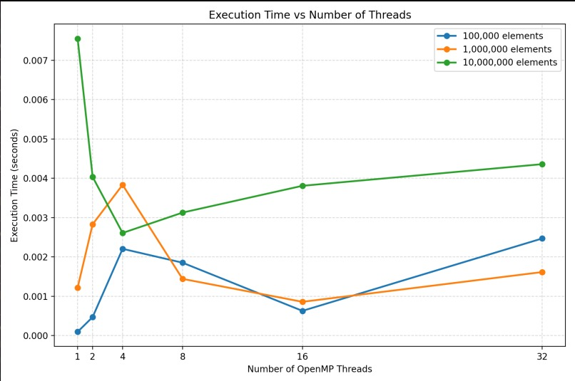
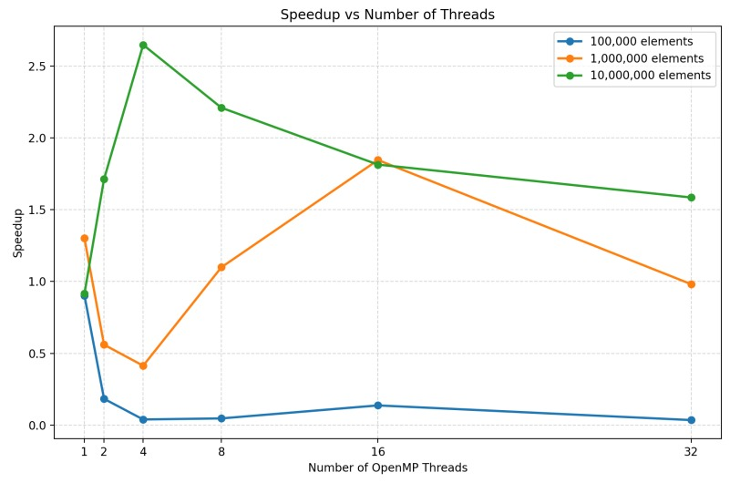
CHECKPOINT 4
Graphs: Execution Time & Speedup
Measured execution time is not monotonic: overhead and available CPU resources affect scaling.
EXECUTION TIME
SPEEDUP
For 10M elements, 4 threads gave the lowest measured OpenMP time: 0.002608 s.
Maximum observed speedup: 2.6485× at 10M elements with 4 threads.
KLE TECHNOLOGICAL UNIVERSITY • COMPUTER SCIENCE (AI)
OPENMP • SUM / AVERAGE
05

Slide 6
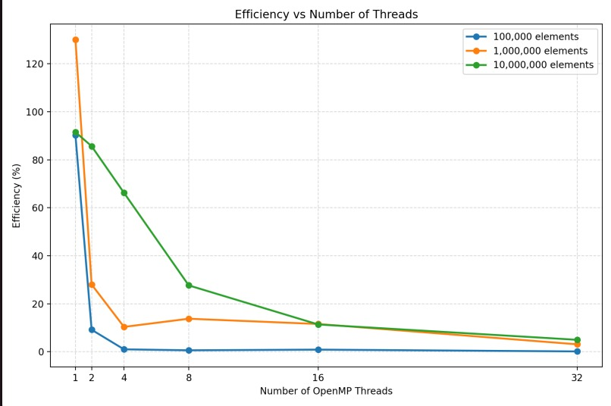
CHECKPOINT 4
Efficiency Analysis
Efficiency indicates how effectively the parallel run uses the selected thread count.
BEST OBSERVED RUN
2.65×
speedup
10M elements • 4 threads • 66.21% efficiency
HOW TO INTERPRET THE GRAPH
Small workloads pay proportionally more thread-management overhead.
For 10M, performance improved up to 4 threads, then declined in this run.
1M / 1-thread efficiency exceeds 100% because the single measured OpenMP time was below its sequential baseline.
Single-run timings → repeat 3–5 times and average
Efficiency (%) = (Speedup / thread count) × 100
KLE TECHNOLOGICAL UNIVERSITY • COMPUTER SCIENCE (AI)
OPENMP • SUM / AVERAGE
06

Slide 7
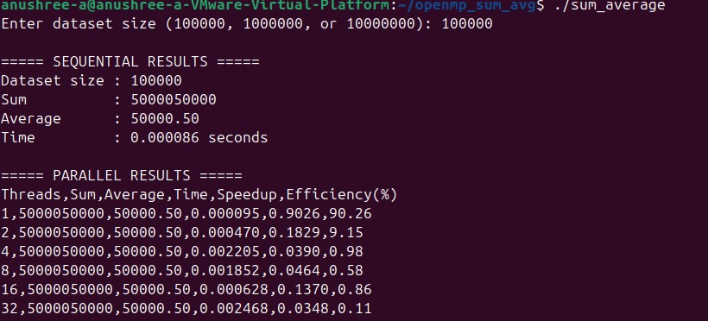
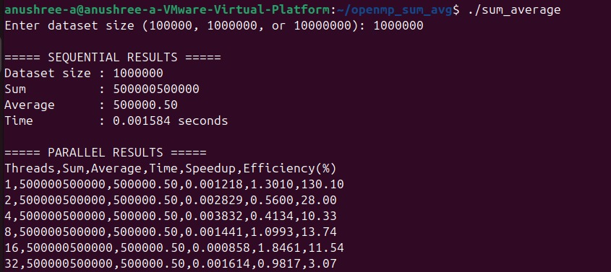
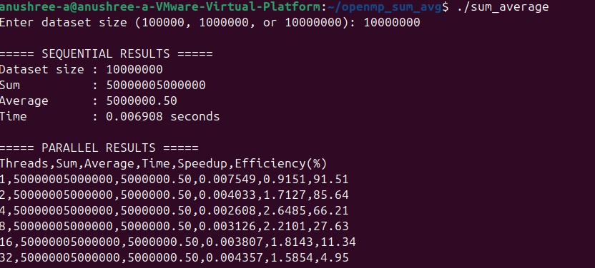
Terminal Output for the Three Dataset Sizes
Screenshots from the Ubuntu runs supplied for this presentation.
100,000 ELEMENTS
1,000,000 ELEMENTS
10,000,000 ELEMENTS
VERIFIED OUTPUT
VERIFIED OUTPUT
VERIFIED OUTPUT
Sum
5,000,050,000
Sum
500,000,500,000
Sum
50,000,005,000,000
Average
50,000.50
Average
500,000.50
Average
5,000,000.50
Sequential baseline
0.000086 s
Sequential baseline
0.001584 s
Sequential baseline
0.006908 s
All OpenMP thread rows produced the same sum and average.
All OpenMP thread rows produced the same sum and average.
All OpenMP thread rows produced the same sum and average.
KLE TECHNOLOGICAL UNIVERSITY • COMPUTER SCIENCE (AI)
OPENMP • SUM / AVERAGE
07

Slide 8
CHECKPOINT 5
Conclusion, Final Demonstration & Technical Viva
Measured findings, limitations, and a simple run-through for the final evaluation.
CONCLUSION
FINAL DEMO PLAN
2.6485×
4 threads
66.21%
1
Compile
gcc -O2 -fopenmp sum_average.c -o sum_average
BEST SPEEDUP
10M DATASET
EFFICIENCY
2
Run a large dataset
All three dataset sizes produced the expected sum and average.
Choose N = 10000000
For 10M elements, 4 threads reduced measured time from 0.006908 s to 0.002608 s.
3
Validate correctness
Show matching sum and average
More threads did not always improve runtime; overhead and timing variation matter.
Explain performance
4
Point to time, speedup, efficiency graphs
LIMITATION / NEXT STEP
Each configuration was measured once, and the times are very short. Repeat 3–5 runs per configuration and report the mean or median for more reliable benchmarking.
VIVA QUICK ANSWERS
reduction(+:par_sum): combines each thread’s partial sum safely.
Speedup = sequential time ÷ parallel time. Scaling is limited by overhead, CPU availability, and measurement variability.
KLE TECHNOLOGICAL UNIVERSITY • COMPUTER SCIENCE (AI)
OPENMP • SUM / AVERAGE
08

Slide 9
THANK YOU
THANKYOU

