Slide 1
Capstone Project
Second Review Presentation
A.Y. 2026-2027
Project Title:
Explainable Employee Burnout Detection from Workplace Communication using Sentiment Analysis and Retrieval-Augmented Generation
Presented by
Saumya Shah | Swara Wairkar | Aryaman Giri | Anushree Devarashetty
70322100115 | 70322100201 | 70322100043 | 7032100175
C040 | C048 | C026 | C038
Under the guidance of : Dr. Shubha Puthran
Computer Engineering Department, MPSTME, Mumbai Campus
Notes:
Good morning. We are presenting the second review of our capstone project on explainable employee burnout detection.

Slide 2
Agenda — Mapped to the Review Rubric
# | Evaluation criterion | Addressed on slides | Evidence we present
A | Literature Review / Market Survey | 6 – 9 | 14 peer-reviewed references; tool comparison
B | Clarity of problem statement | 4 – 5 | Gap statement + 6 measurable objectives
C | Design / System level representation | 10 – 13 | Full architecture; the integration contract
D | Implementation / Results | 14 – 19 | 13,900 lines of code; working system; benchmark
E | Interim Report | 20 – 21 | IEEE-format draft complete; timeline on track
Every slide in this deck is tagged in the bottom-left corner with the rubric criterion it answers.
2
Notes:
Rather than make the panel hunt for evidence, we have mapped the deck directly onto the five evaluation criteria. Each slide carries a tag in the top right showing which criterion it answers.

Slide 3
Progress Since Topic Approval
Committed at topic approval | Status | Delivered
Acquire and clean workplace communication data | Complete | 3 corpora, 542,151 records, unified schema
Sentiment and emotion analysis pipeline | Complete | RoBERTa + NRC lexicon, 20-column output
Transparent burnout scoring | Complete | Additive rule, 3 risk bands, per-record reason
Retrieval-Augmented Generation backend | Complete | 14 modules, FastAPI, 7 endpoints
Interactive dashboard | Complete | Streamlit, 7 charts, PDF export
— (added after approval) | Bonus | Document/image ingestion with OCR
— (added after approval) | Bonus | Quantum ML comparative study — PennyLane + Qiskit
All approved deliverables are complete. Two additional workstreams were undertaken beyond the approved scope.
3
Notes:
Everything we committed to at topic approval is finished, and we have added two workstreams beyond the approved scope: document ingestion with OCR, and a quantum machine-learning comparative study.

Slide 4
Problem Statement
▪ Burnout is an occupational phenomenon recognised by the WHO, yet it is detected late.
  – Organisations rely on periodic self-report surveys — low frequency, low response rates, and vulnerable to under-reporting.
  – By the time a survey registers distress, the disengagement has usually already happened.
▪ Workplace communication carries the signal continuously, but is not used.
  – Email and chat are generated daily and reflect emotional state as it changes, not months later.
▪ Existing machine-learning approaches produce a number, not a reason.
  – A score of 7 tells an HR partner nothing about what to do, who to talk to, or why the employee was flagged.
  – An unexplained score is not actionable, and cannot be audited or contested by the person it describes.
▪ Language models can explain fluently — but they also hallucinate.
  – Left unconstrained, a language model will invent evidence and silently overrule the measured result.
The gap: detection and explanation are treated as one problem, so systems are either accurate but opaque, or fluent but unreliable.
RUBRIC B · PROBLEM STATEMENT
4
Notes:
Burnout is recognised by the WHO as an occupational phenomenon, but organisations detect it late because they rely on periodic surveys. Workplace communication carries the signal continuously. The problem is that existing ML approaches give you a number with no reason, and language models give you a fluent reason that may be invented.

Slide 5
Aim and Objectives
▪ Aim — to build a system that detects burnout risk from workplace communication and explains every decision using only the evidence that produced it.
# | Objective | Measurable outcome | Status
1 | Build a reproducible preprocessing pipeline | Single clean_text contract across 3 corpora | Done
2 | Classify sentiment and emotion per message | RoBERTa + 8-category NRC lexicon | Done
3 | Produce an auditable burnout score | Additive rule; every point traceable | Done
4 | Ground explanation in retrieved evidence | Vector retrieval + fenced-evidence prompt | Done
5 | Prevent the LLM overruling the measurement | risk_level echoed verbatim, never regenerated | Done
6 | Deliver an inspectable HR-facing interface | Dashboard + PDF, evidence shown with answer | Done
RUBRIC B · PROBLEM STATEMENT
5
Notes:
Our aim is one sentence: detect burnout risk from communication, and explain every decision using only the evidence that produced it. We broke that into six objectives, each with a measurable outcome. All six are complete.

Slide 6
Literature Review I — Burnout and Language Models
Ref | Work | Contribution | What we take from it
[1] | WHO (ICD-11) | Burnout classified as an occupational phenomenon | Defines responsible-use boundary: not a diagnosis
[2] | Maslach & Jackson | Maslach Burnout Inventory — three-part schema | Exhaustion / cynicism / efficacy framing
[3] | Xames et al. | ML for burnout prediction from HR and survey data | Confirms the field's reliance on self-report
[4] | Vaswani et al. | Transformer architecture | Basis of the sentiment encoder
[5] | Devlin et al. | BERT — bidirectional pre-training | Contextual representation of workplace text
[6] | Liu et al. | RoBERTa — refined pre-training | Backbone of our classifier
[7] | Barbieri et al. | TweetEval — sentiment fine-tuning | The exact checkpoint we deploy
[8] | Mohammad & Turney | NRC Word–Emotion Association Lexicon | Inspectable emotion counts, not activations
RUBRIC A · LITERATURE REVIEW
6
Notes:
Our literature review covers three threads. The first is burnout measurement itself — the WHO classification and the Maslach inventory. The key finding is that the ML literature overwhelmingly uses self-report and HR data rather than natural language. The second thread is the transformer line that gives us our sentiment classifier.

Slide 7
Literature Review II — Retrieval-Augmented Generation
Ref | Work | Contribution | What we take from it
[9] | Lewis et al. | RAG — parametric + non-parametric knowledge | Core architecture; provenance for every claim
[10] | Karpukhin et al. | Dense Passage Retrieval | Learned dual encoders beat lexical search
[11] | Robertson & Zaragoza | BM25 probabilistic relevance | The sparse baseline we improve on
[12] | Malkov & Yashunin | HNSW graphs for ANN search | Index structure underlying our vector store
[13] | Johnson et al. | GPU billion-scale similarity search | Scaling path beyond the current corpus
[14] | Reimers & Gurevych | Sentence-BERT | all-MiniLM-L6-v2 encoder; cosine comparison
Sentence-BERT reduces exhaustive pairwise comparison from hours to seconds — the property that makes per-employee retrieval feasible at interactive speed.
RUBRIC A · LITERATURE REVIEW
7
Notes:
The third thread is retrieval-augmented generation. Lewis and colleagues showed that combining model weights with an external index improves both accuracy and provenance. Sentence-BERT is what makes it fast enough to be interactive — it turns hours of pairwise comparison into seconds.

Slide 8
Market Survey — Existing Approaches
Approach | Example | Signal | Frequency | Explains? | Auditable?
Engagement surveys | Gallup Q12, Culture Amp | Self-report | Quarterly | Partly | Yes
Pulse survey tools | Officevibe, Peakon | Self-report | Weekly | Partly | Yes
HR analytics / attrition ML | IBM, Workday | Structured HR | Monthly | No | Partly
Workplace analytics | Viva Insights | Metadata only | Continuous | No | Partly
Generic LLM assistant | Prompted chatbot | Free text | On demand | Fluently | No
This project | Burnout RAG | Message content | Continuous | Yes | Yes
No surveyed tool reads message content continuously AND shows the evidence behind its conclusion. That intersection is our contribution.
RUBRIC A · MARKET SURVEY
8
Notes:
We surveyed the commercial landscape. Survey tools are auditable but infrequent. Workplace analytics is continuous but only reads metadata — who mailed whom, not what they said. A generic chatbot explains fluently but cannot be audited. Nothing occupies the intersection: continuous, content-aware, and evidence-backed.

Slide 9
Research Gap and Positioning
▪ Gap identified
  – To the best of our knowledge, prior work treats burnout detection and burnout explanation as a single modelling problem.
  – That forces a choice: an accurate model that cannot explain itself, or a fluent model that cannot be trusted.
▪ Our positioning — the contribution is architectural, not a new model
  – We treat them as two problems with different correctness criteria, joined by a deliberately narrow contract.
  – Correctness for the ML stage means the score is reproducible and every point is traceable to a rule.
  – Correctness for the language stage means every sentence is supported by a retrieved record that is shown to the user.
  – The contract prevents the more fluent component from overruling the more accountable one.
Novelty claim: separation of prediction and explanation under an enforced contract — not a larger model or a new dataset.
RUBRIC A · LITERATURE REVIEW
9
Notes:
This gives us our gap. Prior work treats detection and explanation as one problem, which forces a choice between accuracy and explainability. Our contribution is architectural: we separate them, and we enforce the separation with a contract. That is the novelty we are claiming — not a bigger model.

Slide 10
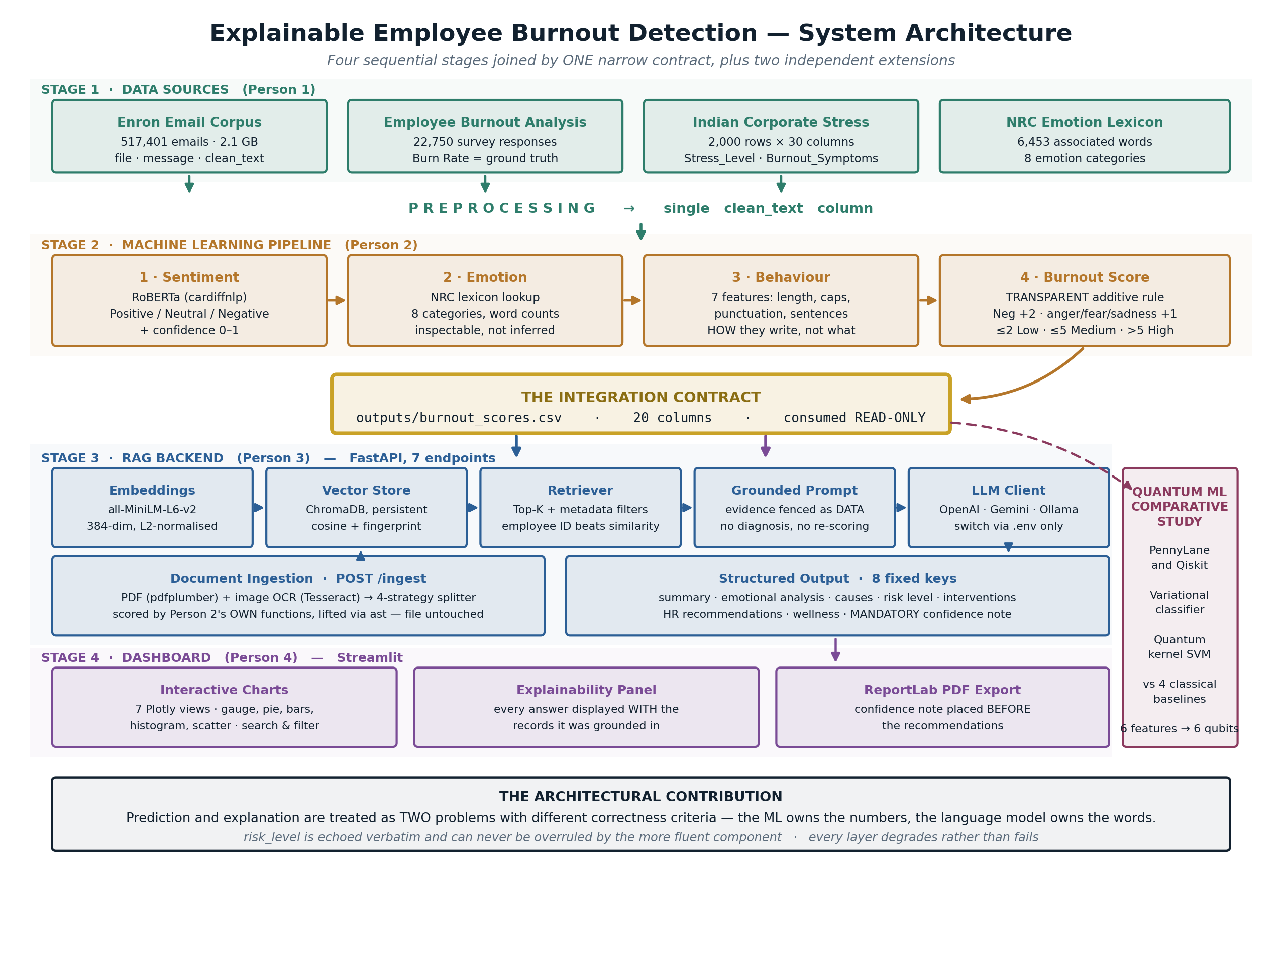
System Architecture
RUBRIC C · SYSTEM DESIGN
10
Notes:
This is the complete system. Four sequential stages, colour-coded by owner, joined by a single contract in the centre. Stage one is data. Stage two is the machine-learning pipeline. The gold box is the contract. Stage three is the RAG backend. Stage four is the dashboard. On the right is the quantum study, which reads the same contract independently.

Slide 11
Key Design Decision — The Integration Contract
▪ The entire system is joined at exactly one point: outputs/burnout_scores.csv — 20 columns, consumed strictly read-only.
Property of the contract | Why it was designed this way
One file, one direction | Stages 3 and 4 can be developed, tested and demonstrated without re-running the 2.1 GB pipeline
risk_level is echoed, never recomputed | The language model is structurally incapable of upgrading or downgrading a person's risk band
Evidence is fenced as data in the prompt | Retrieved records cannot be read as instructions — blocks prompt-injection through message content
Read-only enforcement, verified | Person 1 and Person 2 source files were confirmed byte-identical after integration (git diff + MD5)
Scoring functions reused, not rewritten | Uploaded documents are scored by the original authors' own functions, lifted at runtime via Python's ast module
RUBRIC C · SYSTEM DESIGN
11
Notes:
The single most important design decision is the contract. The whole system meets at one file. Because risk level is echoed rather than regenerated, the language model is structurally incapable of changing someone's risk band — that is not a prompt instruction, it is an architectural guarantee. We verified the read-only property with git diff and MD5 checksums.

Slide 12
Component-Level Design — RAG Backend
Module | Responsibility | Key design choice
embeddings.py | Encode text to vectors | all-MiniLM-L6-v2, 384-dim, L2-normalised so cosine = dot product
vectorstore.py | Persist and search vectors | ChromaDB with a content fingerprint — rebuilds only when data changes
retriever.py | Select evidence | Explicit employee ID overrides similarity; filters relax before failing
burnout_prompt.py | Constrain the model | Evidence fenced as data; 8 mandatory output sections
llm_client.py | Talk to a provider | Abstract base + registry: OpenAI, Gemini, Ollama — switched by .env only
rag_pipeline.py | Orchestrate | Four-strategy JSON parsing; falls back to a rule-based analysis
app.py | Expose the API | 7 FastAPI endpoints, Pydantic-validated request and response
RUBRIC C · SYSTEM DESIGN
12
Notes:
Zooming into stage three. Seven modules, each with one responsibility. Two choices worth calling out: embeddings are L2-normalised so cosine similarity becomes a dot product, which is cheaper; and the LLM client is a registry behind an abstract base, so switching from OpenAI to a local Llama model is a one-line change in the .env file with no code modification.

Slide 13
Design for Failure and Responsible Use
Failure or risk | System response
Language model unreachable or slow | Rule-based analysis is returned with degraded = true and HTTP 200 — the dashboard stays usable
Model returns malformed JSON | Four parsing strategies in sequence; a structured fallback if all four fail
No evidence matches the query | Filters are relaxed step by step; if still empty the system says so rather than inventing an answer
Message content contains injected instructions | Retrieved text is fenced as data; the prompt forbids treating it as instruction
Output mistaken for a clinical diagnosis | A confidence note is a mandatory output section and is placed BEFORE the recommendations in the PDF
Employee privacy | Pseudonymous employee IDs; evidence shown is limited to the records that produced the conclusion
RUBRIC C · SYSTEM DESIGN
13
Notes:
We designed for failure explicitly. Every layer degrades rather than failing. If the language model is unreachable the system returns a rule-based analysis flagged as degraded, and the dashboard keeps working. The confidence note is a mandatory output section, and in the PDF it is placed before the recommendations, not buried at the bottom.

Slide 14
Implementation Status
Component | Owner | Files | Lines | Status
Data acquisition and preprocessing | Person 1 | 7 | 399 | Complete
ML pipeline — sentiment, emotion, behaviour, scoring | Person 2 | included above | — | Complete
RAG backend — FastAPI, 7 endpoints | Person 3 | 17 | 7,162 | Complete
Dashboard — Streamlit, 7 charts, PDF | Person 4 | 7 | 2,824 | Complete
Quantum ML comparative study | Team | 7 | 2,103 | Complete
Automated test suite | Team | 7 | 1,426 | 151 passing
Total |  | 45 | 13,914
Zero lines of Person 1 and Person 2 source were modified during integration — verified byte-for-byte.
RUBRIC D · IMPLEMENTATION
14
Notes:
Just under fourteen thousand lines of code across forty-five files, with a hundred and fifty-one automated tests passing. The line worth emphasising is the last one: we integrated two new subsystems without modifying a single line of the earlier stages.

Slide 15
Backend Implementation — API Surface
Method | Endpoint | Purpose
GET | / | Service identity and version
GET | /health | Provider reachability, model name, record count, masked credentials
GET | /statistics | Aggregate risk, sentiment and emotion counts for the dashboard
POST | /query | Natural-language question → grounded answer + the records used
POST | /report | Full 8-section burnout analysis for one employee or the organisation
POST | /refresh | Rebuild the vector index after the ML pipeline re-runs
POST | /ingest | Upload a PDF or a screenshot — OCR, split, score, index
Provider-agnostic: OpenAI, Google Gemini and local Llama via Ollama are all supported by changing one line in .env.
RUBRIC D · IMPLEMENTATION
15
Notes:
Seven endpoints. Two are worth noting. Health reports whether the provider is actually reachable and masks the credentials, so it is safe to expose. Ingest accepts a PDF or even a screenshot of a chat, runs OCR, splits it into messages, and scores them using the original pipeline's own functions.

Slide 16
Dashboard Implementation
▪ Explainable Employee Burnout Detection using AI + RAG — Streamlit and Plotly, light and dark themes.
  – Overall burnout gauge, risk distribution, sentiment breakdown, emotion profile, score histogram, burnout-versus-sentiment scatter, and a ranked high-risk table.
  – Free-text search and risk filtering across every record.
▪ Explainability panel — the feature that answers the problem statement
  – Every generated answer is displayed together with the exact records it was grounded in, so a reader can check the reasoning rather than trust it.
▪ Document upload
  – Drop in a PDF or a screenshot of a conversation; the record appears in the charts and becomes searchable within seconds.
▪ PDF export via ReportLab
  – All 8 sections, with the confidence note placed before the recommendations.
RUBRIC D · IMPLEMENTATION
16
Notes:
The dashboard is the HR-facing surface. Seven charts, search and filtering, and light and dark themes. The panel that matters most is the explainability panel: every answer is shown together with the records it came from, so the reader checks the reasoning instead of trusting it. We will demonstrate this live.

Slide 17
Results I — Pipeline Output and Verification
What we measured | Result
Records processed end to end | 3 corpora unified — 517,401 emails, 22,750 survey rows, 2,000 stress records
Burnout score output | 20-column table: score, risk band, sentiment, confidence, 8 emotions, 7 behaviour features, reason
Explainability coverage | 100% — every record carries a human-readable reason for its score
Automated tests | 151 passing across data loading, schemas, retrieval, vector store, API and ingestion
Integration safety | Person 1 and Person 2 files byte-identical before and after (git diff + MD5)
Defects found by our own tests, then fixed | 17 — including a silent vector-store failure and a misattributed dominant emotion
RUBRIC D · RESULTS
17
Notes:
On results. The pipeline runs end to end across all three corpora and produces a twenty-column table in which every single record carries a human-readable reason. A hundred and fifty-one automated tests pass. And importantly, those tests found seventeen real defects in our own code before the review — we will show the two most serious.

Slide 18
Results II — Defects Found and Fixed by Our Own Tests
Defect | Why it mattered | Fix
ChromaDB returned collection objects on 1.x and plain strings on 0.6.x | A bare exception handler reported “0 records” after a successful write — a silent data-loss failure | Normalise both return shapes; remove the silent handler and log
Dominant emotion computed with idxmax on all-zero rows | Six of ten records were labelled “anger” when no emotion word was present at all | Return “neutral” when every emotion count is zero
Missing behaviour columns silently created as zero | Fabricated values would have reached the vector store and been cited as evidence | Emotions zero-filled (absent = 0 is true); behaviour left absent
Message minimum length of 12 characters | Dropped “not ok” and “I’m done” — the strongest burnout signals in the corpus | Per-strategy thresholds; chat messages accepted from 3 characters
We report these deliberately: a system that is trusted with wellbeing data has to be able to show how it fails, not only how it works.
RUBRIC D · RESULTS
18
Notes:
We are reporting our own defects deliberately. The first one is the most instructive: a version difference in the vector database combined with a bare exception handler meant the system reported zero records after a completely successful write. The second is the one we care about most ethically — six of ten records were being labelled angry when no emotion word was present at all.

Slide 19
Results III — Quantum ML Comparative Study
Model | Family | Framework | Accuracy | Runtime
Logistic Regression | Classical | scikit-learn | 0.8667 | < 0.01 s
SVM (RBF kernel) | Classical | scikit-learn | 0.8587 | < 0.01 s
Random Forest | Classical | scikit-learn | 0.8533 | 0.20 s
SVM-RBF (same 400 rows) | Classical | scikit-learn | 0.8560 | 0.008 s
Quantum kernel SVM | Quantum | PennyLane | 0.8560 | 0.67 s
QSVC (quantum kernel) | Quantum | Qiskit | 0.8533 | 123.6 s
VQC (variational) | Quantum | PennyLane | 0.7067 | —
VQC (variational) | Quantum | Qiskit | 0.7227 | 292.2 s
▪ The quantum kernel reproduces the classical RBF result to within 0.0000 on the same 400 rows — at roughly 84× (PennyLane) and 15,000× (Qiskit) the compute cost.
  – Cross-framework agreement of 0.27% between two independent implementations validates that the circuits are correct.
RUBRIC D · RESULTS
19
Notes:
Our faculty mentor asked us to investigate quantum machine learning, so we implemented it twice — in PennyLane and in Qiskit — and benchmarked both against four classical baselines. The honest result: the quantum kernel exactly reproduces the classical RBF accuracy at up to fifteen thousand times the compute cost. We report this as a negative result, and the agreement between the two independent frameworks tells us the implementation is correct rather than broken.

Slide 20
Interim Report Status
Section | Content | Status
I. Introduction | Motivation, contributions, scope | Complete
II. Related Work | 4 subsections, 14 references, positioning | Complete
III. System Architecture | Four stages and the integration contract | Complete
IV. ML Pipeline | Preprocessing, sentiment, emotion, behaviour, fusion, scoring | Complete
V. RAG Backend | Embedding, retrieval, prompting, generation | Complete
VI. Dashboard | Interface design and explainability panel | Complete
VII. Verification | 5 subsections — attribution, sparsity, classification quality | Complete
VIII. Defects | Every defect found, its disposition and its owner | Complete
IX. Future Work | Validation study, temporal modelling, deployment | Complete
Drafted in IEEE conference format with 11 figures. Under review by our guide, Dr. Shubha Puthran.
RUBRIC E · INTERIM REPORT
20
Notes:
The interim report is drafted in full IEEE conference format — nine sections, fourteen references and eleven figures. Two sections are unusual for a student report and we included them deliberately: a verification section, and a defects section that records every problem we found and how it was resolved.

Slide 21
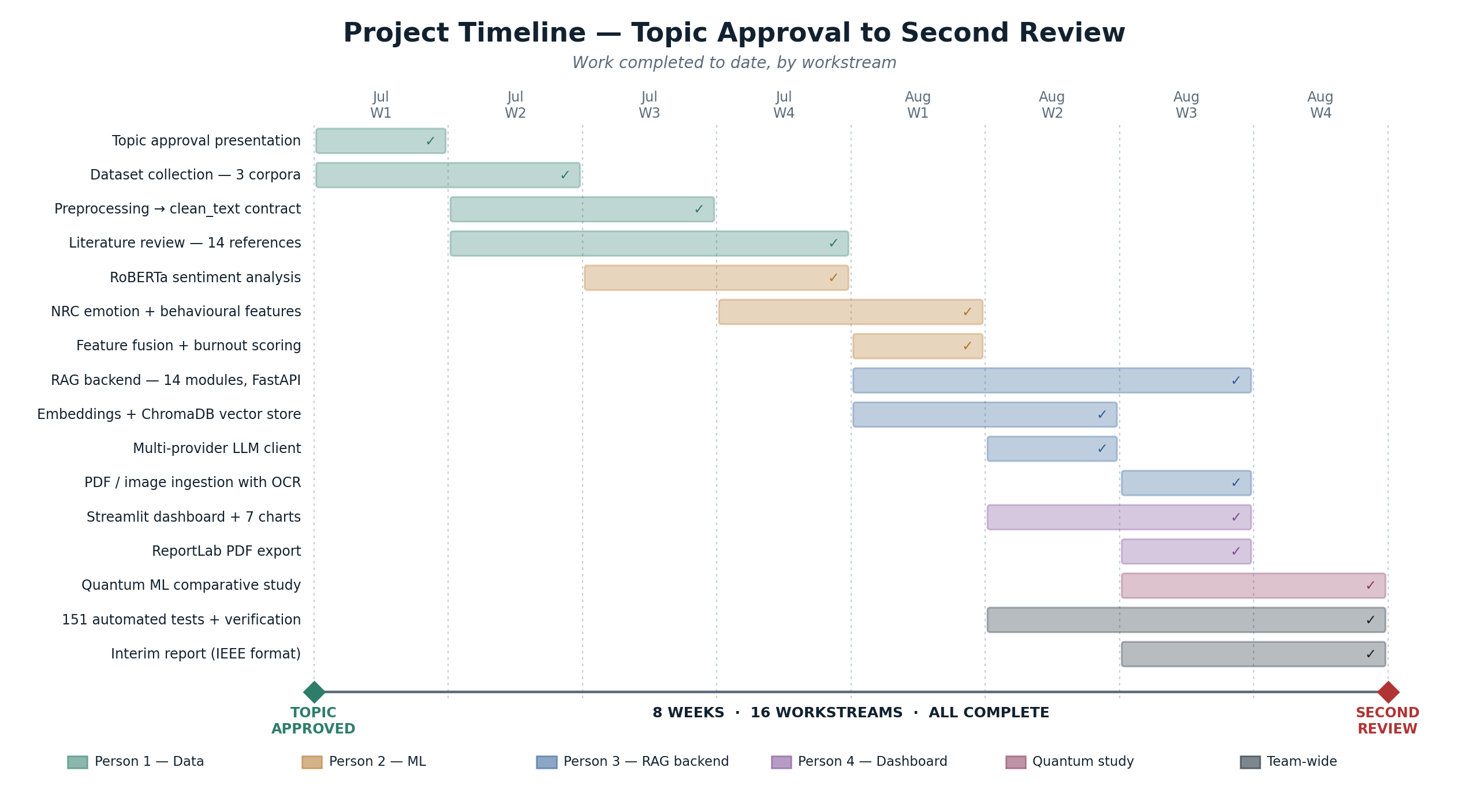
Project Timeline and Progress
16 workstreams across 8 weeks, all complete and on schedule.
RUBRIC E · INTERIM REPORT
21
Notes:
This is our timeline from topic approval to today. Sixteen workstreams across eight weeks, colour-coded by owner, all complete. The overlap between rows is deliberate — because stages three and four consume a file rather than calling code, they could be built in parallel with the pipeline still being tuned.

Slide 22
Limitations and Ethical Considerations
Limitation | How we are handling it
No clinically labelled ground truth for burnout | We report risk bands, never a diagnosis; a validation study against the Maslach inventory is planned
Behavioural features measured on cleaned text lose punctuation and casing | Documented in the report as a defect owned by the preprocessing stage; the fix belongs upstream
Emotion counts are sparse on short messages | Reported honestly as “neutral” rather than forcing a dominant emotion
Surveillance risk if deployed carelessly | Designed for aggregate wellbeing insight, pseudonymous IDs, and evidence visible to the person described
Enron corpus is a single organisation from one era | Two additional corpora included; generalisation is stated as a threat to validity
RUBRIC E · INTERIM REPORT
22
Notes:
We want to be explicit about limitations. We have no clinically labelled ground truth, so we report risk bands and never a diagnosis. And there is a real surveillance risk in a system like this, which is why the evidence is visible to the person being described rather than only to HR.

Slide 23
Future Work — Towards the Final Review
▪ Validation — correlate produced risk bands against Maslach Burnout Inventory responses on a consenting sample.
▪ Temporal modelling — track an individual's trajectory over weeks rather than scoring messages independently; trend is a stronger signal than any single message.
▪ Retrieval evaluation — measure recall@k and answer faithfulness against a hand-annotated evidence set.
▪ Deployment — containerise the backend and dashboard; role-based access so managers see aggregates and only the individual sees their own evidence.
▪ Scaling the index — move from ChromaDB to a GPU-backed index for the full 517,401-message corpus.
▪ Paper submission — complete the empirical evaluation and submit to the target venue.
23
Notes:
Between now and the final review, the priority is validation — correlating our risk bands against a recognised instrument on a consenting sample. Second is temporal modelling: a trajectory over weeks is a much stronger signal than any single message. Third is deployment with role-based access.

Slide 24
Conclusion
▪ We set out to detect burnout risk from workplace communication and explain every decision using only the evidence that produced it.
  – All six objectives from topic approval are complete.
  – The system is running end to end: 3 corpora, an ML pipeline, a RAG backend with 7 endpoints, and an interactive dashboard.
  – 13,914 lines of code, 151 automated tests, 17 self-reported defects found and fixed.
  – Two extensions beyond the approved scope: document and image ingestion, and a two-framework quantum ML study.
  – The interim report is complete in IEEE format with 14 references.
▪ The contribution is architectural: prediction and explanation are two problems, and the contract between them is what makes the output trustworthy.
24
Notes:
To conclude. Every objective from topic approval is complete, the system runs end to end, and the interim report is written. If the panel takes one thing from this review, we would like it to be the contract: prediction and explanation are two different problems, and keeping them separate is what makes the output something an HR partner can actually defend.

Slide 25
References
▪ [1] World Health Organization, “Burn-out an occupational phenomenon,” ICD-11, 2019.
▪ [2] C. Maslach and S. E. Jackson, “The measurement of experienced burnout,” J. Occup. Behav., 1981.
▪ [3] M. D. Xames et al., “Machine learning approaches for employee burnout prediction.”
▪ [4] A. Vaswani et al., “Attention is all you need,” NeurIPS, 2017.
▪ [5] J. Devlin et al., “BERT: Pre-training of deep bidirectional transformers,” NAACL, 2019.
▪ [6] Y. Liu et al., “RoBERTa: A robustly optimized BERT pretraining approach,” 2019.
▪ [7] F. Barbieri et al., “TweetEval: Unified benchmark for tweet classification,” EMNLP Findings, 2020.
▪ [8] S. Mohammad and P. Turney, “Crowdsourcing a word–emotion association lexicon,” 2013.
▪ [9] P. Lewis et al., “Retrieval-augmented generation for knowledge-intensive NLP tasks,” NeurIPS, 2020.
▪ [10] V. Karpukhin et al., “Dense passage retrieval for open-domain question answering,” EMNLP, 2020.
▪ [11] S. Robertson and H. Zaragoza, “The probabilistic relevance framework: BM25 and beyond,” 2009.
▪ [12] Y. Malkov and D. Yashunin, “Efficient and robust approximate nearest neighbor search using HNSW,” 2020.
▪ [13] J. Johnson et al., “Billion-scale similarity search with GPUs,” IEEE Trans. Big Data, 2021.
▪ [14] N. Reimers and I. Gurevych, “Sentence-BERT: Sentence embeddings using siamese BERT-networks,” EMNLP, 2019.
25
Notes:
Our references.

Slide 26
Thank You
Questions and discussion
Saumya Shah · Swara Wairkar · Aryaman Giri · Anushree Devarashetty
Under the guidance of Dr. Shubha Puthran
Computer Engineering Department, MPSTME, Mumbai Campus
26
Notes:
Thank you. We are happy to take questions, and we can demonstrate the running system now if the panel would like.

