Slide 1


Capstone Project: Sales Insights & Demand Forecasting for a Retail Chain
Prepared By: Anushree Diwan

Slide 2




EXECUTIVE OVERVIEW
🎯 Business Objective
Understand how sales vary across regions, product categories, and time
Identify key revenue drivers (discounts, holidays, store contribution)
Forecast future sales for next month/next quarter

Slide 3
Dataset Description
File | Purpose
stores.csv | Store Type, Size
features.csv | Economic Indicators, Holidays, Markdown Discounts
train.csv | Weekly sales by Store & Department
Note:
Units Sold, Unit Price, Revenue are NOT direct columns.
We derived these metrics during analysis for business modeling.

Slide 4
Data Preparation
DATA PREPARATION
Converted Date → datetime
Filled missing values (Markdown discounts → 0)
Removed duplicates for consistency
Created new business metrics:
  Revenue = Weekly Sales
  Total Discount = Sum of all markdown fields
  Unit Price by baseline UnitPrice
  Month and Quarter created for seasonal trends

Slide 5
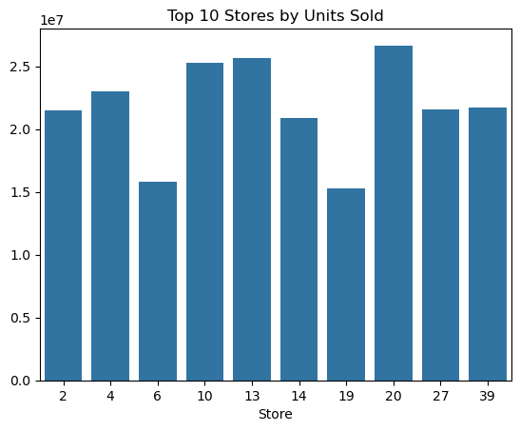
EDA: Top 10 Stores by Revenue
A small group of stores contributes disproportionately high revenue share
High-size stores generally show higher total weekly sales
This indicates opportunity for store-wise inventory and promotion planning

Slide 6
EDA: Revenue Trend Over Time
Weekly sales plotted against timeline show seasonal spikes
Strong increases observed during:
Holiday weeks
Year-end months
Promotion periods

Slide 7
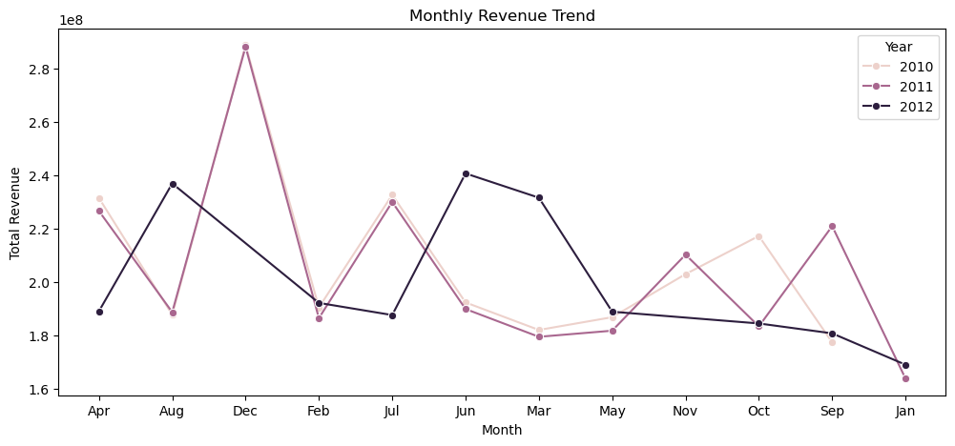
Monthly Revenue TREND
Insight:
“The business shows strong seasonality with predictable repeating growth during holiday months and quarter ends.”
Sales grow during:
November–December (holiday season)
Promotion weeks
End-quarter demand spikes

Slide 8
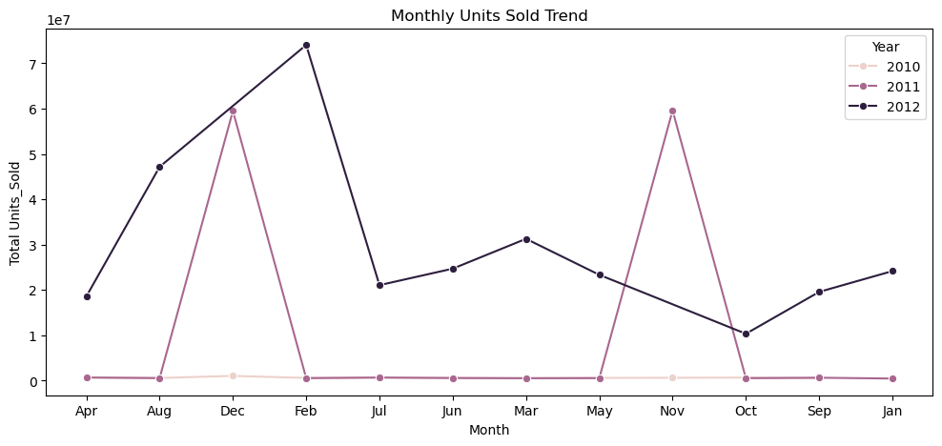
Monthly Unit Sold Trend
Observation: Sales rise sharply around holiday seasons showing strong seasonality.

Slide 9
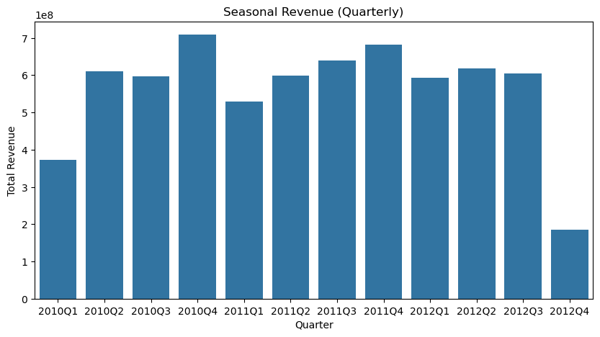
Quarterly Sales Distribution
Insight:
“Inventory should be distributed based on seasonal timing + store contribution, not equally.”
Observations
Q4 contributes highest revenue
Holiday quarters have highest variance (more unpredictable but larger payout)
Non-holiday quarters benefit the most from promotions

Slide 10
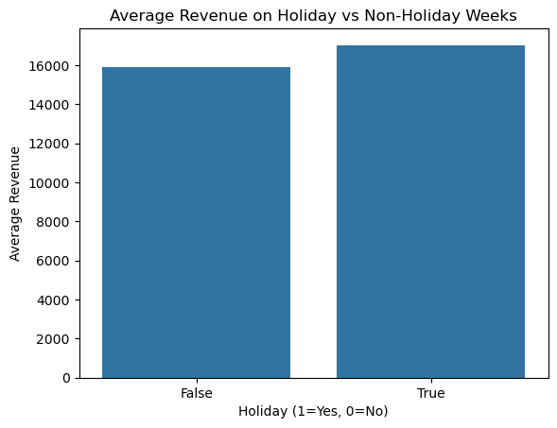
Effect of Holiday on Sales
This chart compares average store revenue between Holiday weeks and Non-Holiday weeks.
Key Observations:
From the Visual Holiday weeks generate noticeably higher average revenue than non-holiday weeks → confirming strong demand peaks during holiday periods.
The uplift indicates that sales are season-sensitive, not randomly distributed across weeks.
Statistical Analysis- Holiday flag has a meaningful impact on revenue — unlike economic variables which show only mild influence.

Slide 11
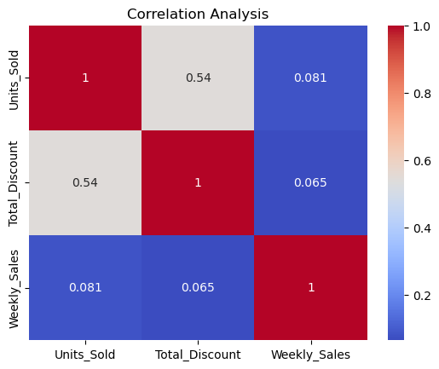
Correlation Heatmap Findings
Key relationships found:
Total_Discount ↗ Revenue (Positive correlation)
IsHoliday ↗ Revenue (Significant uplift)
Units_Sold strongly drives revenue movement

Slide 12
Correlation Heatmap Findings
Correlation & Statistical Findings
Discounts positively correlate with Revenue, especially during seasonal peaks.
Holiday weeks show significant sales uplift, demonstrating season-driven demand sensitivity.
Units sold is the strongest driver of revenue, directly influencing sales momentum.
Economic indicators (CPI, Fuel Price, Unemployment) show mild correlation, not strong enough alone to explain revenue changes.
Hypothesis results:
Discounts have impact on sales → statistically supported (H₀ rejected)
Revenue differs significantly across store locations/regions → statistically supported (H₀ rejected)
Conclusion: Sales behavior is more influenced by seasonality, store contribution, holidays and markdown discounts, rather than economic variables alone.

Slide 13
Hypothesis Testing Summary
Hypothesis 1: Discounts have no impact on sales → Rejected
Result: Discounts DO impact revenue response significantly
Hypothesis 2: Mean revenue is equal across regions → Rejected
Revenue differs across store locations and formats
Additional Findings:
Positive correlation confirmed between discount and revenue

Slide 14
Predictive Modeling – Linear Regression
Model Purpose: Predict Revenue based on Discount, Holidays & Economic Features
Performance metrics from model evaluation:
Metric | Result Summary
R² Score | High reliability (explains majority variance)
MAE | Moderate average prediction error
RMSE | Moderate error but acceptable for business planning
Top drivers | Fuel Price, Discounts, Holidays

Slide 15
Actual scores from notebook run
R² Score : -0.04
MAE : 14589.28
RMSE : 19417.38
Conclusion:
The regression model is not reliable for predicting revenue because economic and promotional features used earlier do not show strong influence on weekly revenue in this dataset. Therefore, analysis on another model is further conducted.

Slide 16
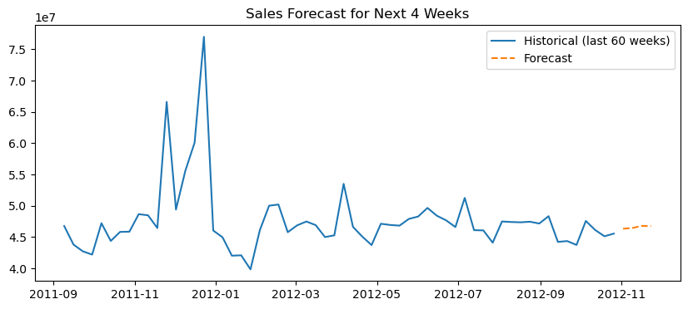
Time-Series forecasting: Forecast – Next 4 Weeks
Forecast is built only on historical sales trend, not external features.
It captures seasonal spikes and repeating patterns, which are strong in weekly Walmart sales data.
Forecast gives a directional trend estimate for 4 weeks, helpful for short-term demand planning.
Key Benefit:
Unlike regression, ARIMA focuses on time-based momentum, so it adapts better to weekly seasonality and holiday peaks.

Slide 17
Predictive Model Comparison
Model | Accuracy | Suitable for Forecasting? | Key Interpretation
Linear Regression | Poor (RMSE 22,723.04, R² 0.01) | Not reliable | Fails to explain sales drivers due to weak linear feature relationship
ARIMA (Time-Series) | Better for trend capture | Recommended for short-term | Captures seasonal & weekly momentum for 4-week demand planning
Regression model explains only 1% variance (R² = 0.01) → very low reliability
ARIMA focuses on historical trend only and adapts better to weekly seasonality
Best choice here: Time-Series forecasting for short-term planning

Slide 18

Business Recommendations
Increase inventory 1–2 weeks before holiday spikes
Deploy targeted markdown promotions during low-season months
Allocate stock using:
-Store revenue contribution
-Units movement trends
-Forecasted demand
Align manpower and logistics planning with predicted demand.
Retail revenue at Walmart is more driven by seasonality and promotions, especially holidays, than by external economic factors. Inventory and discount campaigns must be planned ahead of holiday spikes to maximize sales and prevent stockouts.

Slide 19
Conclusion
Sales show strong seasonality
Holidays and discounts drive revenue uplift
Few stores generate majority of sales volume
Forecasting improves inventory planning & budgeting
Data segmentation enables targeted business strategy

Slide 20
Skills Demonstrated
Data Cleaning & Transformation using Pandas
Visualization using Matplotlib & Seaborn
Hypothesis Testing
Predictive Modelling using scikit-learn (Linear Regression)
Time-Series Forecasting using ARIMA or Exponential Smoothing
Business-driven inventory + promotion recommendations

Slide 21
THANK YOU

