Slide 1
DISCOUNT STRATEGY REVIEW
Discount Strategy Review: Where to Draw the Line
WHAT WE’LL COVER
1. The data
2. The core finding
3. Order trends
4. Category view
5. Product view
6. Recommendation
Sayali Ware
Paul Priluzki
Ishwarya Goudagaon
Anushree Balakrishnan

Slide 2
The data behind this analysis
2 / 8
We looked at every order Eniac completed between January 2017 and March 2018.
40,985
$7.8M
$1.52M
Orders( Completed )
Total revenue
Total discounts
Jan 2017 – Mar 2018
money we collected
16 cents of every $1 of gross value
The question we’re answering
Should Eniac keep offering discounts? And if so — how big should they be, and on what products?
Eniac · Discount Strategy Review

Slide 3
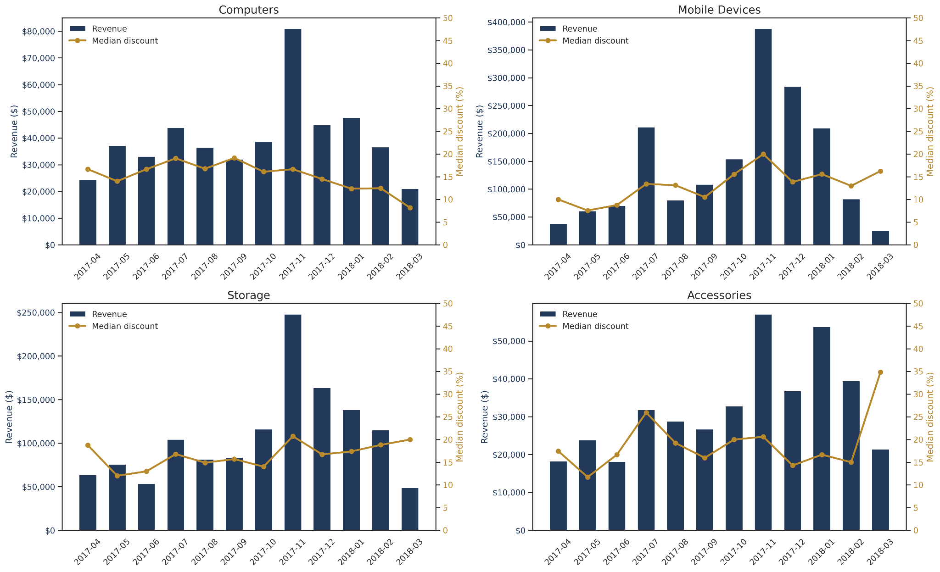
Discount changes often fail to explain sales changes.
3 / 8
Discounts and sales often diverge.
Bigger discounts do not guarantee bigger sales.
Seasonal trends dominate sales performance.
Eniac · Discount Strategy Review

Slide 4
Small discounts pay for themselves. Big ones don’t.
3 / 8
We grouped every order by how big its discount was. Then we compared: what share of all orders came from each group, versus what share of all revenue.
Discount size | Number of orders | % of all orders | % of all revenue
up to 15% | 19659 | 40.9% | 59.0%
15-25% | 12695 | 26.5% | 26.1%
25-35% | 7264 | 15.1% | 10%
35%+ | 8339 | 17.4% | 4.9%
Best balance:
Less discount. More revenue.
Worst balance:
Deep discounts. Weak returns.
Eniac · Discount Strategy Review

Slide 5
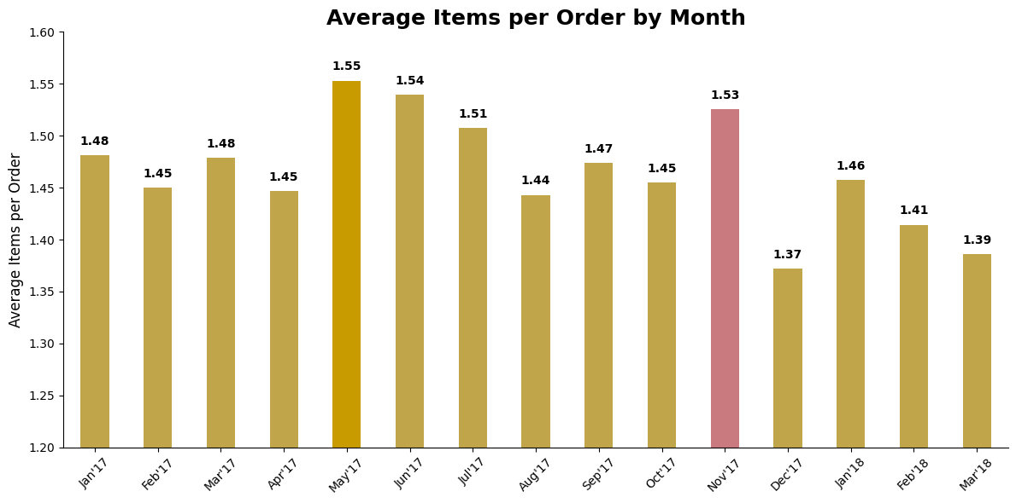
Bigger discounts don’t fill bigger carts
4 / 8
If deep discounts worked as a growth tool, we'd expect people to buy more per order when the discount is bigger. That's not what happens.
1.3 to 1.5 items
products per order, no matter the discount size
Whether the discount is 5% or 45%, shoppers put roughly the same number of items in their basket. A deeper discount just means we collect less money for the same basket. it doesn’t grow the sale.
Basket size peaked in May (1.55 items) and remained similarly high during Black Friday (1.53 items), indicating only modest seasonal variation.
Eniac · Discount Strategy Review

Slide 6
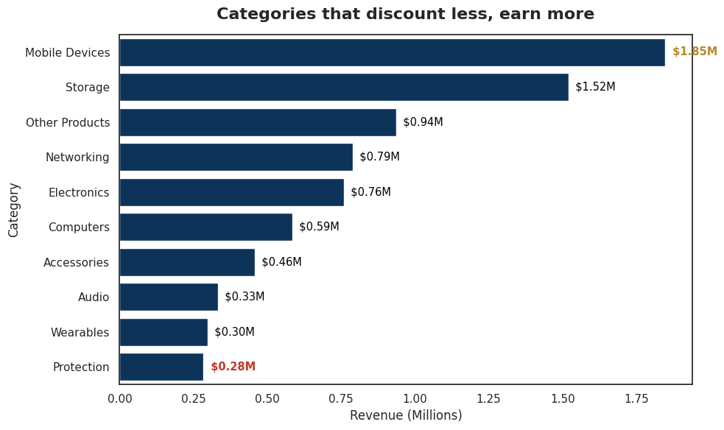
Categories that discount less, earn more
5 / 8
All 10 product categories we sell, ranked by revenue, with their average discount.
Revenue and discount, side by side
Category | Revenue | Discount
Mobile Devices | $1.85M | 9.0%
Storage | $1.52M | 16.8%
Other Products | $0.94M | 21.8%
Networking | $0.79M | 12.7%
Electronics | $0.76M | 16.9%
Computers | $0.59M | 17.2%
Accessories | $0.46M | 20.8%
Audio | $0.33M | 21.9%
Wearables | $0.30M | 11.7%
Protection | $0.28M | 31.2%
Eniac · Discount Strategy Review

Slide 7
Recommendation
7 / 8
Cap everyday discounts at 5-15% off
Proof: at 15% off or less, we earn a bigger share of revenue than the share of order sit takes to get there.
Save discounts over 25% for clearing out old stock only
Proof: today these deals make up 16% of orders, but only 4.8% of revenue.
Don’t discount our best-selling category to compete on price
Proof: Mobile Devices earns the most revenue of any category, with the smallest discount (9%).
Seasonal discounts should stay at 15–22%
Proof: Nov and Dec, two best months, both stayed under 22%, while Jan and July pushed toward 25% without outperforming them.
Eniac · Discount Strategy Review

Slide 8
THANK YOU !!!

