Slide 1

Popularity of Animes
Team- Data Wizards

Slide 2

Introduction
This Anime dataset comes from MyAnimeList.net. According to Wikipedia - "MyAnimeList, often abbreviated as MAL, is an anime and manga social networking and social cataloging application website. The site provides its users with a list-like system to organize and score anime and manga. It facilitates finding users who share similar tastes and provides a large database on anime and manga. The site claims to have 4.4 million anime and 775,000 manga entries. In 2015, the site received 120 million visitors a month.”
Reasons for choosing this dataset:
Anime has become a global phenomenon with a highly engaged fan base, making this dataset both timely and relevant.
Analyzing this anime dataset reveals media consumption and production patterns, offering valuable insights for content creators, marketers, and researchers in entertainment analytics.
The original dataset had 77911 rows x 28 columns which after all the data pre-processing was reduced to 2366 rows x 30 columns.

Slide 3
Q1. How do user engagement metrics (such as popularity, members, and favorites) and the number of users who scored an anime influence its overall score and rank?

Slide 4
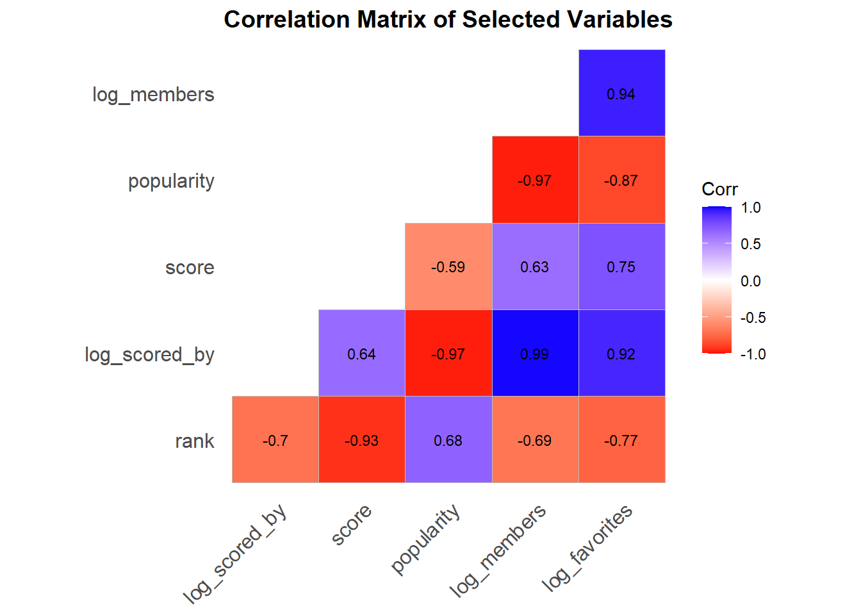


Slide 5
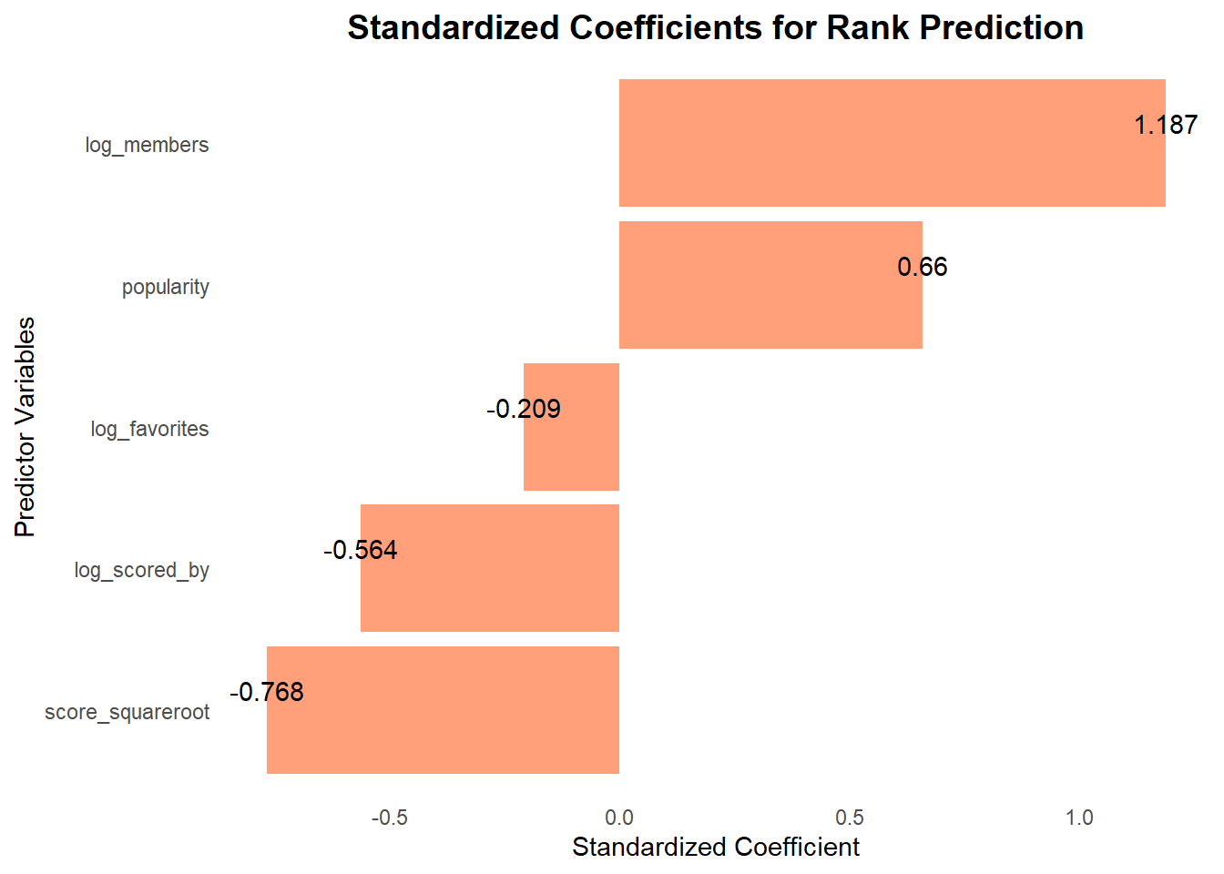
R-squared: 0.9041
Adjusted R-squared: 0.9039

Slide 6
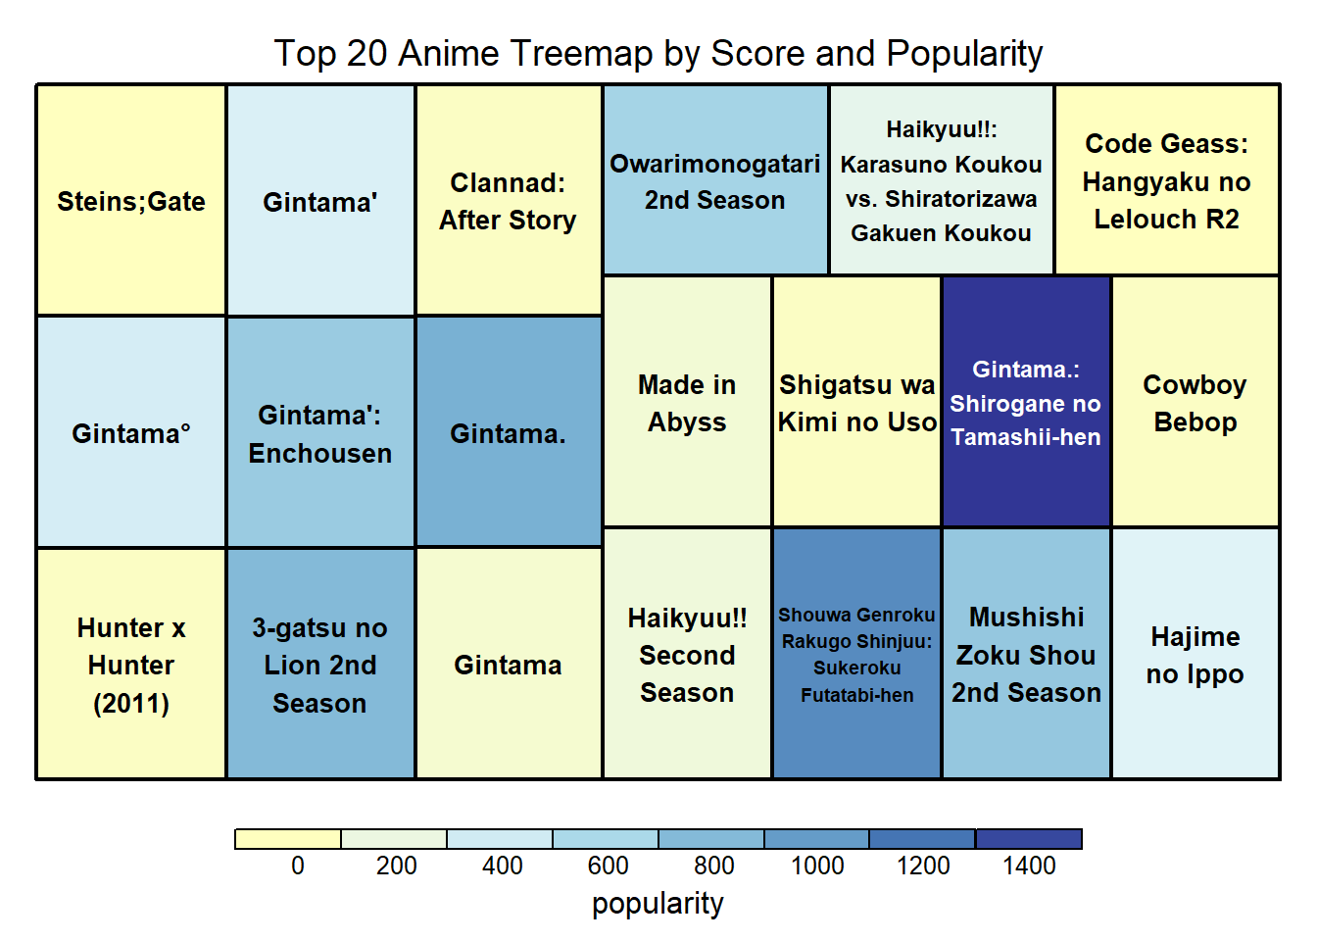

Slide 7
Q2. What production related factors ( studio, producers, source material) are associated with higher anime ratings and critical thinking?

Slide 8
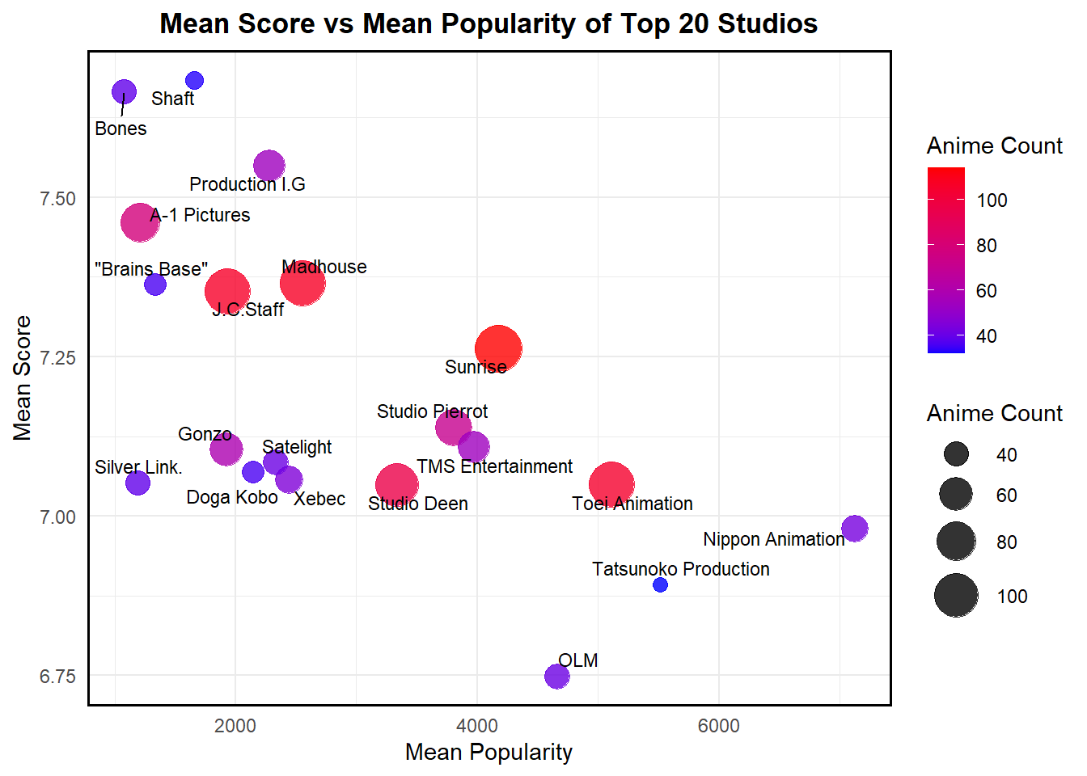

Slide 9
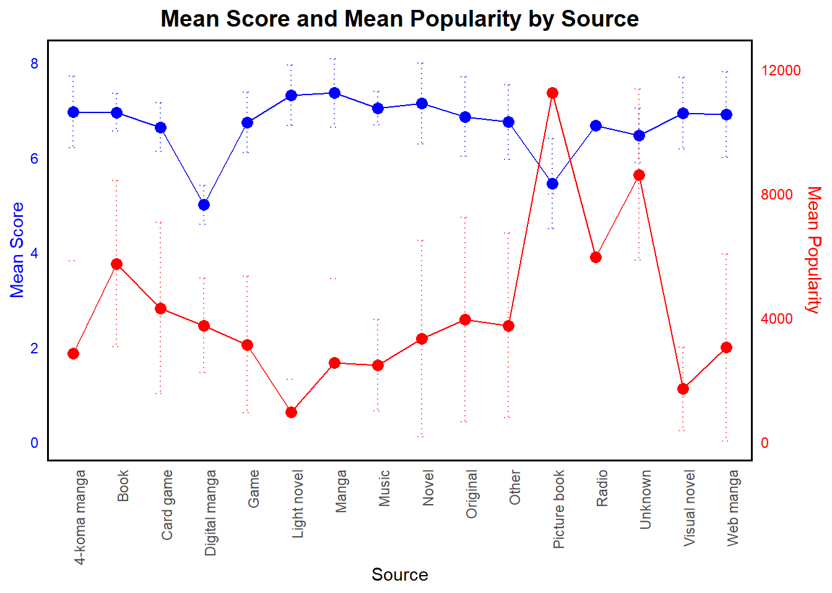

Slide 10
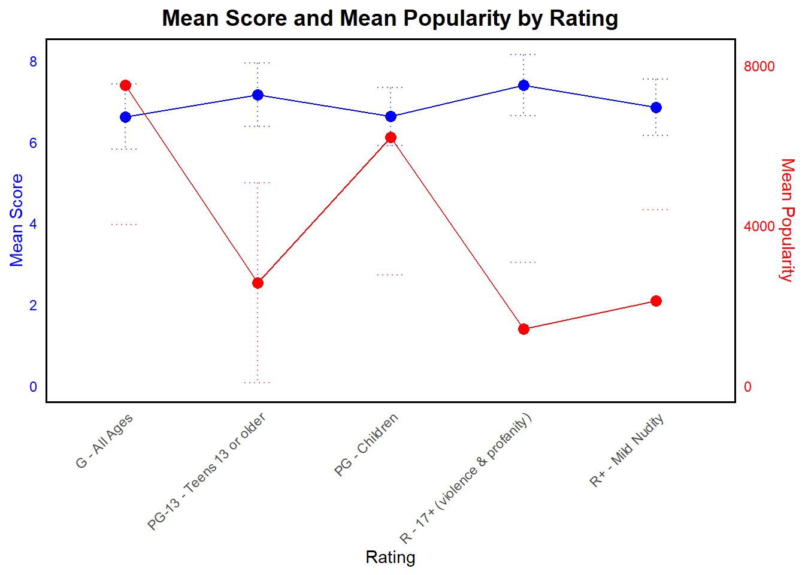

Slide 11
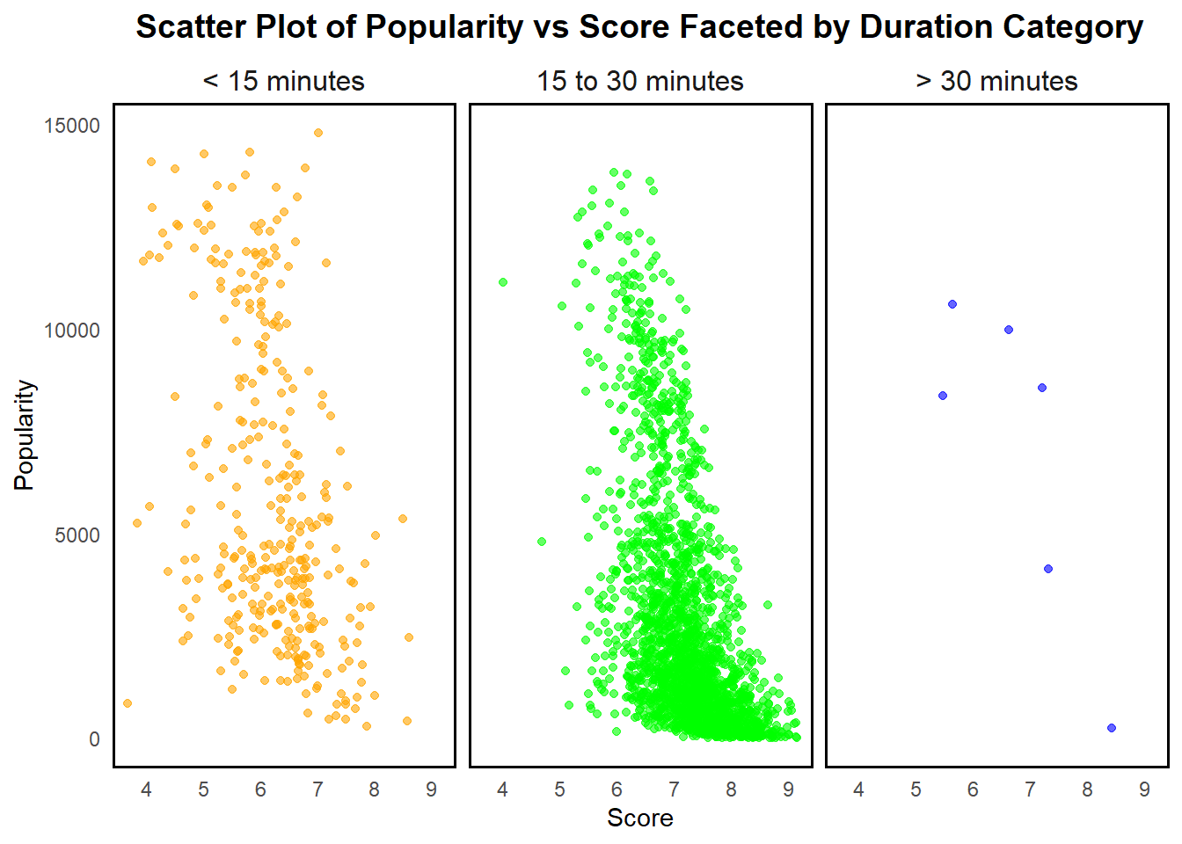

Slide 12
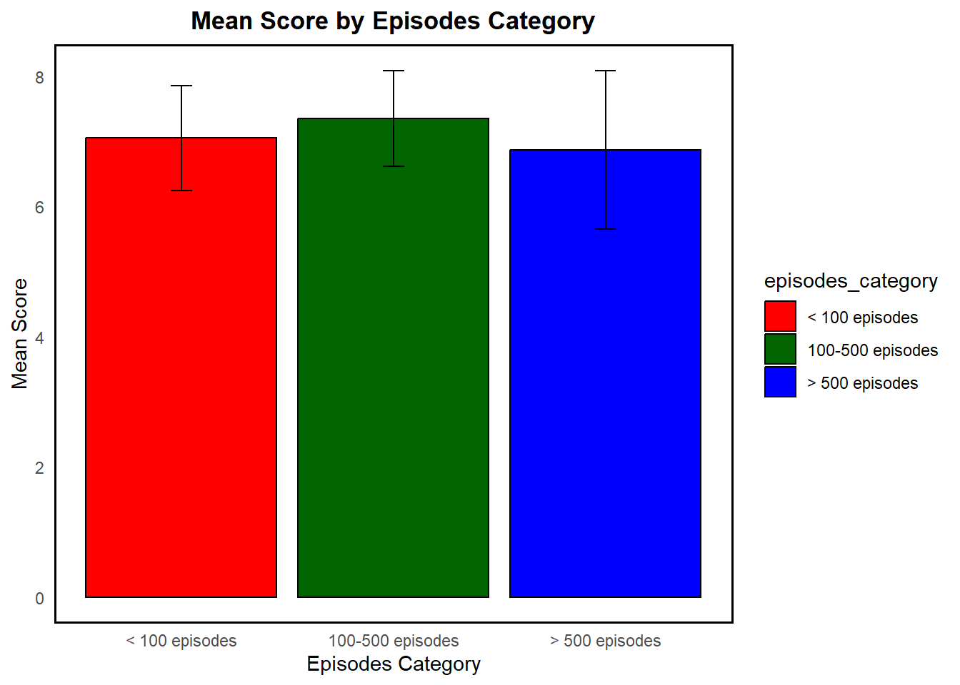
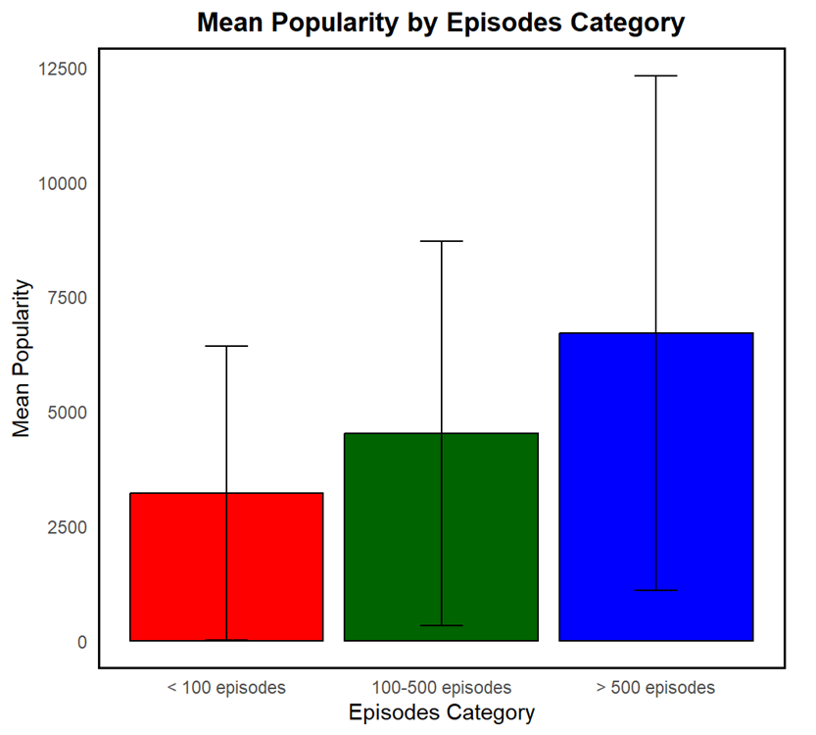

Slide 13
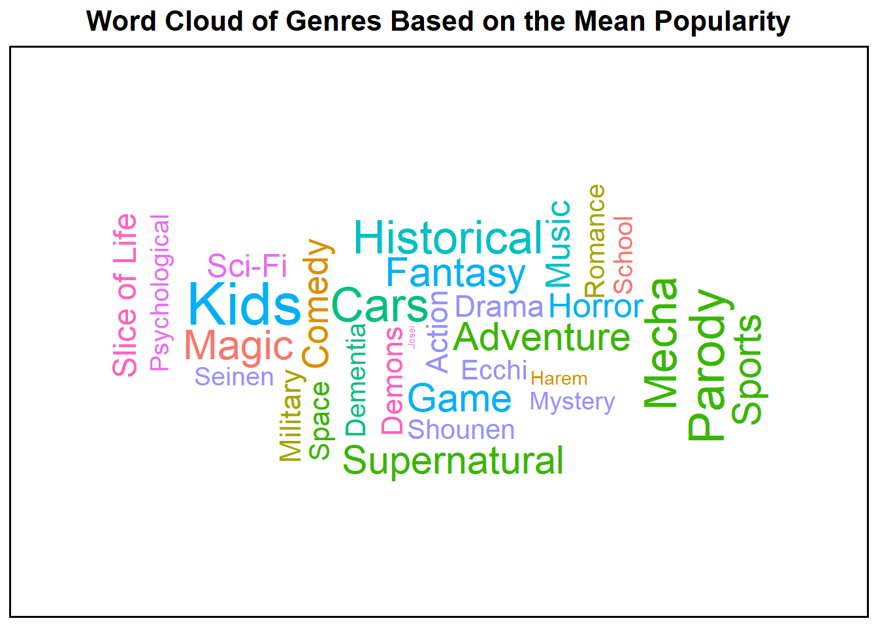

Slide 14

ARIGATO!!

