Slide 1
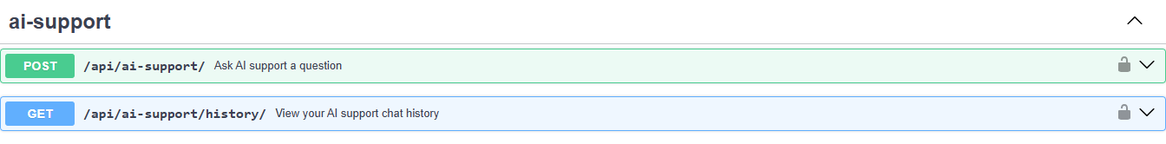
Swagger lists the new AI Support endpoints

Slide 2
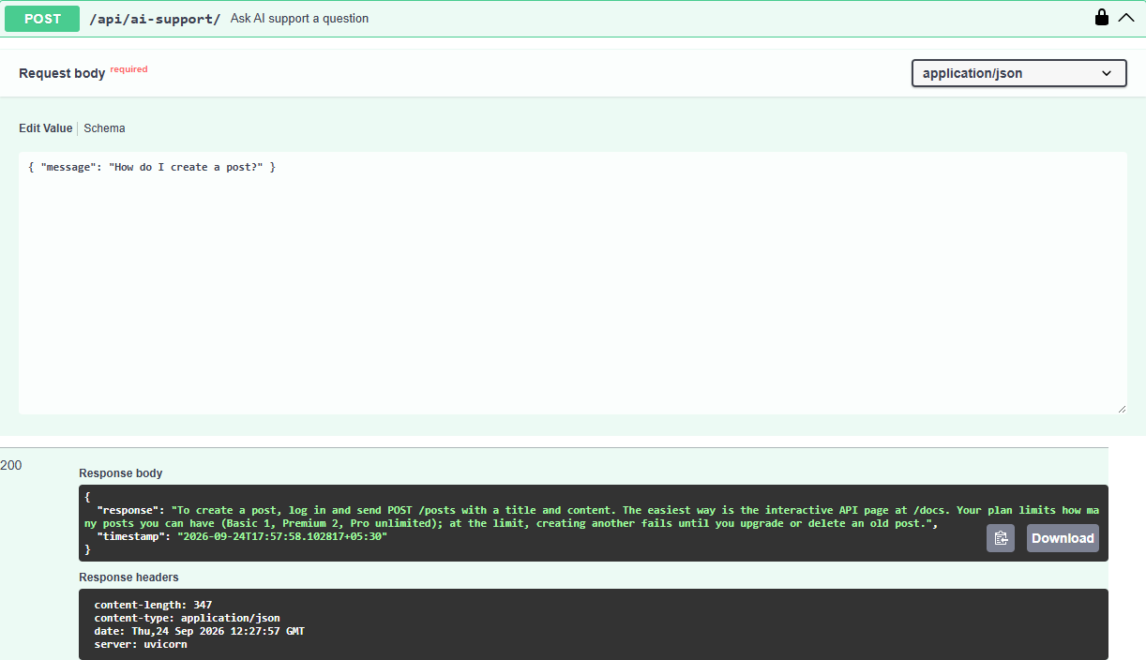
POST /api/ai-support/ returns an FAQ answer (200)

Slide 3

Unknown question receives the fallback response

Slide 4
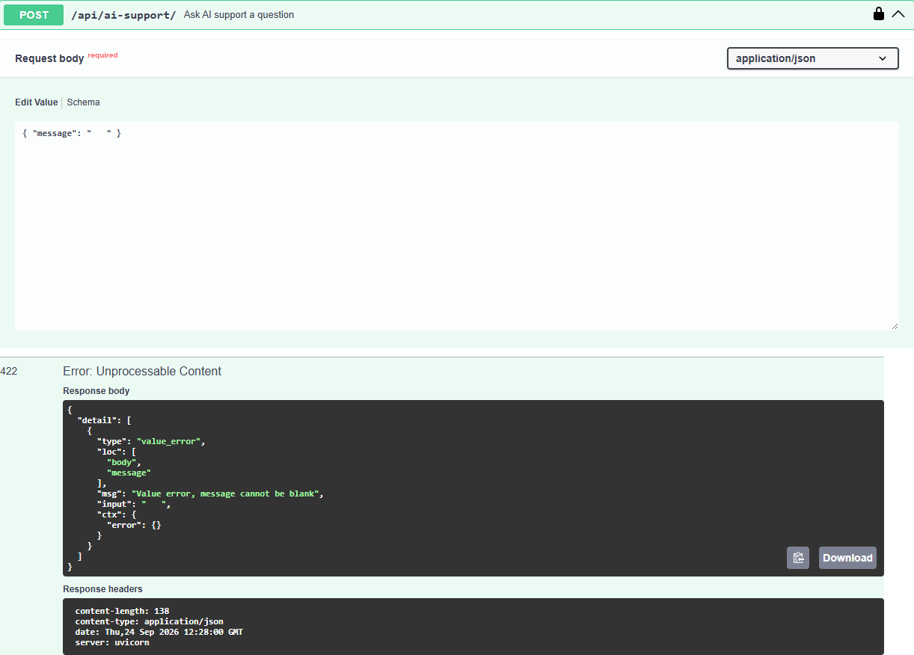
Blank message is rejected with a validation error (422)

Slide 5
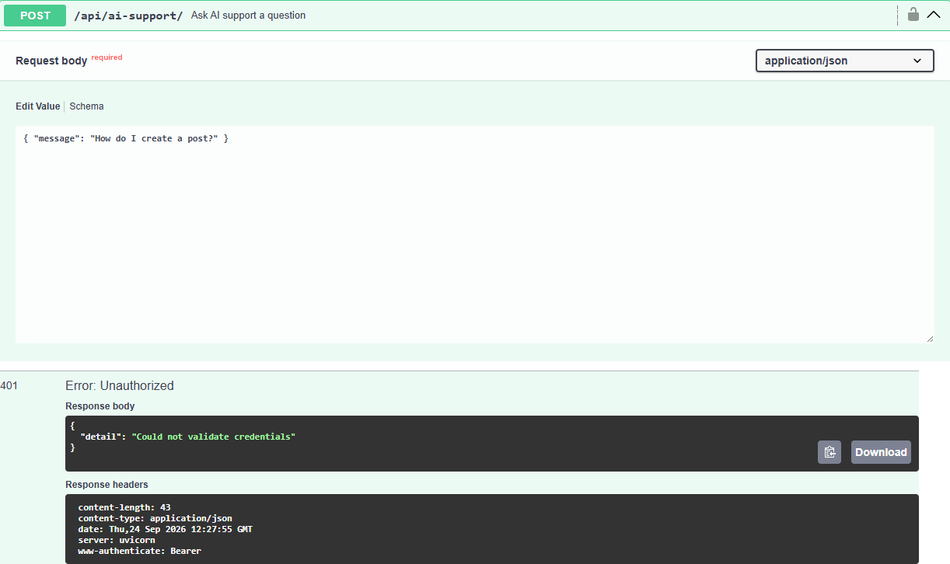
Request without login is rejected (401)

Slide 6
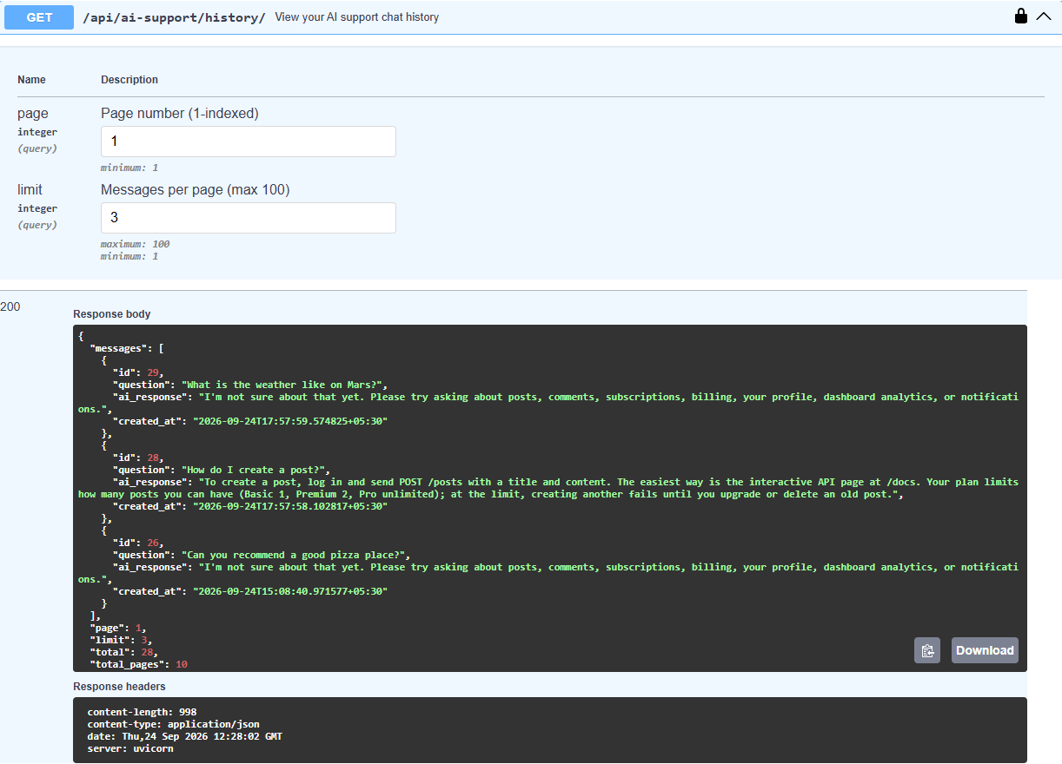
GET /api/ai-support/history/ returns the user's history, newest first

Slide 7
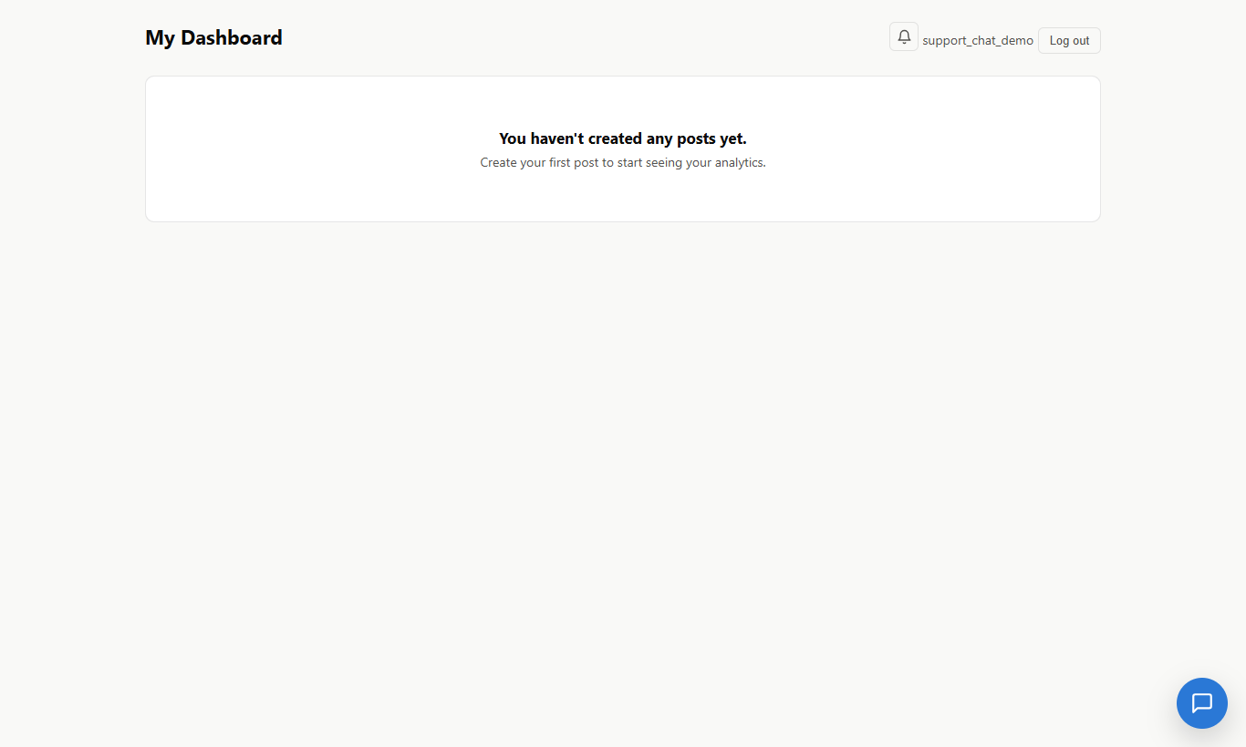
Dashboard with the floating AI Support chat button

Slide 8
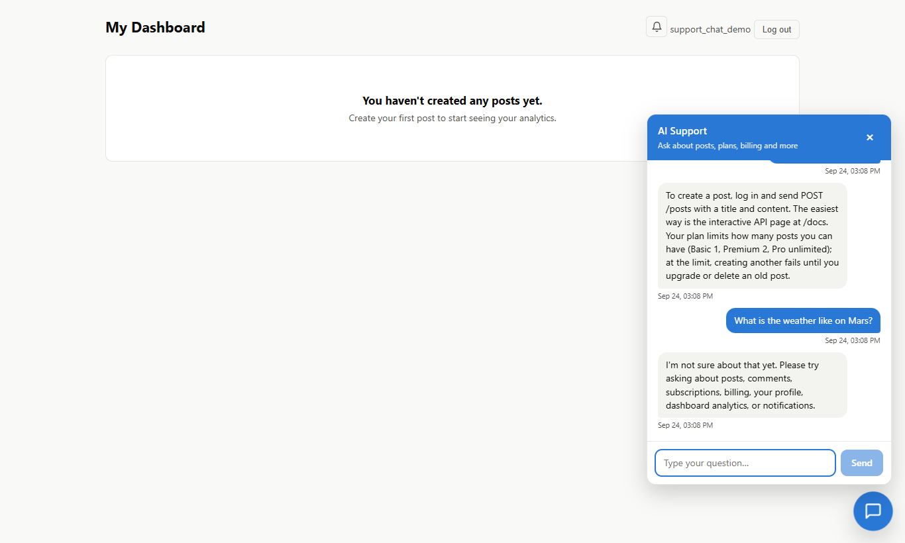
Chat window opens with previous chat history loaded

Slide 9
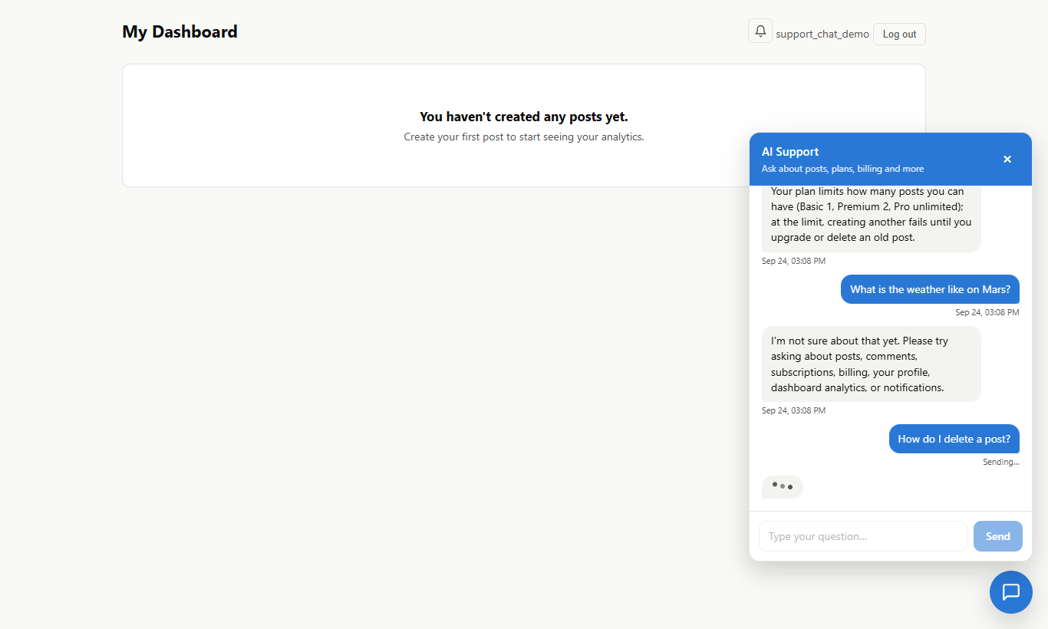
Loading indicator while waiting for the AI response

Slide 10
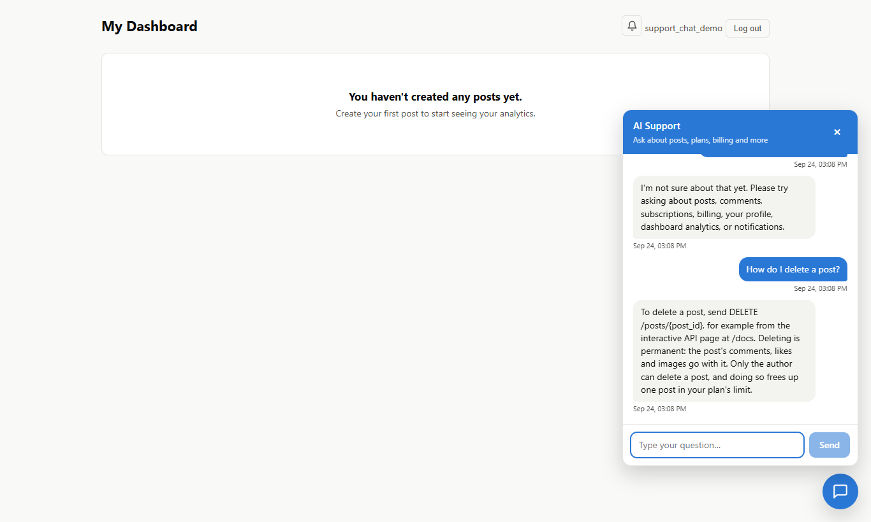
FAQ answer displayed in the chat

Slide 11
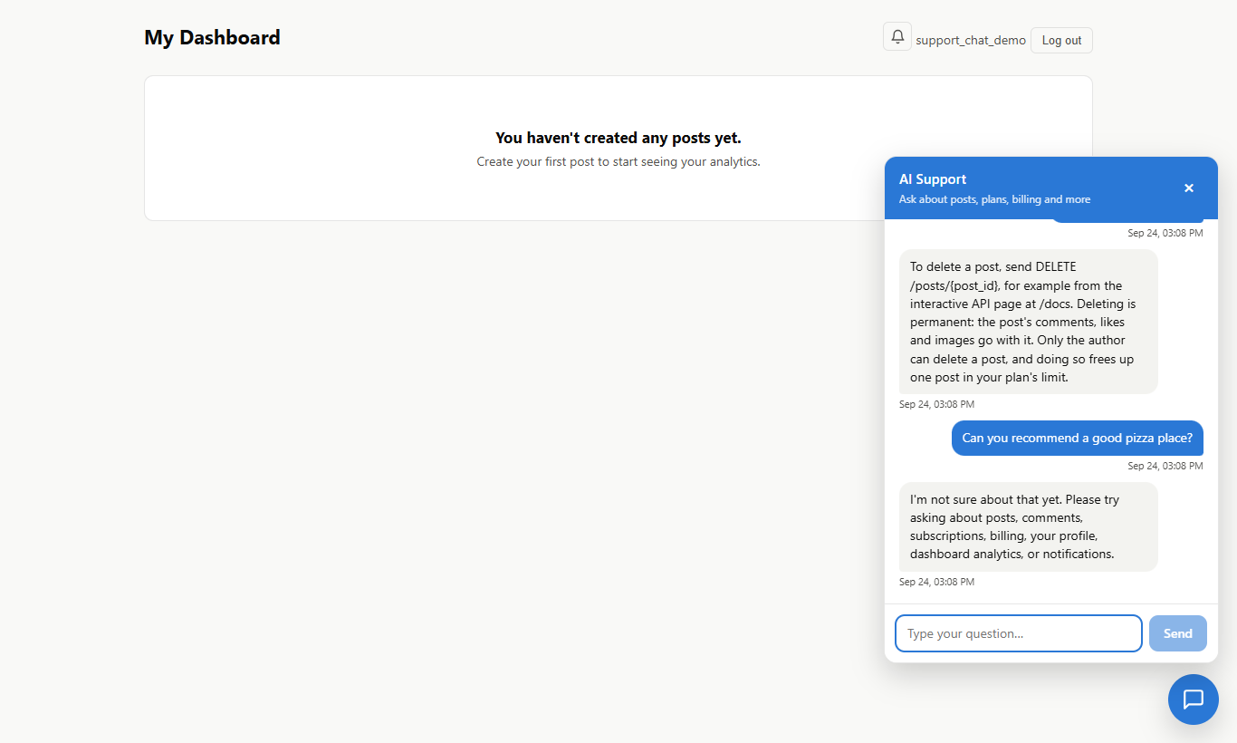
Fallback answer displayed for an unknown question

Slide 12
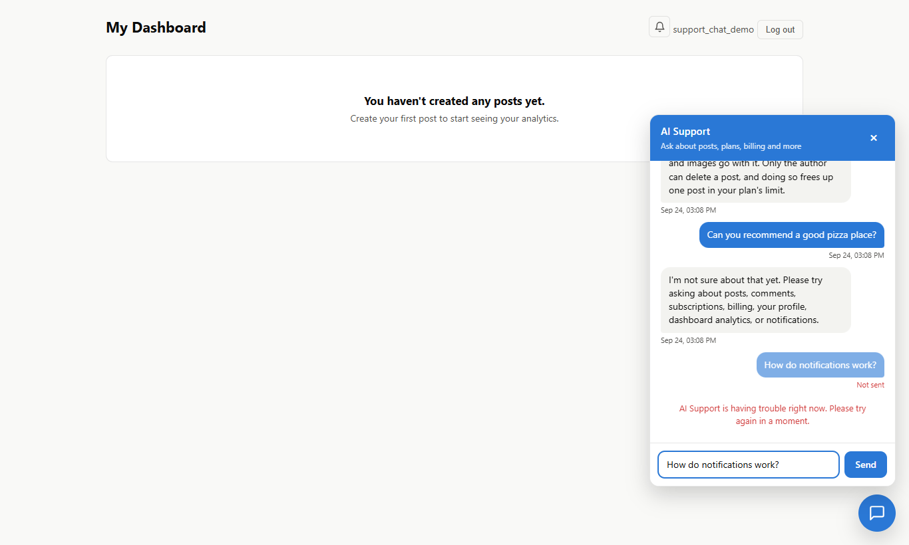
Friendly error message when a request fails

Slide 13
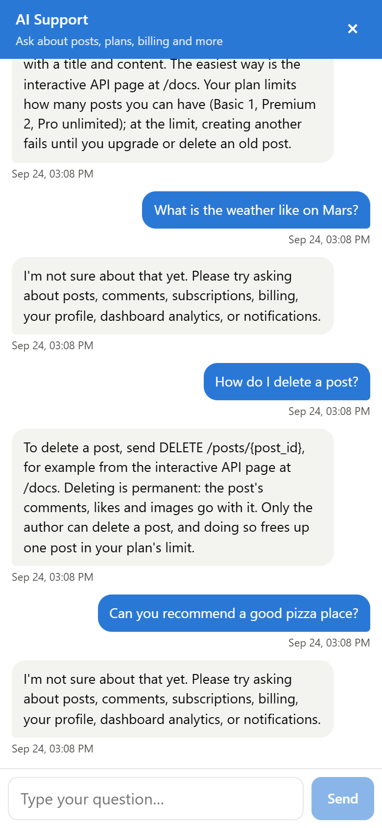
Mobile view: chat fits the full screen

Slide 14
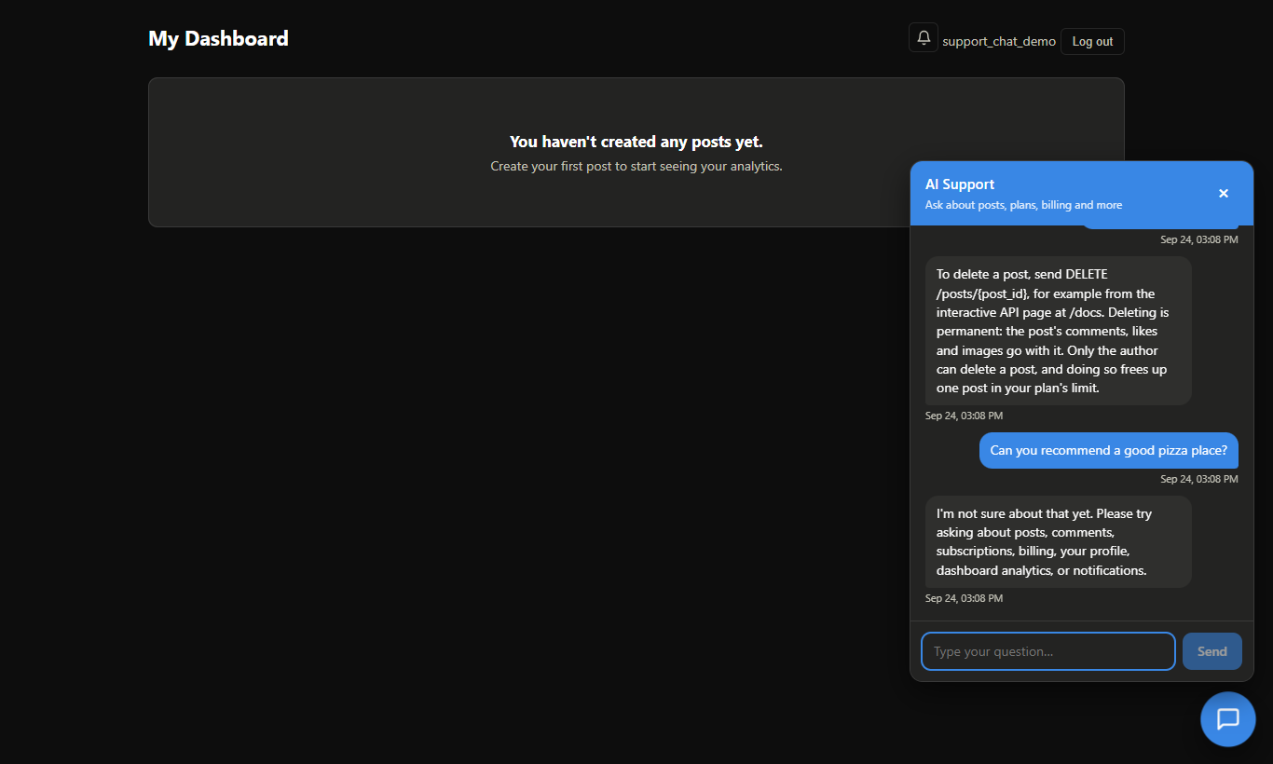
Chat widget follows the dashboard's dark mode

Slide 15
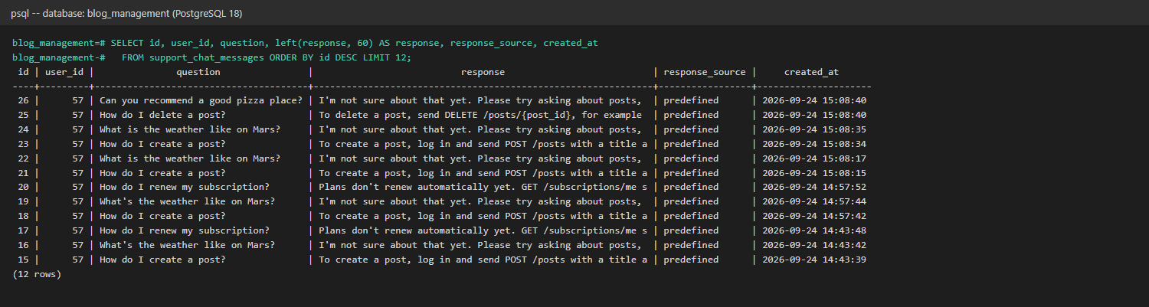
Chat records stored in the PostgreSQL database

Slide 16
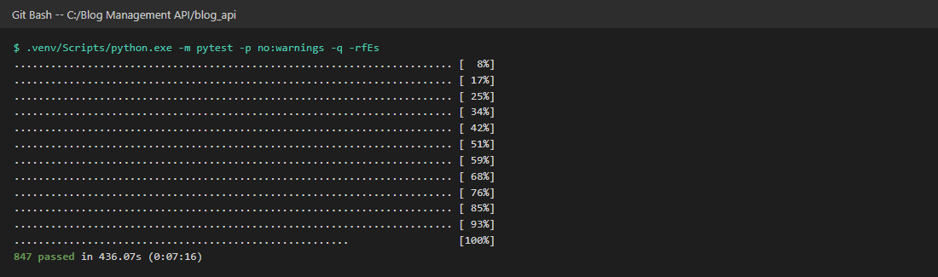
Complete test suite: 847 tests passed

Slide 17
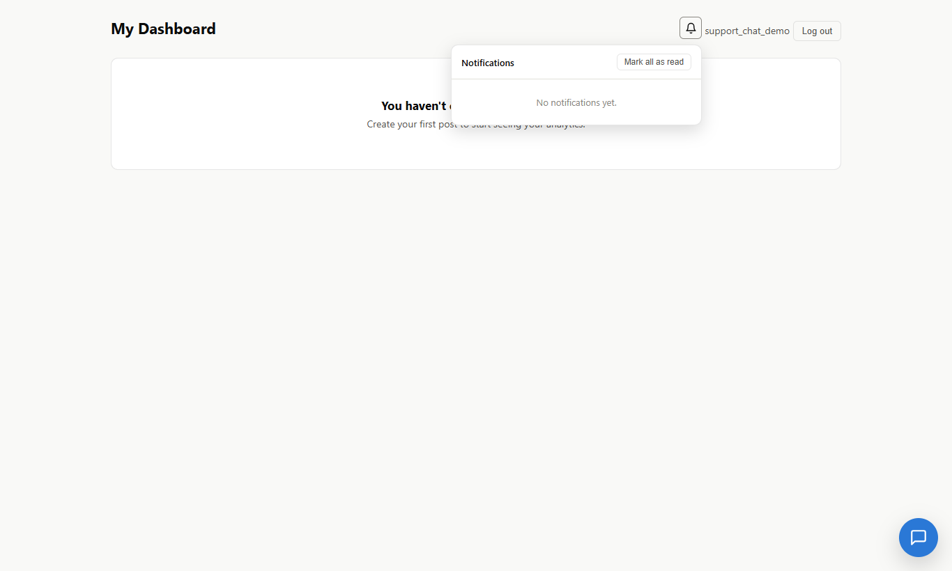
Existing Notification Center still works alongside the chat

