Slide 1
Blog Management API
Live Demo — Real Working & Output Screenshots

Slide 2
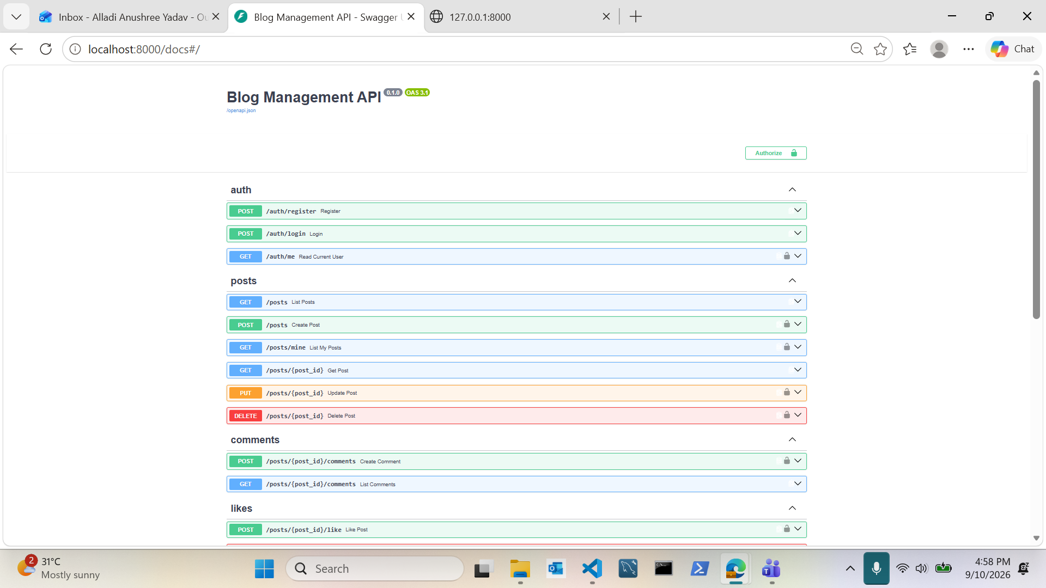
Swagger UI — All API Endpoints

Slide 3
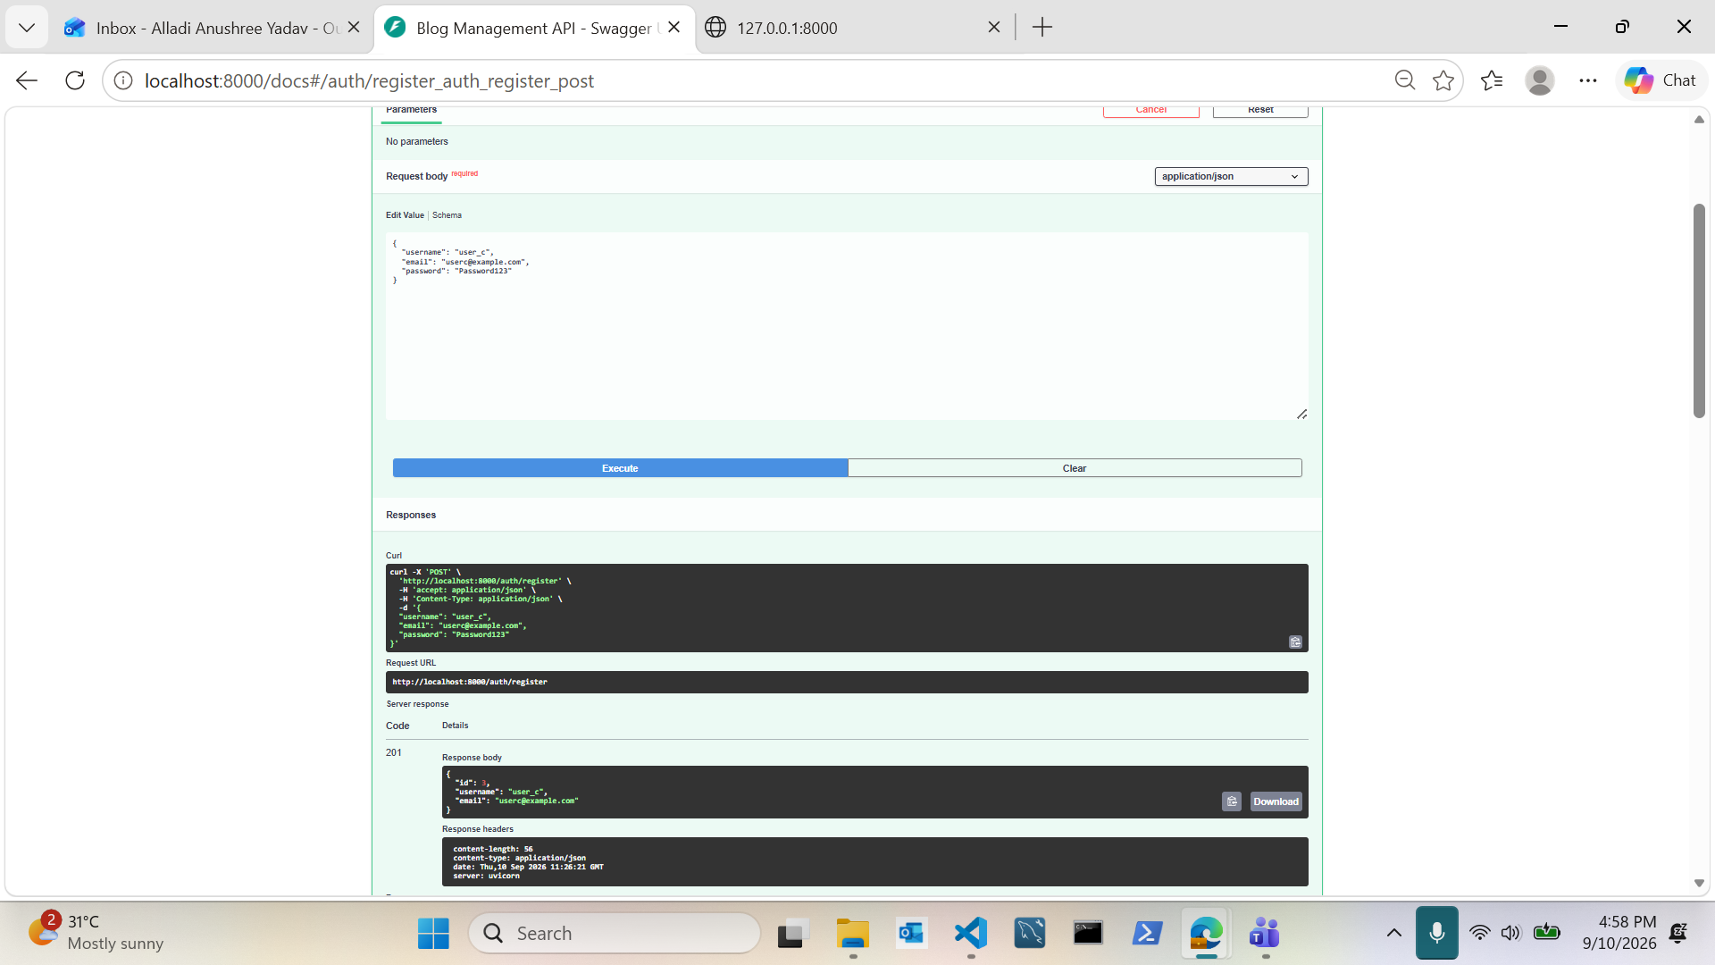
User Registration — Working

Slide 4
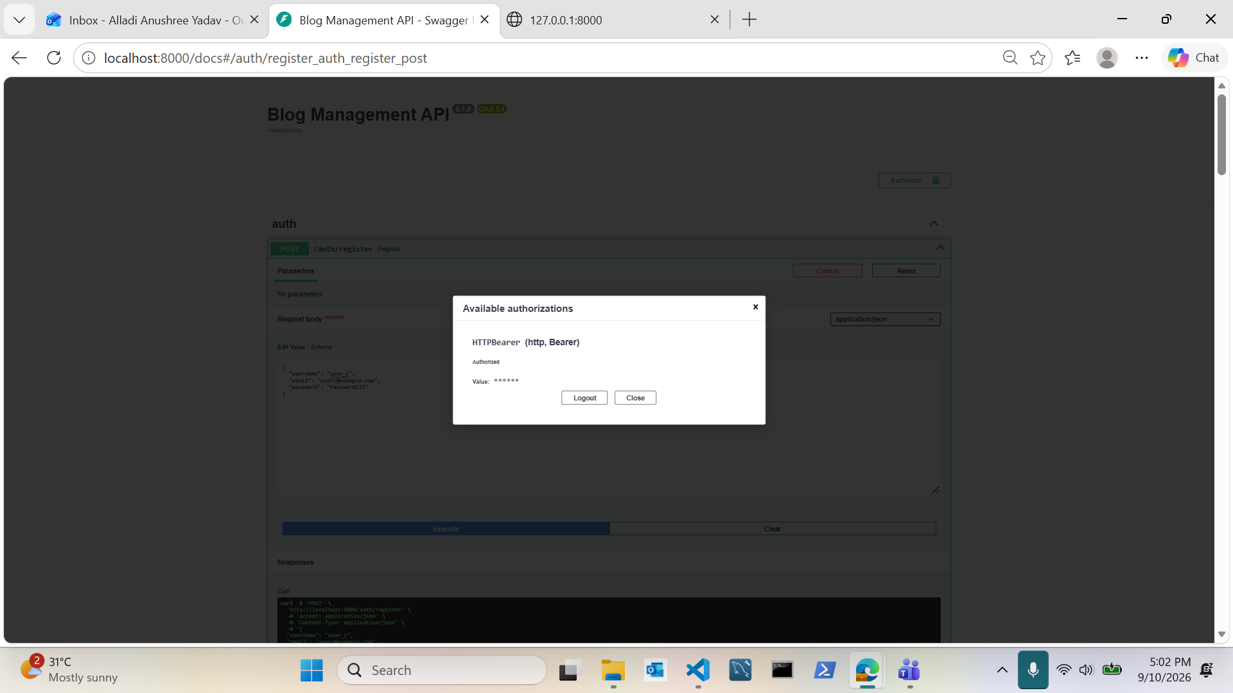
User Login Returns a JWT Token

Slide 5
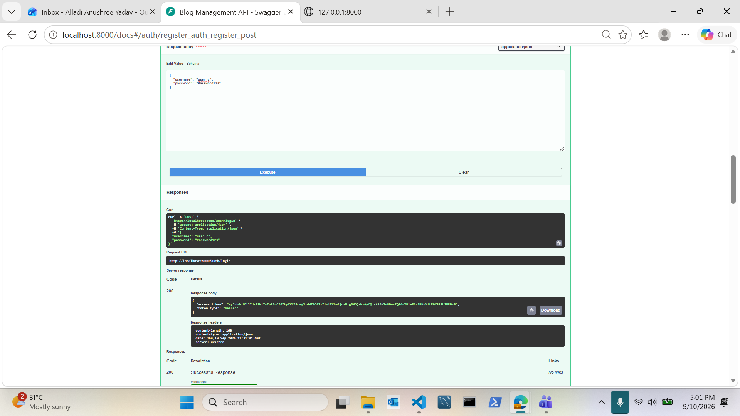
Authorized Request with Bearer Token

Slide 6
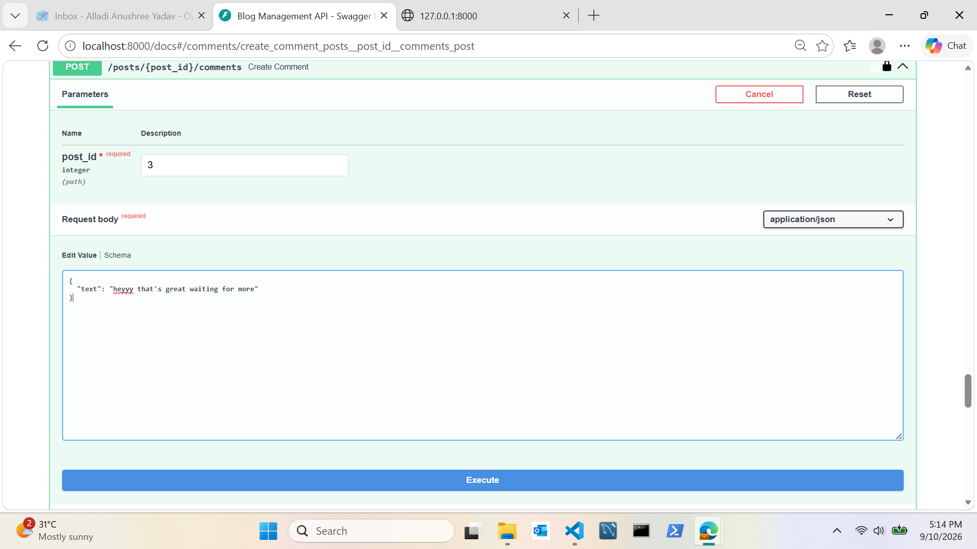
Creating a Comment on a Post

Slide 7
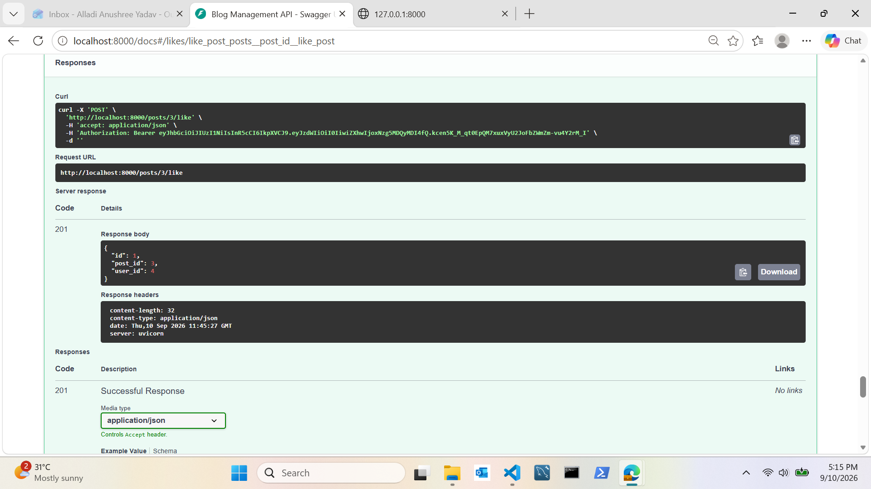
Liking a Post

Slide 8
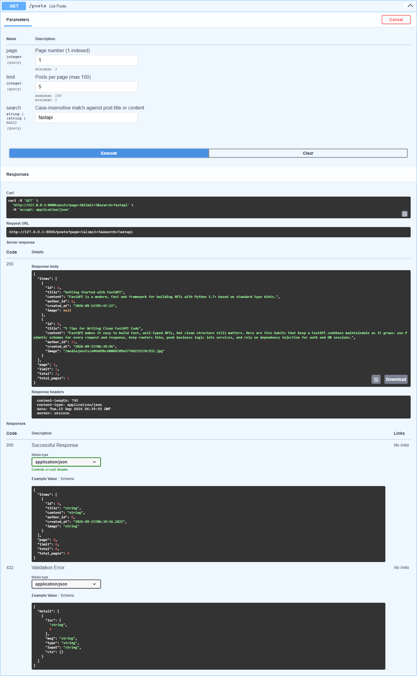
Pagination & Search in Action

Slide 9
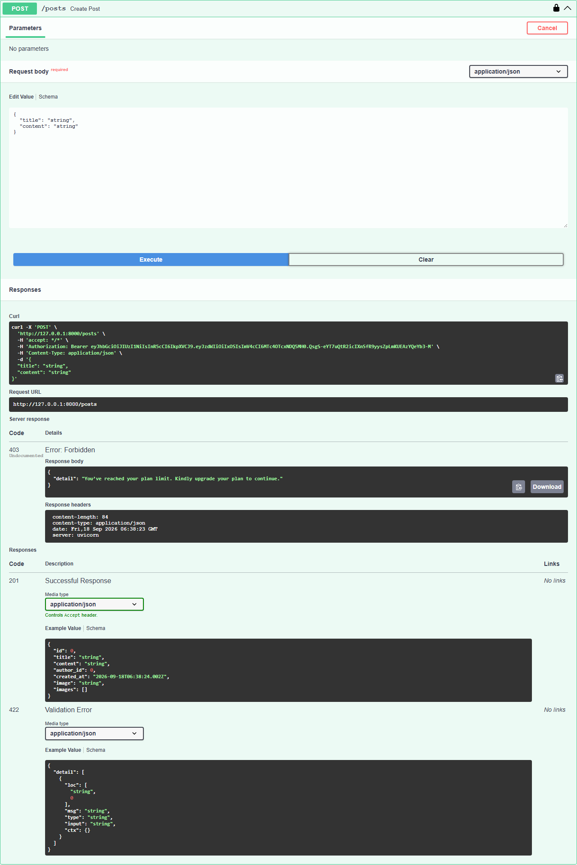
Subscription Limit Enforcement

Slide 10
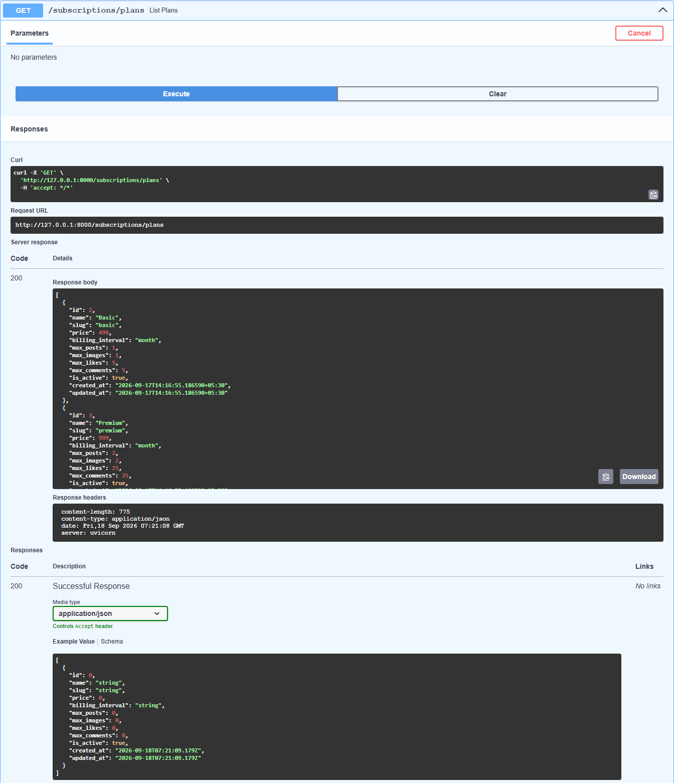
Subscription Plans Endpoint

Slide 11
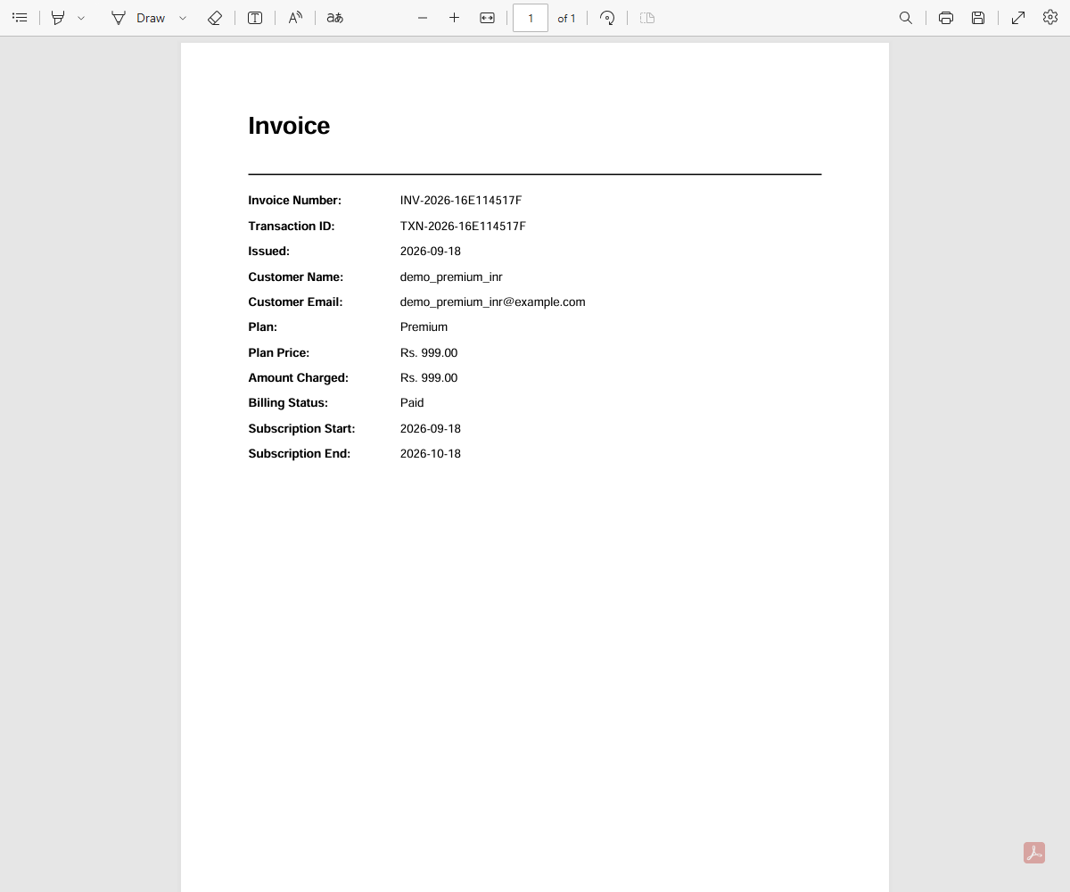
Auto-Generated Invoice Output

Slide 12
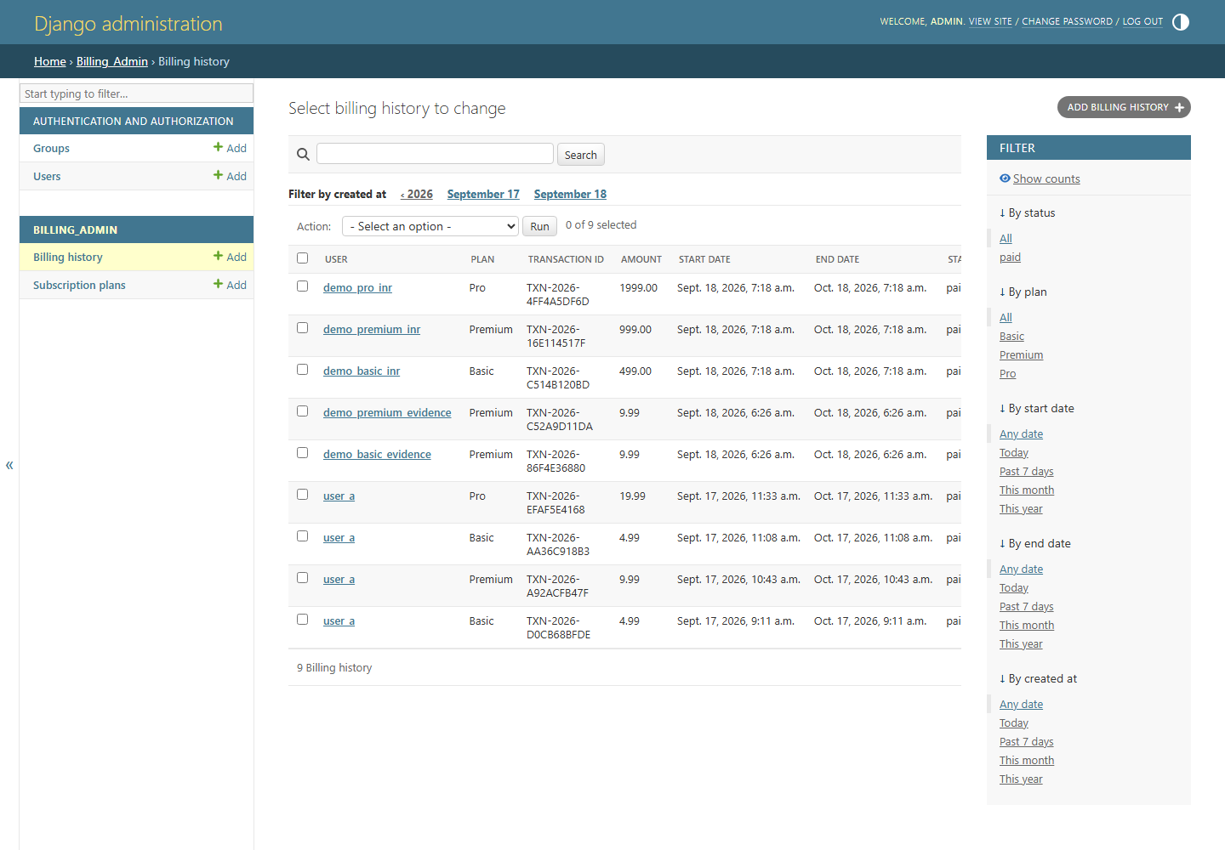
Admin Panel — Billing History

Slide 13
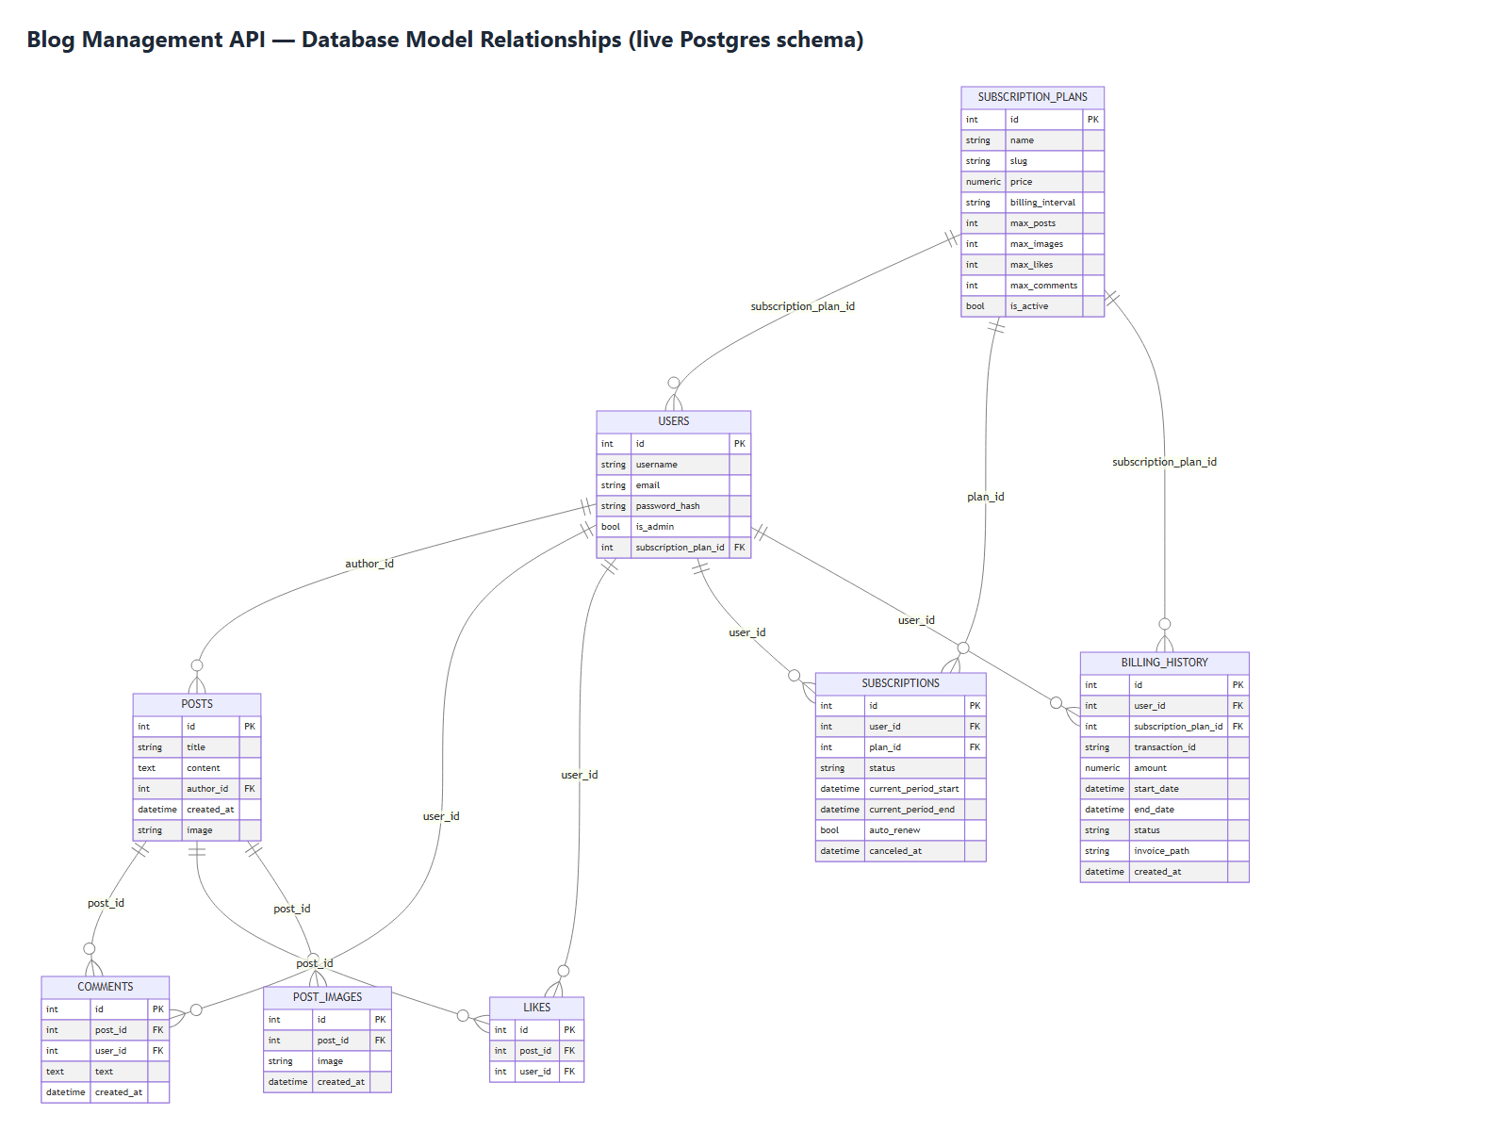
Database Schema — ER Diagram

Slide 14
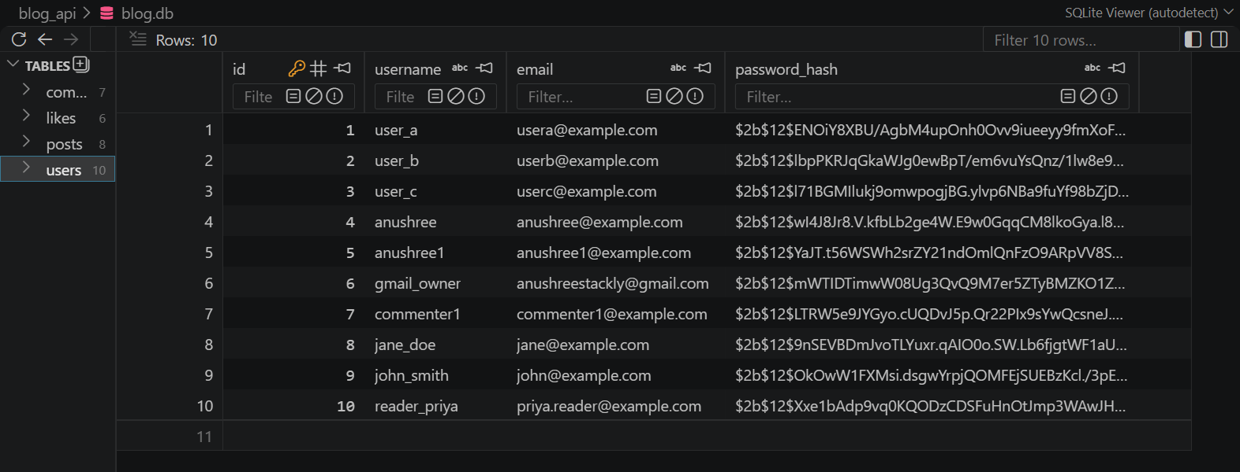
SQLite Database — Users Table

Slide 15
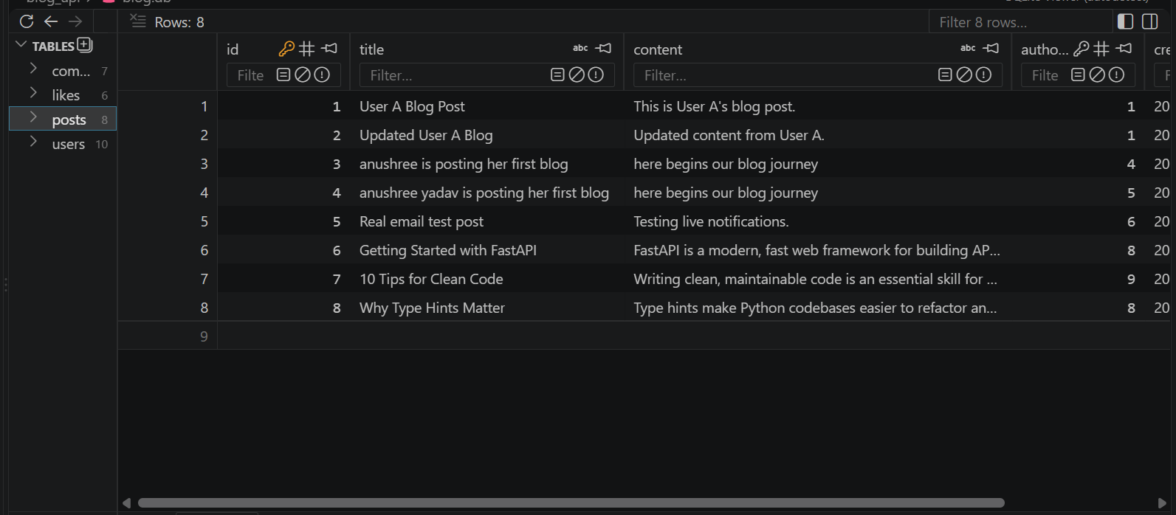
SQLite Database — Posts Table

Slide 16
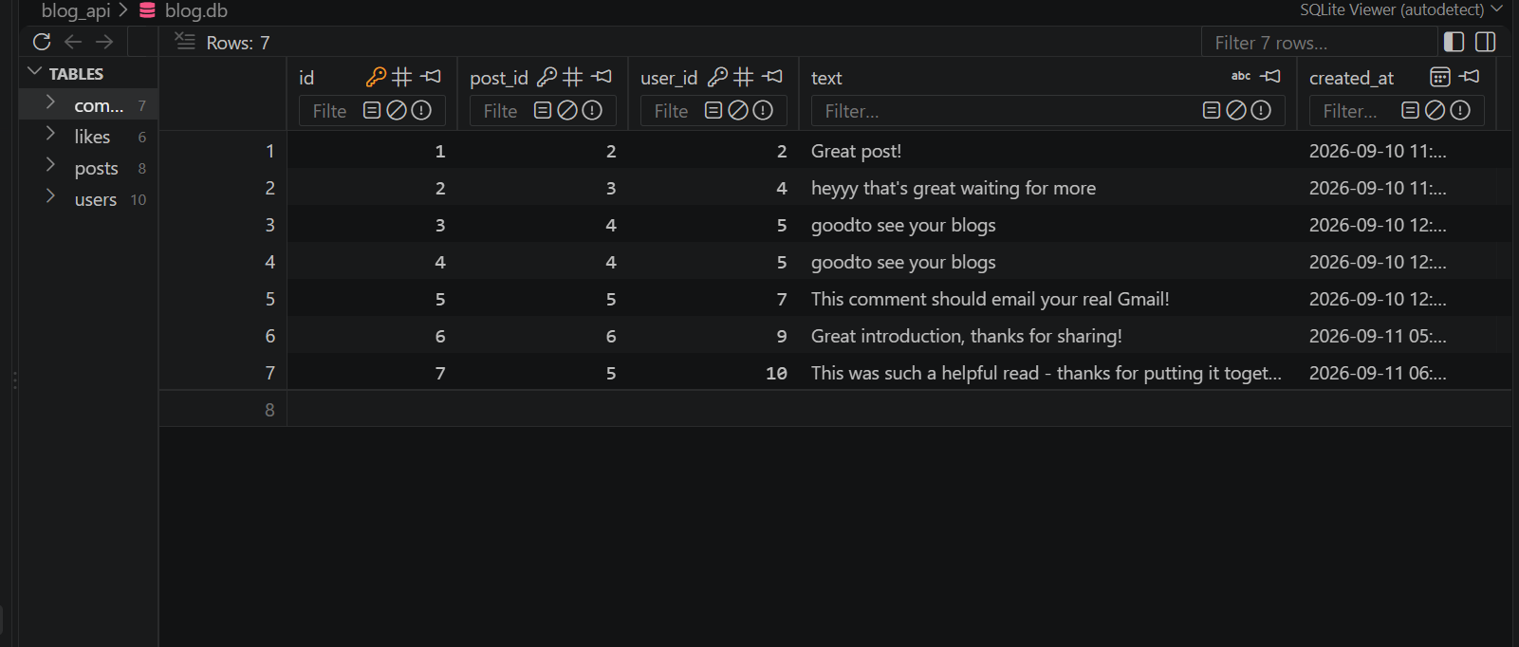
SQLite Database — Comments Table

Slide 17
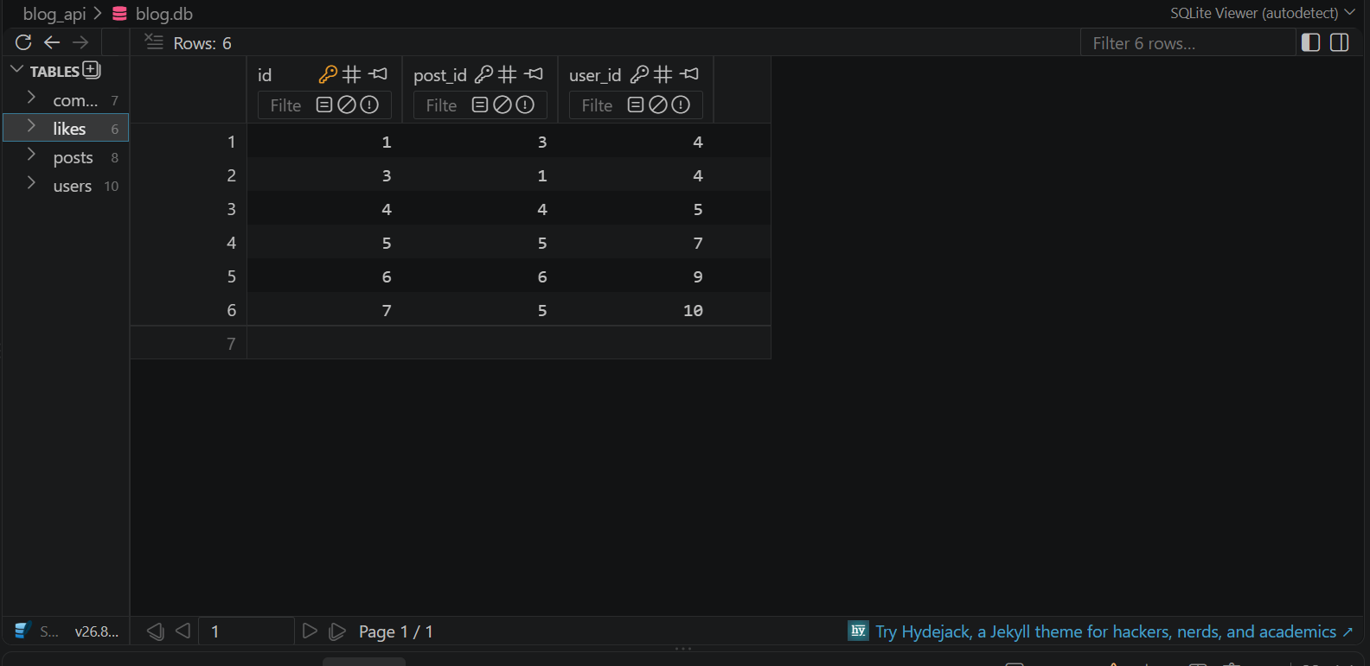
SQLite Database — Likes Table

Slide 18
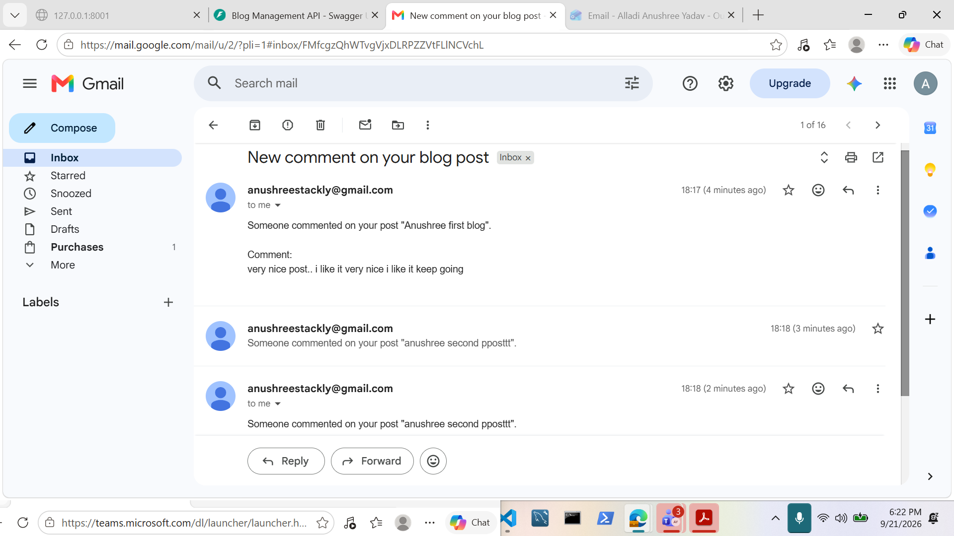
Real Email Notification Received

Slide 19
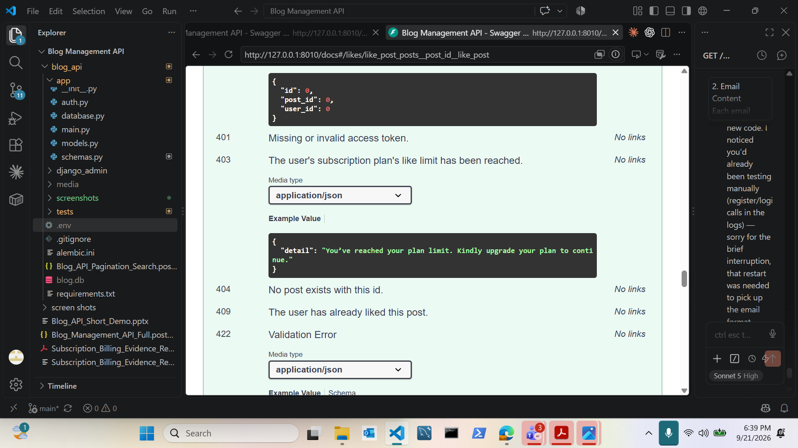
Like Endpoint — Plan Limit Reached (403)

Slide 20
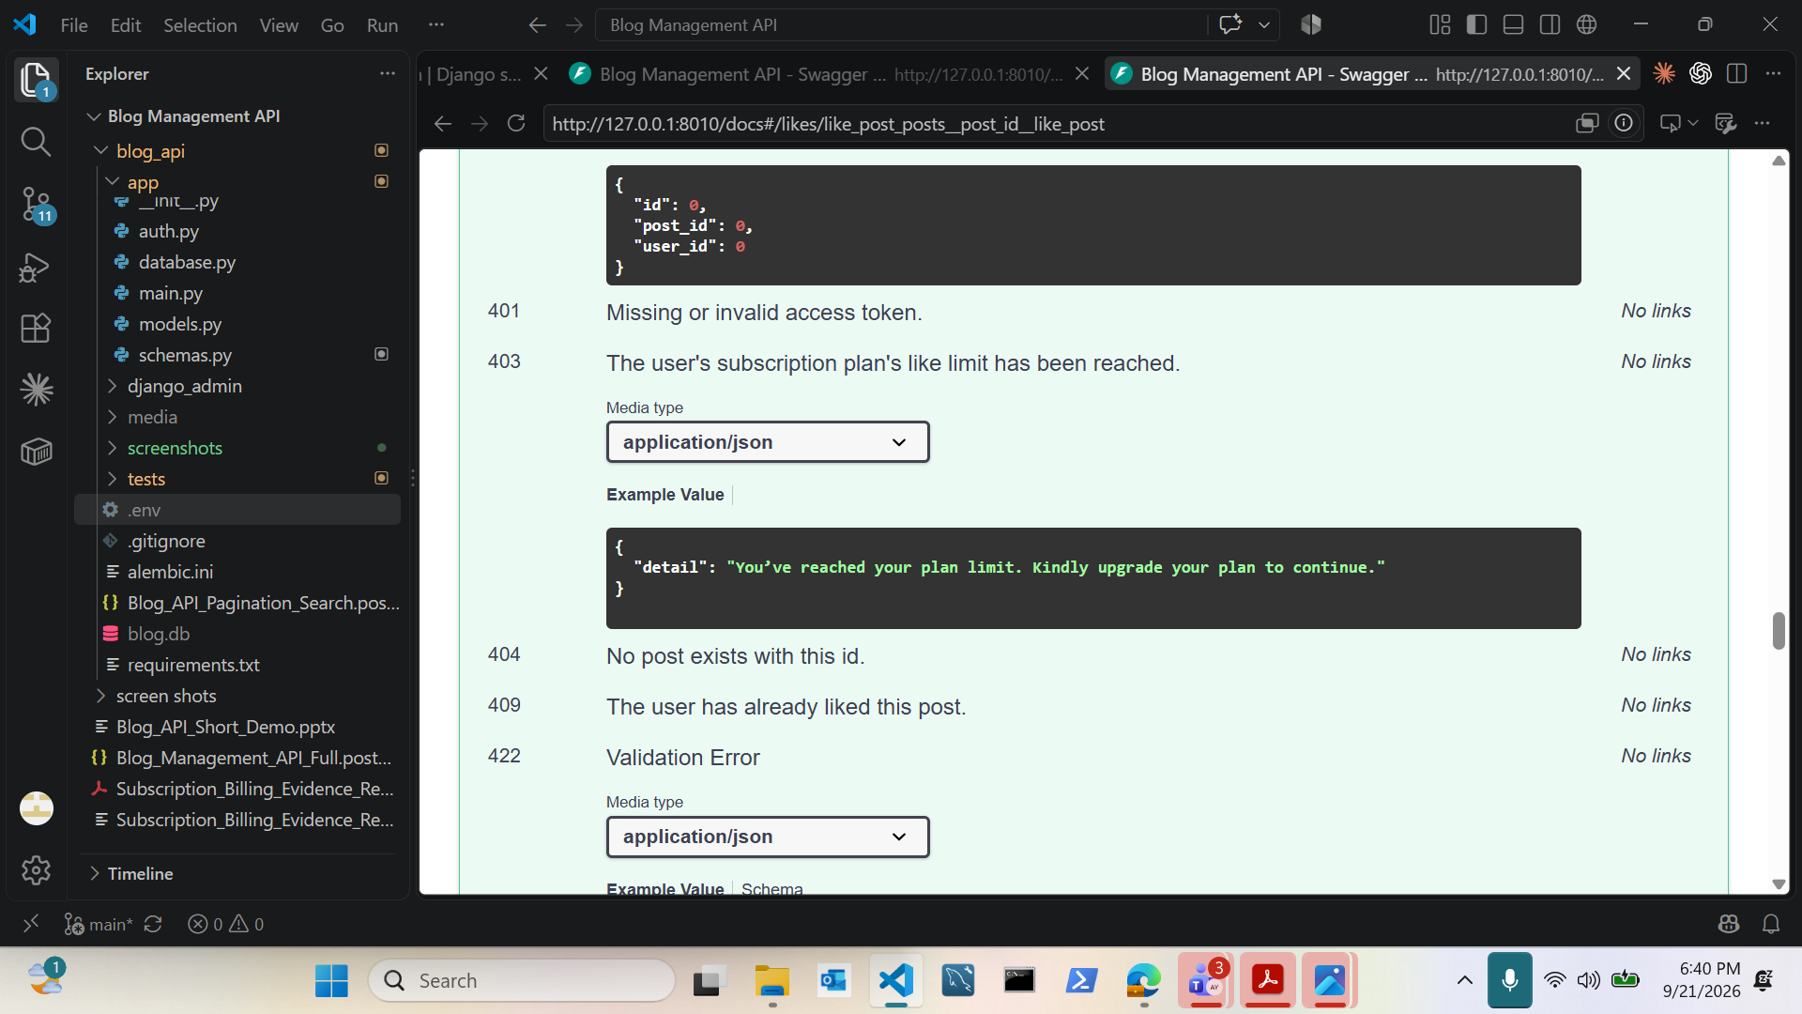
Like Endpoint — Full Response Reference

Slide 21
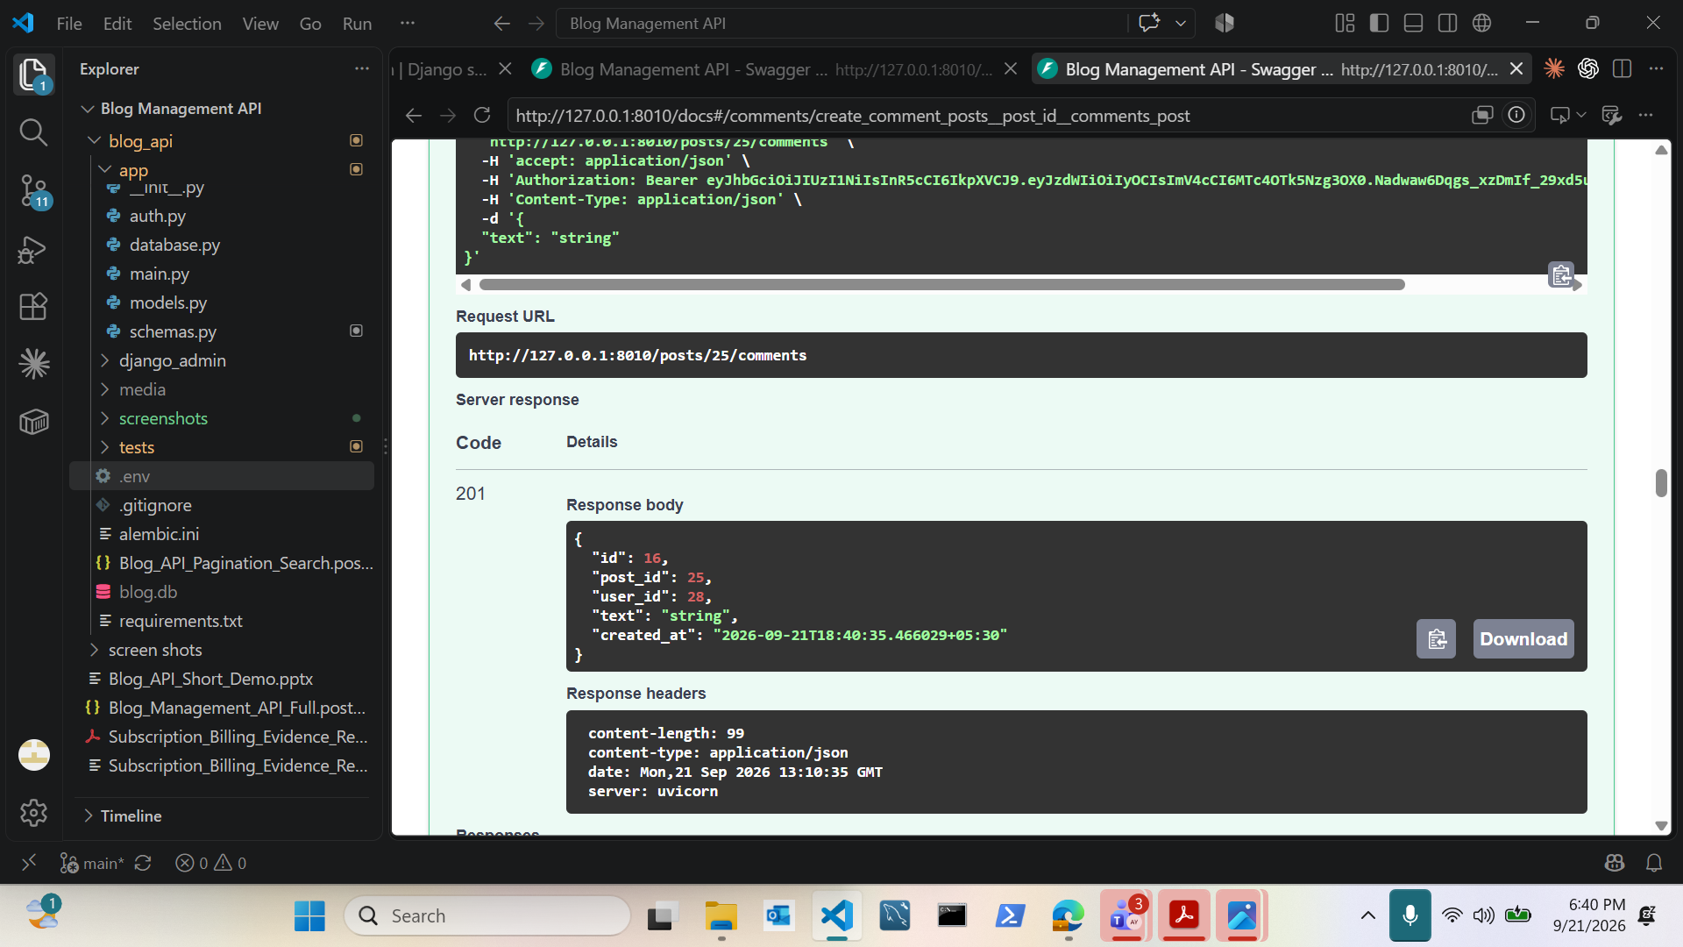
Comment Created Successfully (201)

Slide 22
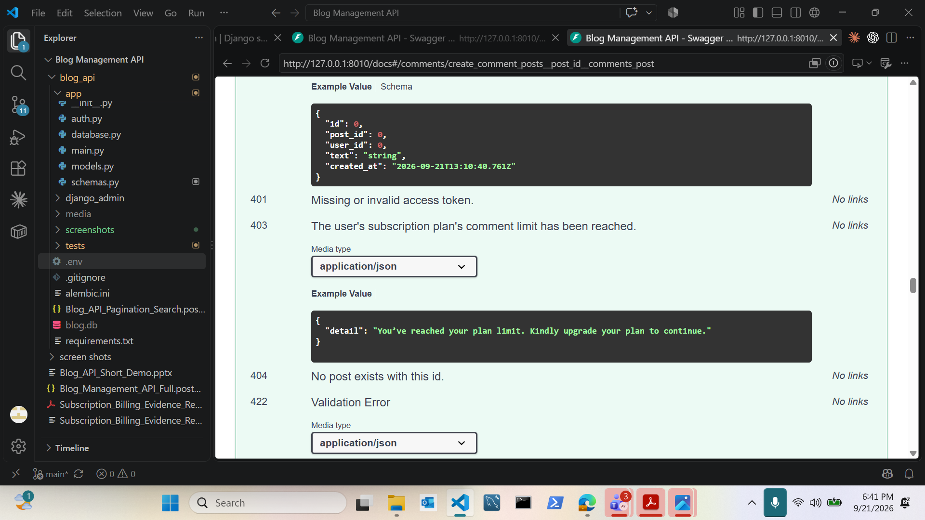
Comment Limit Reached — Plan Enforcement (403)

Slide 23
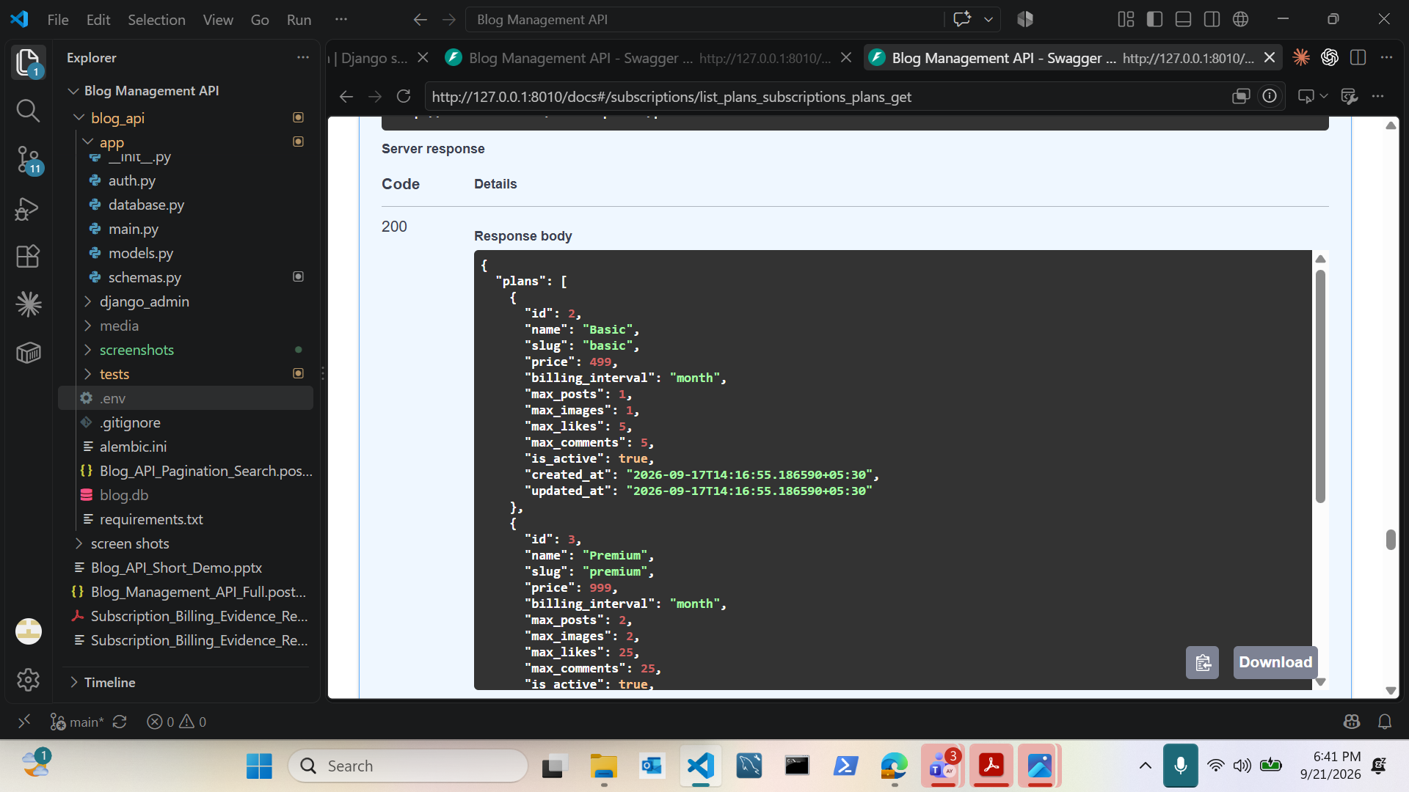
Subscription Plans — Basic & Premium Limits

Slide 24
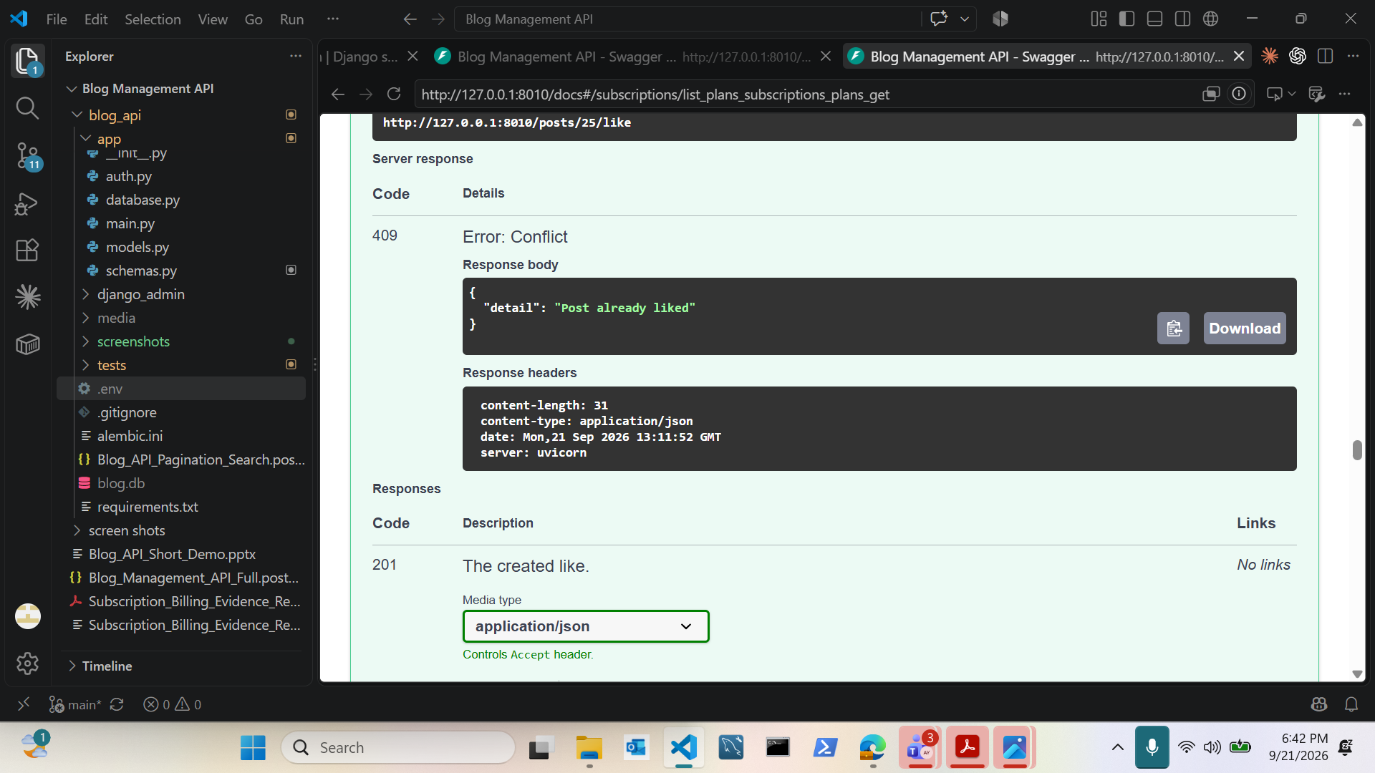
Like a Post — Already Liked (409 Conflict)

Slide 25
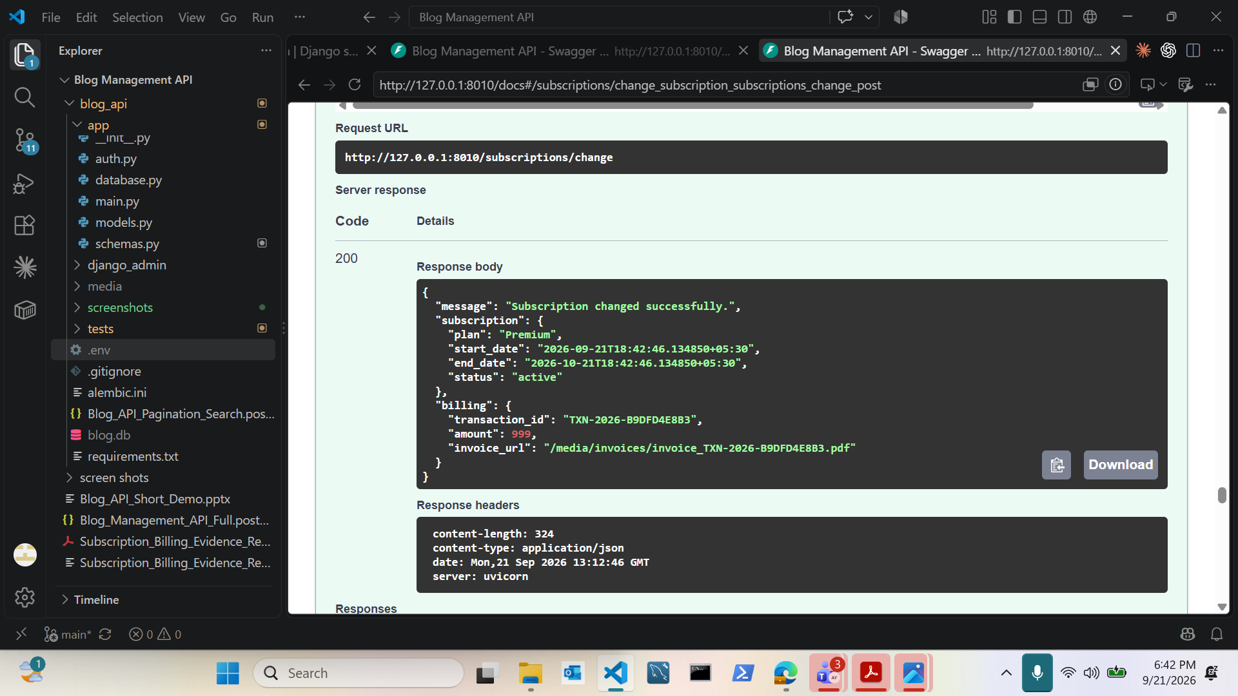
Subscription Change — Invoice Generated

Slide 26
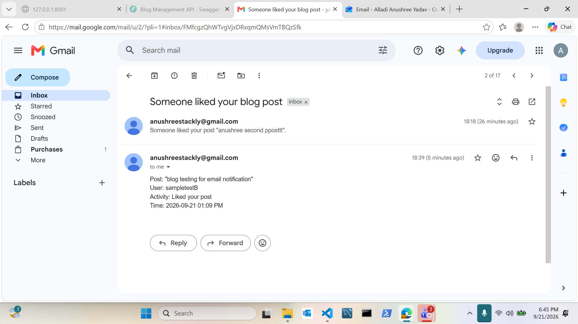
Real Email — Post Liked Notification

Slide 27
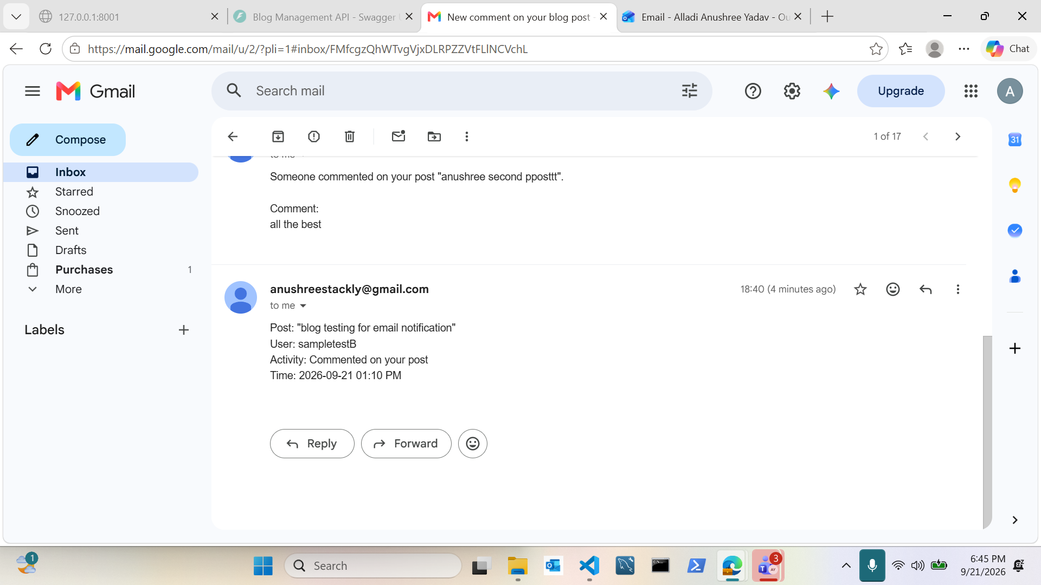
Real Email — New Comment Notification

Slide 28
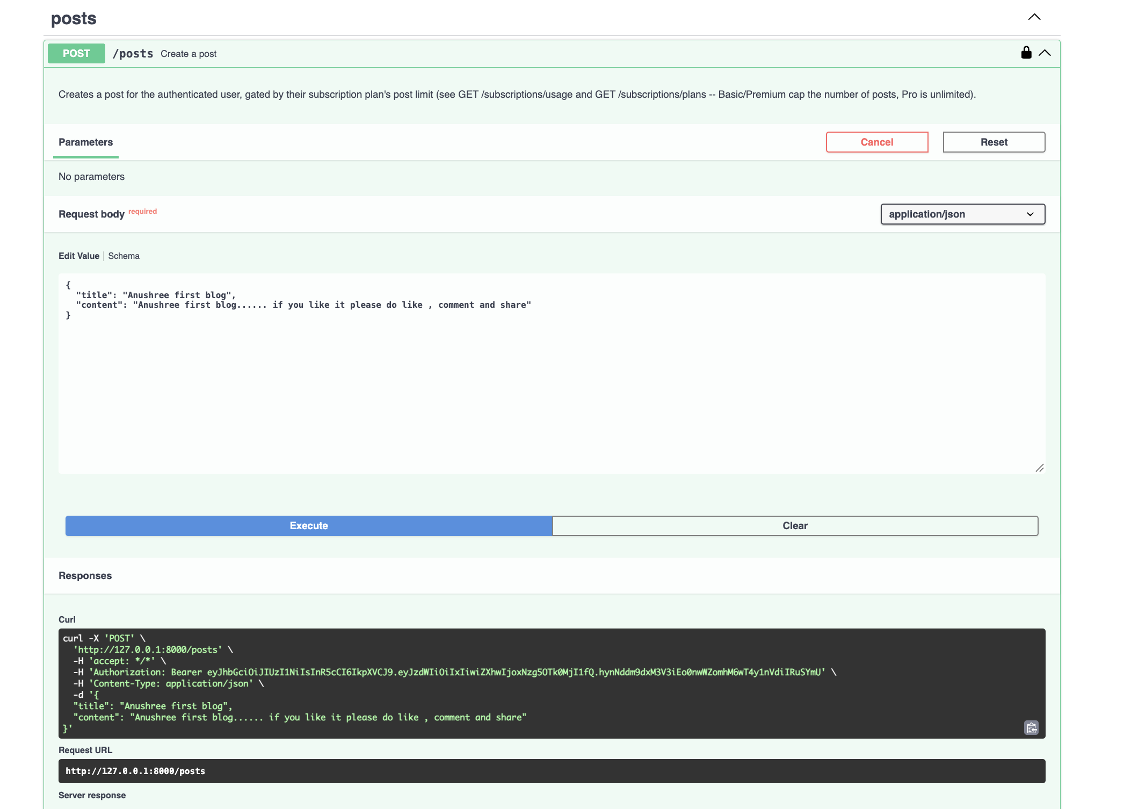
Create Post — Subscription-Gated Endpoint

Slide 29
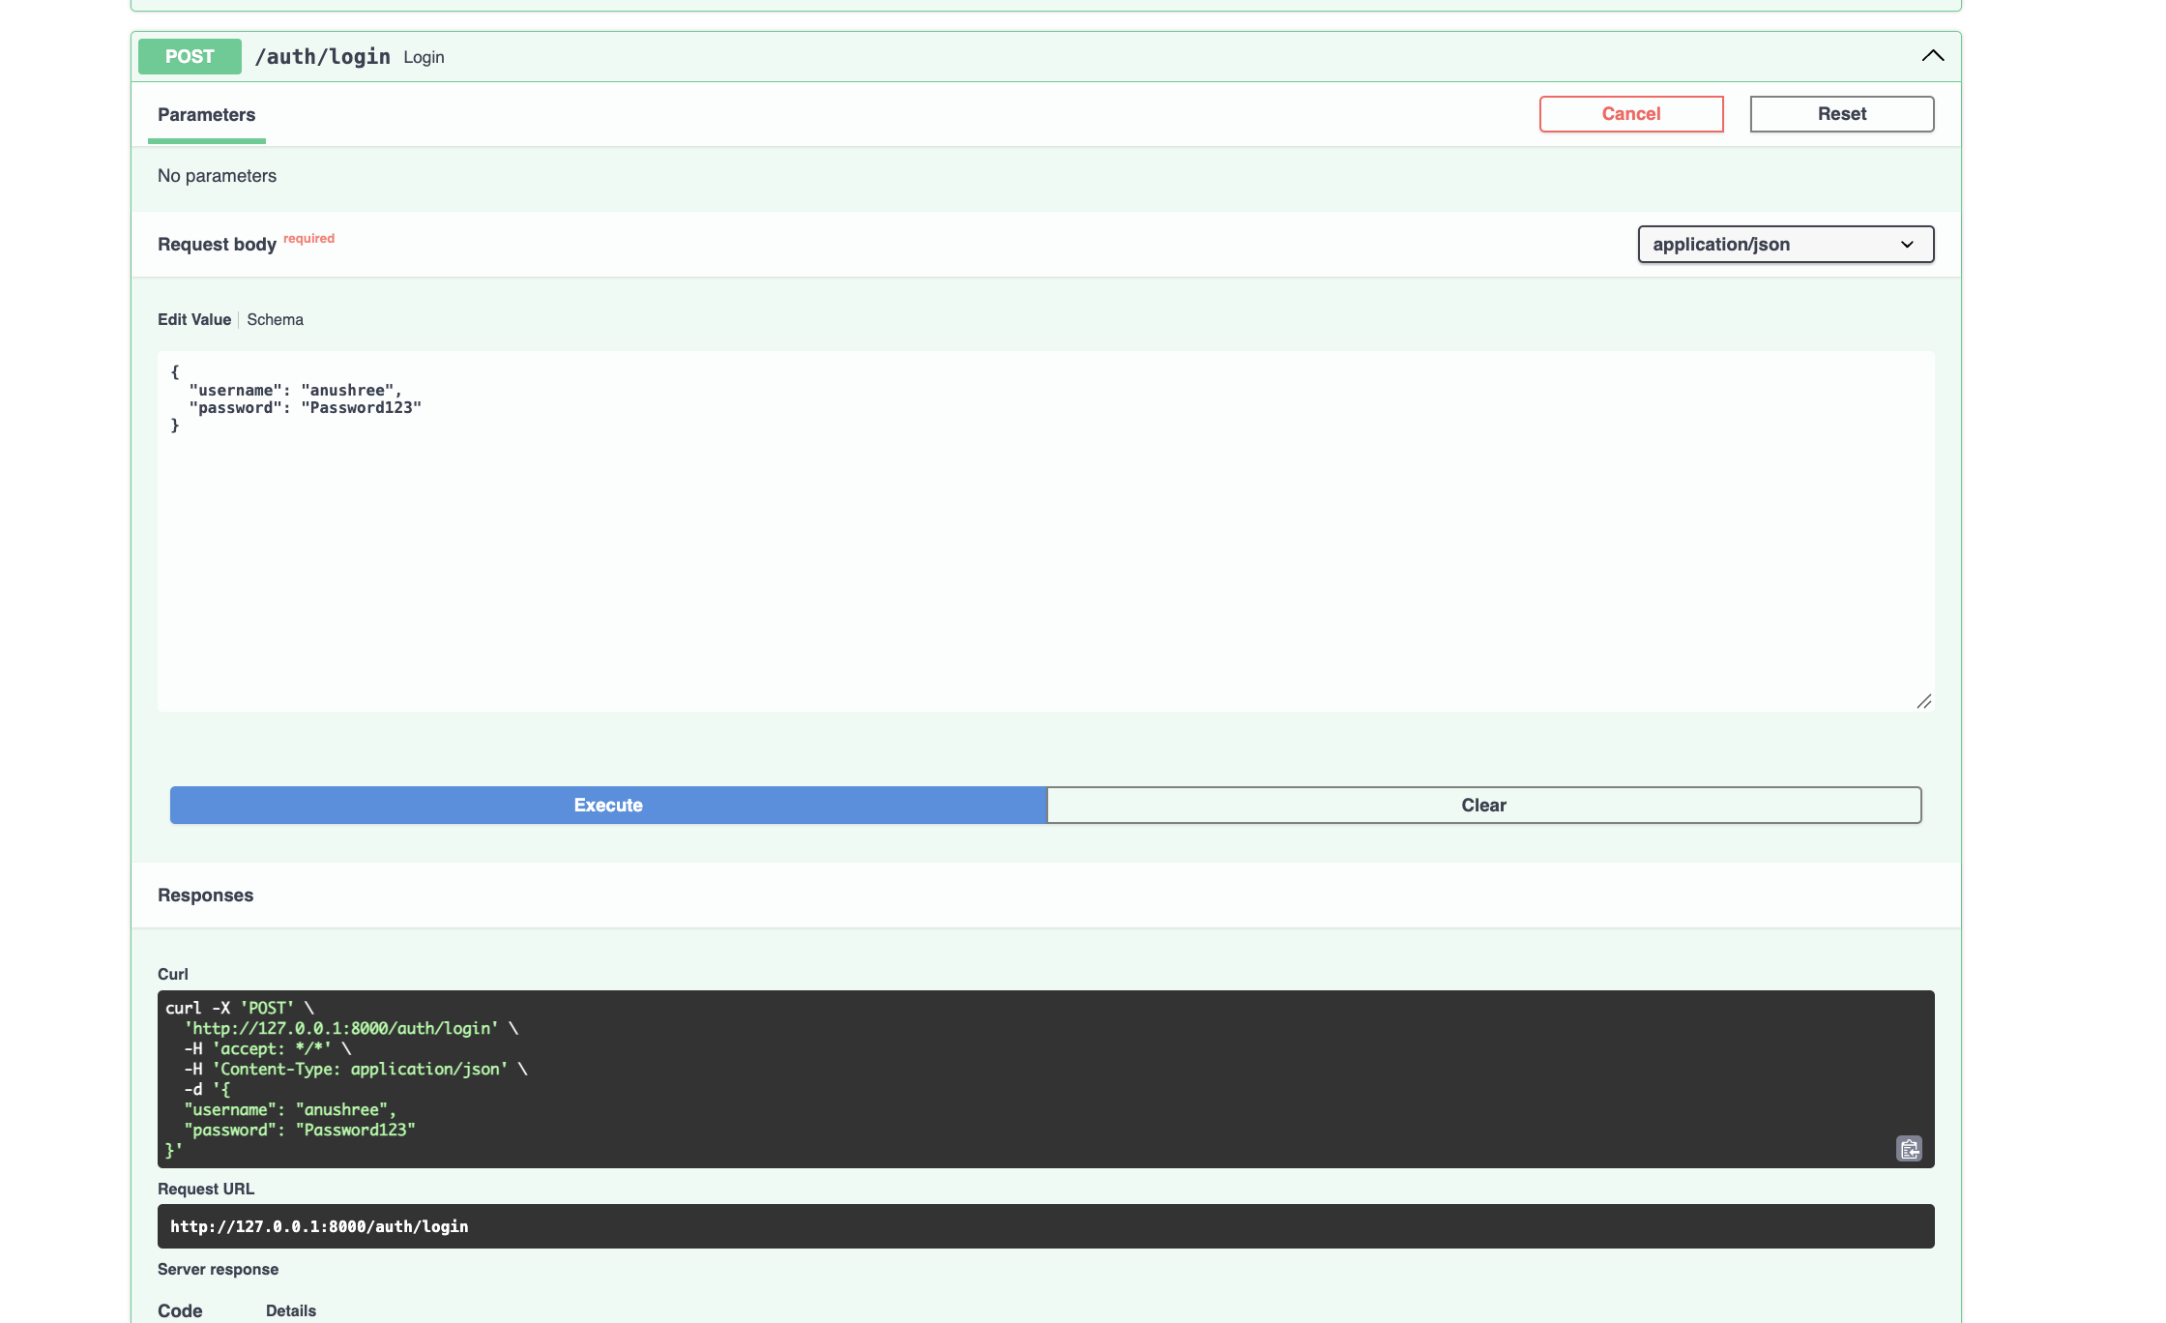
User Login Endpoint — Request Example

Slide 30
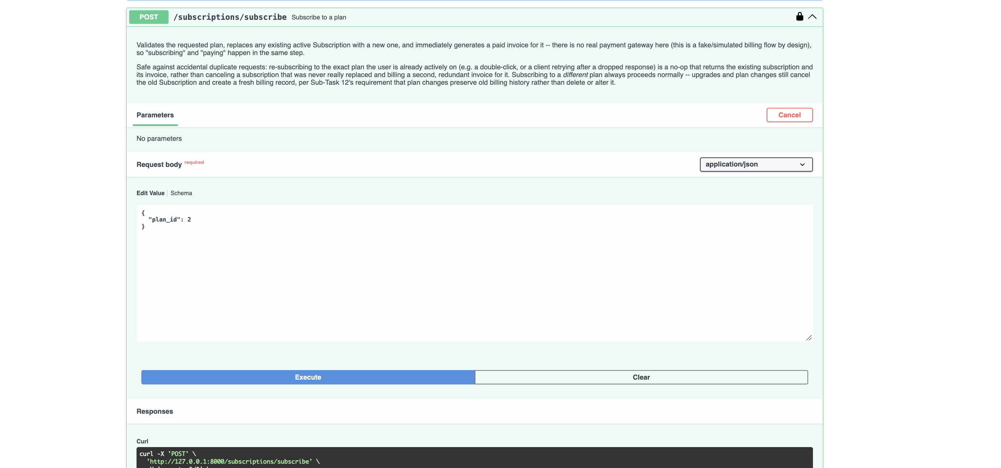
Subscribe to Plan — Endpoint Documentation

Slide 31
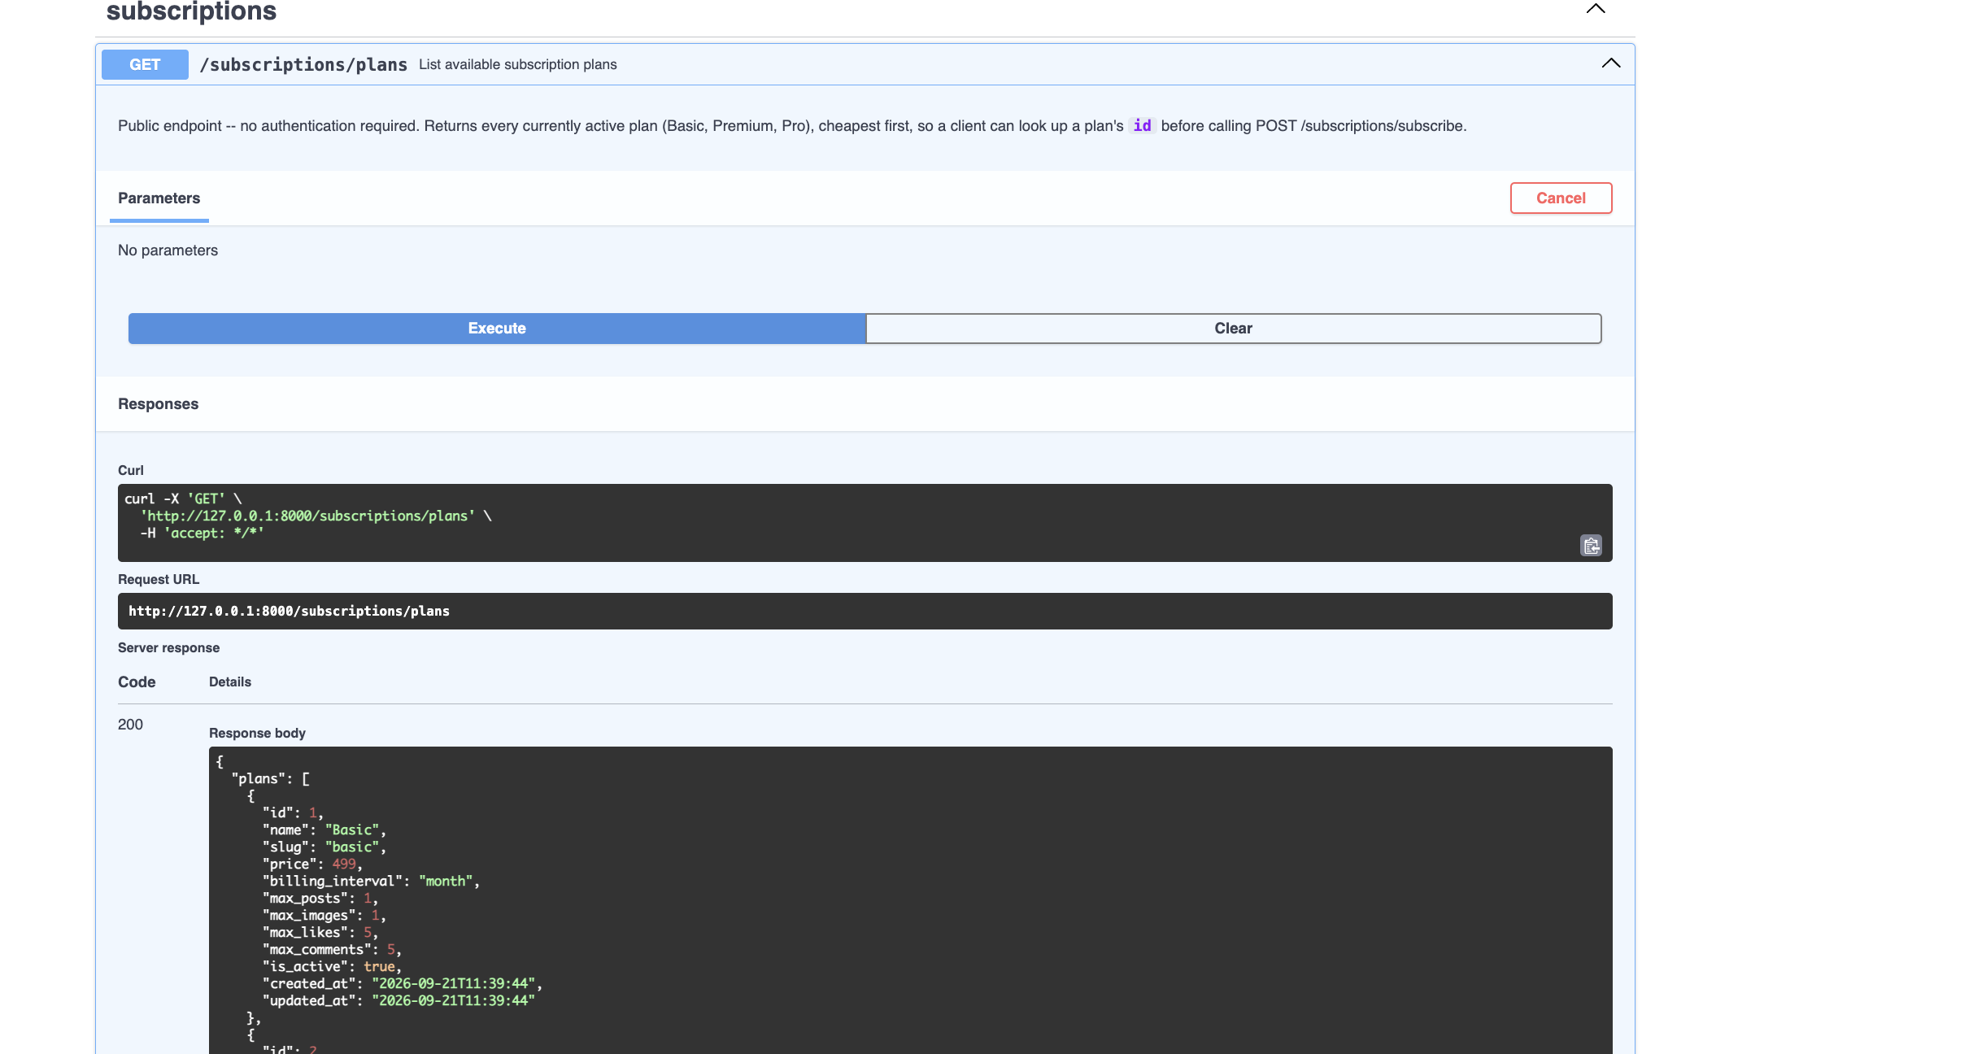
Subscription Plans — Public Endpoint

Slide 32
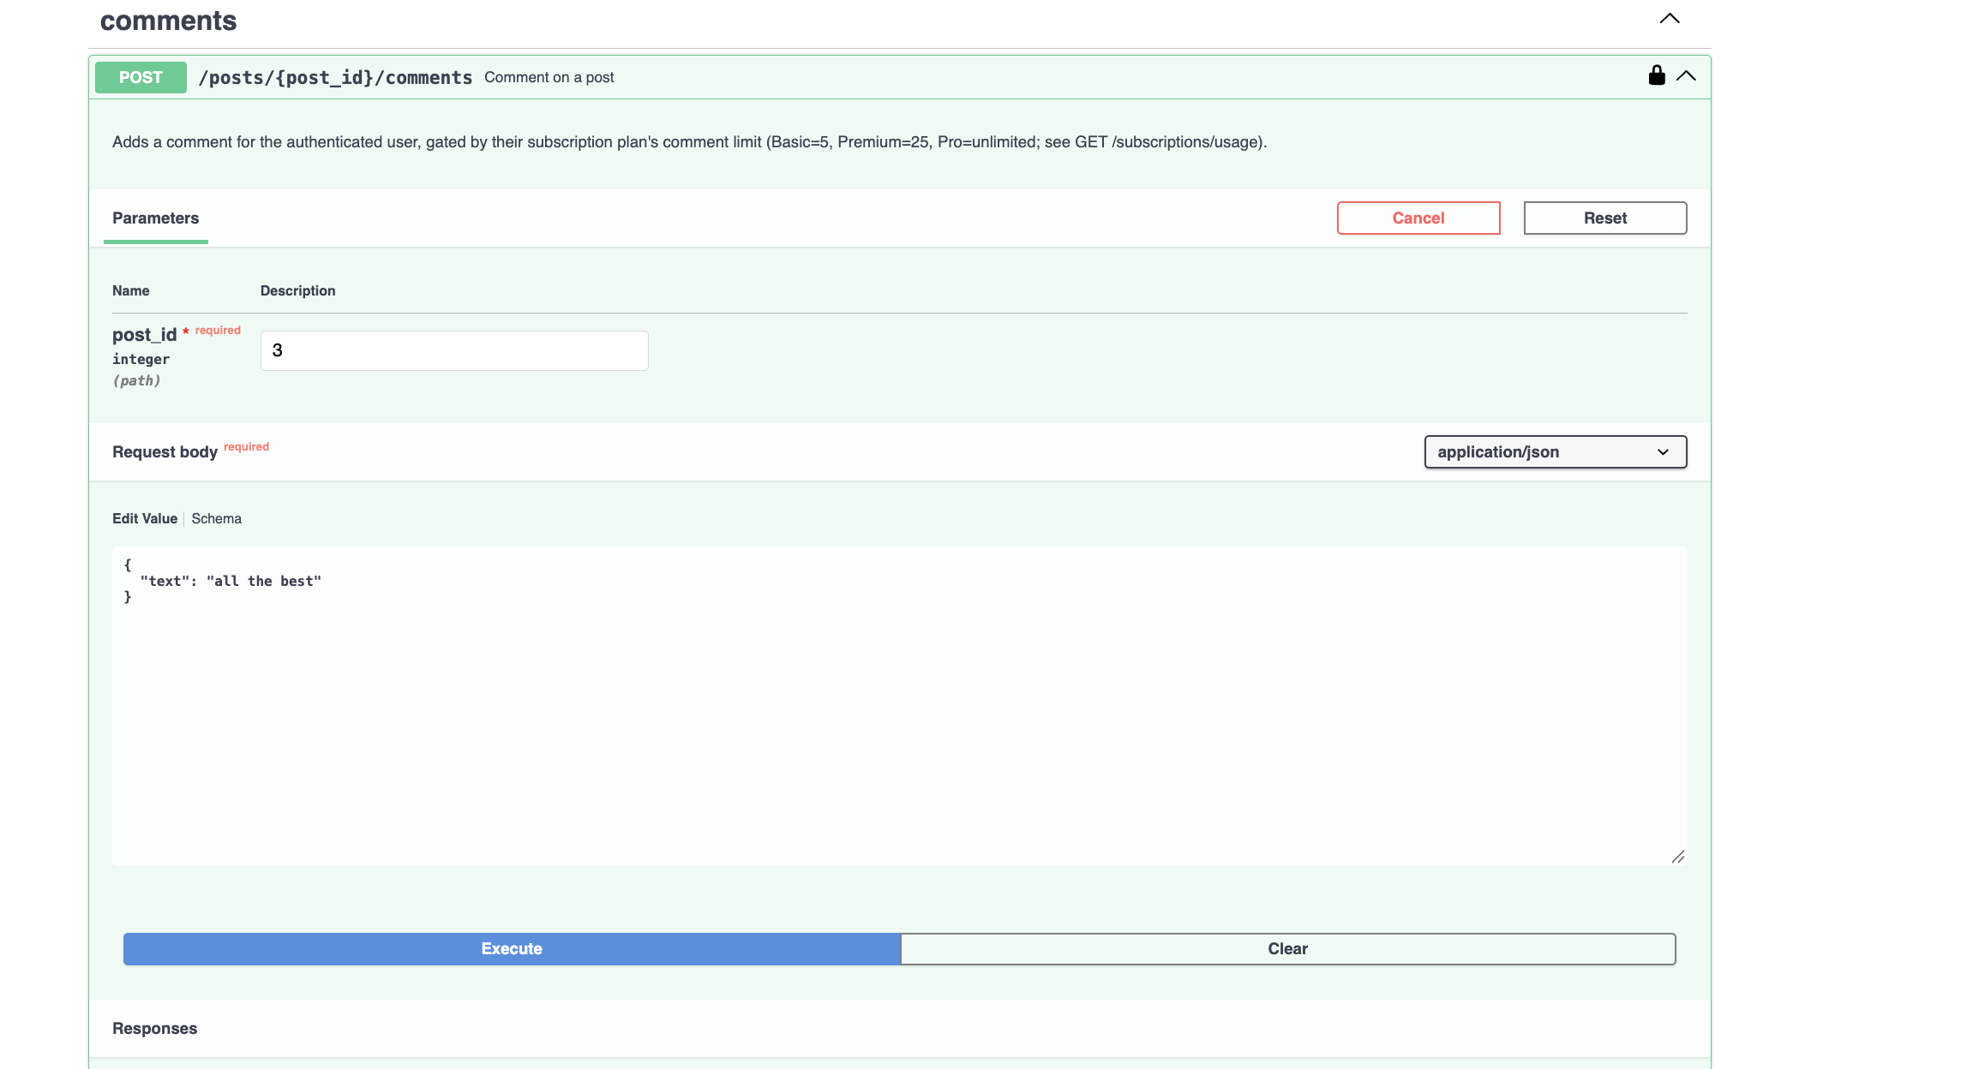
Comment on Post — Plan Limit Documentation

Slide 33
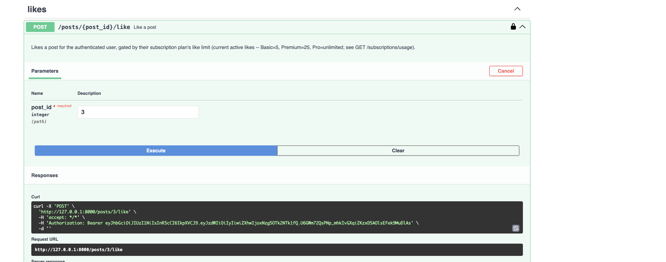
Like a Post — Plan Limit Documentation

Slide 34
Thank You
Blog Management API — Demo Complete

