Slide 1
Blog Management API
Live Demo — Endpoints, Testing & Output

Slide 2
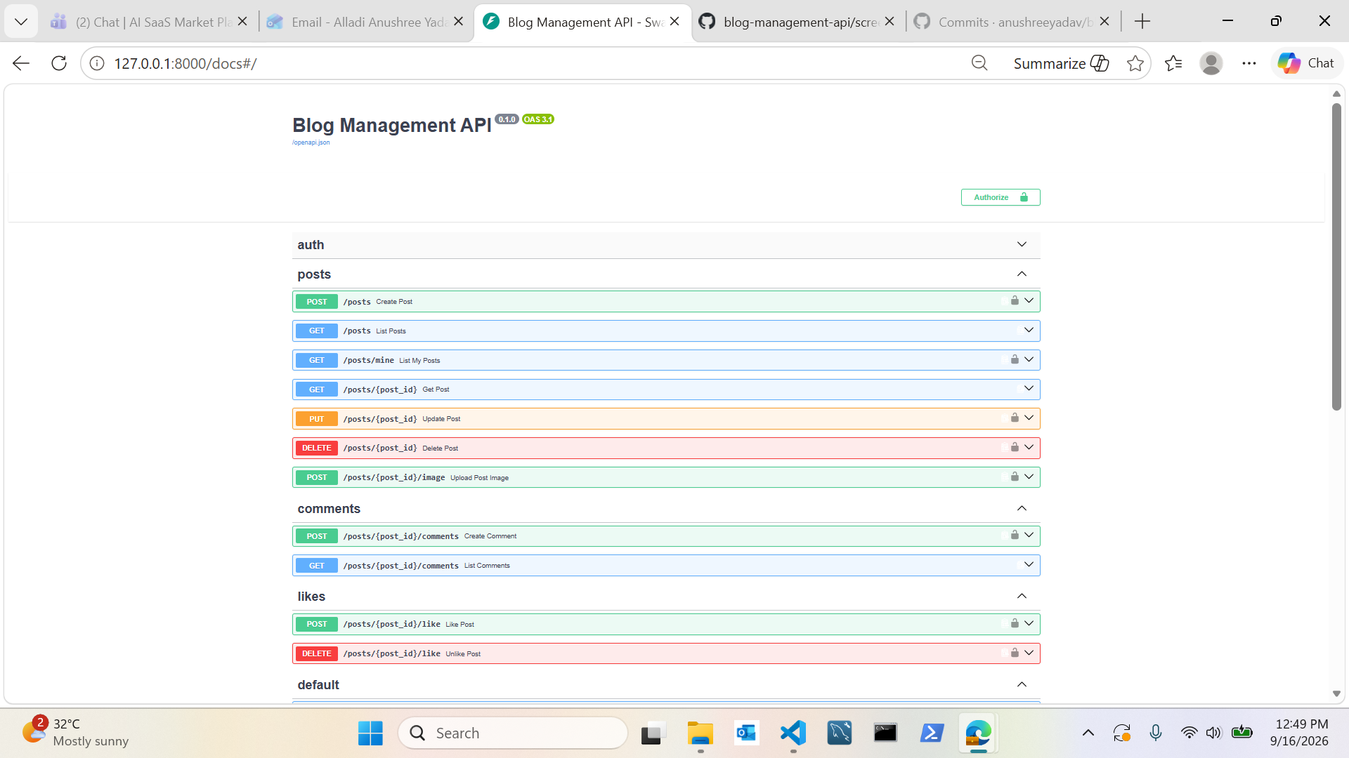
All Endpoints (Swagger UI)
Overview

Slide 3
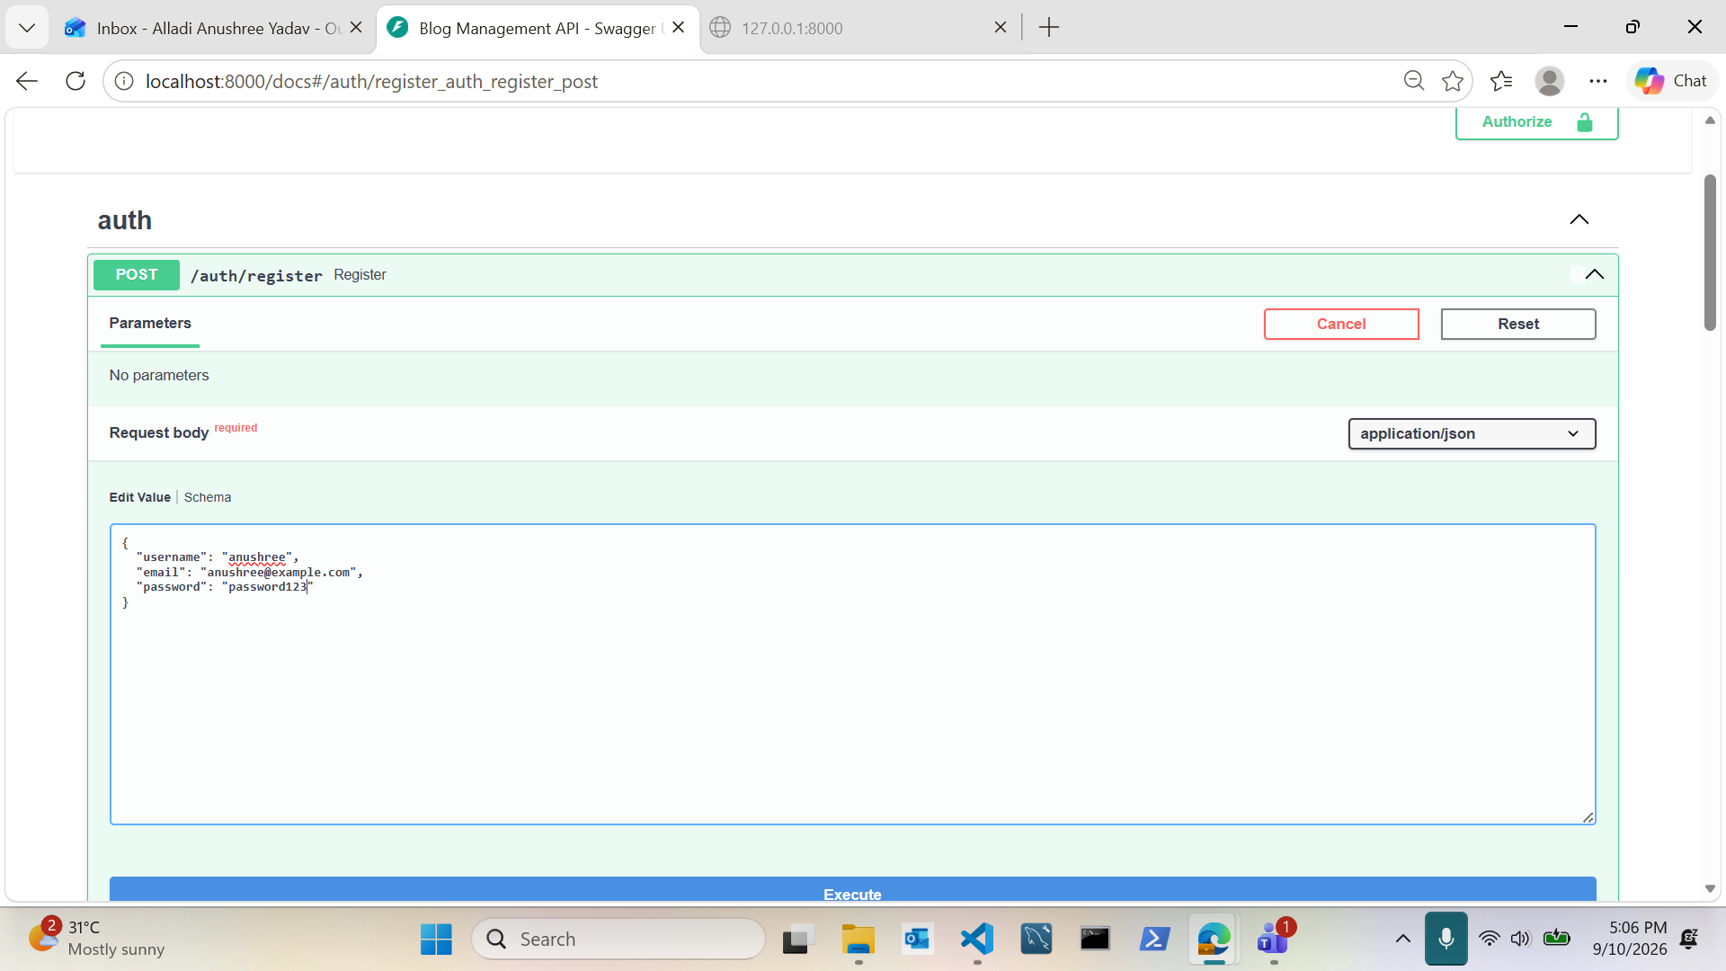
Register a User
Auth

Slide 4
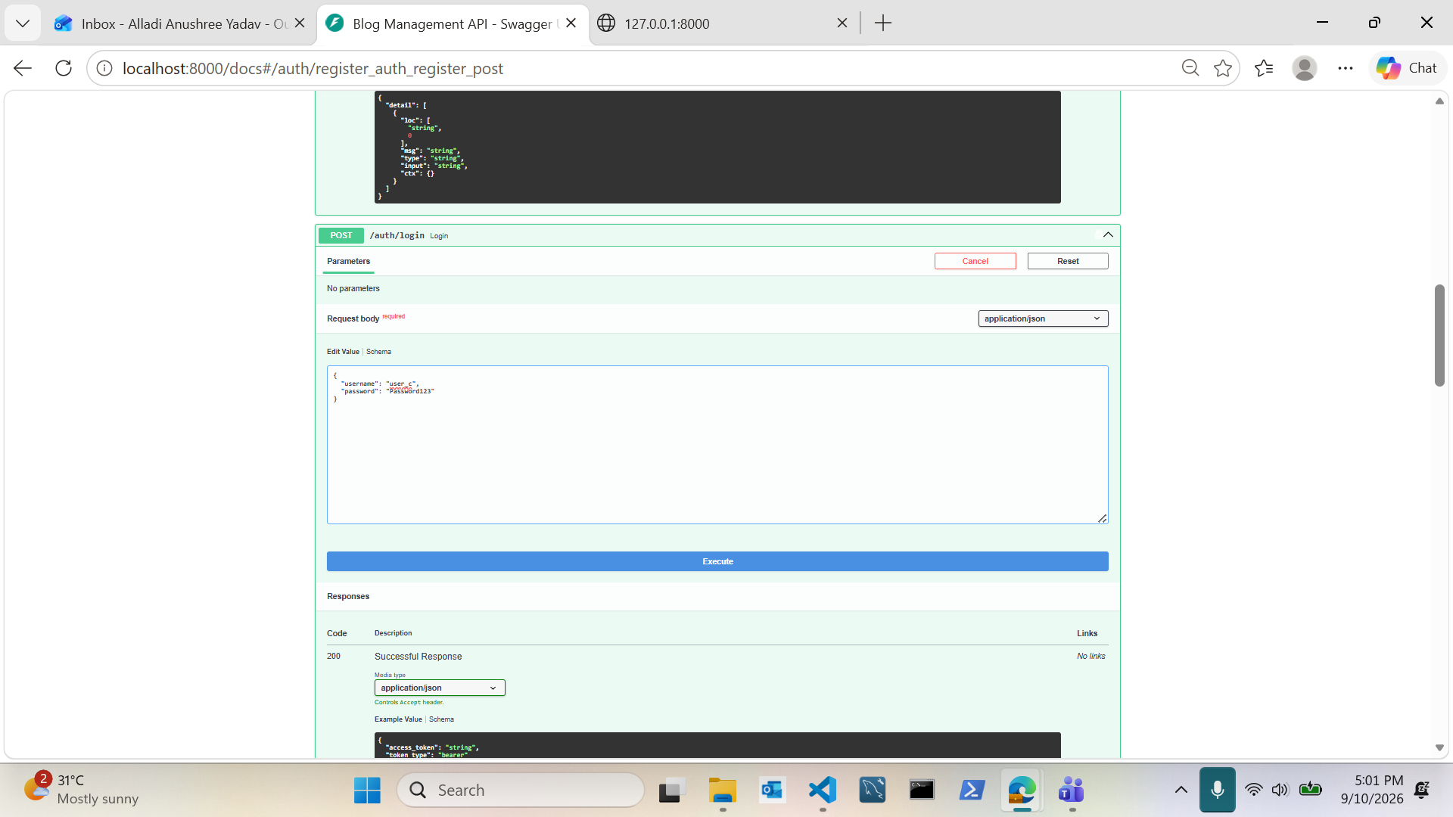
Login — JWT Token
Auth

Slide 5
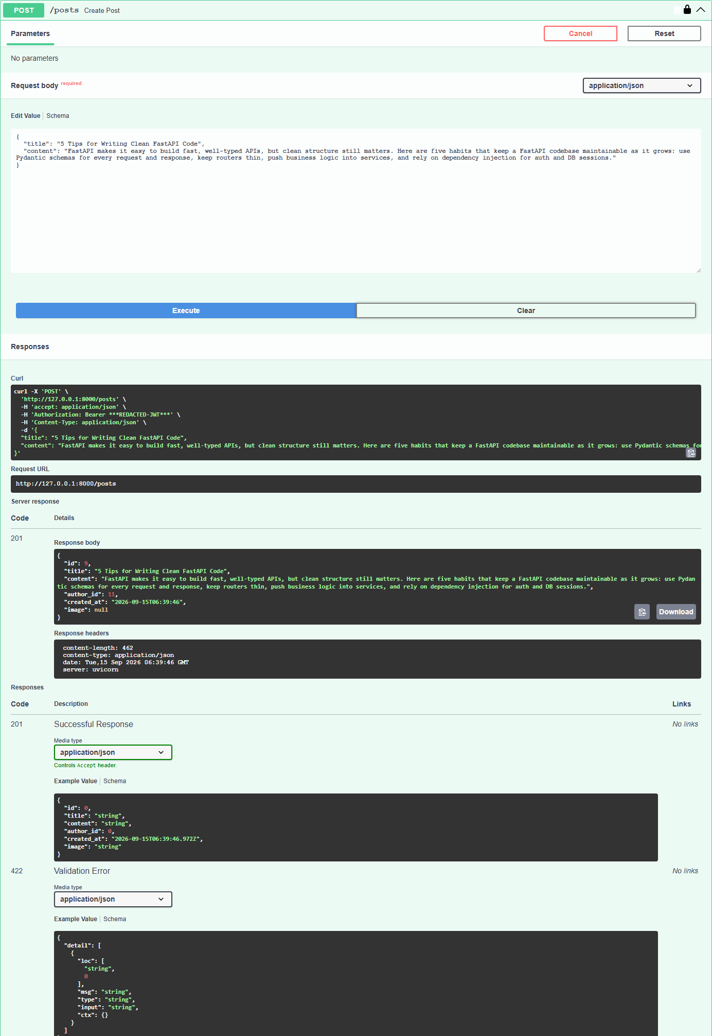
Create Post
Posts

Slide 6
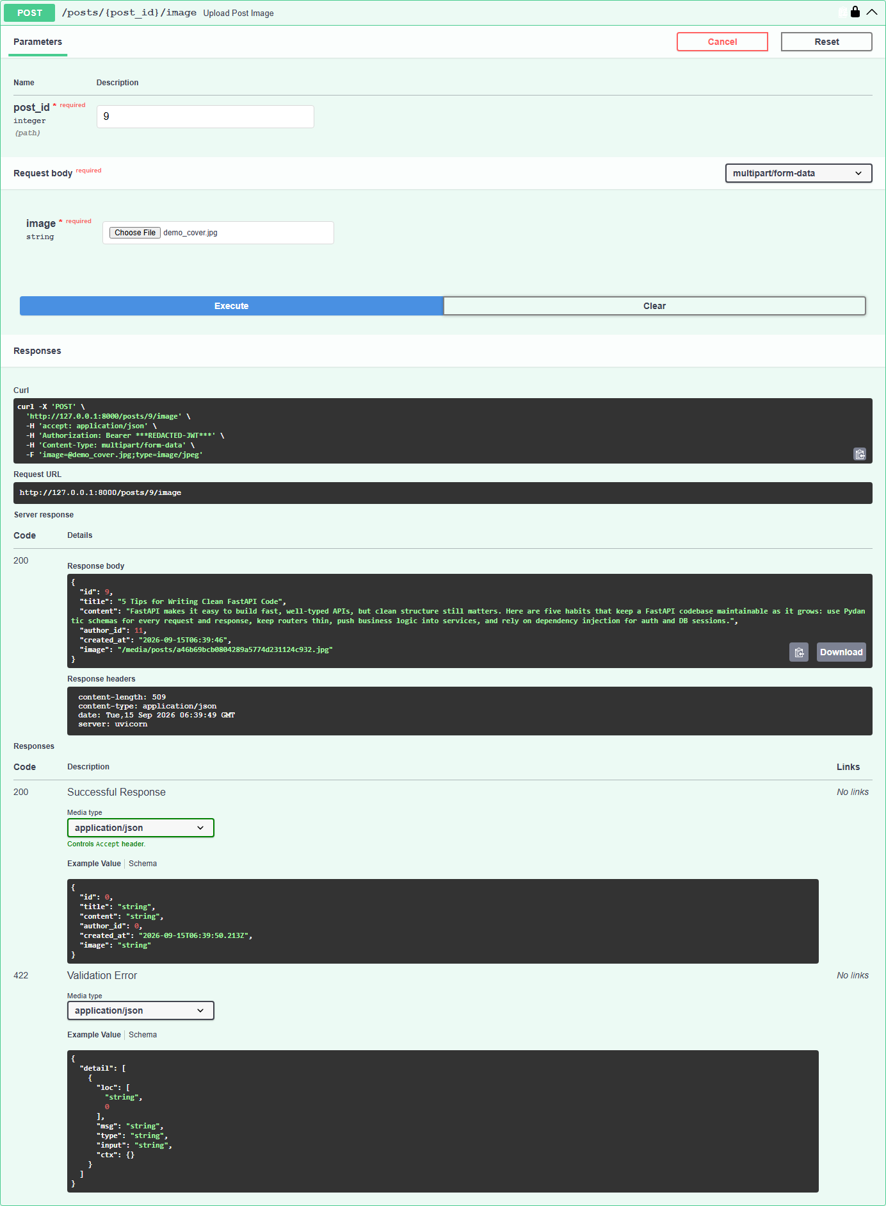
Upload Post Image
Posts

Slide 7
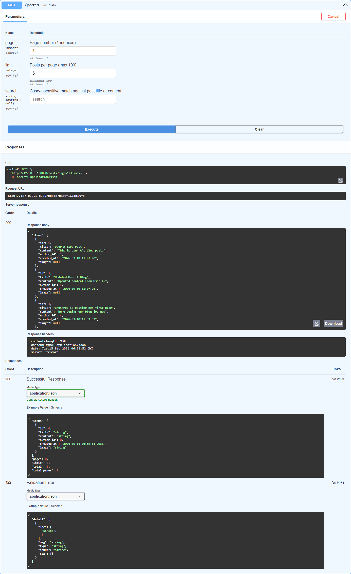
Pagination
Posts

Slide 8
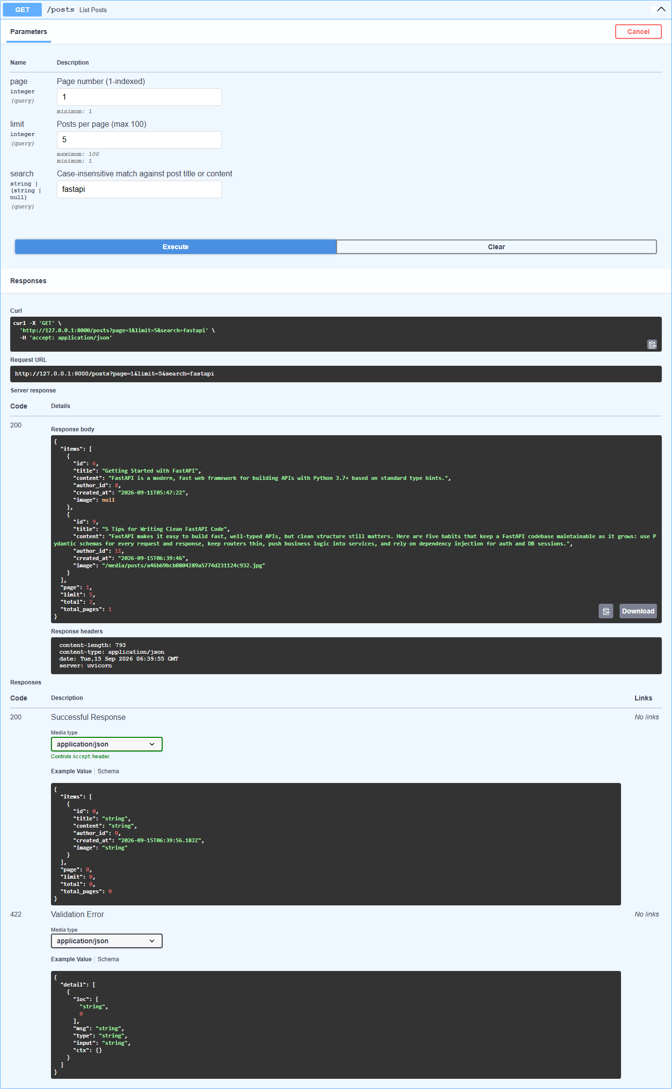
Search + Pagination
Posts

Slide 9
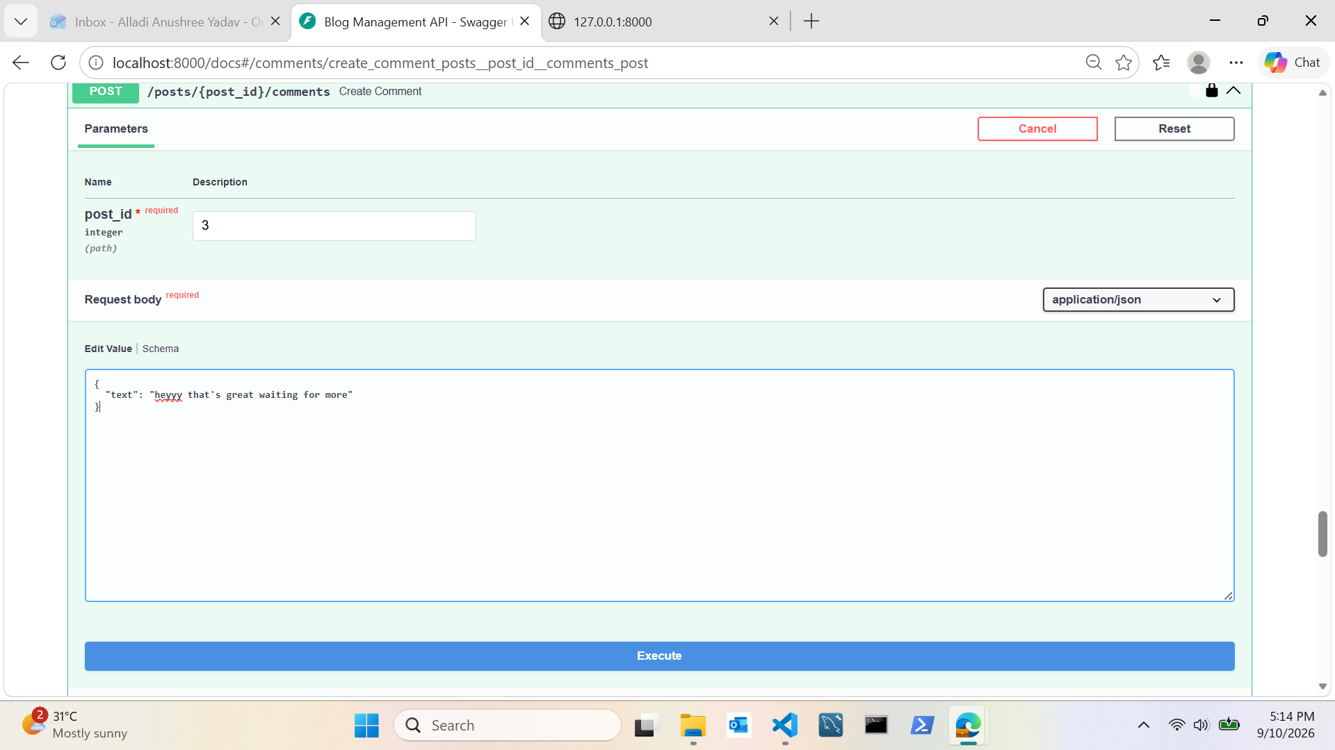
Add Comment
Comments

Slide 10
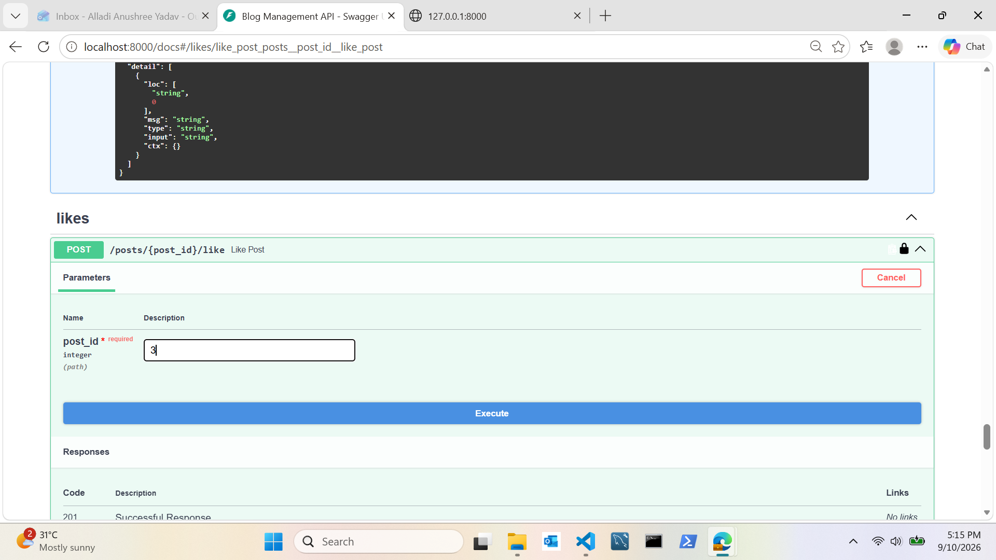
Like a Post
Likes

Slide 11
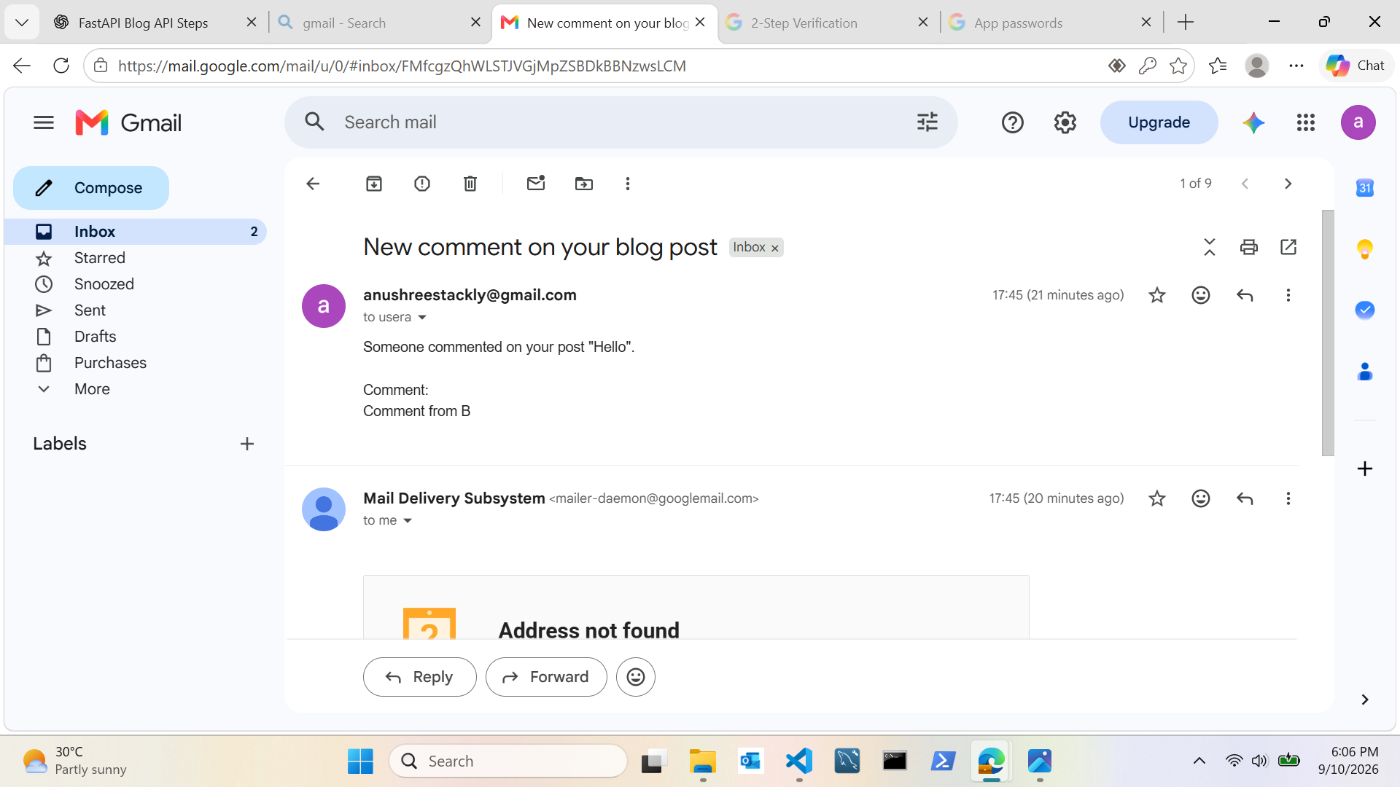
Email Notification Received
Notifications

Slide 12
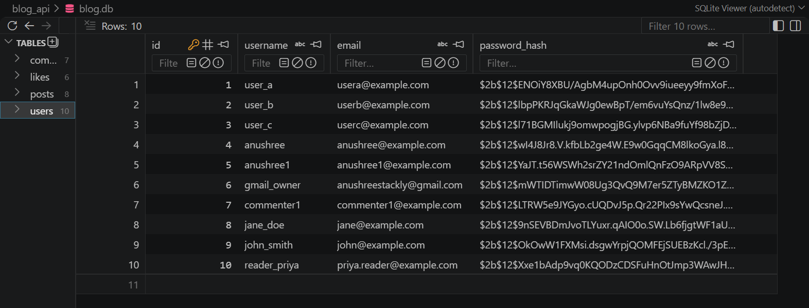
Users Table
Database

Slide 13
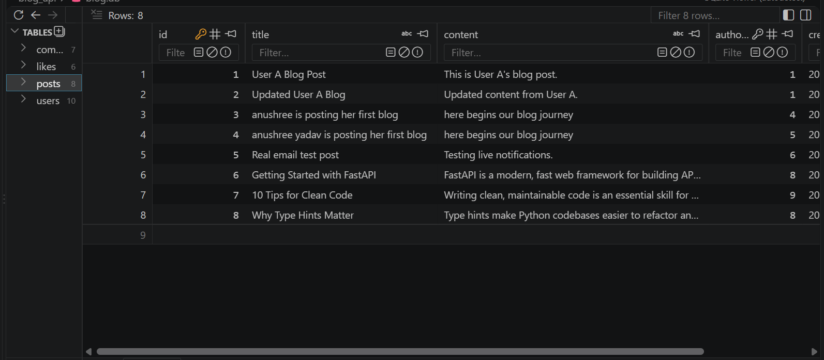
Posts Table
Database

Slide 14
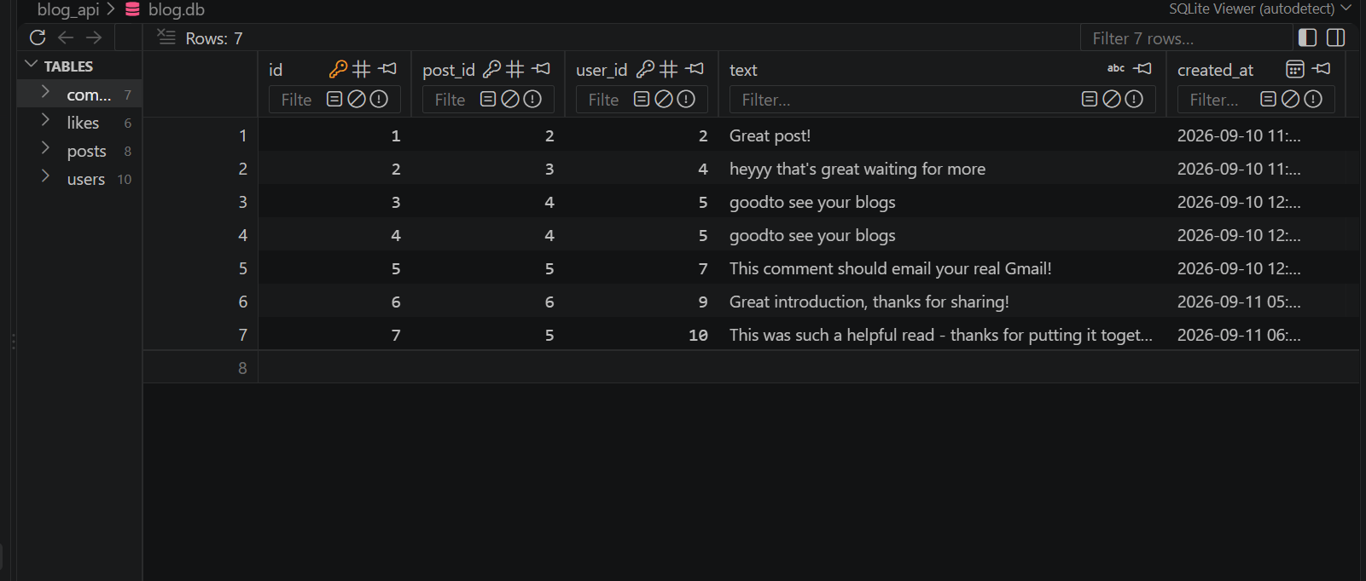
Comments Table
Database

Slide 15
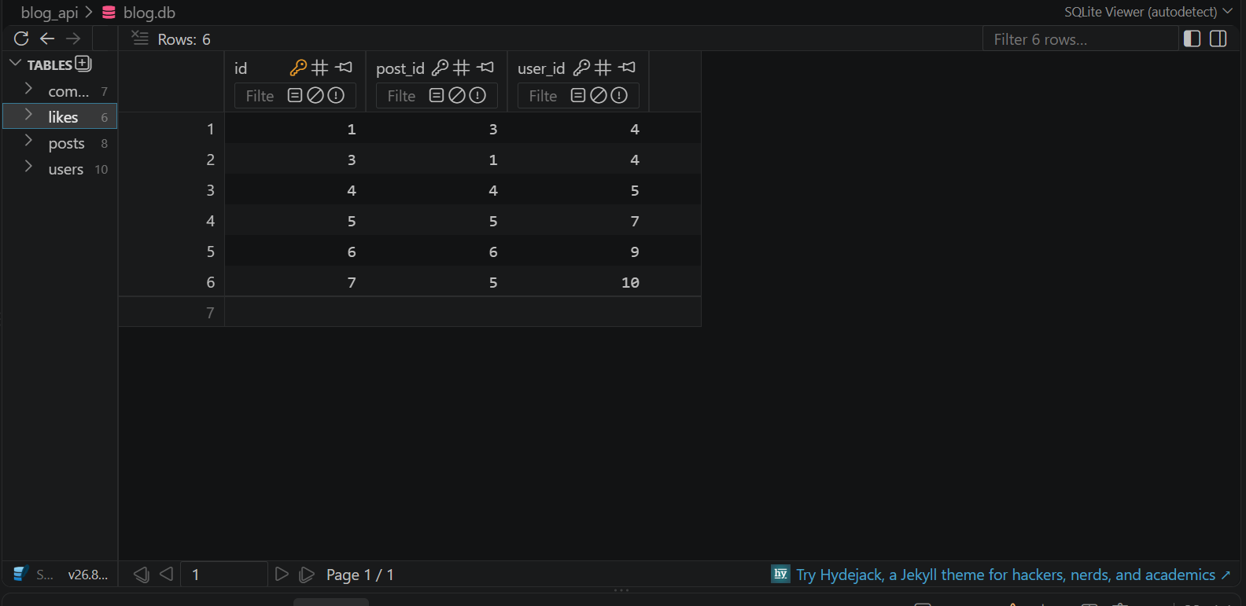
Likes Table
Database

Slide 16
Demo Complete
All endpoints tested end-to-end with real data

