Slide 1
BLOG MANAGEMENT API
Subscription & Billing System
Evidence Report
Live, end-to-end proof of the subscription-based access-control feature: database relationships, plan and billing data, generated invoices, API verification, and plan-limit validation messages — captured directly from the running application and its real Postgres database.
Generated 2026-09-18

Slide 2
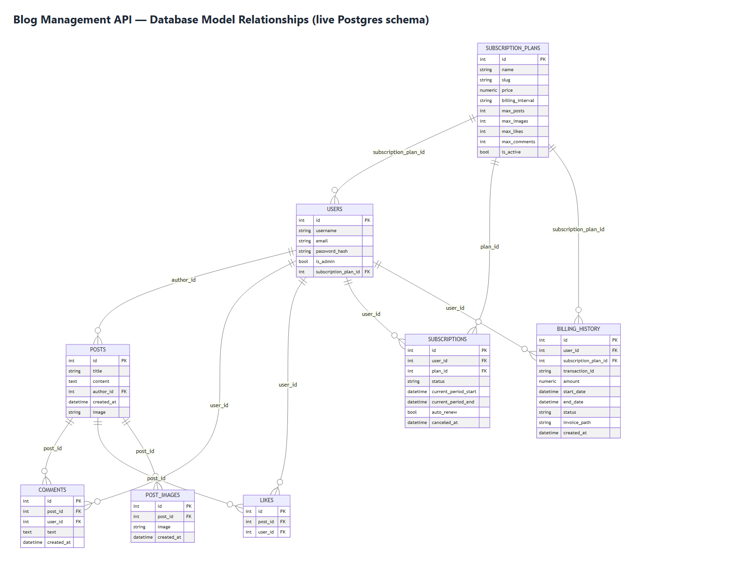
DATABASE MODEL
Live Database Schema
All 8 tables and every foreign key, generated live from the running Postgres database.

Slide 3
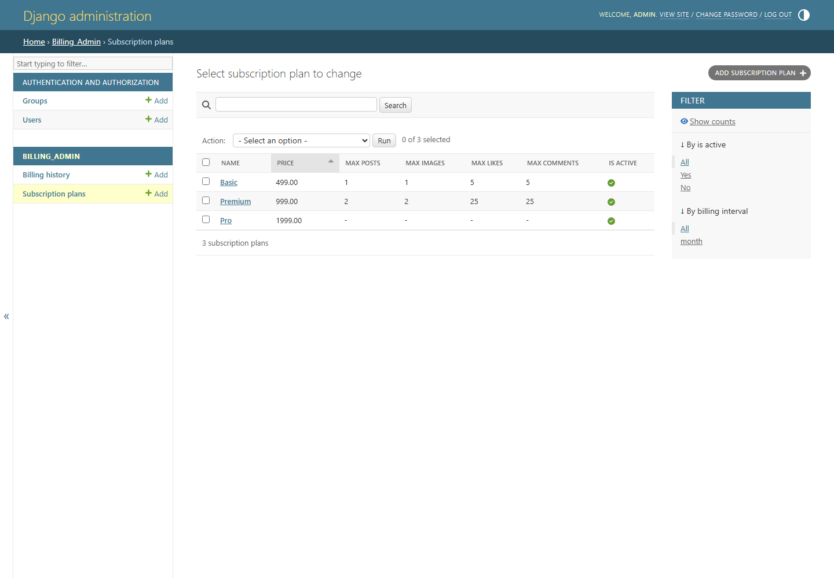
PLAN & BILLING DATA
Subscription Plans
Basic, Premium and Pro with post/image/like/comment limits and INR pricing.

Slide 4
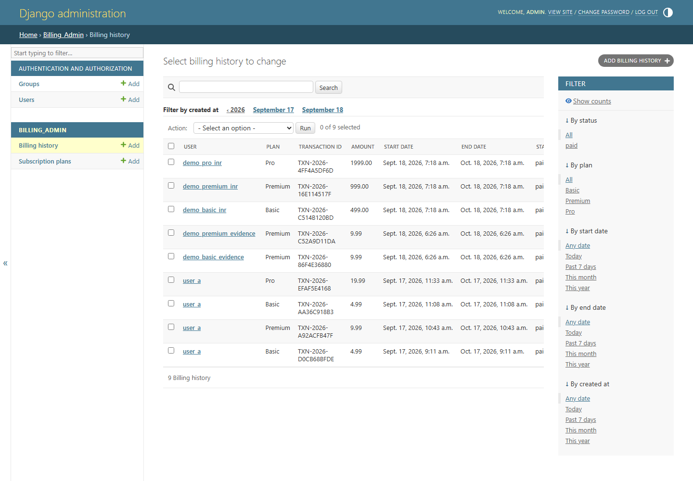
PLAN & BILLING DATA
Billing History Records
Real billing records — user, plan, transaction ID, amount, and status.

Slide 5
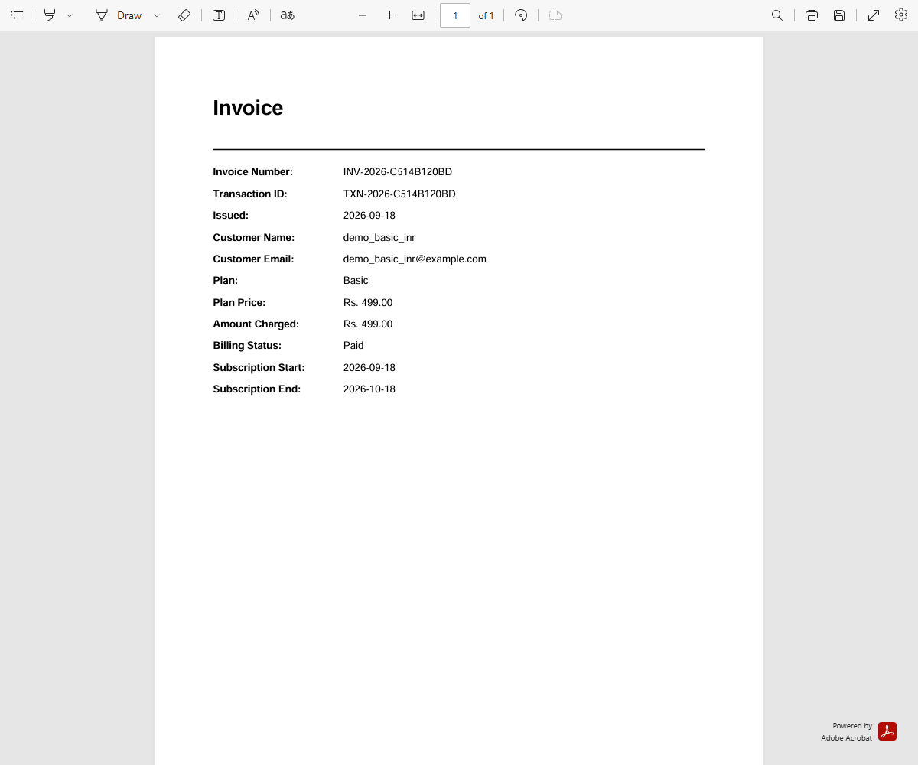
GENERATED INVOICES
Invoice — Basic Plan
Live-generated invoice PDF for a Basic subscription (Rs. 499.00).

Slide 6
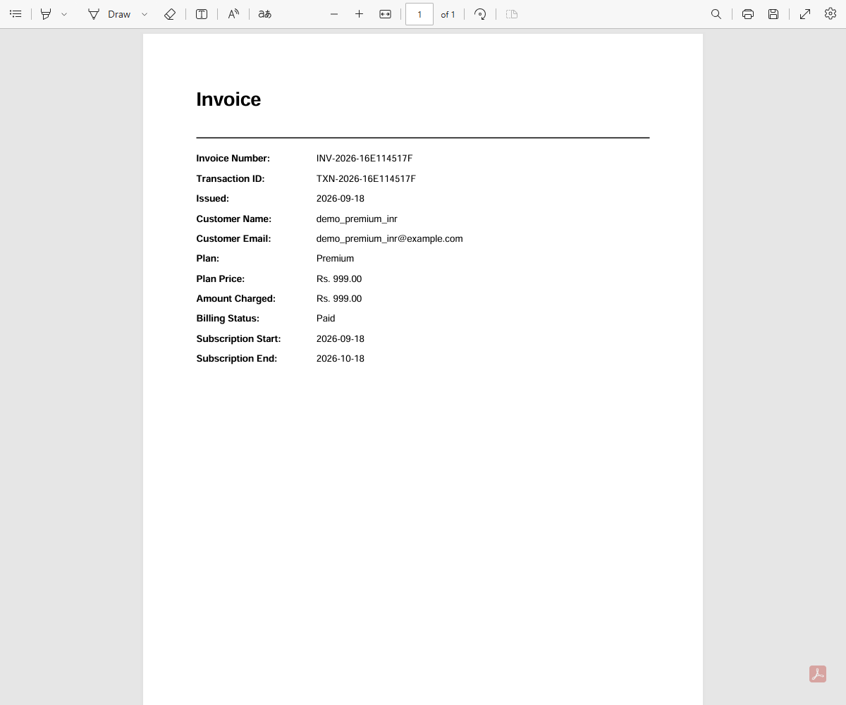
GENERATED INVOICES
Invoice — Premium Plan
Live-generated invoice PDF for a Premium subscription (Rs. 999.00).

Slide 7
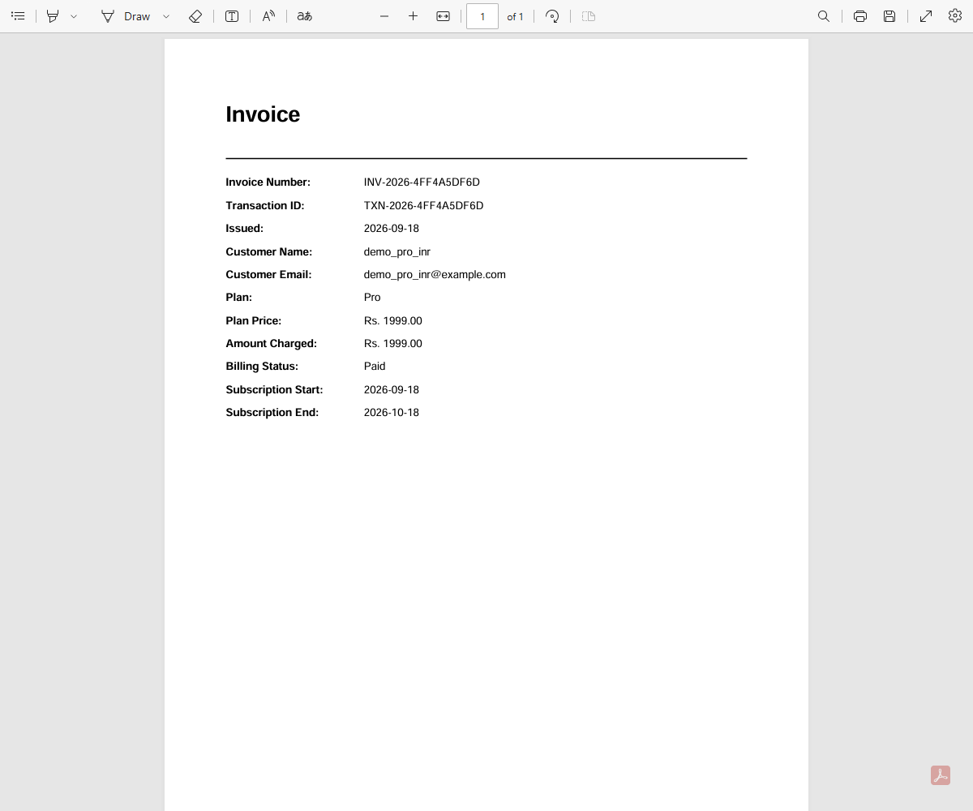
GENERATED INVOICES
Invoice — Pro Plan
Live-generated invoice PDF for a Pro subscription (Rs. 1999.00).

Slide 8
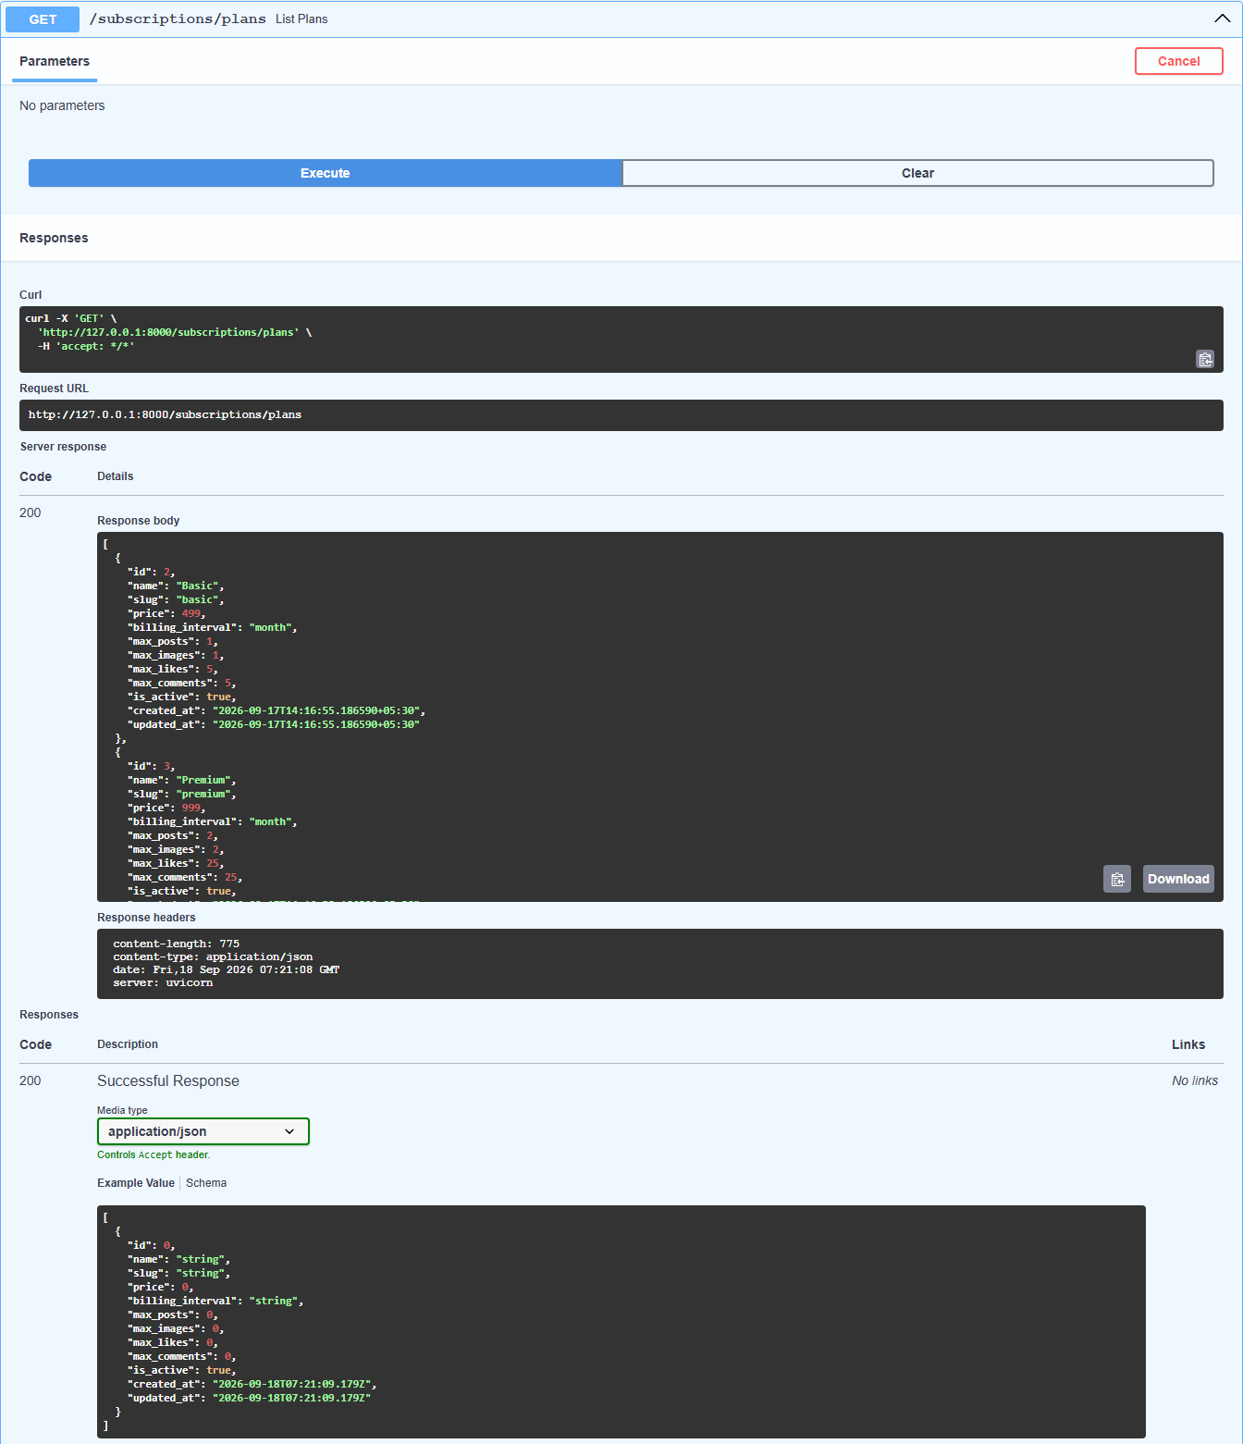
API VERIFICATION
GET /subscriptions/plans
Live 200 response listing every active subscription plan.

Slide 9
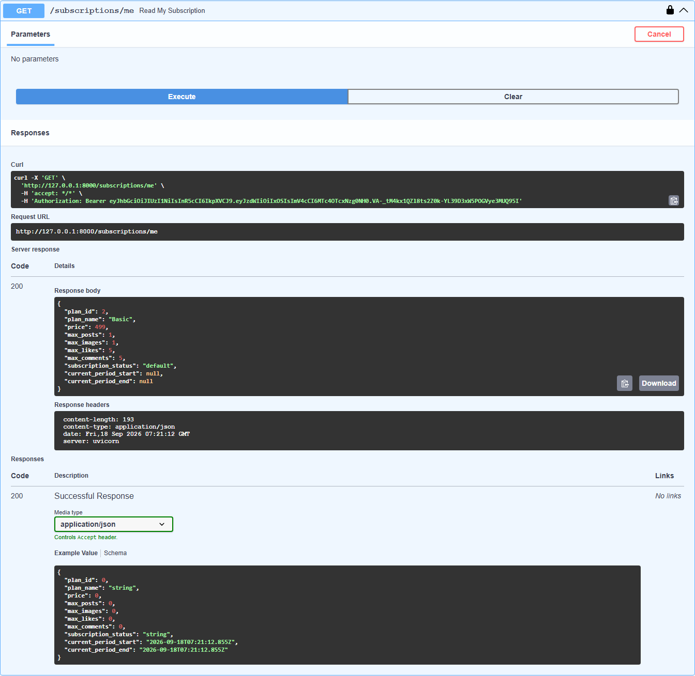
API VERIFICATION
GET /subscriptions/me
A user's current plan, limits, and subscription status.

Slide 10
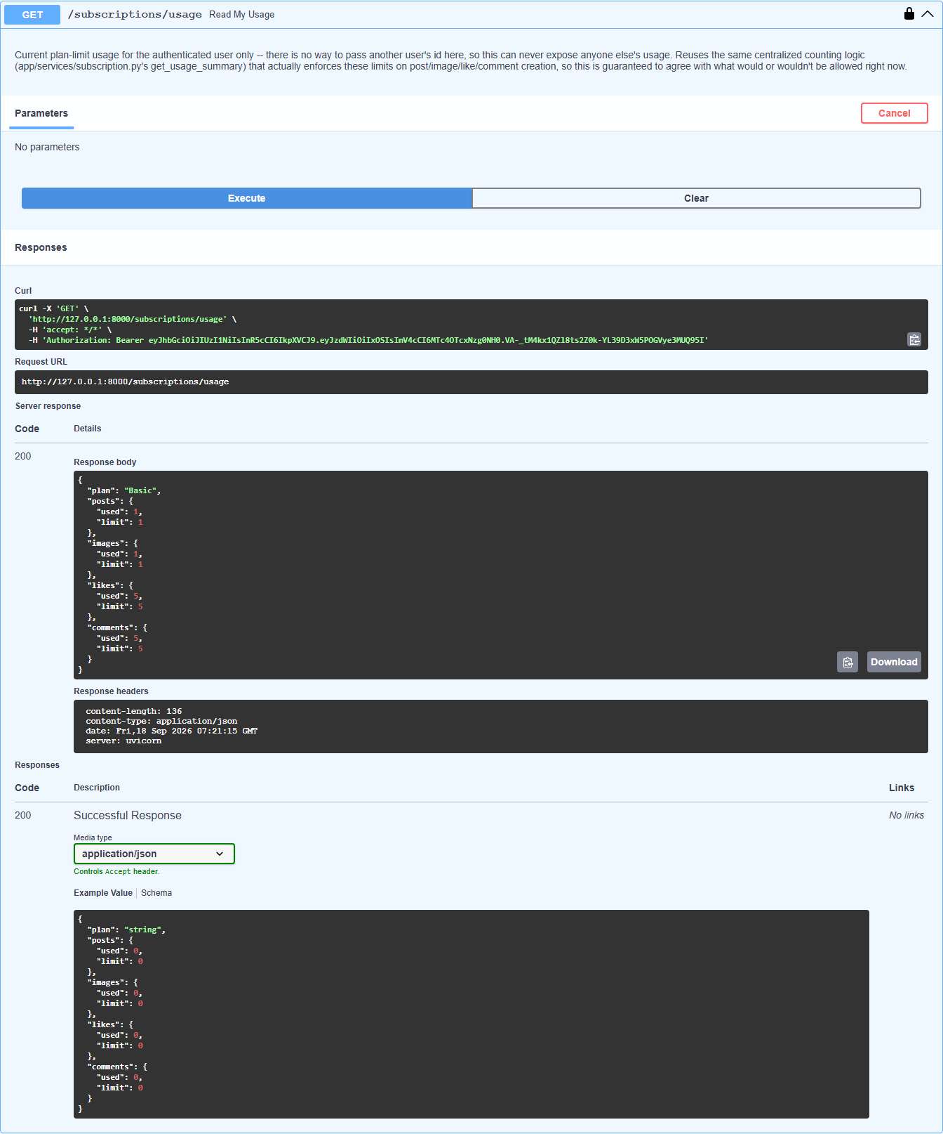
API VERIFICATION
GET /subscriptions/usage
A Basic-plan user shown at exactly their post/image/like/comment limits.

Slide 11
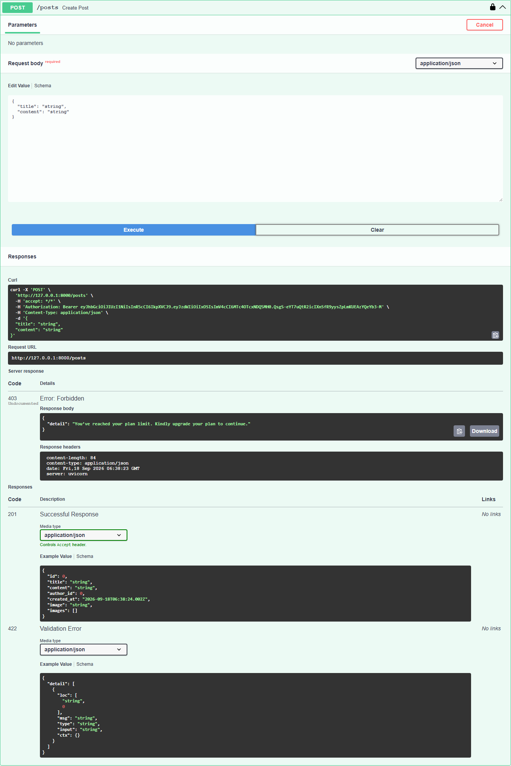
LIMIT VALIDATION MESSAGES
Post Limit Exceeded
Blocked at the post limit with the friendly upgrade message.

Slide 12
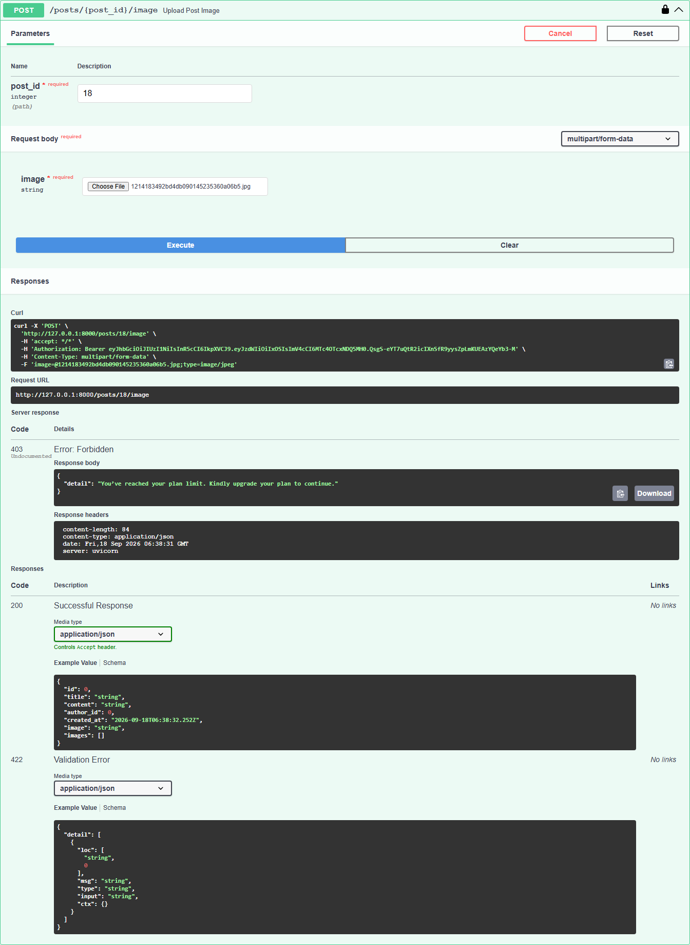
LIMIT VALIDATION MESSAGES
Image Limit Exceeded
Blocked at the per-post image limit with the same upgrade message.

Slide 13
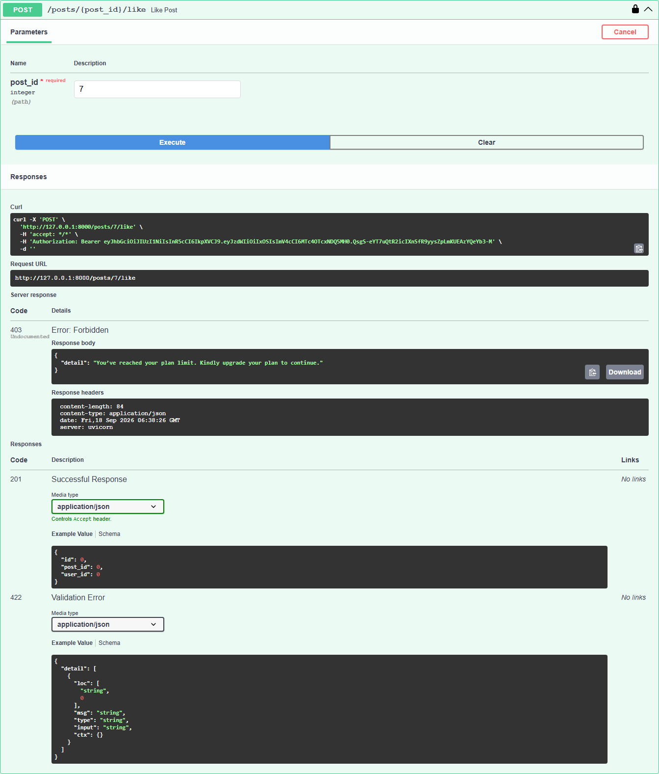
LIMIT VALIDATION MESSAGES
Like Limit Exceeded
Blocked at the like limit with the same upgrade message.

Slide 14
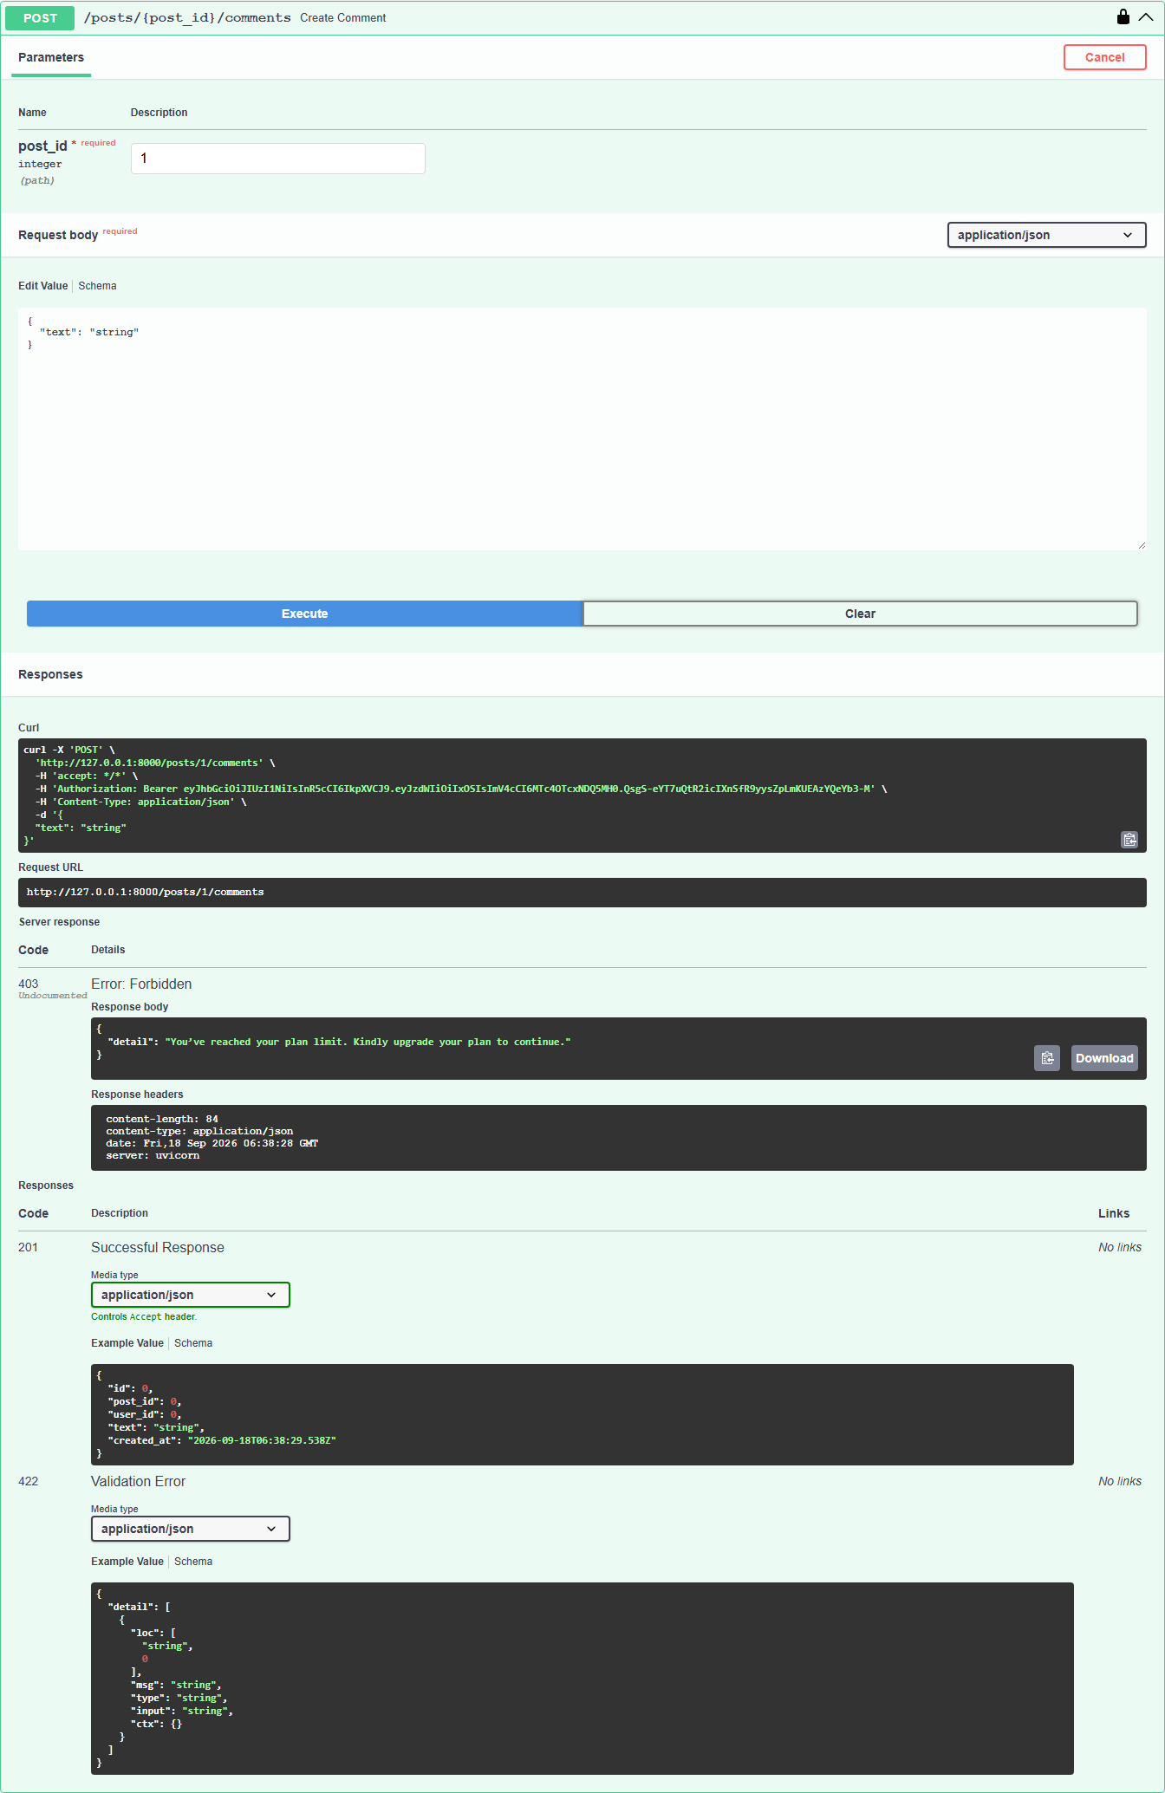
LIMIT VALIDATION MESSAGES
Comment Limit Exceeded
Blocked at the comment limit with the same upgrade message.

Slide 15
TEST SUITE RESULTS
Full Automated Regression Run
423
0
No regressions in existing blog functionality — auth, posts, comments, likes, images, pagination, and search all still pass alongside the new subscription and billing tests.
TESTS PASSED
TESTS FAILED
Category | Test files | Tests
Core blog management (auth, posts, comments, likes, images, pagination, DB) | 3 | 193
Subscription plans & models | 3 | 31
Subscription service & API | 4 | 65
Plan limit enforcement (post/image/like/comment + validation message) | 5 | 41
Billing & invoices | 4 | 76
Subscription access-control security review | 1 | 17
Total | 20 | 423

