Slide 1
User Dashboard & Analytics
Feature demo -- Blog Management API
September 22, 2026

Slide 2
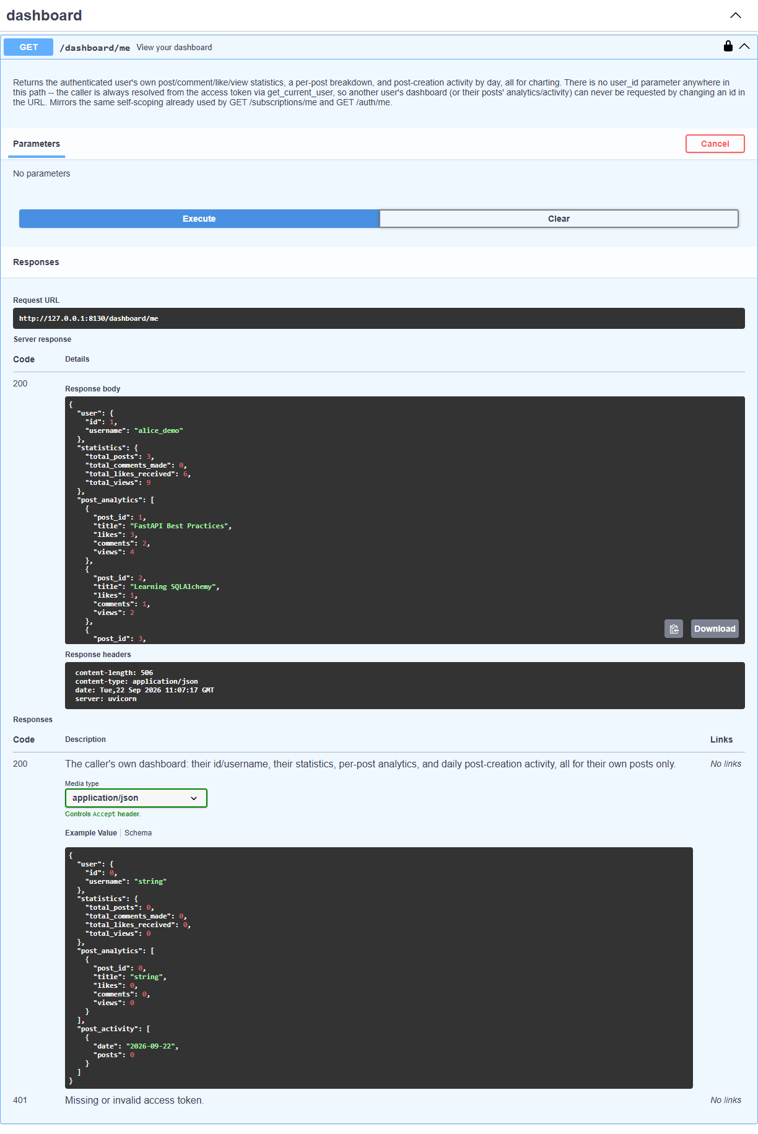
GET /dashboard/me: authenticated, executed live in Swagger

Slide 3
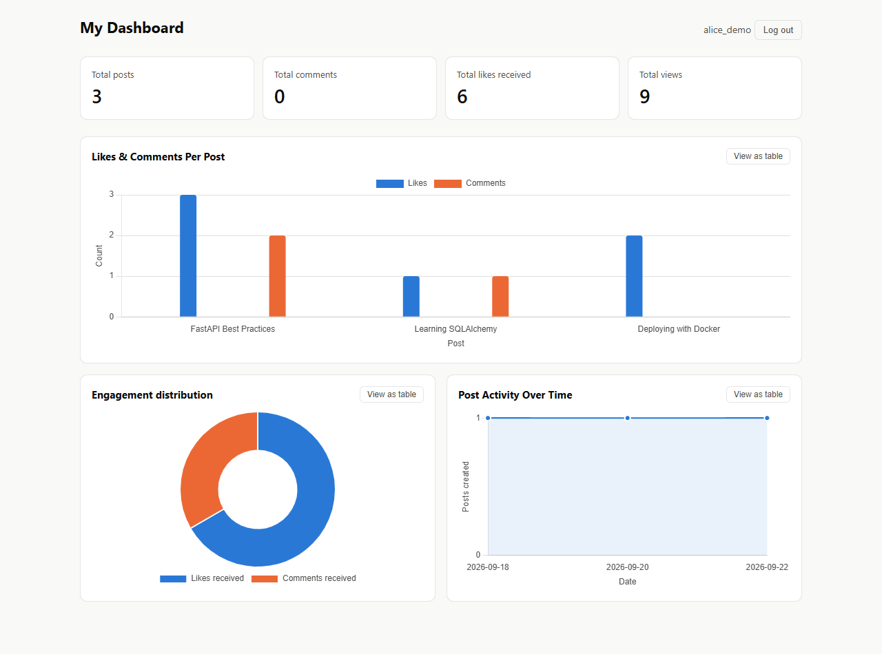
The rendered dashboard: real cards, real charts

Slide 4
Summary cards, close up: posts, comments, likes, views

Slide 5
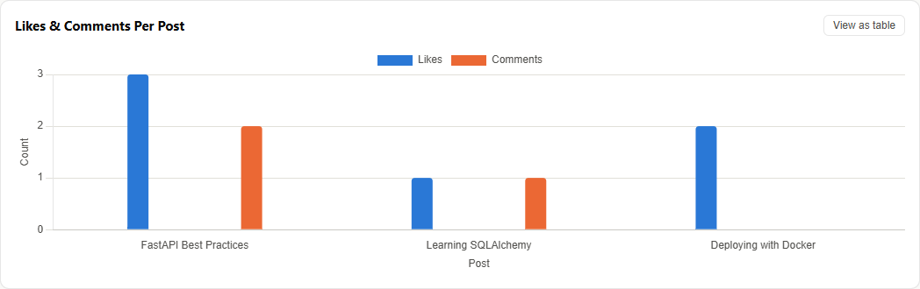
Likes vs. comments per post, as a labeled bar chart

Slide 6
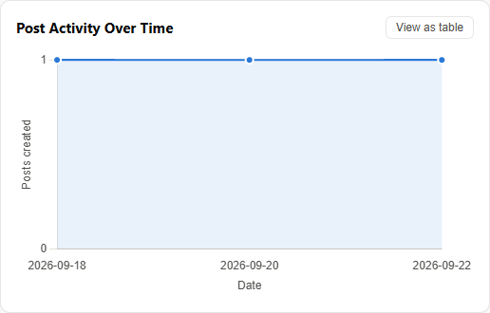
Post activity over time, as a line chart

Slide 7
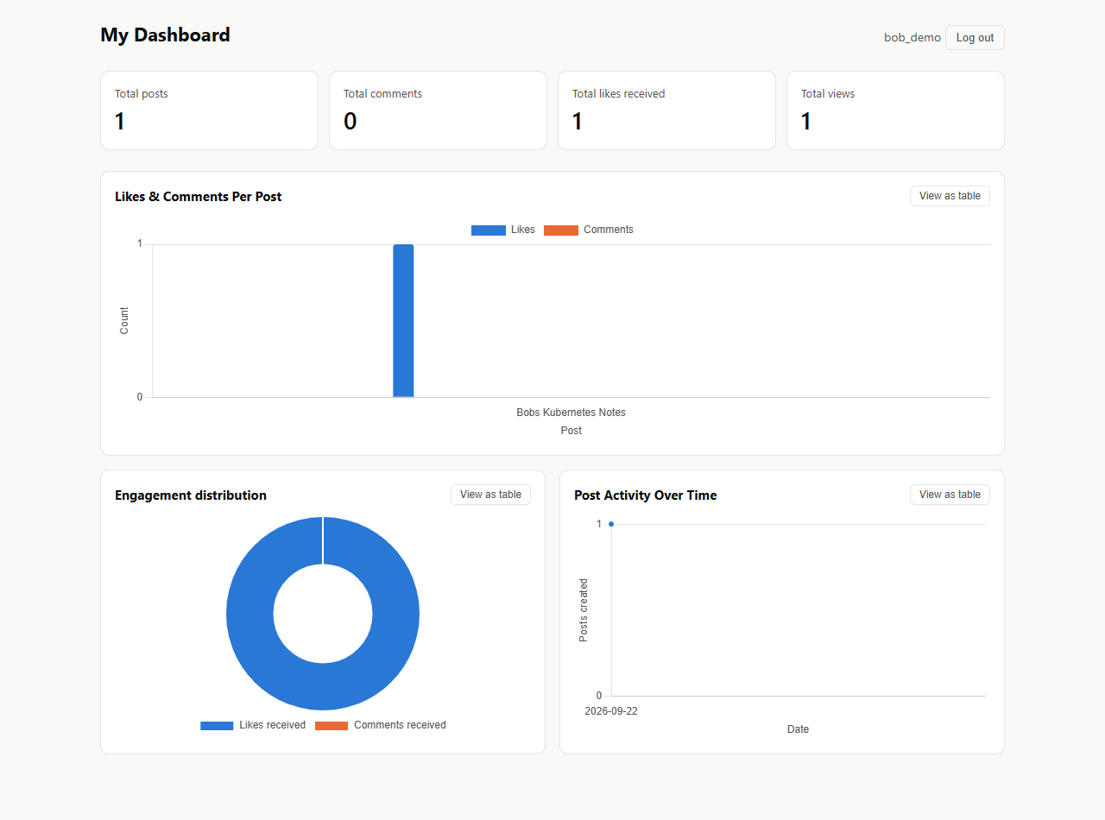
User isolation: a different account sees only its own data
Compare to Slide 3 -- different totals, different posts, zero overlap.

Slide 8
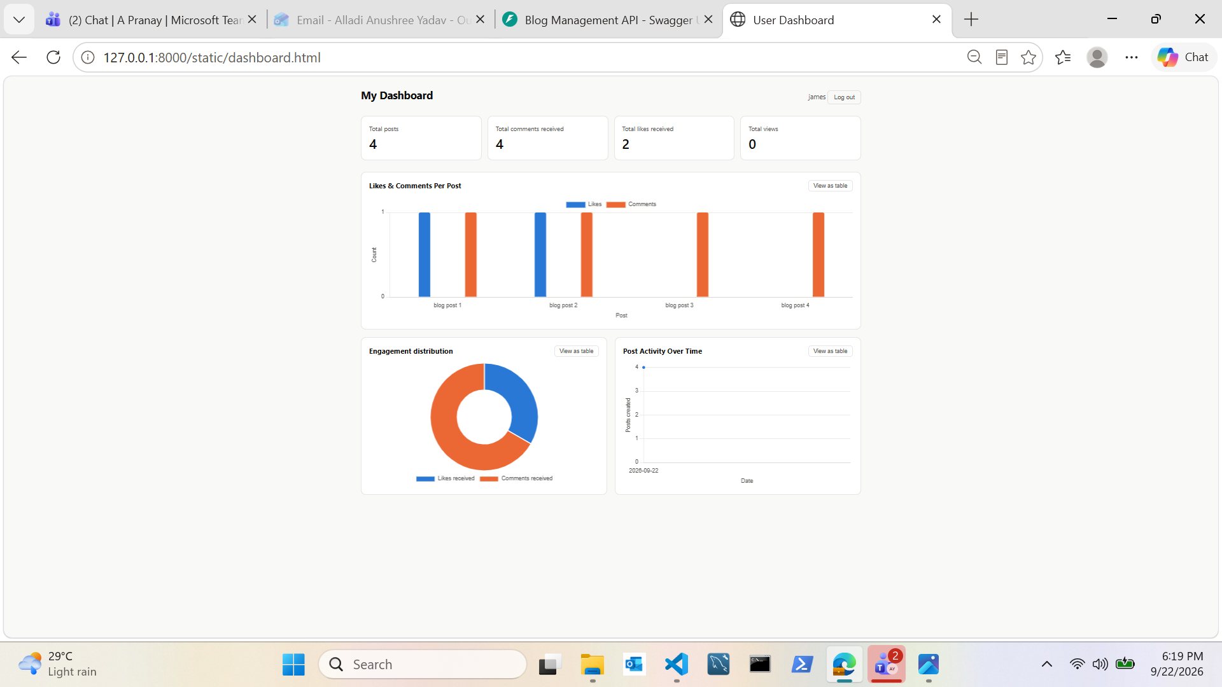
Confirmed live: comments received now display correctly for James
Captured directly from the browser during manual testing, after the total_comments_received fix.

Slide 9
Verified end to end
504 / 504
0
1
tests passing
cross-user data leaks
query per dashboard load

