Slide 1
N
Notification Center
Verification Screenshots
September 23, 2026

Slide 2
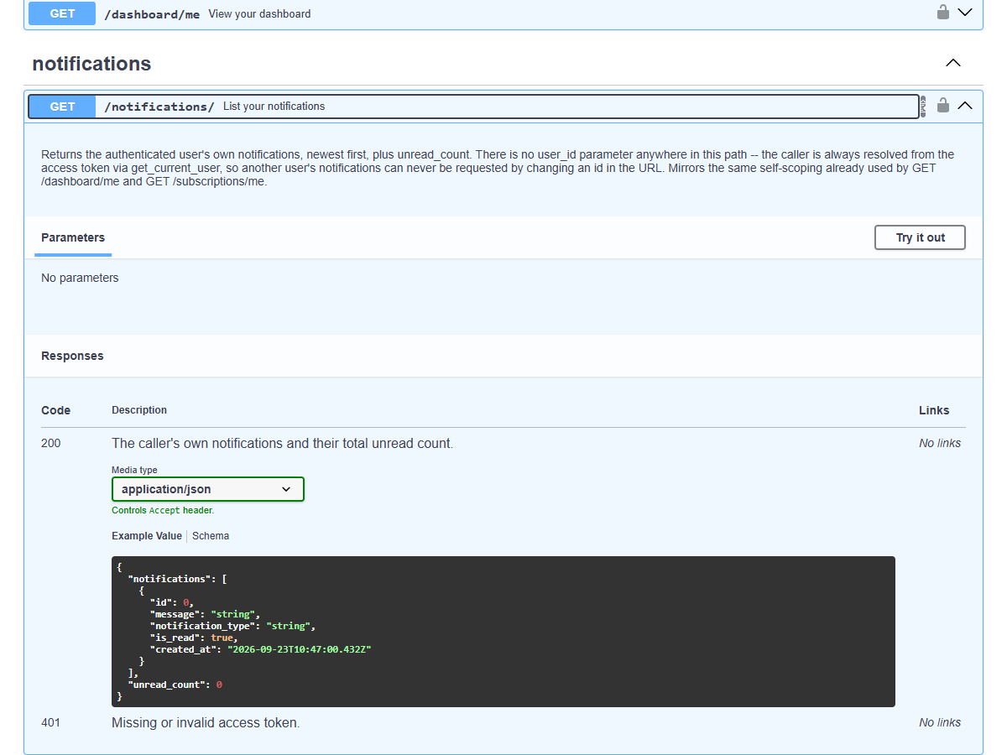
1
Swagger: GET /notifications/ Endpoint

Slide 3
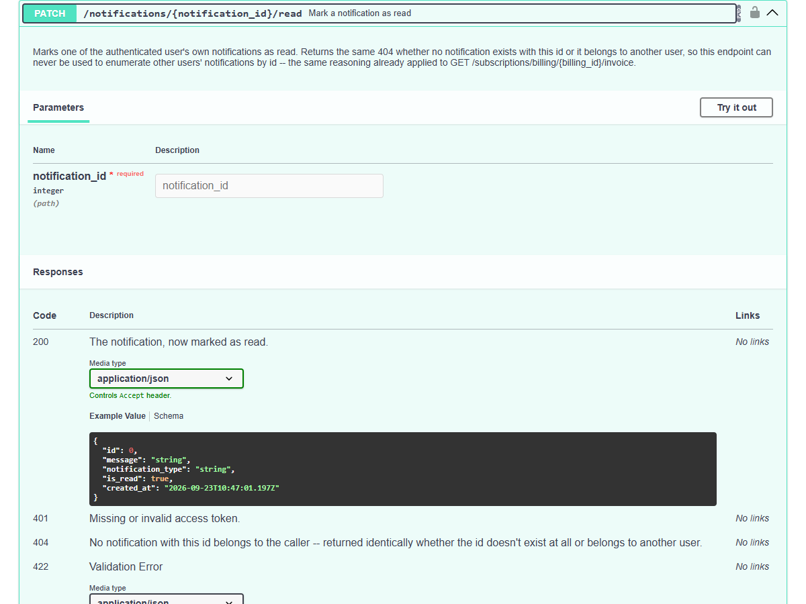
2
Swagger: Mark Notification as Read Endpoint

Slide 4
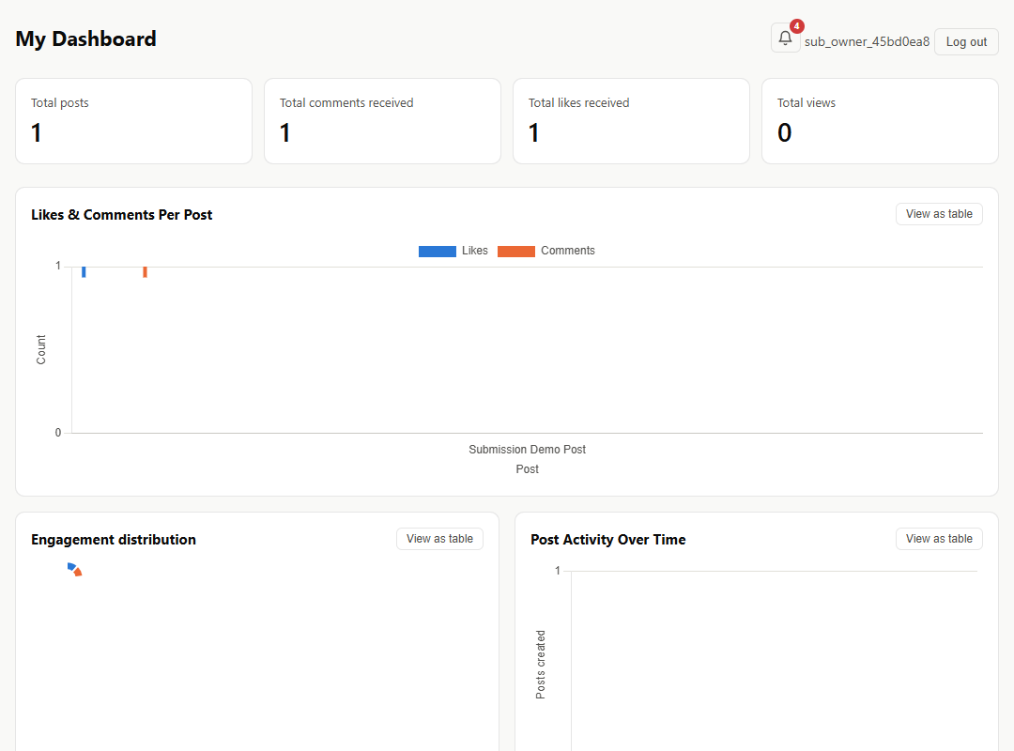
3
Notification Bell with Unread Count Badge

Slide 5
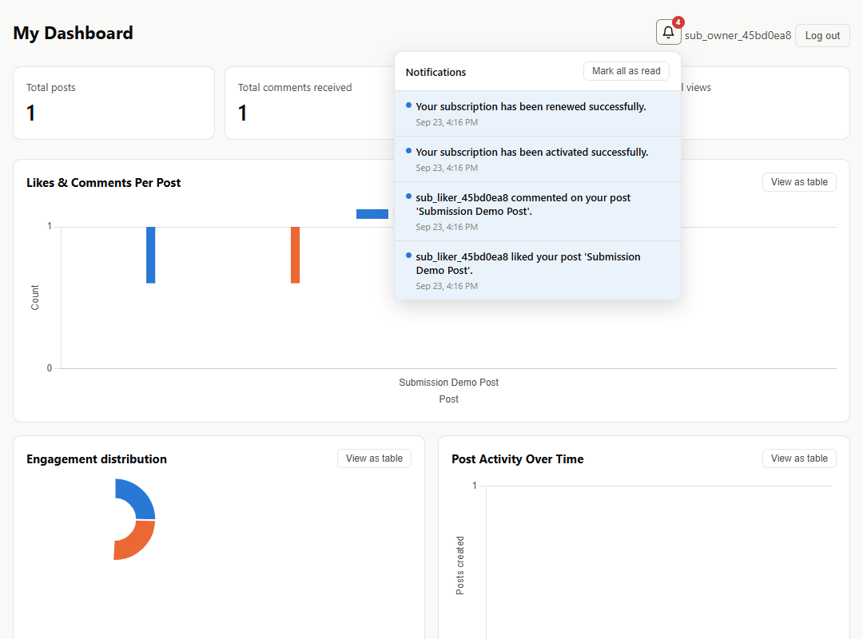
4
Notification Dropdown Showing Recent Notifications

Slide 6
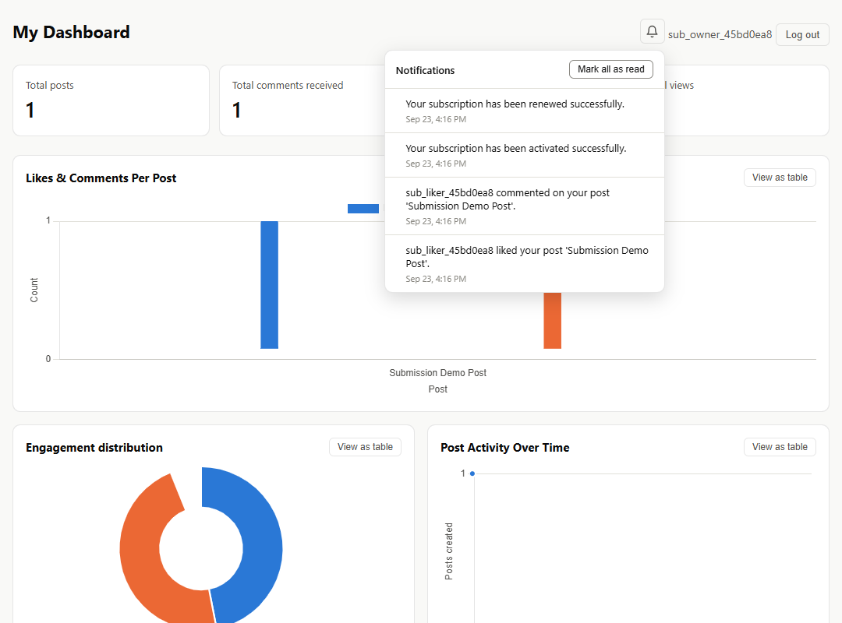
5
Result After Marking All Notifications as Read

Slide 7
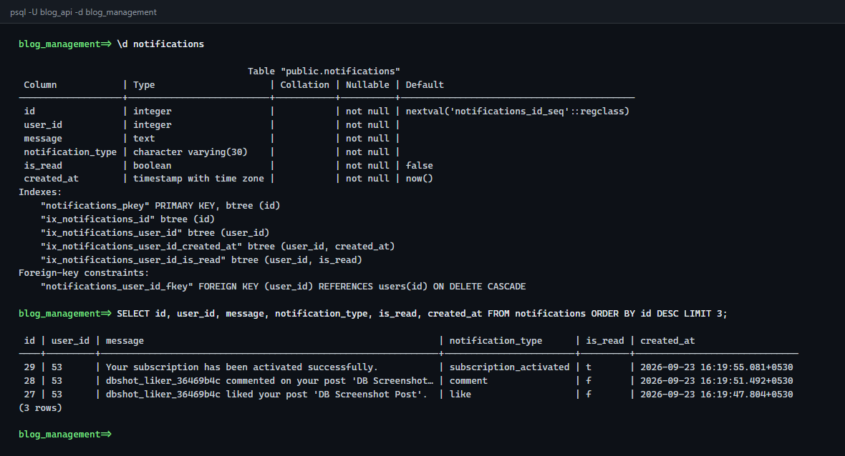
6
Notifications Table in the PostgreSQL Database

Slide 8
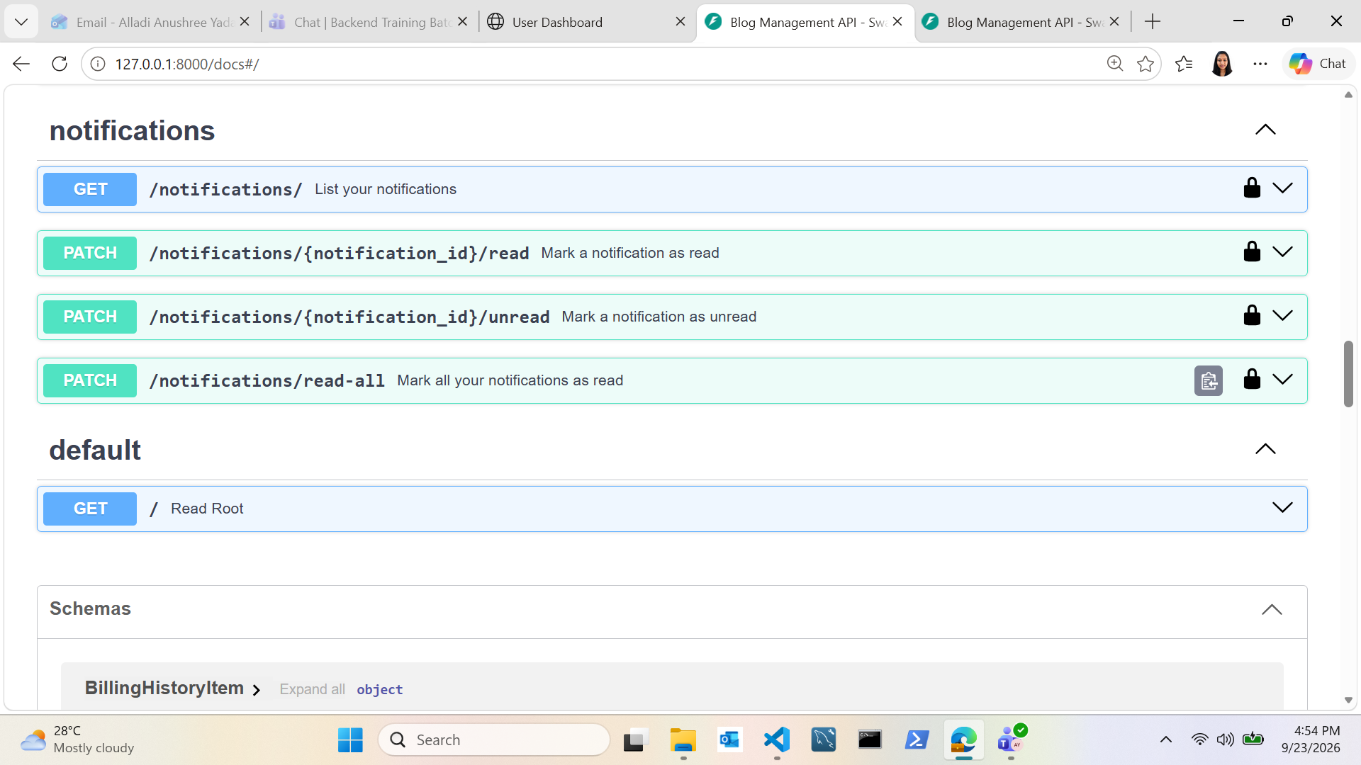
7
Swagger: All Four Notification Endpoints Registered

Slide 9
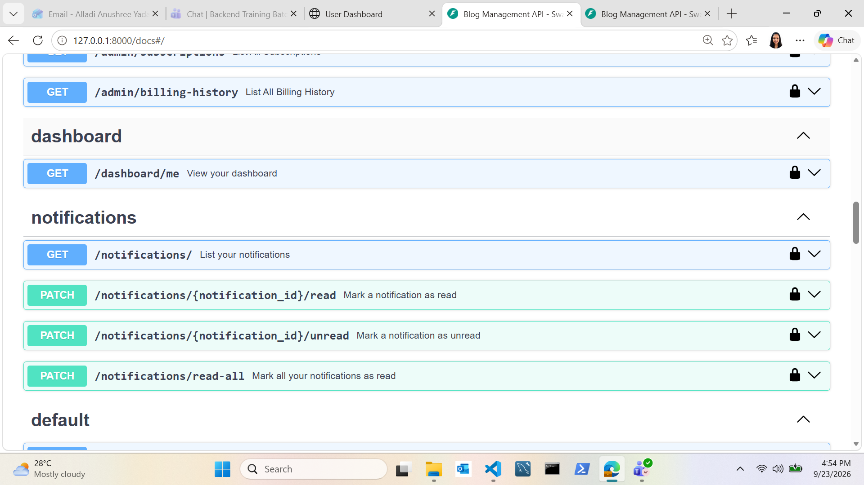
8
Swagger: Notifications Grouped With the Rest of the API

Slide 10
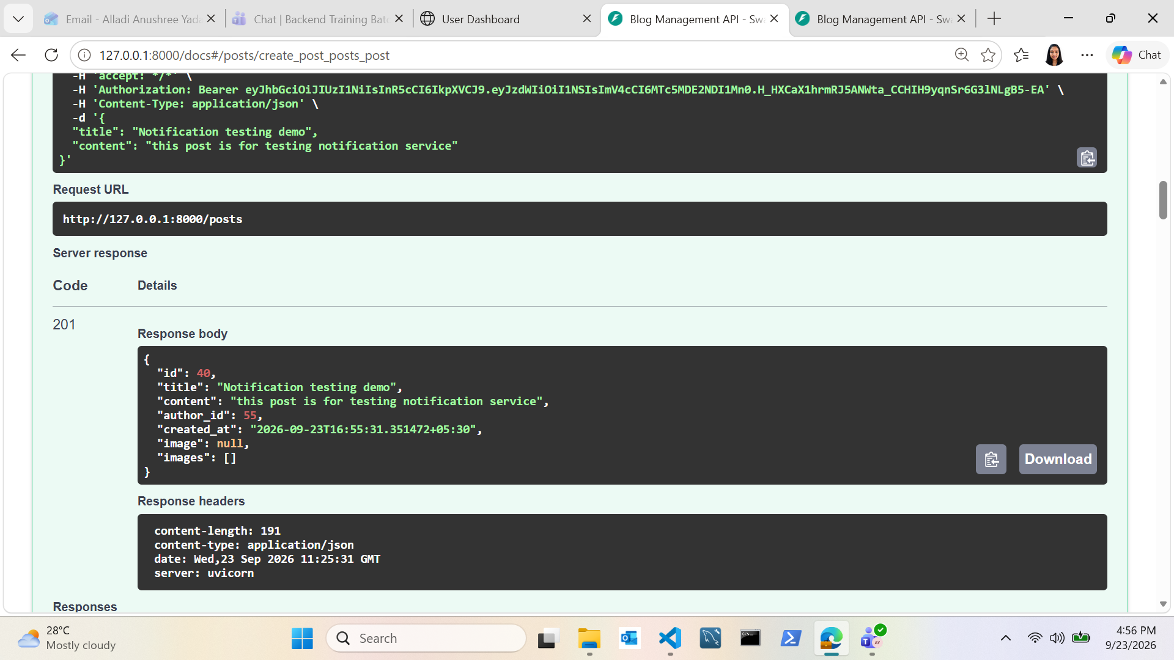
9
Creating a Test Post via Swagger (POST /posts)

Slide 11
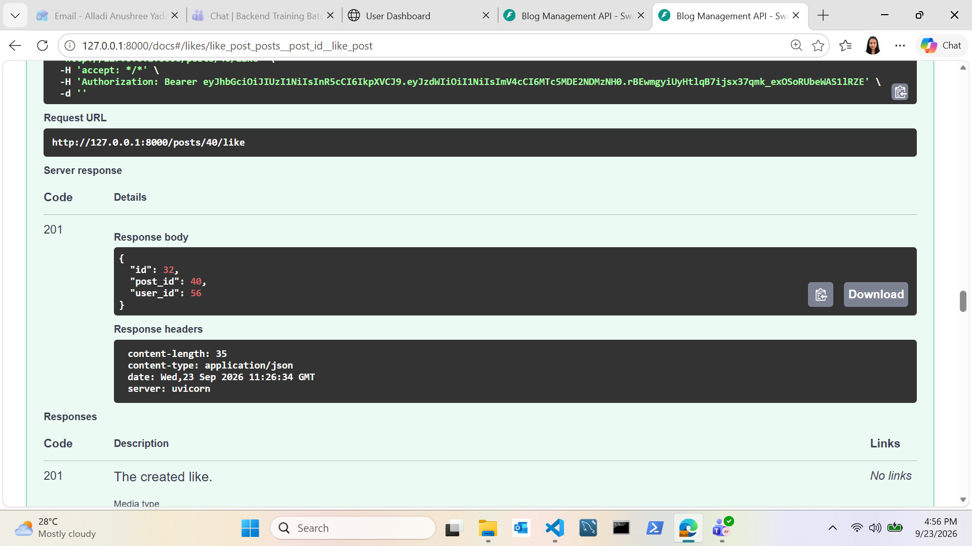
10
Liking the Test Post via Swagger (POST /posts/{id}/like)

Slide 12
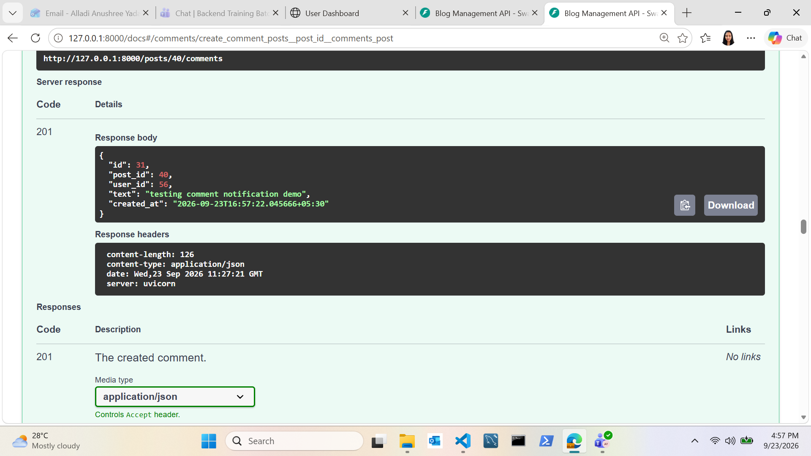
11
Commenting on the Test Post via Swagger

Slide 13
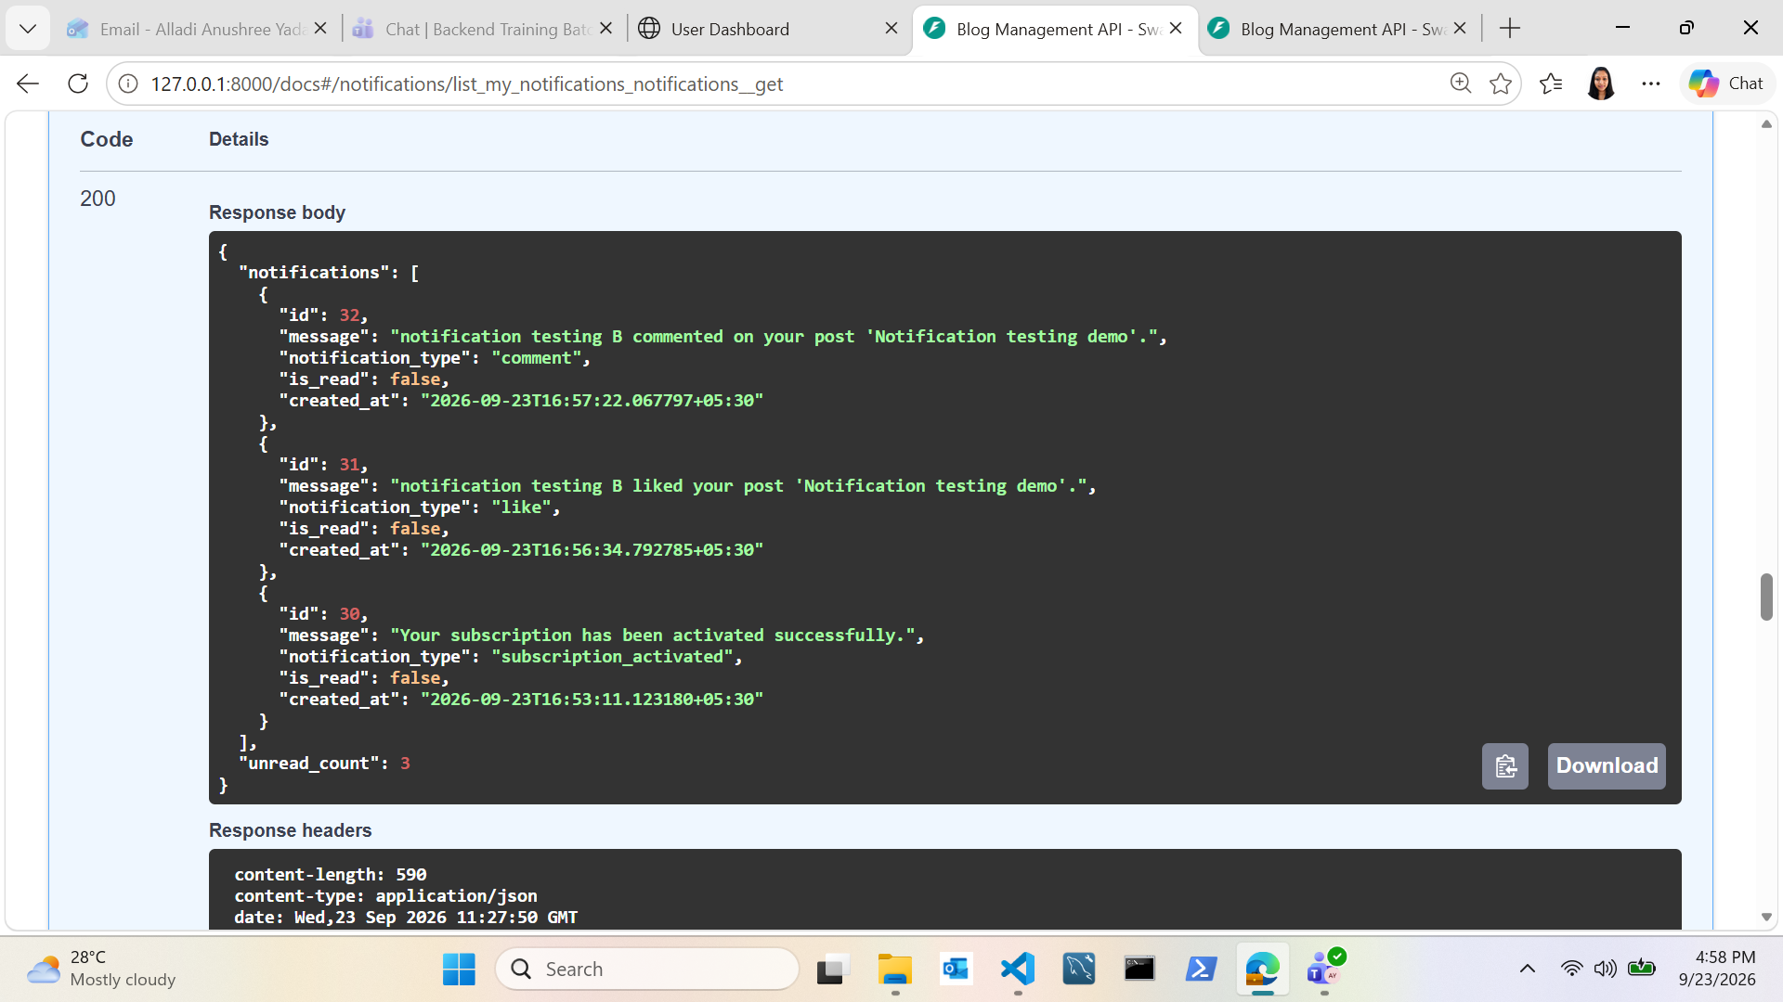
12
GET /notifications/ Returns All Notification Types

Slide 14
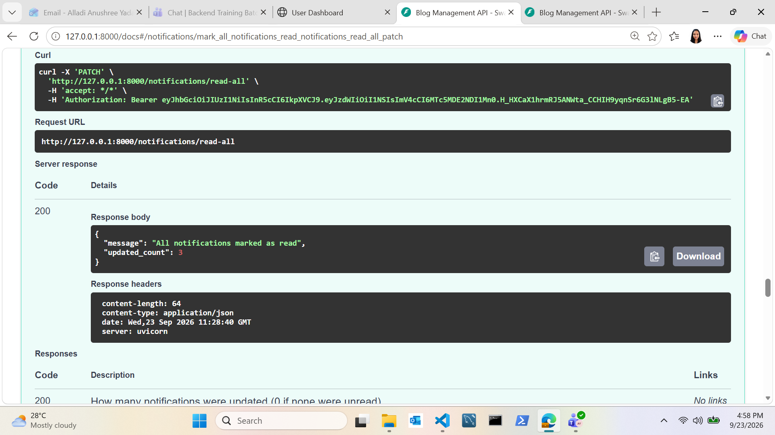
13
Mark-All-As-Read via Swagger (PATCH /notifications/read-all)

Slide 15
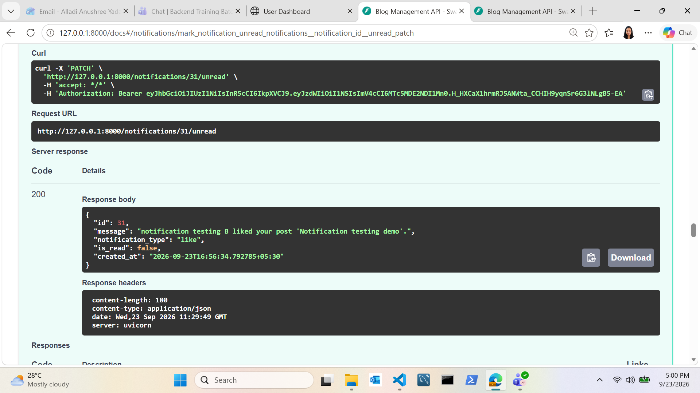
14
Marking a Notification as Unread via Swagger

Slide 16
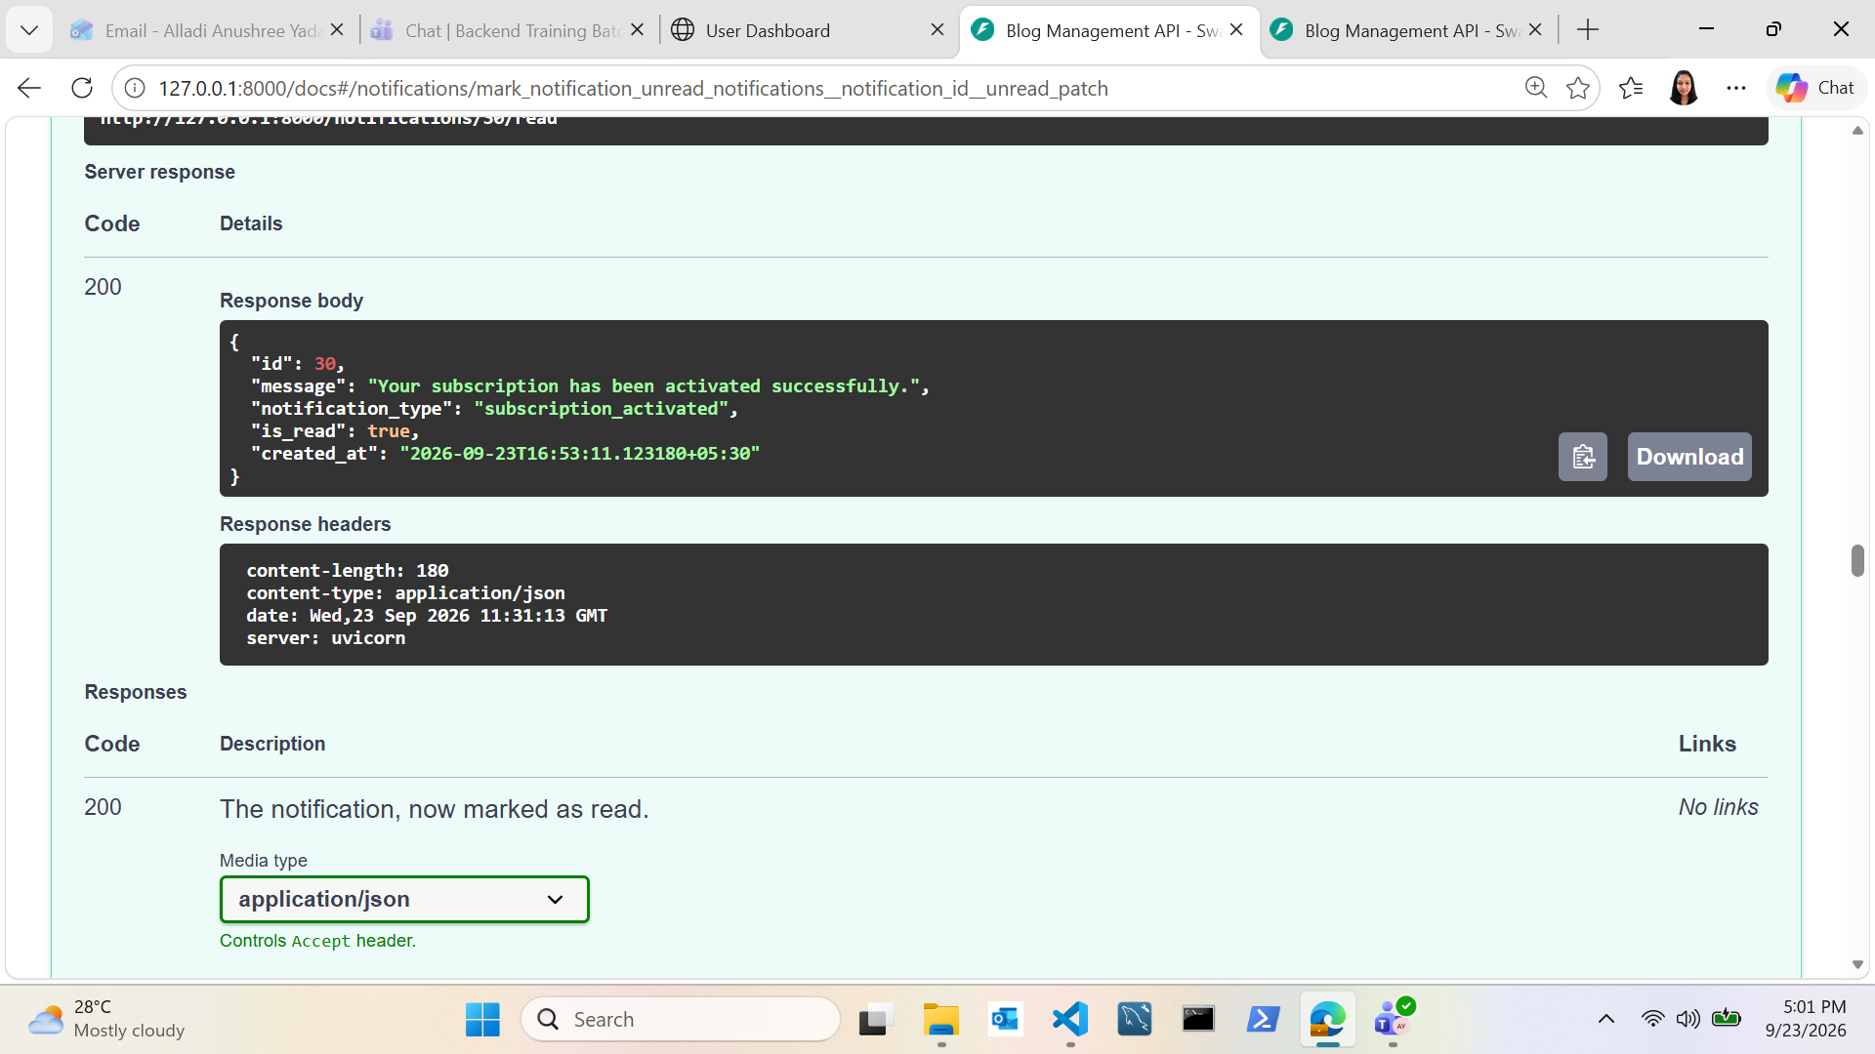
15
Marking an Individual Notification as Read via Swagger

Slide 17
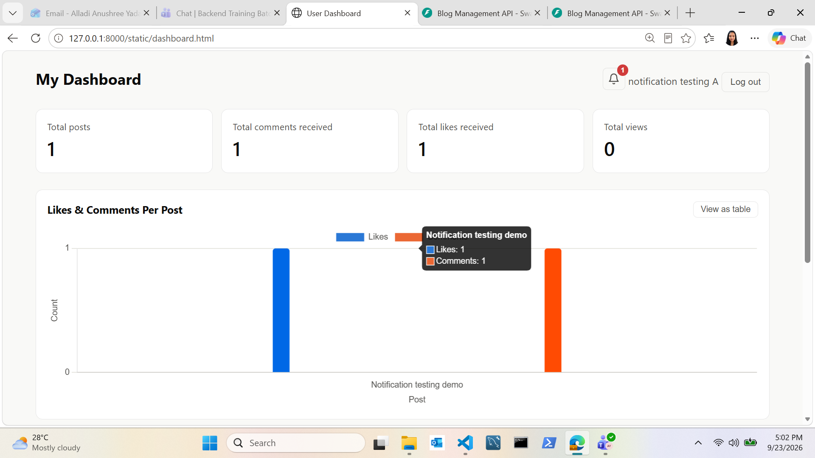
16
Notification Bell Badge on the Live Dashboard (View 1)

Slide 18

17
Notification Bell Badge on the Live Dashboard (View 2)

Slide 19
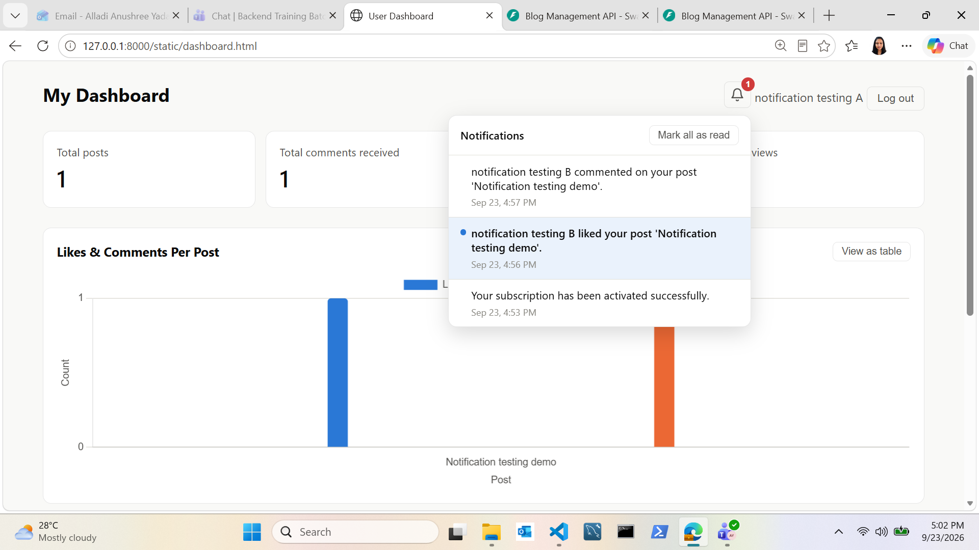
18
Notification Dropdown Open on the Live Dashboard

Slide 20
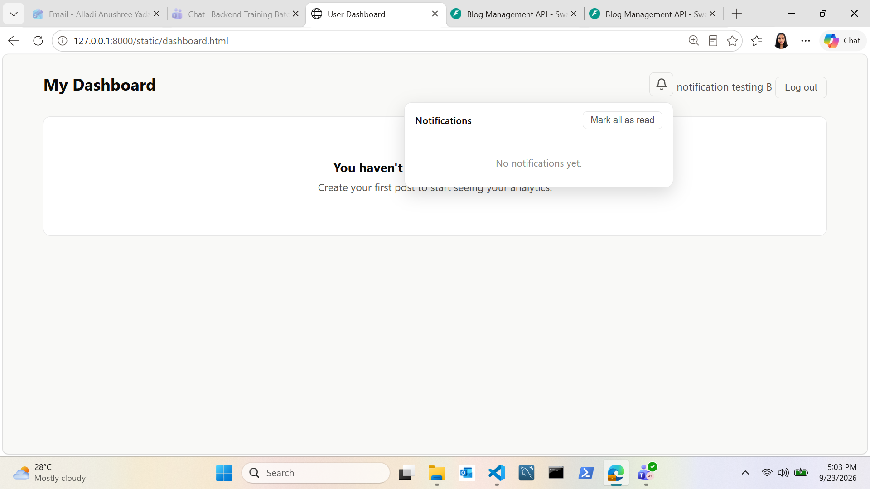
19
A Second User Sees No Notifications (Isolation Check)

Slide 21
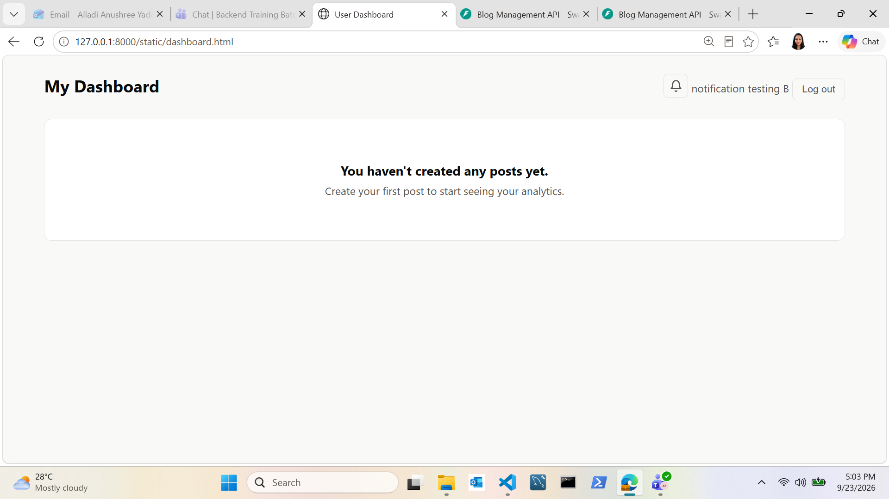
20
Second Test User's Dashboard With Zero Unread Notifications

