Slide 1
FEATURE WALKTHROUGH
Scheduled Blog Publishing
Step-by-step screenshots · Blog Management API (Inkwell)
Draft → Scheduled → Published
41 screenshots across 13 steps · captured 28 September 2026 from the live app and PostgreSQL database
Notes:
Title slide. Every following slide shows one screenshot from blog_api/screenshots/scheduled_publishing.

Slide 2
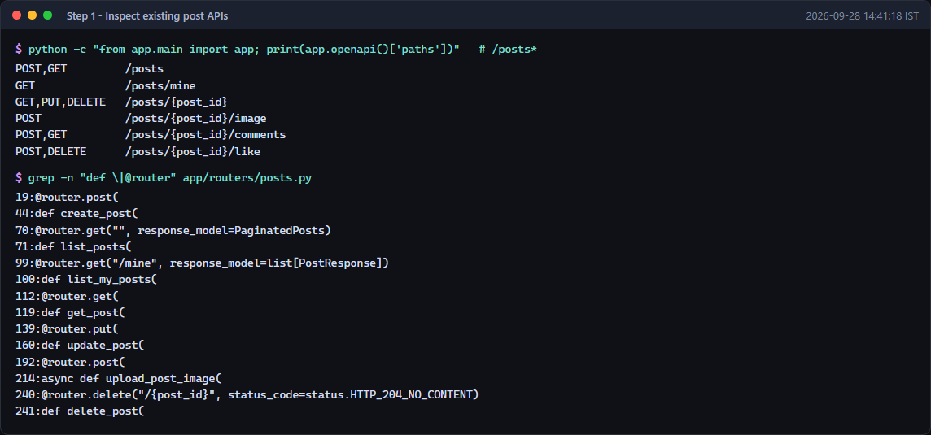
STEP 1
Existing post API endpoints identified during inspection
Scheduled Blog Publishing · Step 1 · Inspection
2 / 44
Notes:
Existing post API endpoints identified during inspection
Source: screenshots/scheduled_publishing/step01_existing_post_endpoints.png

Slide 3
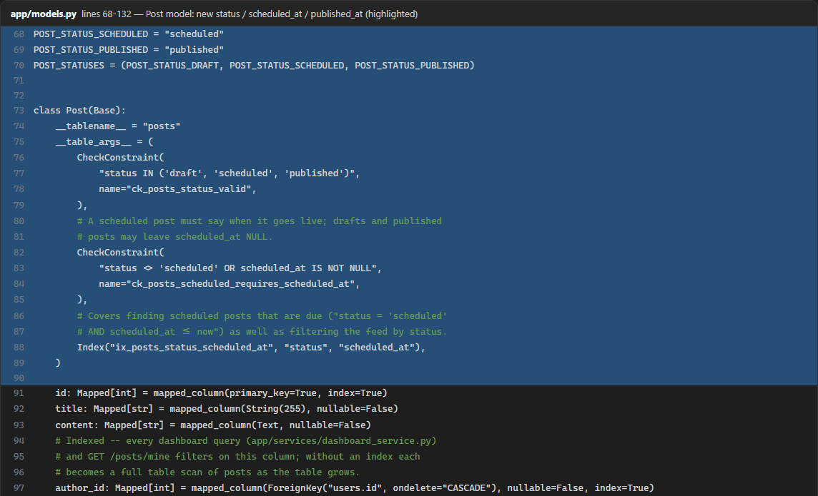
STEP 1
Post model with the new status, scheduled_at and published_at fields (part 1 of 2)
Scheduled Blog Publishing · Step 1 · Inspection
3 / 44
Notes:
Post model with the new status, scheduled_at and published_at fields (part 1 of 2)
Source: screenshots/scheduled_publishing/step01_post_model.png

Slide 4
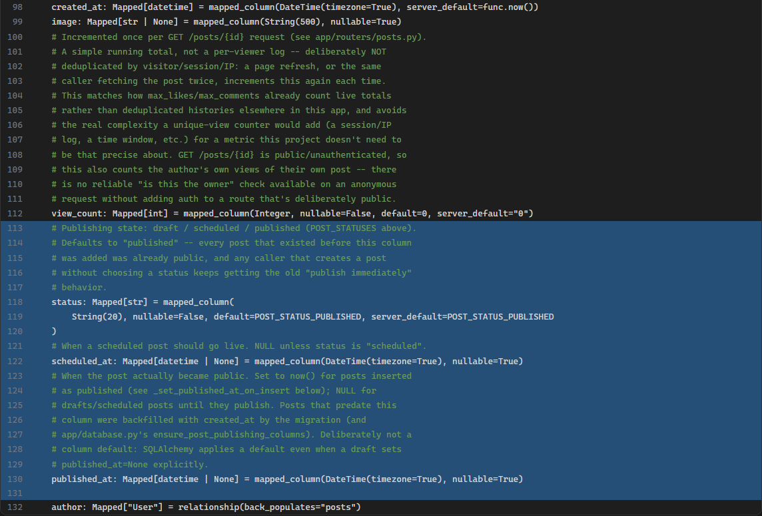
STEP 1
Post model with the new status, scheduled_at and published_at fields (part 2 of 2)
Scheduled Blog Publishing · Step 1 · Inspection
4 / 44
Notes:
Post model with the new status, scheduled_at and published_at fields (part 2 of 2)
Source: screenshots/scheduled_publishing/step01_post_model.png

Slide 5
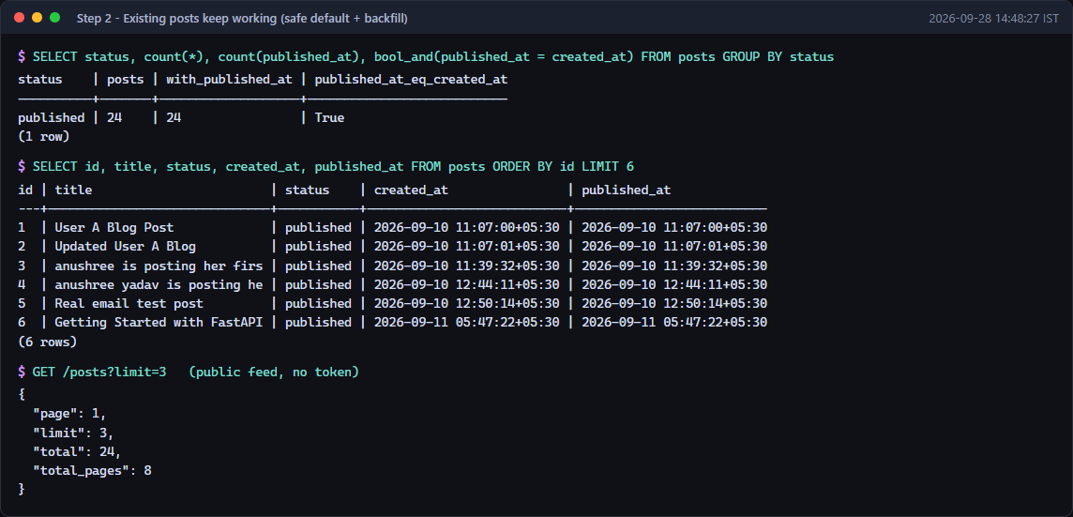
STEP 2
All 24 existing posts stay published, with published_at backfilled
Scheduled Blog Publishing · Step 2 · Database
5 / 44
Notes:
All 24 existing posts stay published, with published_at backfilled
Source: screenshots/scheduled_publishing/step02_existing_posts_backfilled.png

Slide 6
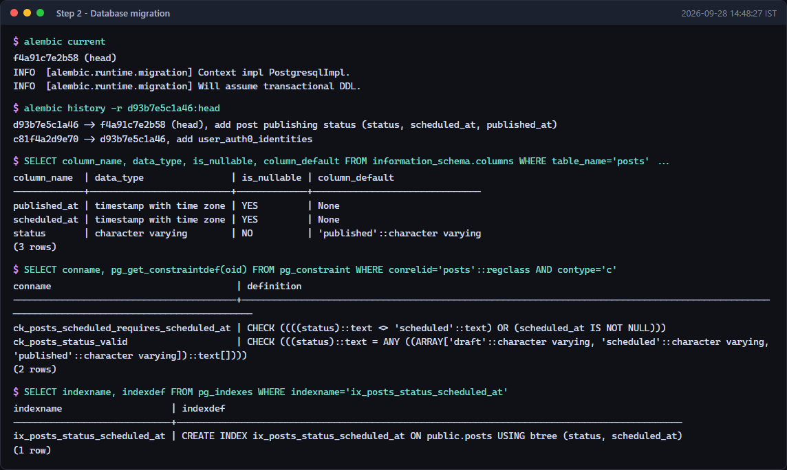
STEP 2
Migration f4a91c7e2b58 applied: new columns, check constraints and index
Scheduled Blog Publishing · Step 2 · Database
6 / 44
Notes:
Migration f4a91c7e2b58 applied: new columns, check constraints and index
Source: screenshots/scheduled_publishing/step02_migration_applied.png

Slide 7
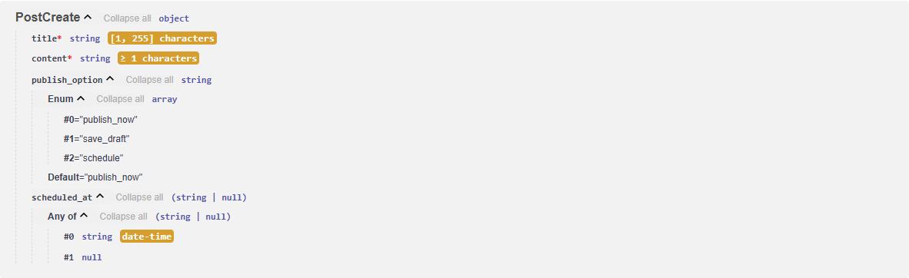
STEP 3
Swagger: PostCreate accepts publish_option and scheduled_at
Scheduled Blog Publishing · Step 3 · Schemas
7 / 44
Notes:
Swagger: PostCreate accepts publish_option and scheduled_at
Source: screenshots/scheduled_publishing/step03_swagger_PostCreate.png

Slide 8
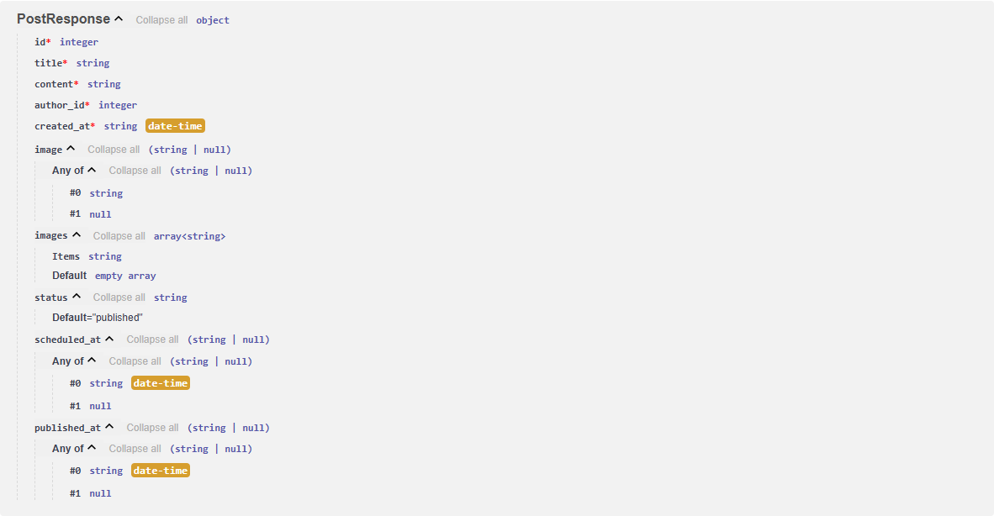
STEP 3
Swagger: PostResponse now returns status, scheduled_at and published_at
Scheduled Blog Publishing · Step 3 · Schemas
8 / 44
Notes:
Swagger: PostResponse now returns status, scheduled_at and published_at
Source: screenshots/scheduled_publishing/step03_swagger_PostResponse.png

Slide 9
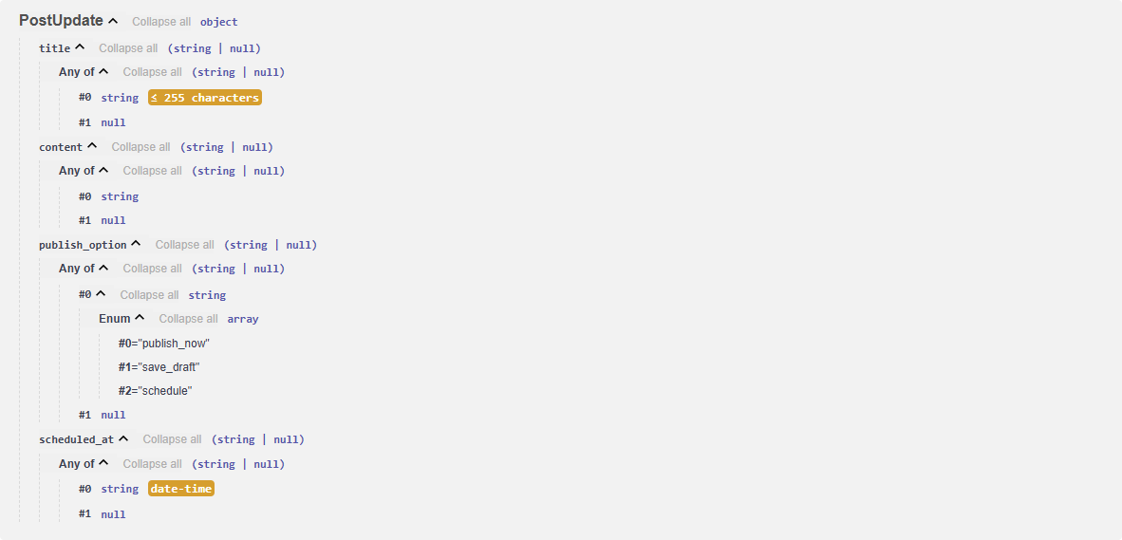
STEP 3
Swagger: PostUpdate supports publishing options when editing
Scheduled Blog Publishing · Step 3 · Schemas
9 / 44
Notes:
Swagger: PostUpdate supports publishing options when editing
Source: screenshots/scheduled_publishing/step03_swagger_PostUpdate.png

Slide 10
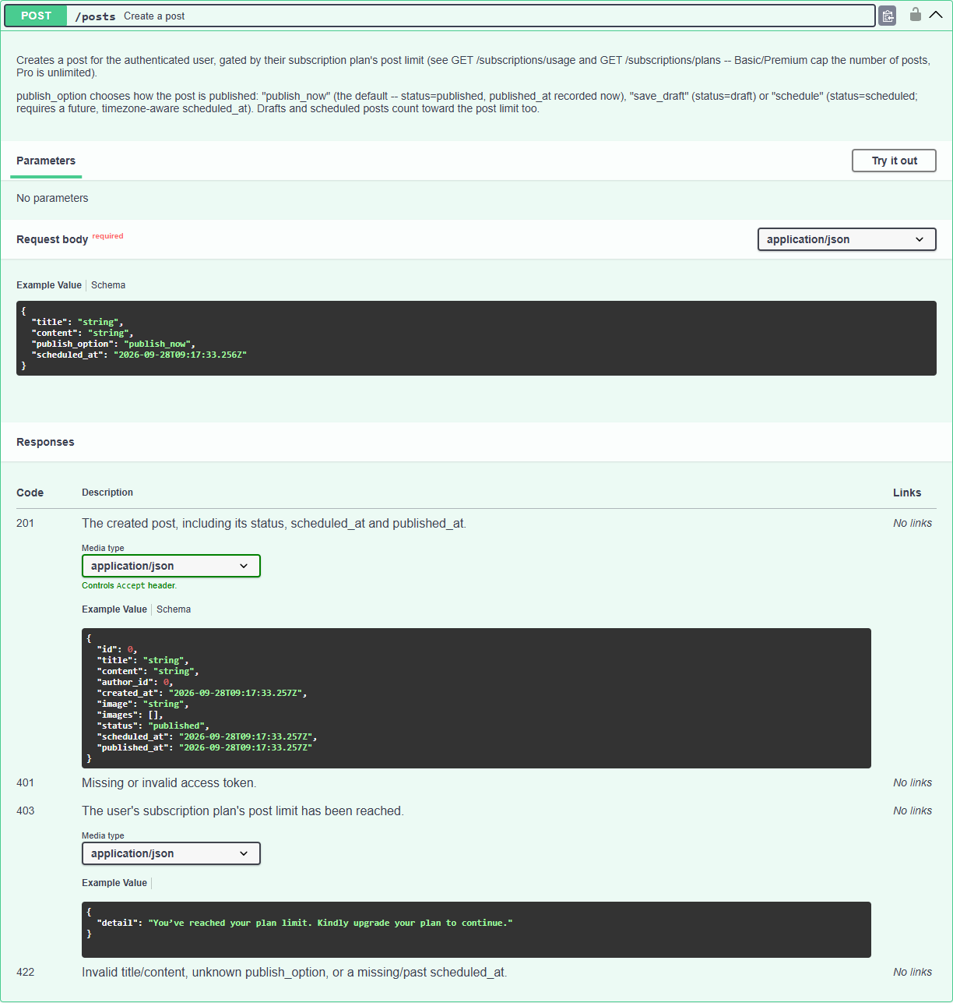
STEP 3
Swagger: POST /posts documents the three publishing options
Scheduled Blog Publishing · Step 3 · Schemas
10 / 44
Notes:
Swagger: POST /posts documents the three publishing options
Source: screenshots/scheduled_publishing/step03_swagger_create_post_docs.png

Slide 11
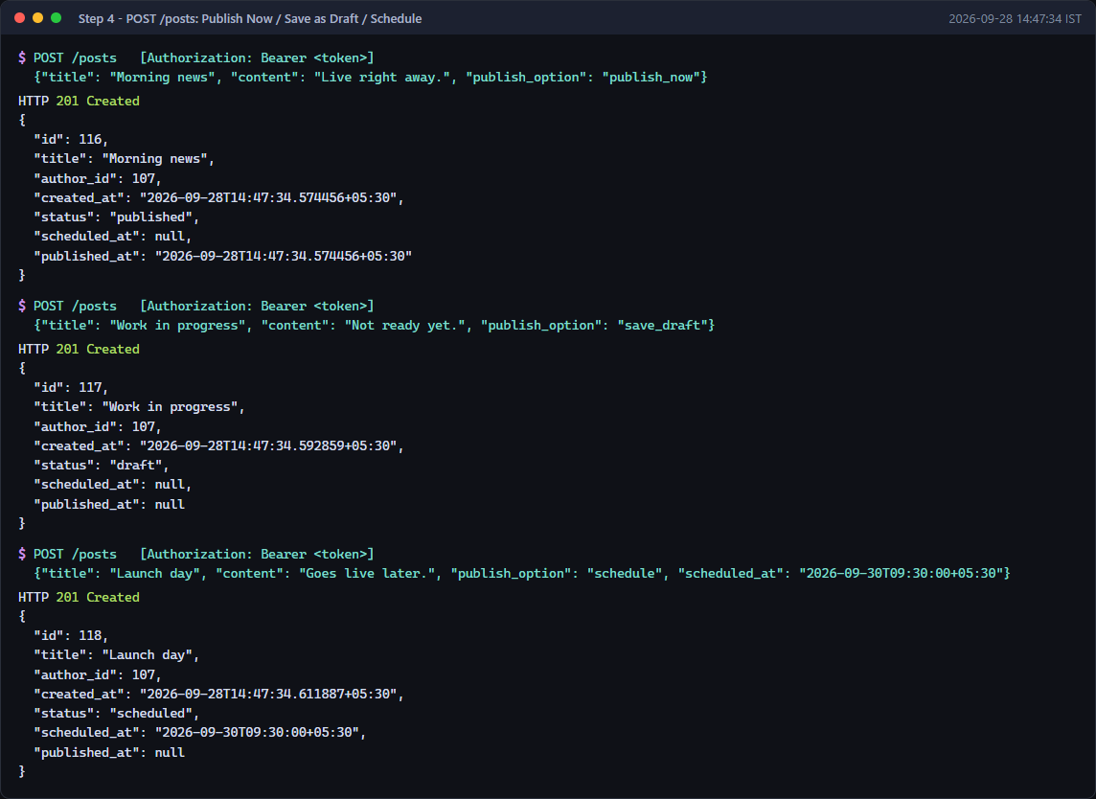
STEP 4
POST /posts: Publish Now, Save as Draft and Schedule responses
Scheduled Blog Publishing · Step 4 · Create API
11 / 44
Notes:
POST /posts: Publish Now, Save as Draft and Schedule responses
Source: screenshots/scheduled_publishing/step04_create_publish_now_draft_schedule.png

Slide 12
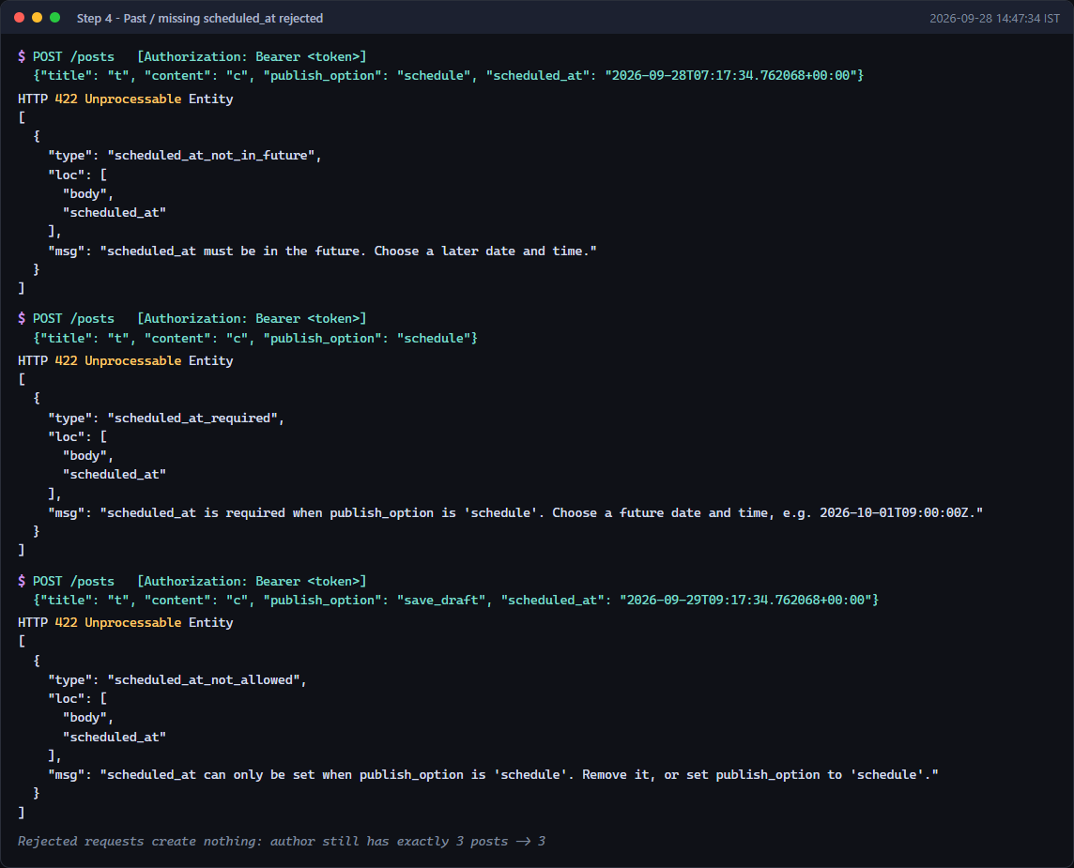
STEP 4
Past or missing scheduled_at is rejected with a clear 422 error
Scheduled Blog Publishing · Step 4 · Create API
12 / 44
Notes:
Past or missing scheduled_at is rejected with a clear 422 error
Source: screenshots/scheduled_publishing/step04_create_validation_errors.png

Slide 13
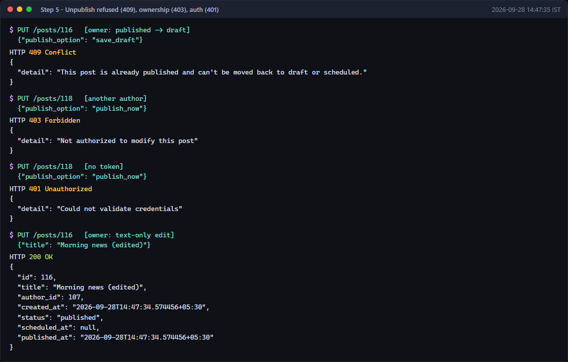
STEP 5
Unpublishing refused (409), other authors blocked (403), no login (401)
Scheduled Blog Publishing · Step 5 · Update API
13 / 44
Notes:
Unpublishing refused (409), other authors blocked (403), no login (401)
Source: screenshots/scheduled_publishing/step05_update_rejections_and_ownership.png

Slide 14
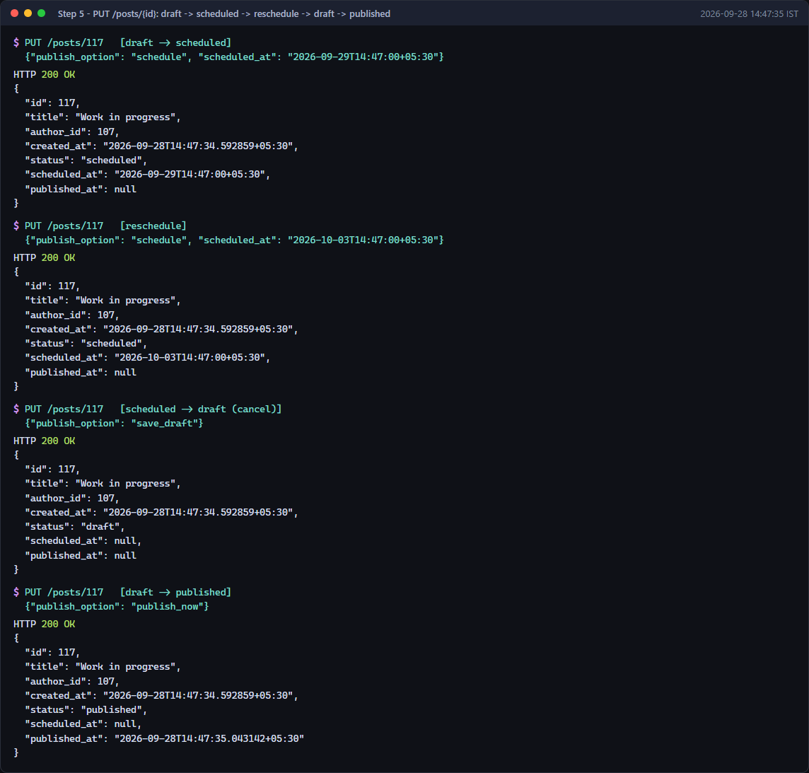
STEP 5
PUT /posts: draft → scheduled → rescheduled → draft → published
Scheduled Blog Publishing · Step 5 · Update API
14 / 44
Notes:
PUT /posts: draft → scheduled → rescheduled → draft → published
Source: screenshots/scheduled_publishing/step05_update_transitions.png

Slide 15
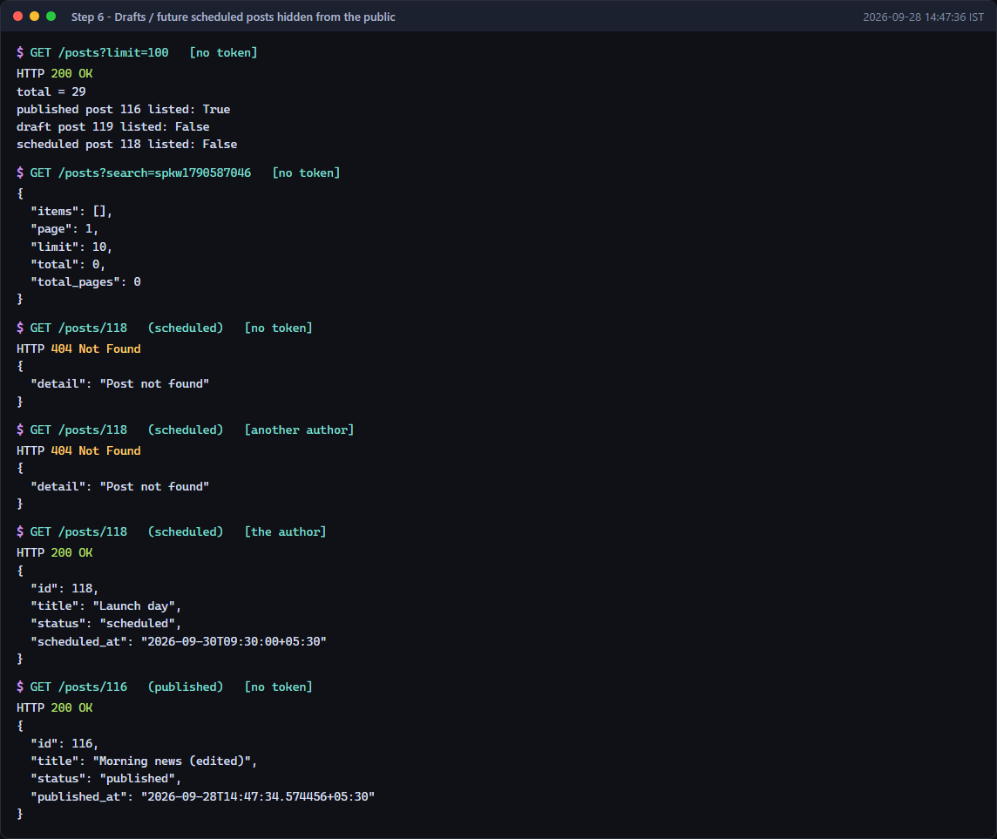
STEP 6
Drafts and future scheduled posts are hidden from the public
Scheduled Blog Publishing · Step 6 · Visibility
15 / 44
Notes:
Drafts and future scheduled posts are hidden from the public
Source: screenshots/scheduled_publishing/step06_public_visibility.png

Slide 16
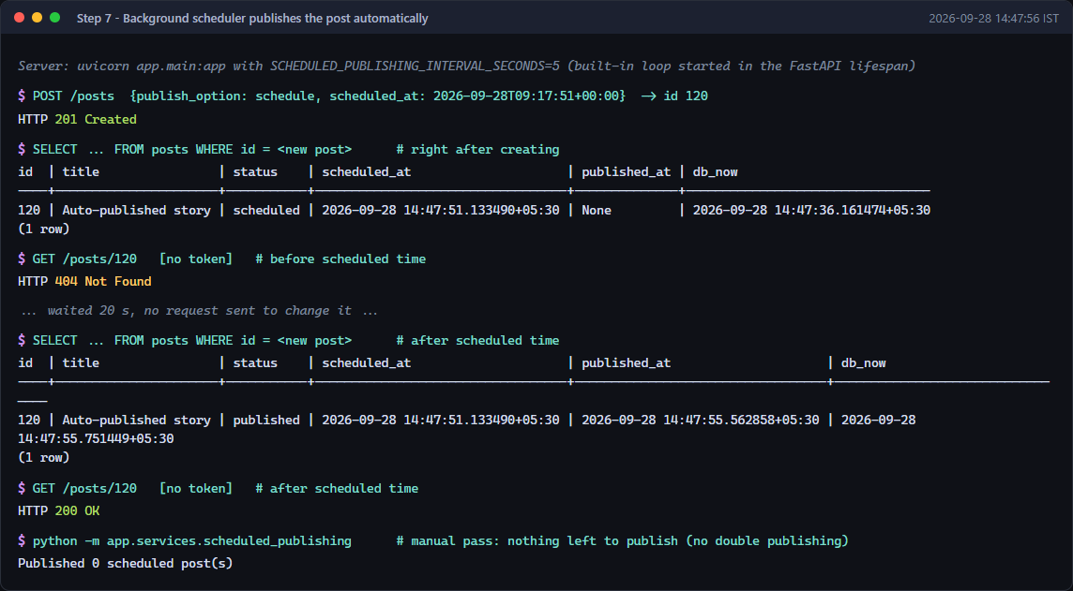
STEP 7
Background scheduler publishes the post automatically at its time
Scheduled Blog Publishing · Step 7 · Auto-publish
16 / 44
Notes:
Background scheduler publishes the post automatically at its time
Source: screenshots/scheduled_publishing/step07_automatic_publishing.png

Slide 17
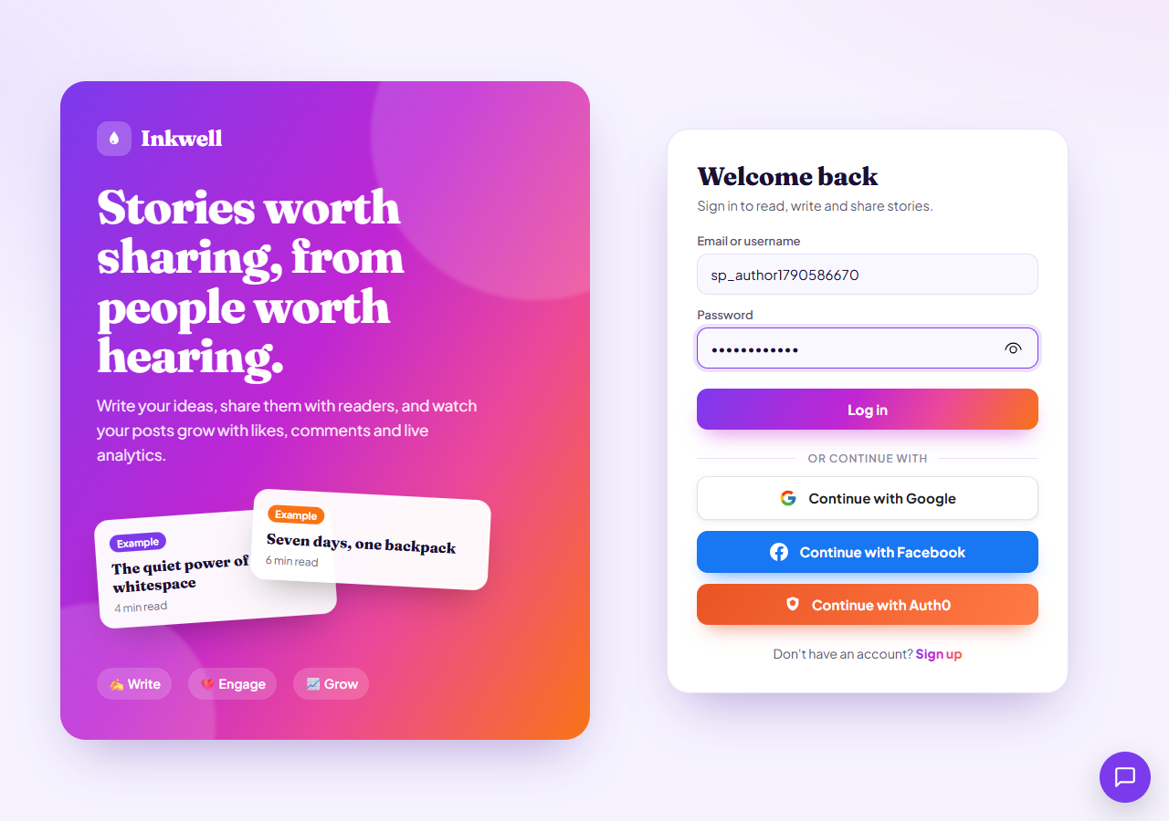
STEP 8
Author signs in to the Inkwell web app
Scheduled Blog Publishing · Step 8 · Editor UI
17 / 44
Notes:
Author signs in to the Inkwell web app
Source: screenshots/scheduled_publishing/step08_01_login.png

Slide 18
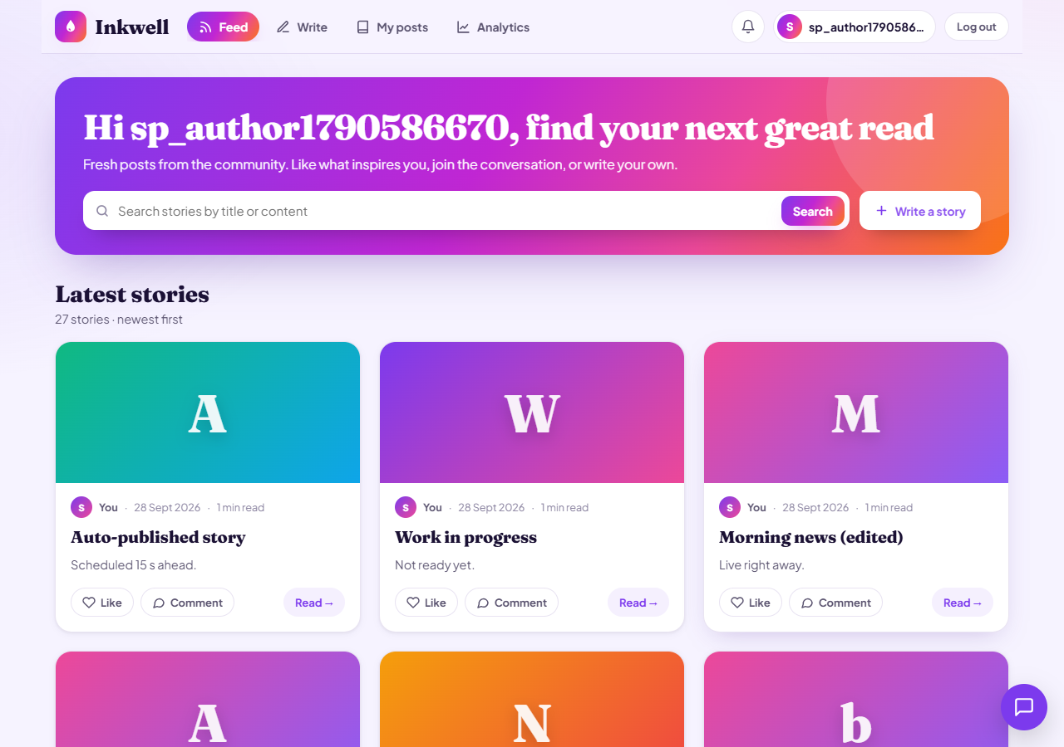
STEP 8
Public feed after signing in
Scheduled Blog Publishing · Step 8 · Editor UI
18 / 44
Notes:
Public feed after signing in
Source: screenshots/scheduled_publishing/step08_02_feed_after_login.png

Slide 19
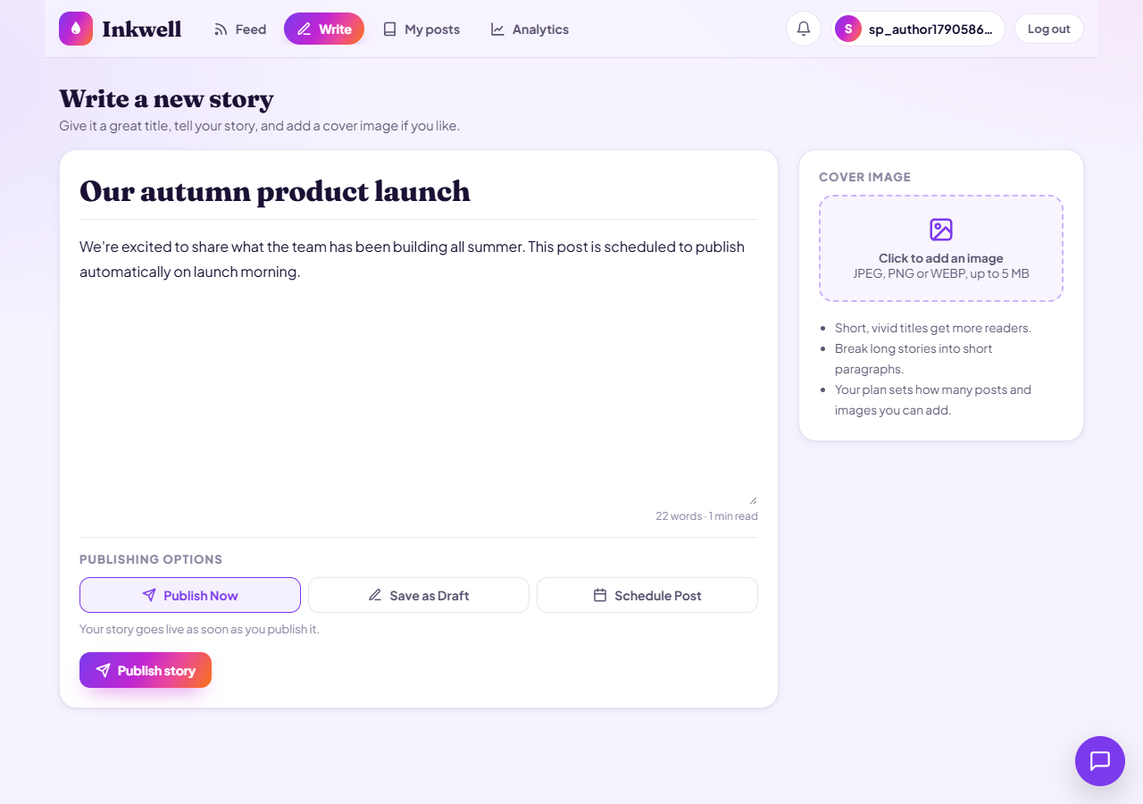
STEP 8
Write page: new Publishing options section, Publish Now by default
Scheduled Blog Publishing · Step 8 · Editor UI
19 / 44
Notes:
Write page: new Publishing options section, Publish Now by default
Source: screenshots/scheduled_publishing/step08_03_write_publish_now_default.png

Slide 20
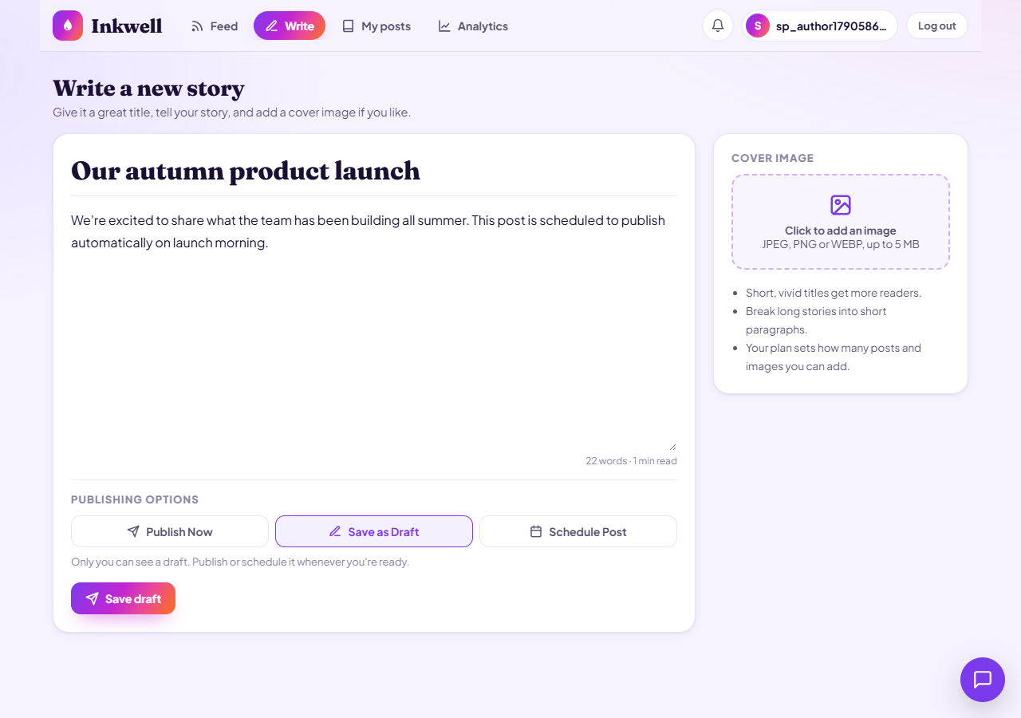
STEP 8
Save as Draft selected: scheduling fields stay hidden
Scheduled Blog Publishing · Step 8 · Editor UI
20 / 44
Notes:
Save as Draft selected: scheduling fields stay hidden
Source: screenshots/scheduled_publishing/step08_04_write_save_as_draft_selected.png

Slide 21
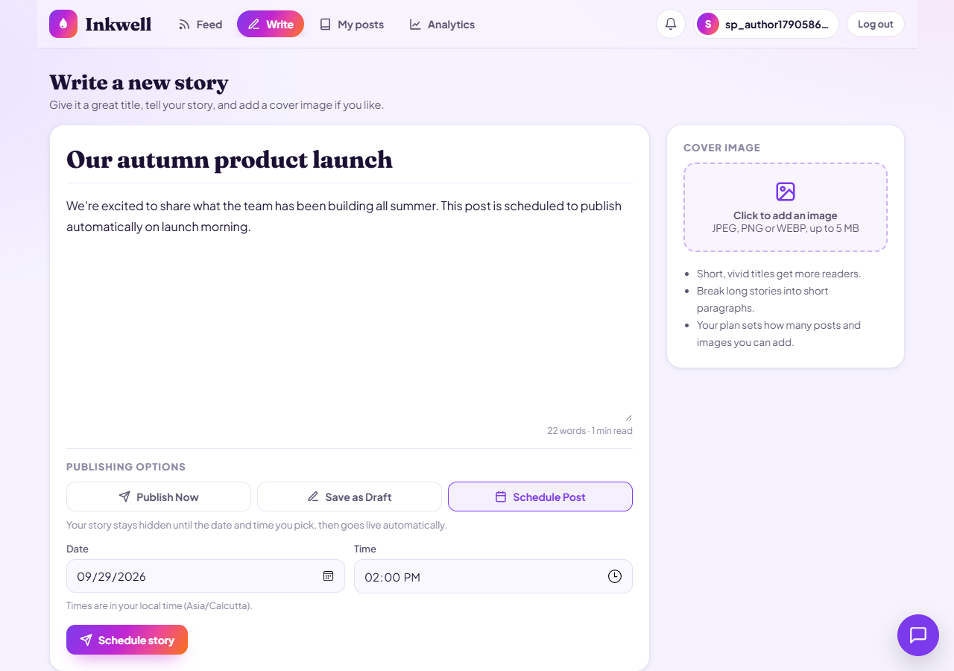
STEP 8
Schedule Post selected: date and time pickers appear
Scheduled Blog Publishing · Step 8 · Editor UI
21 / 44
Notes:
Schedule Post selected: date and time pickers appear
Source: screenshots/scheduled_publishing/step08_05_write_schedule_pickers.png

Slide 22
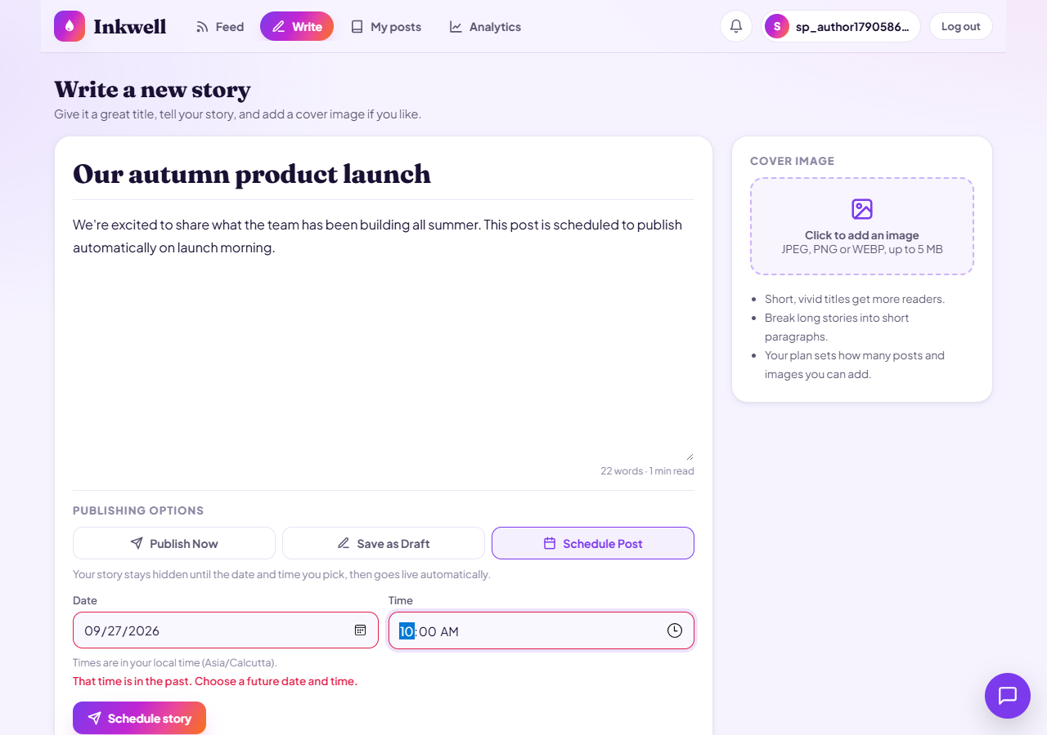
STEP 8
Past date and time blocked with a clear validation message
Scheduled Blog Publishing · Step 8 · Editor UI
22 / 44
Notes:
Past date and time blocked with a clear validation message
Source: screenshots/scheduled_publishing/step08_06_schedule_past_time_error.png

Slide 23
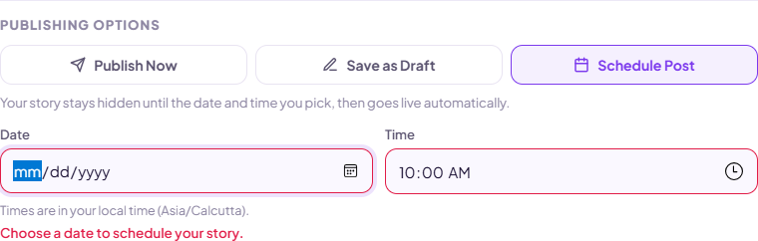
STEP 8
Missing date blocked: “Choose a date to schedule your story.”
Scheduled Blog Publishing · Step 8 · Editor UI
23 / 44
Notes:
Missing date blocked: “Choose a date to schedule your story.”
Source: screenshots/scheduled_publishing/step08_07_schedule_missing_date_error.png

Slide 24
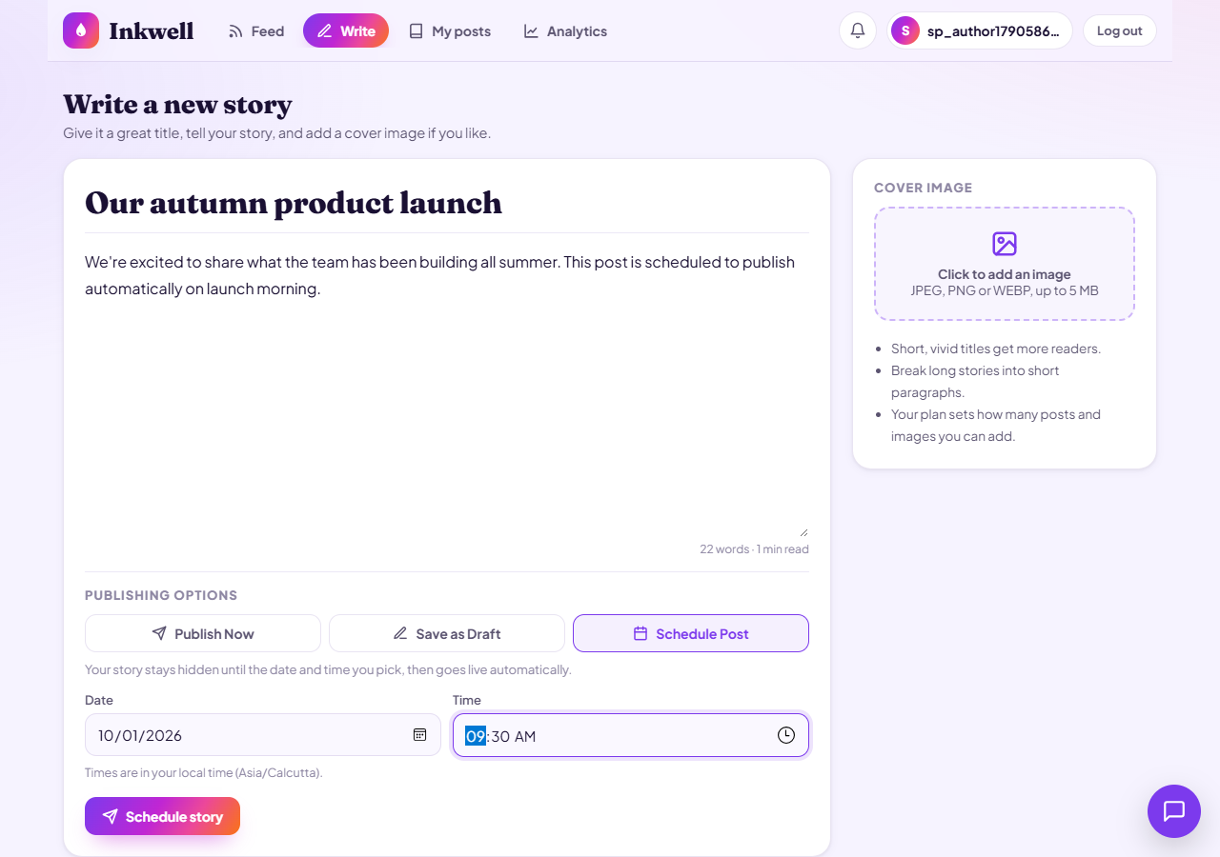
STEP 8
Valid future date and time chosen, local timezone shown
Scheduled Blog Publishing · Step 8 · Editor UI
24 / 44
Notes:
Valid future date and time chosen, local timezone shown
Source: screenshots/scheduled_publishing/step08_08_schedule_valid_time.png

Slide 25
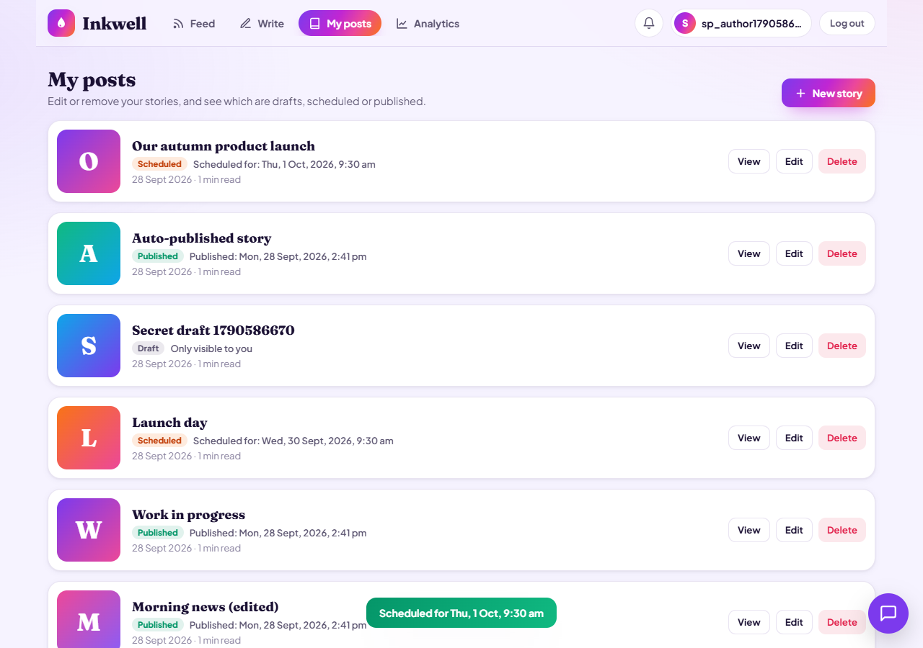
STEP 8
Post scheduled: confirmation toast and Scheduled badge in My posts
Scheduled Blog Publishing · Step 8 · Editor UI
25 / 44
Notes:
Post scheduled: confirmation toast and Scheduled badge in My posts
Source: screenshots/scheduled_publishing/step08_09_scheduled_toast_my_posts.png

Slide 26
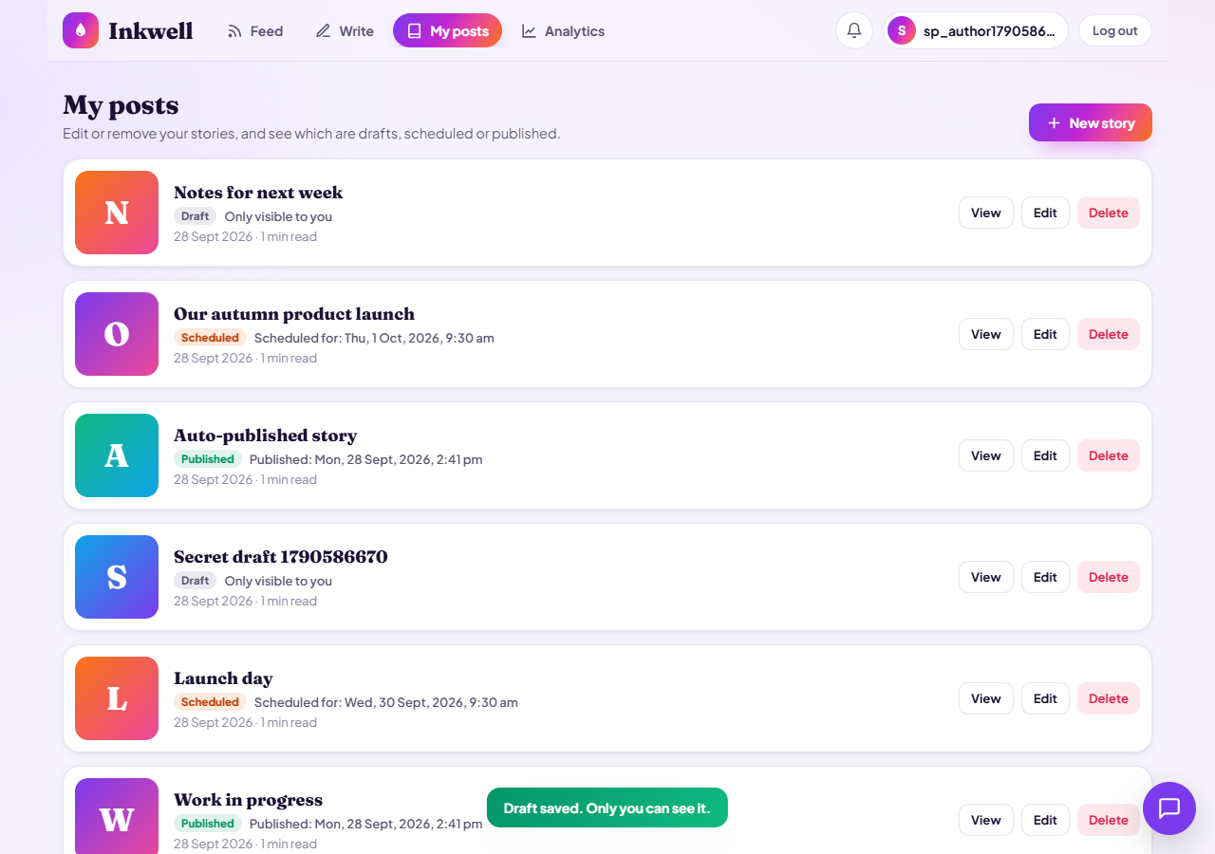
STEP 8
Draft saved: “Only you can see it” confirmation
Scheduled Blog Publishing · Step 8 · Editor UI
26 / 44
Notes:
Draft saved: “Only you can see it” confirmation
Source: screenshots/scheduled_publishing/step08_10_draft_saved_toast.png

Slide 27
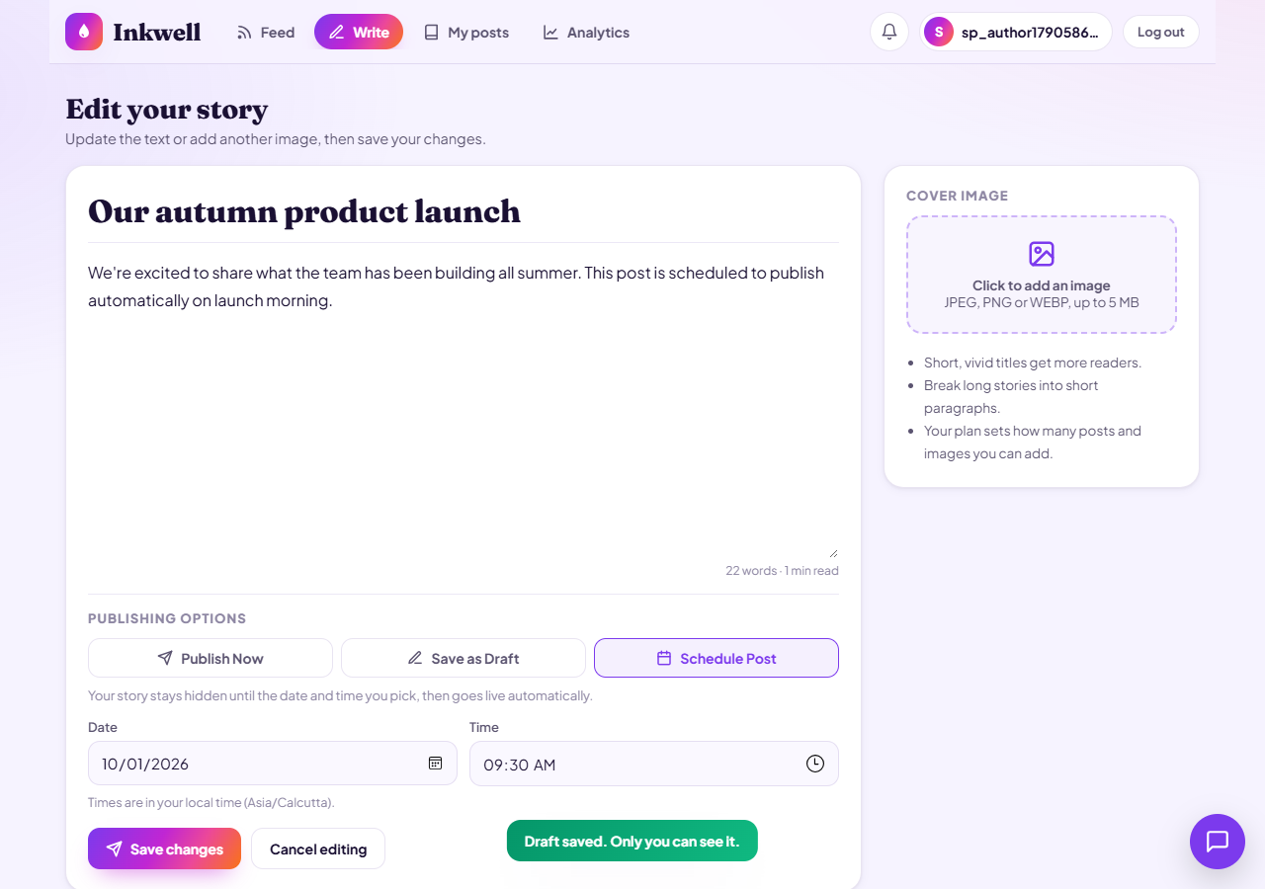
STEP 8
Editing a scheduled post: Schedule Post pre-selected with its date and time
Scheduled Blog Publishing · Step 8 · Editor UI
27 / 44
Notes:
Editing a scheduled post: Schedule Post pre-selected with its date and time
Source: screenshots/scheduled_publishing/step08_11_edit_scheduled_prefilled.png

Slide 28
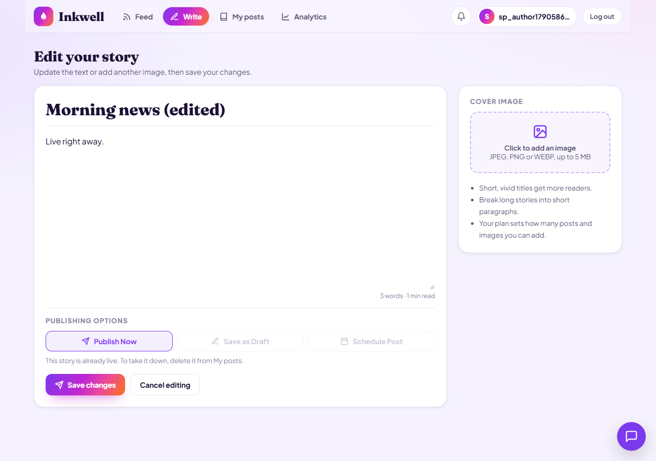
STEP 8
Editing a published post: Save as Draft and Schedule Post are locked
Scheduled Blog Publishing · Step 8 · Editor UI
28 / 44
Notes:
Editing a published post: Save as Draft and Schedule Post are locked
Source: screenshots/scheduled_publishing/step08_12_edit_published_options_locked.png

Slide 29
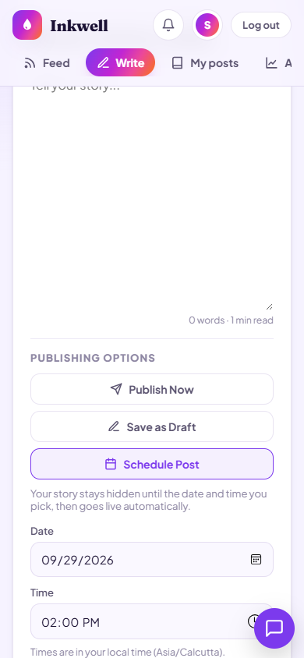
STEP 8
Mobile view: publishing options and date/time pickers stack neatly
Scheduled Blog Publishing · Step 8 · Editor UI
29 / 44
Notes:
Mobile view: publishing options and date/time pickers stack neatly
Source: screenshots/scheduled_publishing/step08_13_mobile_schedule.png

Slide 30
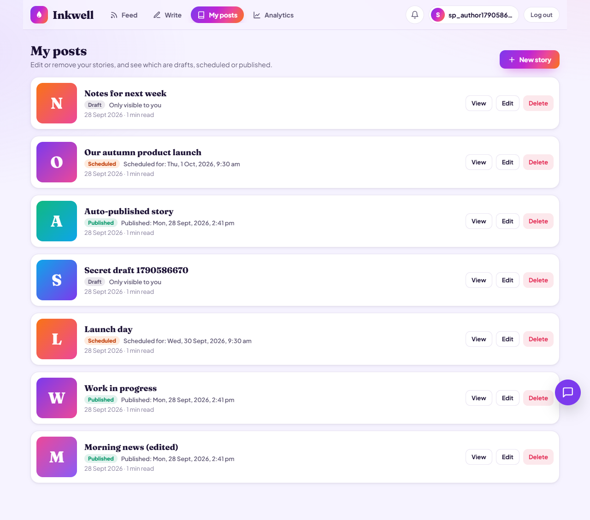
STEP 9
My posts: Draft, Scheduled and Published badges with their dates
Scheduled Blog Publishing · Step 9 · My posts UI
30 / 44
Notes:
My posts: Draft, Scheduled and Published badges with their dates
Source: screenshots/scheduled_publishing/step09_01_my_posts_statuses.png

Slide 31
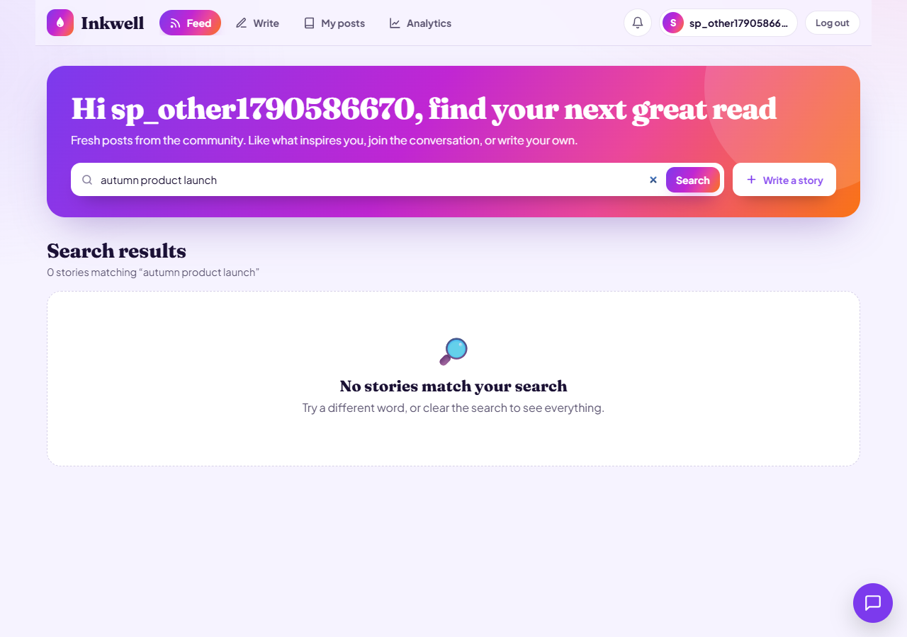
STEP 9
Another user's search cannot find the scheduled post
Scheduled Blog Publishing · Step 9 · My posts UI
31 / 44
Notes:
Another user's search cannot find the scheduled post
Source: screenshots/scheduled_publishing/step09_02_other_user_search_hides_scheduled.png

Slide 32
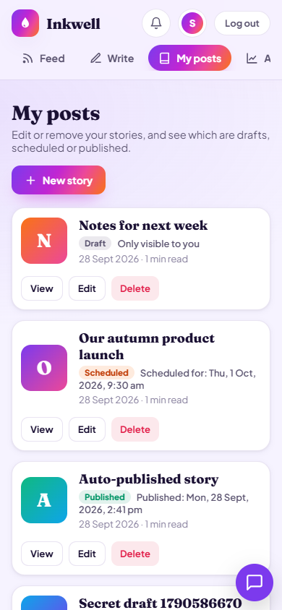
STEP 9
My posts with publishing status on mobile
Scheduled Blog Publishing · Step 9 · My posts UI
32 / 44
Notes:
My posts with publishing status on mobile
Source: screenshots/scheduled_publishing/step09_03_my_posts_mobile.png

Slide 33
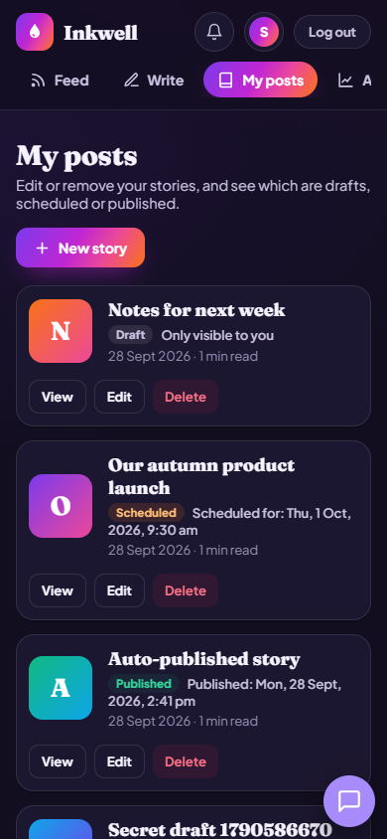
STEP 9
My posts with publishing status on mobile in dark mode
Scheduled Blog Publishing · Step 9 · My posts UI
33 / 44
Notes:
My posts with publishing status on mobile in dark mode
Source: screenshots/scheduled_publishing/step09_04_my_posts_mobile_dark.png

Slide 34
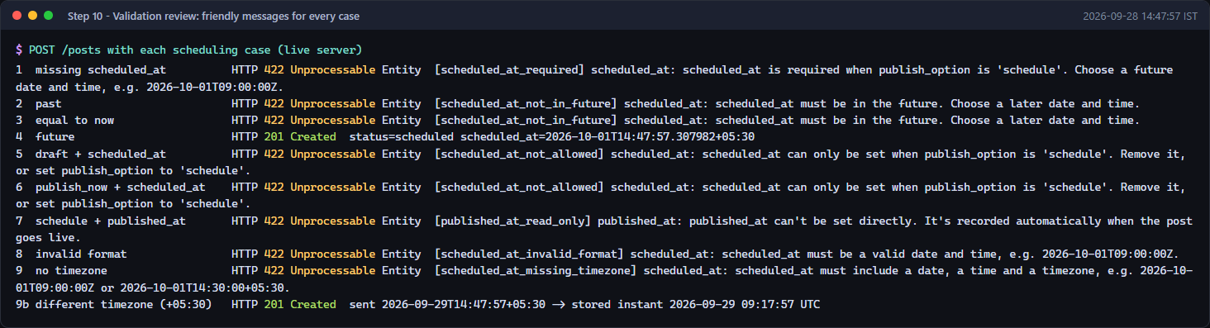
STEP 10
Validation review: every scheduling case returns a friendly message
Scheduled Blog Publishing · Step 10 · Validation
34 / 44
Notes:
Validation review: every scheduling case returns a friendly message
Source: screenshots/scheduled_publishing/step10_validation_cases.png

Slide 35
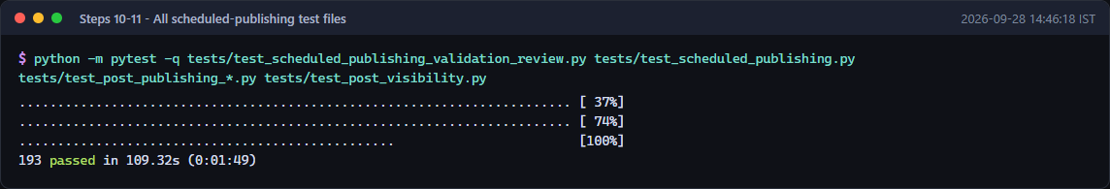
STEPS 10–11
All scheduled-publishing test files pass
Scheduled Blog Publishing · Step 10–11 · Validation
35 / 44
Notes:
All scheduled-publishing test files pass
Source: screenshots/scheduled_publishing/step10_11_all_feature_test_files.png

Slide 36
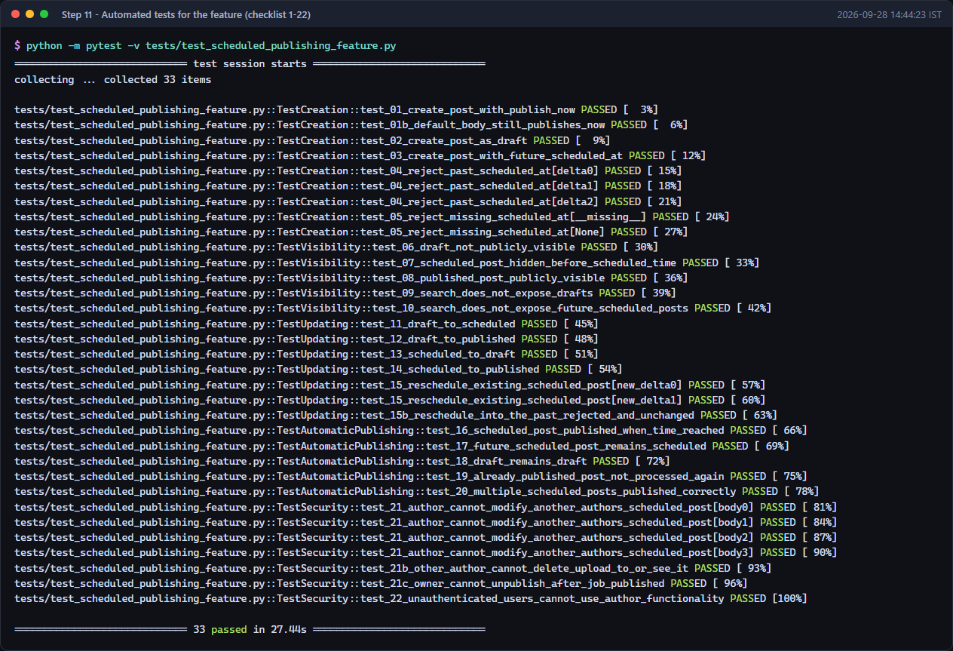
STEP 11
Feature test suite: checklist items 1–22 all pass
Scheduled Blog Publishing · Step 11 · Tests
36 / 44
Notes:
Feature test suite: checklist items 1–22 all pass
Source: screenshots/scheduled_publishing/step11_feature_tests.png

Slide 37
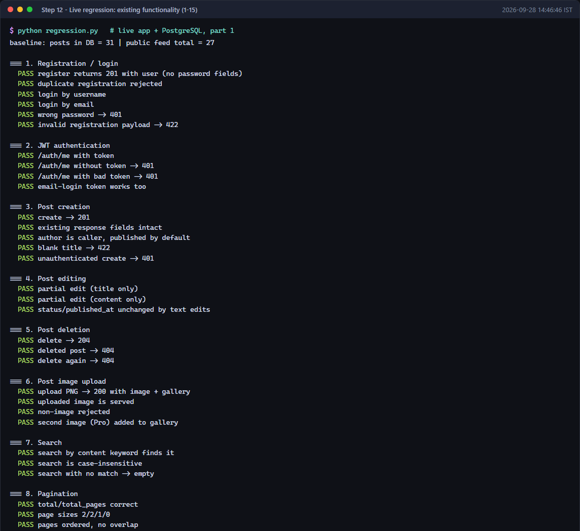
STEP 12
Live regression of existing features (part 1 of 2)
Scheduled Blog Publishing · Step 12 · Regression
37 / 44
Notes:
Live regression of existing features (part 1 of 2)
Source: screenshots/scheduled_publishing/step12_01_regression_existing_features.png

Slide 38
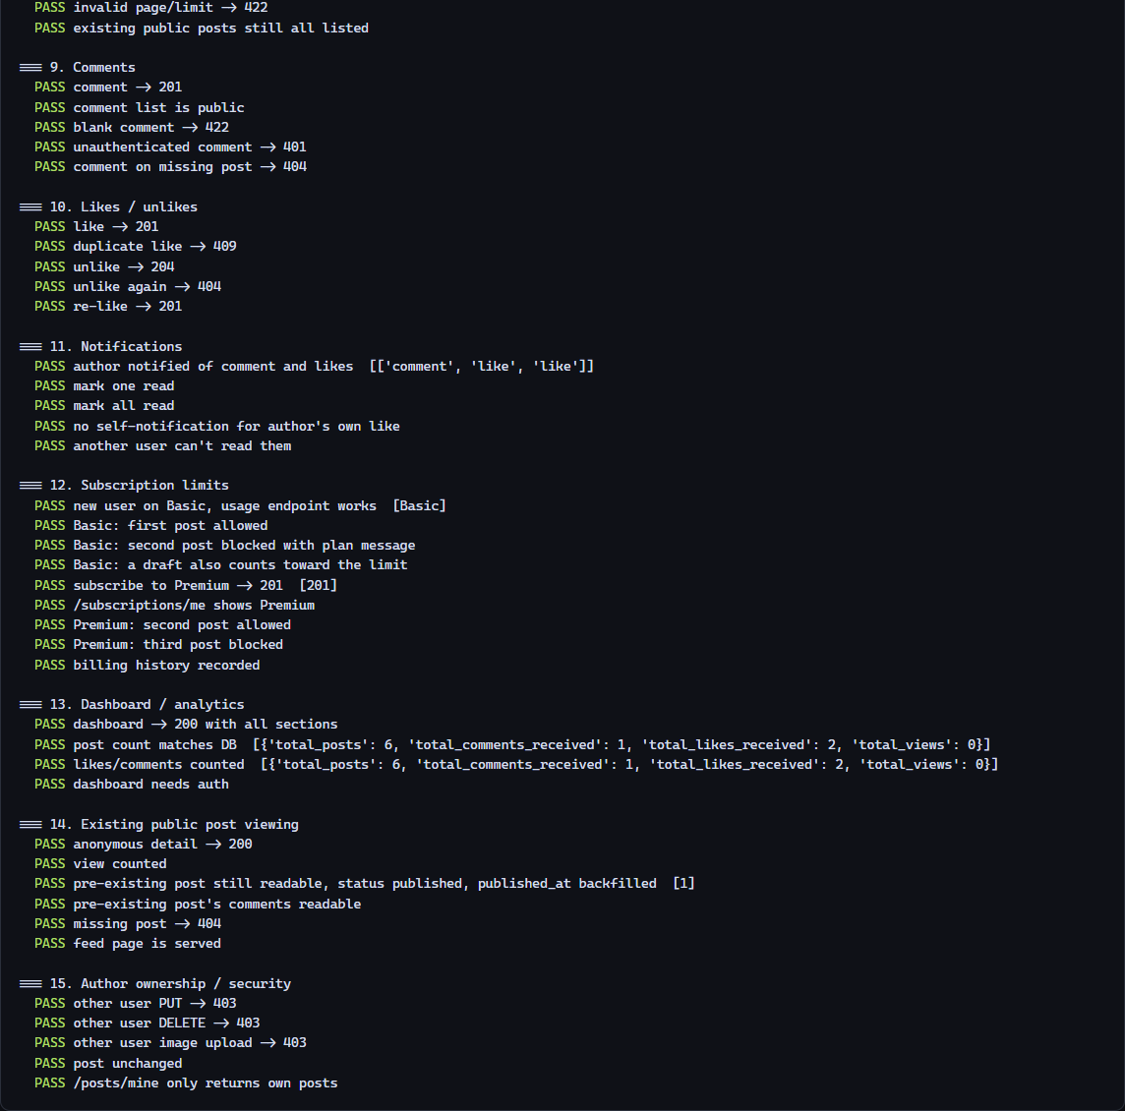
STEP 12
Live regression of existing features (part 2 of 2)
Scheduled Blog Publishing · Step 12 · Regression
38 / 44
Notes:
Live regression of existing features (part 2 of 2)
Source: screenshots/scheduled_publishing/step12_01_regression_existing_features.png

Slide 39
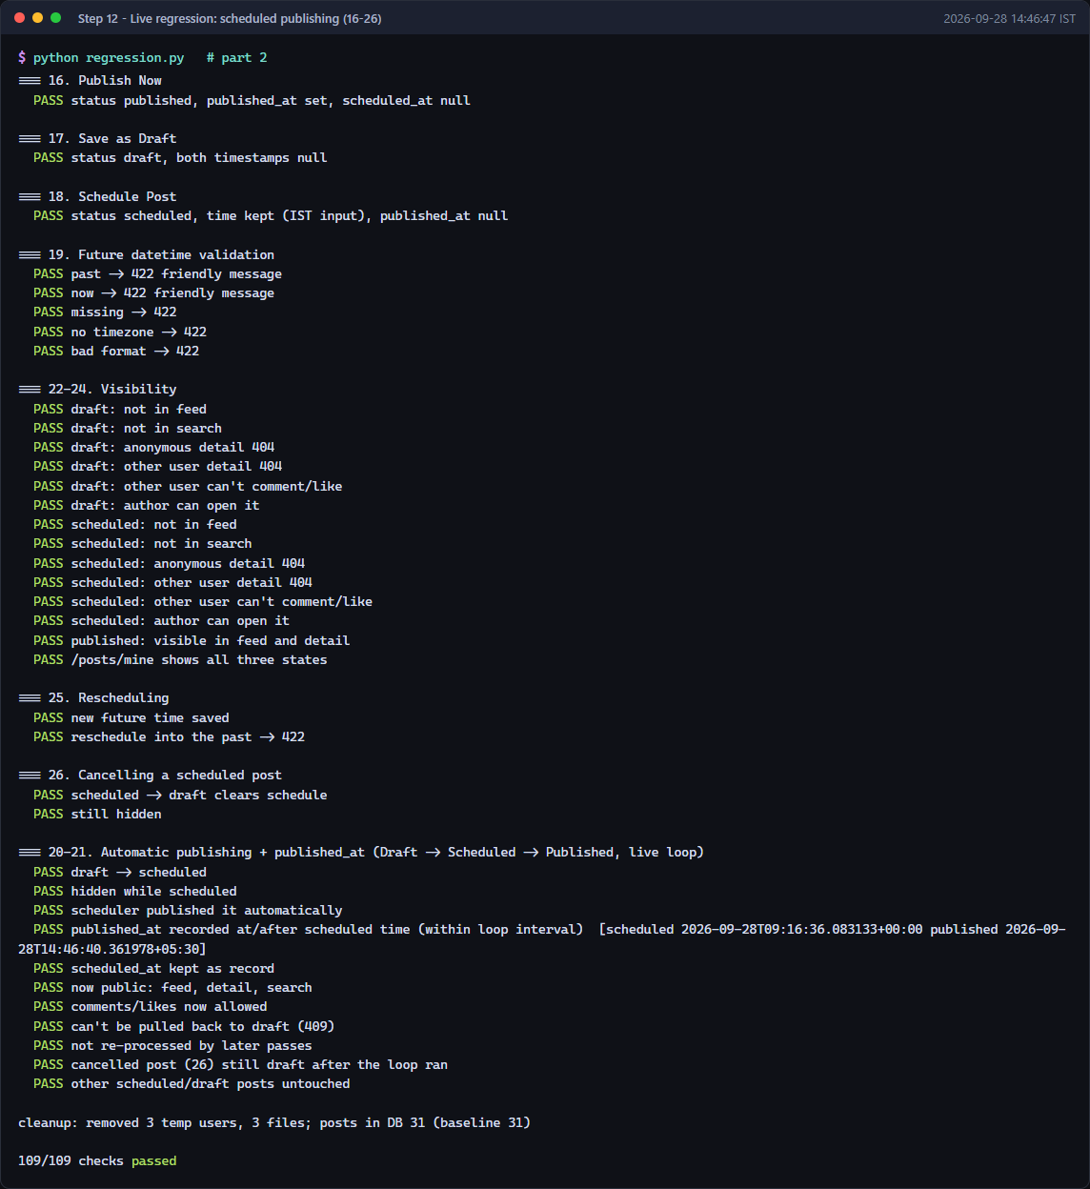
STEP 12
Live regression: all scheduled publishing checks pass (109/109)
Scheduled Blog Publishing · Step 12 · Regression
39 / 44
Notes:
Live regression: all scheduled publishing checks pass (109/109)
Source: screenshots/scheduled_publishing/step12_02_regression_scheduled_publishing.png

Slide 40
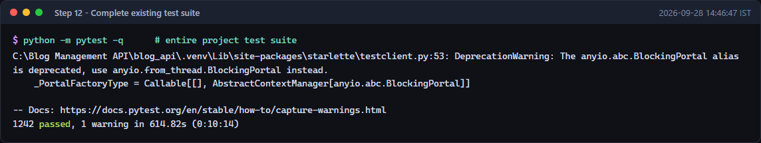
STEP 12
Complete project test suite: 1242 passed, 0 failed
Scheduled Blog Publishing · Step 12 · Regression
40 / 44
Notes:
Complete project test suite: 1242 passed, 0 failed
Source: screenshots/scheduled_publishing/step12_03_full_test_suite.png

Slide 41
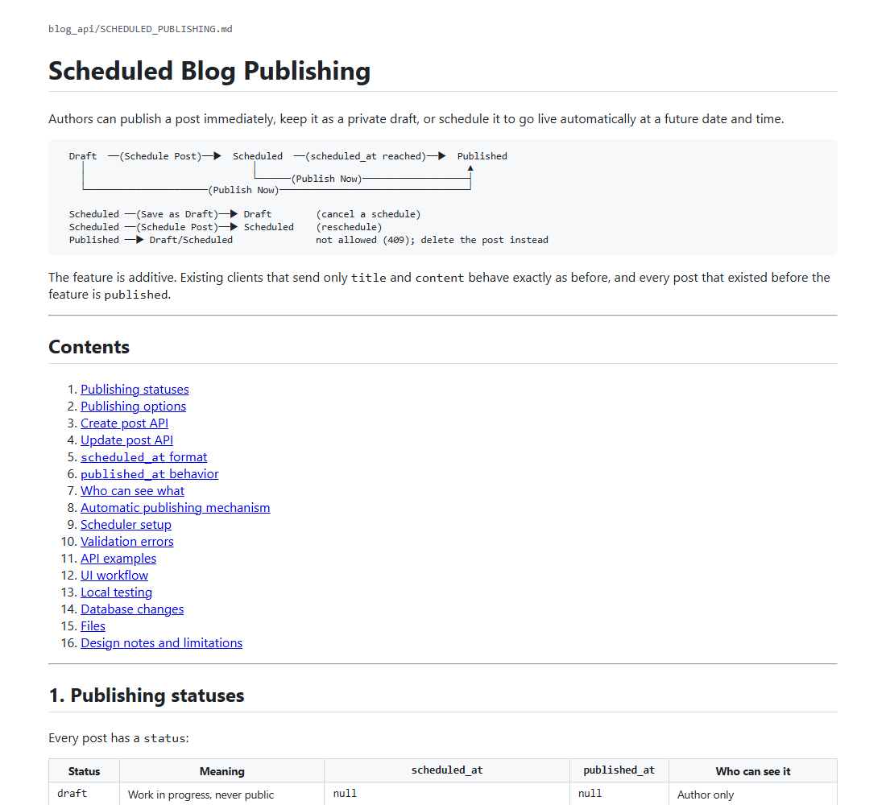
STEP 13
Documentation: SCHEDULED_PUBLISHING.md overview and workflow
Scheduled Blog Publishing · Step 13 · Docs
41 / 44
Notes:
Documentation: SCHEDULED_PUBLISHING.md overview and workflow
Source: screenshots/scheduled_publishing/step13_01_documentation_overview.png

Slide 42
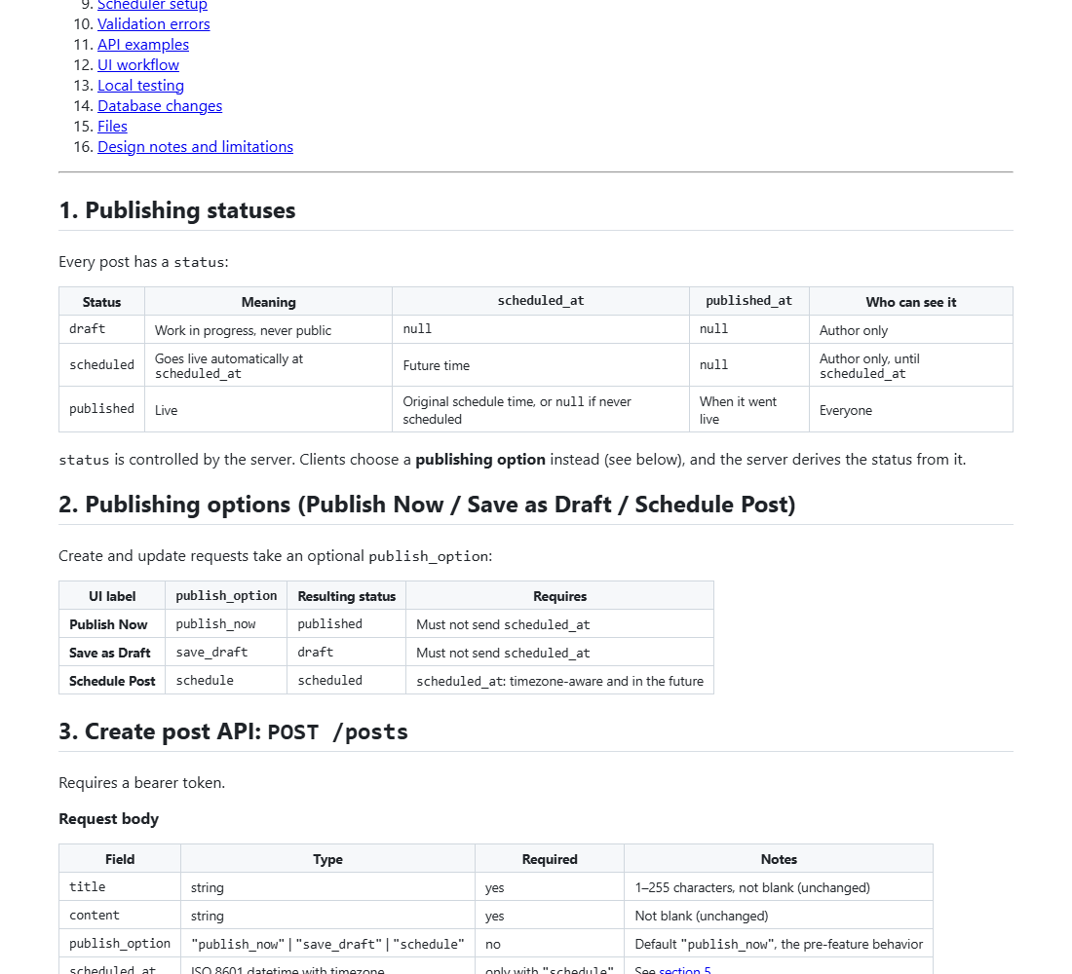
STEP 13
Documentation: publishing statuses, options and the create API
Scheduled Blog Publishing · Step 13 · Docs
42 / 44
Notes:
Documentation: publishing statuses, options and the create API
Source: screenshots/scheduled_publishing/step13_02_documentation_options_create.png

Slide 43
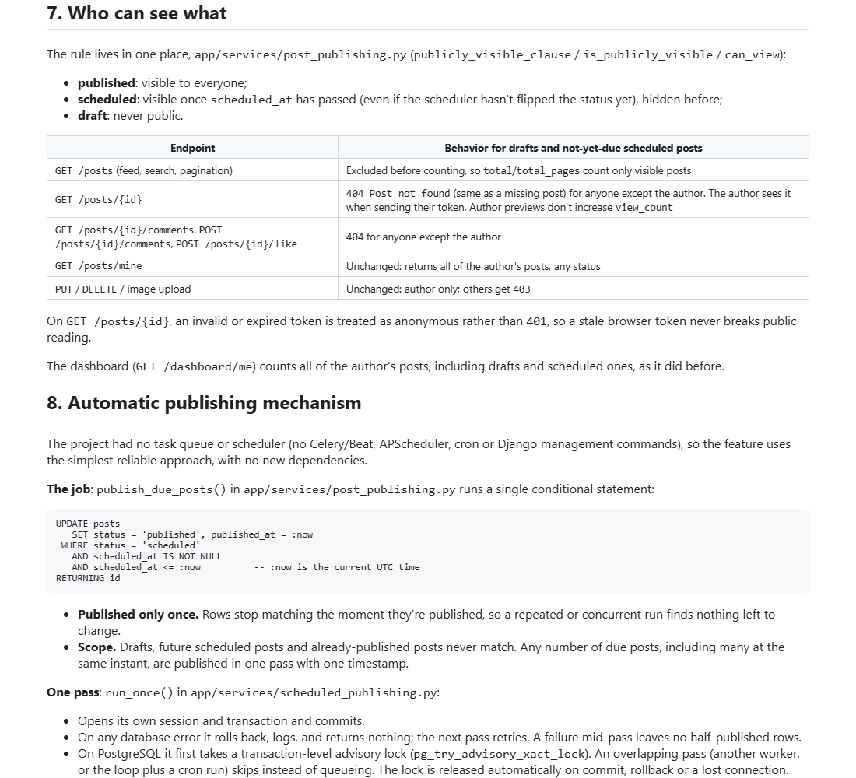
STEP 13
Documentation: visibility rules and the automatic publishing mechanism
Scheduled Blog Publishing · Step 13 · Docs
43 / 44
Notes:
Documentation: visibility rules and the automatic publishing mechanism
Source: screenshots/scheduled_publishing/step13_03_documentation_scheduler.png

Slide 44
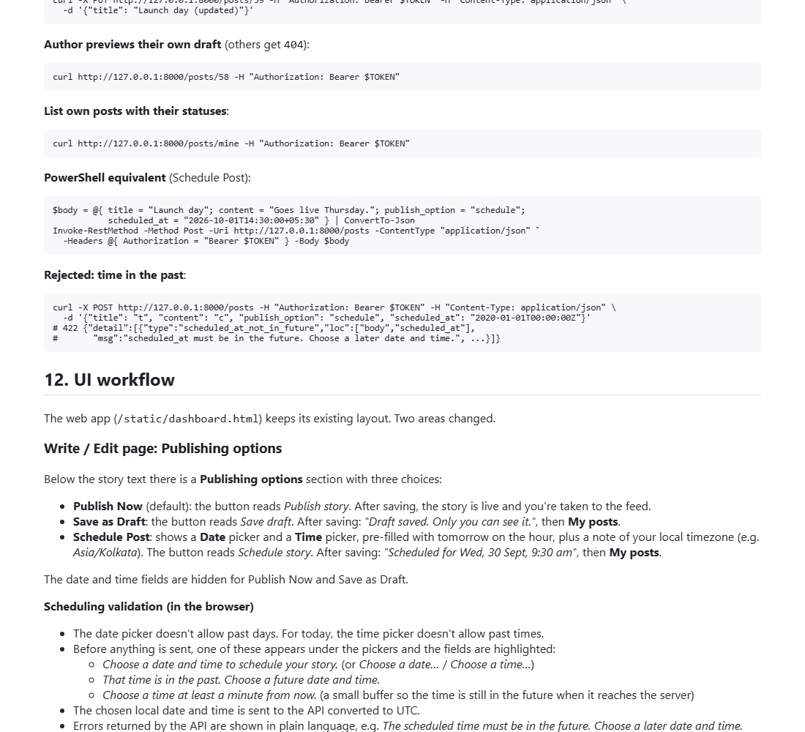
STEP 13
Documentation: API examples and the UI workflow
Scheduled Blog Publishing · Step 13 · Docs
44 / 44
Notes:
Documentation: API examples and the UI workflow
Source: screenshots/scheduled_publishing/step13_04_documentation_ui_workflow.png

