Slide 1
Inkwell Blog
The redesigned blog app and dashboard: sign-in options, feed, reading, writing, analytics and database
23 screenshots | one account for Google and Facebook: gmail_owner (anushreestackly@gmail.com)

Slide 2
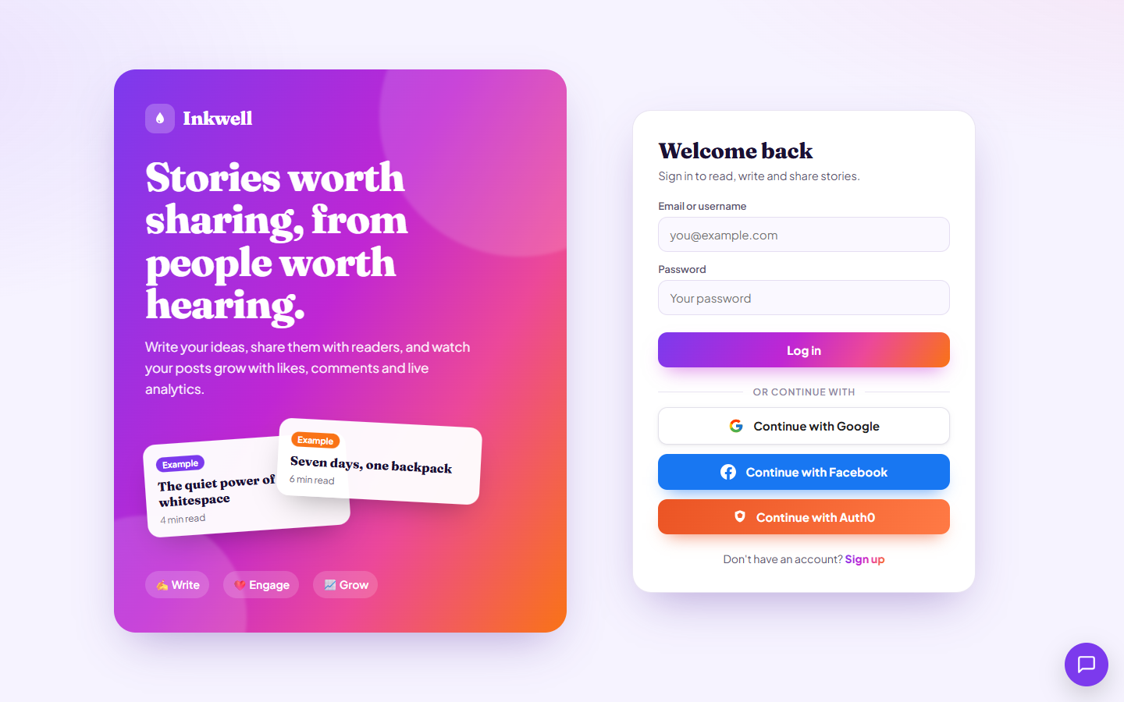
1
Login page: email/password plus Google, Facebook and Auth0 buttons
1 / 23
Notes:
Login page: email/password plus Google, Facebook and Auth0 buttons
Screenshot file: Inkwell_Blog_Screenshots/01_login_page.png

Slide 3
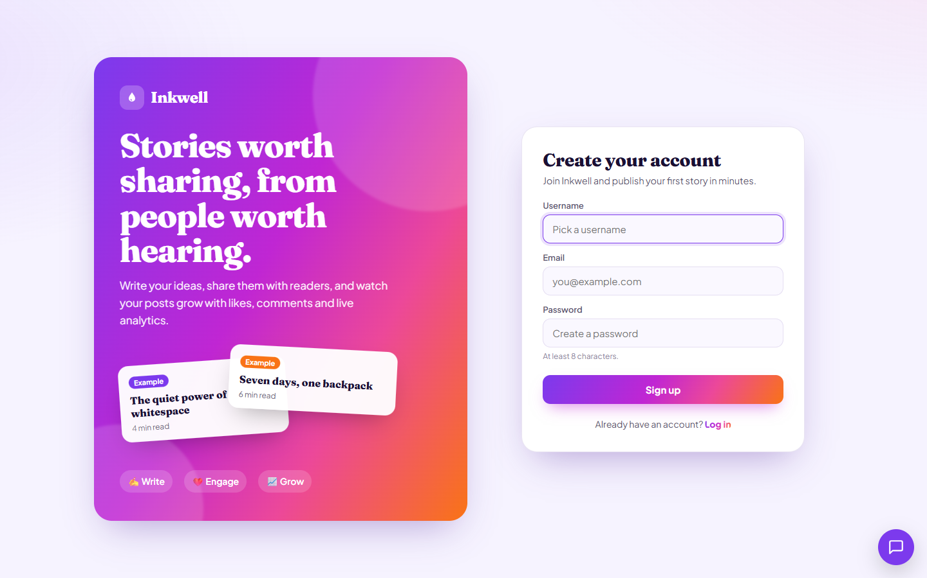
2
Sign up form for a new Inkwell account
2 / 23
Notes:
Sign up form for a new Inkwell account
Screenshot file: Inkwell_Blog_Screenshots/02_signup_form.png

Slide 4
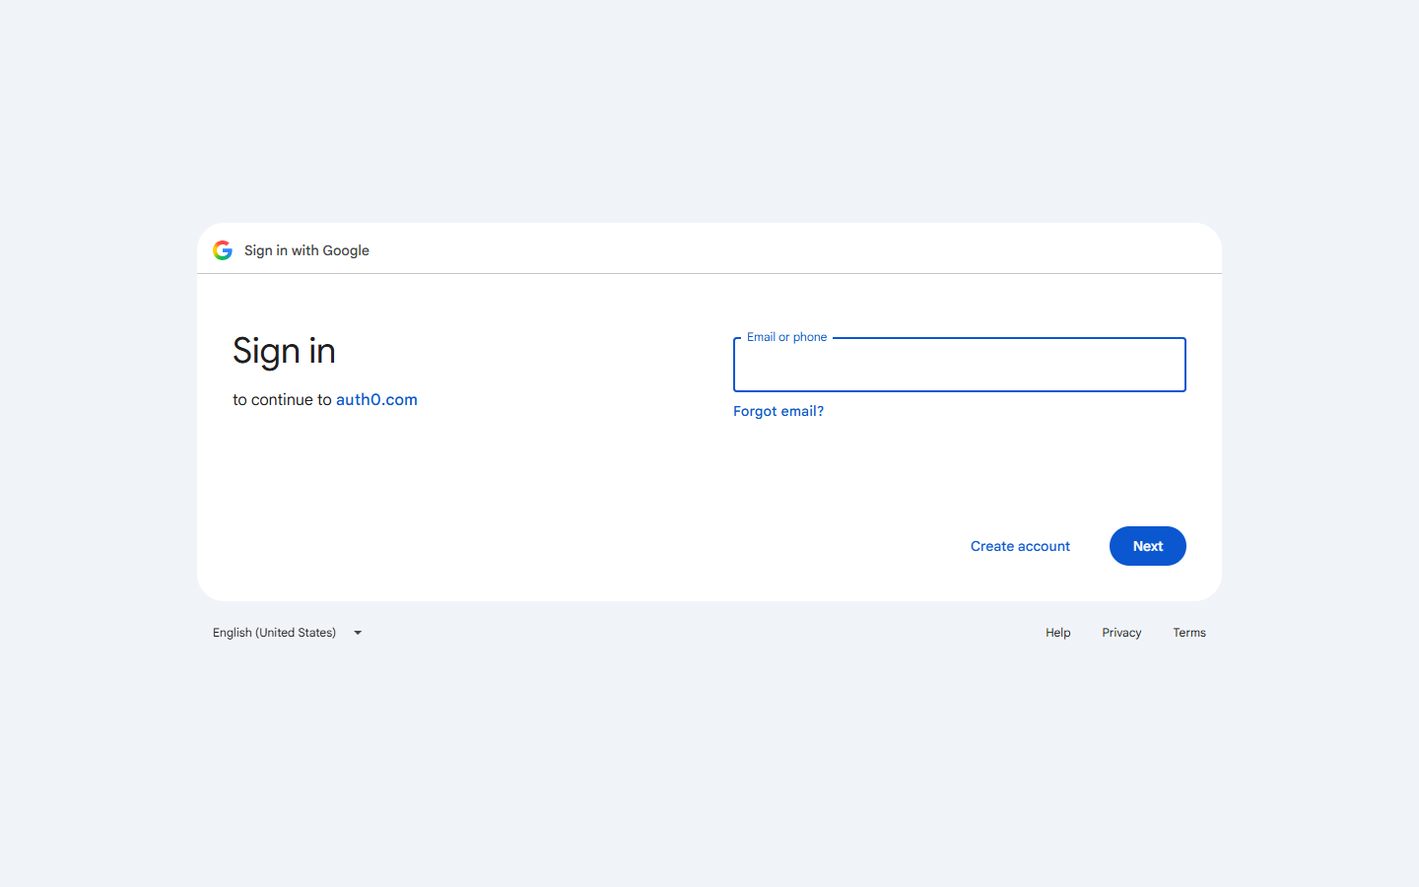
3
Continue with Google opens Google's sign-in through Auth0
3 / 23
Notes:
Continue with Google opens Google's sign-in through Auth0
Screenshot file: Inkwell_Blog_Screenshots/03_google_signin.png

Slide 5
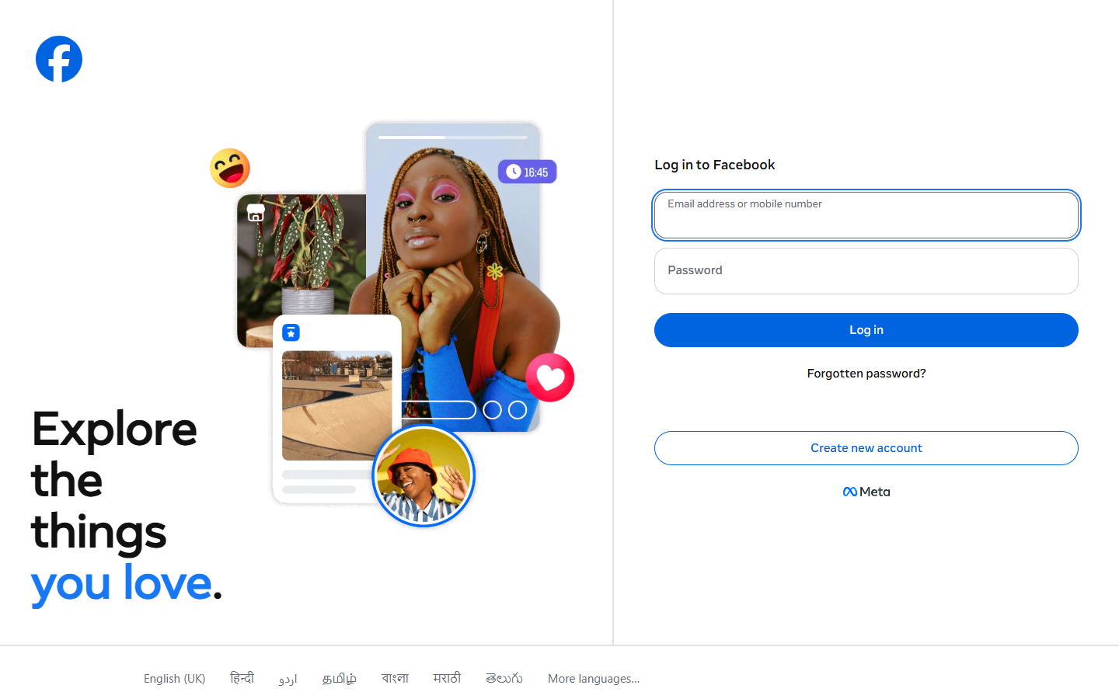
4
Continue with Facebook opens Facebook's login through Auth0
4 / 23
Notes:
Continue with Facebook opens Facebook's login through Auth0
Screenshot file: Inkwell_Blog_Screenshots/04_facebook_login.png

Slide 6
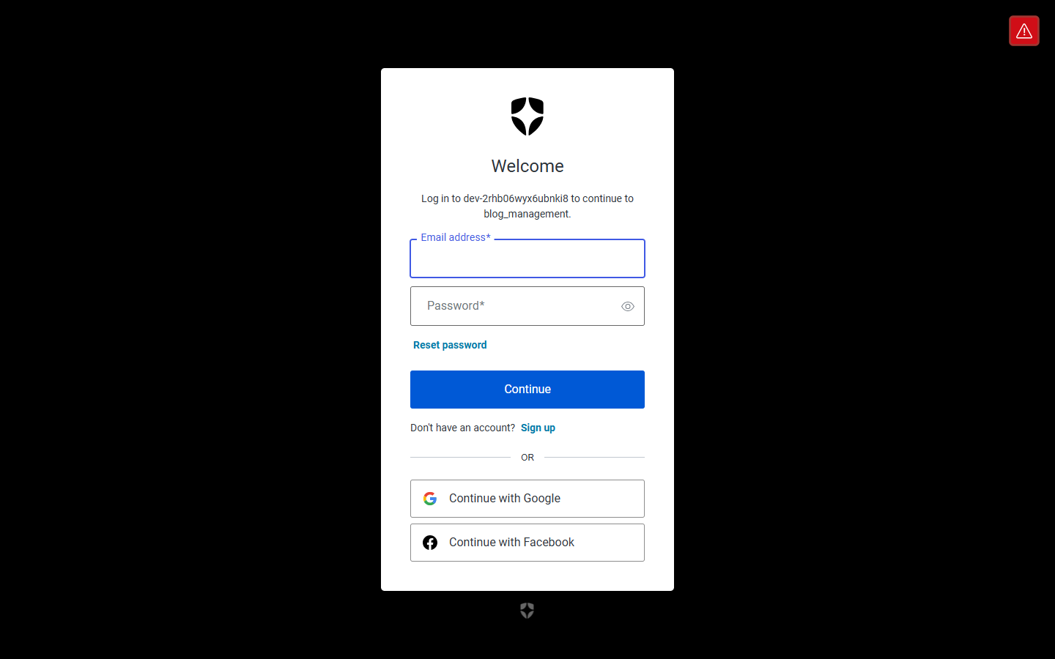
5
Continue with Auth0 opens Auth0's own sign-in page
5 / 23
Notes:
Continue with Auth0 opens Auth0's own sign-in page
Screenshot file: Inkwell_Blog_Screenshots/05_auth0_signin.png

Slide 7
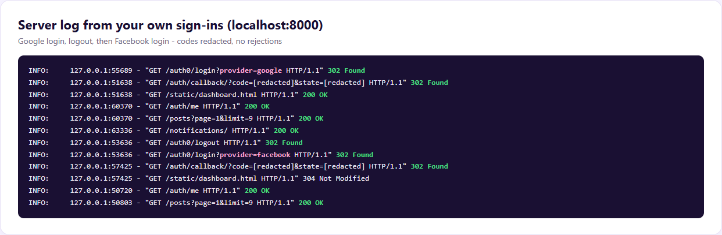
6
Server log: your real Google and Facebook logins both succeeded
6 / 23
Notes:
Server log: your real Google and Facebook logins both succeeded
Screenshot file: Inkwell_Blog_Screenshots/06_server_log_real_logins.png

Slide 8
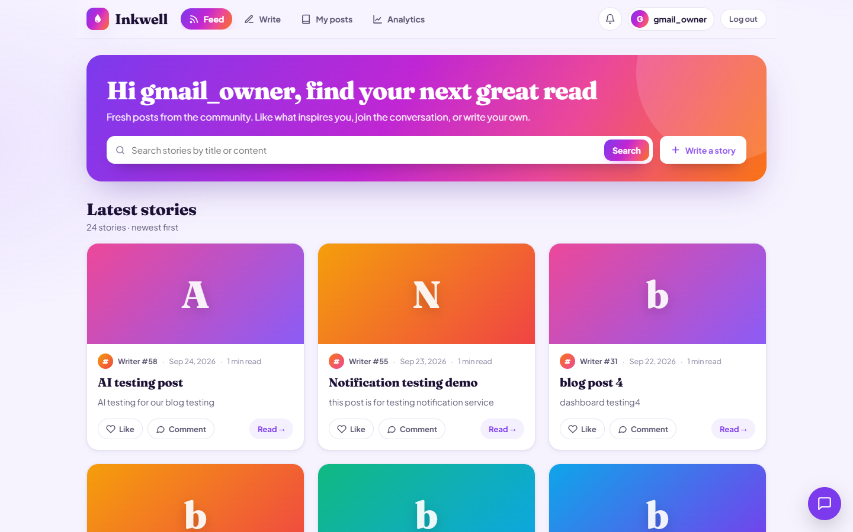
7
Feed: signed in as gmail_owner with the latest stories
7 / 23
Notes:
Feed: signed in as gmail_owner with the latest stories
Screenshot file: Inkwell_Blog_Screenshots/07_feed_signed_in.png

Slide 9
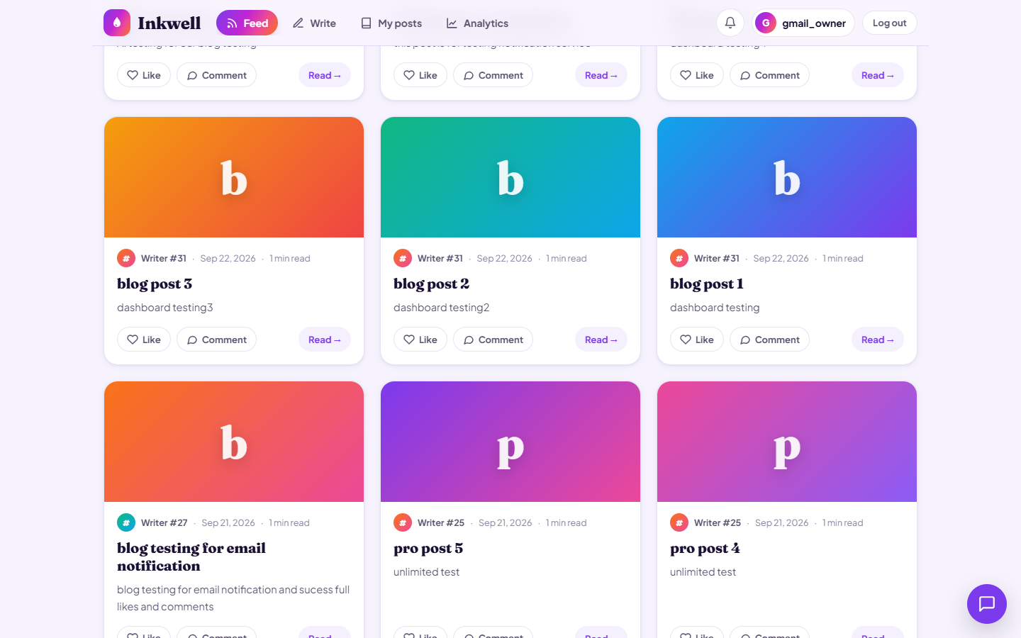
8
Feed: story cards with cover images and colourful covers
8 / 23
Notes:
Feed: story cards with cover images and colourful covers
Screenshot file: Inkwell_Blog_Screenshots/08_feed_more_stories.png

Slide 10
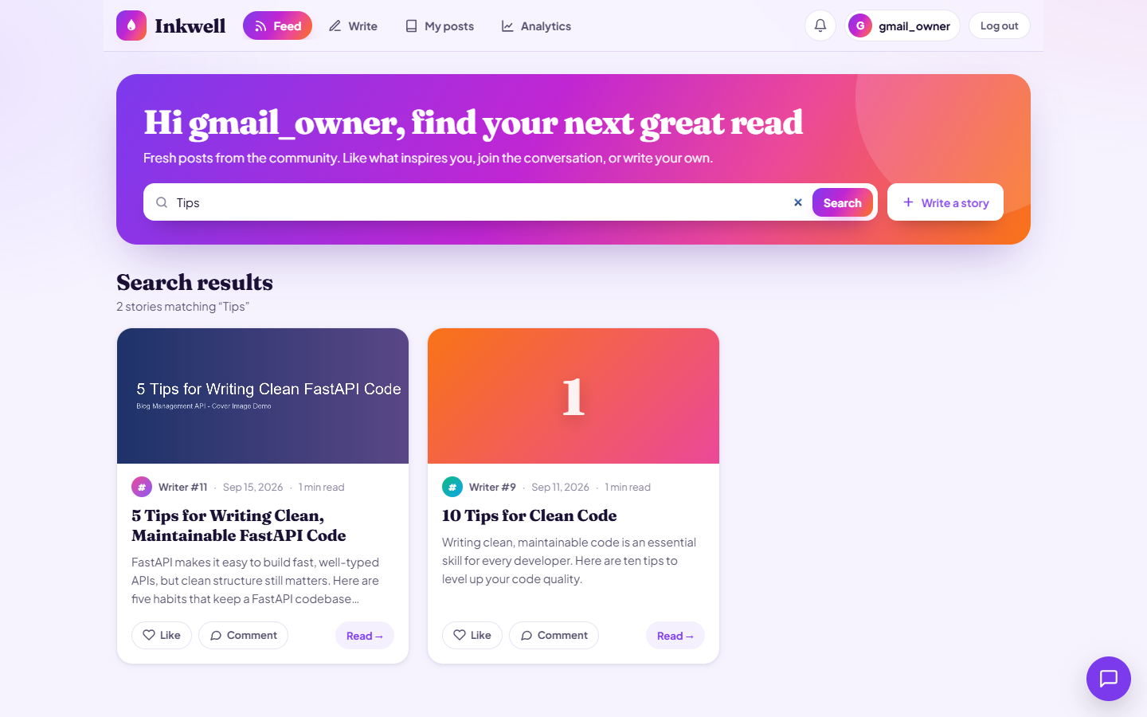
9
Search: stories matching a keyword
9 / 23
Notes:
Search: stories matching a keyword
Screenshot file: Inkwell_Blog_Screenshots/09_search_results.png

Slide 11
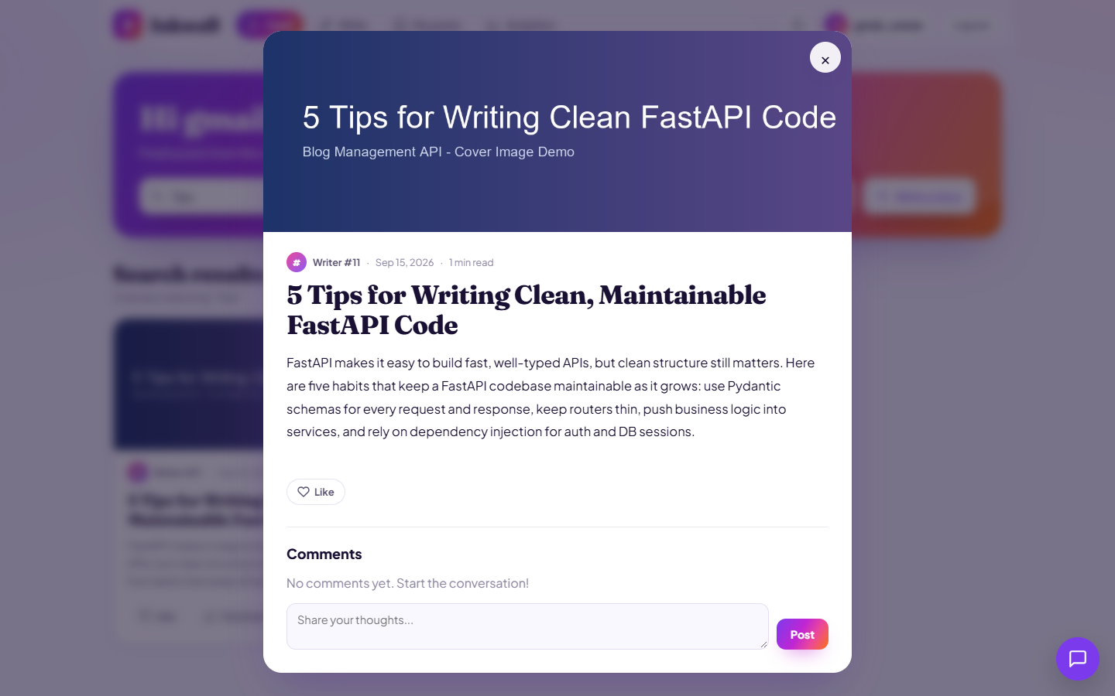
10
Reading a full story with its cover image
10 / 23
Notes:
Reading a full story with its cover image
Screenshot file: Inkwell_Blog_Screenshots/10_reader_with_image.png

Slide 12
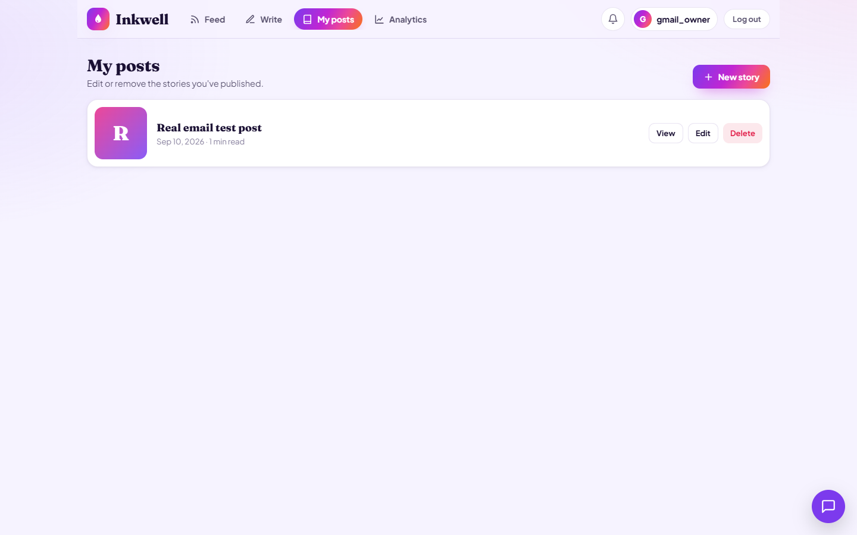
11
My posts: gmail_owner's published story with View, Edit and Delete
11 / 23
Notes:
My posts: gmail_owner's published story with View, Edit and Delete
Screenshot file: Inkwell_Blog_Screenshots/11_my_posts.png

Slide 13
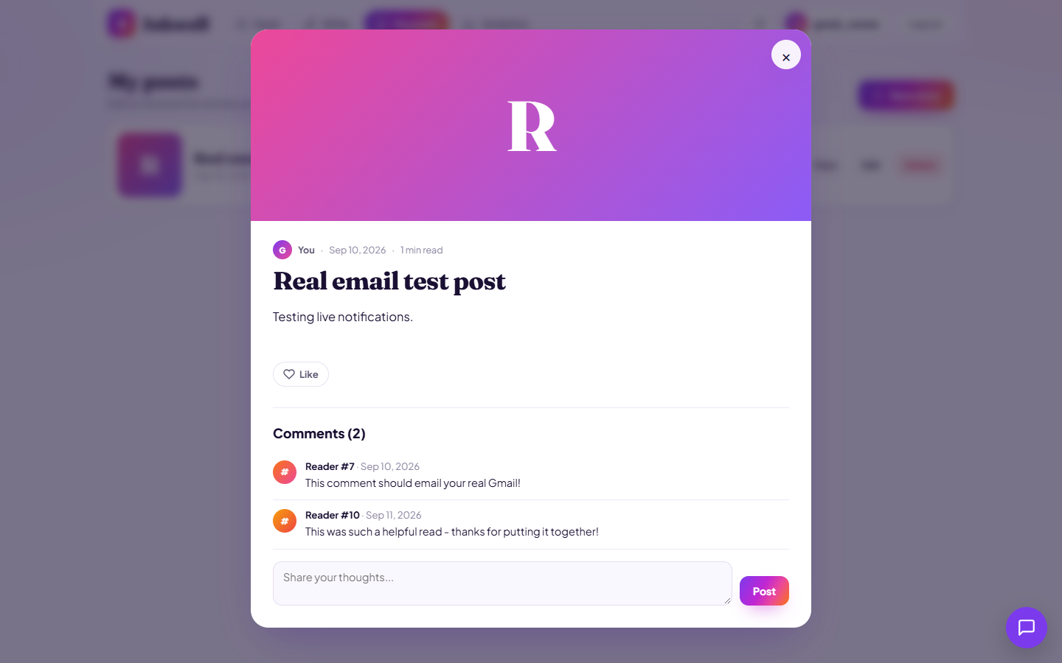
12
Reading gmail_owner's story with its comments
12 / 23
Notes:
Reading gmail_owner's story with its comments
Screenshot file: Inkwell_Blog_Screenshots/12_reader_comments.png

Slide 14
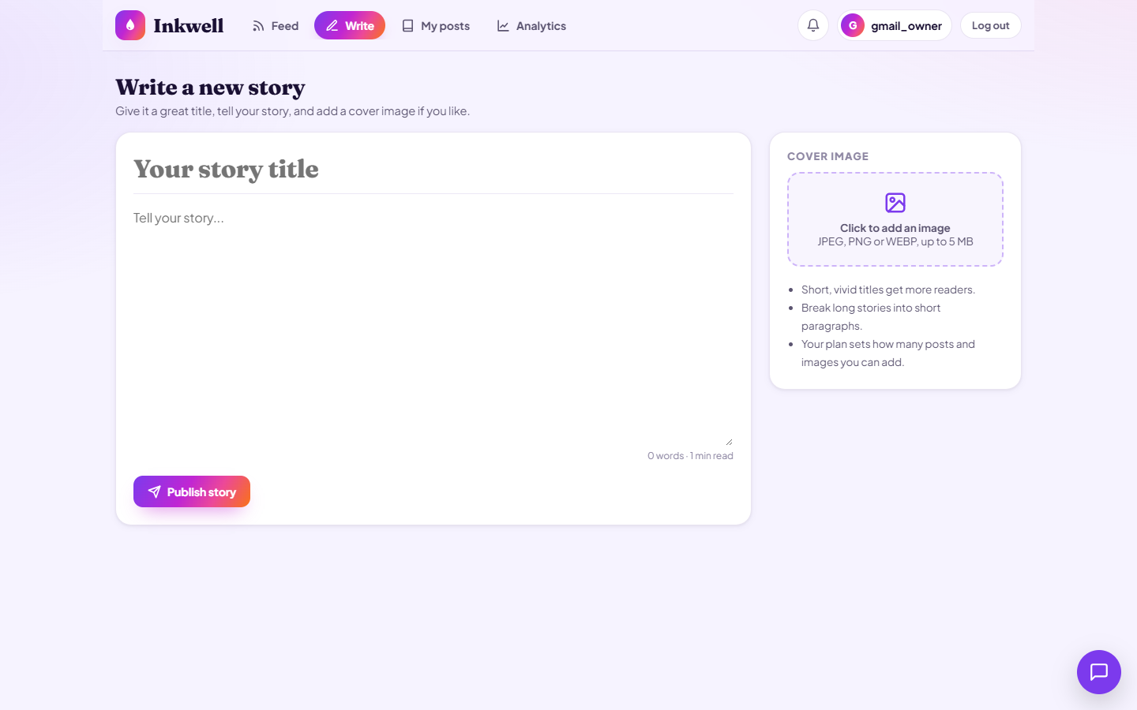
13
Write: title, story editor and cover image picker
13 / 23
Notes:
Write: title, story editor and cover image picker
Screenshot file: Inkwell_Blog_Screenshots/13_write_page.png

Slide 15
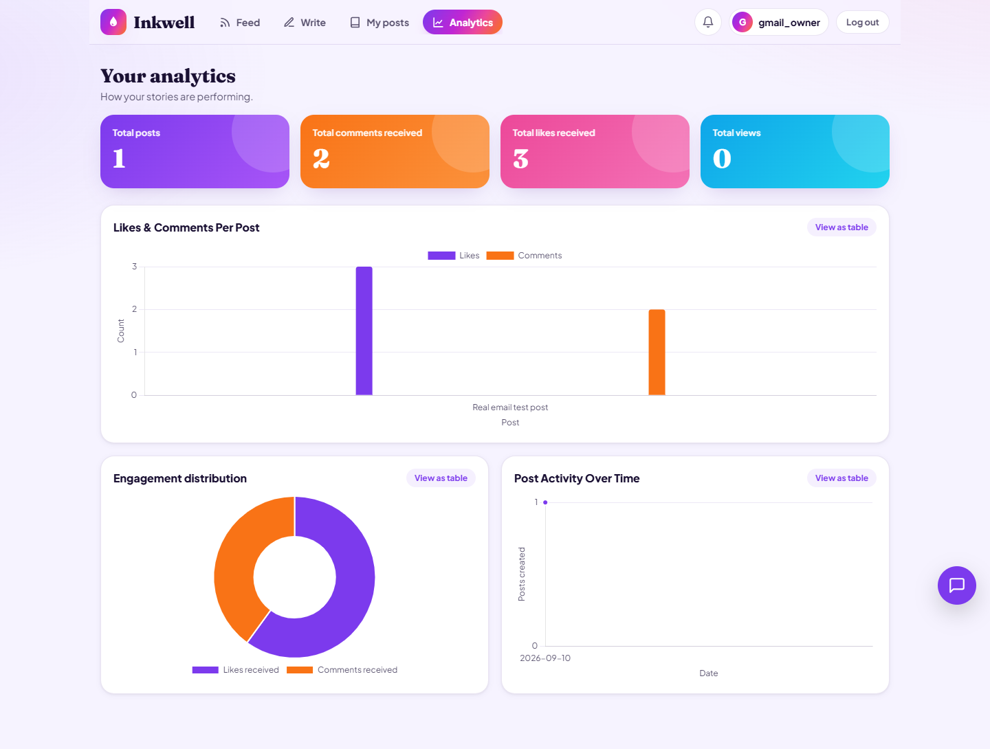
14
Analytics: colourful stat tiles and live charts
14 / 23
Notes:
Analytics: colourful stat tiles and live charts
Screenshot file: Inkwell_Blog_Screenshots/14_analytics.png

Slide 16
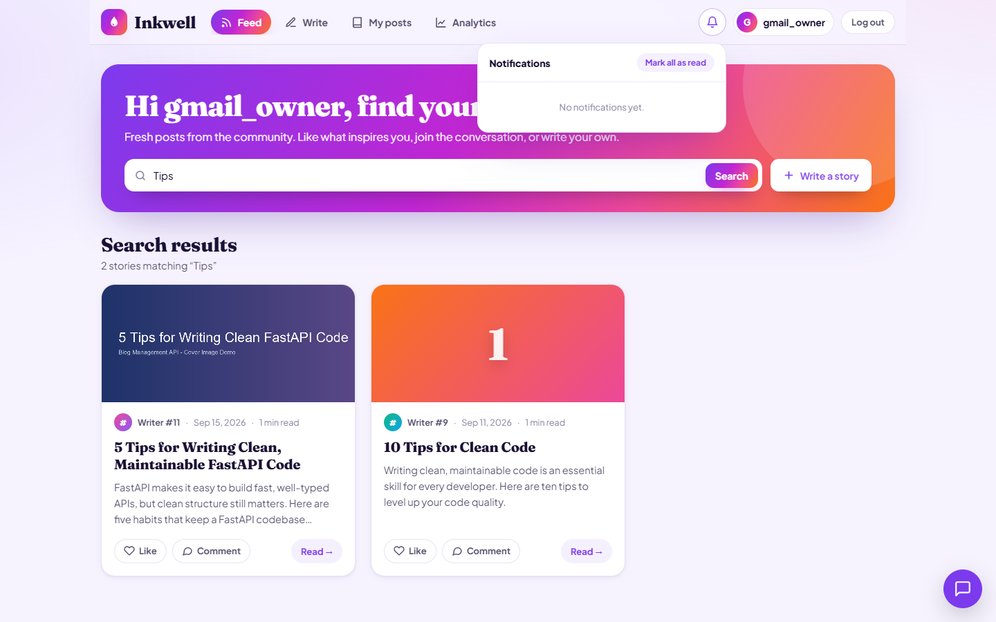
15
Notifications panel from the bell icon
15 / 23
Notes:
Notifications panel from the bell icon
Screenshot file: Inkwell_Blog_Screenshots/15_notifications.png

Slide 17
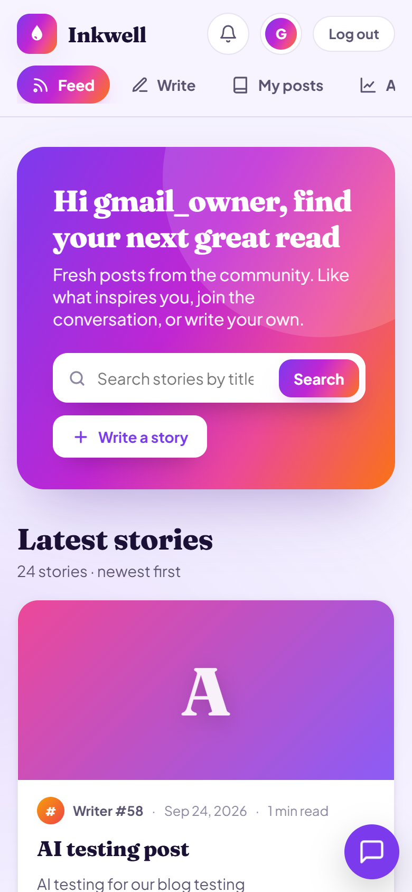
16
Phone view: feed with scrollable tabs
16 / 23
Notes:
Phone view: feed with scrollable tabs
Screenshot file: Inkwell_Blog_Screenshots/16_phone_feed.png

Slide 18
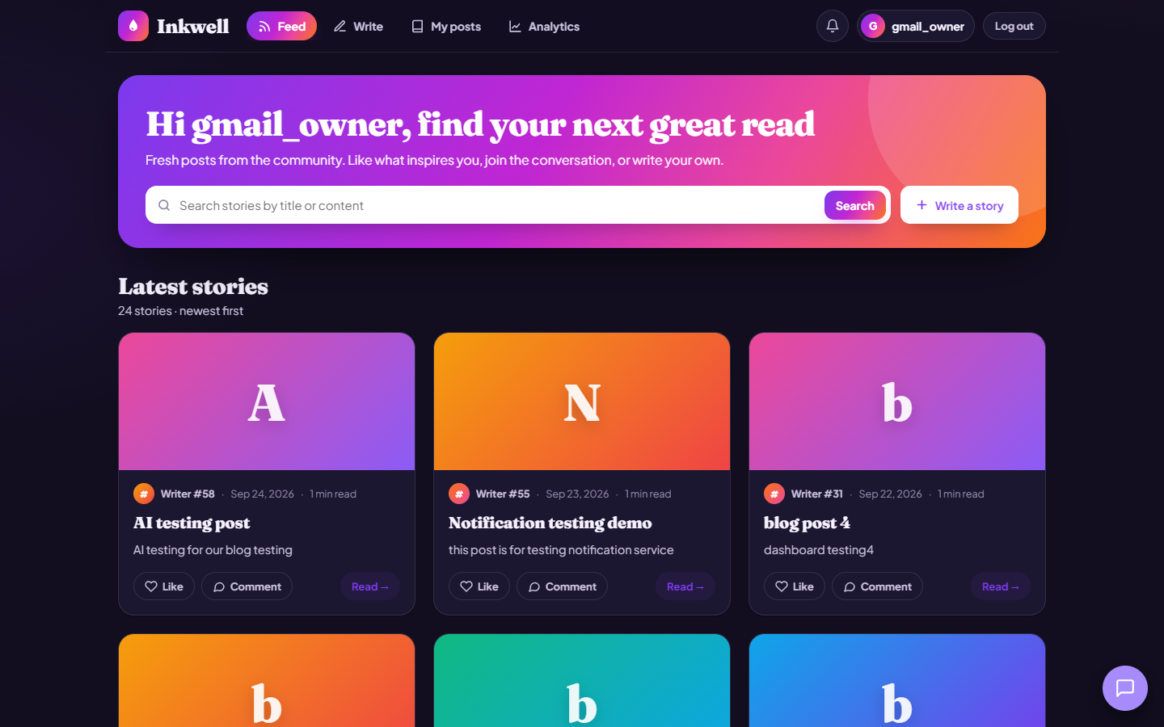
17
Dark mode follows the device setting
17 / 23
Notes:
Dark mode follows the device setting
Screenshot file: Inkwell_Blog_Screenshots/17_dark_mode.png

Slide 19
18
Logged out: back to the Inkwell login page
18 / 23
Notes:
Logged out: back to the Inkwell login page
Screenshot file: Inkwell_Blog_Screenshots/18_logged_out.png

Slide 20
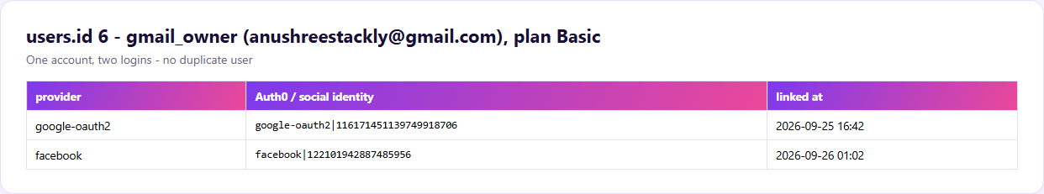
19
Database: gmail_owner has both Google and Facebook linked
19 / 23
Notes:
Database: gmail_owner has both Google and Facebook linked
Screenshot file: Inkwell_Blog_Screenshots/19_db_gmail_owner_both_logins.png

Slide 21
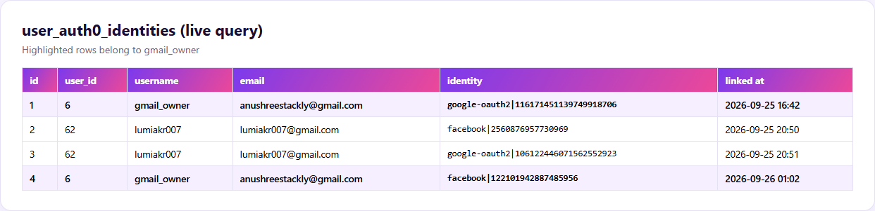
20
Database: user_auth0_identities table with every linked social login
20 / 23
Notes:
Database: user_auth0_identities table with every linked social login
Screenshot file: Inkwell_Blog_Screenshots/20_db_linked_logins_table.png

Slide 22
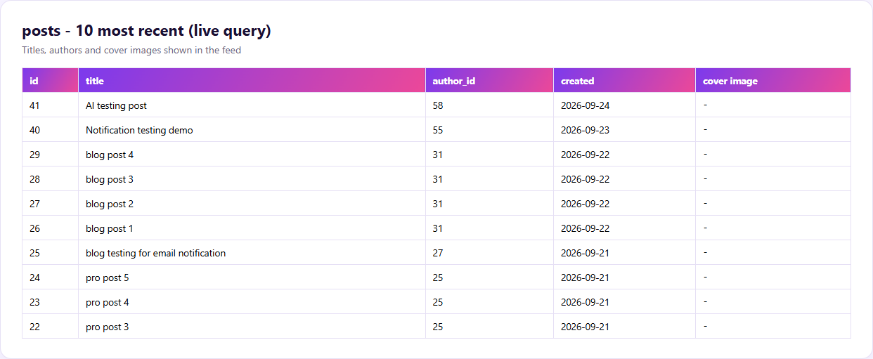
21
Database: posts table behind the Inkwell feed
21 / 23
Notes:
Database: posts table behind the Inkwell feed
Screenshot file: Inkwell_Blog_Screenshots/21_db_posts_table.png

Slide 23
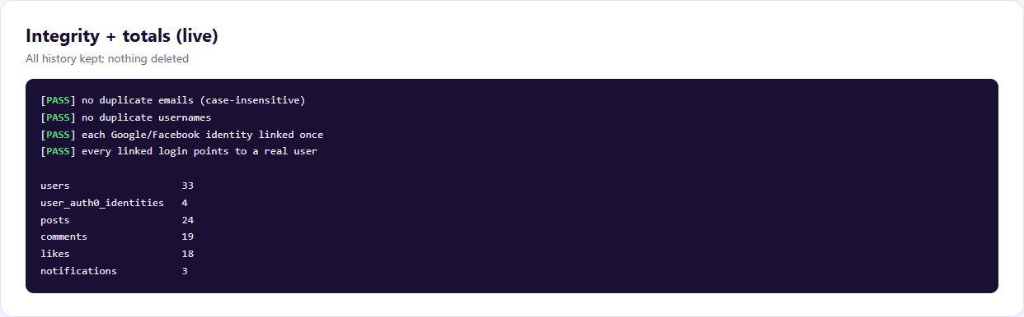
22
Database: integrity checks pass and record counts
22 / 23
Notes:
Database: integrity checks pass and record counts
Screenshot file: Inkwell_Blog_Screenshots/22_db_integrity_counts.png

Slide 24
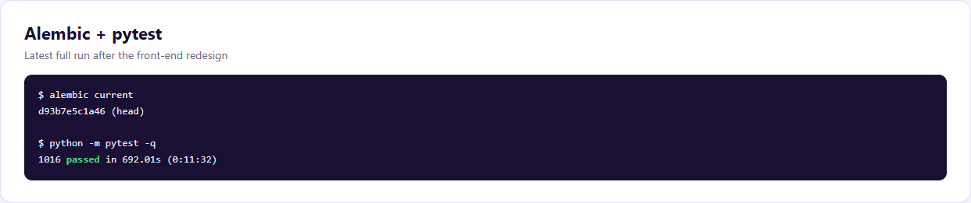
23
Migrations at head and the full test suite passing
23 / 23
Notes:
Migrations at head and the full test suite passing
Screenshot file: Inkwell_Blog_Screenshots/23_migrations_and_tests.png

