Slide 1
ShopEase User Service
Live evidence screenshots
Captured from the running system on 11 November 2026 · 25 screenshots · tokens and passwords redacted

Slide 2
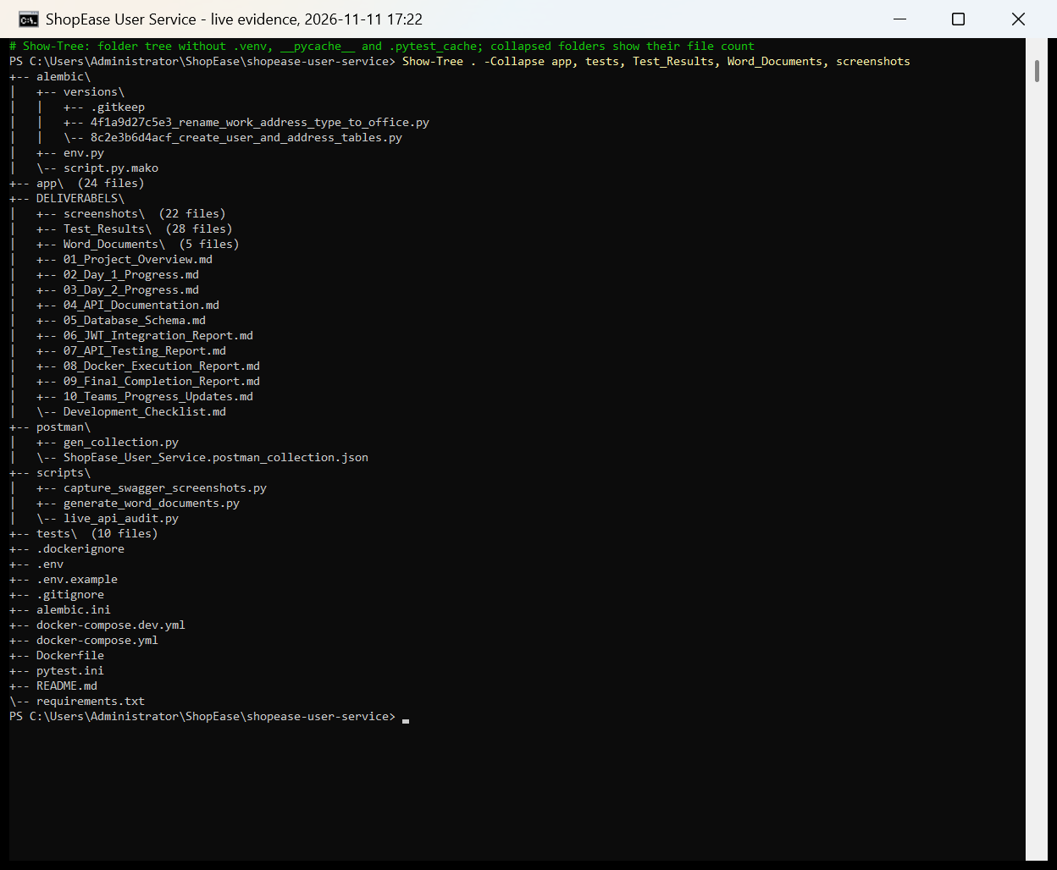
Project folder structure
1

Slide 3
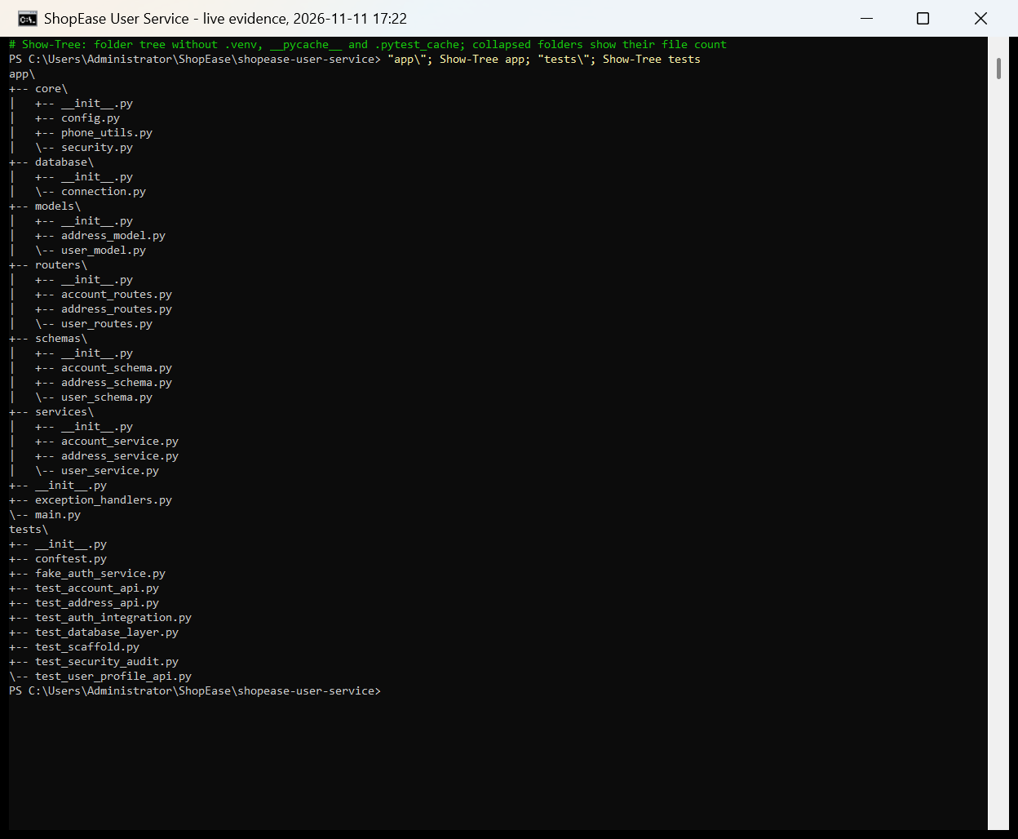
Application and test modules (app/ and tests/)
2

Slide 4
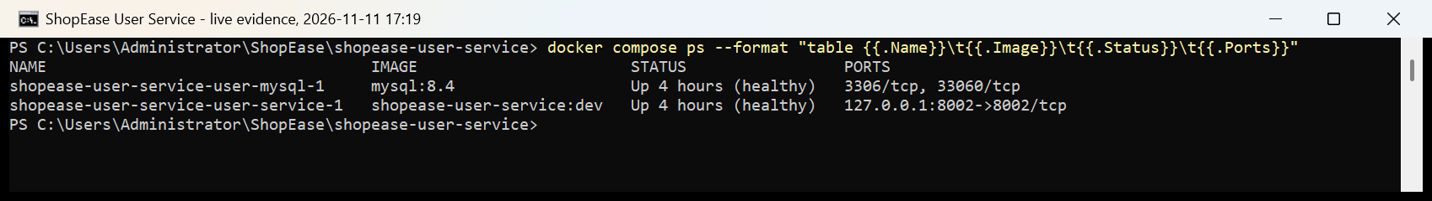
Docker containers running and healthy
3

Slide 5
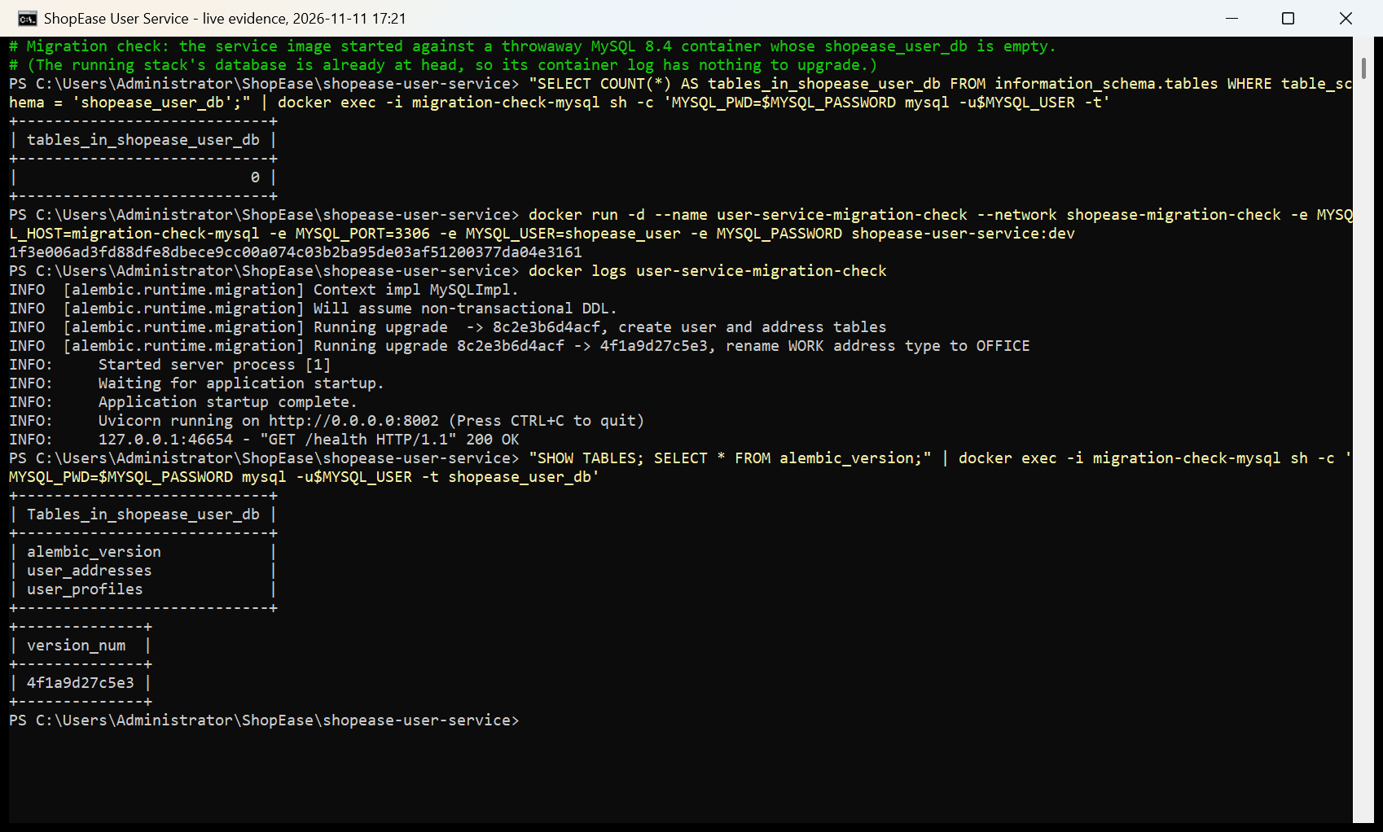
Alembic migrations run on container start
4

Slide 6
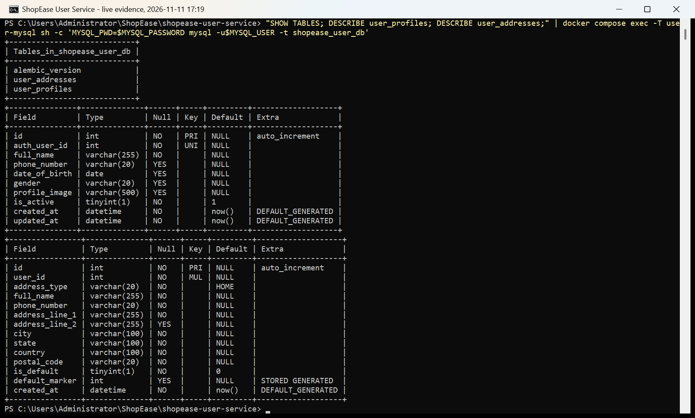
MySQL tables: user_profiles and user_addresses
5

Slide 7
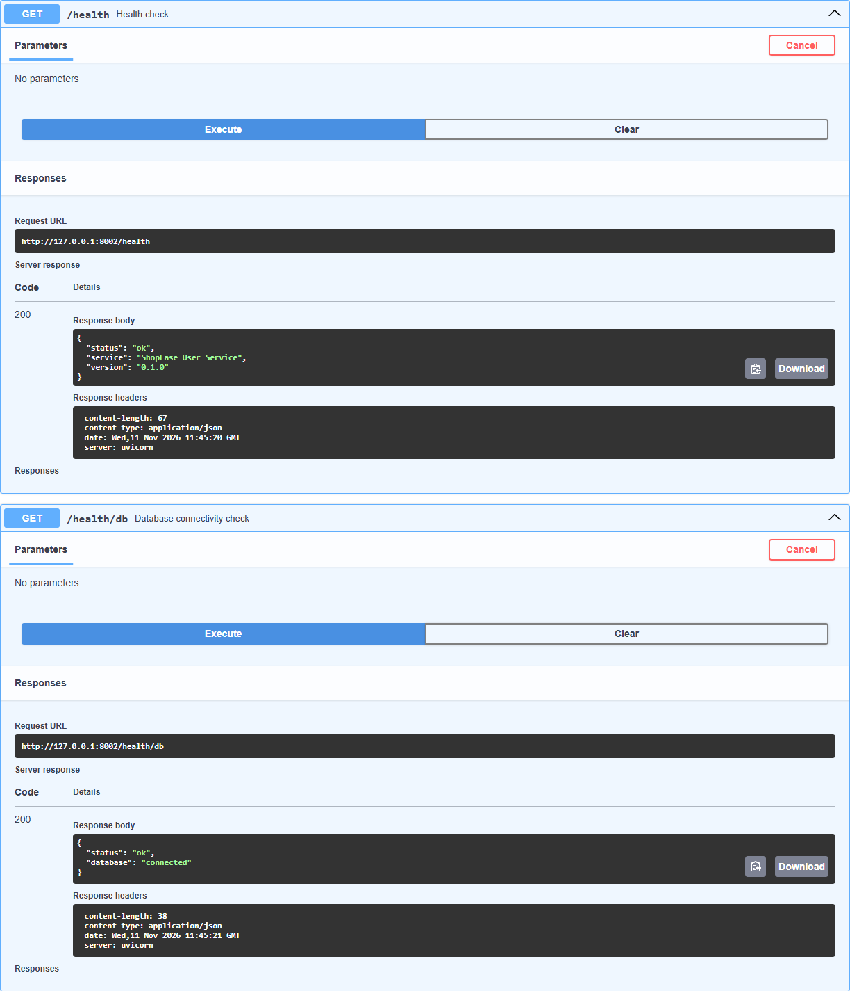
Health checks: service up and database connected
6

Slide 8
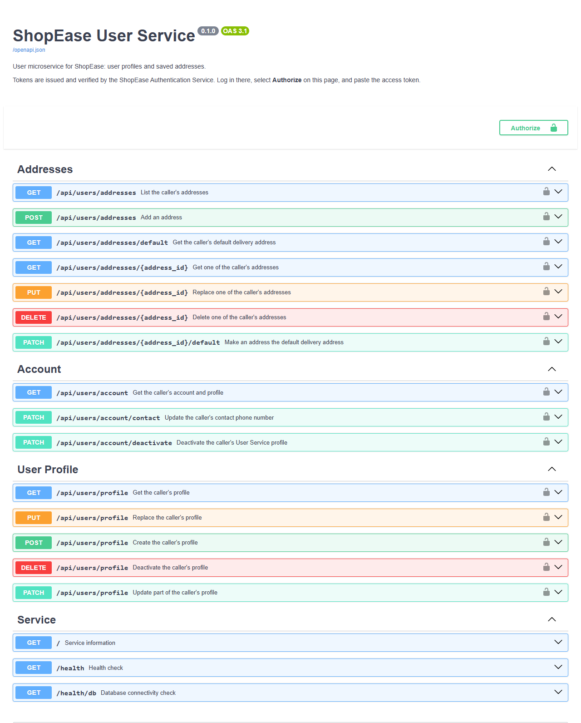
Swagger UI: all User Service endpoints
7

Slide 9
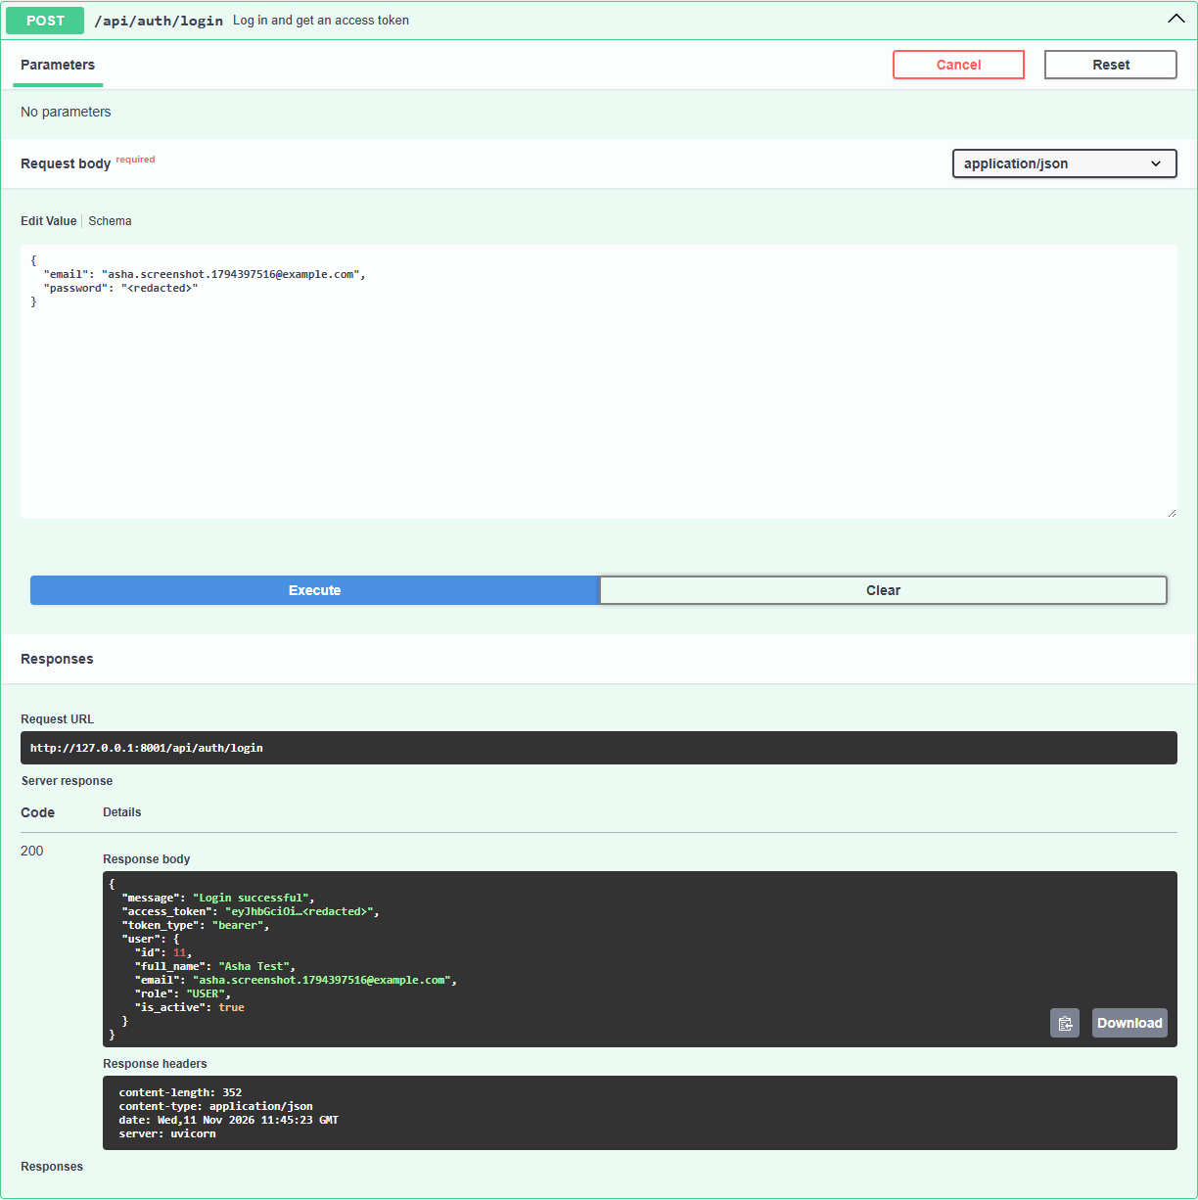
Login on the Authentication Service (token redacted)
8

Slide 10
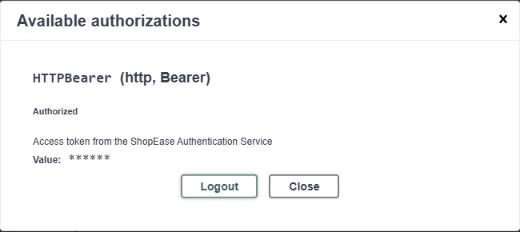
Swagger UI authorized with the JWT access token
9

Slide 11
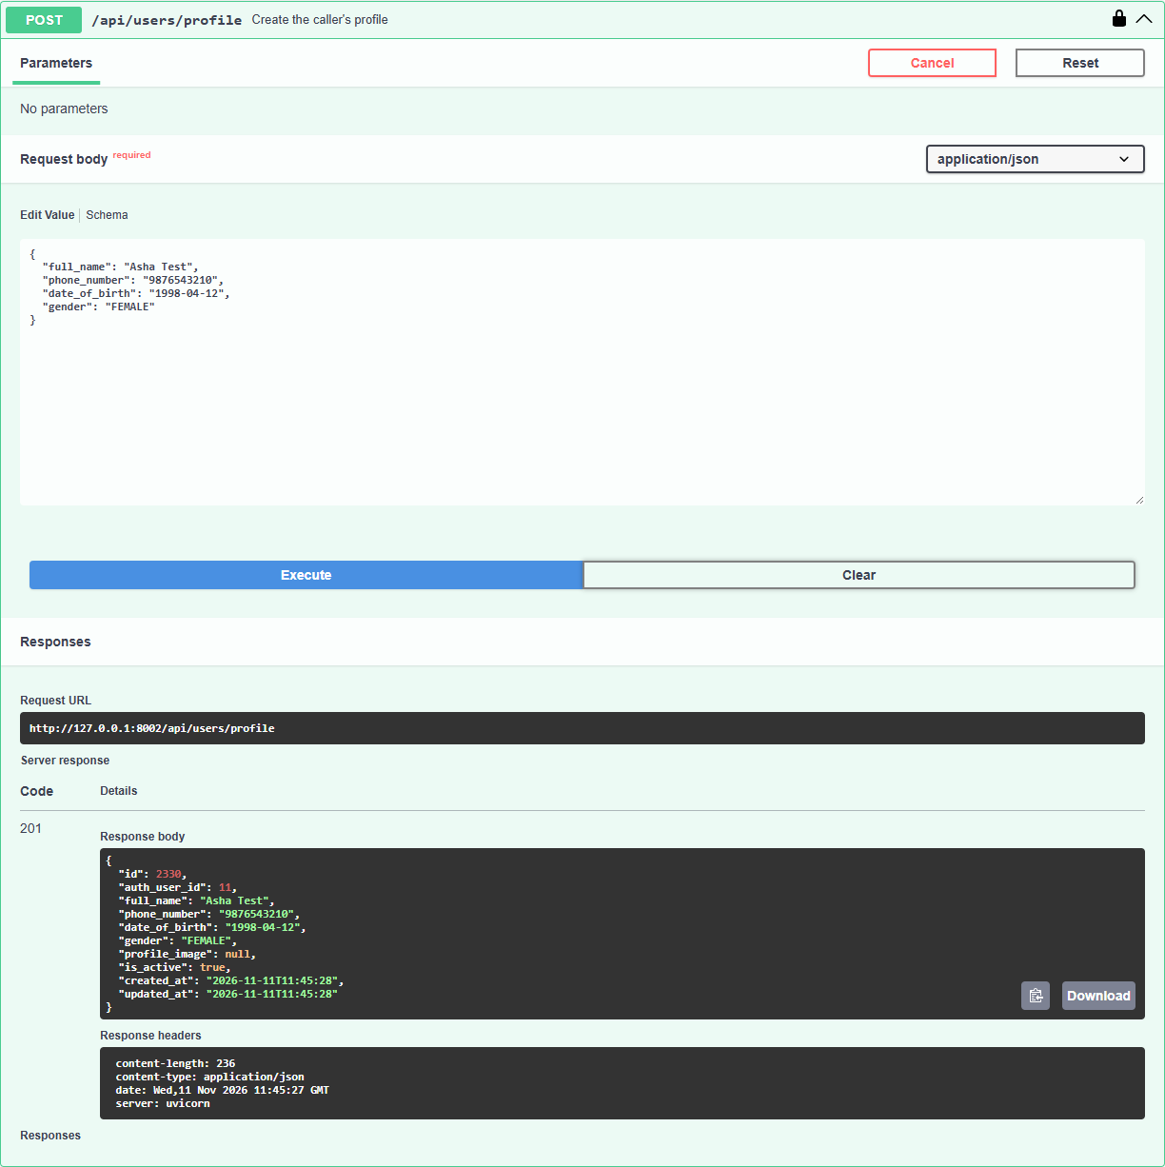
Create profile: POST /api/users/profile (201)
10

Slide 12
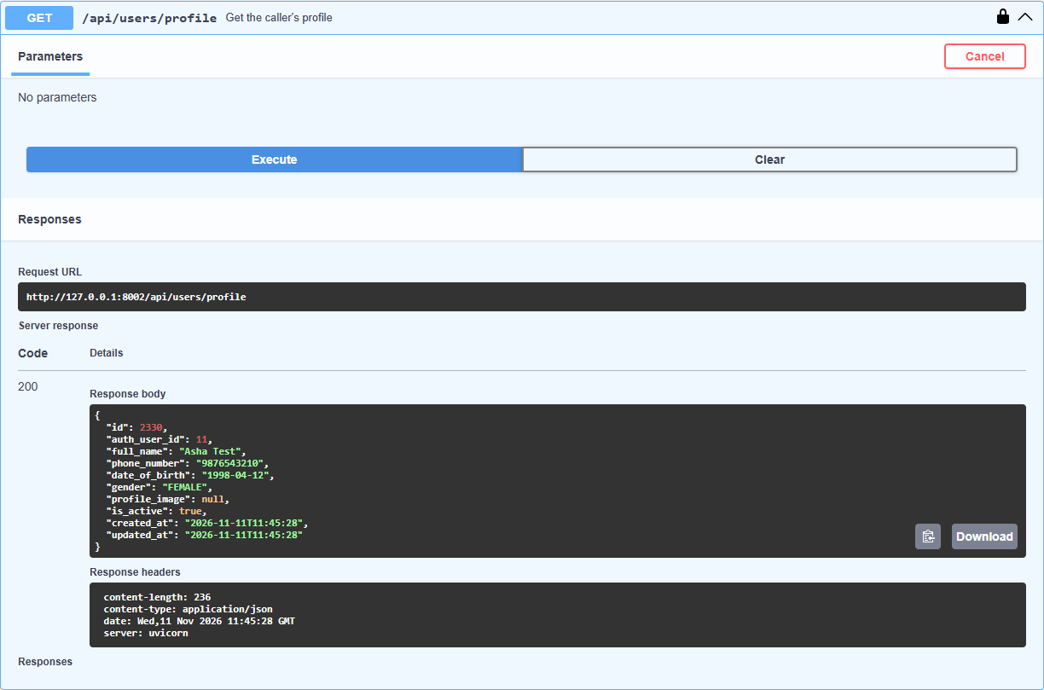
Get profile: GET /api/users/profile (200)
11

Slide 13
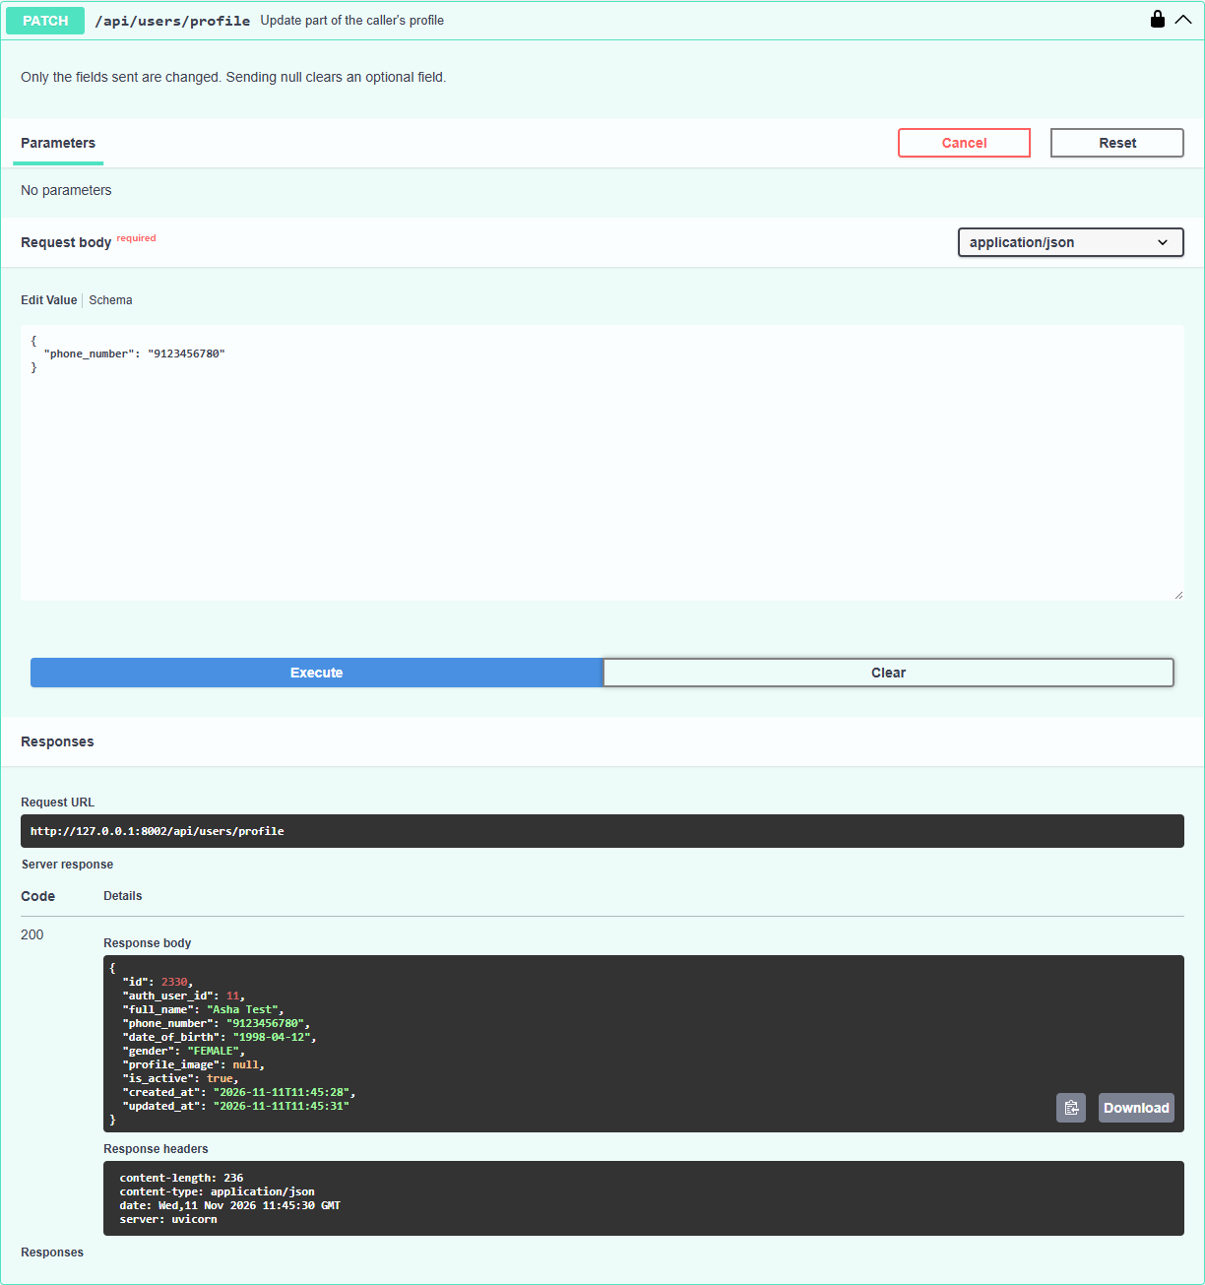
Update profile: PATCH /api/users/profile (200)
12

Slide 14
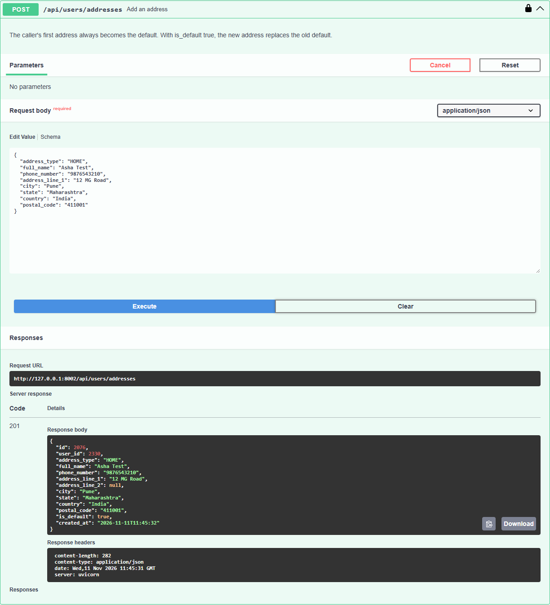
Create address: POST /api/users/addresses (201)
13

Slide 15
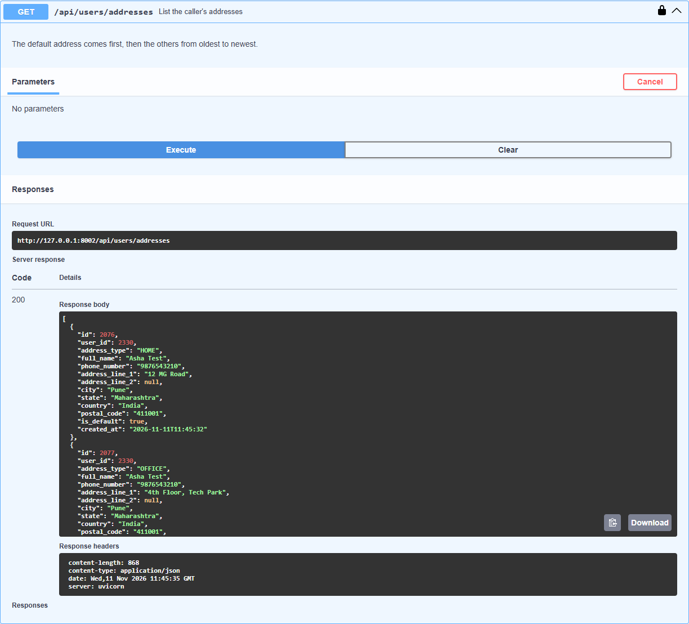
List addresses: GET /api/users/addresses (200)
14

Slide 16
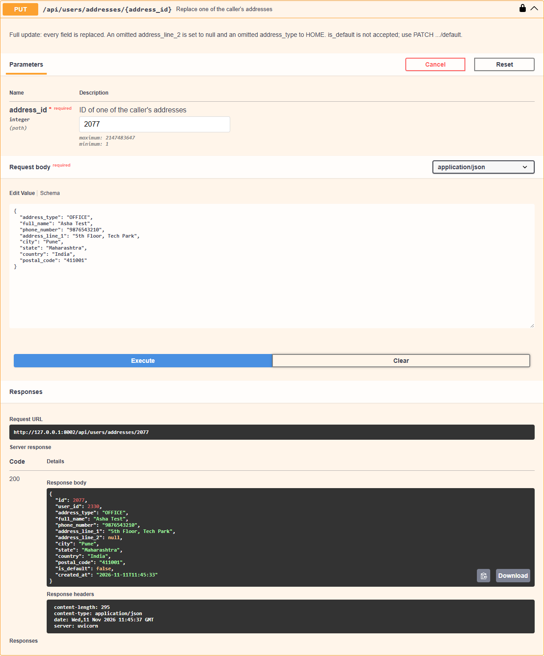
Update address: PUT /api/users/addresses/{id} (200)
15

Slide 17
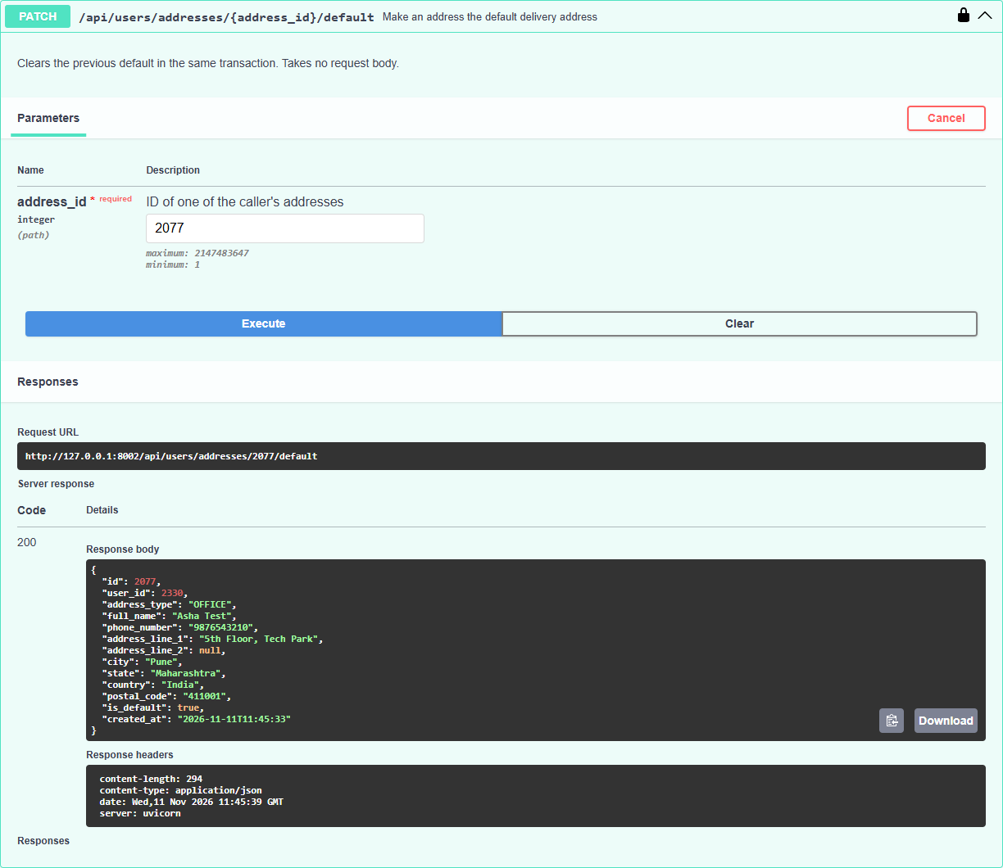
Set default address: PATCH /addresses/{id}/default (200)
16

Slide 18
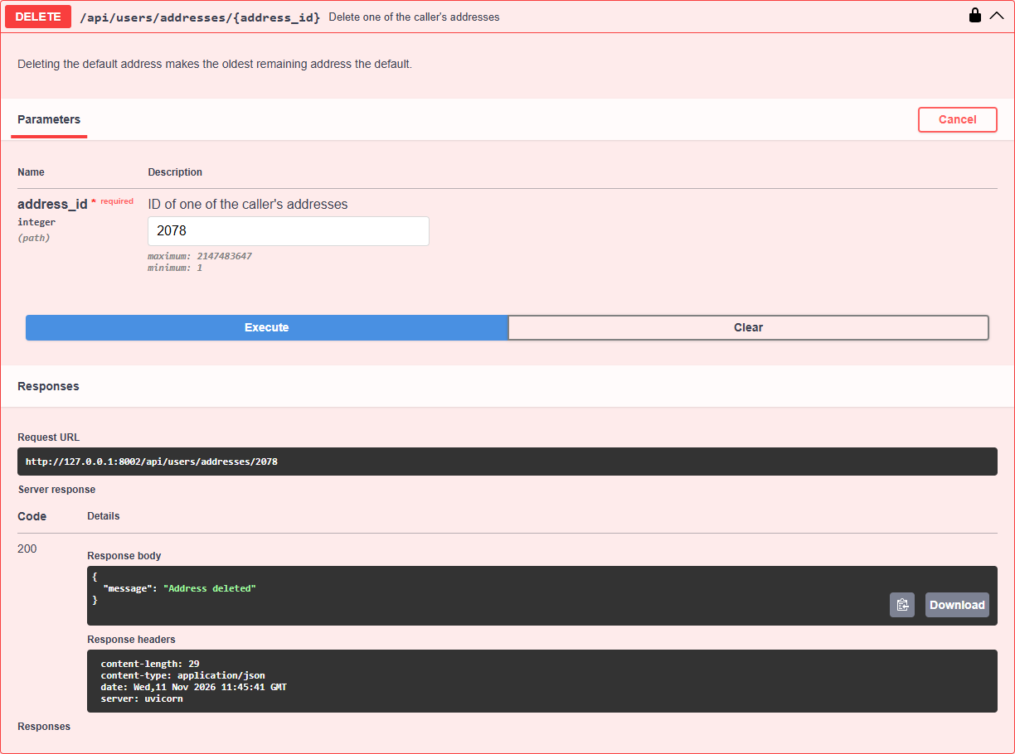
Delete address: DELETE /api/users/addresses/{id} (200)
17

Slide 19
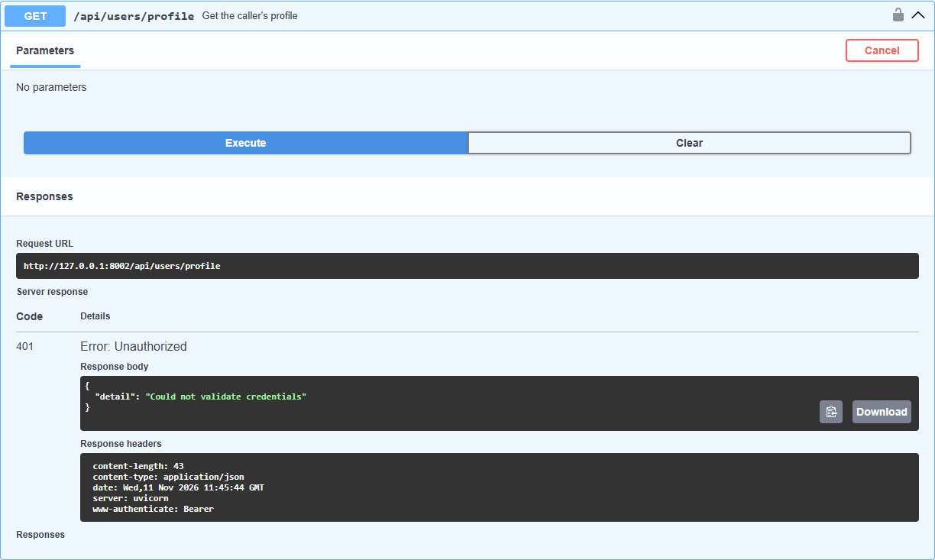
Request without a token is rejected (401)
18

Slide 20
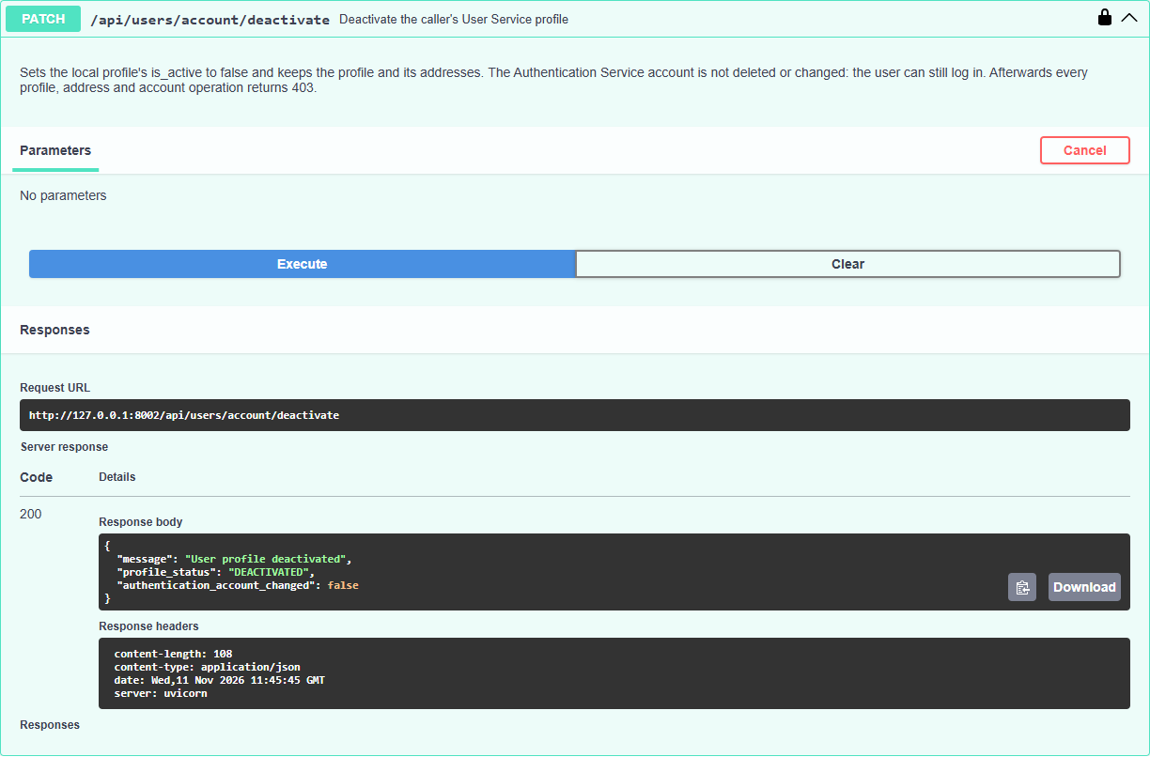
Deactivate account: PATCH /api/users/account/deactivate (200)
19

Slide 21
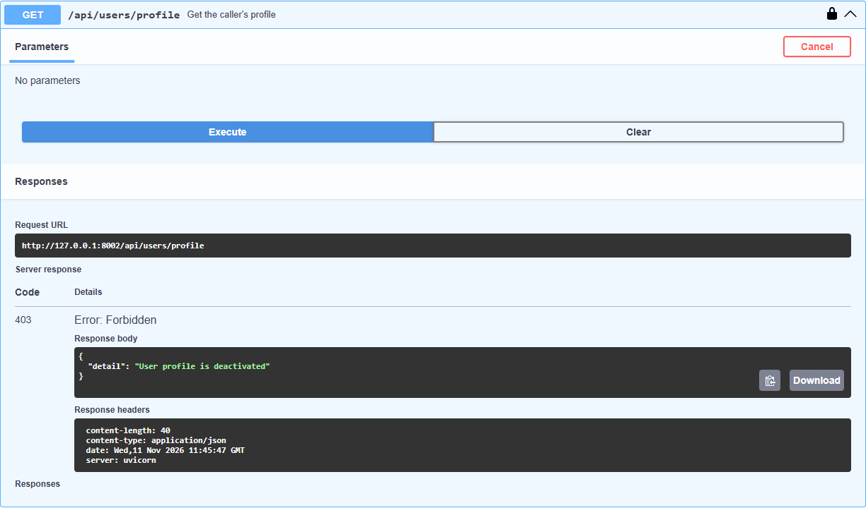
Deactivated profile is blocked (403)
20

Slide 22
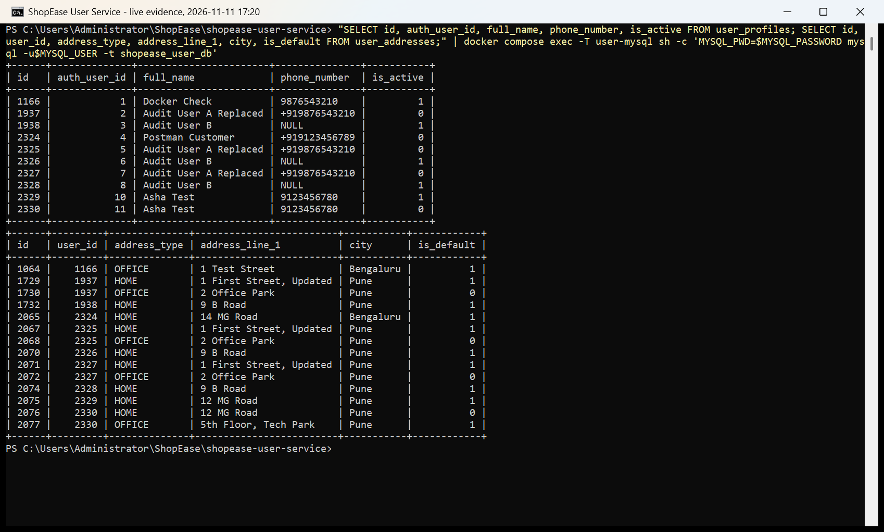
MySQL data: profiles and addresses
21

Slide 23
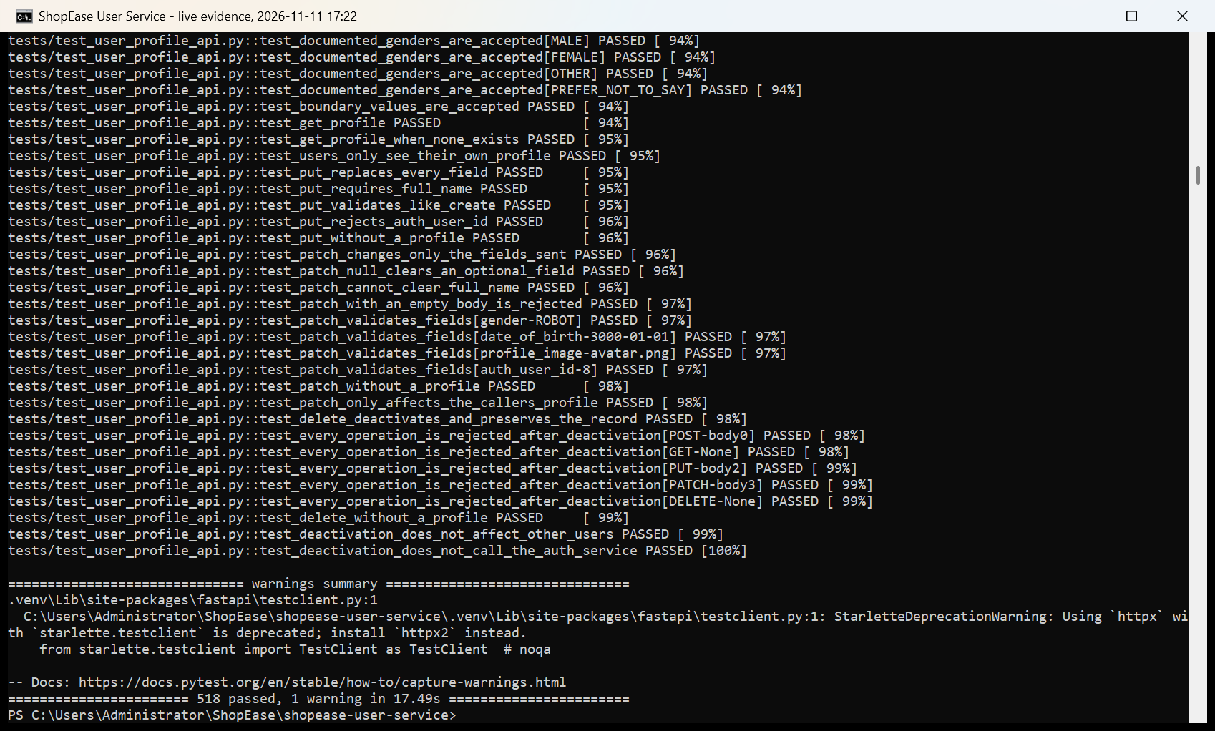
Automated tests: 518 passed (pytest)
22

Slide 24
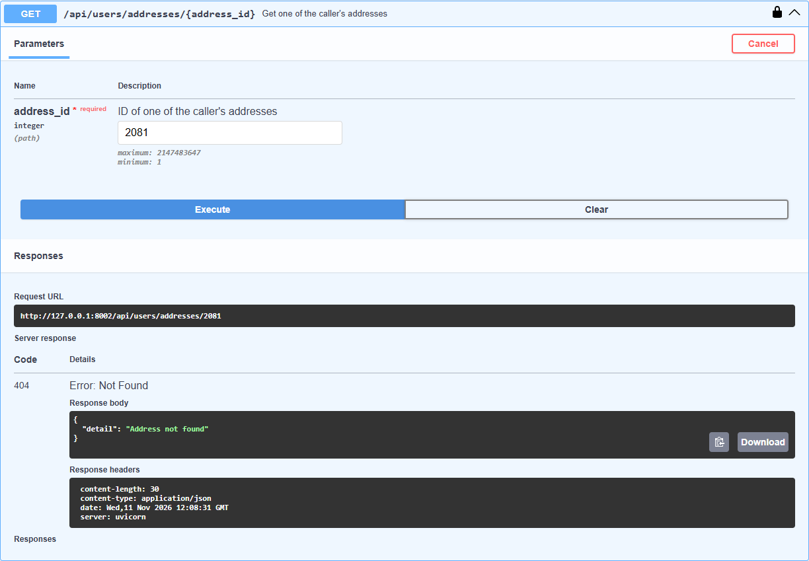
Cross-user read blocked: user B cannot see A's address (404)
23

Slide 25
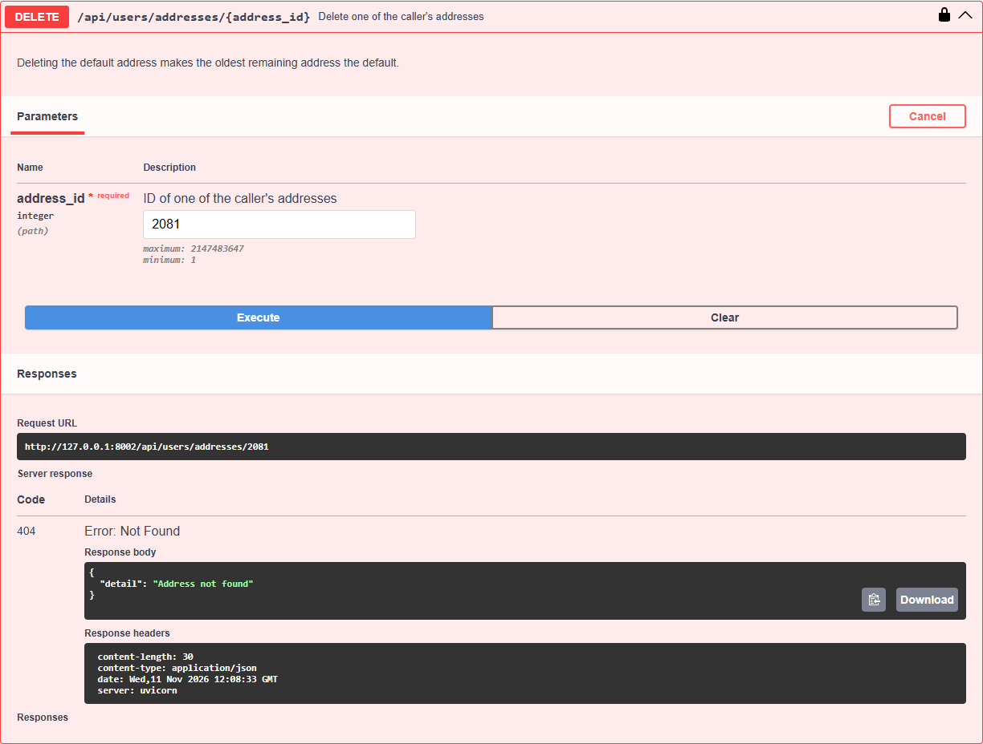
Cross-user delete blocked: user B cannot delete A's address (404)
24

Slide 26
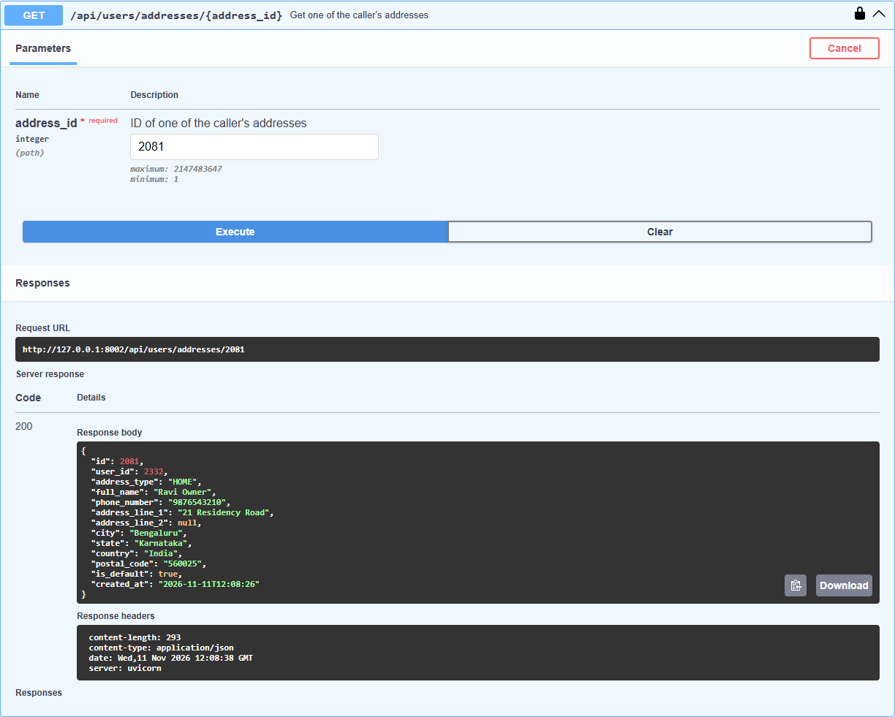
Owner A still has the address, unchanged (200)
25

