Slide 1
Submission Screenshots
ShopEase Product Catalog Service 1.0.0 · captured from the running system on 13 November 2026
25
18 of 18
0
screenshots
checklist items captured
tokens visible (all masked)
Notes:
Every image is a real capture of the running system. Tokens are replaced by <token hidden>.

Slide 2
The 18 checklist items at a glance
Green: live service. Amber: test instance (test database, stand-in Authentication Service), used for ADMIN operations because the live Authentication Service has no ADMIN account yet. Tall captures are cut into equal columns, read left to right; nothing in them is edited.
01
02
03
04
05
06
VS Code project structure
Swagger UI
MySQL database and tables
Category creation
Product creation
Product listing
THIS MACHINE
LIVE
LIVE STACK
TEST INSTANCE
TEST INSTANCE
TEST INSTANCE
07
08
09
10
11
12
Search and filtering
Product update
JWT authorization failure
Admin vs customer access
Stock in
Stock out
TEST INSTANCE
TEST INSTANCE
LIVE
TEST + LIVE
TEST INSTANCE
TEST INSTANCE
13
14
15
16
17
18
Insufficient stock validation
Inventory history
Low-stock products
Docker containers running
Health check
Passing automated tests
TEST INSTANCE
TEST INSTANCE
TEST INSTANCE
LIVE STACK
LIVE
THIS MACHINE

Slide 3
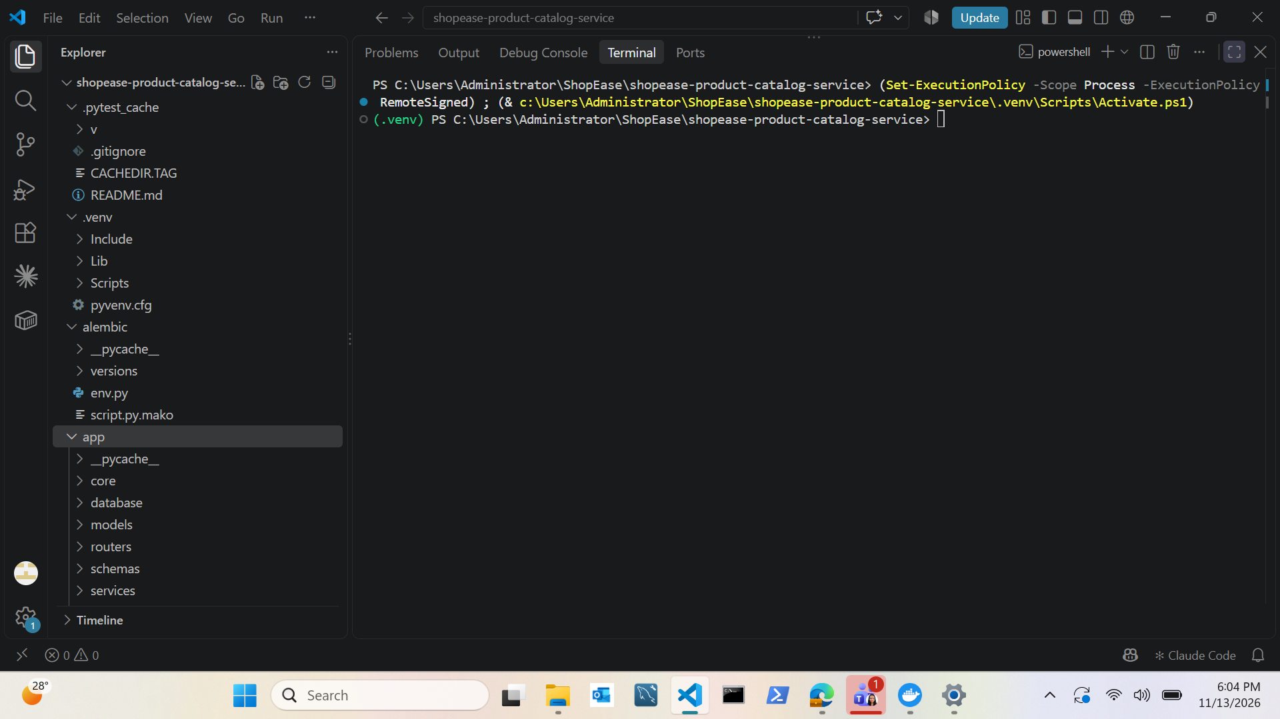
01 · VS Code project structure (1 of 3)
THIS MACHINE · VS Code
Explorer, top: alembic/ (versions, env.py) and app/ with core, database, models, routers, schemas, services.
Notes:
File: DELIVERABELS/screenshots/submission/01_vscode_project_structure/vscode_project_structure_1.png (1920 x 1080 px).

Slide 4
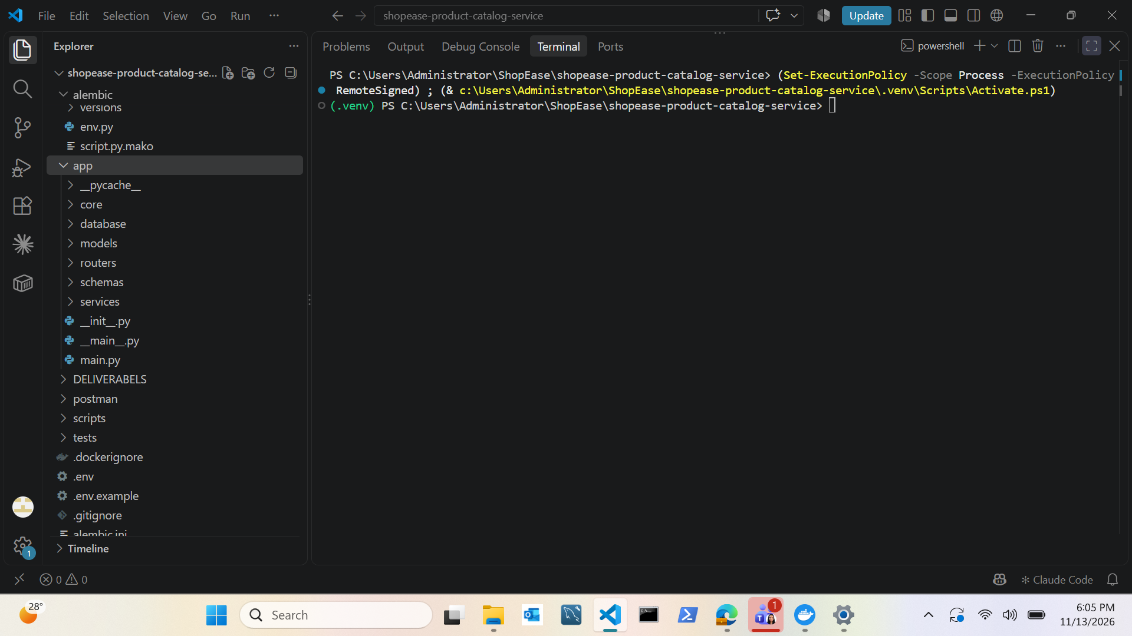
01 · VS Code project structure (2 of 3)
THIS MACHINE · VS Code
Explorer, middle: app/ files (main.py, __main__.py), then DELIVERABELS, postman, scripts and tests.
Notes:
File: DELIVERABELS/screenshots/submission/01_vscode_project_structure/vscode_project_structure_2.png (1920 x 1080 px).

Slide 5
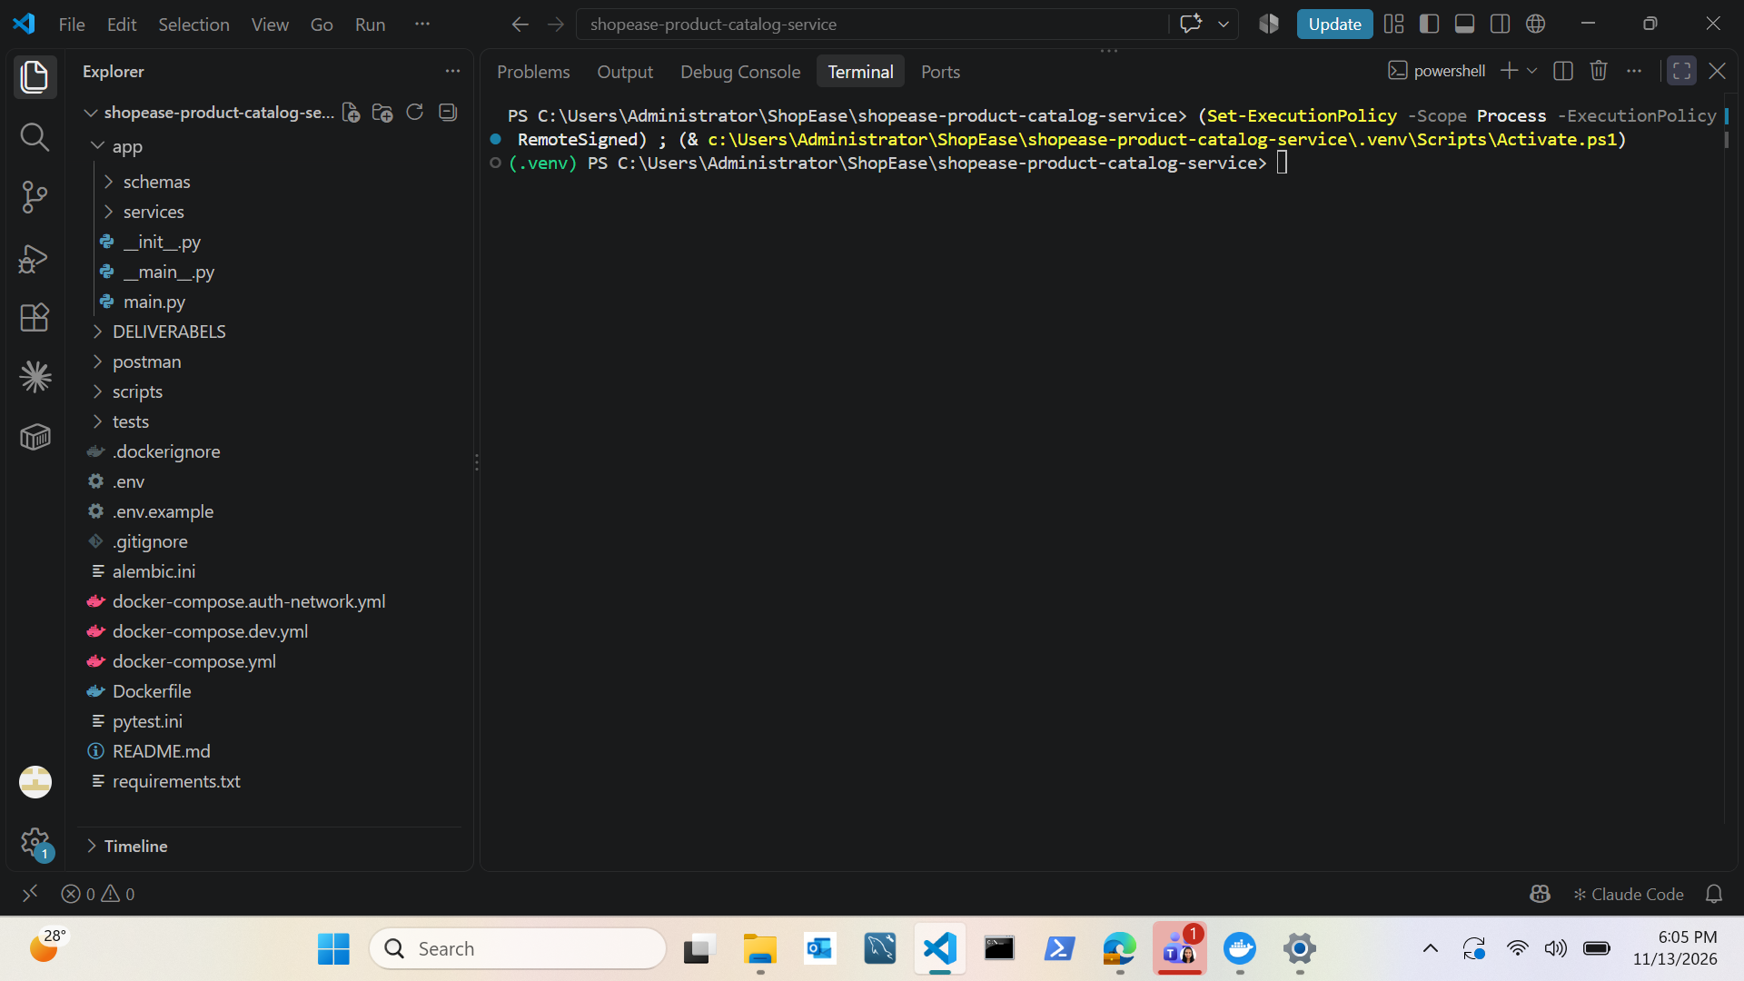
01 · VS Code project structure (3 of 3)
THIS MACHINE · VS Code
Explorer, bottom: Docker and Compose files, alembic.ini, pytest.ini, README.md and requirements.txt.
Notes:
File: DELIVERABELS/screenshots/submission/01_vscode_project_structure/vscode_project_structure_3.png (1920 x 1080 px).

Slide 6
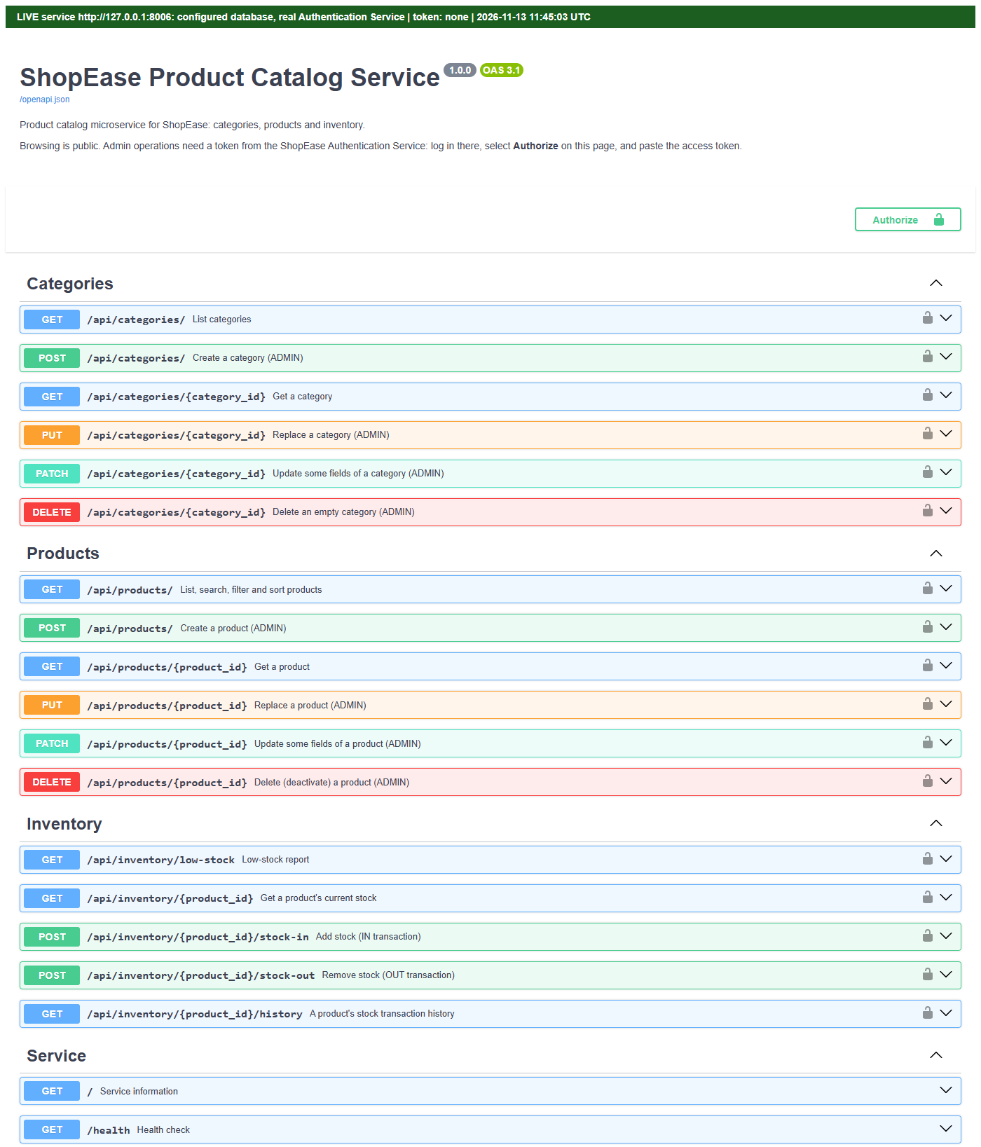
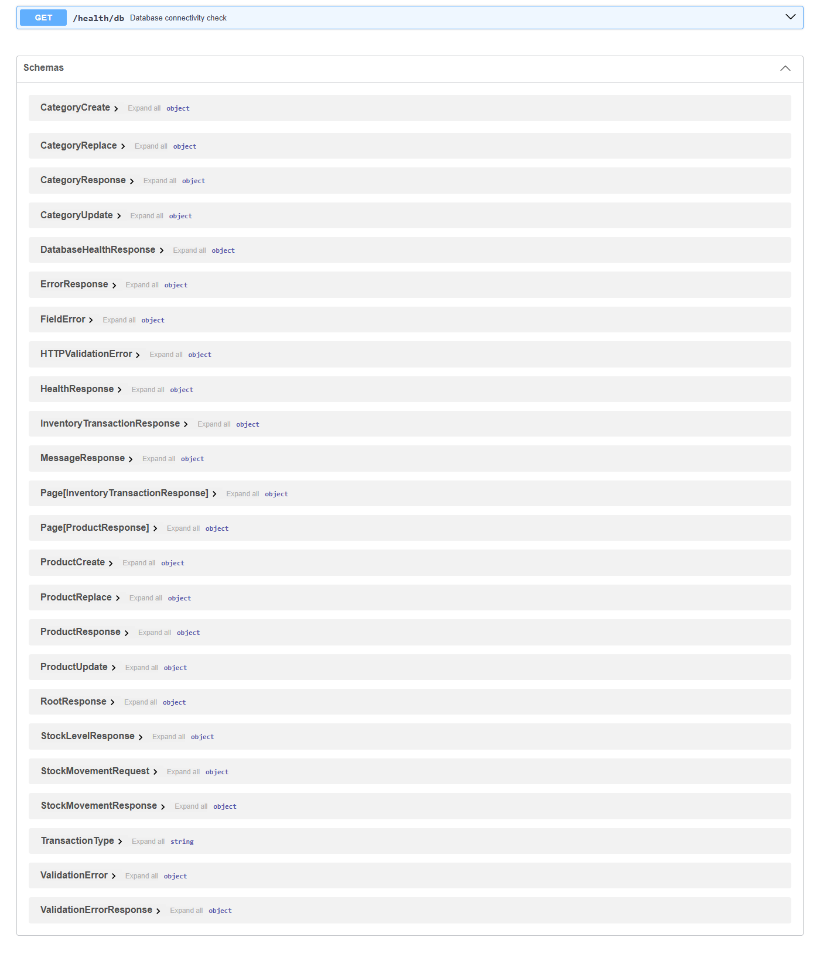
02 · Swagger UI
LIVE · 127.0.0.1:8006
Swagger UI of the running service with the Categories, Products, Inventory and Service groups; no token.
Notes:
File: DELIVERABELS/screenshots/submission/02_swagger_ui/swagger_ui.png (1400 x 3274 px), shown as 2 equal columns read left to right.

Slide 7
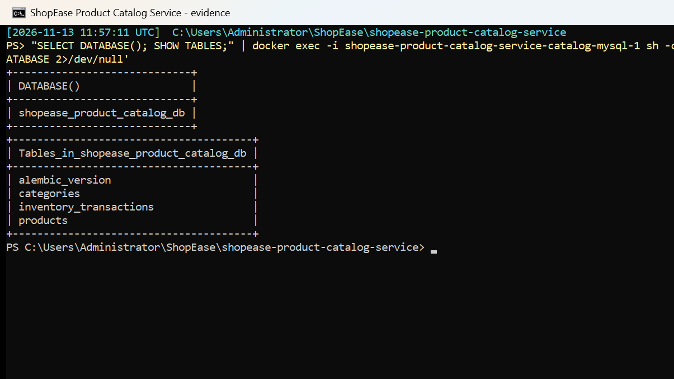
03 · MySQL database and tables
LIVE STACK · Docker
shopease_product_catalog_db in the catalog-mysql container: alembic_version, categories, inventory_transactions, products.
Notes:
File: DELIVERABELS/screenshots/submission/03_mysql_database_and_tables/mysql_tables.png (1205 x 677 px).

Slide 8
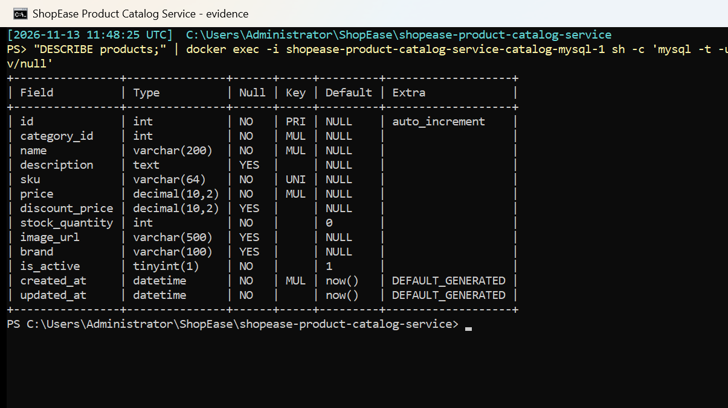
03 · MySQL: products table
LIVE STACK · Docker
DESCRIBE products: unique SKU, DECIMAL(10,2) price, stock default 0, is_active, created_at / updated_at.
Notes:
File: DELIVERABELS/screenshots/submission/03_mysql_database_and_tables/describe_products.png (1205 x 677 px).

Slide 9
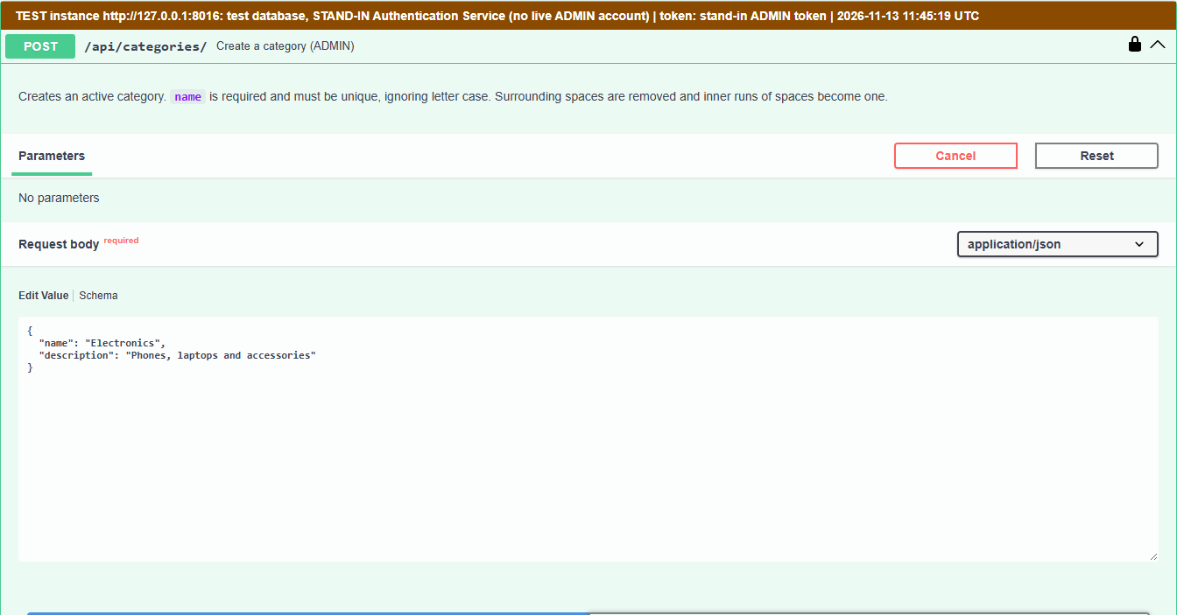
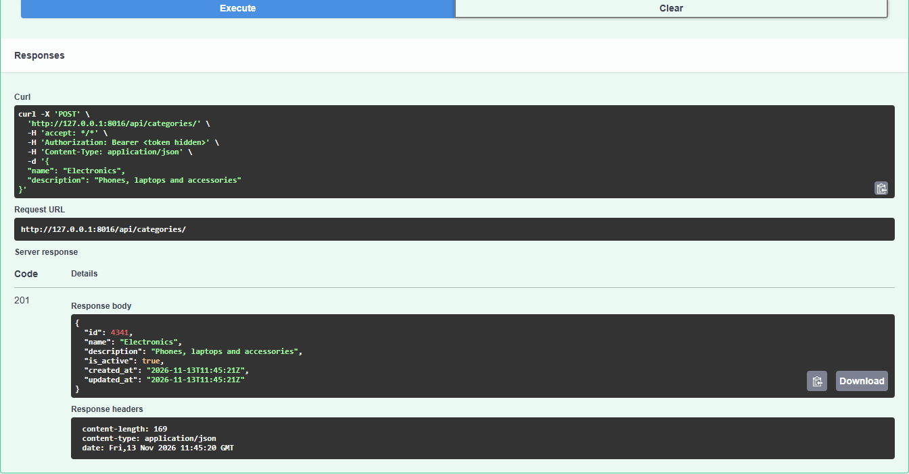
04 · Category creation
TEST INSTANCE · 127.0.0.1:8016
POST /api/categories/ as ADMIN with name and description → 201 Created.
Notes:
File: DELIVERABELS/screenshots/submission/04_category_creation/category_created_201_test_instance.png (1344 x 1406 px), shown as 2 equal columns read left to right.

Slide 10
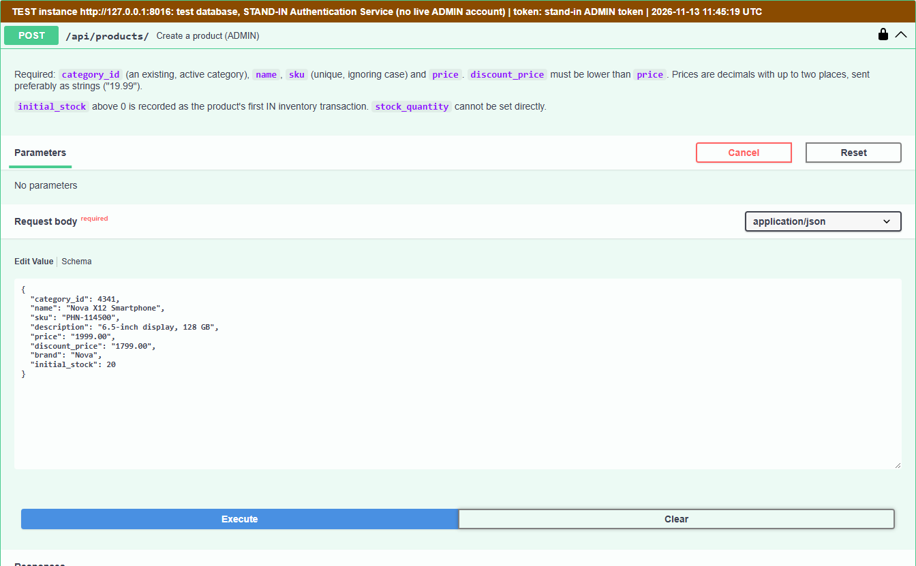
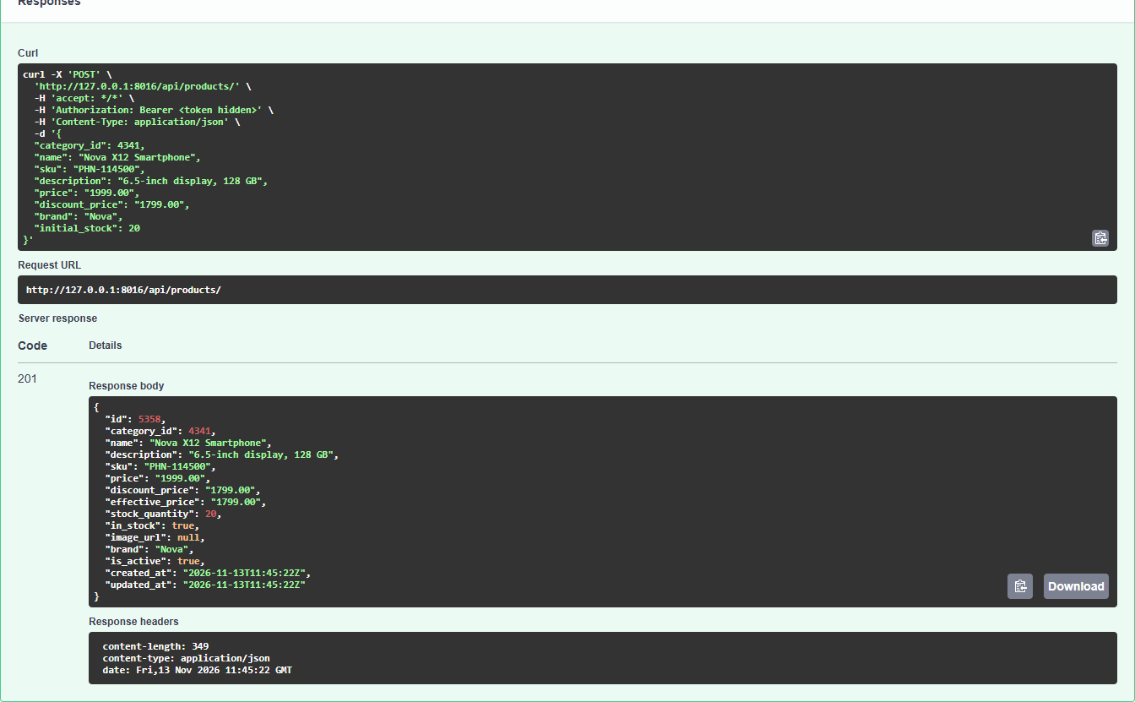
05 · Product creation
TEST INSTANCE · 127.0.0.1:8016
POST /api/products/ as ADMIN with initial_stock 20 → 201 Created (Nova X12 Smartphone).
Notes:
File: DELIVERABELS/screenshots/submission/05_product_creation/product_created_201_test_instance.png (1344 x 1662 px), shown as 2 equal columns read left to right.

Slide 11
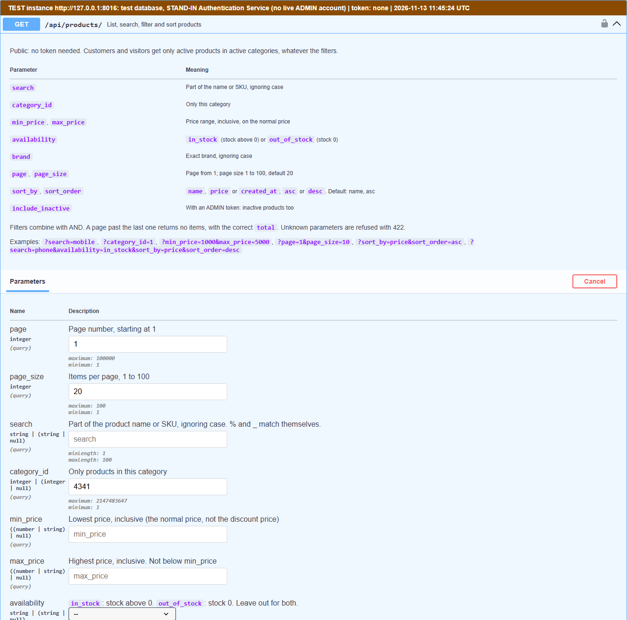
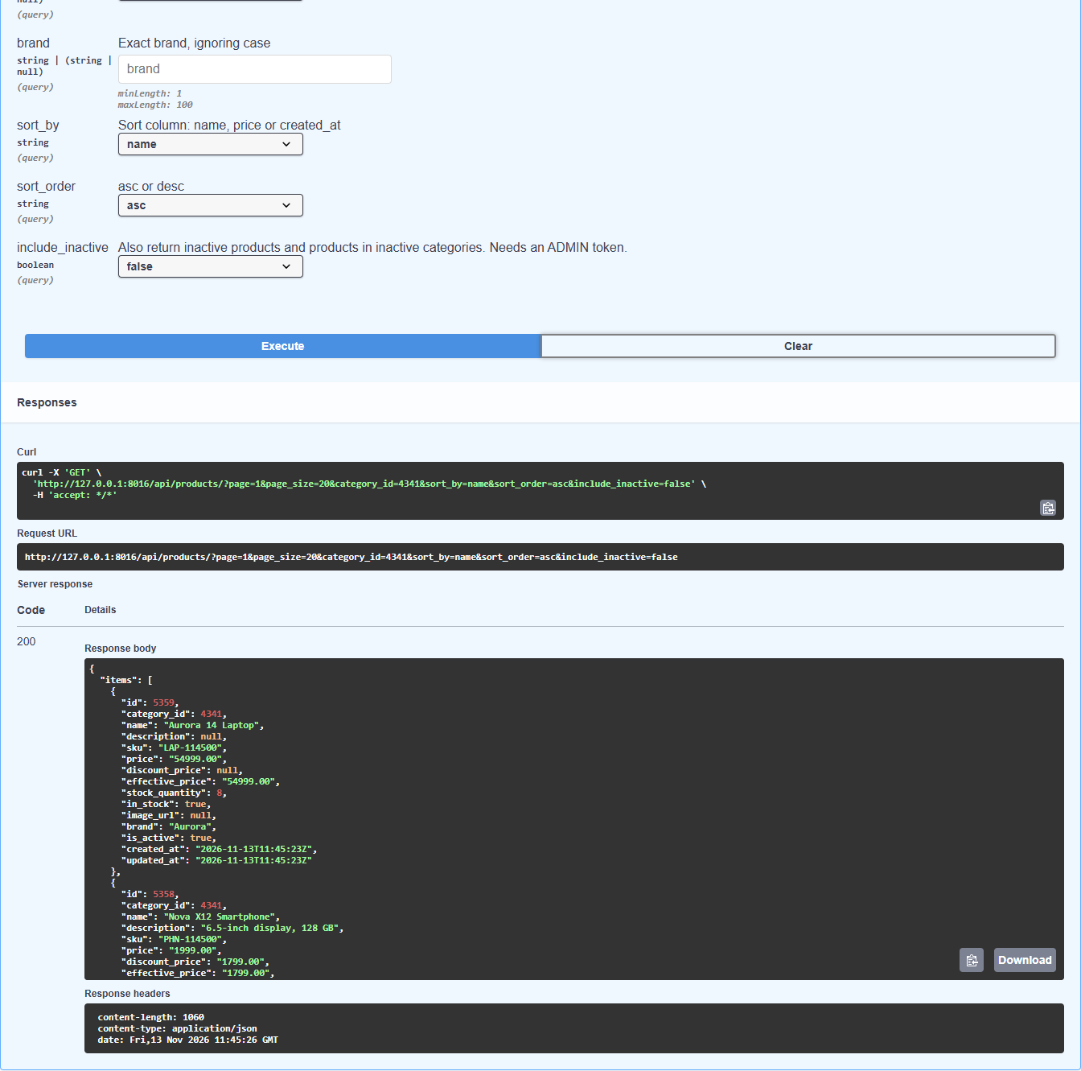
06 · Product listing
TEST INSTANCE · 127.0.0.1:8016
GET /api/products/ for the new category → 200 with items, total, page, page_size and total_pages.
Notes:
File: DELIVERABELS/screenshots/submission/06_product_listing/product_listing_200_test_instance.png (1344 x 2662 px), shown as 2 equal columns read left to right.

Slide 12
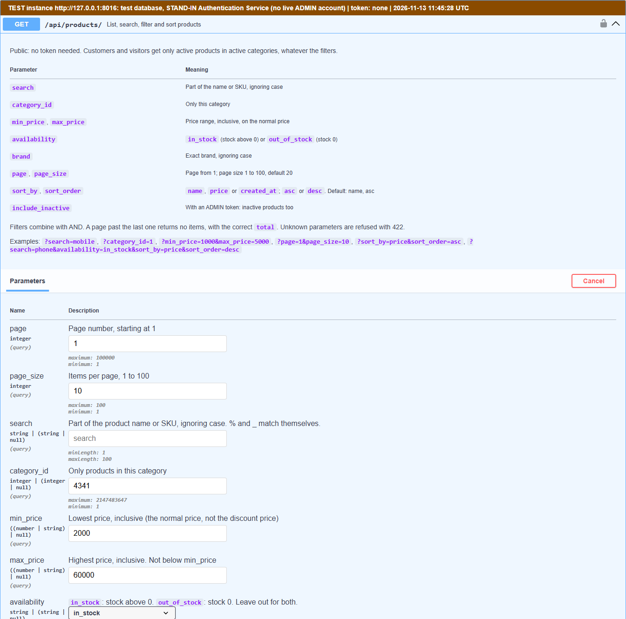

07 · Product search and filtering
TEST INSTANCE · 127.0.0.1:8016
Category, price 2000–60000, in stock, sorted by price descending, page size 10 → 200.
Notes:
File: DELIVERABELS/screenshots/submission/07_product_search_and_filtering/search_filter_200_test_instance.png (1344 x 2662 px), shown as 2 equal columns read left to right.

Slide 13
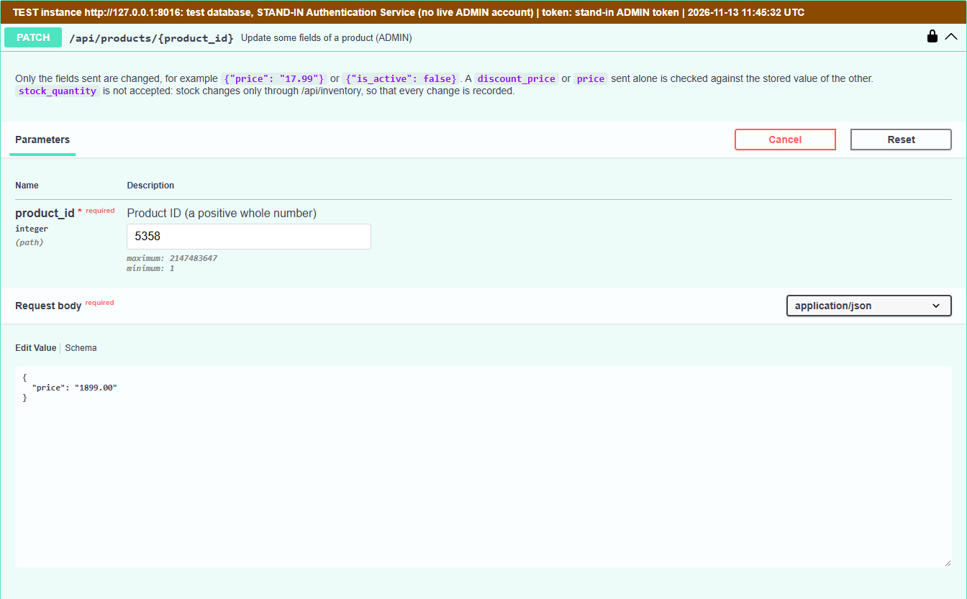
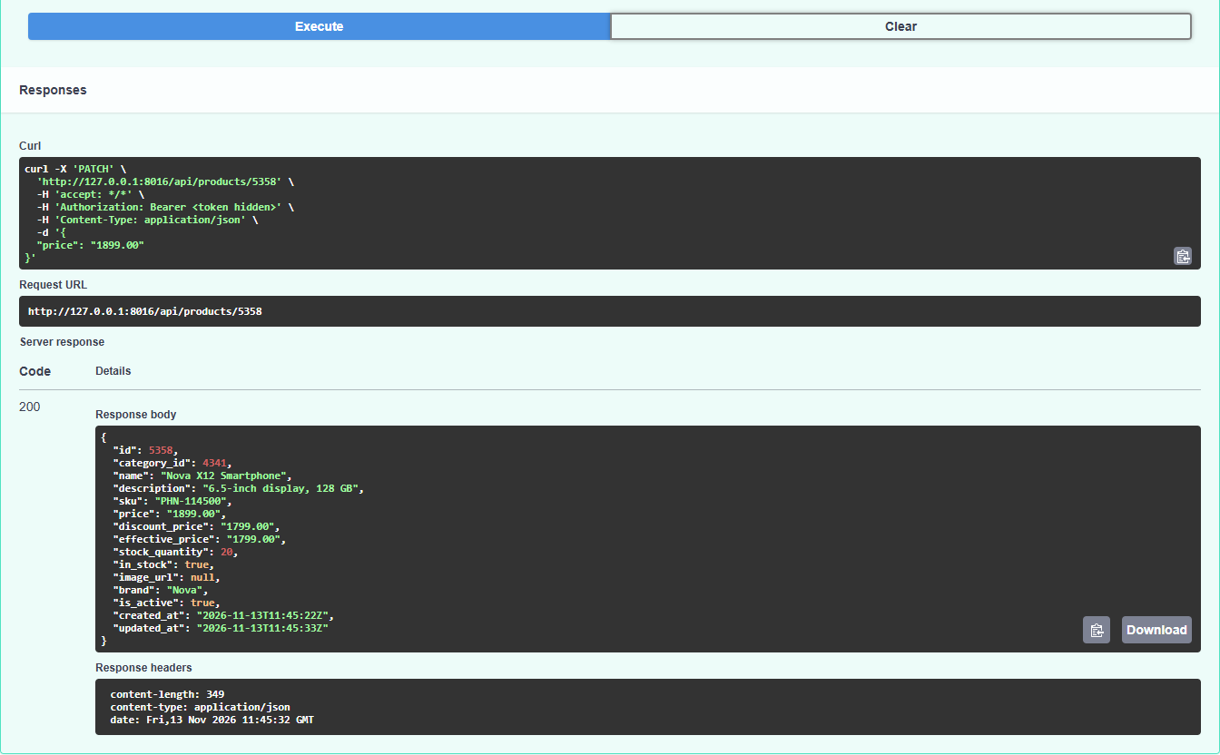
08 · Product update
TEST INSTANCE · 127.0.0.1:8016
PATCH /api/products/{id} with {"price": "1899.00"} → 200; the new price is returned, other fields kept.
Notes:
File: DELIVERABELS/screenshots/submission/08_product_update/product_update_200_test_instance.png (1344 x 1665 px), shown as 2 equal columns read left to right.

Slide 14
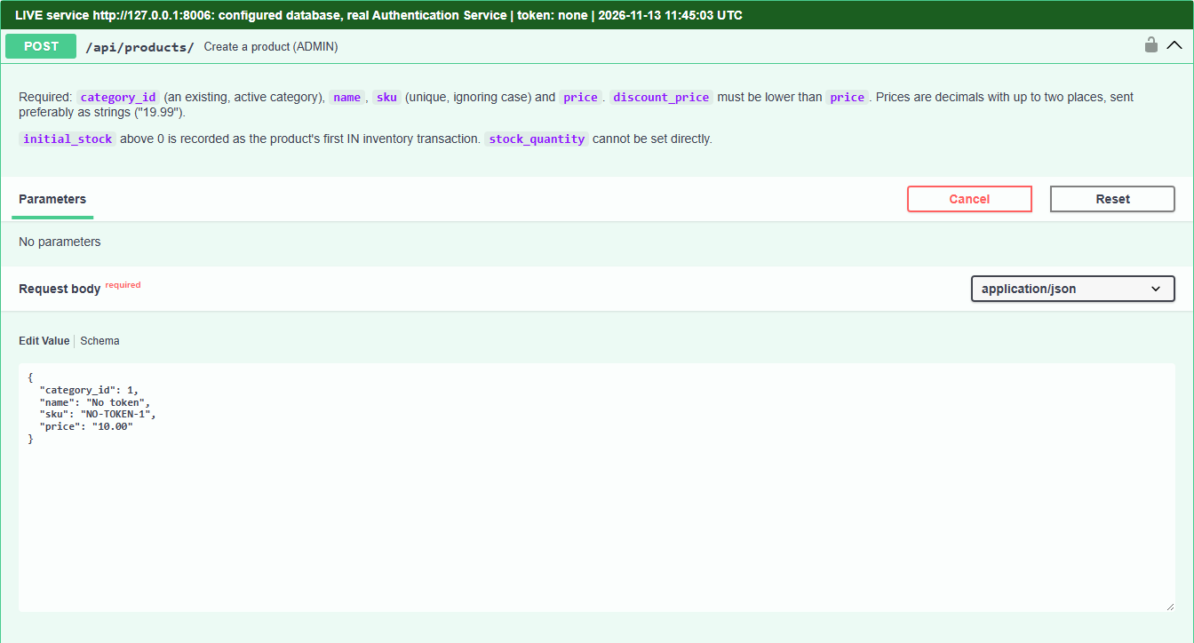
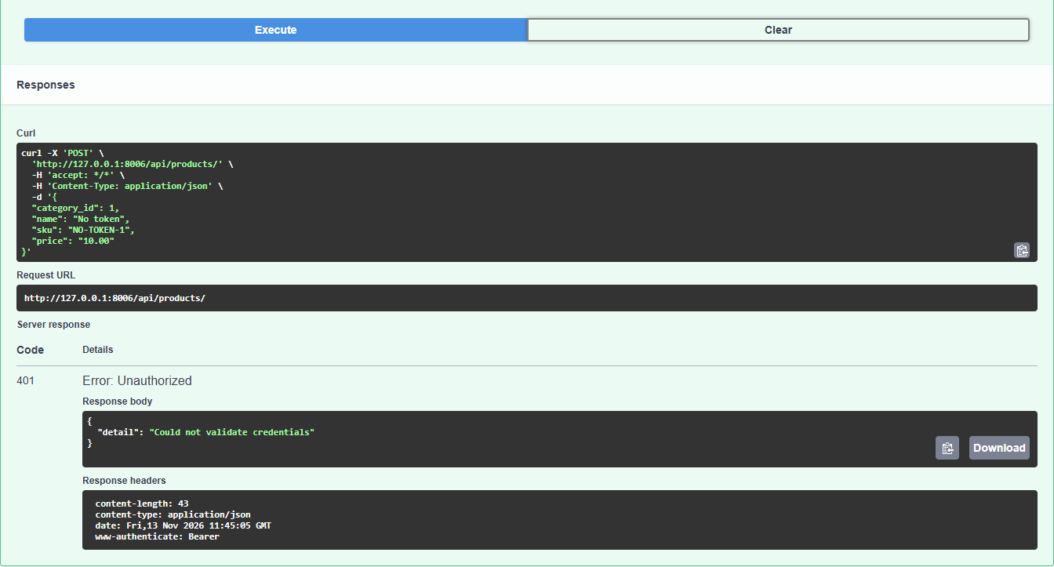
09 · JWT failure: no token
LIVE · 127.0.0.1:8006
POST /api/products/ without a token → 401 "Could not validate credentials".
Notes:
File: DELIVERABELS/screenshots/submission/09_jwt_authorization_failure/no_token_401.png (1344 x 1447 px), shown as 2 equal columns read left to right.

Slide 15
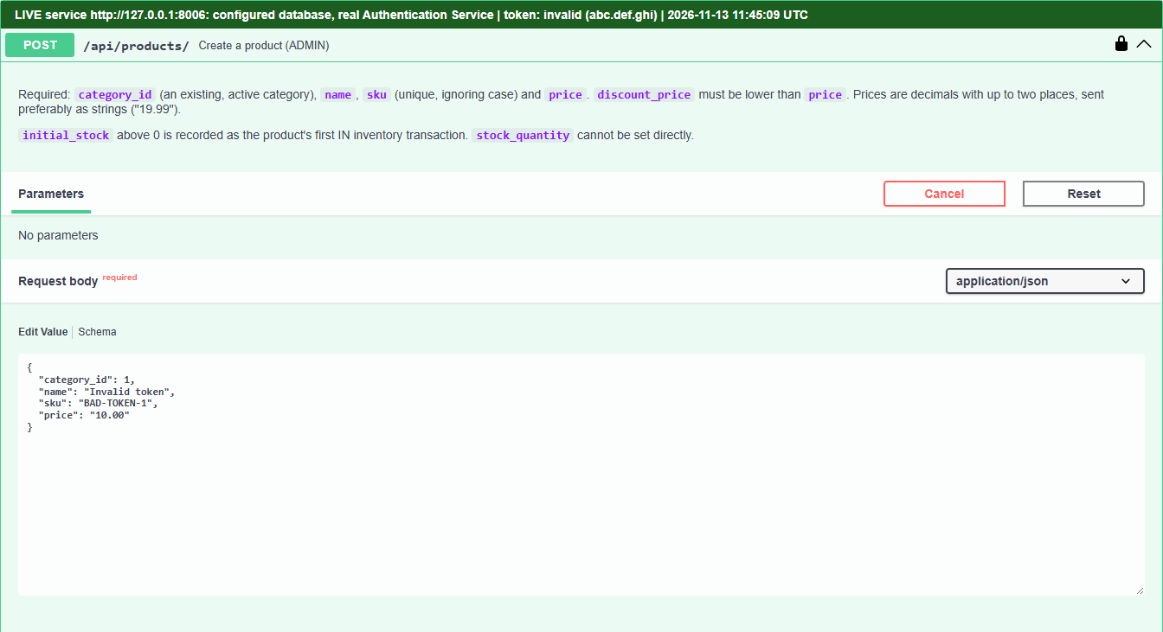
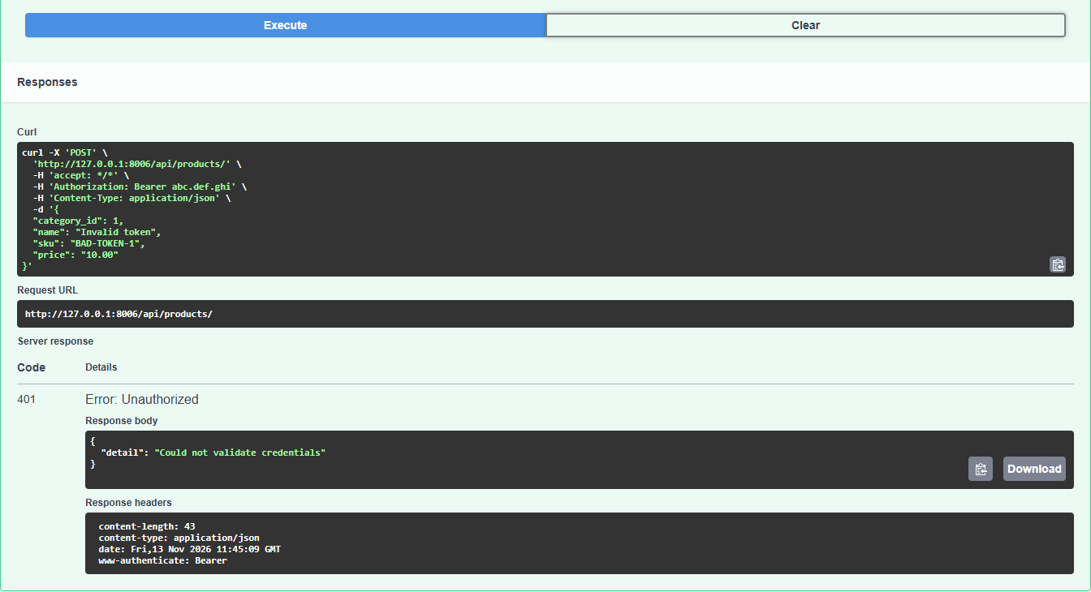
09 · JWT failure: invalid token
LIVE · 127.0.0.1:8006
The same request with the invalid token abc.def.ghi → 401.
Notes:
File: DELIVERABELS/screenshots/submission/09_jwt_authorization_failure/invalid_token_401.png (1344 x 1461 px), shown as 2 equal columns read left to right.

Slide 16
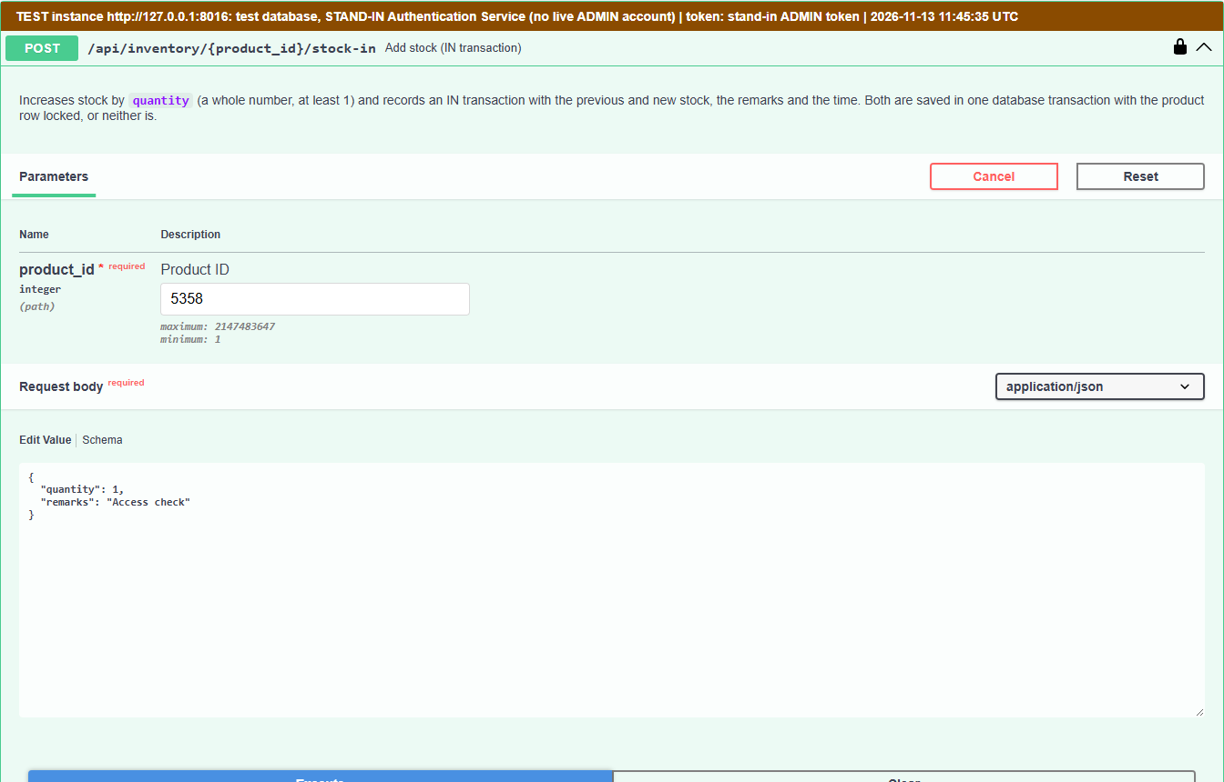
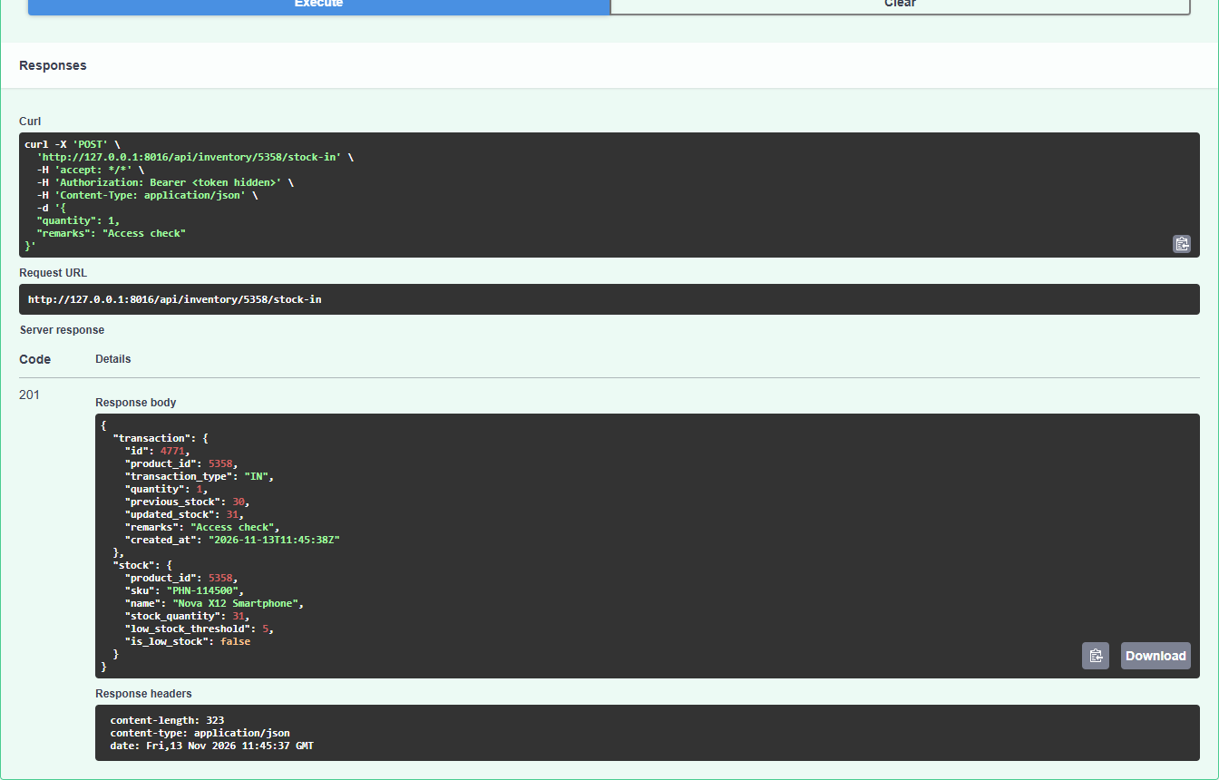
10 · Admin vs customer: ADMIN
TEST INSTANCE · 127.0.0.1:8016
Stock-in as ADMIN → 201 Created.
Notes:
File: DELIVERABELS/screenshots/submission/10_admin_vs_customer_access/admin_201_test_instance.png (1344 x 1720 px), shown as 2 equal columns read left to right.

Slide 17
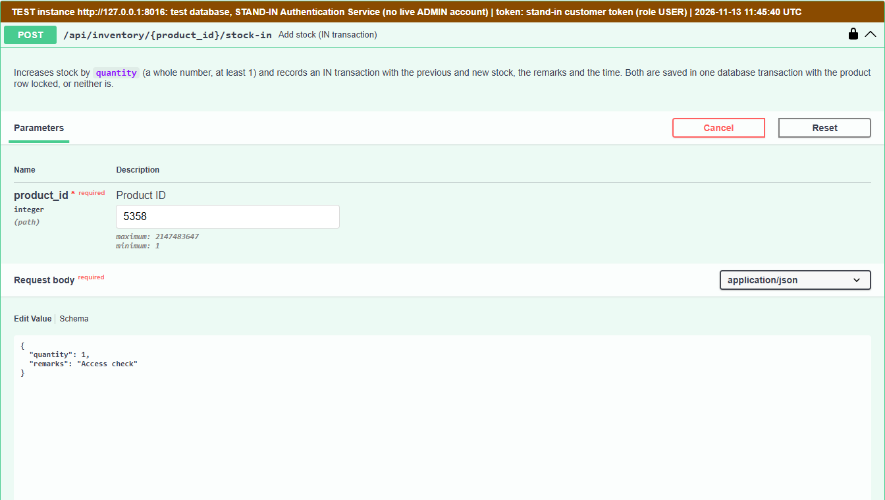
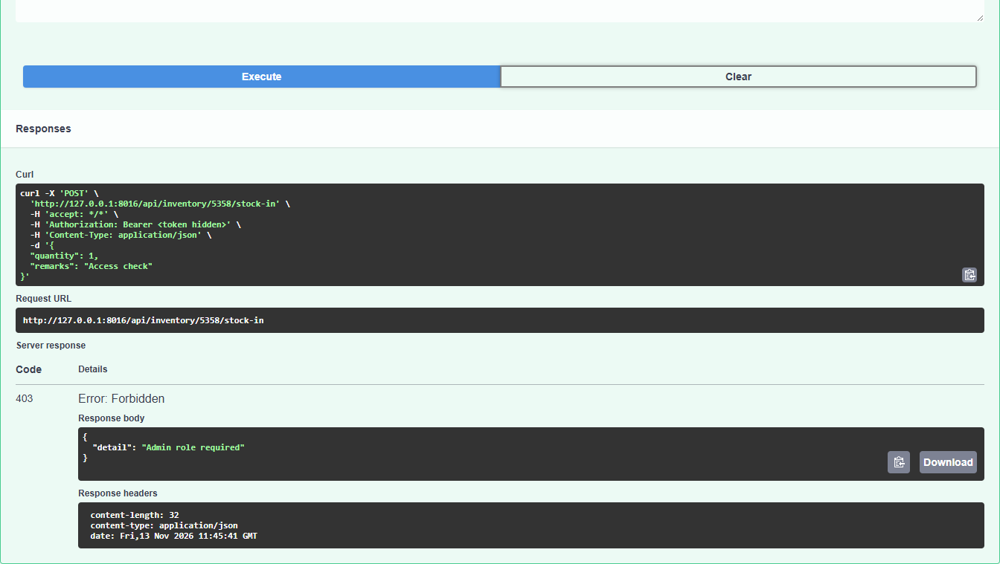
10 · Admin vs customer: customer
TEST INSTANCE · 127.0.0.1:8016
The same stock-in with a customer (USER) token → 403 "Admin role required".
Notes:
File: DELIVERABELS/screenshots/submission/10_admin_vs_customer_access/customer_403_test_instance.png (1344 x 1518 px), shown as 2 equal columns read left to right.

Slide 18
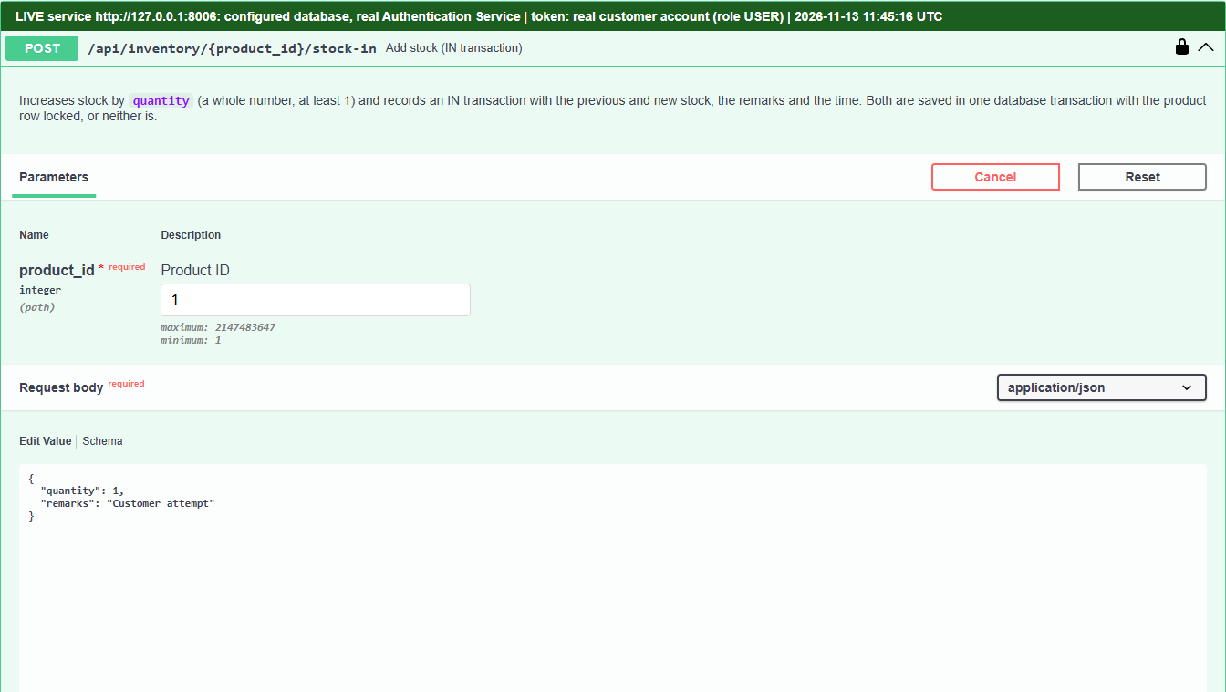

10 · Admin vs customer: real customer
LIVE · 127.0.0.1:8006
A real customer account of the Authentication Service, on the live service → 403 "Admin role required".
Notes:
File: DELIVERABELS/screenshots/submission/10_admin_vs_customer_access/customer_403_live.png (1344 x 1518 px), shown as 2 equal columns read left to right.

Slide 19
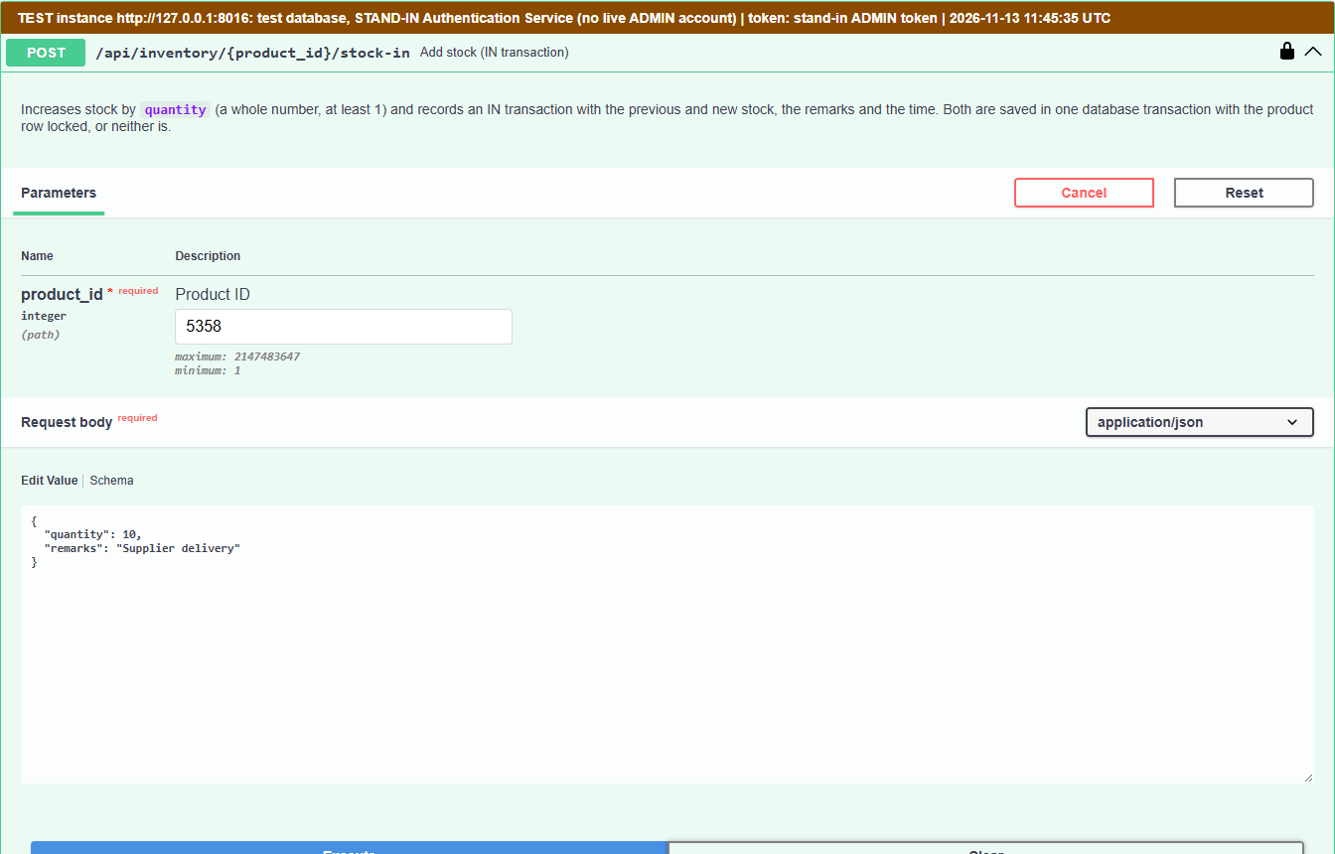

11 · Stock in
TEST INSTANCE · 127.0.0.1:8016
POST /api/inventory/{id}/stock-in, quantity 10, "Supplier delivery" → 201 with previous and updated stock.
Notes:
File: DELIVERABELS/screenshots/submission/11_stock_in/stock_in_201_test_instance.png (1344 x 1720 px), shown as 2 equal columns read left to right.

Slide 20
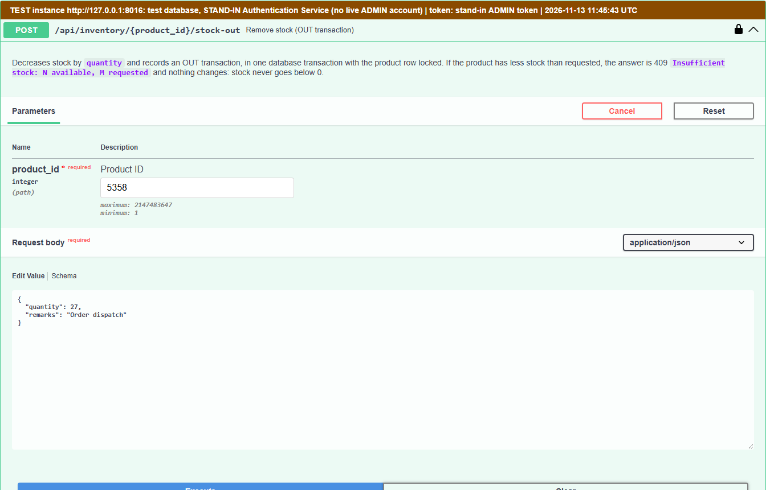

12 · Stock out
TEST INSTANCE · 127.0.0.1:8016
POST /api/inventory/{id}/stock-out, quantity 27, "Order dispatch" → 201; stock reduced.
Notes:
File: DELIVERABELS/screenshots/submission/12_stock_out/stock_out_201_test_instance.png (1344 x 1721 px), shown as 2 equal columns read left to right.

Slide 21
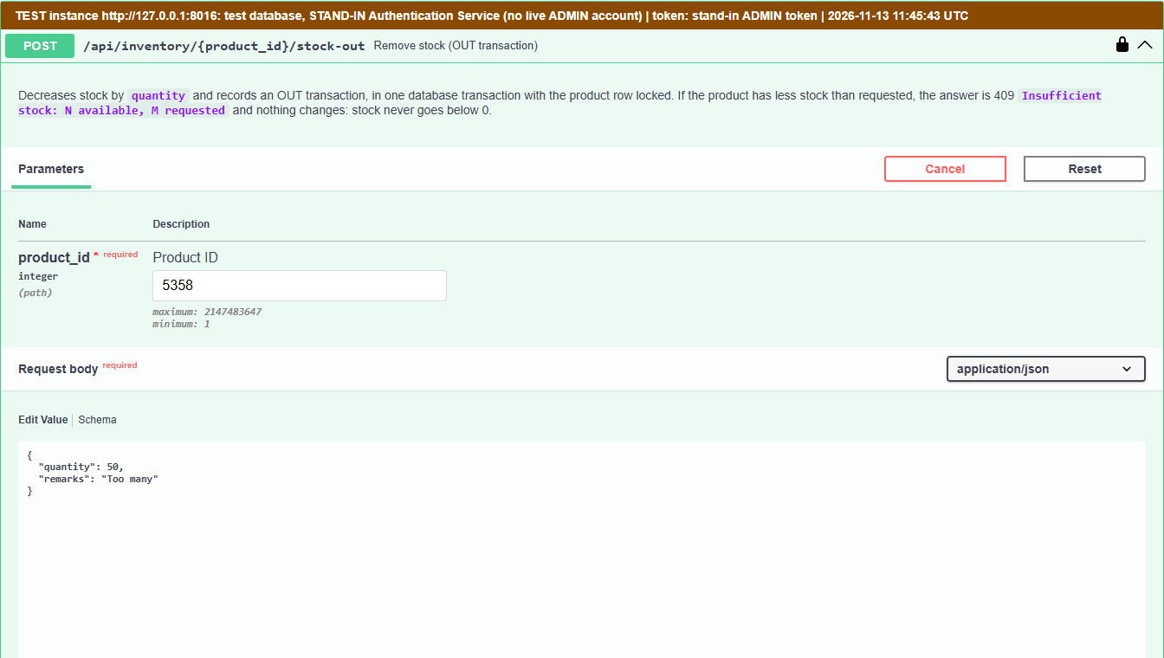
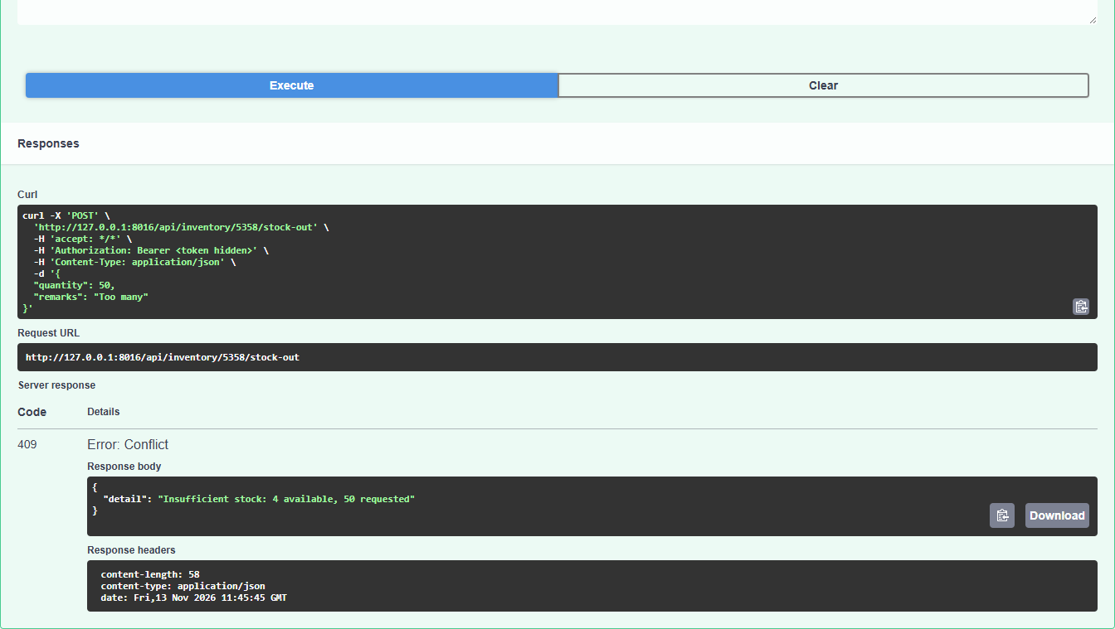
13 · Insufficient stock validation
TEST INSTANCE · 127.0.0.1:8016
Stock-out of 50 with 4 in stock → 409 "Insufficient stock: 4 available, 50 requested"; nothing changed.
Notes:
File: DELIVERABELS/screenshots/submission/13_insufficient_stock_validation/insufficient_stock_409_test_instance.png (1344 x 1519 px), shown as 2 equal columns read left to right.

Slide 22
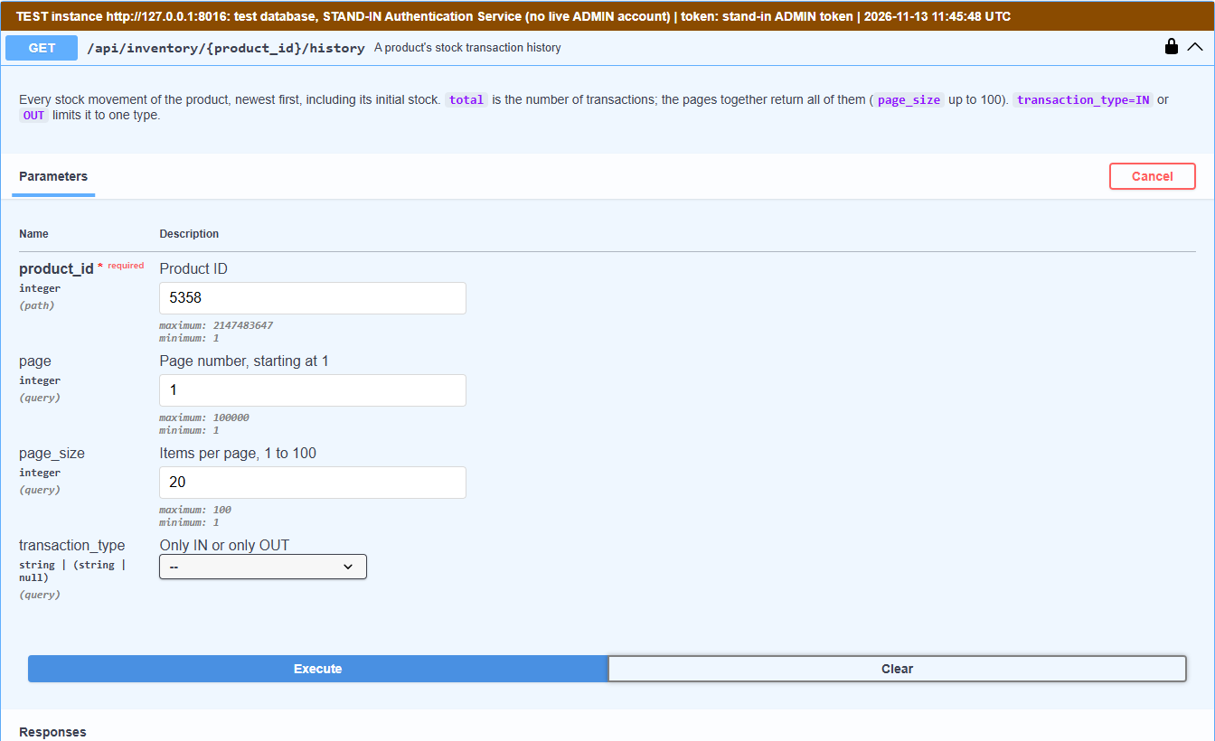
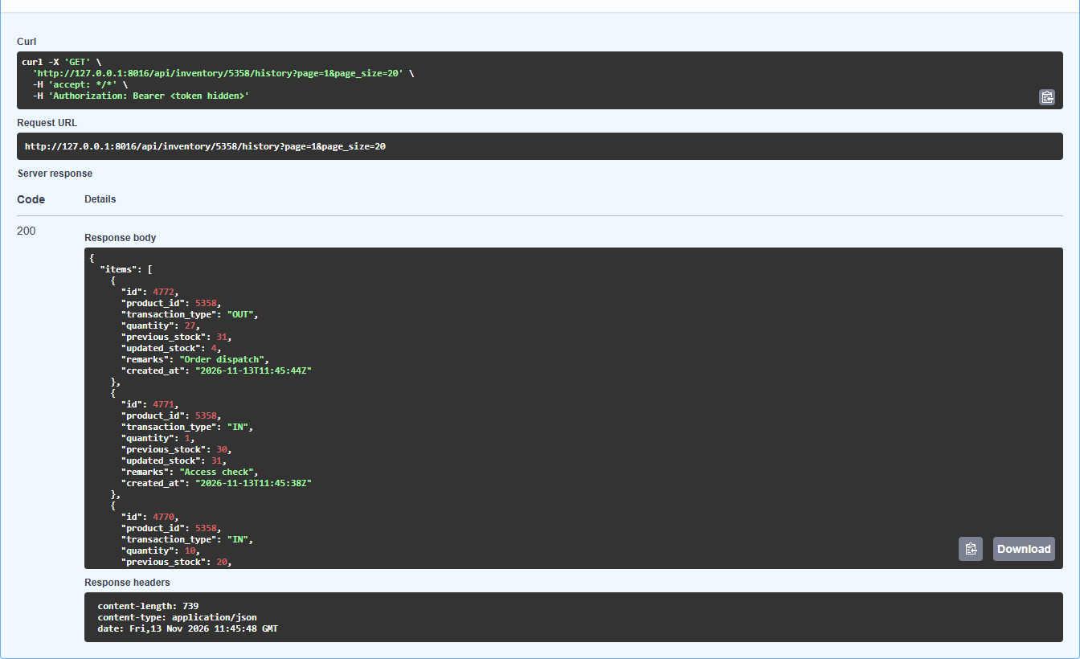
14 · Inventory history
TEST INSTANCE · 127.0.0.1:8016
GET /api/inventory/{id}/history → 200: every IN and OUT movement, newest first.
Notes:
File: DELIVERABELS/screenshots/submission/14_inventory_history/history_200_test_instance.png (1344 x 1640 px), shown as 2 equal columns read left to right.

Slide 23
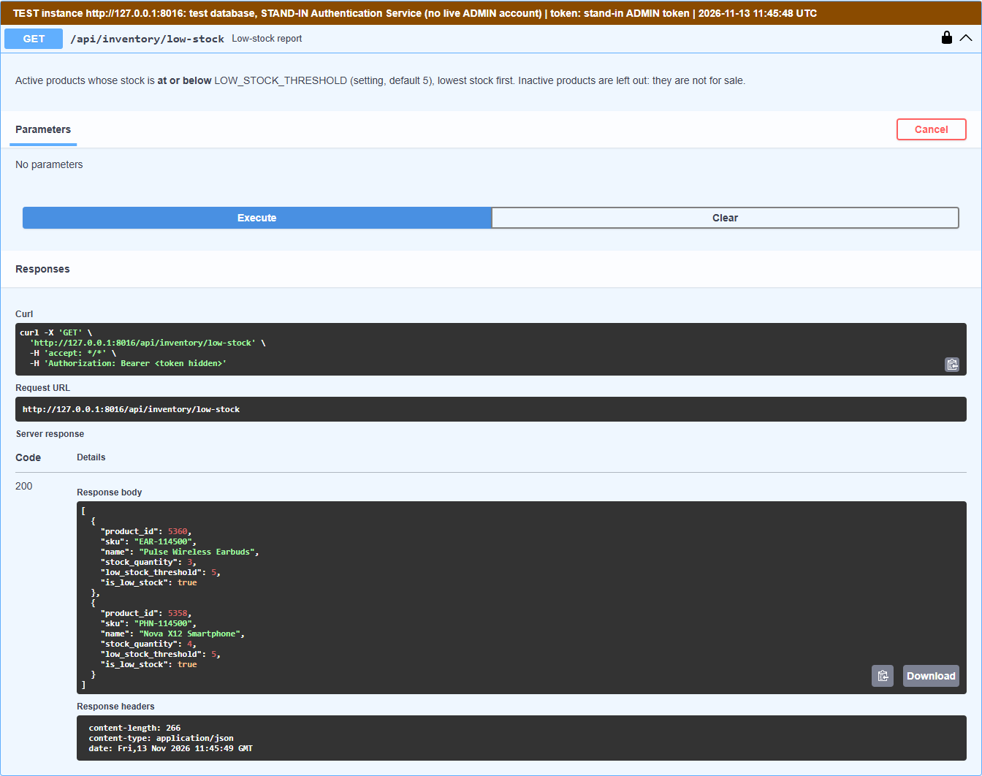
15 · Low-stock products
TEST INSTANCE · 127.0.0.1:8016
GET /api/inventory/low-stock → 200: the earbuds (3) and the smartphone (4), threshold 5.
Notes:
File: DELIVERABELS/screenshots/submission/15_low_stock_products/low_stock_200_test_instance.png (1344 x 1062 px).

Slide 24
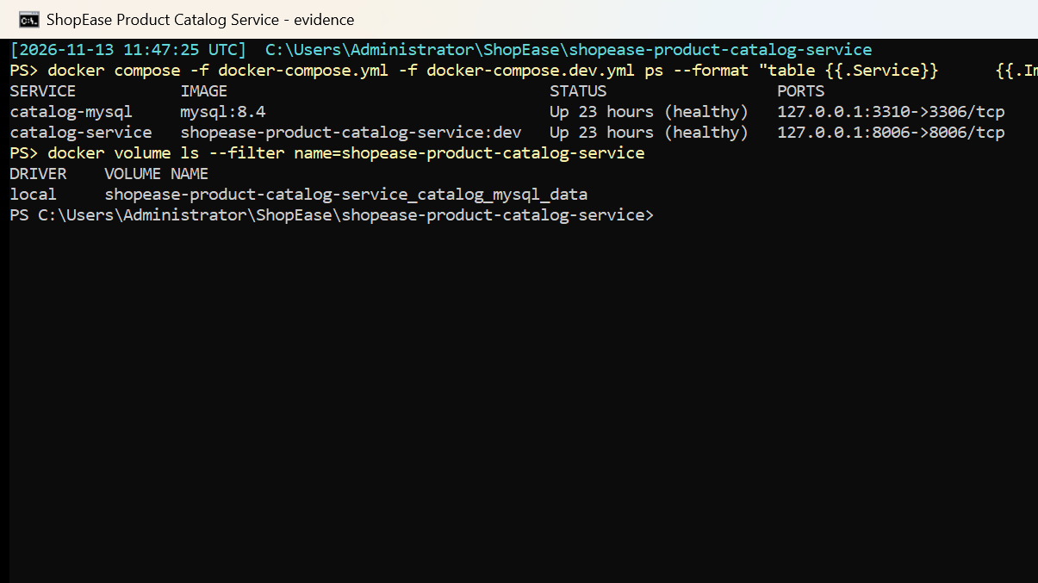
16 · Docker containers running
LIVE STACK · Docker
docker compose ps: catalog-mysql and catalog-service Up (healthy); named volume catalog_mysql_data.
Notes:
File: DELIVERABELS/screenshots/submission/16_docker_containers_running/docker_compose_ps.png (1205 x 677 px).

Slide 25
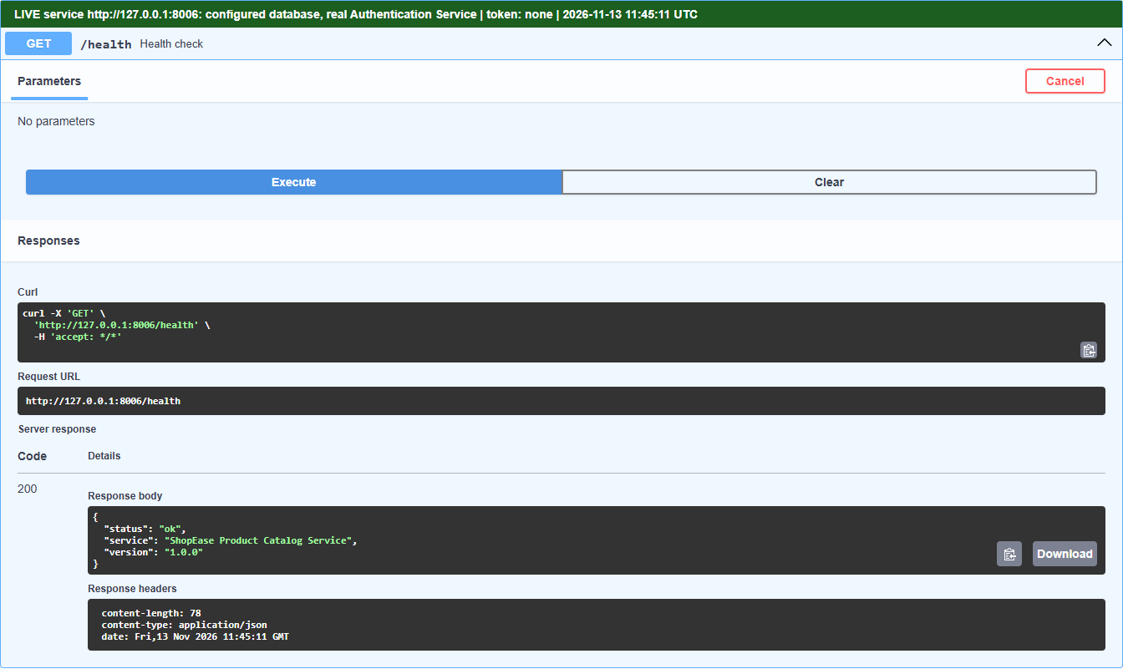
17 · Health check
LIVE · 127.0.0.1:8006
GET /health → 200 {"status": "ok"}.
Notes:
File: DELIVERABELS/screenshots/submission/17_health_check/health_200.png (1344 x 801 px).

Slide 26
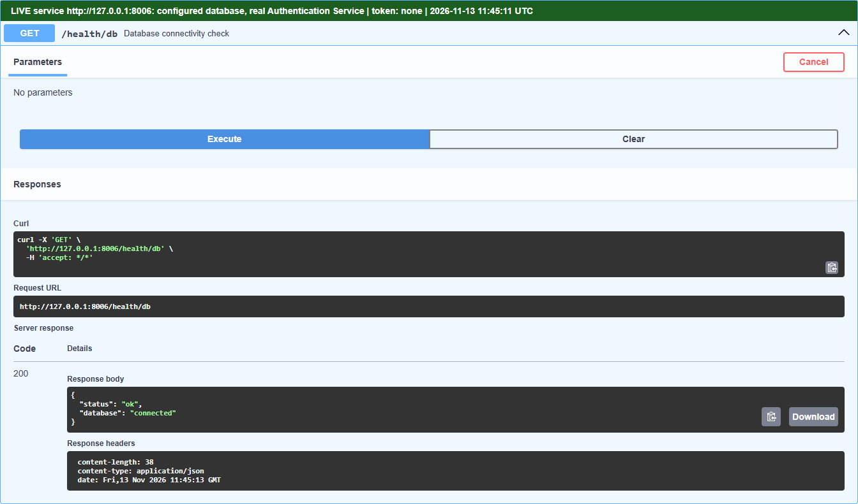
17 · Health check: database
LIVE · 127.0.0.1:8006
GET /health/db → 200, database connected.
Notes:
File: DELIVERABELS/screenshots/submission/17_health_check/health_db_200.png (1344 x 791 px).

Slide 27
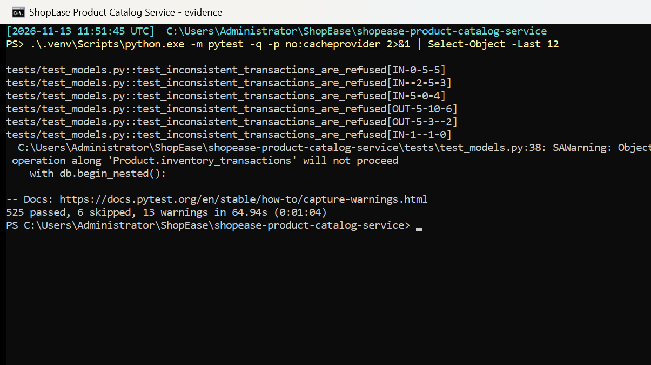
18 · Passing automated tests
THIS MACHINE · pytest
pytest on this machine: 525 passed, 6 skipped (those 6 need MySQL; on MySQL all 531 pass).
Notes:
File: DELIVERABELS/screenshots/submission/18_passing_automated_tests/pytest_passed.png (1205 x 677 px).

Slide 28
How these were captured
Real captures on this computer; nothing mocked or edited
Swagger UI
Terminal
Test instance
Real requests sent from Swagger UI in Microsoft Edge. A banner names the instance, the token and the time; every token reads <token hidden>.
Real console windows ran docker compose ps, the MySQL queries and pytest, then each window was captured.
ADMIN operations ran on the test instance until an ADMIN account exists; its rows were deleted afterwards.

