Slide 1
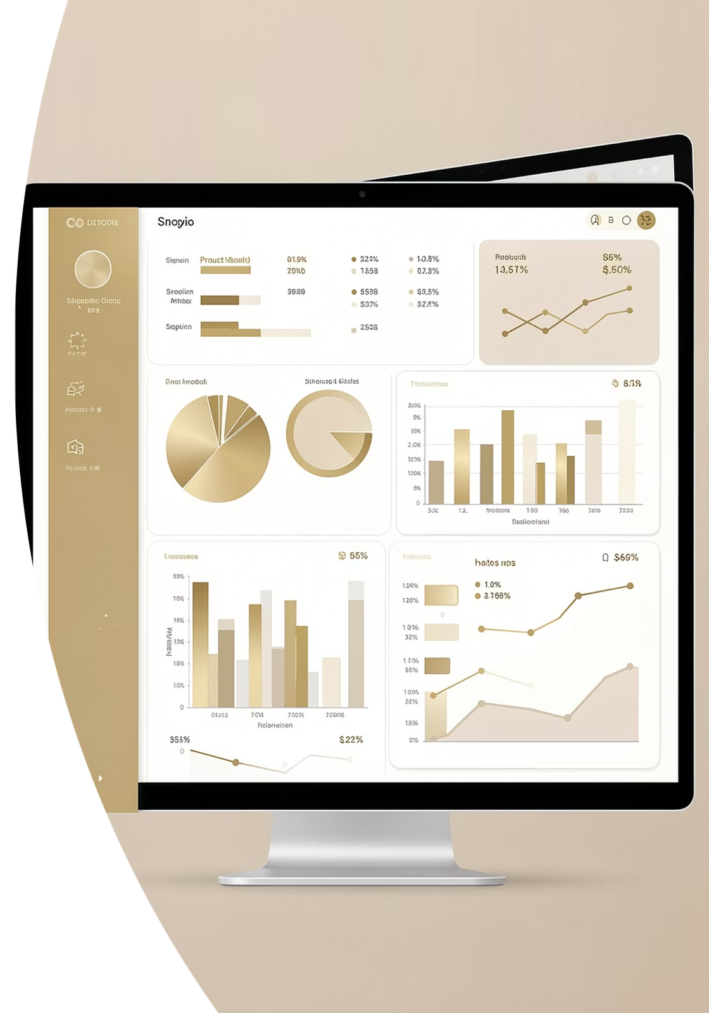
Customer Shopping Behavior Analysis
Uncovering spending patterns, customer segments, product preferences, and subscription behavior from 3,900 transactions to guide strategic business decisions.

Slide 2
Dataset at a Glance
3,900
18
37
Transactions
Features
Missing Ratings
Key Feature Groups
Demographics: Age, Gender, Location, Subscription Status
Purchase Details: Item, Category, Amount, Season, Size, Color
Behavior: Discounts, Promo Codes, Frequency, Review Rating, Shipping

Slide 3

Data Preparation in Python
01
02
Load & Explore
Clean & Engineer
Imported dataset with pandas; used df.info() and .describe() for initial profiling.
Imputed missing Review Ratings with category medians; created age_group and purchase_frequency_days columns.
03
Standardize & Load
Renamed columns to snake_case; dropped redundant promo_code_used; loaded cleaned data into PostgreSQL.

Slide 4
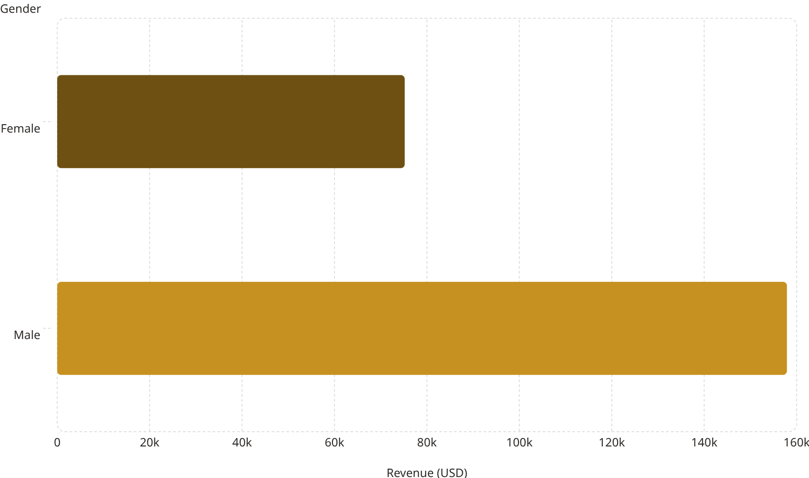
Revenue & Spending Insights
Shipping Type vs. Spend
75.2k
Shipping Type
Avg. Purchase (USD)
Standard
$58.46
Express
$60.48
158k
Express shipping users spend slightly more on average, suggesting a higher-value customer segment worth targeting.

Slide 5
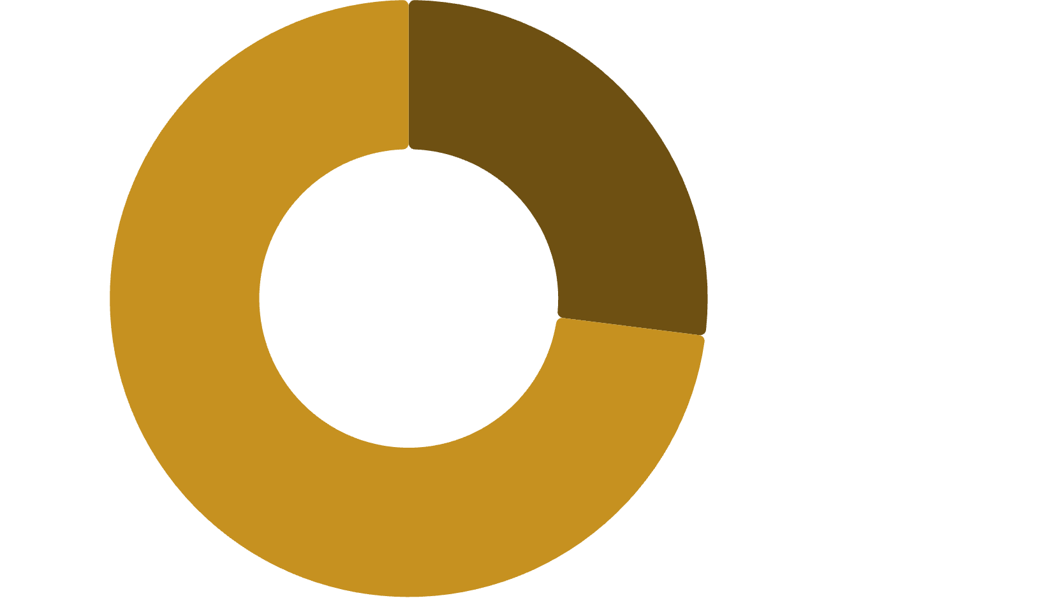
Subscriber vs. Non-Subscriber Breakdown
Revenue Comparison
Status
Avg Spend
Total Revenue
Subscribers
$59.49
$62,645
Subscribers·27%
·27%
·
Non-Subscribers·73%
·73%
·
Non-Subscribers
$59.87
$170,436
Non-subscribers represent 73% of customers — a major opportunity to convert through targeted subscription campaigns.

Slide 6
Top-Rated Products & Discount Dependency
Top 5 Products by Avg. Rating
Most Discount-Dependent Products
Product
Avg. Rating
Product
Discount Rate
Gloves
3.86
Hat
50.00%
Sandals
3.84
Sneakers
49.66%
Boots
3.82
Coat
49.07%
Hat
3.80
Sweater
48.17%
Skirt
3.78
Pants
47.37%

Slide 7

Customer Segmentation & Loyalty
2.13%
Repeat Buyers & Subscriptions
17.97%
Among customers with more than 5 purchases:
Subscription
Repeat Buyers
Loyal·79.9%
·79.9%
·
Returning·17.97%
·17.97%
·
New·2.13%
No
2,518
·2.13%
·
Yes
958
79.9%
The vast majority of loyal customers are not subscribed — a key conversion opportunity.

Slide 8
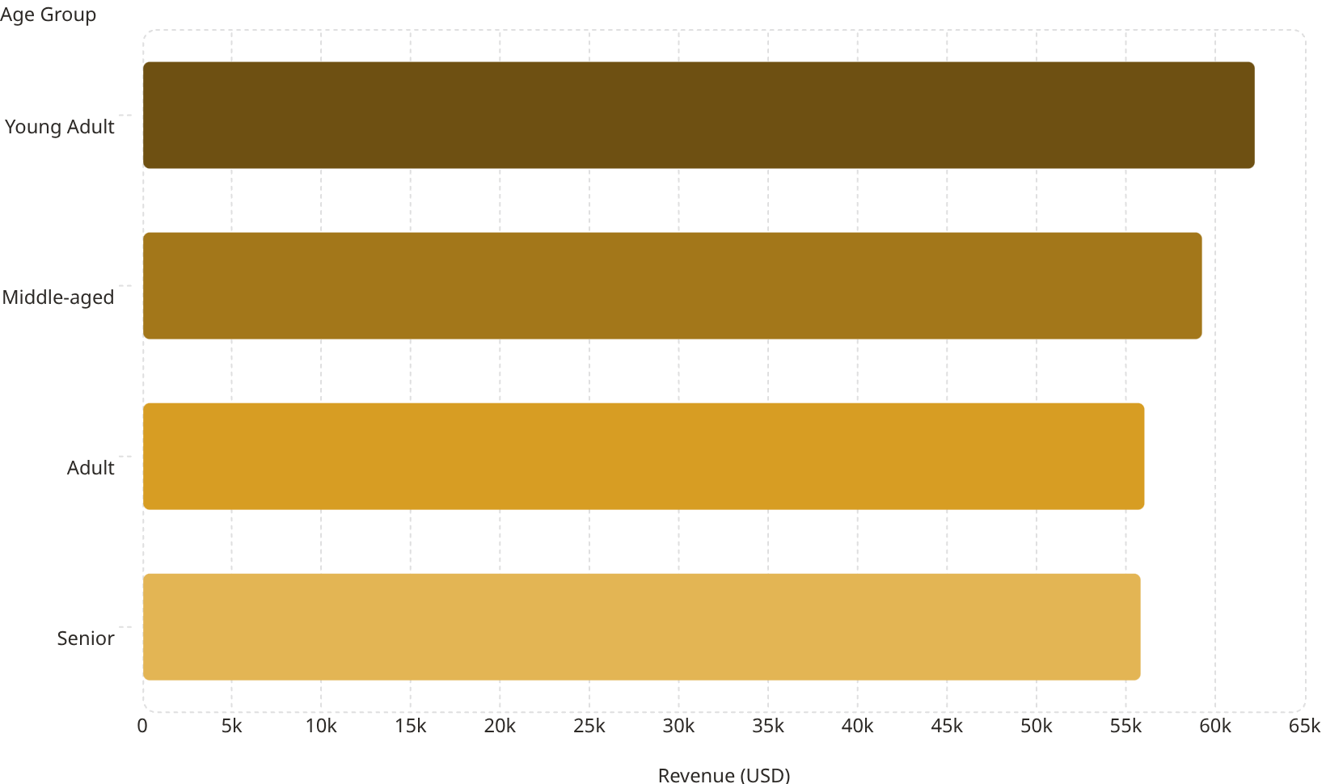
Revenue by Age Group & Top Products by Category
Top Products per Category
62.1k
Category
#1 Product
Orders
59.2k
Accessories
Jewelry
171
56k
Clothing
Blouse / Pants
171
Footwear
Sandals
160
55.8k
Outerwear
Jacket
163

Slide 9
Power BI Dashboard
3.9K
$59.76
3.75
Customers
Avg. Purchase
Avg. Rating
Interactive filters by Subscription Status, Gender, Category, and Shipping Type. Visualizations include revenue by category, sales by age group, and subscription distribution.

Slide 10





Business Recommendations
Boost Subscriptions
Loyalty Programs
Promote exclusive benefits to convert the 73% non-subscriber base.
Reward repeat buyers to accelerate movement into the Loyal segment.
Review Discount Policy
Targeted Marketing
Balance sales boosts with margin control on high-discount products.
Focus on Young Adults and express-shipping users — highest revenue contributors.

