Slide 1


BRAND GROWTH STRATEGY PROJECT
Instagram Marketing & Growth Case Study
BRAND FOCUS:
BY - ANUSHRI SINGH

Slide 2
What's Inside
Brand Overview
Project Objective
1
2
Instagram Audit
Competitor Analysis
3
4
Problems Identified
Marketing Strategy
5
6
Content Calendar
Expected Results
7
8
KPI Dashboard
9

Slide 3
01
Brand Overview
Choosing the right brand for the case study
Selection Criteria
Has an active Instagram account
Has visible competitors in the market
Has enough existing content to analyze
Brand Selected:
Nykaa is one of India's leading beauty, wellness, and personal care e-commerce platforms. It was chosen for this project because its Instagram presence is highly active, marketing-heavy, and offers rich material for audit and analysis — making it an ideal case study for a growth strategy.
Other Brands Considered
Mamaearth
boAt
Zomato

Slide 4

02
Project Objective
Defining a clear, measurable business goal
Every successful social media strategy begins with a clear, measurable business goal.
“How can Nykaa increase Instagram engagement and follower growth by 20% over the next 3 months?”

Slide 5

03
Instagram Audit
Spending 1-2 hours analyzing the current account
Content Categories
Basic Metrics Tracked
Content Type | Frequency
Product Posts | High
Reels | Medium
Influencer Content | Medium
Educational Content | Low
Offers / Discounts | High
Follow
Impressions
Average Likes
Profile Visit
Save
Shares

Slide 6

04
Competitor Analysis
Benchmarking Nykaa against 2-3 close competitors
Competitors selected: Mamaearth, Sugar Cosmetics, Minimalist
Brand | Followers | Engagement
Nykaa | ~3.1M | ~0.05% (avg. 1.6K likes, 16 comments/post)
Mamaearth | ~1.1M | ~0.1% (avg. 1,075 likes, 26 comments/post)
Sugar Cosmetics | ~2.3M | ~0.03–0.10% (avg. 865–6K likes, 5–67 comments/post)
Minimalist | ~531K | Not enough public data to estimate reliably
.
Key Observations:
What competitors do better
What content performs well across the category

Slide 7

05
Problems Identified
Key insights from the audit and competitor comparison
“Nykaa posts many promotional posts but fewer educational reels.”
“Competitors receive higher engagement from influencer collaborations.”

Slide 8
06
Marketing Strategy
The most important part — four core content pillars
B
P
R
U
Pillar 1
Pillar 2
Pillar 3
Pillar 4
Beauty Tips
Product Education
Influencer Reviews
User Generated Content
Each pillar directly responds to a gap found in the audit — increasing Beauty Tips and Product Education content addresses the lack of educational reels, while expanding Influencer Reviews matches what drives engagement for competitors.

Slide 9

07
Content Calendar
A 30-day plan to put the strategy into action
Sample of the first week, designed in Canva using the brand's palette:
Day 1
Day 2
Day 3
Day 4
Day 5
Day 6
Day 7
Skincare Reel
Product Review
Influencer Post
Giveaway
Beauty Tip Carousel
UGC Repost
Behind the Scenes Story
Pillar: Beauty Tips
Pillar: Product Education
Pillar: Influencer Reviews
Pillar: User Generated Content
Pillar: Beauty Tips
Pillar: User Generated Content
Pillar: Product Education
.

Slide 10






09
KPI Dashboard
Tracking performance in Power BI / Excel
Reach
Impressions
Engagement Rate
Follower Growth
Saves
Shares
Tracking these six metrics consistently allows the strategy's effectiveness to be measured against the original objective: a 20% increase in engagement and follower growth within three months.

Slide 11
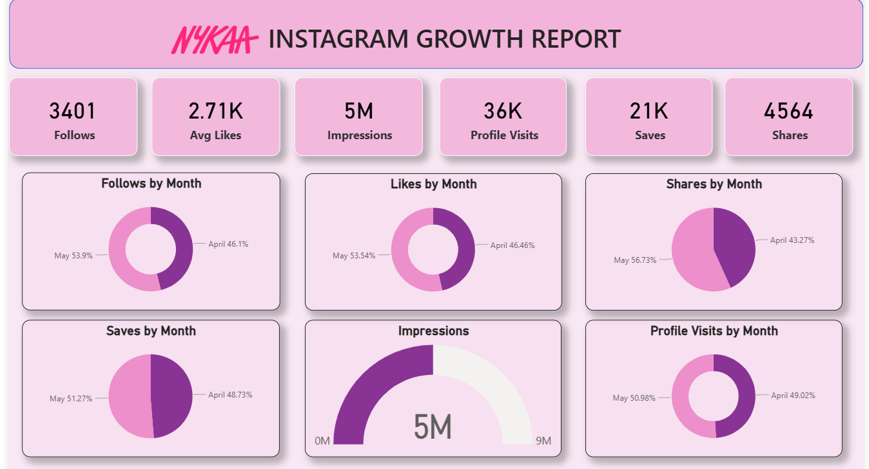
NYKAA DASHBOARD- GITHUB

Slide 12

10
Expected Results
Projected outcomes over the 3-month period
Increased Reach and Impressions through consistent Reels and educational content
Higher Engagement Rate driven by influencer collaborations and UGC
Steady Follower Growth aligned with the 20% target
Improved Saves and Shares from value-driven Beauty Tips content
+20%
Target Growth in Engagement
& Follower Count over 3 Months

Slide 13
Final Portfolio Structure
Brand Overview
Instagram Audit
Competitor Analysis
1
2
3
Problems Identified
Growth Strategy
Content Calendar
4
5
6
Sample Creatives
KPI Dashboard
Expected Results
7
8
9

