Slide 1



A Practice Approach to Proof of Data Possession with Merkle Hash Trees By Anukriti Shrimal Prof. Pascal Felber, Supervisor Dr. Valerio Schavioni, Supervisor
Master Thesis Seminar

Slide 2
Contents
Proof Of Data Possession : What and Why?
Related Work
Background
Proposed Algorithm
Implementation details
Performance Evaluation
Conclusion

Slide 3
Public cloud platforms as storage solutions
High availability
Convenience
Low maintenance
Ease of use and synchronization
Replication
Low cost
No transparency
Lack of security mechanisms by cloud providers

Slide 4
Concerns over cloud platforms’ security
1 in 4 organizations who use IaaS or SaaS have had data stolen
1 in 5 have experienced an advanced attack against their public cloud infrastructure
Permanent data losses in reported incidents by many providers like Google, Dropbox, U.S. Healthcare
In many cases, outsourcing data means losing control over it
Cloud platforms do not have mechanisms to ensure their customers about data possession

Slide 5
Proof of Data Possession
Current possibility:
Retrieve the file, compare it with local copy of data (if exists)
Definition
The ability of a storage system to generate proofs of possession of the client’s
data, without having to retrieve the whole file.

Slide 6
Cloud infrastructure for storage solutions
Entities involved :
The client application
The remote server
Cluster node(s) (as selected by the server)
Data loss :
Unintentional: Software/hardware failure
Intentional: To optimize their own storage

Slide 7
Related Work
Jules and Kalinski’s Proof of Retrievability using error-correcting sentinels.
D´ecio Luiz Gazzoni Filho and Paulo S´ergio Licciardi Messeder Barreto using RSA hashing algorithm with central server.
Shuai Han, Shengli Liu, Kefei Chen and Dawu Gu provided algorithm using Maximum Rank Distance. The client file is encoded block-wise to generate homomorphic tags with the help of an MRD code.
Muhammad Saqib Niaz and Gunter Saake took further the concept of homomorphic tags using Merkle hash trees.

Slide 8
Possible Solutions
• Retain local copy of data
• Retain block hashes of the file
• Generate Merkle hash tree from block hashes and retain just the root node hash value
• Outsource computation of Merkle hash tree and metadata storage to a central server

Slide 9
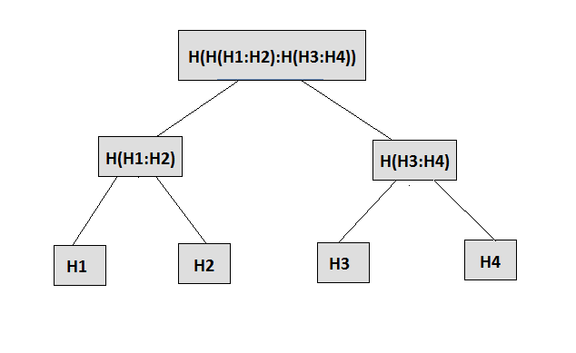
Merkle hash tree

Slide 10
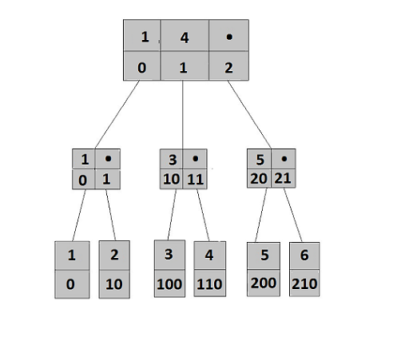

Radix Path Identifier
• A node’s parent RPI rpiparent can be calculated as rpi/rb
• A node pointer’s index can also be calculated using formula rpi mod rb

Slide 11
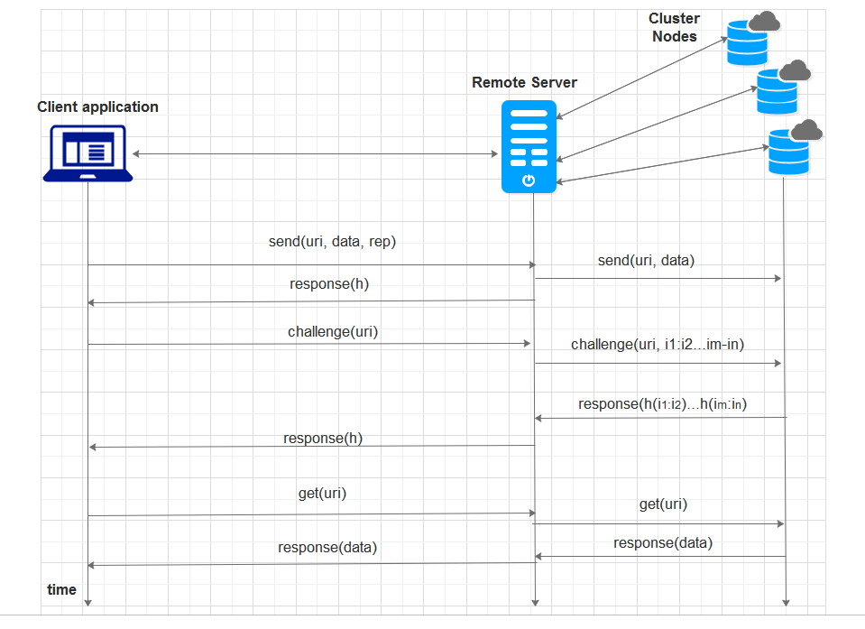
Proposed Algorithm: Architecture

Slide 12
Algorithm for Merkle hash tree generation
On receiving the file, server breaks a file into blocks of equal sizes, applies hash function on each block content and inserts the generated block hashes one by one into an empty B+ tree
Once all block hashes are inserted at leaves into the tree, it needs to traverse it twice
First, bottom to up combining the hashes until reaching the root
Secondly, the server traverses it breadth-first starting from the root node, assigning RPI for each value within the node
The server then stores the generated Merkle hash tree along with the RPI values into its local database as JSON. It also stores the filesize and blocksize of the file
It then forwards the file to cluster nodes and returns the root hash to the user

Slide 13
Algorithm to handle Challenge requests
On receiving a challenge for the file, the server selects some blocks randomly which are then queried from one of the cluster nodes
The cluster node evaluates the hash values and returns them to the server
The server now needs to rebuild the Merkle root hash value using the values returned from the cluster node
The algorithm makes use of RPI to recreate the root hash to use values from the cluster node, when present or from its database, otherwise. This is done using a bottom-up depth-first approach. Whenever an internal node has a block which was requested from the cluster, it needs to re-evaluate the node hash value

Slide 14
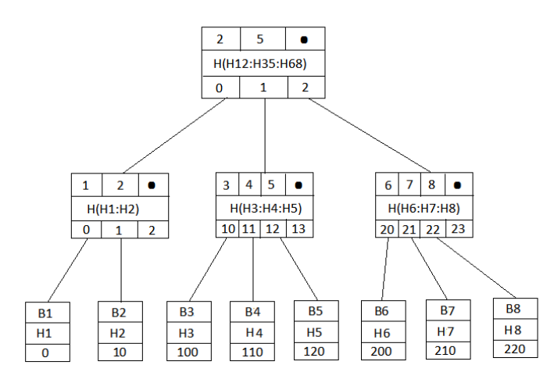
Regeneration of root hash for challenge response

Slide 15
Use cases
• Consider a case where a malicious cluster node deletes the file. Upon receiving a challenge request, it cannot guess the hash values of requested file indexes
• Consider a case where a malicious cluster node deletes parts of the file. Since the server can request a hash-value of any random block in the future, there is a good chance of the node getting caught in one of the future challenges
• In case there are multiple replicas and all cluster nodes collude, at least one of them will have to retain the file to fulfil future challenge requests
• All block hashes have been requested from given replica. In that case, the cluster node can remember the hashes mapped by data indexes and delete the file. This attack is unlikely as the server divides the file in relatively large number of blocks
• A second case where this algorithm might fail is when the central server colludes and never forwards a challenge to the cluster node. In order to avoid this, a third-party trusted server can be used. Another alternative is to use SGX

Slide 16
End to end performance evaluation (Send file)
S. No. | File size (KB) | 1 Cluster Node |  | 2 Cluster Nodes |  | 3 Cluster Nodes
 |  | Non-Secured | Secured | Non-secured | Secured | Non-secured | Secured
1 | 64 | 2.0358 | 2.0413 | 2.03665 | 2.04735 | 2.0383 | 2.05
2 | 128 | 2.041 | 2.04455 | 2.04145 | 2.0455 | 2.0437 | 2.0502
3 | 256 | 2.04985 | 2.059 | 2.04995 | 2.06065 | 2.0507 | 2.06565
4 | 512 | 2.0681 | 2.07195 | 2.073 | 2.073 | 2.07045 | 2.0766
5 | 1024 | 2.0997 | 2.1062 | 2.10175 | 2.1093 | 2.10955 | 2.11625
Table : Send file time statistics (in seconds) for secured and non-secured mode

Slide 17
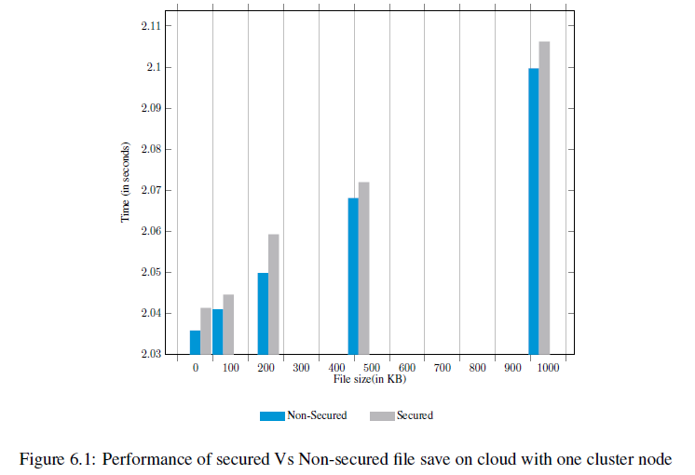
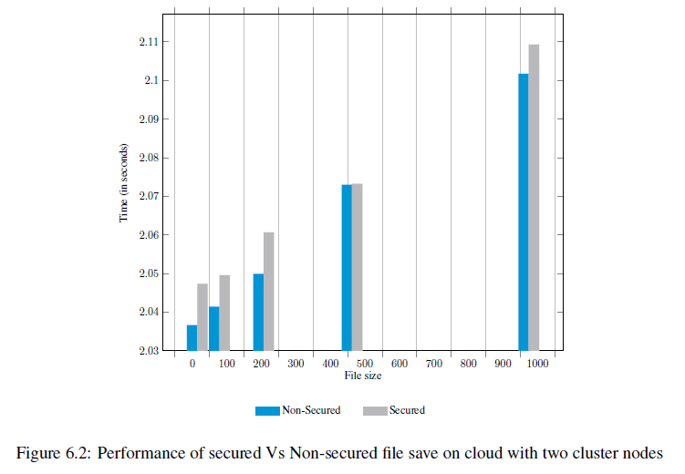
End to end algorithm overhead (Send file)

Slide 18
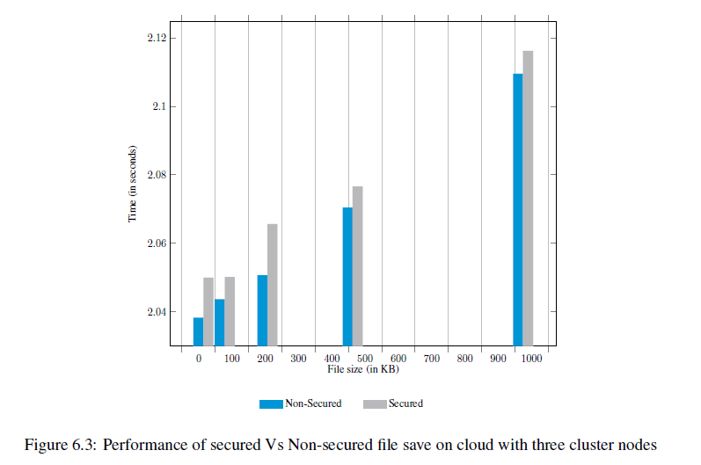
End to end algorithm overhead (Send file) Contd.

Slide 19
End to end algorithm overhead (Challenge)
S. No. | File size (KB) | 1 Cluster Node | 2 Cluster Nodes | 3 Cluster Nodes
1 | 64 | 0.0272 | 0.0276 | 0.0275
2 | 128 | 0.02735 | 0.02735 | 0.02765
3 | 256 | 0.0272 | 0.02765 | 0.02755
4 | 512 | 0.0269 | 0.02705 | 0.02765
5 | 1024 | 0.0273 | 0.02755 | 0.0274
Challenge file time statistics (in seconds)

Slide 20
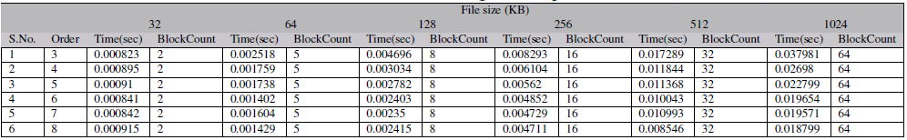
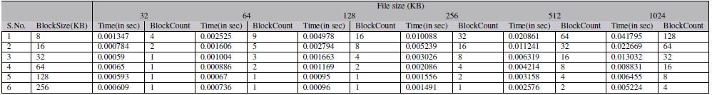
Algorithm performance tuning

Slide 21
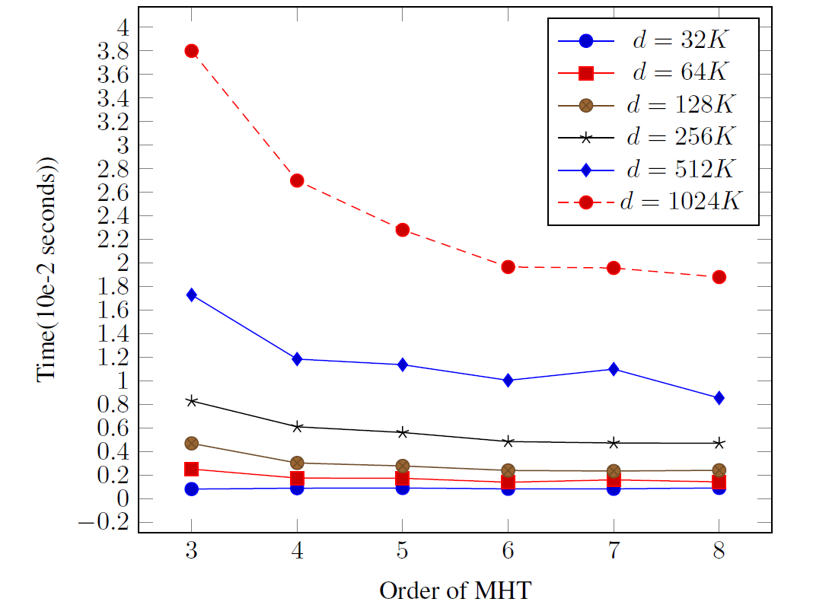
Algorithm performance tuning

Slide 22
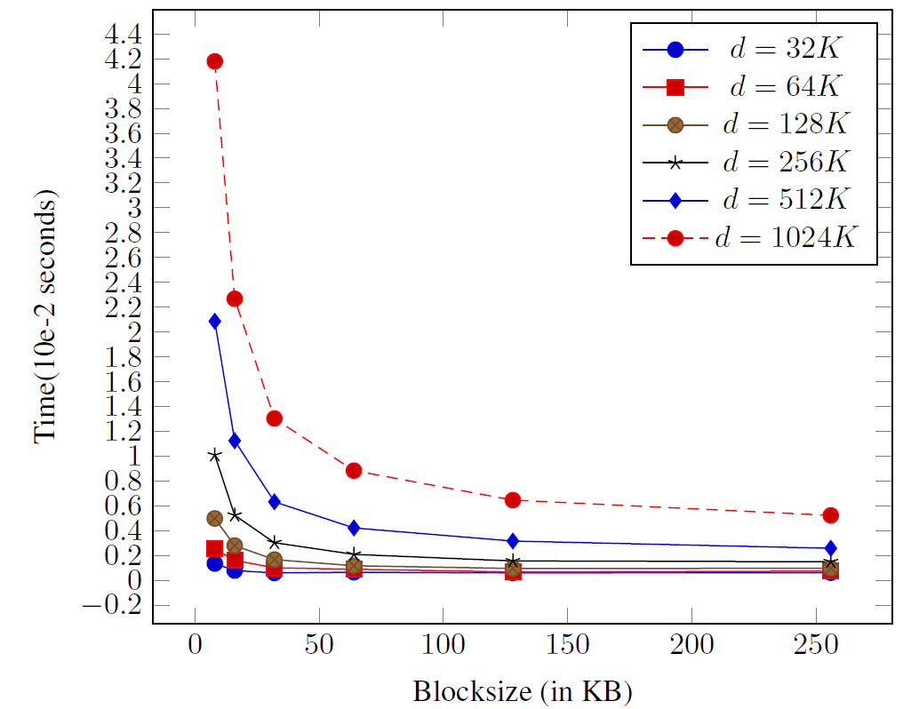
Algorithm performance tuning

Slide 23
Conclusion
The current implementation for PoDP is efficient with minimal performance overhead
It covers most of the use-cases as previously explained.
Future:
Trusted Remote Server with Software Guard Extensions (SGX)

Slide 24
THANK YOU!
Questions?

