Slide 1
Performance Evaluation of Queue Scheduling Algorithms (RR, WRR, DRR, Delay-EDD)
Mid-term presentation
Anukriti Shrimal
Ahana Mallik
October 17, 2016

Slide 2
Contents
Objective
Experiment testbed
Scenarios
Metrics
Conclusion

Slide 3
Objective
Performance evaluation of different queue scheduling algorithms using OMNet++ v4.6 and inet v3.2.0:
Round Robin
Weighted Round Robin
Deficit Round Robin
Weighted Fair Queuing
Delay EDD (Earliest Due Date) (Maybe)

Slide 4
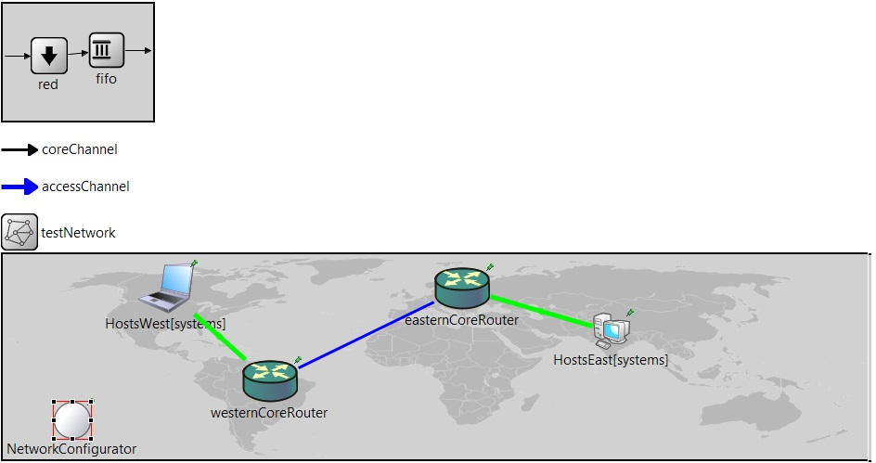
Experiment design (Proposed)

Slide 5
Scenarios
Different traffic profiles would be used to emulate network traffic.
VOIP traffic.
Video Streaming
Internet browsing
Other parameters to be varied to test performance:
Queue Size: Min to Max to be defined in router queues.
Packet Sizes: Min to max to be defined in traffic generators.

Slide 6
Metrics
The performance of the schedulers could be measured using following parameters:
Queueing delay: Elapsed time between enqueue and dequeue of packet in router.
End-to-end delay: Elapsed time between transmission of first packet and reception of last packet
End-to-end Delay jitter: Variation/jitter observed between end-to-end delays.
Packet drop rate: Effect on drop rate of each scheduling algorithm.

Slide 7
Metrics
Another factor influencing the performance is the drop policy.
By default, drop-tail policy is to be used.
If time permits, impact of RED(Random Early Detection) policies on the queue performance would be tested.

Slide 8
What’s Next
Refine testbed.
Implement the aforementioned schedulers.
Define and take measurement of the specified metrics.
Analyse and interpret simulation results.
If possible, use ‘Throughput meter’.
Maybe
Implement an EDD scheduler
Test impact of RED on the network performance.

