Slide 1

BANK MANAGEMENT SYSTEM
M.ANUSHYA
III CSBS
95072218005

Slide 2
Table of contents
01
04
02
05
03
06
Abstract
Features
Flow diagram
Introduction
Proposed work
Conclusion

Slide 3
Abstract
Bank Management System Project in Python is a straightforward GUI-based program that is simple to grasp and utilize. The GUI is created with the Tkinter package. When it comes to the application, users may easily register an account and log in to manage their bank accounts.

Slide 4
Introduction
In this project, the Bank management System Python Project using Tkinter, the user can create an account by entering information such as his or her username, opening balance, and pin number. The user must then submit those data in order to gain access to their account. The user can see transaction information, balance inquiries, credit and debit amounts, and more. The user can credit or debit sums by merely specifying a specific amount.

Slide 5
Features
Account Creation
Login
Dashboard Menu
Credit Amount
Debit Amount
Check Balance
Transaction History

Slide 6
Proposed Work
Data Validation and Error Handling
Security Enhancements
User Interface Improvements
Modular Code Structure
Database Integration
Transaction Notifications
Logging and Monitoring

Slide 7
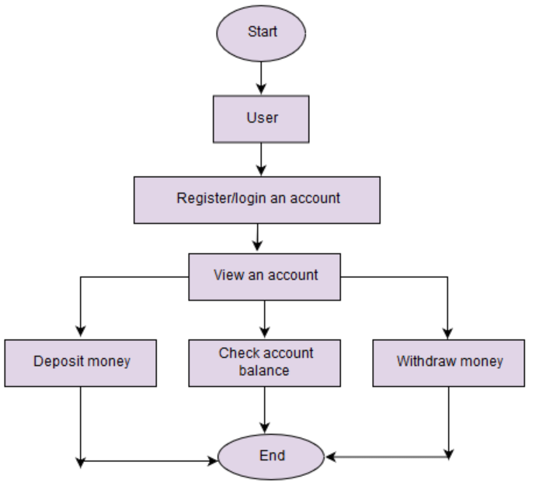
Flow Diagram

Slide 8
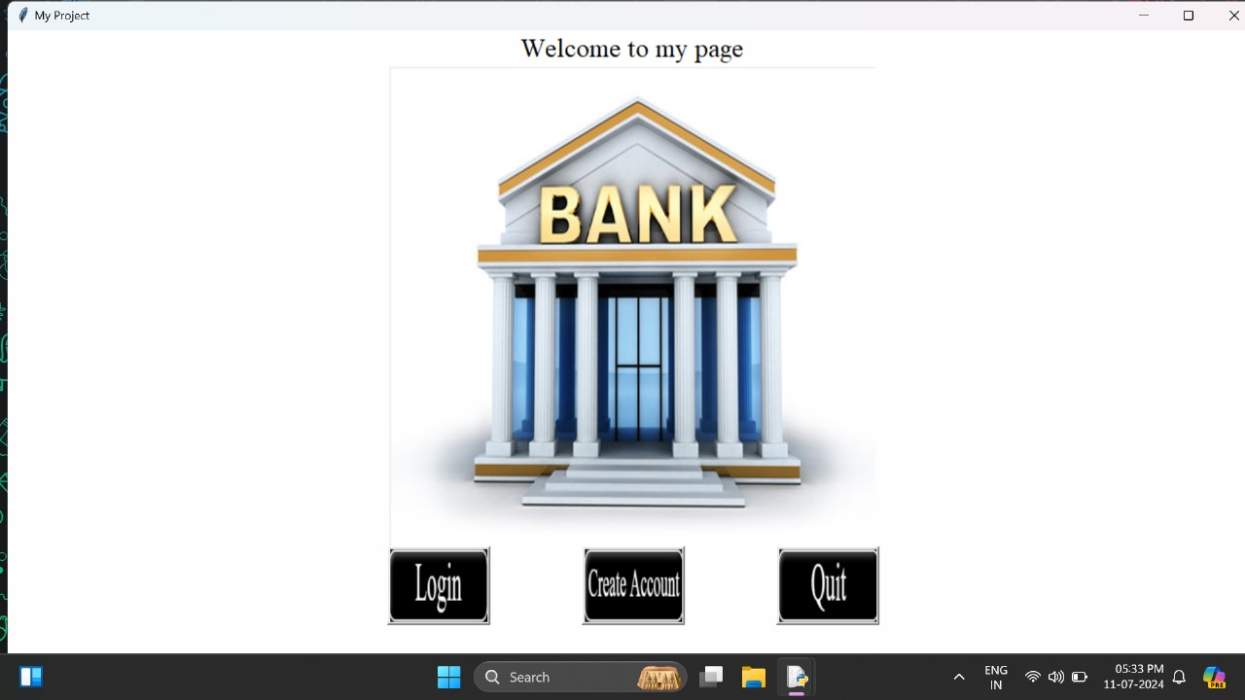
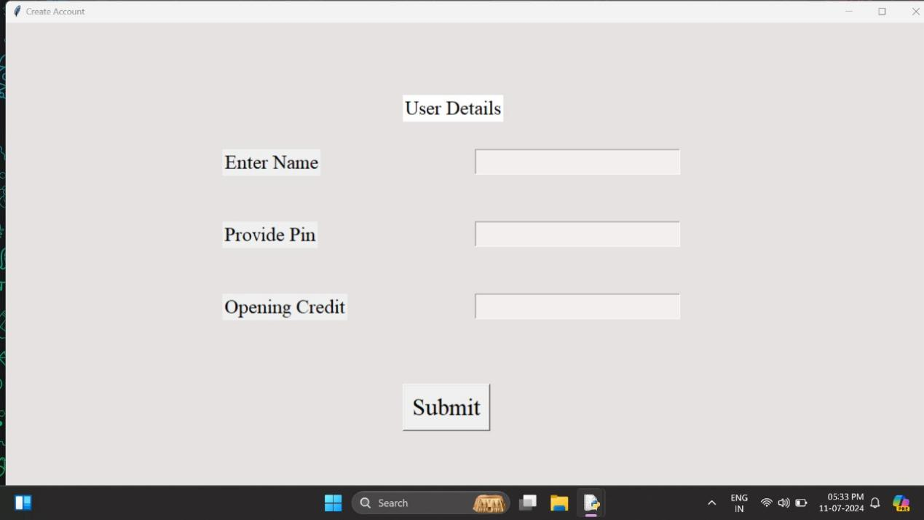
Results

Slide 9
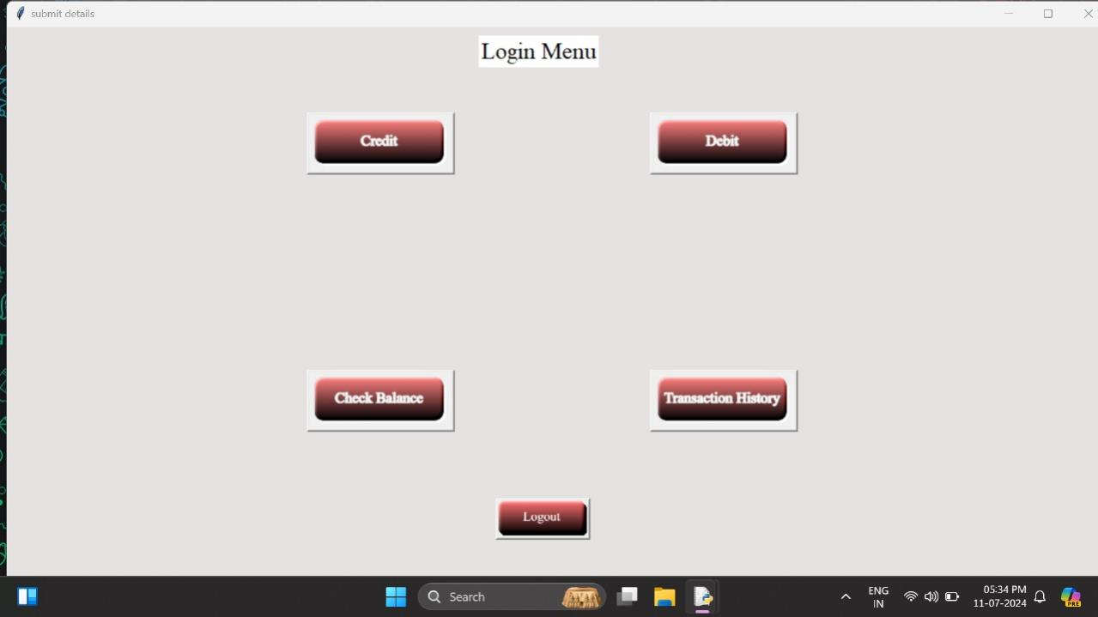
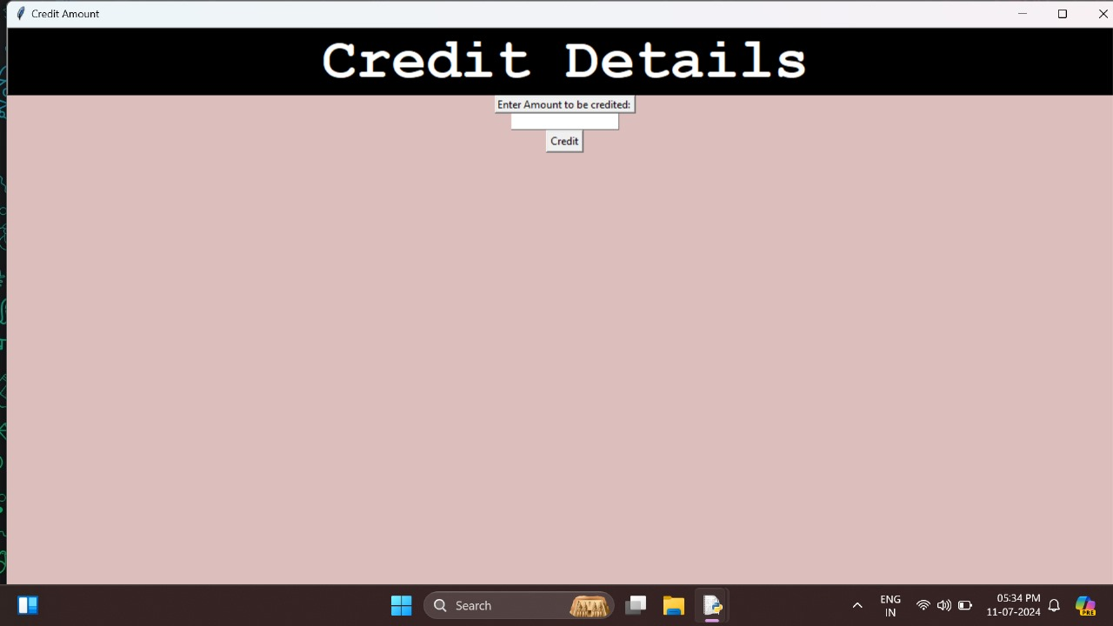
Results

Slide 10
Conclusion
The project demonstrates the development of a simple Banking System using Python and Tkinter, providing essential banking functionalities such as user authentication, account management, and transaction history tracking. This system can serve as a foundation for more advanced banking applications, aiding in the understanding of core concepts in application development, file handling, and user interface design in Python.

