Slide 1
Transformers algorithm-based UNIVERSITY QUERY BOT
MENTOR
Mr.C.Rajesh Kumar Assistant Professor IT
Domain: Artificial Intelligence and Machine Learning
TEAM MEMBERS
20TUIT008-ANUSRI K
20TUIT030-JANANI B S
20TUIT041-KAVIYA S

Slide 2
UNIVERSITY QUERY BOT
PROBLEM DEFINITION
The students details will be shared in a WhatsApp group for all parents to view, but they may not always receive sufficient information. Sometimes, in-person visits are required. A university query bot has been developed to maintain privacy and provide access to student information at any time. The project aims to create and implement an AI-based chatbot for the WhatsApp platform, utilizing Artificial Intelligence and Machine Learning algorithms. We plan to implement an AI-based virtual assistant to address college-related queries. This College-Oriented Intelligence machine will respond to students' queries, enhancing the efficiency and effectiveness of existing online AI systems and chat bots.

Slide 3
OBJECTIVE
The project aims to create and implement an AI-based chatbot for the WhatsApp platform, utilizing Artificial Intelligence and Machine Learning algorithms. We plan to implement an AI-based virtual assistant to address college-related queries. This College-Oriented Intelligence machine will respond to students' queries, enhancing the efficiency and effectiveness of existing online AI systems and chat bots. The chatbot is integrated using the WhatsApp Business API and is designed to provide teachers, students, and parents with comprehensive information about academic details, attendance, and overall performance. This chatbot is particularly beneficial for universities, as it addresses parents' questions using the AI in the bot, trained using the Pre Trained Transformer Based Deep Learning Algorithm.

Slide 4
LITERATURE SURVEY
1.”College Enquiry Chat-Bot System”;”Harshala Gawade”;”2020”. The chat-bot system is designed and suggested in paper utilizing the Chat Fuel platform and integrated into a Facebook page. The chatbot's purpose is to make students feel as though they are conversing with college staff, answering their questions with conversational text. The AI feature that is set up makes the bot intelligent and responds to user inquiries. This project's development is centered around an intelligent chatbot system that will handle academic tasks such as inquiries about admission, the cost structure, information about scholarships, departmental schedules, and the specific documents that must be attached, among other things. It will be possible to use this chat-bot system to clear the queries in lesser time.

Slide 5
LITERATURE SURVEY
2. Chatbots applications in education : “A systematic review”;”Chinedu Wilfred Okonkwo”;2021. The Chatbot system is one of the most often utilized AI tools to enhance educational activities. According to Clarizia et al. (2018), chatbots are thought to be a helpful tool for enhancing learning in a classroom setting . Using a variety of technology tools, including chatbot systems, instructors can manage instruction in this Fourth Industrial Revolution (4IR) period through an online platform or a classroom platform. This study examines an online learning environment where students can use chatbots to learn. One of the most significant ways to improve and encourage a more individualized learning experience is through the employment of chatbot technology in the classroom.

Slide 6
EXISTING SYSTEM
IBM WATSON CHATBOT
The Watson Chatbot can also be tailored to meet particular college requirements, which helps to ensure that everyone involved has a smooth and cutting-edge learning experience .It can help students choose courses, give advice on academic planning, and even help faculty with administrative duties. It can also provide information about campus resources.
Because of its seamless integration with current college systems, the chatbot can access and retrieve real-time data, guaranteeing that the information it provides is correct and current. The adaptability and scalability of the IBM Watson Chatbot are important features.
Colleges can modify the chatbot to represent the distinct character and needs of their school, giving users a personalized experience. Because of its versatility, the chatbot can be accessed via a variety of platforms, including websites and mobile apps, so it can interact with teachers and students wherever they feel most at ease.By utilizing the potent powers of IBM Watson, the chatbot offers instructors and students an easy-to-use interface through which they can obtain information, get help, and have interactive discussions.

Slide 7
EXISTING SYSTEM
IBM WATSON CHATBOT
The Watson Chatbot can also be tailored to meet particular college requirements, which helps to ensure that everyone involved has a smooth and cutting-edge learning experience .It can help students choose courses, give advice on academic planning, and even help faculty with administrative duties. It can also provide information about campus resources.
Because of its seamless integration with current college systems, the chatbot can access and retrieve real-time data, guaranteeing that the information it provides is correct and current. The adaptability and scalability of the IBM Watson Chatbot are important features.
Colleges can modify the chatbot to represent the distinct character and needs of their school, giving users a personalized experience. Because of its versatility, the chatbot can be accessed via a variety of platforms, including websites and mobile apps, so it can interact with teachers and students wherever they feel most at ease.By utilizing the potent powers of IBM Watson, the chatbot offers instructors and students an easy-to-use interface through which they can obtain information, get help, and have interactive discussions.

Slide 8
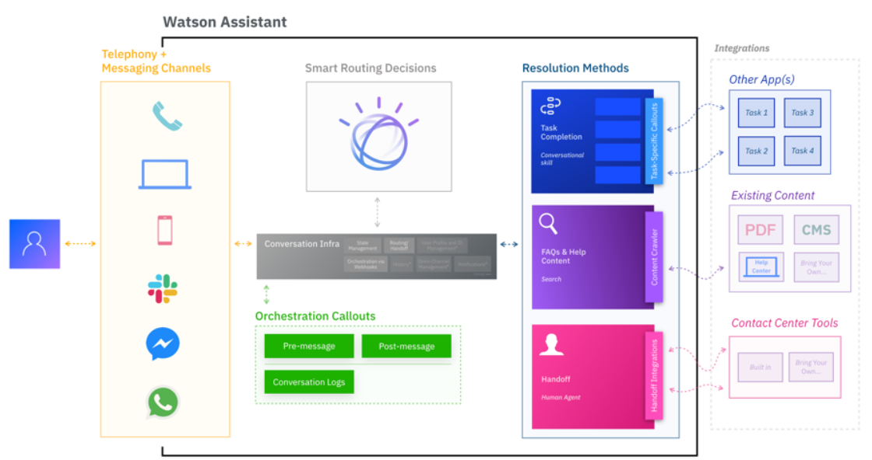

Slide 9
PROPOSED SYSTEM
The proposed system is to create and implement an AI-based chatbot for the WhatsApp platform, utilizing Artificial Intelligence and Machine Learning algorithms. We plan to implement an AI-based virtual assistant to address college-related queries.
This College-Oriented Intelligence machine will respond to students' queries, enhancing the efficiency and effectiveness of existing online AI systems and chat bots.
The chatbot is integrated using the WhatsApp Business API and is designed to provide teachers, students, and parents with comprehensive information about academic details, attendance, and overall performance.
This chatbot is particularly beneficial for universities, as it addresses parents' questions using the AI in the bot, trained using the Pre Trained Transformer Based Deep Learning Algorithm and Natural Language Processing(NLP).

Slide 10
METHODOLOGY - INNOVATION EMPLOYED IN THE PROJECT
The project aims to establish a chatbot between users and colleges using artificial intelligence to respond to users queries. The chatbot will use natural language processing (NLP) technologies to process text input, which will undergo parsing, tokenization, and stemming.
The transformer algorithm-based model is utilized in the design and training of a chatbot to create a human-like conversation for optimal user response. The accuracy of a model is significantly influenced by the quality and quantity of the training data.
The output will be displayed on the WhatsApp API Business Platform, allowing users to ask queries. The project uses Python as the language, as it is user-friendly and has object-oriented concepts. The Artificial Neural Network (Pre Trained Transformer )algorithm will be used, along with dashboard as a database.

Slide 11
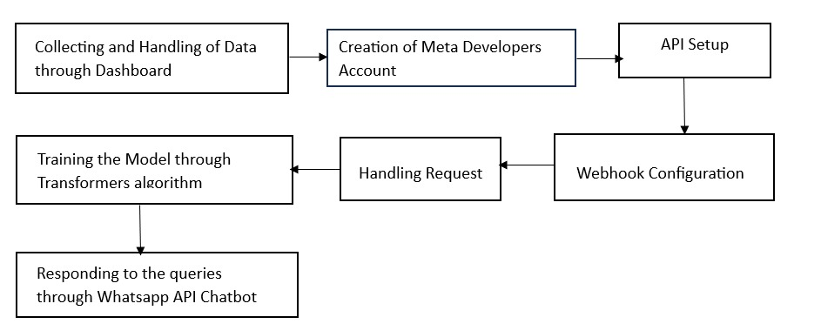

Slide 12
METHODOLOGY - INNOVATION EMPLOYED IN THE PROJECT
The Student's attendance ,academic performance and college related events, examination ,fees structure related data will be collected and maintained through dashboard.
The collected data will be used to train the model by using transformer algorithm. Socket Programming is used to handle request and response.
Facebook meta developers and WhatsApp business account is created. Recipient mobile number is added to send and receive messages.

Slide 13
EXPECTED OUTPUT OF THE PROJECT
Artificial intelligence and knowledgeable databases are rapidly growing technologies that can transform pattern matching and virtual assistance. A chat bot based on android is being developed to convert humans into machines and answer user queries.
The main goal is to reduce work load on college office staff and improve response times to user queries. This project aims to improve user experience and efficiency. In the near future, a significant addition is the introduction of a voice api, allowing users to submit queries through their voice, with the system providing both text and voice output.

