Slide 1
Data analysis and Data Insight
Data set Used | DataCo Smart Supply Chain
Source | Kaggle
Tools used | Tableau
By Anuj Srivastava

Slide 2
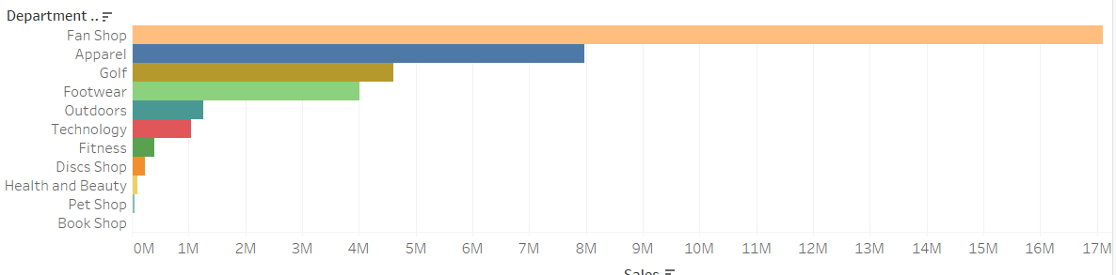
From the above graph generated we can see that the sales in Fan Shop department
Is the most.

Slide 3
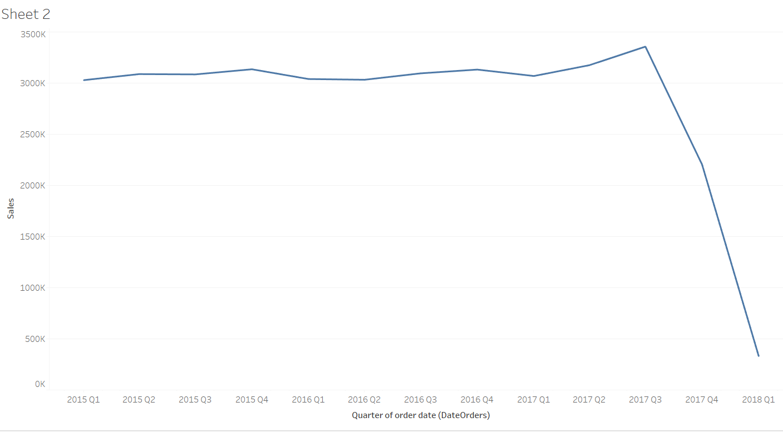
Quarterly results of sales

Slide 4
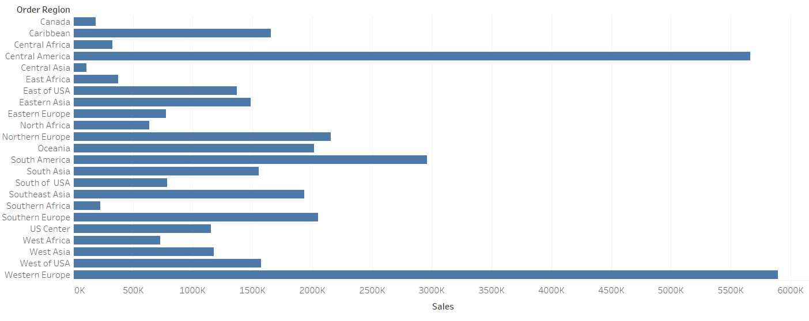
Sales according to region

Slide 5
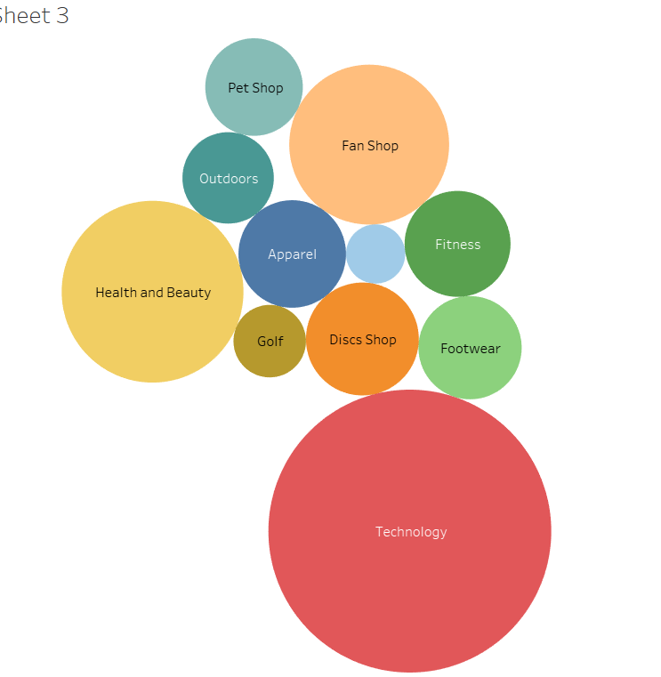
Things Falling under technology are more expensive

