Slide 1
Information Extraction from Legal Documents
By: Yamuna N R, Sowmya Prakash, Ahamad Shaik, Anustup Das
Supervisor : Sabine Wehnert
October 30th, 2018

Slide 2
Agenda
Problem Description
Information Extraction
Techniques for Information Extraction
Tasks to do
Workflow
Evaluation workflow of GATE
Team Members & Roles
Project Schedule
References

Slide 3
Problem Description
Lawyers and Enterprises face an ultimate challenge to trace large number of new legal texts or jurisdictions integrated into existing knowledge to ensure compliance. Thus, requires a context sensitive search and a grouping methodology which ensures that all relevant documents are retrieved for a specific situation[2].

Slide 4
Information Extraction
Task of automatically extracting structured information from unstructured or semi-structured machine readable documents.
Retrieval of information from various contextually relevant and semantically related legal texts based on concept hierarchy[2].
Some popular Open source tools – GATE, UIMA, tm(R), RapidMiner, NEJI. [7]

Slide 5
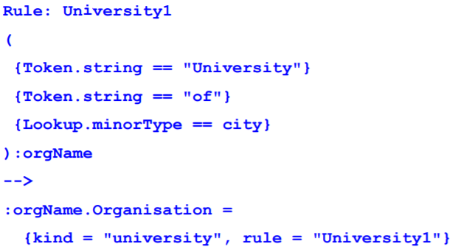
JAPE Rules (Java Annotation Patterns Engine)
JAPE Grammar consists of a set of phrases, each of which consists of a set of pattern rules[4]
Example of JAPE rule:
Continued…

Slide 6
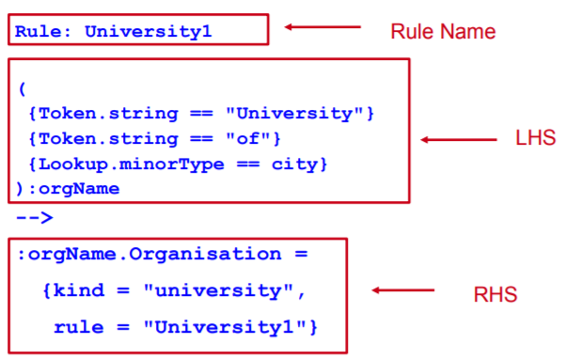
Parts of the rule
Pattern specified will be an annotation of type “Organization”, which is an entity name.
“Kind” is an attribute with value “university”.
“Rule” is another attribute with value “University1”[8]

Slide 7
Tokenizer
Task of chopping sequence of characters in a document into small chunks called Tokens[5]. Sometimes, throwing away punctuations.
Examples:
Input: Friends, Romans, Countrymen, lend me your ears;
Output:
Start-punctuation:“ ( “, end-punctuation “ ) “, other punctuation “ : “.
Currency symbols: „$“ , „ ￡“ … and symbol “&“.

Slide 8
Parts of Speech Tagging
Part of speech tag is associated with each word.
Resources: Lexicon collected from corpus with word, list of valid tags.
Two steps during tagging:
1. Initial guess based on lexicon (contain most likely tag)
2. Correction based on a list of rules (contextual)
Example: ‘book’ can be a verb (book that ﬂight) or a noun (hand me that book) [6].

Slide 9
Named Entity Recognition
It is the task that locate and classify atomic elements in text into predefined categories such as the names of persons, organizations, locations[2].
Identification of named entities in text.
Accessing DBpedia knowledge for Named Entity Resolution

Slide 10
Tasks to do
Literature survey of tools which support Rule-based Annotations.
Gather tool and techniques for information extraction.
Implementation of automated workflow for rule-based annotations for large collection of documents by extracting several feature types.

Slide 11
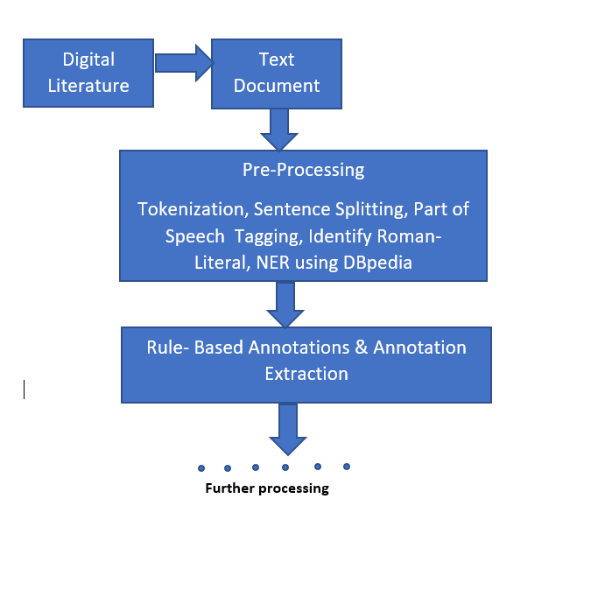
Workflow

Slide 12
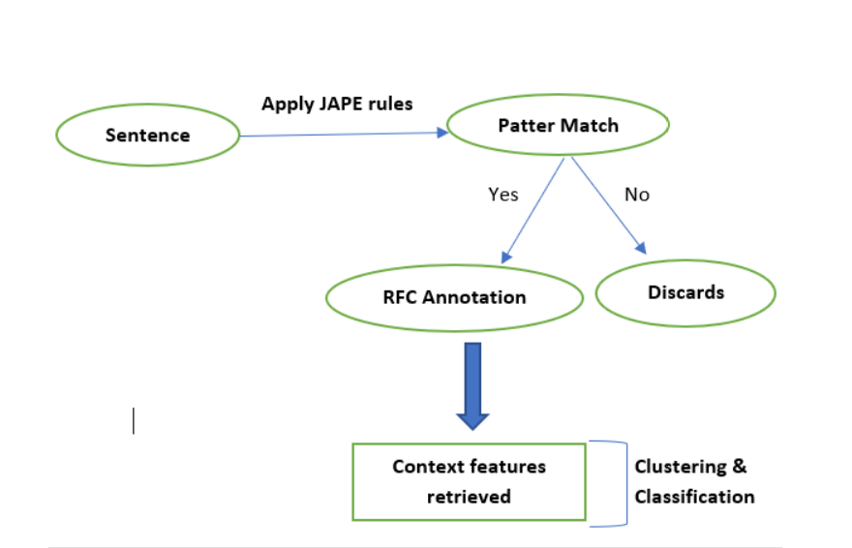
Evaluation workflow of GATE
Pattern Match

Slide 13
Team Members & Roles
Sowmya Prakash : Literature Reader
Yamuna N R : Literature Writer
Ahamad Shaik : Developer
Anustup Das : Team Lead

Slide 14
Project Schedule description
Milestone 1: Literature Research / Requirement collection & analysis
Deadline: 30.10.2018
Understand Problem Description
Literature research on relevant topics (sources: Google Scholar, DBLP, Citeseer, IEEE.org, ScienceDirect, Research Gate)
Webster &Watson (Forward/Backward Search)
Gain idea on existing approaches
Milestone 2 : Additional information gathering
Deadline: 20.11.2018
Concept understanding & additional literature research
Research on alternative Tools for Implementation
Features and tasks tool can perform
continued…

Slide 15
Project Schedule description
Milestone 3: Implementation
Deadline: 11.12.2018
Testing and Big fixing
Comparing results with existing approach
Drafting reports
Literature writing / Report writing
Milestone 4: Documentation and Evaluation
Deadline: 22.01.2019
Review & Refine reports
Evaluation of results
Final report submission

Slide 16
References
[1] Wang, Shuting & Lee Giles, C & Liang, Chen & Wu, Zhaohui & Williams, Kyle & Pursel, Barton & Brautigam, Benjamin & Saul, Sherwyn & Williams, Hannah & Bowen, Kyle. (2015). Concept Hierarchy Extraction from Textbooks. 147-156. 10.1145/2682571.2797062.
[2] Sabine Wehnert, David Broneske, Stefan Langer, Gunter Saake(2018) Concept Hierarchy Extraction from Legal Literature. October 2018.
[3] http://kontext.fraunhofer.de/haenelt/kurs/Referate/Hopp_Lin_Valiath_GATE-JAPE-ANNIE-presentation.pdf
[4] A Semantic Framework for Web service Annotation, Matching and classiﬁcation in Bioinformatics - Scientific Figure on ResearchGate. Available from:[https://www.researchgate.net/An-example-of-a-JAPErule_fig2_230651087] (accessed 29 Oct, 2018)
[5] https://en.wikipedia.org/wiki/Lexical_analysis#Tokenization
[6] https://web.stanford.edu/~jurafsky/slp3/ed3book.pdf
[7] http://www.odbms.org/2017/06/text-annotation-tools/
[8] https://gate.ac.uk/sale/talks/gate-course-may10/track-1/module-3-jape/module-3-jape.pdf

Slide 17
Thank you!
12

