Slide 1
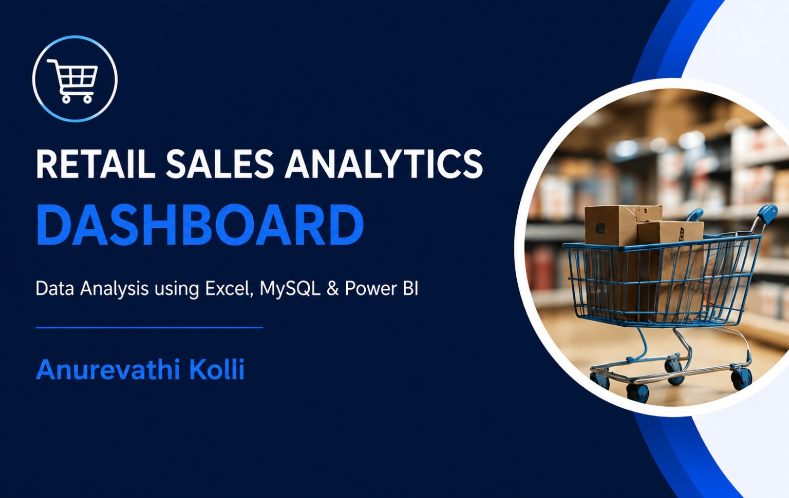

Slide 2
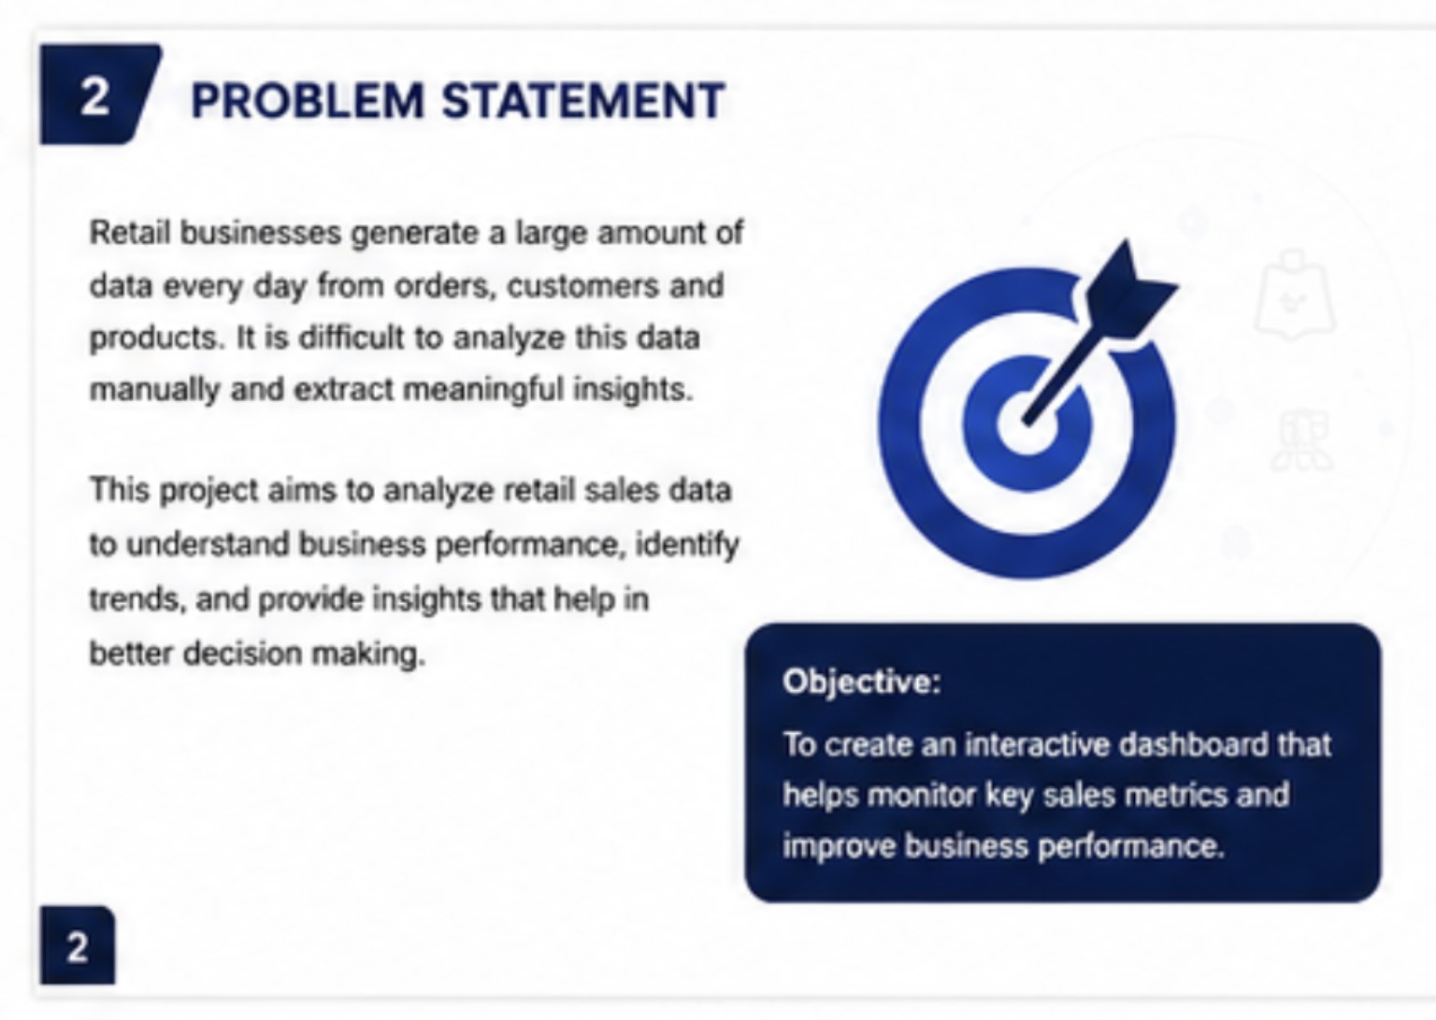

Slide 3
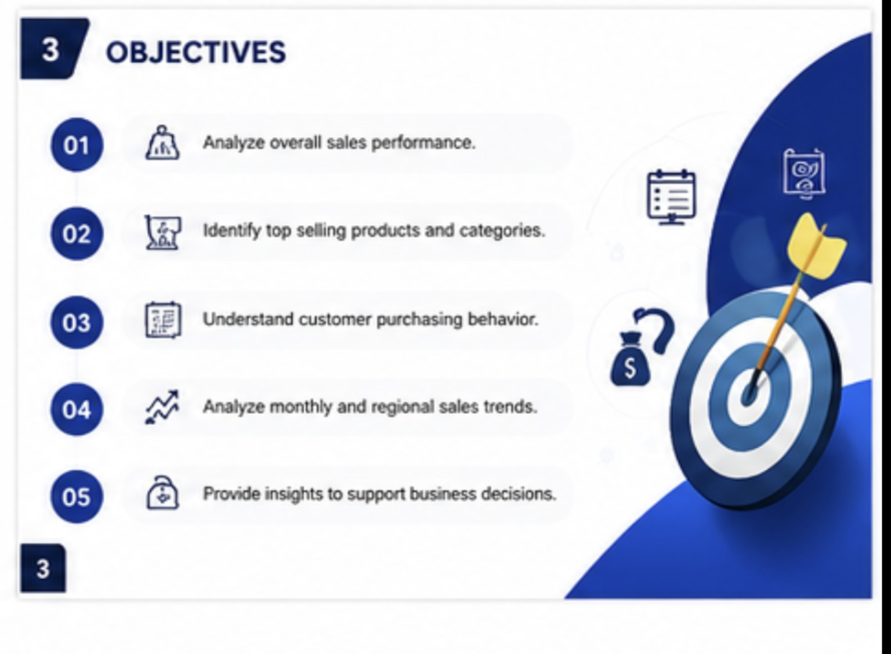

Slide 4
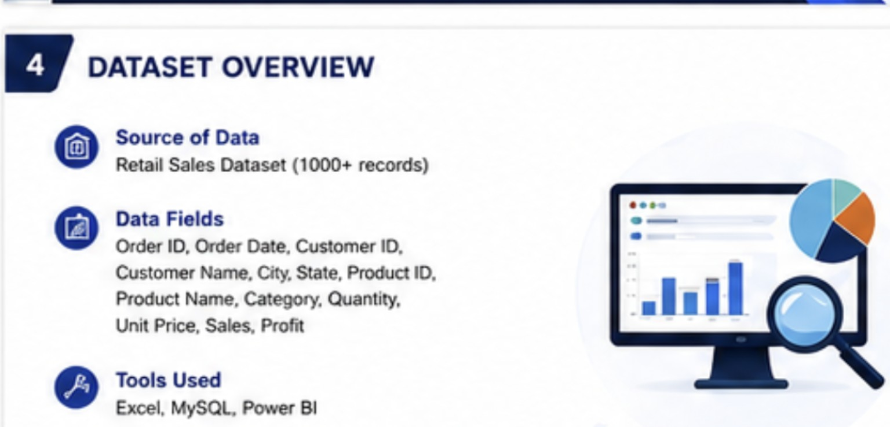

Slide 5
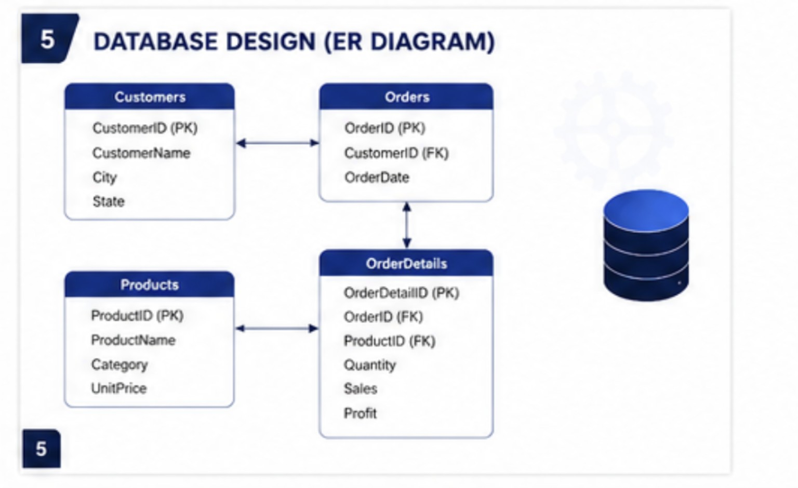

Slide 6
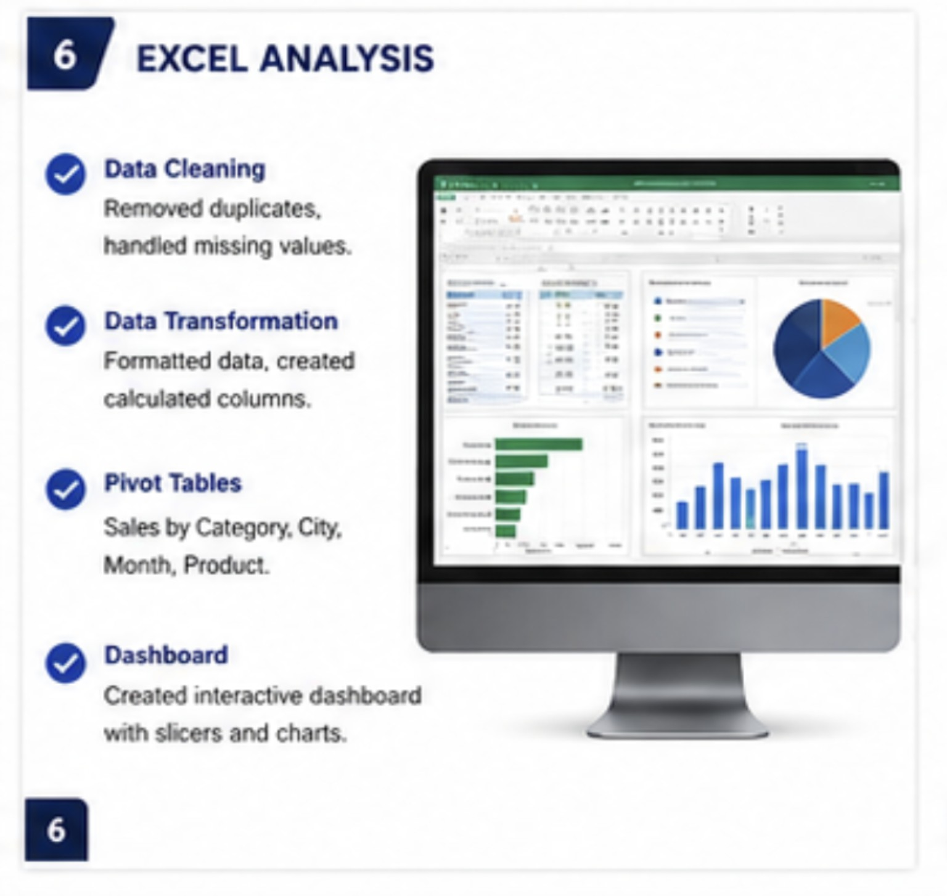

Slide 7
7
EXCEL DATA CLEANING – DETAILED PROCESS
Before analysis, the retail dataset was checked, cleaned and standardized in Excel to improve accuracy and consistency.
7
Remove duplicates
7
Handle missing values
7
Check data types
Checked Order ID and other key fields for duplicate records using Data → Remove Duplicates.
Used filters to identify blanks. Important missing values were corrected where possible; unnecessary incomplete rows were removed.
Verified Order Date as Date, Quantity as Number, Unit Price/Sales/Profit as numeric and IDs as consistent text/number fields.
7
Standardize text
7
Validate values
7
Format the dataset
Cleaned inconsistent names and categories using TRIM, CLEAN and Find & Replace where required.
Checked negative/zero quantities, unusual prices and sales/profit values using filters and conditional formatting.
Converted the range to an Excel Table, applied clear headers and consistent number/date formatting.
7
Create calculated fields
7
Final quality check
Created useful fields such as Month, Year and derived metrics needed for PivotTables and dashboard analysis.
Confirmed the cleaned table had consistent columns, no unexpected blanks/duplicates and was ready for Power BI analysis.
7

Slide 8
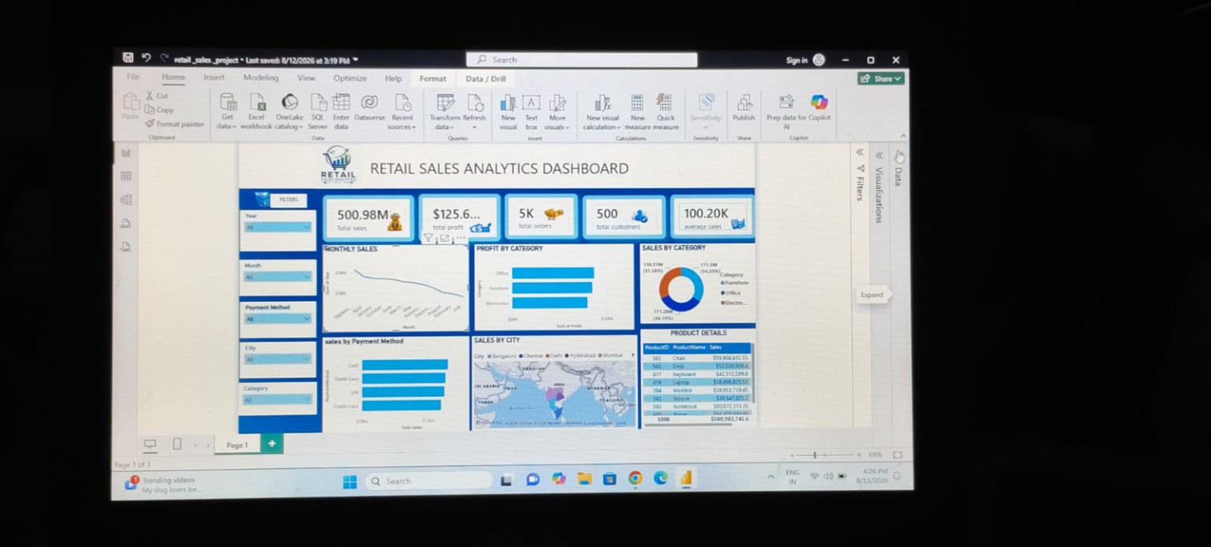
8
RETAIL SALES ANALYTICS DASHBOARD
Interactive Power BI dashboard with KPI cards, slicers, trends, category analysis, city analysis and product details.
8

Slide 9
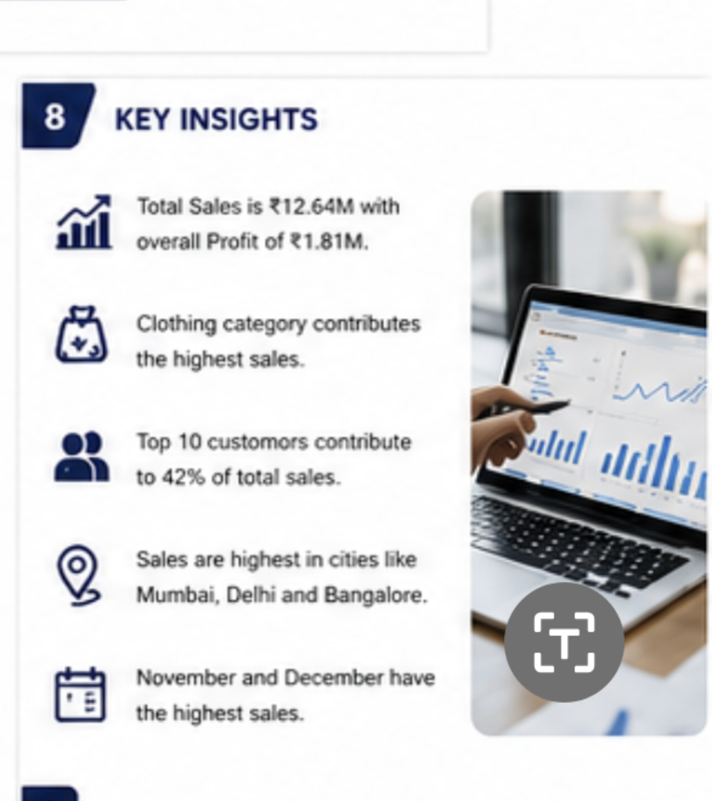

Slide 10
10
BUSINESS RECOMMENDATIONS
10
Strengthen top categories
10
Focus on high-value customers
Prioritize inventory, promotions and visibility for high-performing categories such as Clothing.
Use customer segmentation and targeted offers to retain the strongest revenue contributors.
10
Plan for peak months
10
Optimize regional strategy
Increase stock availability and campaign readiness before November and December demand peaks.
Allocate inventory and marketing budgets toward high-sales cities while testing growth opportunities elsewhere.
10
Monitor profit, not only sales
Track margin alongside revenue so promotions improve profitable growth rather than volume alone.
10

Slide 11
11
LEARNING & PROJECT OUTCOMES
Technical Learning
Business & Presentation Learning
• Excel data cleaning, validation, formatting and PivotTable analysis.
• Relational data modelling using Customers, Orders, Products and OrderDetails.
• Power BI data transformation, DAX measures, slicers and interactive visuals.
• KPI design and dashboard storytelling for business users.
• Translate raw retail data into measurable business KPIs.
• Identify trends, customer concentration and regional opportunities.
• Present insights clearly and connect findings to business actions.
• Build an end-to-end analytics workflow from data to decision.
11

Slide 12
Q&A
Questions & Discussions
THANK YOU

