Slide 1
Epileptic Seizure Recognition
- Anuthi Bhansali

Slide 2
Problem Statement
Epilepsy is the second most common brain disorder after migraine. Automatic detection of epileptic seizures can considerably improve the patients’ quality of life. Current Electroencephalogram (EEG)-based seizure detection systems is a must to deal with some of the challenges faced in real-life situations.
Seizures can happen unexpectedly and can result in injuries such as falling, biting of the tongue, or losing control of one’s urine or stool. Hence, these are some of the reasons why seizure detection is of utmost importance for patients under medical supervision that are suspected to be seizure prone. This project will use binary classification methods to predict whether an individual is having a seizure or not.

Slide 3
Market need to solve this problem
There are many cases where the epileptic seizure goes undetected like not responding or staring blankly for a brief period which may result in serious consequences.
There are many cases where patients suffer from these attack during operations or during delivery of a baby, detection of a seizure is necessary in these situations so that the required measures can be taken and bad consequences can be avoided.

Slide 4
Dataset
The dataset includes 4097 electroencephalograms (EEG) readings per patient over 23.5 seconds, with 500 patients in total.
The 4097 data points were then divided equally into 23 chunks per patient; each chunk is translated into one row in the dataset.
Each row contains 178 readings that are turned into columns; in other words, there are 178 columns that make up one second of EEG readings.
All in all, there are 11,500 rows and 180 columns with the first being patient ID and the last column containing the status of the patient, whether the patient is having a seizure or not.

Slide 5
Algorithms used
The dataset is trained and validated on many algorithms and the results of them are compared. The algorithms used are-
ANN
Logistic regression
Naive Bayes
Random Forest
Extremely Randomized Forest
Stochastic Gradient Descent
Gradient Boosting
Extreme Gradient Boosting
KNN

Slide 6
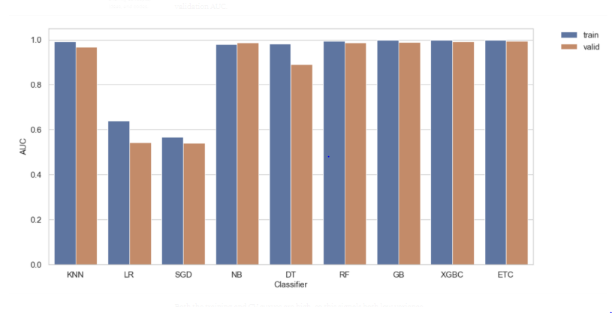
Results
The best performing model, with an AUC of 0.997, is the optimized extra trees classifier and Artifical Neural Network.

Slide 7
Leveraging ML Model on AWS SageMaker
Create an Amazon S3 Bucket
Create an Amazon SageMaker Notebook Instance
Create a Jupyter Notebook
Download, Explore, and Transform the Training Data
Train a Model
Deploy the Model to Amazon SageMaker
Validate the Model
Clean Up
Integrating Amazon SageMaker Endpoints into Internet-facing Applications

Slide 8
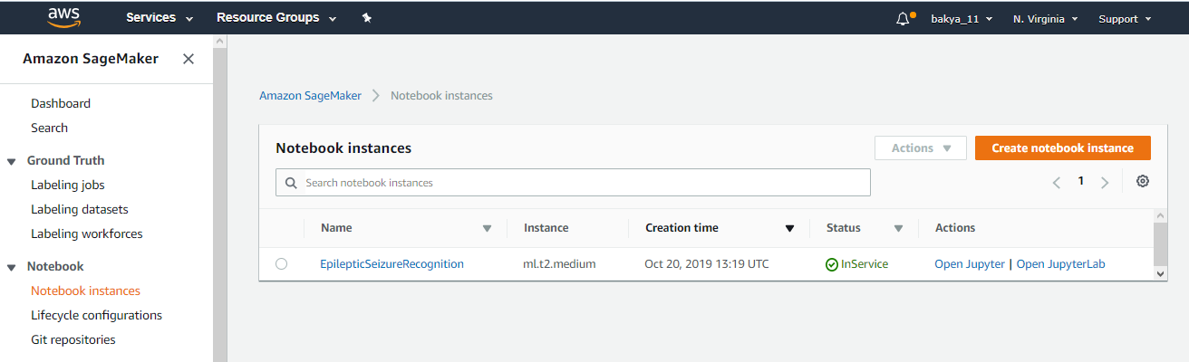

Slide 9
Thank You

