Slide 1

Physics-Informed
Neural Networks
Business Applications & Industry Value
Where AI meets the laws of physics to deliver measurable ROI
Notes:
1

Slide 2
What is a PINN?
Traditional simulation: accurate but slow & expensive
Pure AI/ML: fast but physically wrong — unreliable for engineering decisions
Observed Data
Physics Laws
Neural Network
Sensor readings, simulations, historical records
+
PDEs, conservation equations, boundary conditions
+
Learns patterns, approximates solutions
= PINN: Simulation-speed predictions that obey the laws of physics
Works with sparse data · No mesh required · Physically valid outputs · 100× faster than classical solvers
Notes:
2

Slide 3
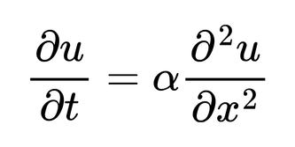
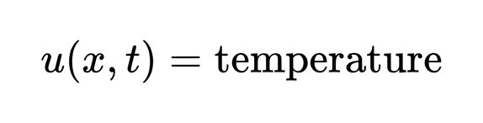
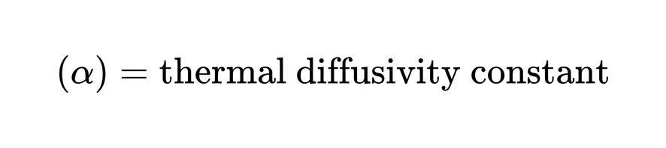
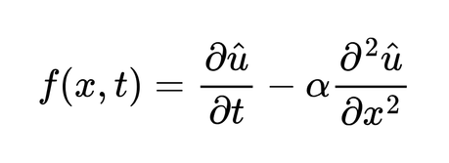
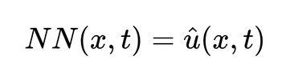
How PINNs Work — Heat Equation Example
Consider the one-dimensional heat equation:
Step 1: Neural Net Prediction
Step 2: Auto-Differentiation
Step 3: PDE Residual
Step 4: Loss Minimization
→
→
→
NN takes (x, t) as input and outputs predicted temperature û(x,t).
Derivatives ∂û/∂t and ∂²û/∂x² are computed automatically via backprop.
Residual f(x,t) = ∂û/∂t − α∂²û/∂x² measures physics violation.
Optimizer minimizes combined loss until PDE residual → 0.
Notes:
4

Slide 4
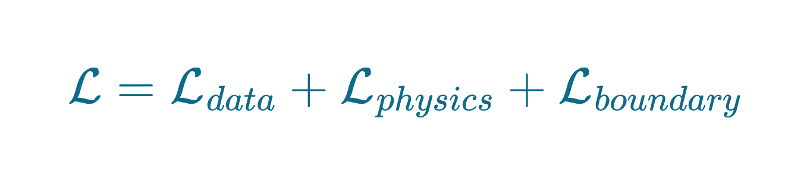
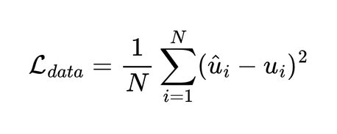
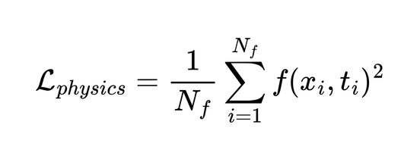
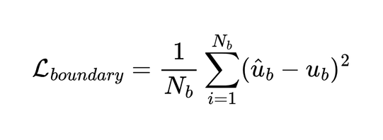

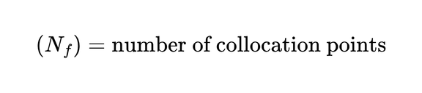
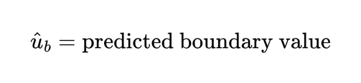
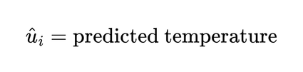
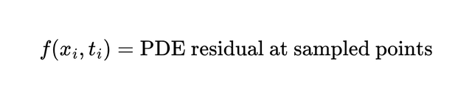
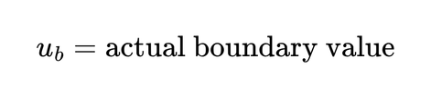
PINN Loss Function
Data Loss
Physics Loss
Boundary Loss
Fits known observations
Minimizes prediction error
Standard MSE form
Enforces PDE satisfaction
Sampled at collocation pts
Penalizes residual violation
Enforces boundary conditions
Ensures valid solutions
E.g., u(0,t) = 0
Notes:
5

Slide 5
Advantages of PINNs
Incorporates physics directly into learning
Requires less labeled data
Mesh-free approach
Continuous solution representation
Useful for inverse problems
Faster inference after training
Reduces computational and prototype cost
Enables real-time predictions

Slide 6

Oil & Gas
8×
<1%
50%
faster planning
prediction error
fewer test runs
Reservoir Simulation
Production Forecasting
Enhanced Oil Recovery
Challenge
Challenge
Challenge
Classical simulation: weeks of compute per run
Sparse well data makes pure ML unreliable
Coupled thermal + chemical + flow equations too complex
PINN Solution
PINN Solution
PINN Solution
PINNs replicate Darcy flow physics, deliver results in minutes
Physics constraints fill data gaps, prevent impossible predictions
PINNs embed multiphysics governing equations simultaneously
Business Benefit
Business Benefit
Business Benefit
8× faster field development planning
History matching without full simulation re-runs
Optimized injection strategies with less trial runs
Notes:
6

Slide 7
Aerospace & Manufacturing
✈ Aerospace
⚙ Manufacturing
Aerodynamics (lift/drag)
Air Knife Optimization
CFD surrogate models replace mesh simulations. NVIDIA uses PINNs for DGX heat sink design. Automotive aerodynamic drag sensitivity now computed in seconds.
Kinetic Vision (Cincinnati) used NVIDIA PhysicsNeMo to optimize air knife designs — reducing physical prototype iterations.
Structural Health Monitoring
Induction Hardening
PINNs predict stress/strain at unmonitored points. Virtual sensors reduce hardware costs by 40%.
PINNs identify material properties from sensor data in real time. Replaces costly material testing cycles.
Spacecraft Trajectory Optimization
Digital Twins
Physics-constrained path planning achieves minimal-thrust trajectories that RL methods miss.
Physics-constrained neural networks enable real-time digital twins of equipment — powering predictive maintenance.
Notes:
7

Slide 8
Healthcare & Life Sciences
❤️ Cardiac Biomechanics
🩸 Blood Flow Modeling
Parametric PINNs simulate personalized left ventricular mechanics from patient cardiac images. Runs faster than finite element models while maintaining clinical accuracy.
Hidden Fluid Mechanics technique uses PINNs to recover velocity and pressure fields from imaging data alone — no direct measurement needed.
💡 Personalized treatment planning without invasive procedures
💡 Stroke risk assessment from standard MRI/CT scans
💊 Drug Delivery Optimization
🧬 Medical Imaging Enhancement
PINNs model how drugs diffuse through tissue governed by transport PDEs, optimizing dosage schedules with minimal lab experiments.
Physics constraints improve reconstruction of MRI and CT images from sparse measurements, reducing scan time while maintaining diagnostic quality.
💡 Faster drug trials, reduced R&D cost
💡 Lower patient radiation exposure, faster throughput
Notes:
8

Slide 9
Energy, Climate & Finance
🌱 Energy & Climate
📈 Finance & Risk
Wind Power Forecasting
Option Pricing
Hybrid PINN framework achieved R² = 0.998 for wind prediction in permanent magnet generators — outperforming pure ML.
PINNs solve Black-Scholes PDE directly — pricing options and Greeks under jump-diffusion models with sparse market data.
Climate Modeling
Volatility Modeling
MC-PINN reduces ocean temperature anomaly errors by 37% vs CMIP6 models, using 82% less compute.
Physics-constrained networks model stochastic volatility with convergence guarantees unavailable to pure ML.
Earthquake Early Warning
Hedging Optimization
SeisPINN localizes seismic events to 0.5 km accuracy within 5 seconds of P-wave arrival (vs 2.1 km traditional).
PINN framework on NIFTY50 options achieves significantly lower pricing error and hedging costs vs neural-SDE baseline.
82% less compute cost · 37% lower prediction error · Real-time results where classical solvers take days
Notes:
9

Slide 10
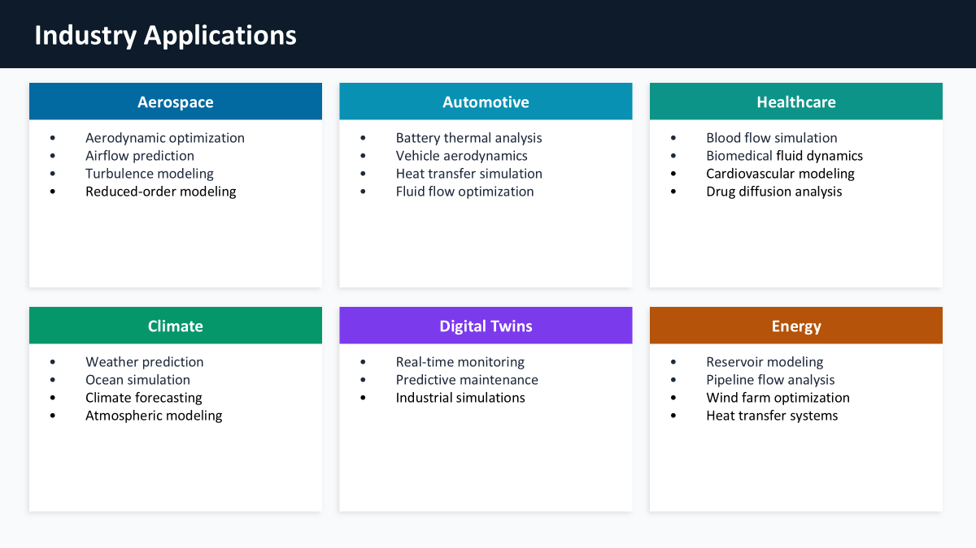

Slide 11
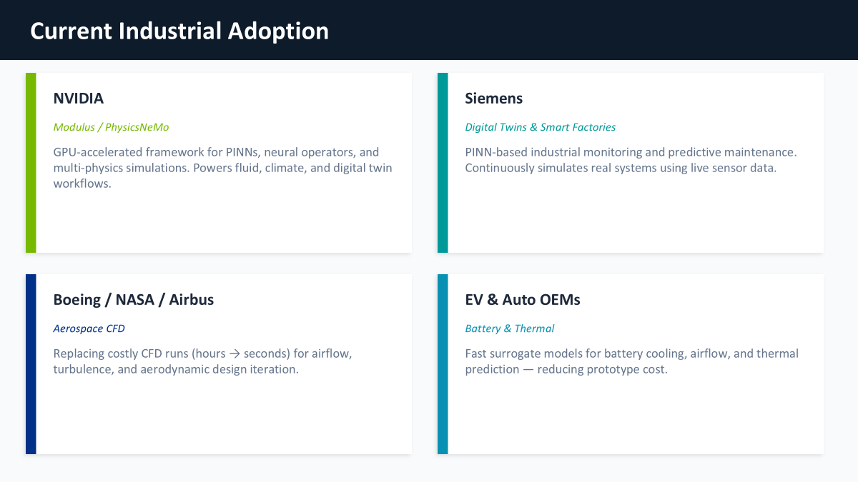

Slide 12
Who is Already Investing?
NVIDIA
Platform
Ansys
Tooling
Siemens Digital
Tooling
Platform provider
Engineering simulation
Industrial digitalization
PhysicsNeMo (open-source). GPU-accelerated PINN training for CFD, weather, digital twins.
Integrating PINNs as surrogate models into FEA workflows. Structural and thermal analysis.
Physics-ML for manufacturing digital twins and industrial automation systems.
Baker Hughes
Domain
MathWorks
Tooling
Kinetic Vision
Domain
Oil & gas technology
Finance & engineering
Manufacturing tech
Reservoir simulation and production forecasting using physics-constrained ML.
PINN toolbox for option pricing and engineering simulations. Presented at 2024 Finance Conference.
Air knife optimization using NVIDIA PhysicsNeMo — reducing physical prototype cycles.
Notes:
10

Slide 13
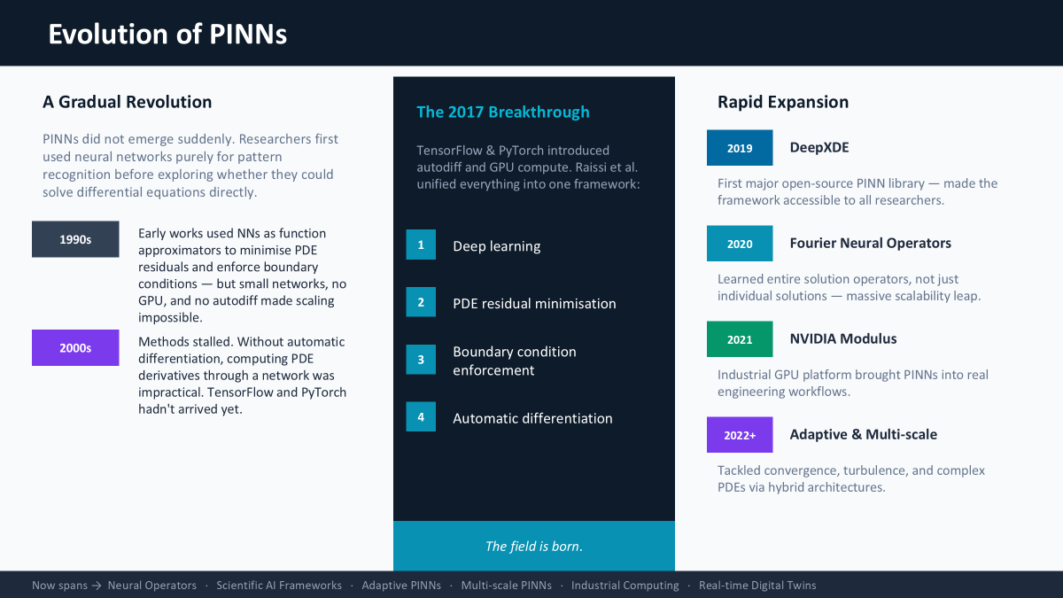

Slide 14
Evolution Table
Year | Paper / Work | Main Contribution | Key Innovation Introduced
1994 | Dissanayake & Phan-Thien | First major attempt to use neural networks for solving PDEs | Introduced neural networks as PDE approximators with physics-based loss
1998 | Lagaris et al. | Improved neural PDE solving with exact boundary handling | Introduced trial solution functions that automatically satisfy boundary conditions
2000 | Lagaris et al. | Extended neural PDE methods to complex geometries | Enabled handling of irregular boundaries and more realistic domains
2017 | Raissi et al. — Physics-Informed Neural Networks (PINNs) | Formal introduction of modern PINNs | Combined deep learning, automatic differentiation, PDE residual loss, and physics constraints
2019 | DeepXDE | First major PINN framework/library | Simplified implementation of PINNs, PDEs, geometries, and boundary conditions
2020 | Fourier Neural Operators (FNO) | Introduced neural operator learning for PDEs | Learned entire PDE operators instead of single solutions, improving scalability
2020 | DeepONet | General operator learning framework | Learned mappings between function spaces for solving families of PDEs
2021 | NVIDIA Modulus / PhysicsNeMo | Industrial scientific AI framework | Large-scale GPU-accelerated PINNs and scientific ML for real-world engineering applications
2022+ | Adaptive & Multi-Scale PINNs | Improved training and scalability of PINNs | Adaptive sampling, better convergence, and handling of complex multi-scale physics
2024+ | Scientific Foundation Models | Large pretrained AI models for scientific computing | Generalized physics learning for digital twins, climate modeling, and real-time simulation

Slide 15
The Business Case
Why PINNs deliver ROI that pure ML cannot
100×
82%
37%
<1%
Faster than classical
numerical solvers
Less compute cost
in climate modeling
Lower prediction
error in key domains
Reservoir prediction
error with sparse data
Hours → seconds for simulation
vs. CMIP6 benchmark models
Ocean temperature anomalies
vs. 3–5% for pure ML
When to choose PINNs over standard ML:
You have limited labeled data but know the governing physics
Predictions MUST be physically valid — no impossible outputs
Classical simulation is too slow for real-time or design optimization
You need to solve inverse problems — infer hidden system parameters from measurements
PINNs — where AI respects physics to deliver engineering-grade business outcomes
Notes:
11

