Slide 1
INTERNSHIP FINAL PRESENTATION
Insurance Reserve Intelligence Platform
Physics-Informed Neural Networks for Insurance Reserve Prediction
YOUR NAME:
[Presenter Name]
MENTOR:
[Mentor Name]
COMPANY:
[Company Name]
DATE:
[Presentation Date]

Slide 2
BACKGROUND
What is an Insurance Reserve?
Premium
Collected today
Insurance companies collect premiums today.
Claims may occur many years later.
Companies must estimate future liabilities.
The estimated liability is called the insurance reserve.
Accurate reserve estimation is essential for pricing, solvency and risk management.
↓
Reserve
Held as liability
↓
Claim
Paid in future
BUSINESS IMPORTANCE
Reserve estimation affects: Pricing, Capital Planning, Regulatory Compliance, Profitability.
Insurance Reserve Intelligence Platform
03

Slide 3
PROBLEM STATEMENT
Current Challenges
Classical Solver
Solves ODEs per policy — Slow
PROBLEMS
Solves one policy at a time
Computationally expensive
Slow for large portfolios
Repeated solving required for optimization
Stress testing becomes expensive
↓
Physics-Informed NN
Learns reserve function — Fast
GOAL
Learn the reserve function using Physics-Informed Neural Networks (PINNs) and Knowledge-Informed Neural Networks (KINNs) for insurance reserve estimation, preserving actuarial principles.
Insurance Reserve Intelligence Platform
04

Slide 4
PROJECT OVERVIEW
Why Physics-Informed Neural Networks?
Traditional Neural Network | PINN
Learns only from data | Learns from data + domain knowledge + physics
Needs large datasets | Works with smaller datasets
May violate physics | Physics + actuarial constraints enforced
Black box | More interpretable
PROJECT EVOLUTION
The platform was initially developed using PINNs and later extended to support KINNs, allowing domain knowledge and actuarial constraints to be incorporated more explicitly.
Insurance Reserve Intelligence Platform
05

Slide 5
ARCHITECTURE
Overall Project Pipeline
Policy Generator
→
Classical Thiele Solver
→
Reserve Dataset
→
PINN Training
→
Reserve Predictor
→
Evaluation
Sensitivity
Optimization
Stress Testing
Future Works
.
Synthetic data and classical physics train the network; the trained model then feeds evaluation, sensitivity and optimization.
Insurance Reserve Intelligence Platform
06

Slide 6
DATASET GENERATION
Synthetic Data Generation
Since real insurance datasets were unavailable, synthetic policies were generated.
GENERATED VARIABLES
Age
Policy Term
Interest Rate
Sum Assured
Mortality
Premium
Each policy was solved using the classical Thiele Solver to generate reserve trajectories.
Insurance Reserve Intelligence Platform
07

Slide 7
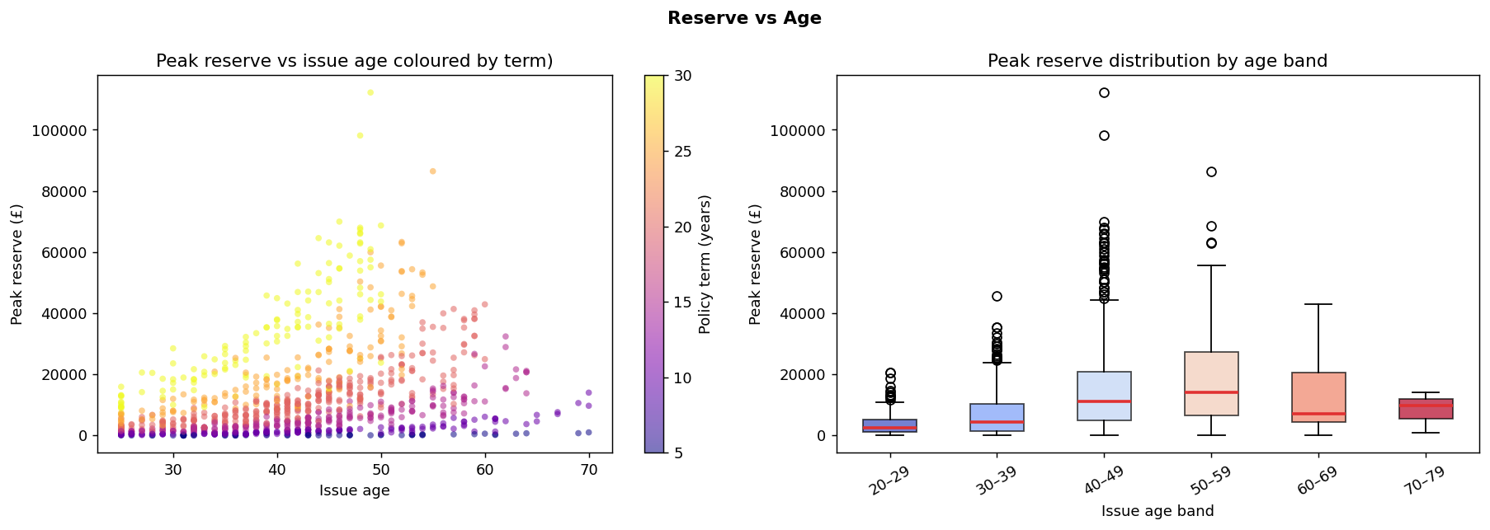
Older policyholders and longer policy terms tend to require higher peak reserves due to increased liability.
The colour band indicates policy term, showing that longer-duration policies (yellow) generally require higher peak reserves than shorter-duration policies (purple).

Slide 8
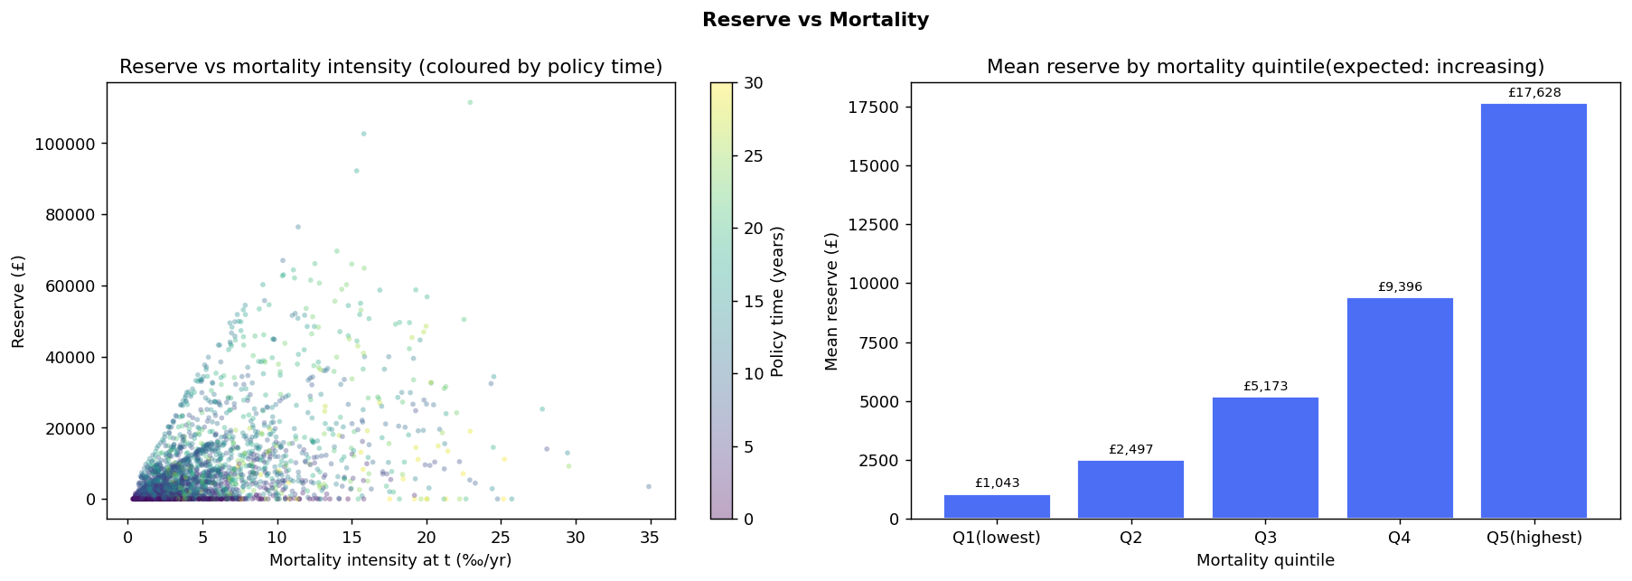
Mortality intensity (‰/year) represents the annual probability of death, expressed as deaths per 1,000 policyholders per year.
The reserve increases consistently as mortality intensity increases
higher mortality ⇒ higher reserve

Slide 9
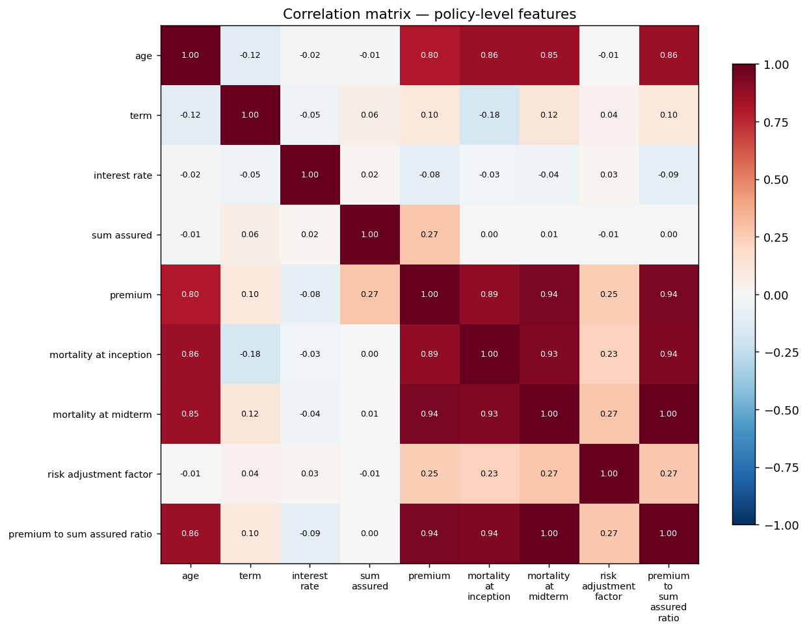
The correlation matrix shows the relationships between policy features,
with red indicating strong positive correlation, blue indicating negative correlation, and white indicating little or no relationship.

Slide 10
MODEL TRAINING
PINN + KINN Architecture
Time
Neural
Network
Age
Interest Rate
Reserve
→
→
Premium Ratio
Sum Assured
Mortality
TRAINING LOSSES
Data Loss
PDE Loss
Boundary Loss
Monotonicity
Smoothness
Regularization
Insurance Reserve Intelligence Platform
08

Slide 11
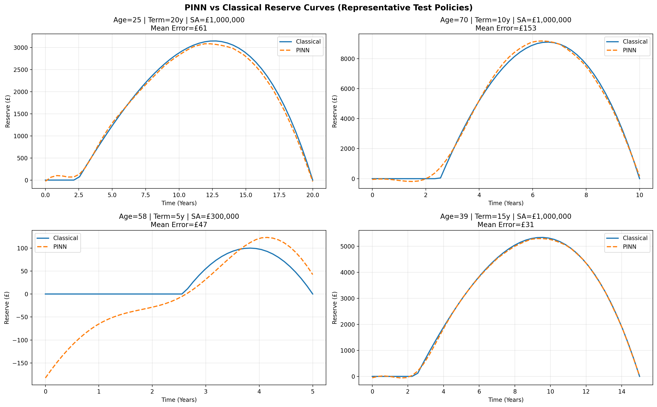
EVALUATION
Evaluation Framework
METRICS
MSE
RMSE
MAE
R²
VALIDATION
Classical Solver Comparison
Reserve Trajectory
Prediction Accuracy
Insurance Reserve Intelligence Platform
11

Slide 12
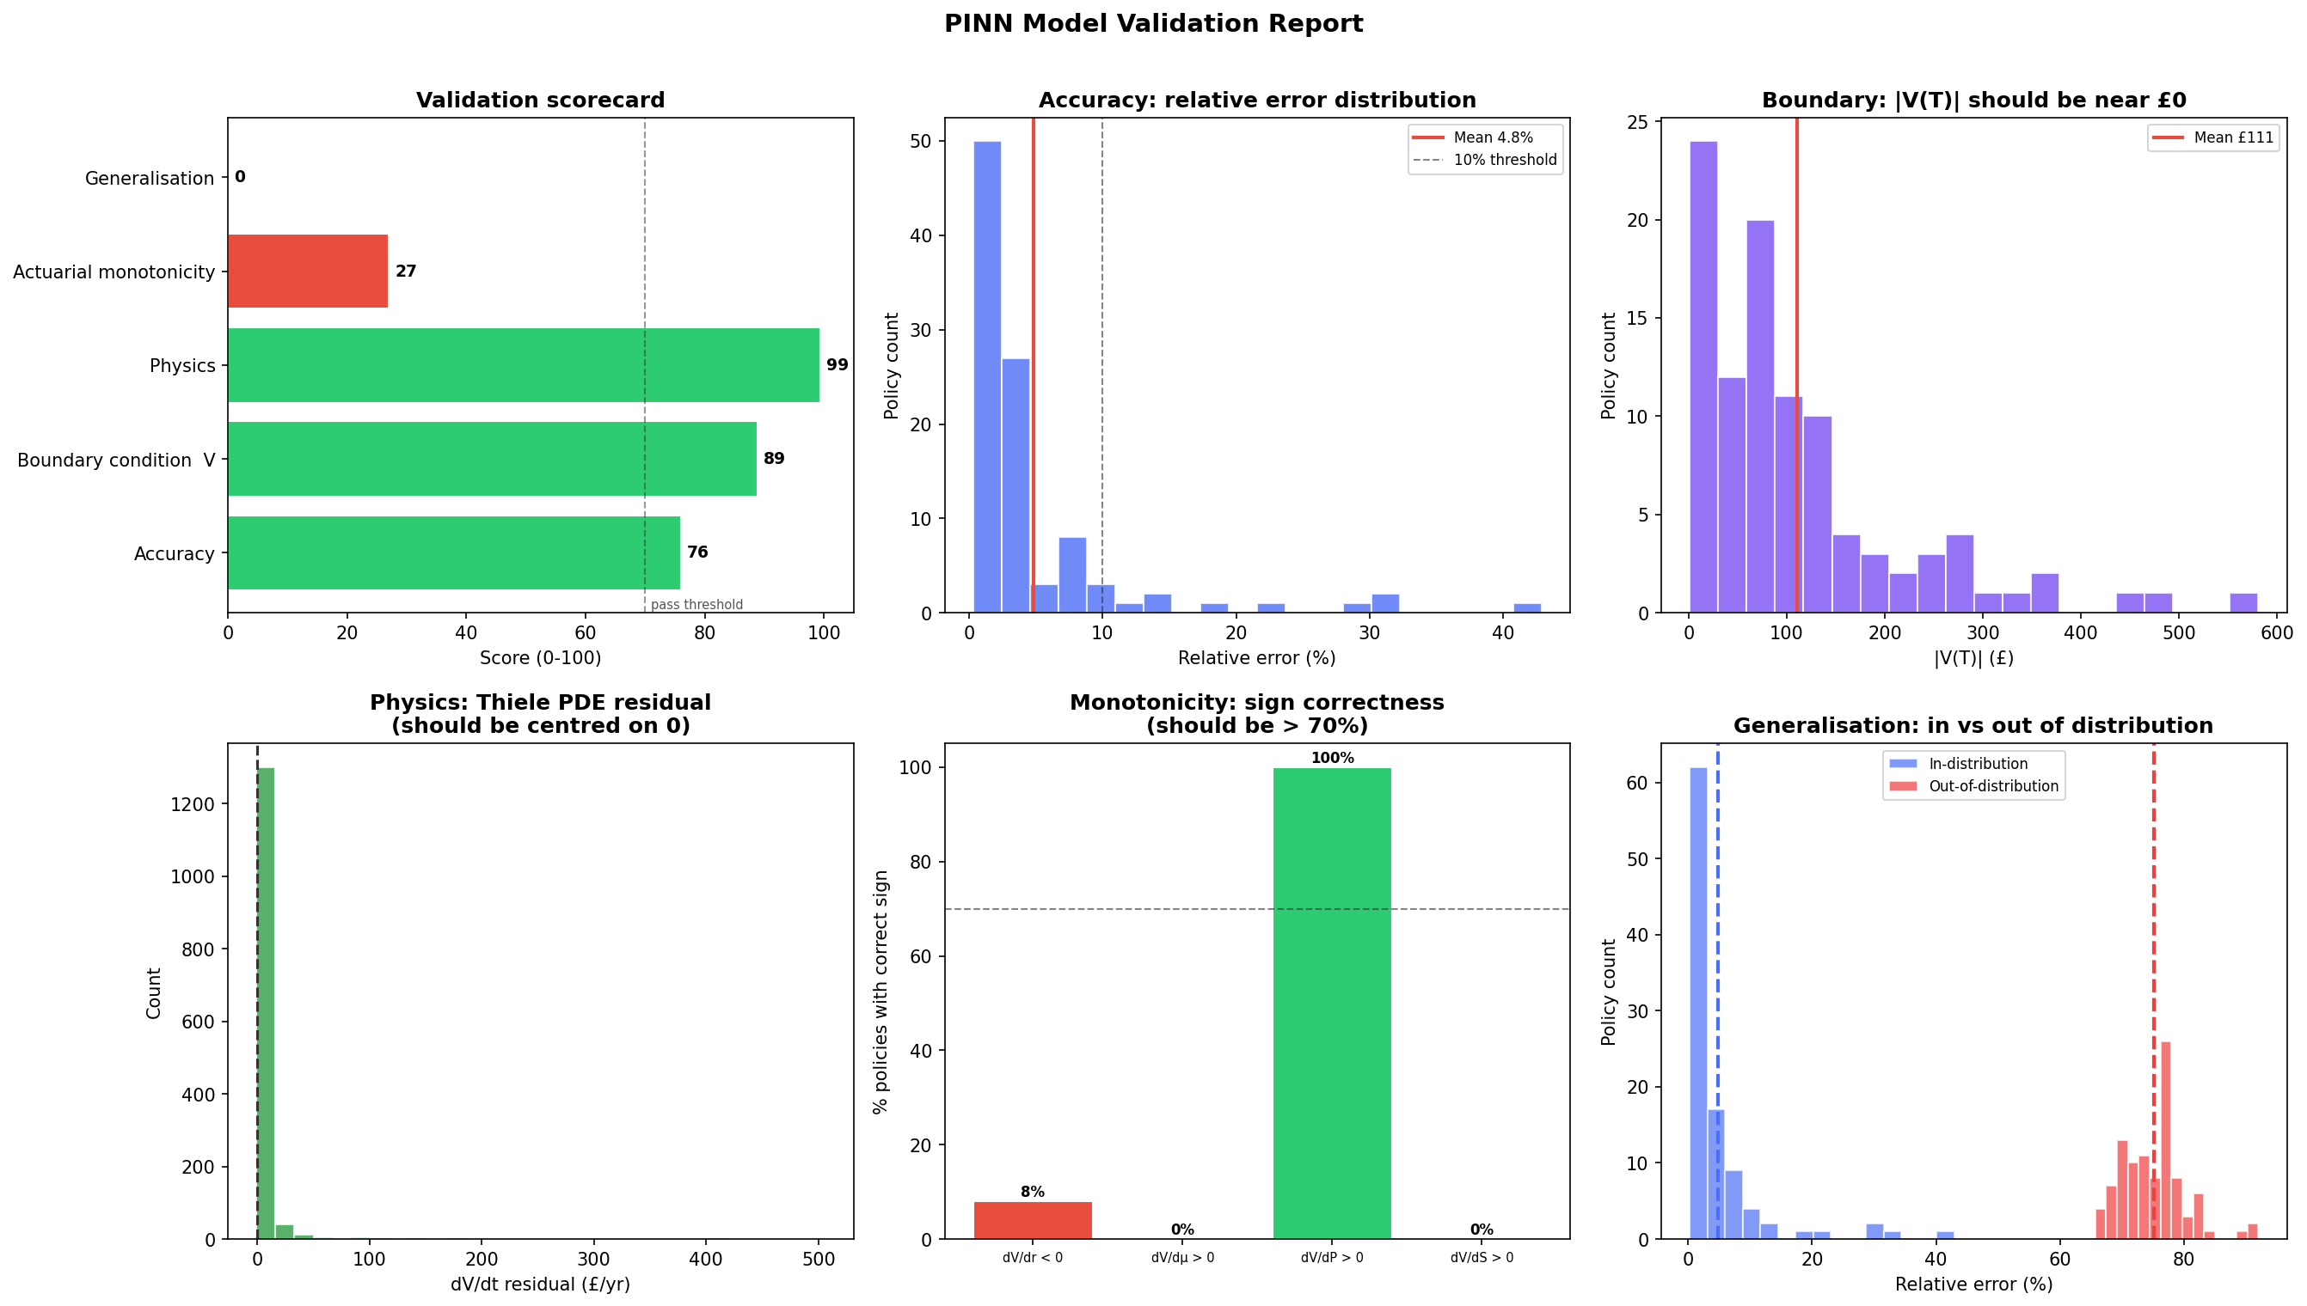

Slide 13
SENSITIVITY ANALYSIS
Sensitivity Analysis
BUSINESS QUESTION
VARIABLES
How does reserve change when one assumption changes?
Interest Rate
Mortality
Premium Ratio
Sum Assured
Reference Policy
↓
Perturb ONE variable
↓
PINN
↓
Finite Difference
↓
Sensitivity
Insurance Reserve Intelligence Platform
12

Slide 14
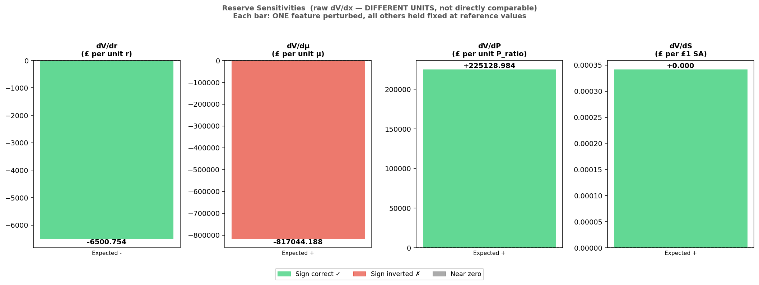
Sensitivity Plot
This plot shows the sensitivity of reserve to changes in key policy variables (interest rate, mortality, premium, and sum assured), indicating whether the model follows the expected actuarial direction of change.
The model correctly predicts that reserves increase with premium, interest rate and sum assured (green), but the sensitivities to mortality have the opposite sign to actuarial expectations (red),

Slide 15
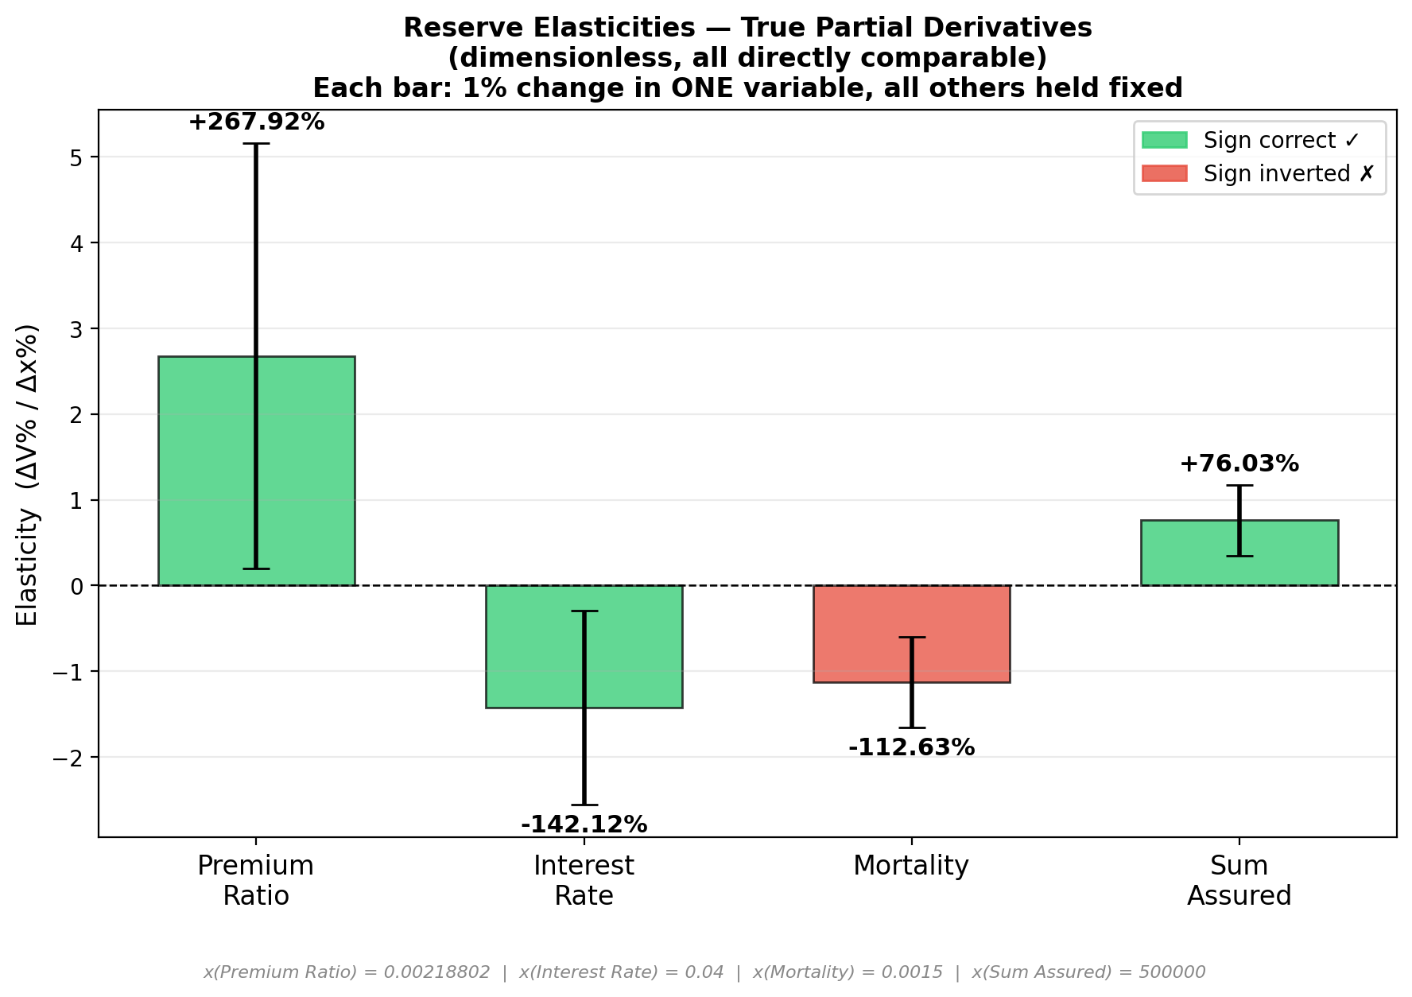
Elasticity Analysis
This plot compares the relative influence (elasticity) of each input variable on the predicted reserve, allowing all variables to be compared on the same scale regardless of their units.

Slide 16
OPTIMIZATION
Optimization Framework
Policy
OPTIMIZATION MODULES
↓
Premium Optimization
Capital Allocation
Product Design
Portfolio Optimization
Reserve Predictor
↓
Objective Function
↓
SciPy Optimizer
↓
Optimal Decision
Optimization uses the trained reserve model rather than repeatedly solving the ODE.
Insurance Reserve Intelligence Platform
14

Slide 17
OPTIMIZATION
Current Optimization Modules
Module | Objective
Premium | Maximize Profit
Capital | Minimize Capital
Product Design | Optimize Product Parameters
Portfolio | Optimize Portfolio Profit
BUSINESS CONSTRAINTS
Reserve ≥ 0
Solvency Ratio
Premium Bounds
Insurance Reserve Intelligence Platform
15

Slide 18
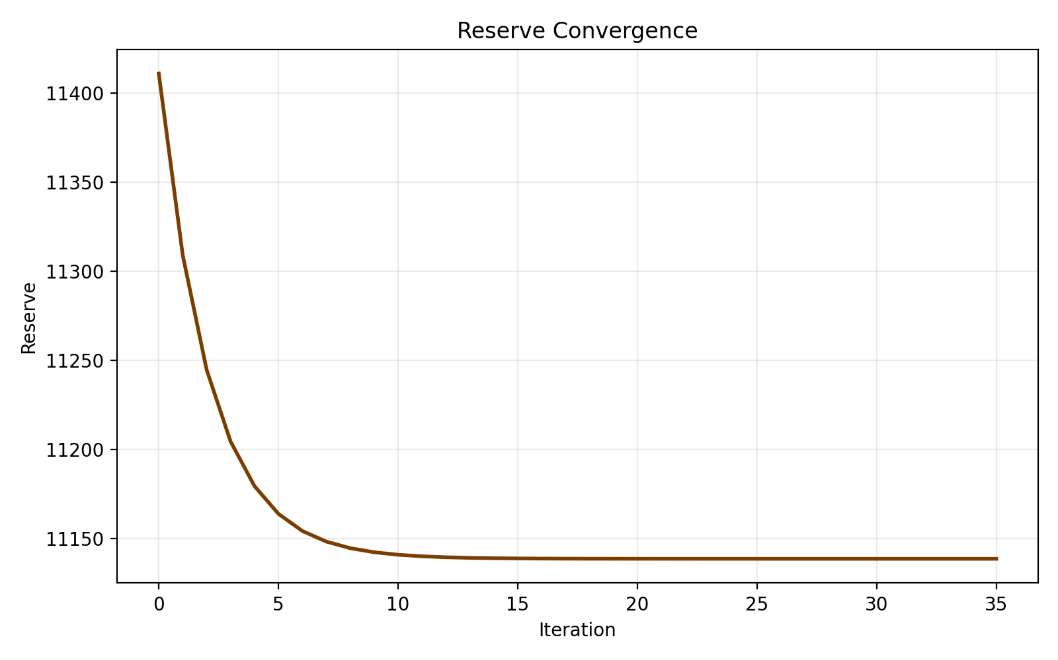
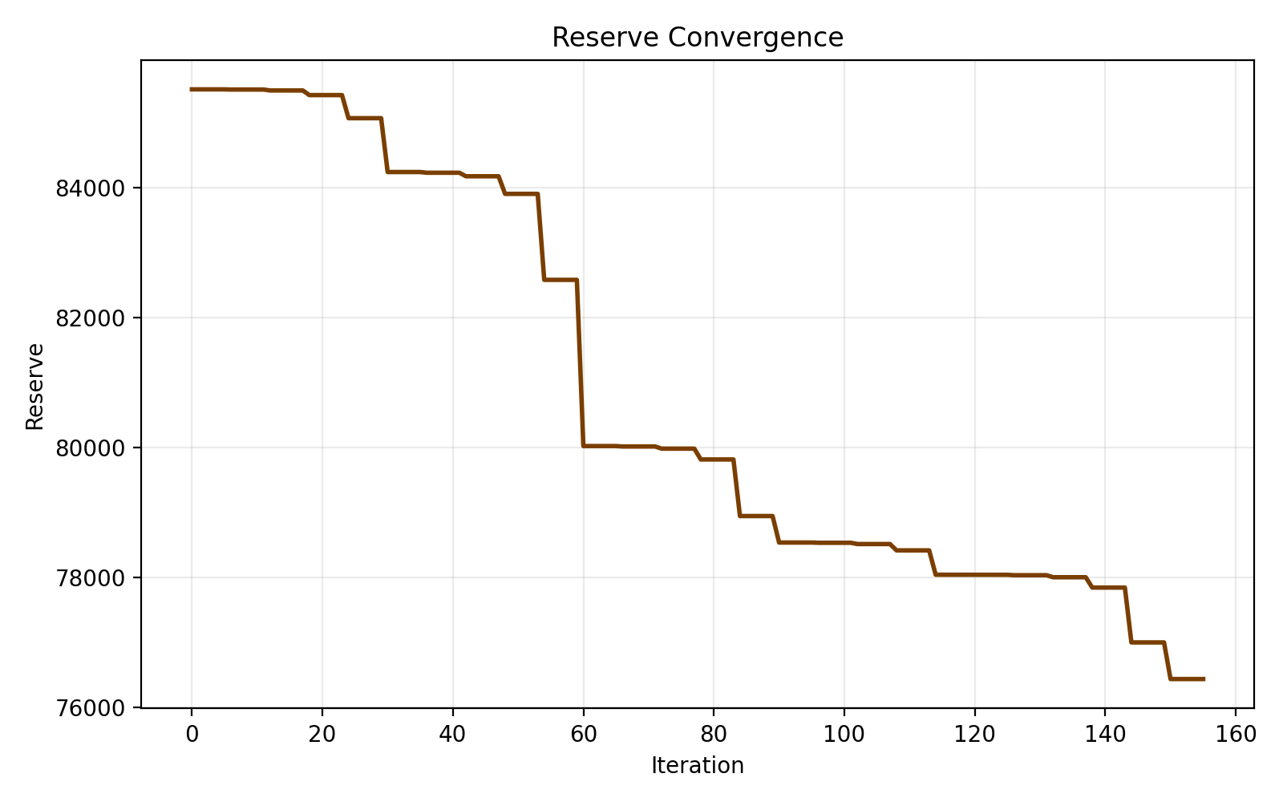
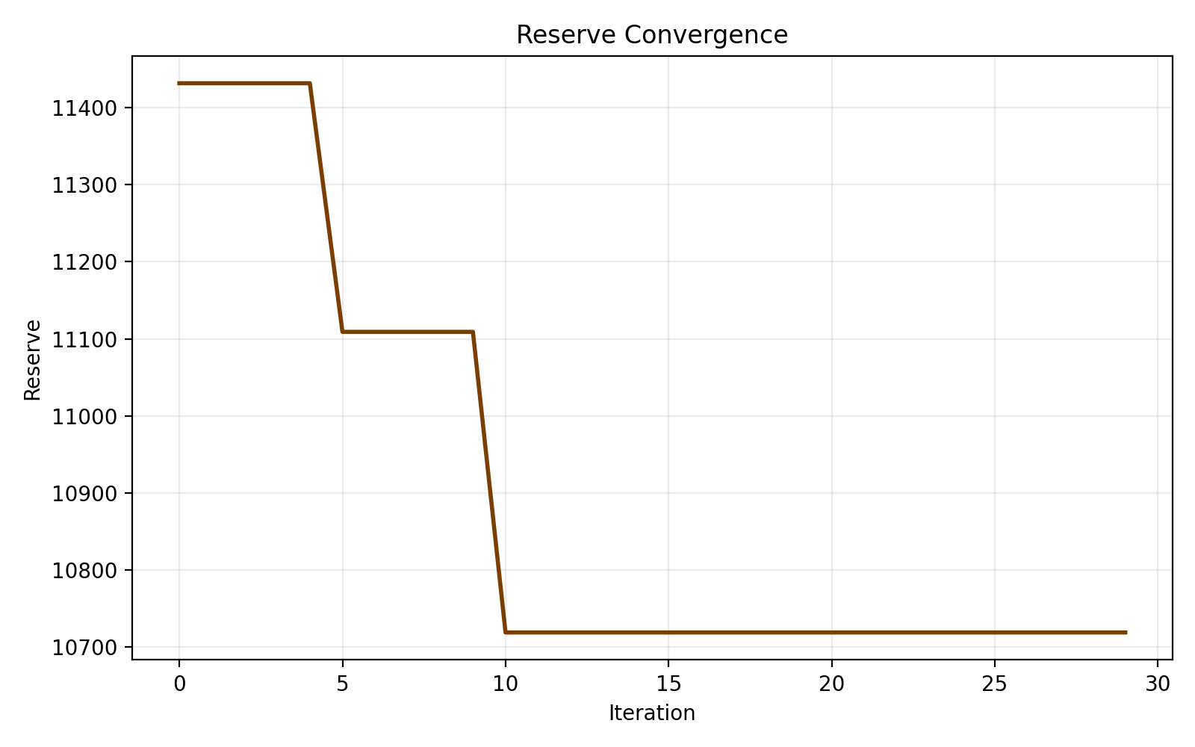
Pricing Reserve
Product design Reserve
Portfolio Reserve
This is reserve while only premium changes.
Reserve changes for first few iterations then stabilizes
This is reserve while product features change.
More movement than pricing reserve eventually stable
This is total reserve for multiple policies.
Smoother than single-policy graphs
Total reserve changes gradually then stabilizes

Slide 19
CURRENT STATUS
Results
SHOW
COMPLETED
Evaluation metrics
Sensitivity plots
Reserve plots
Optimization plots
✓
PINN/KINN Reserve Prediction
✓
Evaluation Framework
✓
Sensitivity Framework
✓
Optimization Framework
✓
Visualization Pipeline
✓
Modular Architecture
Insurance Reserve Intelligence Platform
16

Slide 20
CURRENT STATUS
Current Challenges
Problem | Status
Mortality Sensitivity | Under Investigation
Real Dataset | Future Work
Portfolio Validation | Future Work
Deployment | Future Work
Insurance Reserve Intelligence Platform
17

Slide 21
FUTURE WORK
Future Work
Improve remaining sensitivities
Benchmark against classical methods
Support more insurance products
Real insurance datasets
Portfolio-scale optimization
Stress Testing improvement
Digital Twin implementation
Interactive dashboard
Production deployment
Insurance Reserve Intelligence Platform
19

Slide 22
CONCLUSION
Project Summary
Developed an end-to-end Insurance Reserve Intelligence Platform.
Built a PINN-based reserve prediction framework.
Integrated physics-informed training.
Developed evaluation, sensitivity and optimization modules.
Established a foundation for future actuarial AI research.
Thank You

Slide 23
APPENDIX
Classical Reserve Equation (Thiele Equation)
CLASSICAL ACTUARIAL MODEL
PINN FORMULATION
The reserve for a term-life policy is governed by Thiele's Differential Equation:
Instead of directly solving the ODE for every policy, the neural network learns:
dV(t)/dt = rV(t) + P − μ(t)(S − V(t))
V = f(t, policy)
During training, the prediction is constrained by:
Where
Training data
Thiele Equation
Boundary condition
Business constraints
V(t) = Reserve
r = Interest rate
P = Premium
μ(t) = Mortality intensity
S = Sum assured
The PDE residual becomes another loss function during optimization.
WHY USE A PINN?
Thiele Equation
Instead of repeatedly solving the differential equation, the trained model approximates the reserve function while remaining consistent with actuarial physics.
↓
Physics Residual
↓
Neural Network
Insurance Reserve Intelligence Platform
21

