Slide 1
RiskShield AI
Innovative Measures for Proactive Risk Management
Bank of Baroda Hackathon 2024
BOB The Risk Manager
Anuj
27/06/2024

Slide 2
Problem Statement: The banks faces significant challenges in effectively managing and mitigating various types of risks, including credit, operational, market, and liquidity risks. Traditional risk management approaches are often reactive, involve human interventions, lack real-time insights, and struggle to keep up with the increasing volume and complexity of data. This limits the bank's ability to proactively identify potential risks, take timely actions, and ensure compliance with regulatory standards, ultimately impacting its financial stability and operational efficiency.

Slide 3
Alternatives/Competitive Products for the Problem
Traditional Risk Management Systems
Description: These systems are based on historical data and statistical models. They rely heavily on manual processes and periodic assessments.
Pros: Proven methodologies, established regulatory compliance.
Cons: Reactive approach, lack of real-time insights, limited scalability with increasing data volume.
Legacy On-Premise Risk Management Software
Description: These are traditional, on-premise software solutions for risk management, often requiring substantial hardware and maintenance.
Pros: Established reputation, robust data processing capabilities.
Cons: High initial investment, inflexible, requires regular updates and maintenance.

Slide 4
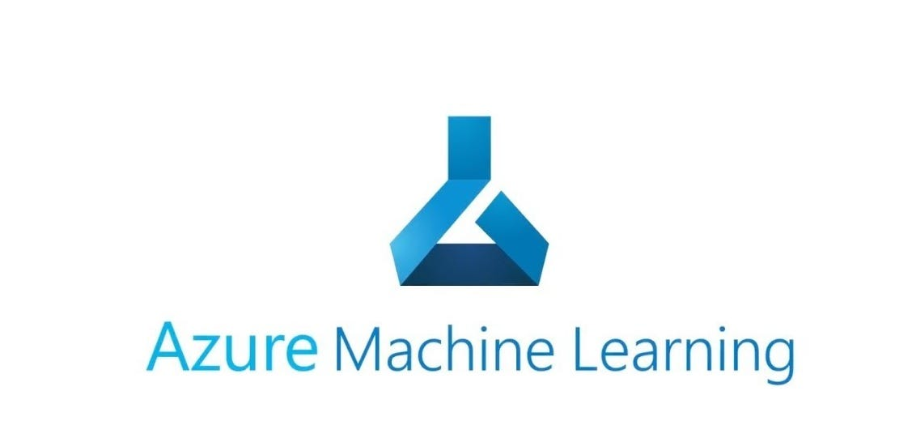
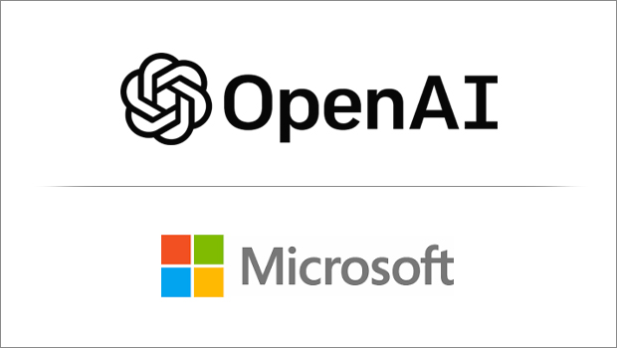
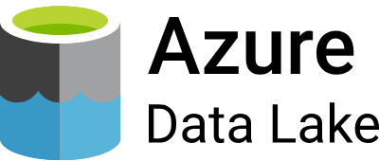
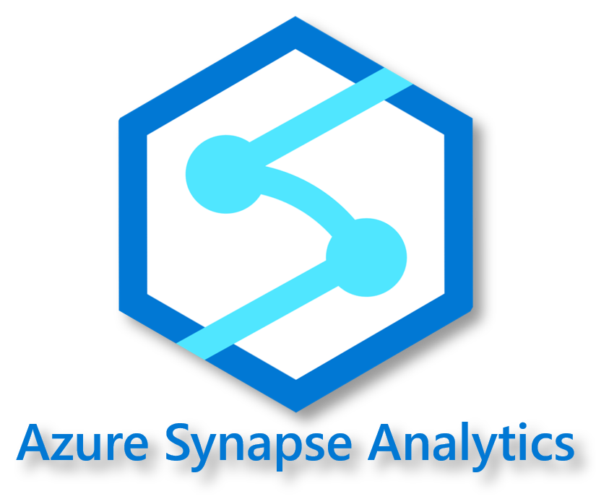

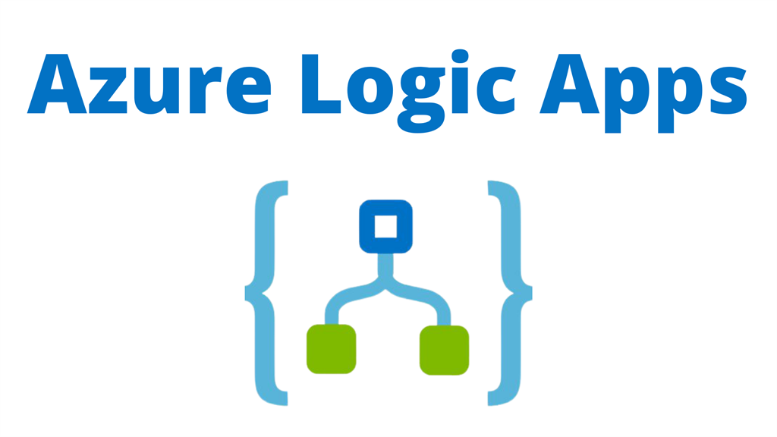

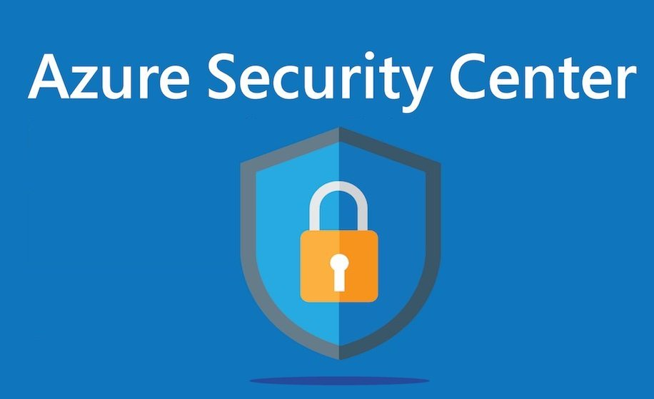
Microsoft tools or resources to build Production level RiskShield AI

Slide 5

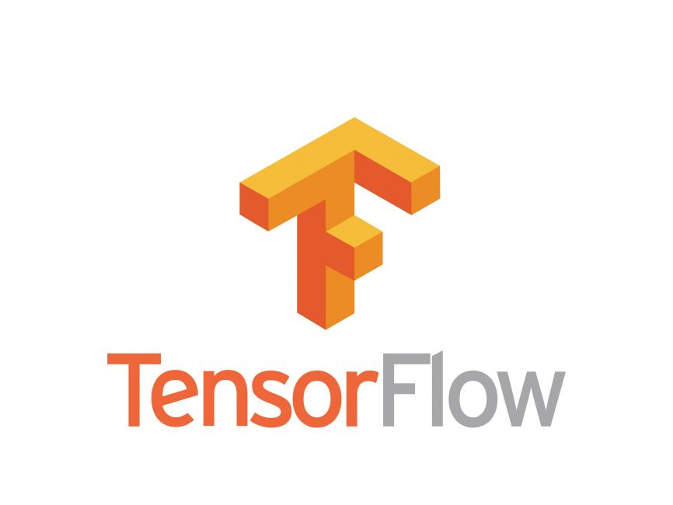
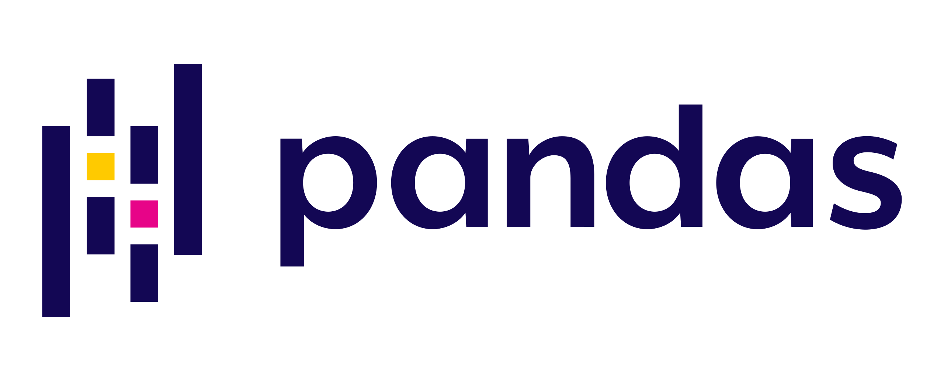
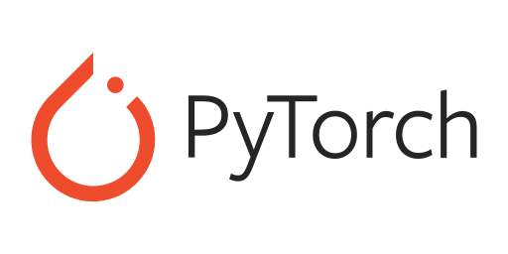
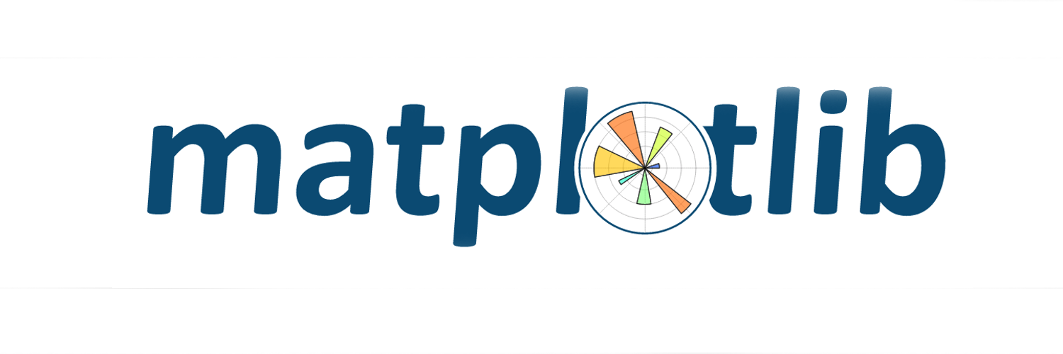
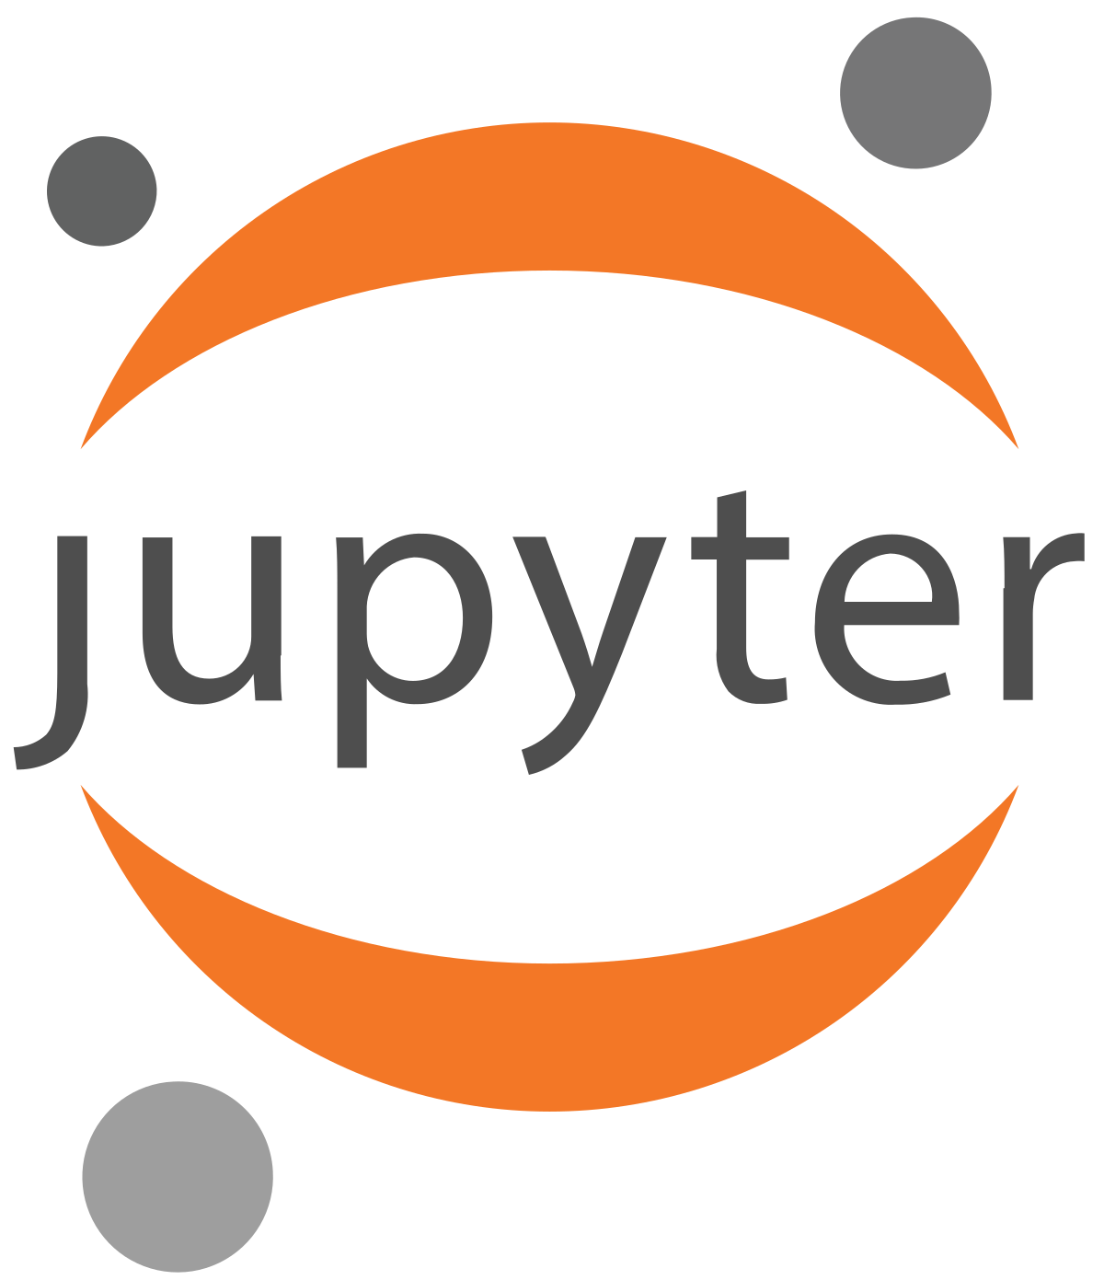

Other open-source tools or resources to build Production level RiskShield AI

Slide 6

Solution Overview
Risk Prediction
Develop AI models using Azure OpenAI to forecast potential credit defaults, market fluctuations, and operational issues.
Utilize historical data, market trends, and customer behavior to improve prediction accuracy.
Risk Assessment:
Continuously monitor and evaluate risk levels across assets, transactions, and customer portfolios using AI.
Create real-time visual dashboards with Power BI to display risk assessments.
Risk Mitigation:
Implement automated workflows to respond to identified risks.
Use Azure Logic Apps to trigger alerts, hold transactions, and perform compliance checks automatically.
Regulatory Compliance:
Ensure compliance with regulations through automated checks and audits.
Use AI to generate detailed compliance reports and identify potential breaches.

Slide 7

Methodology
Step 1: Data Collection and Processing
Data Sources and Types
Credit Risk
Data Sources: Loan portfolios, credit scores, payment histories, financial statement. Data Types: Customer demographics, loan amounts, repayment schedules, default rates.
Market Risk
Data Sources: Stock prices, bond yields, commodity prices, interest rates.
Data Types: Historical price data, market indices, trading volumes, economic indicators.
Operational Risk
Data Sources: Transaction logs, system performance metrics, incident reports, fraud detection systems.
Data Types: Error rates, downtime statistics, fraud cases, process inefficiencies.
Liquidity Risk
Data Sources: Cash flow statements, balance sheets, transaction histories, interbank lending rates.
Data Types: Liquidity ratios, asset-liability mismatches, funding gaps, liquidity coverage ratios.
Data Ingestion and Management
Azure Data Lake: Store and manage large datasets efficiently.
Azure Synapse Analytics: For data integration, transformation, and analytical processing.
Azure Data Factory: Ingest streaming data for real-time analysis.

Slide 8

Methodology
Step 2: AI Model Development
Types of Models and Techniques
Credit Risk Models
Techniques: Logistic regression, decision trees, gradient boosting, neural networks.
Example: A model predicting the probability of default based on customer credit history and financial behavior.
Market Risk Models
Techniques: Time series analysis, Monte Carlo simulations, VAR (Value at Risk) models.
Example: A model forecasting market volatility using historical price data and economic indicators.
Operational Risk Models
Techniques: Anomaly detection, clustering, process mining.
Example: A model detecting fraudulent transactions in real-time using transaction patterns and behavioral analysis.
Liquidity Risk Models
Techniques: Stress testing, liquidity gap analysis, scenario analysis.
Example: A model assessing liquidity gaps under different market conditions using cash flow data and balance sheet metrics.
Model Development and Deployment
Azure Machine Learning: Develop, train, and deploy predictive models.

Slide 9

Methodology
Step 3: Real-Time Monitoring and Alerting
Automated Workflows and Alerts
Azure Logic Apps: Automate workflows for triggering alerts, transaction holds, and compliance checks.
Power Automate: Create custom workflows for different risk scenarios.
Dashboards and Visualization
Power BI: Develop interactive dashboards to visualize risk levels and trends in real-time.
Credit Risk Dashboards: Display default probabilities, loan portfolio health, customer risk scores.
Market Risk Dashboards: Show market volatility indices, asset price movements, risk exposure.
Operational Risk Dashboards: Monitor transaction errors, system performance metrics, fraud detection alerts.
Liquidity Risk Dashboards: Track liquidity ratios, funding gaps, cash flow projections.
Alert Mechanisms
Types of Alerts:
Threshold-Based Alerts: Triggered when risk metrics exceed predefined thresholds.
Anomaly-Based Alerts: Triggered by unexpected patterns or deviations from normal behavior.
Alert Channels:
Email Notifications: Send alerts to risk managers and relevant stakeholders.
SMS/Phone Alerts: For immediate notifications on critical risk events.
Dashboard Alerts: Visual indicators and notifications within Power BI dashboards.

Slide 10
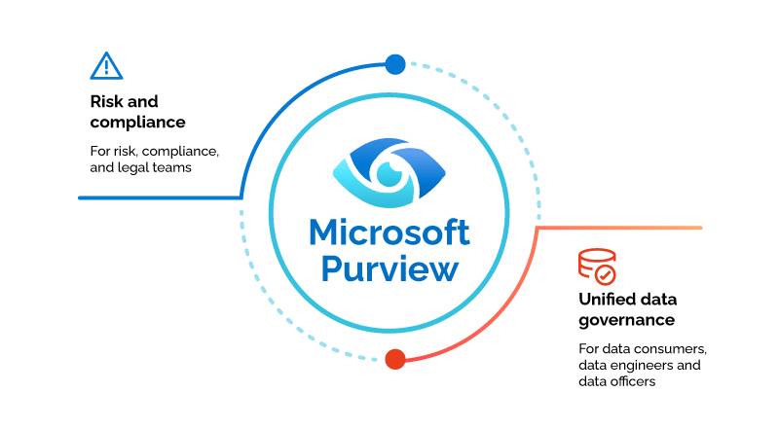


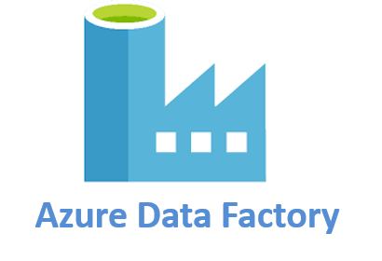

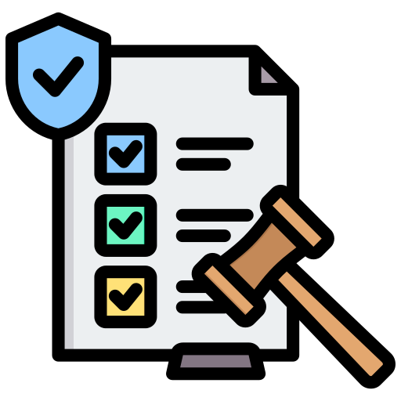

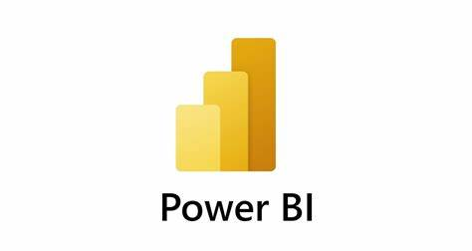
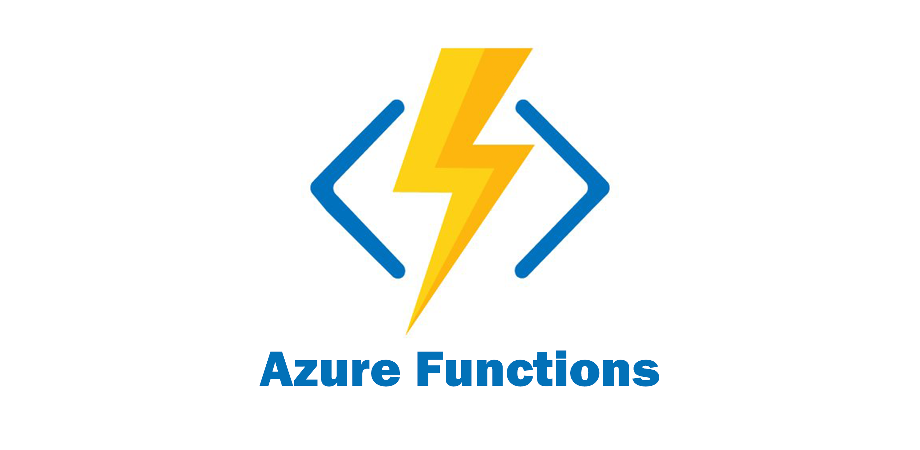

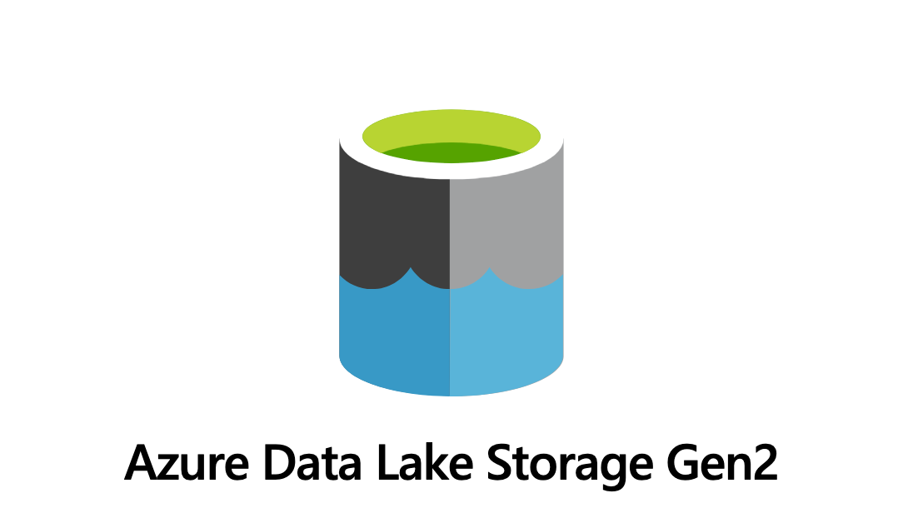
Architecture
Data Sources
Loan histories, payment records, Stock prices, interest rates, Transaction logs, system errors, Cash flow statements
Data Ingestion
Compliance check on ingested data
Push data into AI Models
Visually present the Monitored data
Monitors predicted data and generate alerts to anomalies
Compliance Reporting
Risk Mitigation automated responses such as alerts, transaction holds, and compliance checks
Stores crucial data insights

Slide 11






Unique Offerings aka Key Differentiators
Real-Time Risk Management
Comprehensive Risk Coverage
Advanced AI and Machine Learning Models
Automated Workflows and Alerts
Scalability and Flexibility
User-Friendly Dashboards

Slide 12
Adoption Plan
Pilot Program
Internal Training and Onboarding
Phased Rollout
Stakeholder Engagement
Marketing and Communication
Continuous Improvements and deployements

Slide 13
Business Potential and Relevance
Enhanced Credit Risk Management: Reduces the likelihood of loan defaults, improves the quality of the loan portfolio, and minimizes financial losses by assessing the creditworthiness of potential borrowers by analyzing historical data, market trends, and customer behavior patterns.
Operational Risk Reduction: Enhances operational efficiency, reduces the risk of costly disruptions, and improves the bank's overall reliability by mitigating risks associated with human errors, fraud, and system failures.
Market Risk Mitigation: Protects the bank's investment portfolio, optimizes trading strategies, and ensures stable financial performance by predicting and respond to market volatility by analyzing market trends and other economic indicators.
Liquidity Risk Management: Prevents liquidity crises, maintains customer confidence, and ensures the bank's solvency by monitoring cash flow and liquidity positions in real-time to ensure the bank can meet its short-term obligations.
Regulatory Compliance: Avoids regulatory penalties, maintains the bank’s reputation, and ensures legal compliance by automating compliance checks and audits to ensure adherence to regulatory standards and generate timely compliance reports.
Cost Efficiency: Lowers operational costs, improves resource utilization, and increases overall efficiency by automating routine risk assessment and mitigation tasks, reducing the need for manual intervention and resource allocation

Slide 14




User Experience
Bank Executives
Risk Management Team
Compliance Officers
Customers
Improved Decision-Making
with interactive dashboards and detailed reports. Regulatory Confidence
of mind with assurance which gives peace of adherence to regulatory standards.
Enhanced Risk Detection with proactive risk management with fewer surprises and crises. Streamlined Workflows which reduce manual workload leading to faster response times to emerging risks
Automated Compliance Monitoring
and reduced risk of regulatory breaches, simplifying audit preparation. Detailed Reporting
with enhanced accuracy and timeliness in compliance documentation
Personalized Financial Services
with Increased Confidence
giving customer greater peace of mind knowing their assets are protected by advanced risk management practices.

Slide 15
Scalability, Ease of Deployment and Maintenance
Ensuring Seamless Scalability
Cloud Infrastructure: Utilizing Azure Data Lake and Azure Service Fabric, RiskShield AI can manage and scale to accommodate vast datasets. It can handle terabytes of data efficiently, with the ability to scale up as data volumes grow without performance degradation.
AI Model Scalability: Azure OpenAI and Azure Machine Learning support the development and deployment of numerous AI models, allowing the system to incorporate new risk types and data sources seamlessly. It can scale to deploy hundreds of models concurrently, ensuring continuous and accurate risk assessment.
Real-Time Monitoring: Azure Logic Apps and Power BI enable real-time monitoring and alerting, capable of processing thousands of transactions per second, ensuring prompt and responsive risk mitigation.
Ease of Deployment and Maintenance
Quick Deployment: The solution can be deployed on Azure within weeks, leveraging Azure’s integrated services for a streamlined setup. Modular design ensures each component is independently deployable, reducing complexity.
Automated Maintenance: Automated pipelines for data ingestion, model retraining, and system updates reduce manual intervention. Azure’s management tools ensure continuous monitoring and maintenance with minimal effort.
Scalable to Terabytes: RiskShield AI can handle terabytes of data, scaling as required to accommodate growing data volumes, without compromising on performance or speed.
User-Friendly Dashboards: Power BI dashboards provide easy-to-interpret visualizations, simplifying risk management for end-users and reducing the need for extensive training or support.
RiskShield AI is designed for robust scalability and ease of deployment, ensuring that it can grow with the Bank’s needs while remaining simple to implement and maintain.

Slide 16
Security Considerations
Ensuring Security and Integrity in RiskShield AI
Data Encryption:
At Rest: All sensitive data stored in Azure Data Lake is encrypted using Azure Storage Service Encryption (SSE) to protect against unauthorized access.
In Transit: Data transmitted between components is secured using Transport Layer Security (TLS) to prevent interception and ensure data integrity.
Identity and Access Management:
Azure Active Directory (AAD): Utilizes AAD for robust identity management, ensuring that only authenticated users can access the system.
Role-Based Access Control (RBAC): Implements fine-grained access controls, allowing only authorized personnel to access specific functionalities and data within the platform.
Network Security:
Virtual Network : Deploys the solution within an Azure VNet to isolate resources and secure internal communications.
Network Security Groups (NSG): Configures NSGs to restrict inbound and outbound traffic, minimizing exposure to potential threats.

Slide 17
Security Considerations
Ensuring Security and Integrity in RiskShield AI
Threat Detection and Response:
Azure Security Center: Continuously monitors the system for vulnerabilities and potential threats, providing real-time alerts and recommendations for remediation.
Azure Sentinel: Leverages Azure Sentinel for advanced threat detection and automated response, ensuring proactive security measures.
Compliance and Auditing:
Regulatory Compliance: Ensures adherence to financial regulations and industry standards based on region.
Audit Logs: Maintains comprehensive audit logs of all user activities and system events, enabling traceability and accountability.
Multi-Factor Authentication (MFA):
User Authentication: Implements MFA for accessing the data to provide an additional layer of security, reducing the risk of unauthorized access.

Slide 18
GitHub Repository Link
https://github.com/anuujj/risk-shield-ai

Slide 19
Thank You
Anuj | Software Engineer @Paytm

