Slide 1
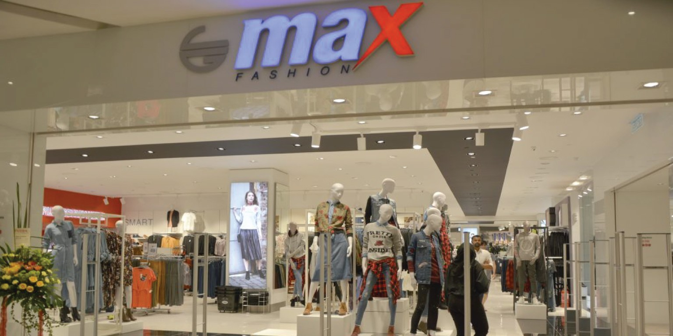

CUSTOMER CHURN ANALYSIS
January 2021

Slide 2

Problem Statement |
Current State
Future State
Context: Max Fashion is a fashion brand under the banner of the Dubai based Landmark Group. Max brings international fashion and value to discerning shoppers in over 325 stores across 16 countries.
Trigger: Over the past one year max fashion has faced a drop in sales by 20% and an increase in churn by 12% but they are unable to identify the responsible factors
Action: The team needs to validate the relationship between customer churn and sales drop and then identify the root cause of it.
Outcome: Max fashion has a better understanding of factors responsible behind churn leading to an improvement in customer retention rate
Behaviour: Developed a framework to understand the effect of factors contributing to churn and build a model over it to detect early churn behaviour in customers
Insights: key attributes under customers demographics, customer purchase pattern, and customer purchase power were identified which leads to churn
Gap
Identify potential factors resulting in increased churn rate

Slide 3




Process flow |
Impact Measurement
Define Churn
Responsible factors
Recommendations
Link customer churn to revenue to understand how churn impacts revenue drop
Establish if customers are valuable enough to retain (CLTV)
Detection of churn is harder in fashion industry as different customers have different buying cycle
Segment customers based on their purchase habits
Customers missing their expected shopping trips are considered as churned customers
Create an exhaustive list of factors that can impact customer behaviour resulting in churn
Carry out EDA to understand how these factors impacts customer churn
Create a model that would detect early churn behaviour in customers
Personalize customer online experience
Improve customers social media engagement
Loyalty rewards plan
Price elasticity
Seasonality analysis and more
Callout:
Customers who have no shopping records for a timeframe of one year are considered as churn
Churned customers are valuable enough to retain

Slide 4

Impact Measurement |
Total Revenue
Spend per
customer
Average order
value
Purchase
frequency
Customer count
Churned Customers
Loss in net customer count
Customers are spending less
Number of new customers acquired are less compared to churned customers leading to loss in net sales
Degradation in purchase behaviour or purchase power of existing customer
New customers is not adding enough value to compensate the revenue loss from churned customers
Reduction in each shopping trip
Existing customers are buying less number of products or they have shifter towards cheaper alternatives
Customers are buying less frequently than usual
Existing customers are buying from competitors or have increased the gap in their buying behaviour

Slide 5



Responsible factors |
Potential factors resulting in increased churn rate
customer controlled factors
company controlled factors
external factors
Demographics (Age, Income group, Gender)
Product Affinity
Brand Affinity
Customer loyalty(tenure, SOW, etc)
Promotion and price sensitive
........
Online/Offline store Infra
Online/Offline assortment
Product mix
Payment methods
Customer service
Promotional campaign
Return policy
Loyalty Programs
.......
Competitors
Country’s economical condition
COVID (pandemics)
Seasonality affect
........

Slide 6






Analytical approach |
Data Gathering
Data preprocessing
Exploratory data analysis
Data collection process focuses on gathering main categories of information. Variety in data provides better results
There are many data quality issues in the data sources that retailers provide due to various kinds of errors like collection error, measurement error, etc
By leveraging various statistical tools and graphs find hidden relationships and patterns in data to identify the reason of customer churn
Why ?
Customer: Demographics, Registration date, wish list
Order: Product list, Order info, Delivery and payment info
Site login : Login, search, abandoned carts
Support: Complains and inquiries
Missing value treatment : Imputation, deletion
Outlier treatment: Imputation, capping Trimming
Aggregation : rollup features over different timeframes or orders (feature creation)
Discretization: binning (feature creation)
Univariate analysis :
Continuous variables (box plot, distribution plot , etc)
Categorical variable (count plot, etc)
Bivariate analysis : Understand the relationship of variables with churn
Multivariate analysis : Multicolinearity , identify hidden relations
What ?
Domain specific data obtained from online and offline sources
Quality data ready to perform further analysis and modelling
Based on yoy change in features understand how they impact churn and provide recommendations based on results
Outcome?

Slide 7

Recommendations |
Dummy case study
Organise female centric promotional campaigns as females (specially low spenders) are more likely to get churned
Provide more personalized experience to low spending females on max fashions online portal (redesign the entry page highlighting products on promotion)
Add favourite button next to shopping cart button on max fashions online portal (as low spenders buy less at once increasing their dependency on favourite button)

