Slide 1

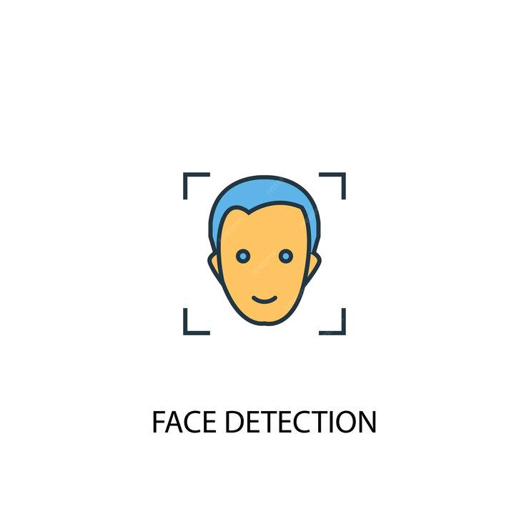
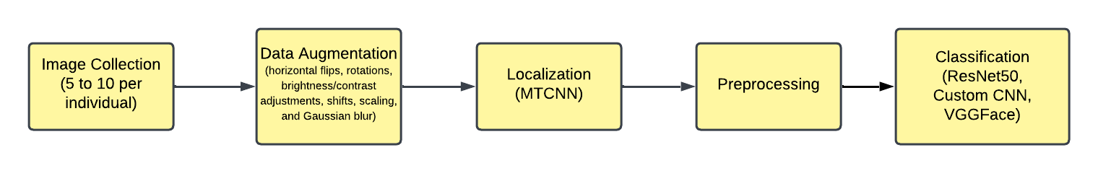
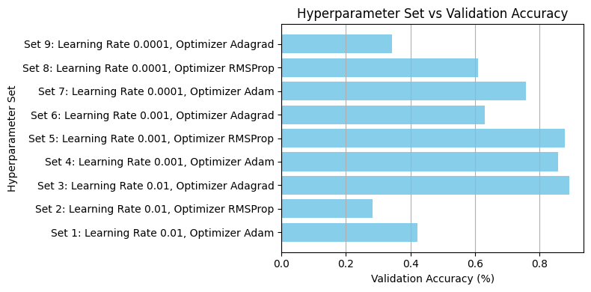
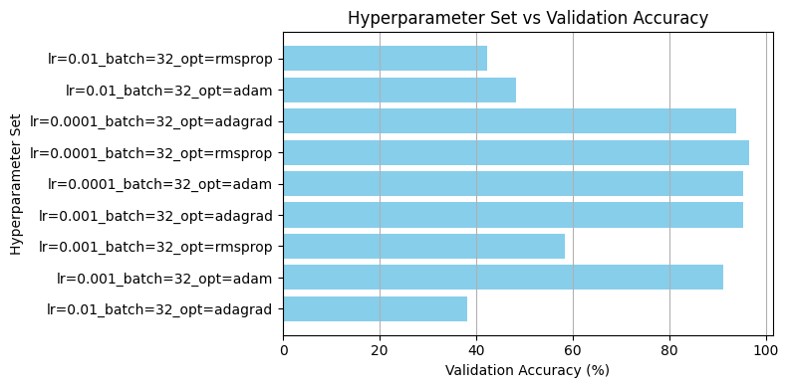
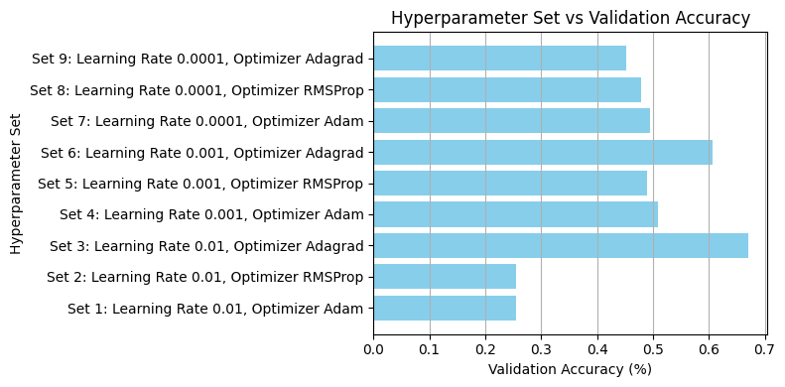
AttendEase: An Intelligent Attendance System using Face Detection
Anuvind MP [AM.EN.U4AIE22010], R S Harish Kumar [AM.EN.U4AIE22042] Department of Computer Science and Engineering,
Amrita Vishwa Vidyapeetham, Amritapuri,
Kollam 690525, Kerala, India.
Motivation & Problem Statement
Methodology
To develop an intelligent attendance system that leverages deep learning to automate attendance marking from group photos, addressing challenges posed by limited initial data.
The pipeline starts with augmenting the limited initial dataset of 5–10 images per individual using techniques like rotation, scaling, flipping, and brightness adjustment to create a diverse dataset.
MTCNN is then used for precise face localization, detecting and aligning faces in both augmented images and group photos.
The localized face data is fed into three models—custom CNN, ResNet50, and VGG—for training, with parameters like learning rates and epoch counts optimized.
The models are evaluated on accuracy and computational efficiency, and the best-performing model is deployed for real-time attendance tracking through facial recognition.
Introduction
AttendEase automates attendance marking using deep learning, addressing challenges of limited initial data with advanced image augmentation techniques. The project evaluates a custom CNN, ResNet50, and VGG, analyzing performance based on accuracy, efficiency, and model parameters. This scalable and adaptable approach offers a practical solution for real-world attendance tracking through facial recognition.
Challenges in Data Collection
Tackling Data Limitations
For effective facial recognition, at least 100 images per individual are typically required to train robust models. However, capturing such a large number of images for every person is often impractical, especially in real-world scenarios with time and resource constraints.
To address this, advanced image augmentation techniques—including rotation, scaling, flipping, and brightness adjustment—are applied to expand the dataset synthetically. These methods transform 5–10 initial images per individual into a diverse and extensive dataset, enabling robust training and reliable facial recognition.
Results and Analysis
Conclusion &
Future Work
We performed hyperparameter tuning for all the 3 models, testing various learning rates and optimizers.
The learning rate 0.001 performed better consistently in all the 3 models and 0.01 was the worst.
Custom CNN
ResNet50
VGG
This case study developed AttendEase, an intelligent system for automated attendance marking using facial recognition. The system leveraged image augmentation and models like custom CNN, ResNet50, and VGG to accurately detect and identify faces, improving performance over time.
Further study can expand upon these results to handle larger datasets, explore real-time deployment including fault detection, and advance the application of deep learning for automated systems in diverse domains.
In terms of optimizers, Adam gave higher accuracies consistently.
Overall both ResNet50 and VGG performed the best achieving the highest accuracy of 96.64% with RMSprop and 0.001 learning rate and adam and 0.0001 respectively
We observed that the Adam optimizer consistently delivered stable results across all models due to its adaptive learning capabilities. A learning rate of 0.001 performed best, providing a balance between convergence speed and accuracy, ensuring effective learning and reliable performance.

