Slide 1
Introduction to Robot Simulation (Gazebo)

Slide 2
Gazebo is a free, open-source robot simulation environment.
The project is run by Open Robotics, the same group looking after ROS, however the projects are managed separately and Gazebo is not a "part of" ROS.
This distinction can sometimes be a little confusing, and although Gazebo and ROS do integrate very well, they approach some things a bit differently.
With Gazebo,can create a virtual "world", and load simulated versions of our robots into it. Simulated sensors can detect the environment, and publish the data to the same ROS topics that real sensors would, allowing easy testing of algorithms.
Then, forces can be applied to the simulated actuators on the robot, taking into account things like friction.

Slide 3
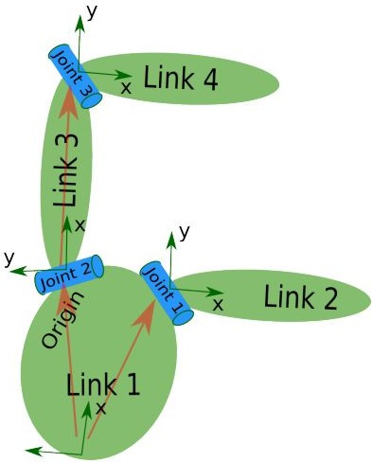
Defining the Structure
Each “Link” is a reference frame of a sensor
Each “joint” defines the transformation that maps the child link in the parent link.
ROS does not handle closed kinematic chains, thus only a “tree” structure is allowed
The root of the tree is usually some convenient point on the mobile base (or on its footprint)
Slide Credit: Wolfram Burgard, University of Freiburg

Slide 4


Robot Simulation
HARDWARE
Simulators mimic the real world, to a certain extent
Plugins Sensors Models Worlds
Physics
ODE
Bullet
Actuators Sensors
Embedded controllers
Simulates robots, sensors, and objects in a 3-D dynamic environment
Generates realistic sensor feedback and physical interactions between objects
Why use them?
Save time and your sanity
Experimentation much less destructive
Use hardware you don’t have
Create really cool videos
Tools Rviz CLT
Nodes Controller Planner
Communications
Topics Services

Slide 5
Simulation Architecture
Stage
TCP/IP
Cmd
Player
Gazebo
Client
(your program)
Data
SHM
TCP/IP
Real Hardware
TCP/IP

Slide 6
Simulation Architecture
Gazebo runs two processes:
Server: Runs the physics loop and generates sensor data.
Executable: gzserver
Libraries: Physics, Sensors, Rendering, Transport
Client: Provides user interaction and visualization of a simulation.
Executable: gzclient
Libraries: Transport, Rendering, GUI
Run Gazebo server and client separately:
Run Gazebo server and client simultaneously:
$ gzserver
$ gzclient
$ gazebo

Slide 7
Elements within Simulation
World
Collection of models, lights,plugins and global properties
Models
Collection of links, joints,sensors, and plugins
Links
Collection of collision and visual objects
Collision Objects
Geometry that defines a colliding surface
Visual Objects
Geometry that defines visual representation
Constraints between links
Sensors
Collect, process, and output data
Plugins
Code attached to a World, Model, Sensor, or the simulator itself
Joints

Slide 8
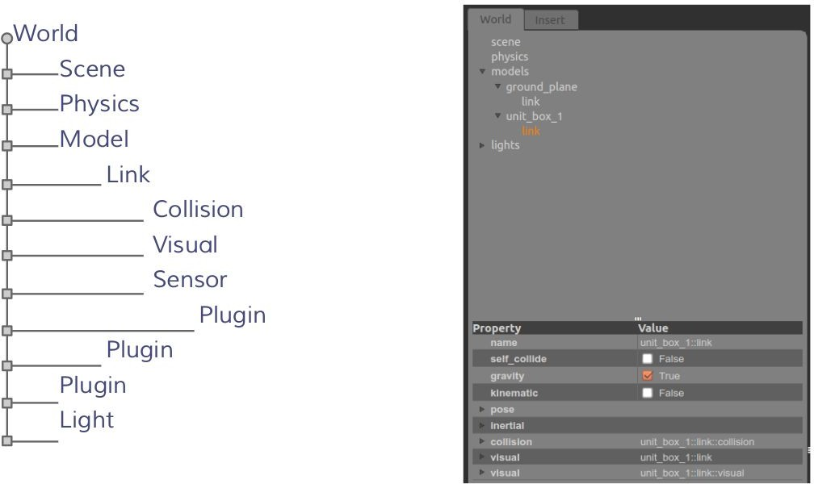
Element Hierarchy

Slide 9
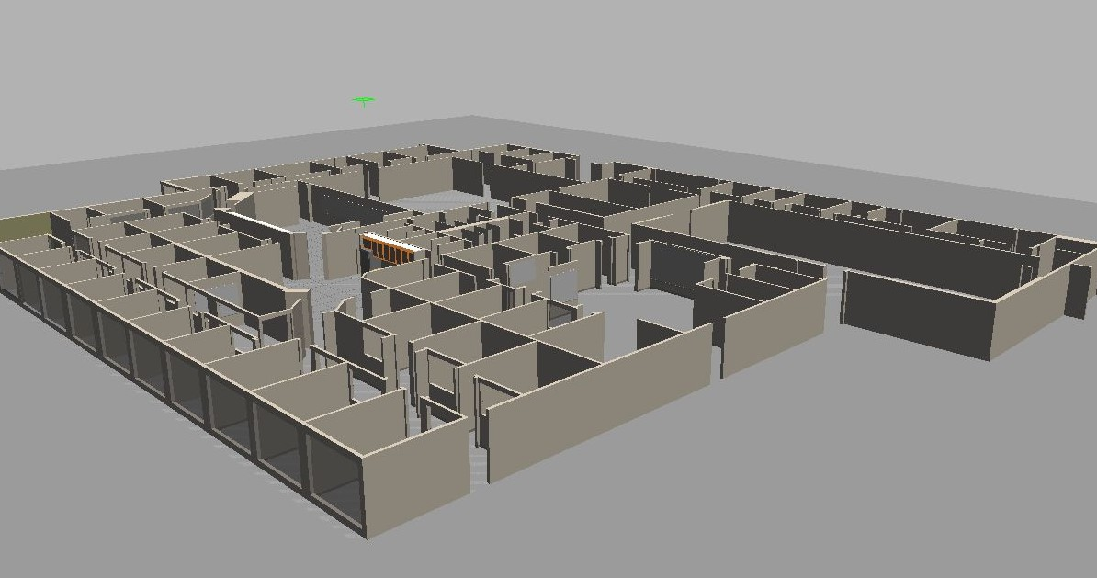
World
A world is composed of a model hierarchy
The Gazebo server (gzserver) reads the world file to generate and populate a world
This file is formatted using SDF (Simulation Description format) or URDF (Unified Robot Description Format)
Has a “.world” extension
Contains all the elements in a simulation, including robots, lights, sensors, and static objects
Willow Garage World

Slide 10
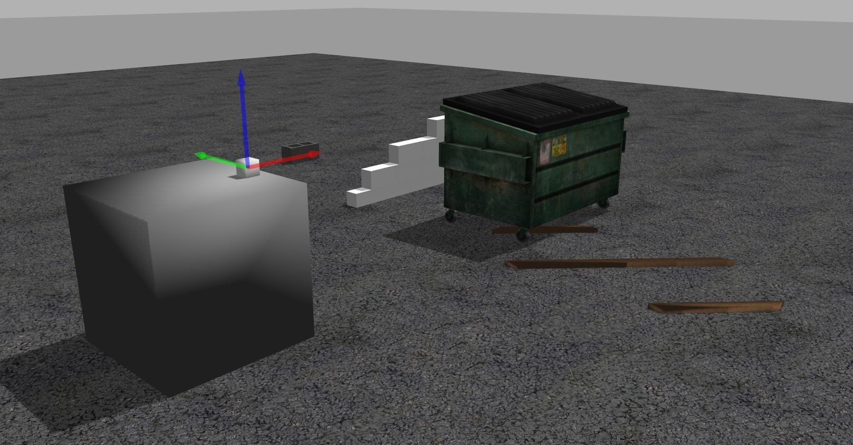
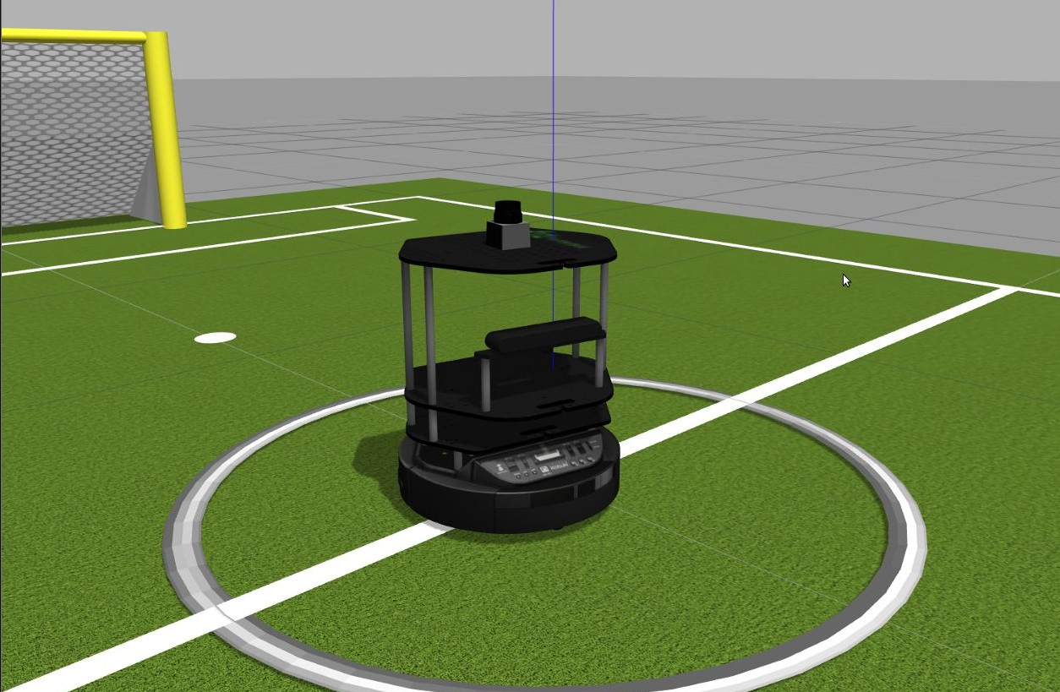
Models
Each model contains a few key properties:
Physical presence (optional):
Body: sphere, box, composite shapes
Kinematics: joints, velocities
Dynamics: mass, friction, forces
Appearance: color, texture
Interface (optional):
Control and feedback interface (libgazebo)

Slide 11
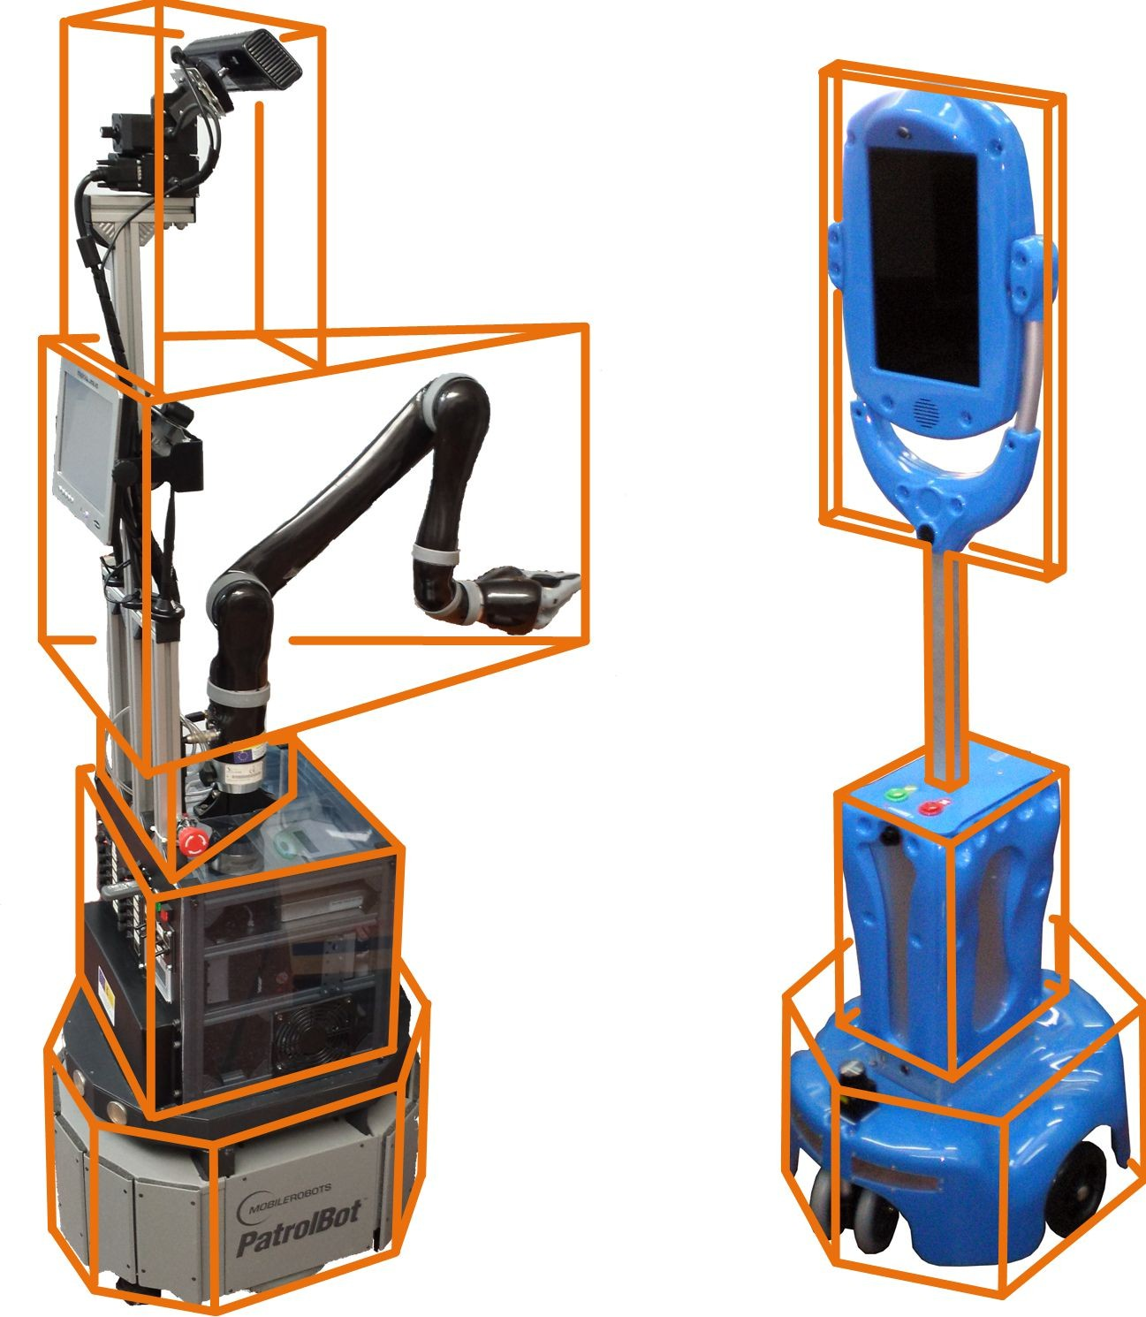
Element Types
Collision and Visual Geometries
Simple shapes: sphere, cylinder, box, plane
Complex shapes: heightmaps, meshes

Slide 12
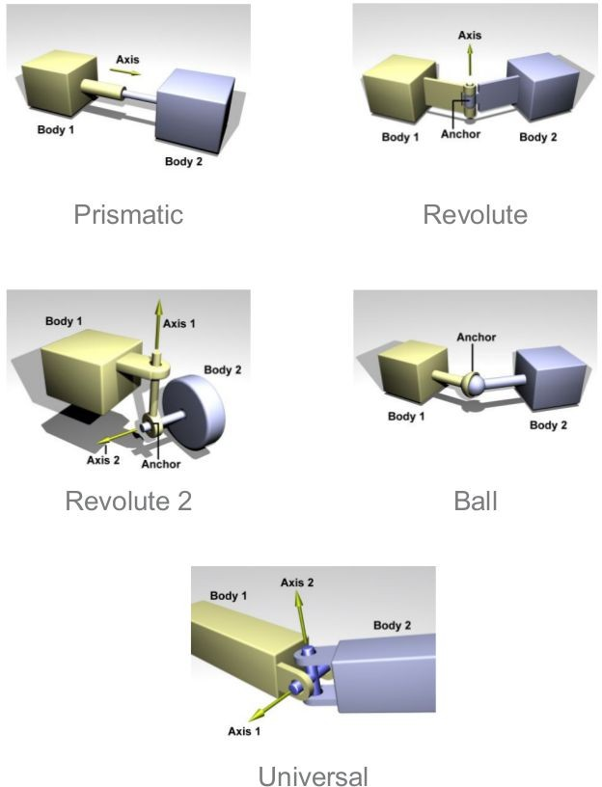
Element Types
Collision and Visual Geometries
Simple shapes: sphere, cylinder, box, plane
Complex shapes: heightmaps, meshes
Joints
Prismatic: 1 DOF translational
Revolute: 1 DOF rotational
Revolute2: Two revolute joints in series
Ball: 3 DOF rotational
Universal: 2 DOF rotational
Screw: 1 DOF translational, 1 DOF rotational

Slide 13
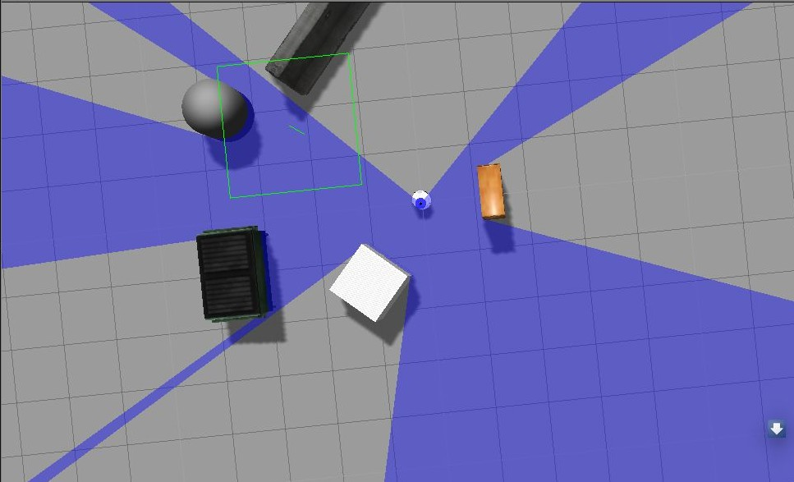
Element Types
Sensors
Ray: produces range data
Camera (2D and 3D): produces image and/or depth data
Contact: produces collision data
RFID: detects RFID tags
Lights
Point: omni-directional light source, a light bulb
Spot: directional cone light, a spot light
Directional: parallel directional light, sun
LiDAR sensor in Gazebo

Slide 14
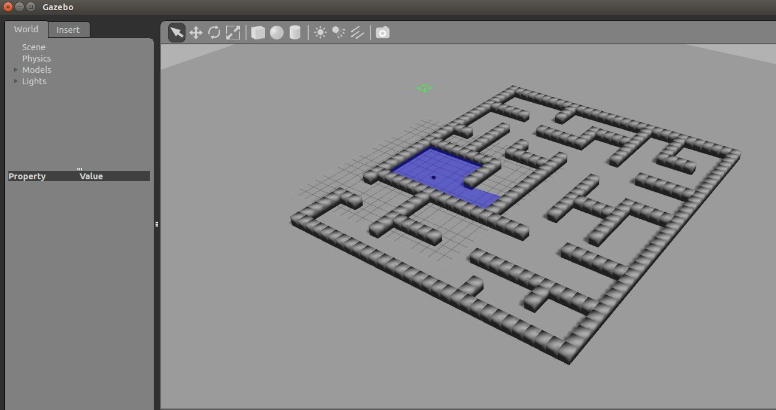
How to use Gazebo to simulate your robot?
Steps:
load a world
load the description of the robot
spawn the robot in the world
publish joints states
publish robot states
run rviz

Slide 15
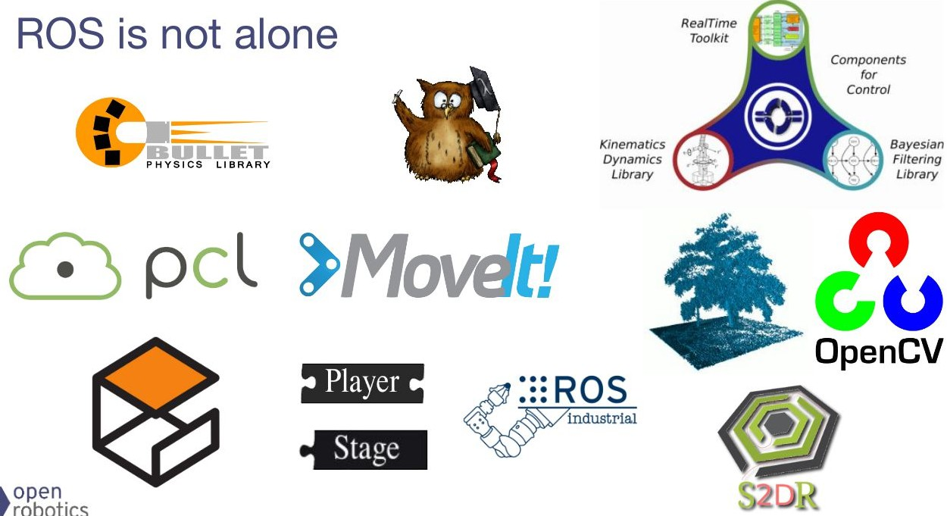
Libraries/Tools available with ROS
Image Courtesy: Open Source Robotics Foundation

