Slide 1



BERT

Slide 2
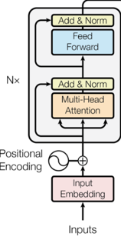

No: of Parameters Calculation- ${BERT}_{base}$

Slide 3
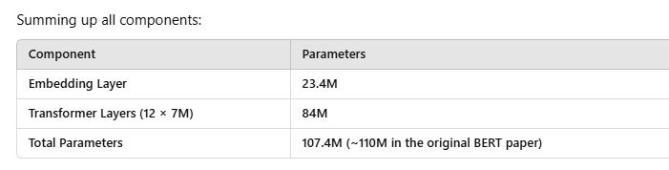
Total Parameters - ${BERT}_{base}$
Maximum Input Sequence length of BERT- 512 tokens
Vocabulary Size- 30,000
Token Embedding + Segment Embedding + position embedding
BERT-base
The number of encoder layers L =12
The attention head A = 12
The hidden unit H = 768 (each token gets represented as a 768-dimensional vector.)
The total number of parameters - 110 million
Explicitly counted parameters: 107.4M
Bias terms + LayerNorm + other small components: ~2.5M
Final total (rounded in the paper): ~110M

Slide 4

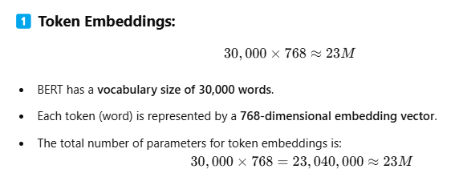

${BERT}_{base}$– Parameter Calculation
Maximum Input Sequence length of BERT- 512 tokens
Embedding Layer
Each token (word or subword) is mapped to a 768-dimensional vector.
vocabulary lookup matrix of size 30,000(v)×768(d).
learned token embeddings are updated during pretraining using Masked Language Modeling (MLM).

Slide 5
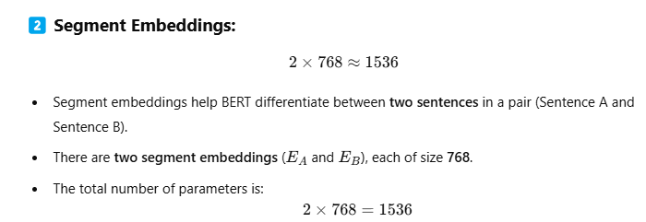
${BERT}_{base}$– Parameter Calculation
Embedding Layer- Segment Embedding

Slide 6
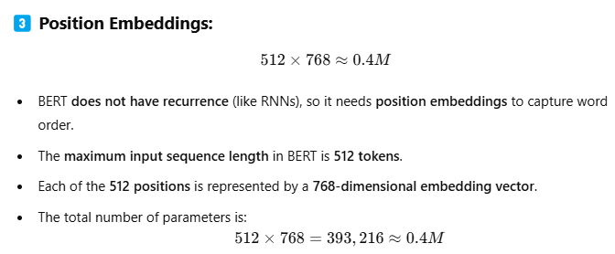
${BERT}_{base}$– Parameter Calculation
Embedding Layer- Position embedding

Slide 7
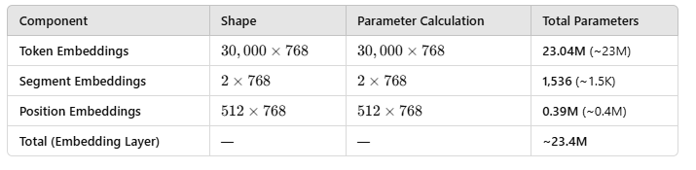
${BERT}_{base}$– Parameter Calculation
Embedding Layer- Summary

Slide 8
No of Parameters- Transformer layers

Slide 9
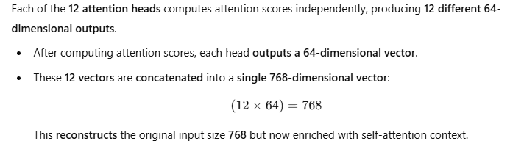
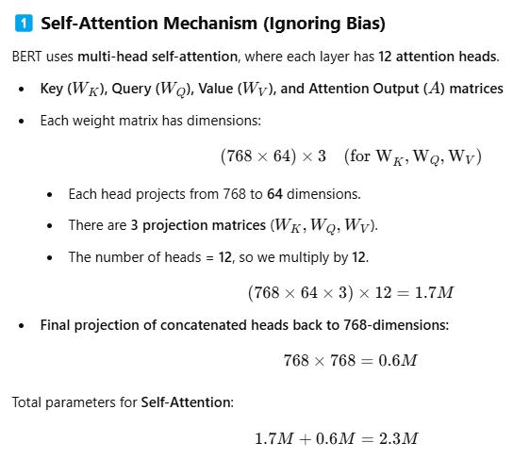
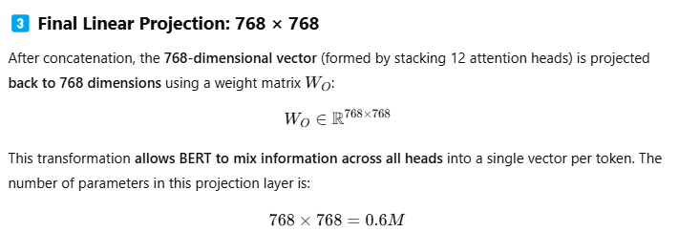
${BERT}_{base}$– Parameter Calculation
Transformer Encoder Layers
Without the linear projection layer, the outputs from different heads remain separate, and their information is not integrated effectively.

Slide 10
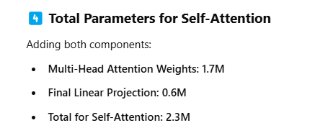
Summing up-Self attention
${BERT}_{base}$– Parameter Calculation
Transformer Encoder Layers

Slide 11
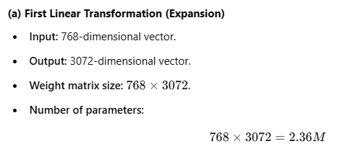
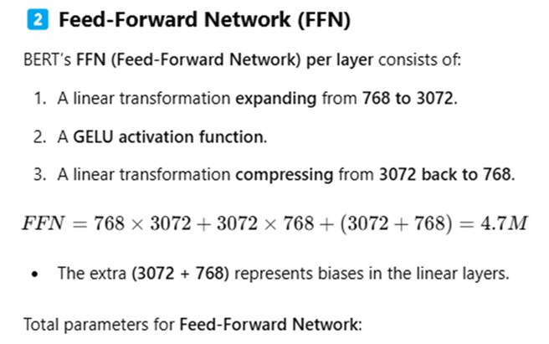
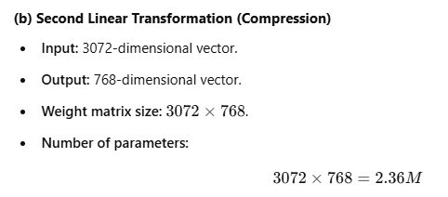
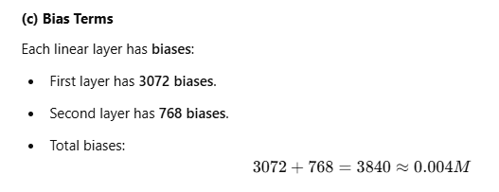

BERT base Parameter Calculation –cont.
Transformer Encoder Layers

Slide 12
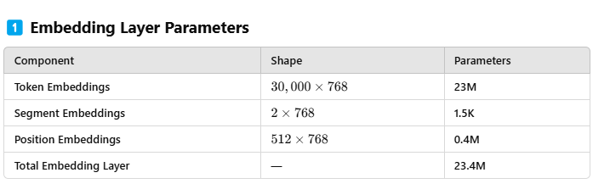
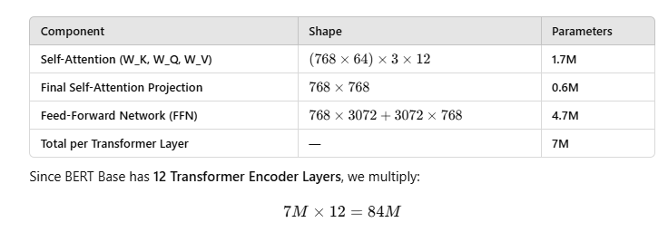
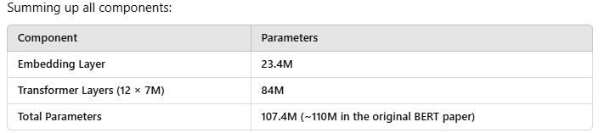
Summary

Slide 13
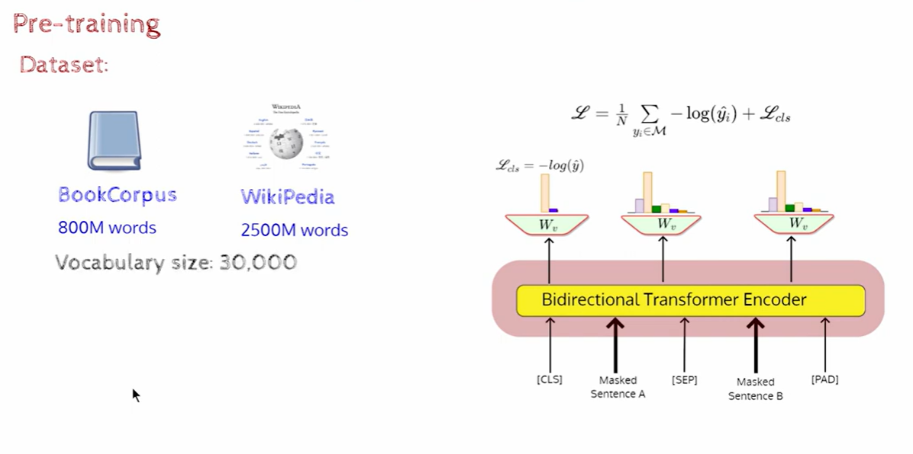
BERT Loss function

Slide 14
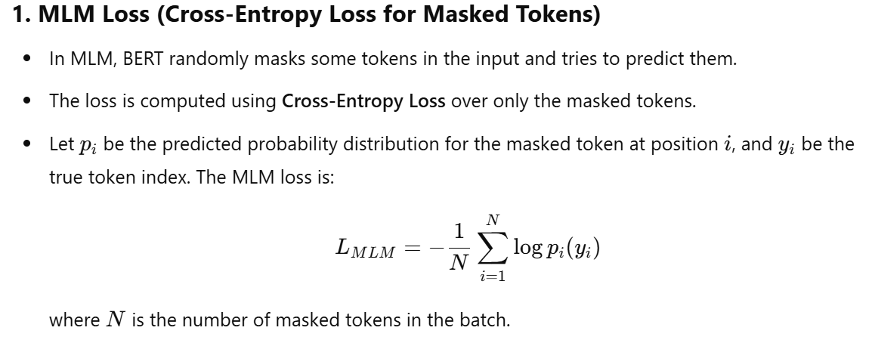

Slide 15
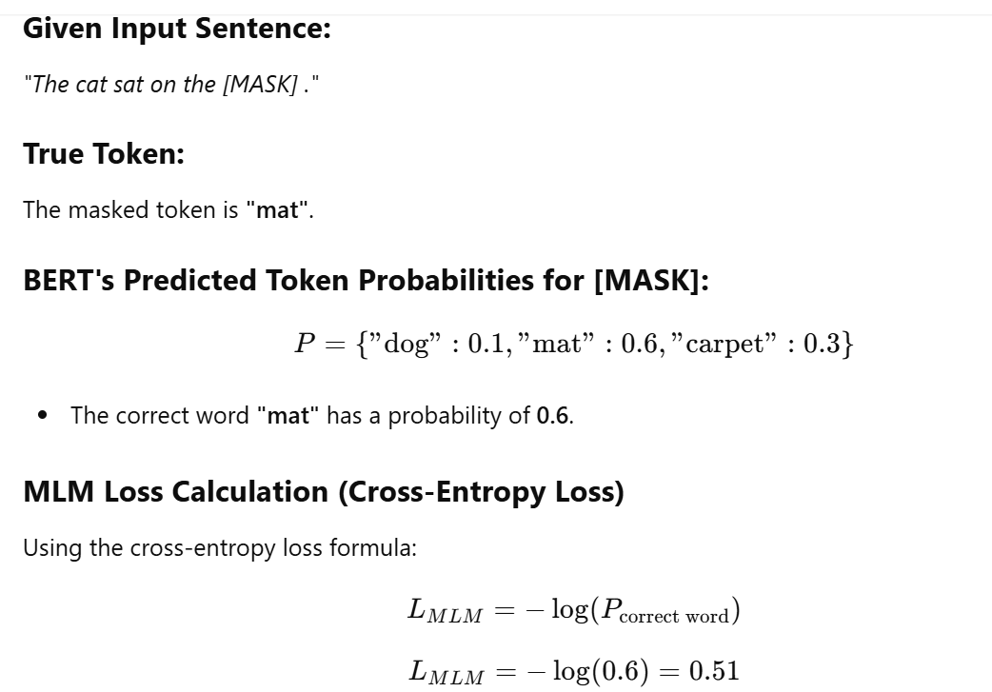
log(1)=0
Log(.999) =-.0004
Log(.0001)=-4
Log(0)=-infinity

Slide 16
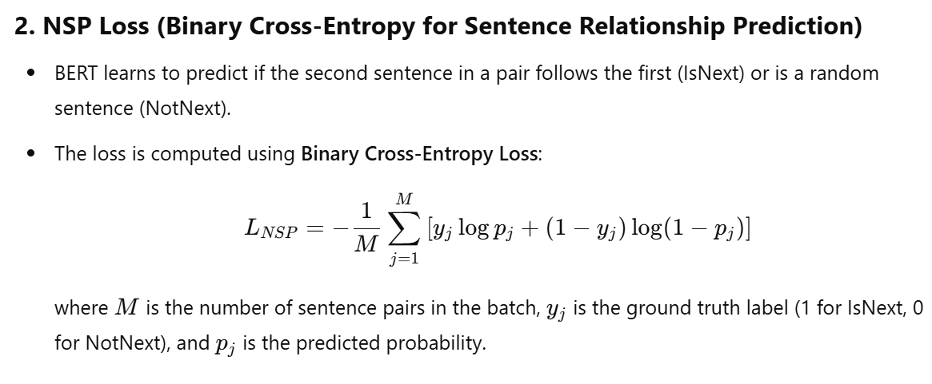
Term1 -Maximise probability/minimise Loss for predicting class 1 correctly.
Term 2- Maximise probability/minimise Loss for predicting class 0 correctly.

Slide 17
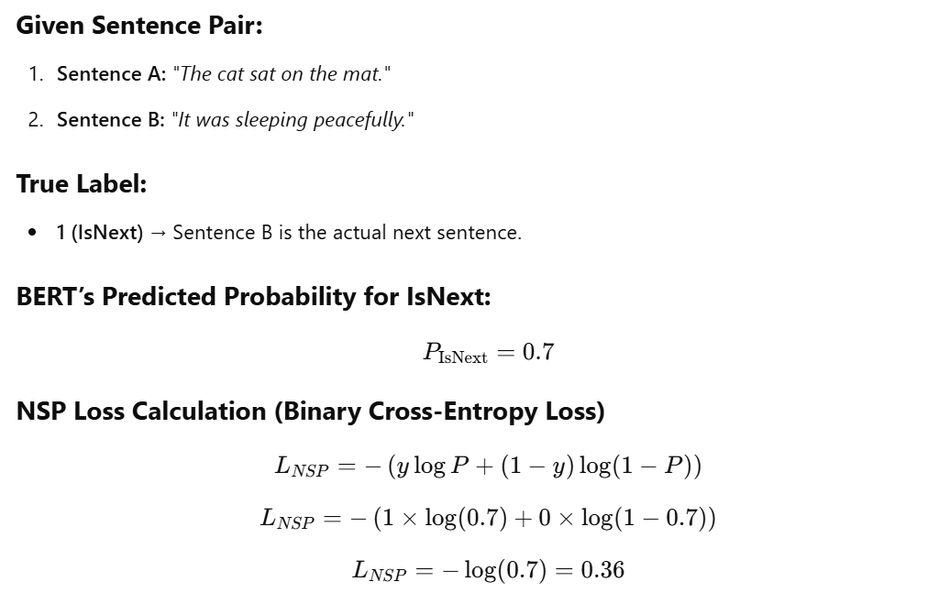
The Binary Cross-Entropy (BCE) loss ensures that the model learns to assign high probabilities to correct outputs and low probabilities to incorrect outputs. It does this by penalizing incorrect predictions heavily and rewarding correct predictions.
Loss is very low → Model is rewarded for making a correct and confident prediction.
Loss is very high → Model is strongly penalized for being confident but wrong.
Loss is moderate → Model is uncertain, so it’s penalized, but not as heavily as a confident wrong answer.
log(1)=0
Log(0)=-infinity

Slide 18
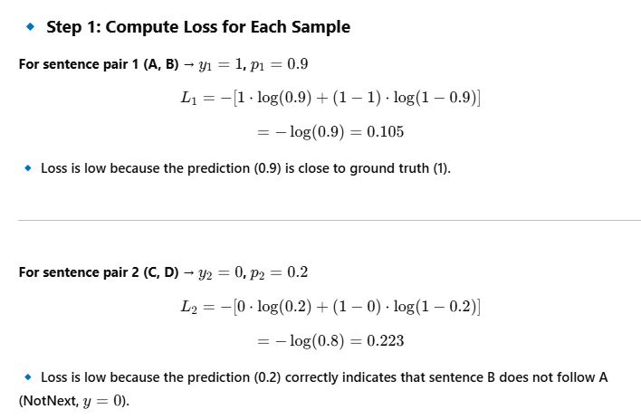
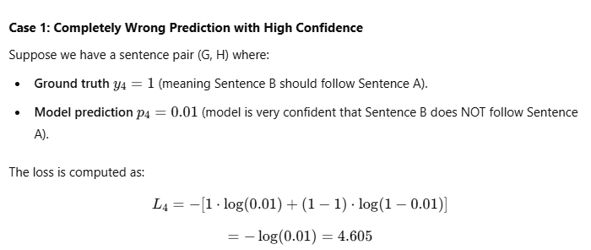
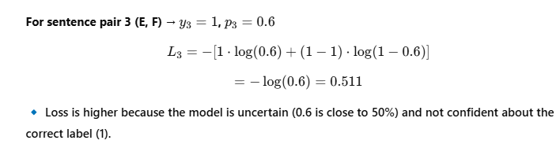
log(1)=0
Log(0)=-infinity

Slide 19
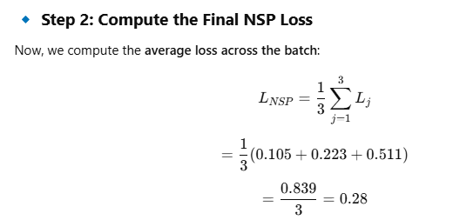

Slide 20
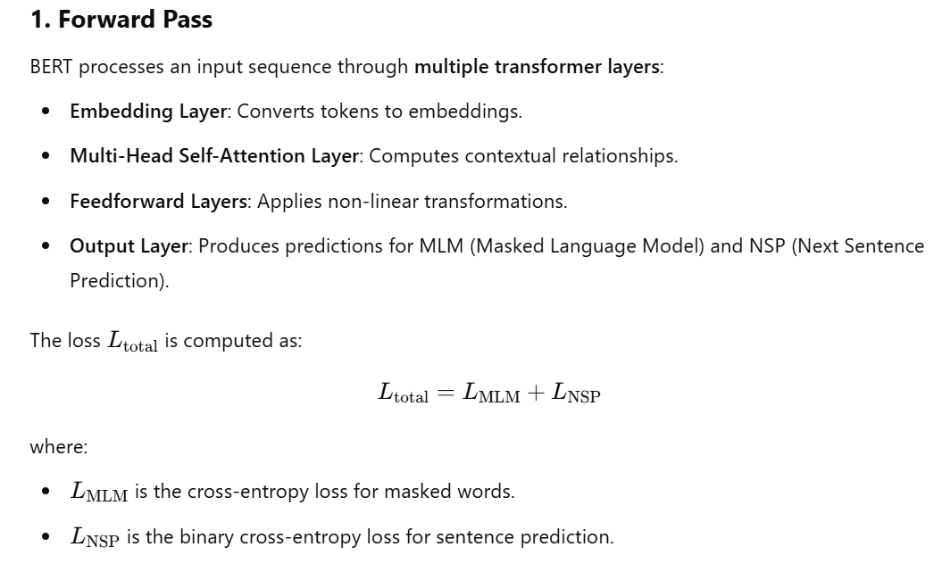

Slide 21
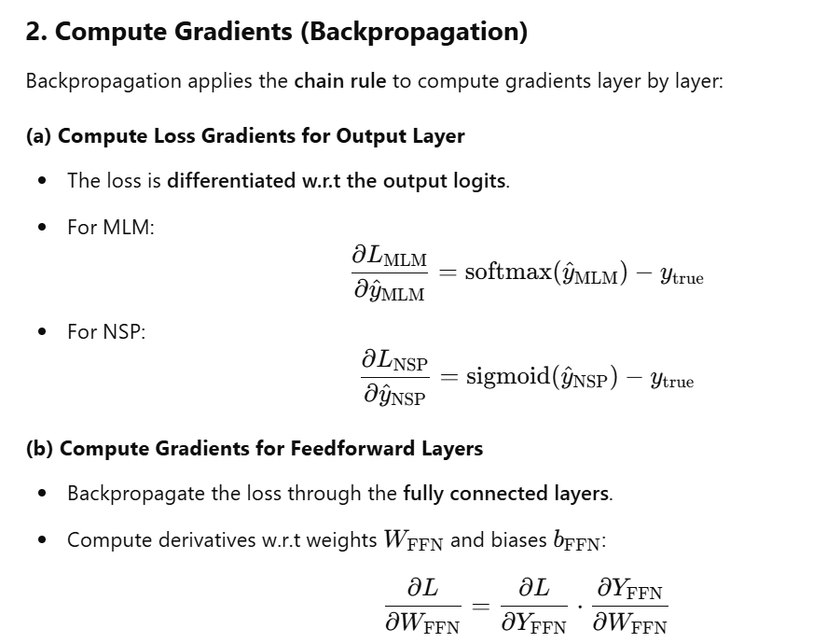


Slide 22
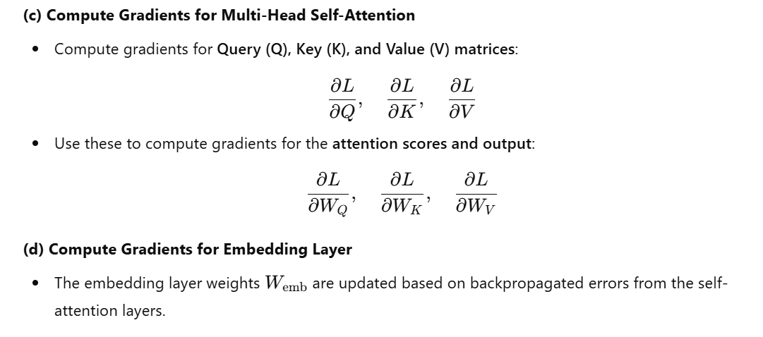

Slide 23
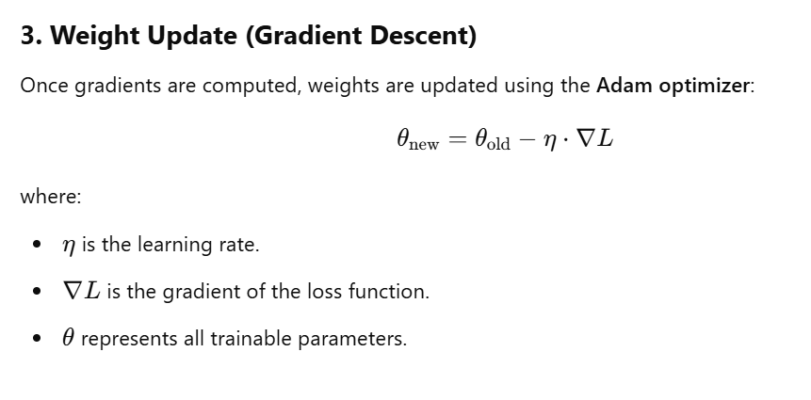

Slide 24
Namah shivaya

