Slide 2
Decoder-based models
Decoder-based models are trained to generate coherent and contextually relevant text by autoregressively predicting the next word or token based on the preceding ones.
Some of the most common decoder-based models are GPT-2 and GPT-3 proposed by OpenAI, which are adept at understanding the context provided and generating output that corresponds to the input they receive.

Slide 3
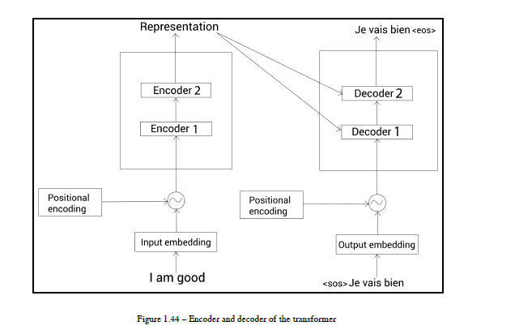
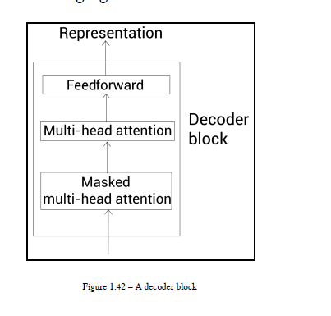

Slide 4
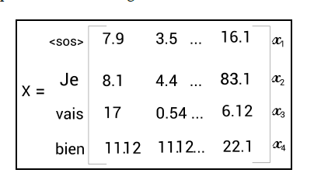

Slide 5
To predict the word next to the word <sos>, our model should not attend all the words to the right of <sos>
So, mask all the words to the right of <sos>

Slide 6
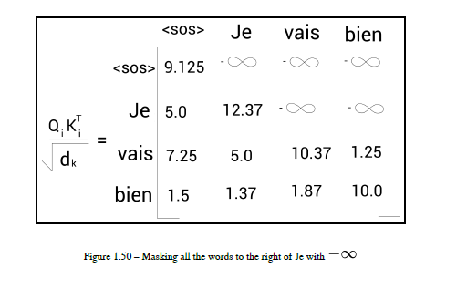
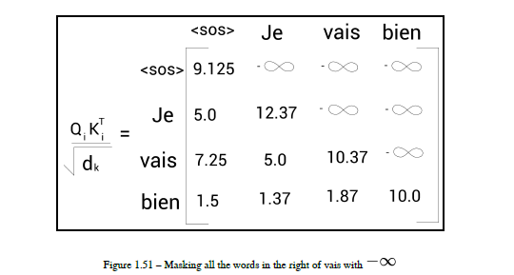

Slide 7

Now, we can apply the softmax function to the preceding matrix and multiply the result by the value matrix, , and obtain the final attention matrix, .
Similarly, we can compute h number of attention matrices, concatenate them, and multiply the result by a new weight matrix, , and create the final attention matrix, , as shown:

Slide 9
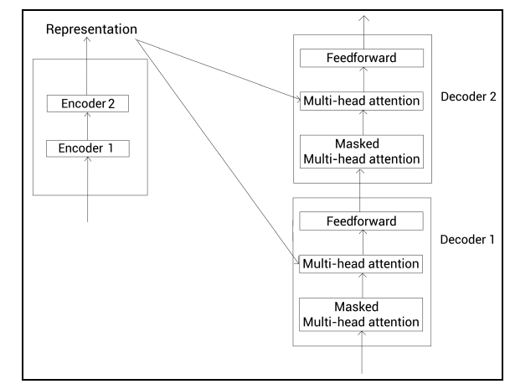
Multi-head attention(encoder-decoder attention)

Slide 10
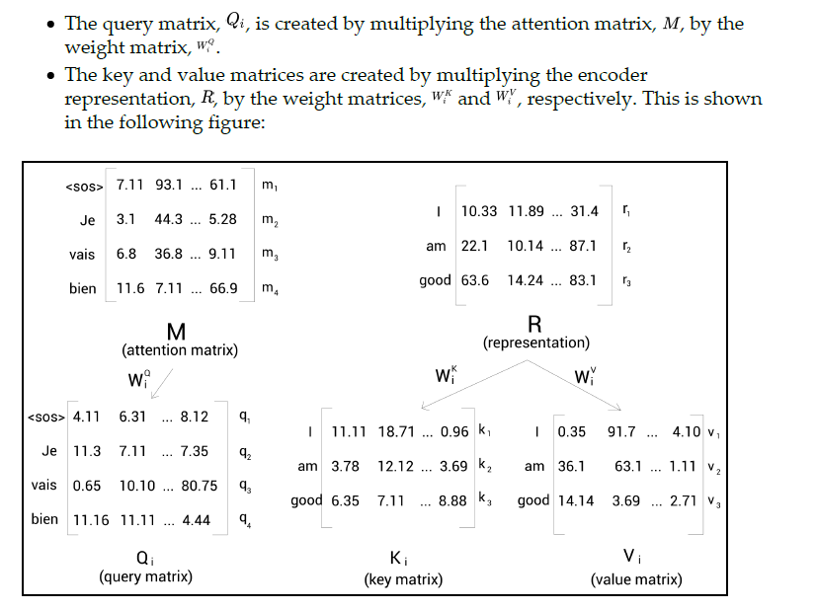

Slide 11
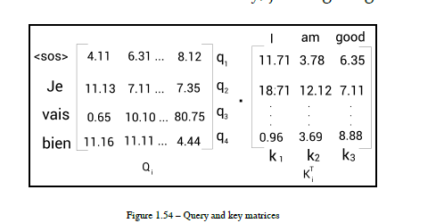
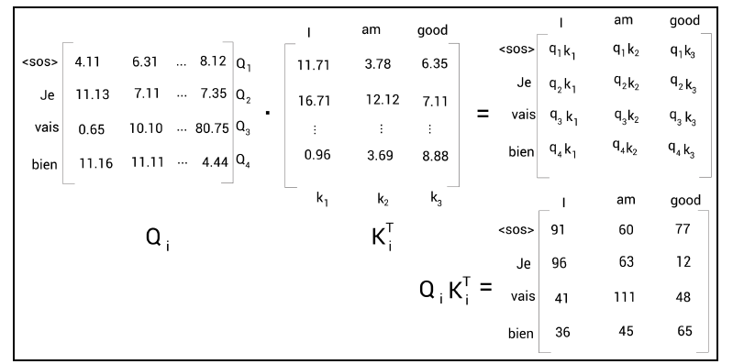

Slide 12
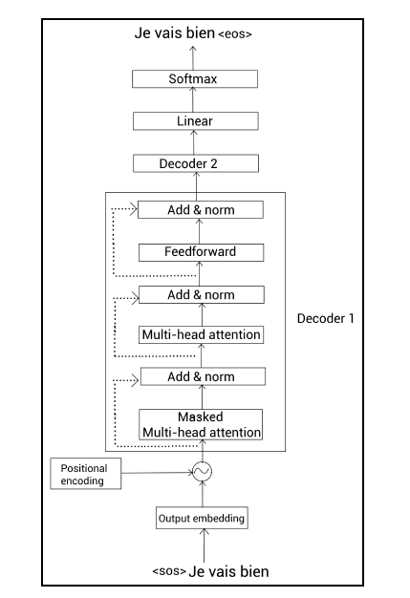

Slide 13
Masked multi-head attention
instead of feeding the input directly to the decoder, we convert it into an
embedding (output embedding matrix) and add positional encoding, and then feed it to the
decoder.

